Slide 1
Distributed Generation Monitoring Tool
Duke Energy Carolinas – Grid Solutions – Joe Lavalliere – 2015

Slide 2
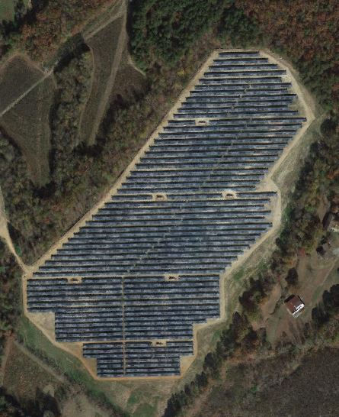
Outline
The Need for a Distributed Generation (DG) Monitoring Tool
Getting Started – The Available Displays
“DEC Visuals”
DEC Geographic View
DEC Dashboard
Distributed Energy Resources (DER) Tabular Display
“Individual Displays”
PV site Characteristics and Real-Time measurements
“Landfill Gas & Hydro Facilities”
Aggregate DER PI Tags to be pushed to EMS

Slide 3
The Need for a Distributed Generation Monitoring Tool (1 of 3)
Solar capacity will almost double once Solar Facilities finish construction!

Slide 4
The Need for a Distributed Generation Monitoring Tool (2 of 3)
Almost 70MW was added in just 2014 alone.
2015 data was not included because many sites are still under construction. This is projected to be 100+ MW.
This data only includes utility scale sites with electronic reclosers.

Slide 5
The Need for a Distributed Generation Monitoring Tool (3 of 3)
Currently, there is a total of ~200MW of Non-Utility Generation (NUG) with 150MW under construction connected at a distribution level service. This will be 350MW of NUG.
DCC Operators and Engineers do not have a convenient way to monitor DERs on network using DMS/DOMS.
This tool will make people aware of the voltage swings and that connected solar sites are causing reverse power flow on the substation.

Slide 6
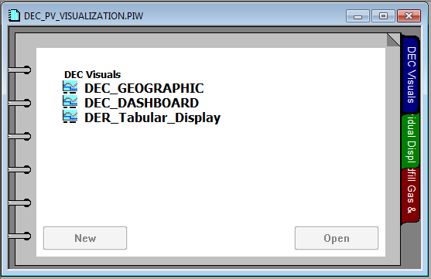
Getting Started – The Available Displays
When the file is first opened, three tabs will be are available for you to select.
“DEC Visuals” Provides high-level views of DER operation.
“Individual Displays” Provides a detailed display of each Solar Facility.
“Landfill Gas & Hydro” Provides multiple sites per display of only single phase recloser RT data and three phase power generation.
“DEC_GEOGRAPHIC” is the main PI Display that was designed to fit on a DCC wall-mounted TV. More detail on next slide.

Slide 7
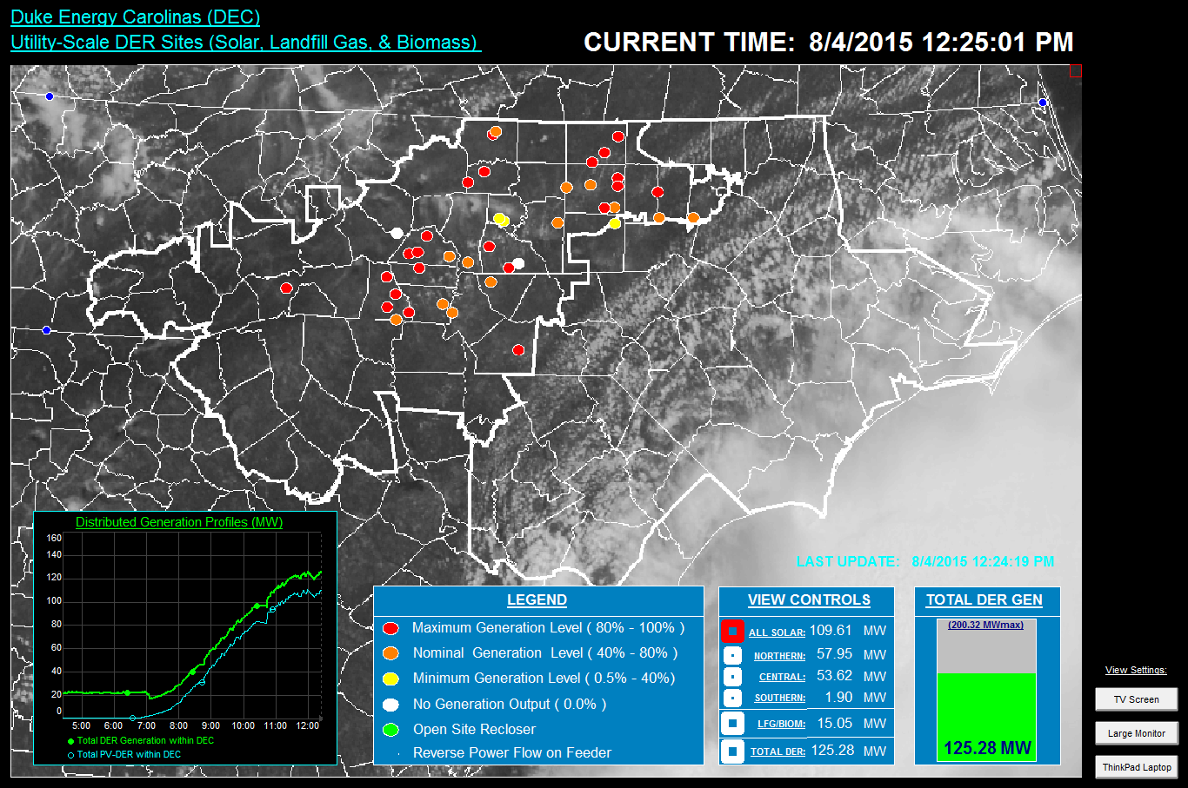
“DEC Visuals” - DEC Geographic View (1 of 2)
Site Symbols:
Hover-over: Displays PV Site Name with PPA (MW) amount.
Single Click: Navigates to the PV Site’s individual display.
Satellite Image Update:
Observation: Time of Update.
Every 2 minutes an update occurs that will refresh the satellite image and location of site symbols.
Distributed Generation Profile:
Observation: R.T. & previous 8hrs of Total DER Generation along with Solar (PV) Generation.
1
2
3

Slide 8
“DEC Visuals” - DEC Geographic View (2 of 2)
Site Symbol LEGEND:
Multi-State Conditions: Site symbol color is dependent on its R.T. power output. Base of percentage is the PP or Nameplate MW.
Flashing Condition: Occurs when there is reverse power flow observed at the upstream feeder circuit breaker.
VIEW CONTROLS:
Button Action: A single click of a square will hide/show DER sites.
TOTAL DER GEN:
Visual Aid: Displays relation of maximum telemetered MW and R.T. MW measurement.
4
5
6

Slide 9
“DEC Visuals” - DEC Dashboard (1 of 2)
“DEC Visuals” - DEC Dashboard Display. Double click title to open.

Slide 10
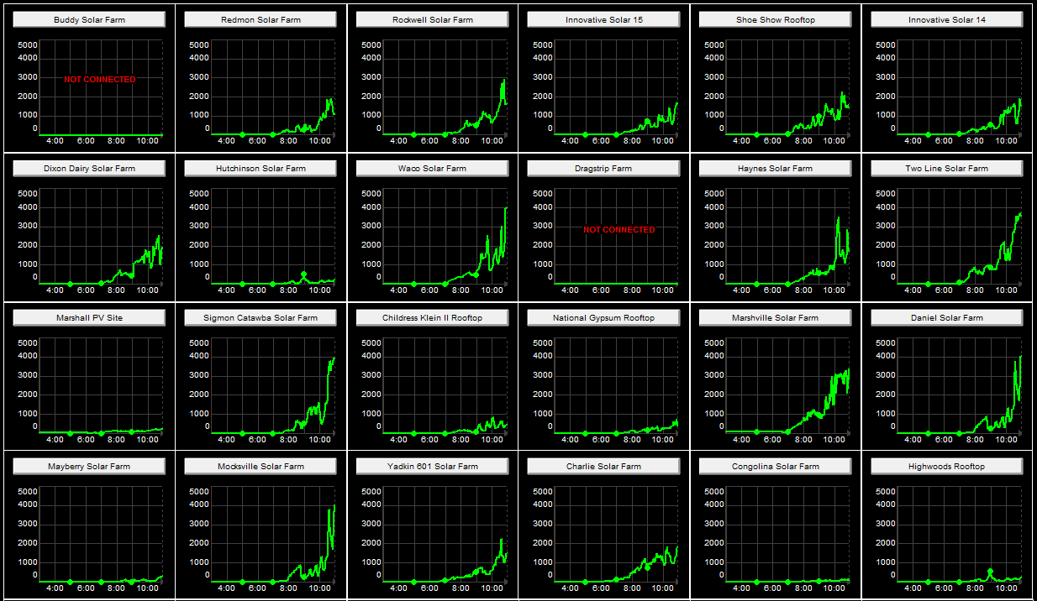
“DEC Visuals” - DEC Dashboard (2 of 2)
1
PV Site Action Button:
Single Click: This will navigate you to the Individual Site PI display.
Three Phase Power Output:
Observation: Displays the three phase power output of the solar site, all on a 5,000kW scale.
Provides the user a quick way to inspect the operation of all PV sites.
2

Slide 11
“DEC Visuals” – DER Tabular Display (1 of 2)
“DEC Visuals” - DEC Tabular Display. Double click title to open.

Slide 12
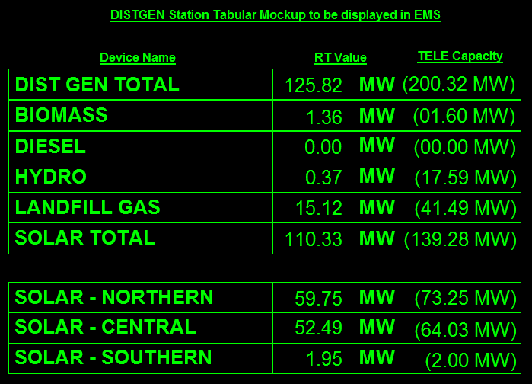
“DEC Visuals” – DER Tabular Display (2 of 2)
RT Value:
Observation: Provides the real-time MW generation of each type of DER. Updated every minute.
TELE Capacity:
Observation: Provides a static reference to the available capacity of operational PI tags.
Regional Solar:
Observation: Provides the real-time MW Solar generation broken down into DEC regions.
3
1
2

Slide 13
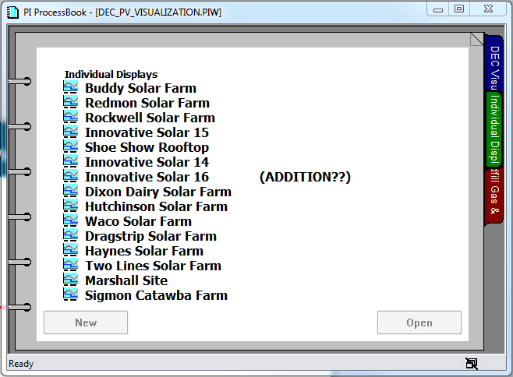
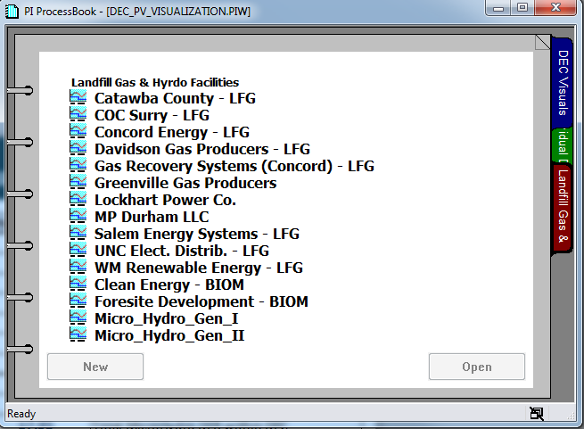
“Individual Displays” – PV Site Characteristics & RT Operation (1 of 3)
“Individual Displays” – PV Site Characteristics & R.T. Operation. Double click title to open.
Over 50+ displays created.
“Landfill Gas & Hydro Facilities” – Site Characteristics & R.T. Operation. Double click title to open.
Over 12+ displays created.

Slide 14
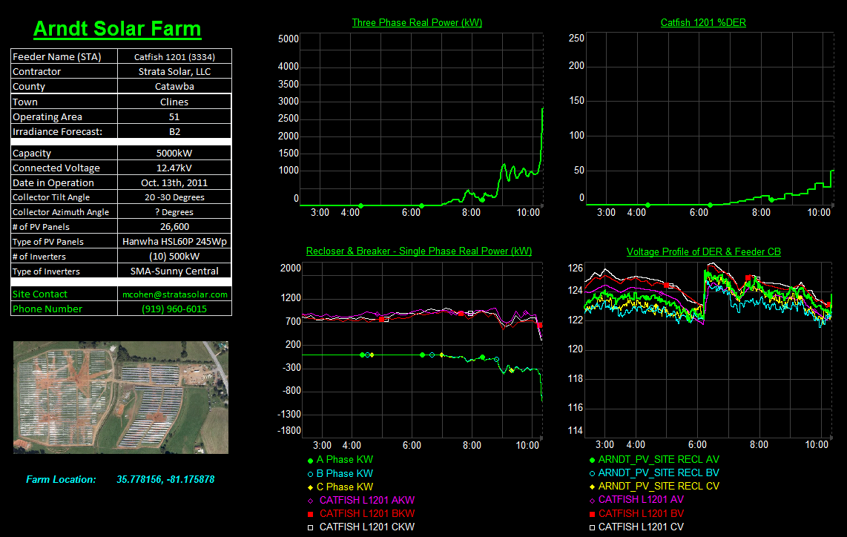
“Individual Displays” – PV Site Characteristics & RT Operation (2 of 3)
Site Description:
Information: Provides the user with feeder name, location, technical specifications, and Site Contact.
Arial Site View:
Google Maps image along with exact Latitude, Longitude of site.
Recloser & Breaker – Single Phase Real Power (kW):
Observation: Displays raw data of single phase kw measurements of the site recloser and its feeder’s circuit breaker at the substation.
1
2
3

Slide 15
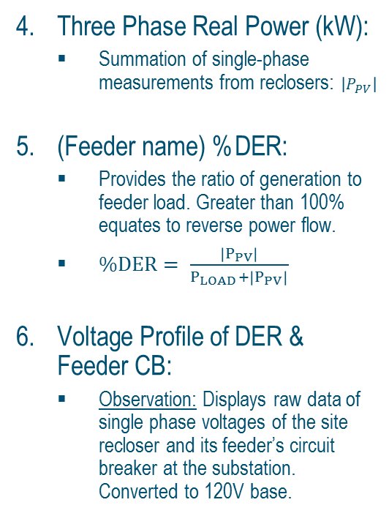
“Individual Displays” – PV Site Characteristics & RT Operation (3 of 3)
4
5
Three Phase Real Power (kW):
Summation of single-phase measurements from reclosers: $\left|P_{PV}\right|$
(Feeder name) %DER:
Provides the ratio of generation to feeder load. Greater than 100% equates to reverse power flow.
$\%DER= \frac{\left|P_{PV}\right|}{P_{LOAD}+\left|P_{PV}\right|}$
Voltage Profile of DER & Feeder CB:
Observation: Displays raw data of single phase voltages of the site recloser and its feeder’s circuit breaker at the substation. Converted to 120V base.
6

Slide 16
Aggregate DER PI Tags to be pushed to EMS
The follow tags are available in PI-Server CLTECRDPIP1 for an easy means to pull historical data and push real-time values to EMS servers.
Each TOTAL tag has (2) other tags associated with it, a .GROSS & .COUNT

Slide 18
Salesforce Data Overview

