Slide 1


AEP: Achieving Hierarchical Fault Tolerance in DSM Through Atomic Execution Protection
Zixuan Wang¹, Qi Wu¹, Hang Huang^{1∗}, Jia Rao^{2∗}, Hui Lu^{2∗}, Hao Fan¹, Zhuo Huang¹, Song Wu^{1∗},Hai Jin¹
¹Huazhong University of Science and Technology (HUST)
²The University of Texas at Arlington
(UTA)
Notes:
Good morning everyone. I’m Zixuan Wang from Huazhong University of Science and Technology.
Today, I am going to present our research on Achieving Hierarchical Fault Tolerance in Distributed shared memory Through Atomic Execution Protection.

Slide 2
Agenda
Background & Motivation
AEP Design and Implementation
Evaluation
Conclusion

Slide 3

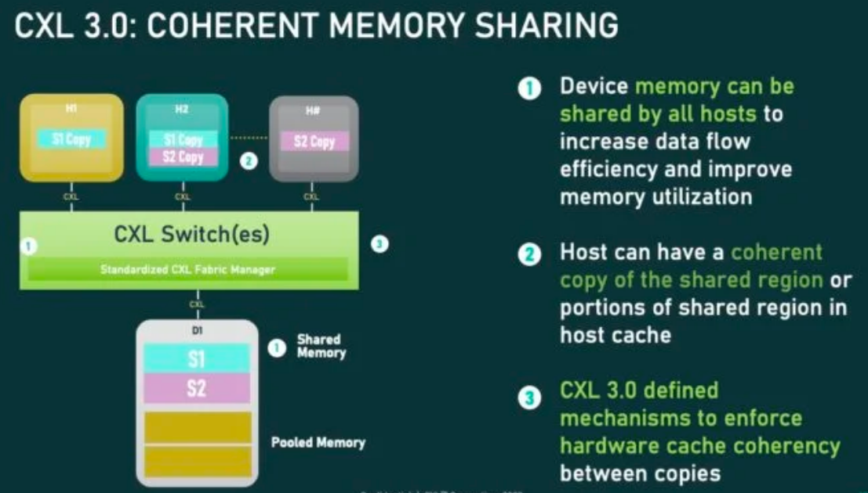

Distributed Shared Memory
CXL 3.0 makes cross-node shared data structures practical
Zero-copy
Serialization-free message passing
CXL 3.0 cache coherency technologies
Client 1
DSM
Client 2
Send
Receive
Node 1
Node 2
Notes:
In traditional cross-node data sharing systems, data typically goes through multiple copies as well as serialization and deserialization. This introduces significant overhead and leads to high latency. With CXL type 3, however, we gain a cache-coherent memory sharing mechanism, which makes cross-node shared data structures practical. Under this model, Clients on different machines can directly communicate through the DSM. Overall, CXL 3.0 shifts distributed shared memory from being merely feasible to being truly efficient, providing a powerful new infrastructure foundation for building cross-node systems.

Slide 4



Partial Failures
However, DSM management faces the challenge of partial failures
Client 1
DSM
Client 2
❶malloc
1.1 meta op
❸deadlock
msg1
1.2 get buf
❷Client 1 termination
Node 1
Node 2
Unexpected client failures/termination can corrupt the allocator state！
Notes:
然而，DSM内存管理系统面临部分错误挑战，当多个client共享一个内存分配器时，client的任意崩溃就会导致内存分配器内部状态损坏，考虑上图的这样一种情况：当client 1进行内存分配时，其需要查找freelist,由于多个client的内存分配可能同时进行，因此freelist需要进行锁等同步原语进行控制，当client 1在持锁期间被OS 终止执行，那么该锁将无人释放，因此造成系统全局死锁。同样的问题也会造成内存分配器元数据更新不一致，从而导致系统崩溃。
However, DSM memory management faces a critical challenge under partial failures. When multiple clients share a single memory allocator, the crash of any client can corrupt the allocator’s internal state.
Consider this example: when Client 1 performs a memory allocation, it must traverse the freelist, which is protected by locks due to concurrent access. If Client 1 is terminated by the OS while holding the lock, the lock is never released, leading to a global deadlock.
Similar issues arise during metadata updates, and unexpected client failures can leave the allocator in an inconsistent state, ultimately causing system-wide crashes.

Slide 5
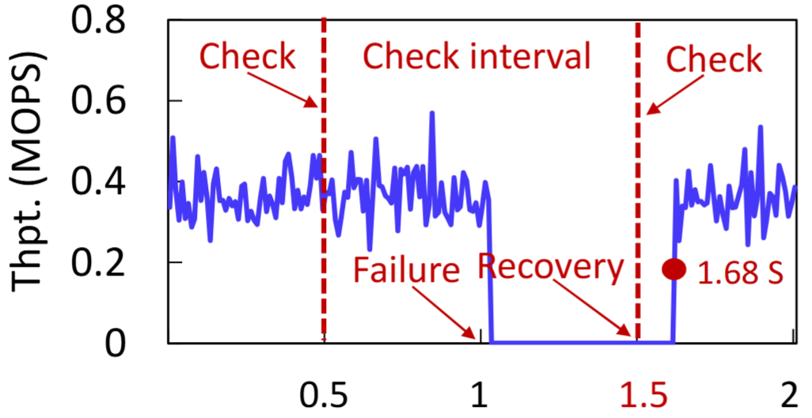
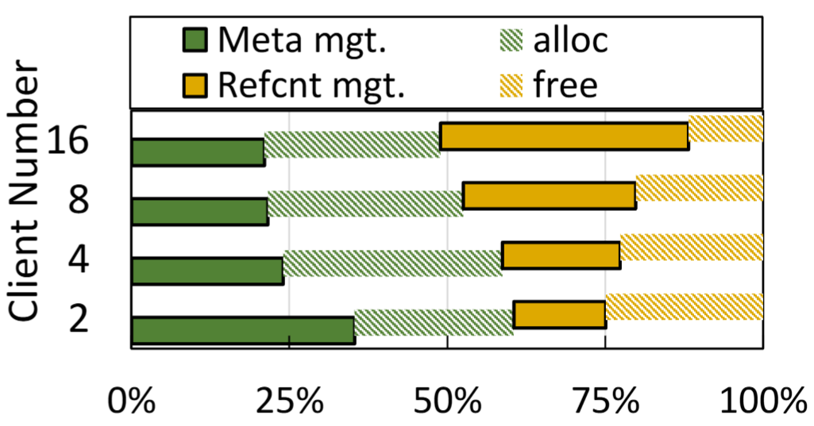
Current Solutions
No partial failure support[1]
Lack of fine-grained fault tolerance for independent clients
Lack flexibility
Blocking recovery mechanisms[2]
Recovery induces global stalls, stop-the-world!
Lock-free, high complexity and poor performance[3]
Complex consistency distributed protocols
Significant runtime overhead
“Stop-the-world” recovery
Memory fence & cache flush
[1]Serialization/Deserialization-free State Transfer in Serverless Workflows (Eurosys’ 24)
[2]Rearchitecting in-memory object stores for low latency (VLDB’ 22)
[3]Partial Failure Resilient Memory Management System for (CXL-based) Distributed Shared Memory (SOSP’ 23)
Notes:
针对这个问题，现有研究主要通过三类方案来解决：第一种方法从分布式应用的工作流入手，针对预先固定工作流为每一个client定制专属内存通信信道，当client失败，系统仅需将相关的固定信道销毁即可，这样的系统无法面对复杂多变的工作流
第二种方案采用基于日志的阻塞式恢复算法，当死锁发生时，系统需要等待恢复进程开始工作并基于日志进行恢复，因此会引入全局停顿问题
第三种方案采用基于时代矩阵的分布式事务算法，在保证无锁的同时，通过日志确保了内存管理关键步骤的原子性，但是这也在内存分配的关键路径引入了多次内存屏障与cache flush指令，经过我们的测量，这部分的开销占据内存分配总开销的49.86%以上
因此，尽管DSM系统可以降低数据传递开销，但是软件管理开销极大
Existing work mainly tackles this problem with three classes of approaches.
The first designs around the application workflow. It predefines workflows and assigns each client a dedicated memory communication channel. When a client fails, the system simply tears down the corresponding channel. However, this approach does not generalize well to dynamic and complex workloads.
The second relies on log-based, blocking recovery. When a deadlock occurs, the system must pause and wait for a recovery process to replay logs, which introduces global stalls.
The third adopts era-based distributed transactions. It achieves lock-free execution and ensures atomicity via logging, but at the cost of multiple memory fences and cache flushes on the critical path of allocation. Our measurements show that this overhead accounts for more than 49.86% of total allocation cost.
As a result, while DSM reduces data movement overhead, it incurs substantial software management overhead.

Slide 6


Motivation
Only Client crash
Node crash
Client 1
Client 1
Client 6
Client 2
Client 6
Client 2
Fast!
Slow
Client 5
DSM mem pool
3
DSM mem pool
Client 3
Slow
Client 5
Node 1
Node 3
?
Client 4
Node 2
Client 4
Client crash
Current Solutions: Flat failure domains,
high-overhead distributed coordination
Can we exploit intra-node locality
to enable fast, fine-grained management?
Notes:
我们发现，在多个机器组成的DSM系统种，复杂的分布式一致性算法仅需要在跨机状态同步时需要，但是现有的DSM内存分配算法都采用扁平化的错误域模型，这意味着这些系统将每一个client当作一个独立的机器，因此，即便是两个client处于同一个机器上，现有方案仍然需要非常重的分布式事务进行状态容错。而现如今，现代集群调度通常具有亲和性，当多个client经常相互协作时，调度算法倾向于将他们调度到同一个节点以此降低通讯开销，因此，Can we exploit intra-node locality to enable fast, fine-grained management?
We observe that in DSM systems spanning multiple machines, complex distributed consistency protocols are only necessary for cross-node state synchronization. However, existing DSM allocators adopt a flat failure-domain model, treating each client as an independent machine.
As a result, even clients co-located on the same node still rely on heavyweight distributed transactions for fault tolerance.
However, in practice, modern cluster schedulers often exploit affinity: clients that frequently interact are likely to be co-located on the same node to reduce communication overhead.
This raises a key question: can we exploit intra-node locality to enable fast, fine-grained memory management?

Slide 7
Motivation
Node crash
Client 1
Client 6
How to achieve low-overhead, non-blocking fault tolerance
within a node?
Must tolerate arbitrary client crashes within a node
Client 2
Fast!
Slow
Client 5
DSM mem pool
Node 1
Node 3
Client 4
Client crash
Node 2
Notes:
想要实现这一点，我们就必须要找到一种能够在单节点内部容忍部分错误的机制，该机制需要比现有的era-based分布式事务算法更加的高效，以此在节点内分配/通信时构建快速路径，但遗憾的是，没有现有工作在该方向上进行探索。
To achieve this, we need a mechanism that can tolerate partial failures within a single node. Such a mechanism must be significantly more efficient than existing era-based distributed transaction approaches, enabling a fast path for intra-node allocation and communication.
Unfortunately, this direction remains largely unexplored by existing work.

Slide 8
Agenda
Background & Motivation
AEP Design and Implementation
Evaluation
Conclusion

Slide 9
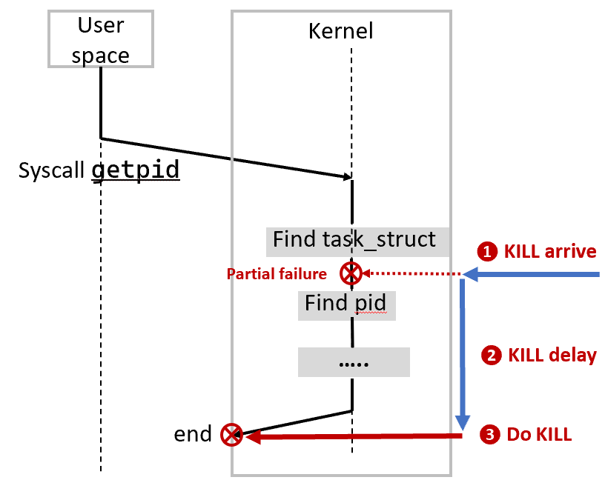

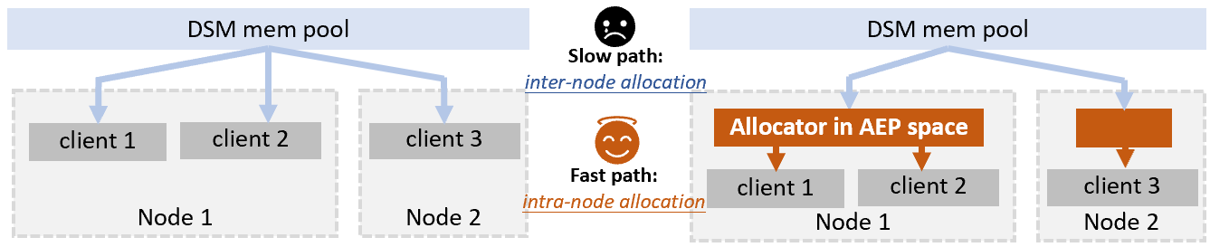
Design Insight: Learning from the Kernel
The kernel address space is shared memory and also faces partial failures
Kernel metadata is shared across processes
SIGKILL may arrive during metadata updates
Kernel defers termination till. syscall completes
Atomic Execution Protection (AEP)
A novel kernel semantic
Provide atomicity for user-space function-level code
Fast path: no memory fence, flush, context switch!
Flat DSM management
Hierarchical DSM management
Notes:
为了解决这个问题，我们将目光放到了内核，我们发现，内核地址空间本身就是一种共享内存，其被单个机器内部的多个进程共享，内核内部也具有大量的元数据例如inode，hashtable，pagetable等等，那么，内核是怎么防止部分错误问题发生的呢？
我们发现，内核采用了一种“延迟终止”的机制，当外部终止信号到来时，内核会短暂的忽略这个信号，直到本次内核流程执行完毕即将退出内核时，内核才会真正结束当前进程，这个机制十分简洁高效，其无需任何的日志等操作。
因此，我们将内核的思路迁移到用户态，并提出atomic execution protection机制，这是一个内核原语，其可以保证用户态的某一段关键代码要么不执行，要么完全执行完整，内核不会在执行到一半的时候终止进程。
基于这个机制，我们可以在单节点内部为DSM内存管理提供快速路径，AEP机制会保证单节点内部单次函数的调用，例如malloc free，send等等完整执行，因此无需任何内存屏障、cache刷新等容错相关操作。
To address this challenge, we turn to the OS kernel. The kernel address space is essentially shared memory across processes on a single node, and it maintains rich metadata structures such as inodes, hash tables, and page tables. This naturally raises the question: how does the kernel tolerate partial failures?
We find that the kernel relies on a simple yet effective mechanism, which is called deferred termination. When a kill signal arrives, the kernel temporarily defers handling it until the current kernel execution path completes. Only when the control flow is about to return to user space does the kernel actually terminate the process. This design avoids partial updates without requiring logging.
Inspired by this, we bring the idea to user space and propose Atomic Execution Protection (AEP). AEP is a kernel primitive that guarantees a critical user-level code region either does not execute at all or runs to completion—preventing mid-execution termination.
With AEP, we enable a fast path for intra-node DSM memory management. Operations such as malloc, free, and send can complete atomically within a node, eliminating the need for memory fences, cache flushes, or other fault-tolerance overheads on the critical path.

Slide 10
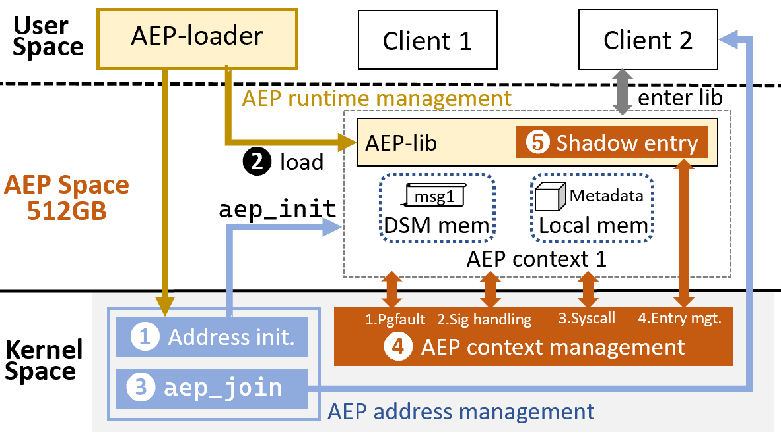
Key Design Elements of AEP
AEP: efficient intra-node fault tolerance without log or distributed coordination
Context Management
Atomic running environment for AEP programs
Runtime Management
AEP program development, compilation, and loading
Address Management
Tenant isolation, intra-tenant sharing
Notes:
本图为AEP基本架构，我们开辟了一块地址空间用于运行受AEP保护的程序，受保护的程序需要被加载进入这个地址空间，之后，应用可以通过调用位于AEP空间的函数来执行malloc，free等操作，这些操作函数因为受到AEP保护，因此都可以保证完整性与原子性。基于AEP的目标，AEP由图中的三个部分组成，分别对应AEP面临的三个挑战，首先，如何高效的让内核准确的感知用户态一个调用的开始与结束？这对应了context管理，其次，内存分配器需要在同一个租户的多个client之间进行共享，并同时保证租户间隔离，如何实现高效的隔离与共享？这对应AEP 地址空间管理，最后，用户如何基于AEP构建自己的内存分配器？如何方便的使用AEP机制？AEP程序如何运行？这部分对应AEP runtime 管理
This figure shows the overall architecture of AEP. We reserve a dedicated address space to host AEP-protected programs. These programs are loaded into the AEP space, and applications invoke functions within this space to perform operations such as malloc and free. Since these functions are protected by AEP, they guarantee both atomicity and execution completeness.
To achieve this goal, AEP is designed around three key components, each addressing a core challenge. First, how can the kernel efficiently and precisely detect the start and end of a user-level invocation? This is handled by context management.
Second, the memory allocator must be shared among multiple clients within the same tenant, while ensuring isolation across tenants. This is addressed by AEP address space management, which enables efficient sharing and isolation.
Finally, how can developers build and use allocators on top of AEP, and how are AEP programs executed? This is supported by AEP runtime management, which provides the programming and execution environment for AEP.

Slide 11
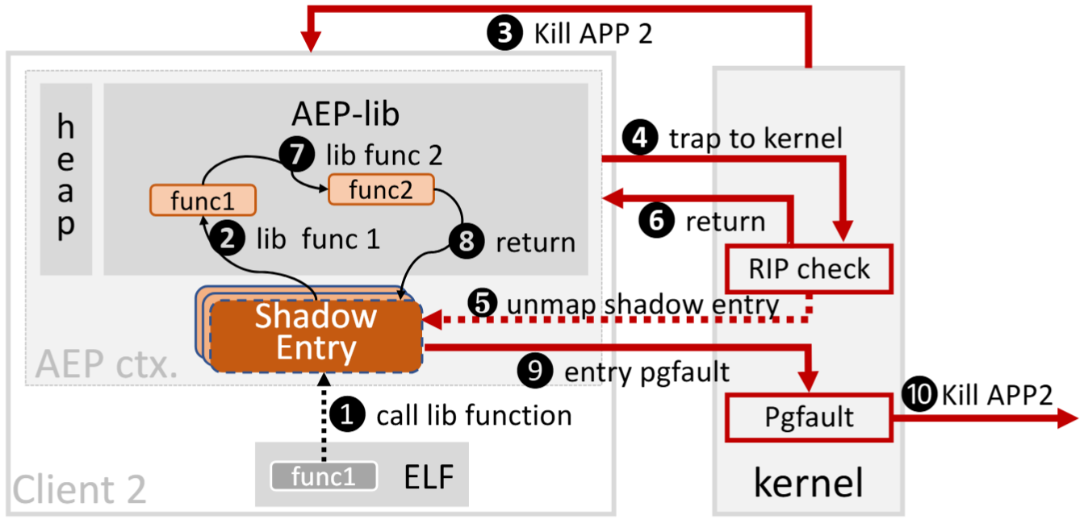
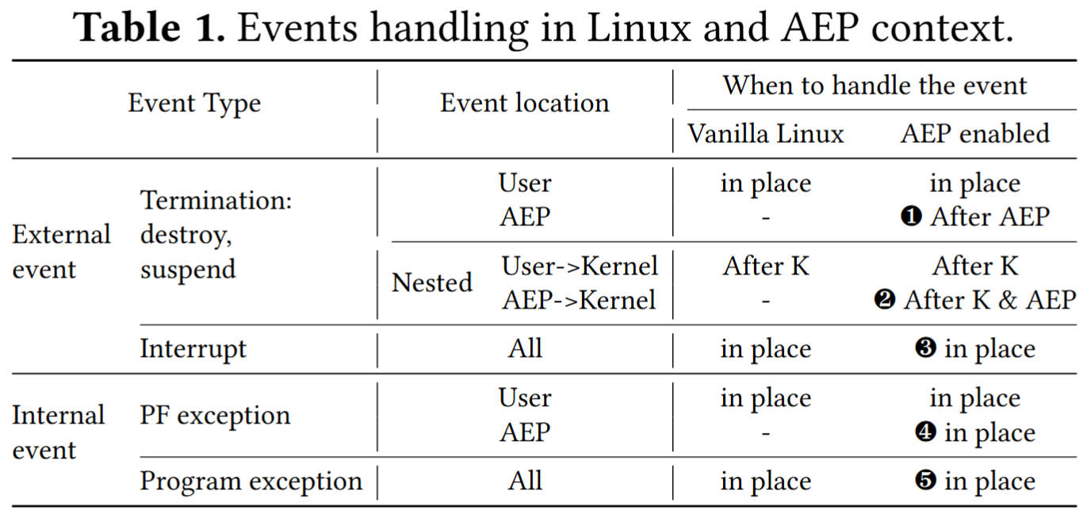
AEP Context Management: Shadow Entry
Challenge: How can the kernel detect user-level function completion?
Strawman Solutions:
Uprobe
Call Stack Unwinding
Need kernel entry, high overhead!
Solution: Shadow entry
RIP check
Unmap function entry
Return & continue
Pagefault & kill
Notes:
为了让内核感知用户态函数的执行完成，一个简单的想法就是采用Linux uprobe机制，在用户态临界区代码上插入断点，但是这样会导致每一次进入临界区都陷入内核，因此非常低效
我们提出shadow entry机制，当用户态程序进入临界区代码时，首先需要执行shadow entry中的代码，之后，当应用在执行用户态临界区时收到kill信号，陷入内核后，内核会根据IP指针判断程序当前处于临界区，之后unmap shadown entry，然后让进程返回用户态继续运行，这样，在临界区执行完成即将返回shadow entry时，会触发缺页中断，这是可以确保临界区完整执行，内核因此可以安全的Kill掉进程。
To let the kernel detect the completion of a user-level critical section, a straightforward idea is to use Linux uprobes by inserting breakpoints into the critical code. However, this would trap into the kernel on every entry, making it prohibitively expensive.
Instead, we propose a shadow entry mechanism. Before entering a critical section, the program first executes a small piece of code in the shadow entry. If a kill signal arrives while the application is executing inside the critical section, the kernel inspects the instruction pointer to determine that the process is still within the protected region. It then unmaps the shadow entry and resumes the process in user space.
When the critical section finishes and control returns to the shadow entry, this triggers a page fault due to the unmapped region. At this point, the kernel can safely terminate the process, ensuring that the critical section has executed to completion.

Slide 12
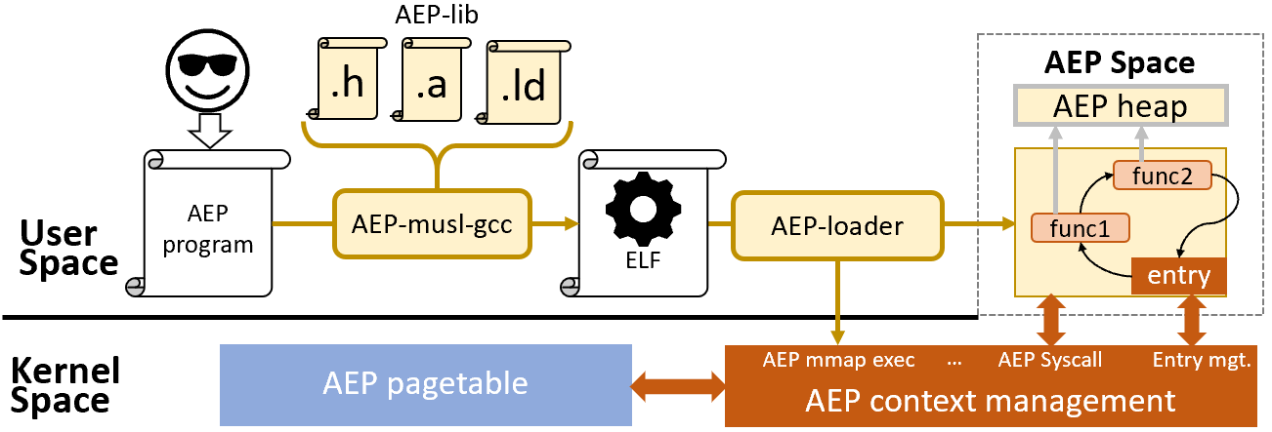
AEP Runtime Management
Challenge: How to write, compile and load a AEP program?
Solution: AEP-lib Develop AEP programs based on AEP-musl
AEP-loader
Avoid reimplementing an AEP ELF loader in kernel
Corner Case:
If all clients fail, the AEP program
must continue running!
Private heap:
AEP mmap, brk
Static linked
Notes:
AEP机制的原子性导致了一个隐含的corner case：当所有的client都挂掉了，AEP上下文中的程序仍然可以继续运行，这意味着，AEP program 独立于任何应用的存在而存在，为了实现这一点，AEP 程序需要拥有私有的堆内存来存放自己的元数据，AEP程序需要具有独立的，隔离于用户态地址空间的独立空间，为此，我们构造了AEP address space，AEP program需要运行在这个地址段上，并在这个地址空间中使用AEP mmap与AEP brk。
另一方面，任何的应用都无法动态加载AEP program，因此AEP program是一个静态链接程序，需要一个独立的加载器来调用AEP exec来一次性加载完全。
为了对AEP program编写者屏蔽上述细节，我们将这些封装到AEP-lib中，编程人员可以基于这个库进行AEP program的编译与开发。
A subtle corner case arises from AEP’s atomicity is that: if all clients crash, the AEP context may continue running independently. In other words, an AEP program can outlive any individual application.
To support this, the AEP program must maintain its own private heap for metadata and execute within an isolated address space, separate from the normal user space. We therefore introduce an AEP address space, where AEP programs run and manage memory via AEP-specific system call such as AEP mmap and AEP brk.
On the other hand, AEP programs cannot be dynamically loaded by any applications. Instead, they are statically linked and require a dedicated loader, which invokes aep mmap exec to load the entire program at once.
To hide these complexities from developers, we encapsulate all mechanisms into an AEP-lib, enabling programmers to conveniently build and deploy AEP programs on top of our system.

Slide 13
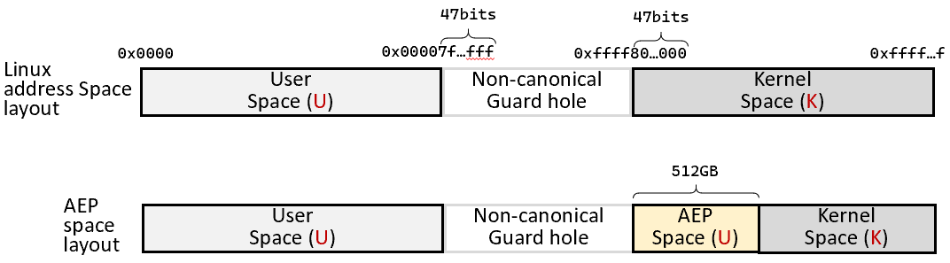
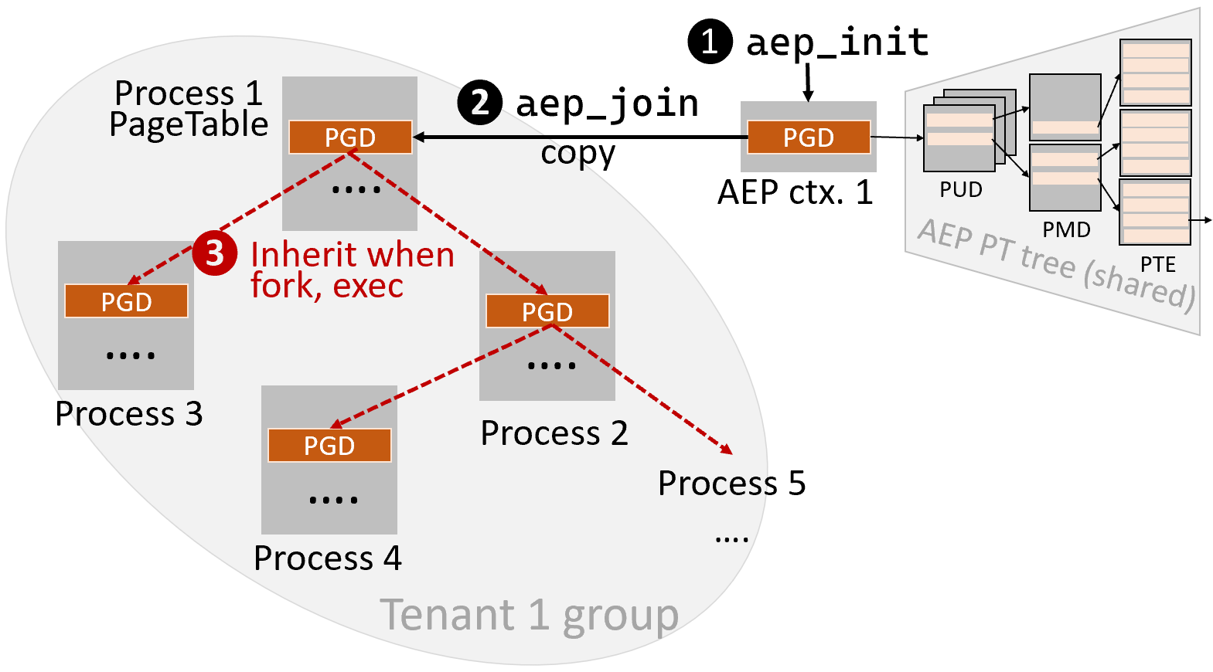
AEP Address Management
Challenge: How to provide tenant-level isolation and intra-tenant client sharing?
Solution: AEP pagetable
Tenant-private isolated AEP page table tree
❶AEP_init: Create an AEP page table
❷AEP_join: Add the container/app’s first process to the AEP page table
❸Inherit: Child processes inherit the AEP page table
Notes:
由于AEP空间需要独立于用户态空间，并且还需要在多个进程之间共享，因此我们将一段高地址作为AEP空间，由于在现有操作系统中，高地址在所有进程之间共享，因此AEP space 的多租户隔离问题是一个挑战。
为了解决这个问题，我们构造AEP页表，每一个租户拥有一个AEP页表，因此租户之间AEP地址空间相互隔离，每当租户启动一个应用，AEP页表都需要与应用的第一个进程绑定，并强制在之后的所有子进程之间继承，因此，租户内部的多个应用或容器都会共享一个AEP地址空间
Since the AEP space must be isolated from the normal user space while also being shared across processes, we place it in a reserved high address range. However, in existing OS designs, high address regions are typically shared across all processes, which makes multi-tenant isolation a key challenge.
To address this, we introduce AEP page tables. Each tenant is assigned a dedicated AEP page table, ensuring that AEP address spaces are isolated across tenants. When a tenant launches an application, its AEP page table is bound to the first process and is then inherited by all child processes.
As a result, multiple applications or containers within the same tenant naturally share a single AEP address space, achieving efficient intra-tenant sharing while preserving inter-tenant isolation.

Slide 14
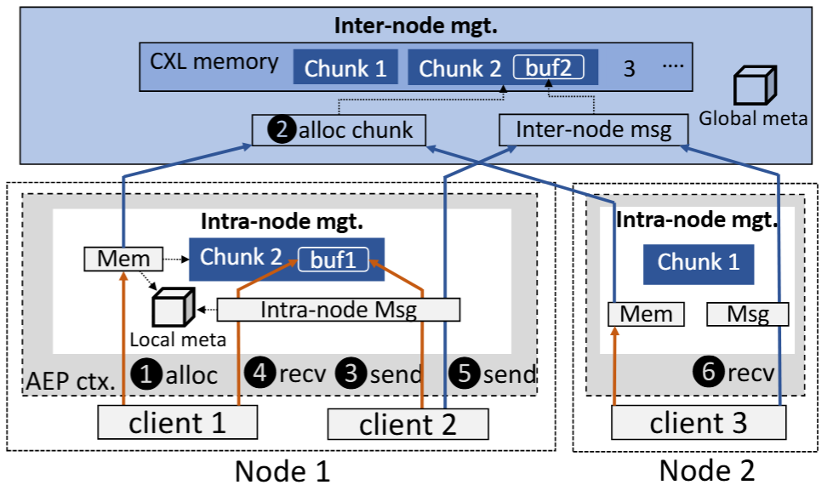
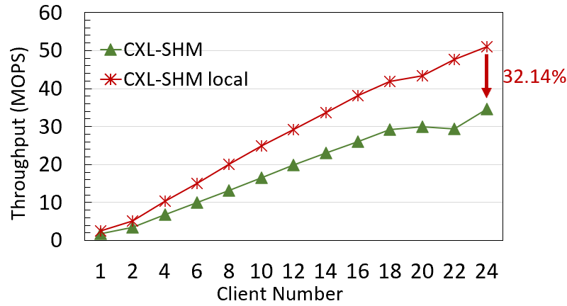
AEP-DSM: AEP + Inter-node Management
Decouple intra-node and inter-node management
Inter-node: On first request, a node is assigned a large memory chunk
Intra-node: Subsequent requests are served locally until more chunks are needed
Challenge:
Remote metadata access -> 32% performance drop
Reference counting -> High cross node ref-update overhead
Notes:
基于AEP我们构造了层级化的分布式共享内存管理系统AEP-DSM，其分为两层，client首先通过intra-node分配器进行内存分配，该层级运行在AEP中，为快速路径，开销低，当分给本node的DSM内存不足时，进入inter-node allocator来分配一大块DSM内存给本节点使用，该层会使用分布式一致性事务来进行内存分配以保证在节点崩溃时可被恢复，属于慢速路径。
只有状态修改需要跨节点更新时，inter-node managemnt才会触发，这通常是跨节点内存传递或者节点内存分配，如果状态修改仅局限于节点内部，例如client内存分配，或者是同节点内存传递，那么无需触发慢速路径，因此系统性能得到提升。
为了将层级化架构的性能发挥到极致，我们仍然面临两点挑战，第一点，由于现有内存分配算法大多将内存块描述元数据与内存块本身放在一起，因此在分配过程进行freelist搜索时，引入远程内存访问，根据我们的测量，其会引入大约32%的吞吐量下降；第二点，现有的引用计数方案对每一个内存块进行细粒度追踪，因此在跨节点传输时引用计数更新频率过高从而引入大量分布式一致性事务，从而降低性能。
Building on AEP, we design a hierarchical DSM system, AEP-DSM, with two levels.
The fast path is an intra-node allocator running inside AEP, handling local allocations with low overhead. When node-local remote memory is exhausted, the system falls back to an inter-node allocator, which allocates large DSM chunks using distributed transactions for fault tolerance, forming the slow path.
Inter-node management is only triggered for cross-node state changes, such as remote memory transfers or global allocation. Purely intra-node operations remain on the fast path, avoiding unnecessary overhead.
However, two key inefficiencies remain. First, co-locating metadata with memory blocks causes remote accesses during freelist traversal, reducing throughput by about 32%. Second, fine-grained reference counting leads to frequent cross-node updates, introducing excessive distributed transaction overhead.

Slide 15
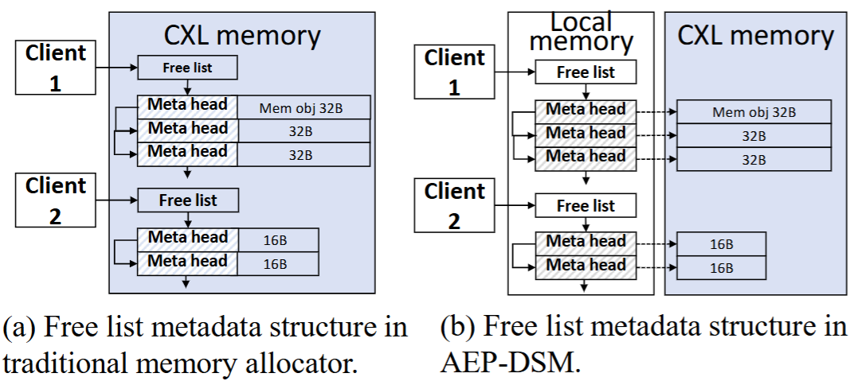
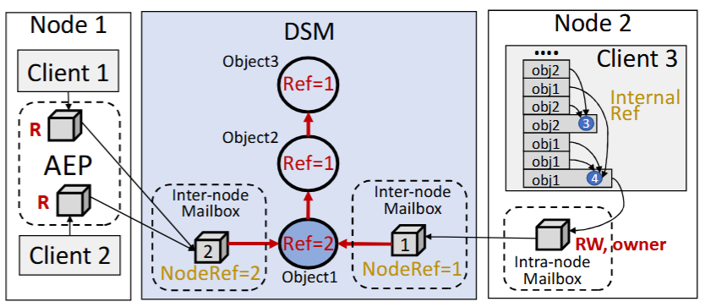
AEP-DSM: AEP + Inter-node Management
Challenge:
Remote metadata access
Reference counting
Solutions:
decouples memory objects from metadata
Root-only reference counting
decouples memory objects from metadata
Root-only reference counting
More details in the paper
Notes:
为了解决第一个挑战，我们将元数据与内存块分离管理，并使用本地内存存放元数据，这些元数据受到AEP保护，只有在内存块被跨节点发送时元数据才会同步到CXL内存中；对于第二个挑战，我们设计了root-only引用计数，该方案只在复杂数据结构的根节点记录整个数据结构的被引用数量，对于结构的内部内存对象只记录内部引用，以此降低了引用修改次数。细节详见论文
To address the first challenge, we decouple metadata from memory blocks and store metadata in local memory protected by AEP. These metadata are only synchronized to CXL memory when the corresponding memory blocks are transferred across nodes.
For the second challenge, we introduce root-only reference counting, which maintains the reference count only at the root of a complex data structure. Internal objects track only intra-structure references, significantly reducing the number of reference updates.
please refer the detailed implementation to the paper.

Slide 16
Agenda
Background & Motivation
AEP Design and Implementation
Evaluation
Conclusion

Slide 17
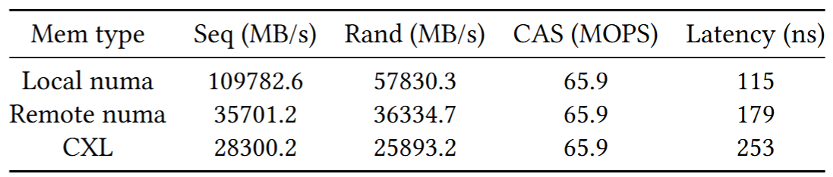
Evaluation Setup
Dual-socket server
CPU: 2 Intel Xeon Gold 6416H 2.10GHz, 36 physical cores (72 logical threads)
Memory: 128GB local DRAM
CXL: Montage CXL memory controller [1] (CXL 1.1), 32GB memory pool
OS: Ubuntu 22.04, Linux 6.9.2
Compared Systems:
lock-based DSM: Lightning[VLDB’22]
lock-free DSM: CXL-SHM[SOSP’23]
Baseline: local memory, no fault tolerance.
Local mem 128GB
CPU 0
CPU 1
Remote mem pool 32GB
Memory throughput and latency characteristics
[1]Montage 2025. Montage CXL Memory Expander Controller. Montage,https://www.montage-tech.com/MXC/M88MX5891&5851.
Notes:
为了评估AEP机制的有效性，我们采用CXL1.1设备进行模拟，两个CPU模拟不同节点，他们之间可以通过cache一致性协议来保证对于CXL内存的访存一致性，我们选取了lock-based DSM系统Lightning与lock-free DSM 系统CXL-SHM作为对比对象。
To evaluate the effectiveness of AEP, we use a CXL type 1 device for emulation. Two CPUs are treated as separate nodes, and cache coherence is used to ensure consistent access to CXL memory.
We compare AEP-DSM against two baselines: Lightning, a lock-based DSM system, and CXL-SHM, a lock-free DSM design.

Slide 18
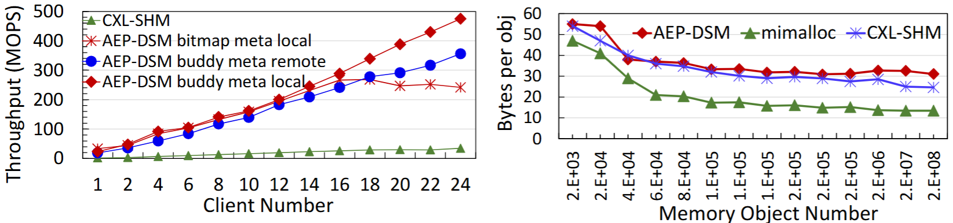
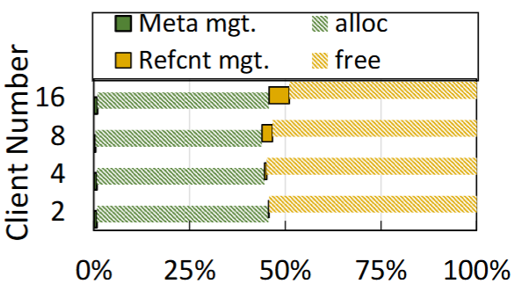
Microbenchmark: Threadtest
13× higher throughput than CXL-SHM
Need 6 extra bytes of local metadata per object vs. CXL-SHM
Profiling: Memory fences & flushes occur only on inter-node allocations, keeping overhead low.
Intra-node allocator can be customized!
Notes:
对于内存分配器微基准测试，我们选用threadtest benchmark, 实验结果表明AEP-DSM相比于CXL-SHM吞吐量提升较大，且可以随意定制intra-node内存分配器算法，我们在实验中尝试了基于bitmap与基于buddy system的算法，结果发现基于buddysystem的算法扩展性更佳，因此我们在后续实验中均采用此算法。
另一方面，我们对AEP-DSM进行了深入分析，发现cache flush与memory fence占比不足10%，这点说明了the impact of AEP-DSM’s design advantage –by offloading intra-node fault tolerance to the AEP context,AEP-DSM can eliminate flush and fence operations from theintra-node allocation fast path
For the memory allocator microbenchmark, we use the threadtest benchmark. The results show that AEP-DSM achieves up to a 13× throughput improvement over CXL-SHM. In addition, AEP allows flexible customization of the intra-node allocator. We evaluate both bitmap-based and buddy-system-based designs, and find that the buddy system provides better scalability, so we use it in all subsequent experiments.
We further analyze AEP-DSM and find that cache flushes and memory fences account for less than 10% of total cost. This highlights a key advantage of our design: by offloading intra-node fault tolerance into the AEP context, AEP-DSM removes flush and fence operations from the fast path of intra-node allocation.

Slide 19
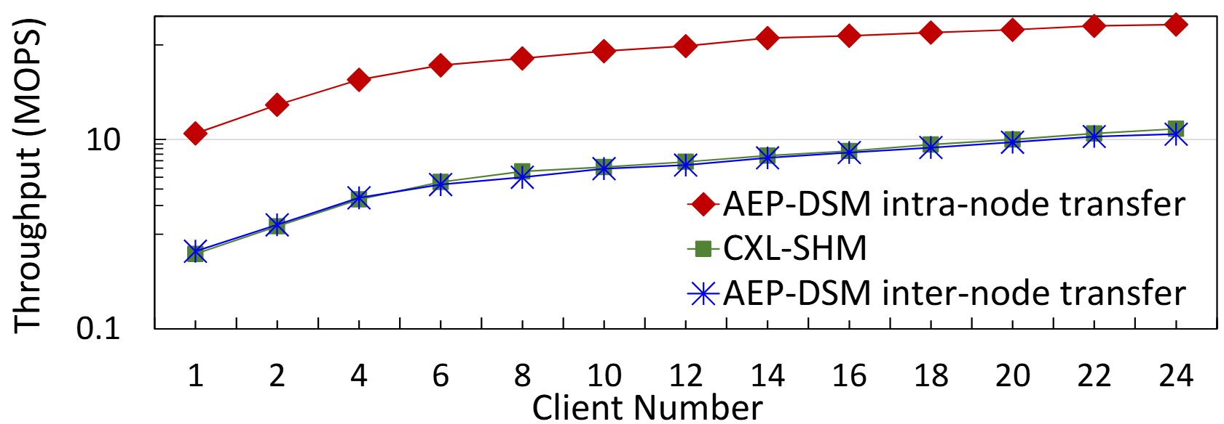
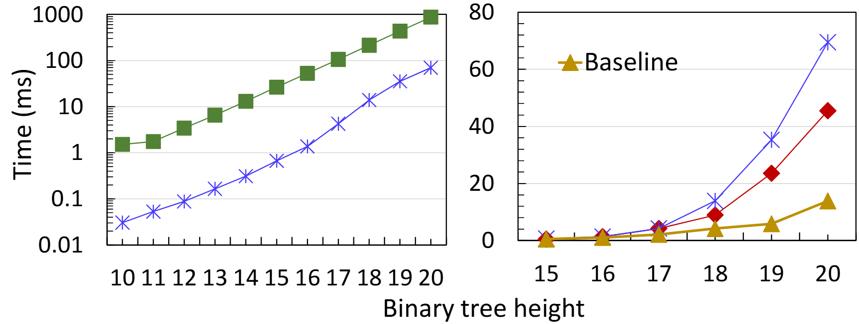
Microbenchmark: Memory Transmission
12×
3.72× slower
Single object transfer performance
14.4× higher throughput for intra-node single-object transfers
Two systems perform comparably in the cross-node case
Structural object (binary tree) transfer
12× faster than CXL-SHM -> Root only refcount
Notes:
在内存传递测试中，我们对单内存对象和复杂数据结构对象的传递进行了分别测试，首先，在单内存对象传递测试中，AEP-DSM的inttra-node传递性能相比于CXL-SHM高14倍，而跨节点传递性能与CXL-SHM相当，这说明了AEP-DSM的层级化设计的性能优势
而在跨节点传递一颗二叉树时，AEP-DSM相比于CXL-SHM性能提升了12倍，这是由于AEP-DSM的root-only refcount设计，该设计使得只有二叉树的根节点需要进行跨节点引用计数更新，其他子节点的访问无需引用计数更新
In the memory transfer evaluation, we separately test single-object transfers and complex data structure transfers.
For single-object transfers, AEP-DSM achieves a 14× speedup over CXL-SHM for intra-node transfers, while maintaining comparable performance for cross-node transfers. This demonstrates the efficiency of our hierarchical design.
For cross-node transfers of a binary tree, AEP-DSM achieves up to a 12× performance improvement. This gain comes from our root-only reference counting design, where only the root node requires cross-node reference updates, while all internal nodes avoid costly reference tracking.

Slide 20
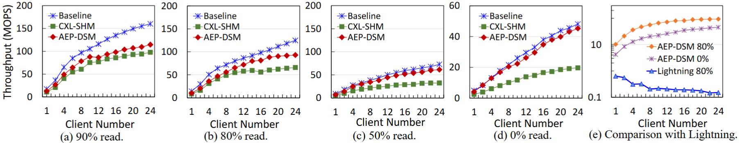
Real-World Applications: KV store
AEP-DSM’s gains over CXL-SHM increase with write intensity, reaching up to 2.36× higher throughput in the write-only case.
Notes:
基于AEP-DSM，我们实现了一个KV存储，来衡量其在真实负载下的性能，随着写比例的增高，AEP-DSM的性能提升逐渐增大，这是因为当全读时，负载仅局限于远程内存读，与内存分配无关，而随着写负载增大，内存分配比例增高，AEP-DSM的优势得到显现，最终，在全写的场景下，AEP-DSM相比于CXL-SHM提升两倍左右。
Based on AEP-DSM, we build a key-value store to evaluate performance under realistic workloads.
We observe that the performance gain of AEP-DSM increases as the write ratio grows. This is because under read-only workloads, the system is dominated by remote memory accesses and is largely independent of memory allocation. However, as the write intensity increases, memory allocation becomes a larger fraction of the workload, allowing AEP-DSM’s advantages to emerge.
Ultimately, in a write-only scenario, AEP-DSM achieves around a 2× performance improvement over CXL-SHM.

Slide 21
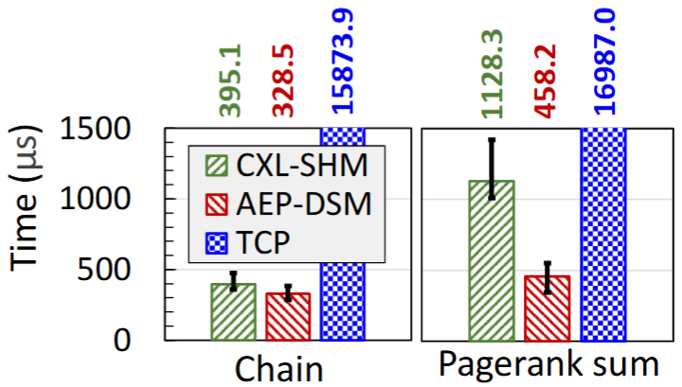
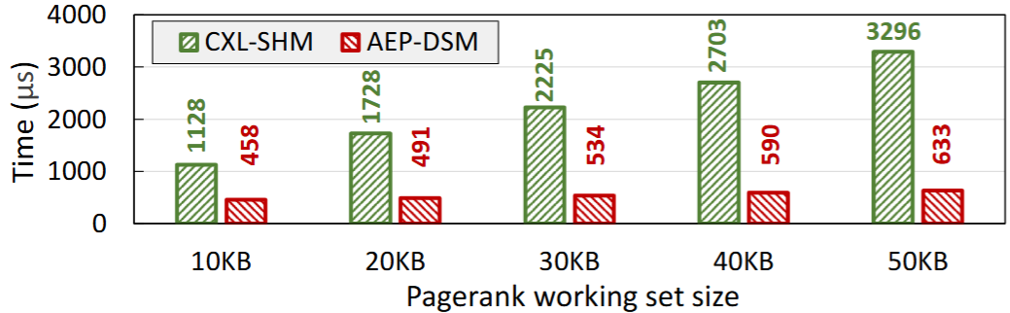
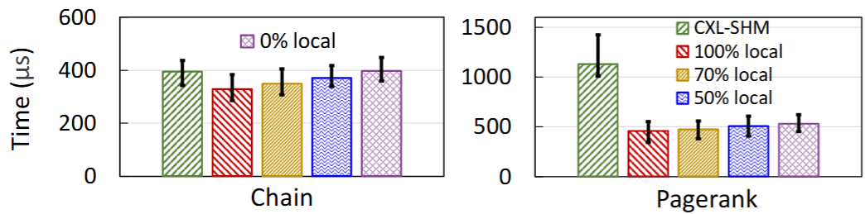
Real-World Applications: Serverless workflow
For chain benchmark, 1.20× speedup vs. CXL-SHM
For PageRank, 2.46×
AEP-DSM’s efficient memory allocation dominates communication cost
Intra-node test
AEP-DSM achieves a 2.12× speedup over CXL-SHM in PageRank, memory allocation dominating the workload
Inter-node test
Notes:
when functions solely communicate within a single node.result shows that both AEP-DSM and CXL-SHM out-perform TCP-based communication, underscoring the advantage of DSM for function interaction. In the chain benchmark,AEP-DSM yields a 1.20x speedup over CXL-SHM, whereas a more substantial 2.46x improvement is observed for PageRank，在进一步时间分解中我们发现，尽管内存传递部分的提升比例更大，但是由于其占总耗时比例低，因此不构成主要瓶颈，而内存分配过程由于耗时占比高，因此主导性能提升。更进一步的测试也能证明这一点：随着pagerank的工作集变大，性能提升越来越明显。
同样的规律也可以在跨节点测试中发现：在跨节点serverless chain测试中，随着本地节点通信比例降低，AEP-DSM与CXL-SHM性能趋同，这与内存传递性能测试预期一致，而对于pagerank 测试，即便通信全部跨节点，AEP-DSM性能仍然优于CXl-SHM，这意味着，对于内存密集型负载，DSM的软件管理开销已经成为了瓶颈，而不再是数据传递。
In serverless benchmark, When functions communicate within a single node, both AEP-DSM and CXL-SHM significantly outperform TCP-based communication, highlighting the benefit of DSM for function interaction.
In the chain benchmark, AEP-DSM achieves a 1.20× speedup over CXL-SHM, while in PageRank, the improvement increases to 2.46×. Further breakdown shows that although memory transfer brings larger relative gains, it contributes little to overall runtime due to its small proportion. Instead, memory allocation dominates the execution time and becomes the main source of performance improvement. This is further confirmed by scaling experiments, where the performance gain increases as PageRank’s working set grows.
A similar pattern appears in cross-node experiments. In the serverless chain benchmark, as the fraction of local communication decreases, AEP-DSM’s performance converges with CXL-SHM, consistent with expectations from memory transfer behavior. In contrast, for PageRank, AEP-DSM remains superior even when all communication is cross-node. This indicates that for memory-intensive workloads, DSM software management overhead—not data movement—has become the dominant bottleneck.

Slide 22
Agenda
Background & Motivation
AEP Design and Implementation
Evaluation
Conclusion

Slide 23
Conclusion
AEP: a light-weight kernel-assisted mechanism that guarantees atomic completion of DSM allocator operations, tolerating intra-node partial failures without costly distributed coordination
Hierarchical: Decouple intra-node and inter-node management
Supports customizable memory allocation algorithms
Three key designs in AEP
Efficient Shadow entry
Efficient multi-tenant isolation via mutipule AEP page table
Flexible and portable AEP runtime
Takeaways: In distributed shared memory, memory allocation becomes a performance bottleneck
Notes:
So in this research, we propose AEP, a light-weight kernel-assisted mechanism that guarantees atomic completion of DSM allocator operations, tolerating intra-node partial failures without costly distributed coordination, it decouple intra-node and inter-node management and Supports customizable memory allocation algorithms

Slide 24
AEP: Achieving Hierarchical Fault Tolerance in DSM Through Atomic Execution Protection
Thank You! Q&A
Zixuan Wang¹, Qi Wu¹, Hang Huang^{1∗}, Jia Rao^{2∗}, Hui Lu^{2∗}, Hao Fan¹, Zhuo Huang¹, Song Wu^{1∗},Hai Jin¹
¹Huazhong University of Science and Technology (HUST)
²The University of Texas at Arlington
(UTA)

