Slide 1



Adaptive Resource Views for Containers
Hang Huang¹, Jia Rao², Song Wu¹, Hai Jin¹, Kun Suo², Xiaofeng Wu²
¹ Huazhong University of Science and Technology
² The University of Texas at Arlington
June 28 2019
Notes:
Hello, everyone:
I am Hang Huang. Today, I will be presenting our work “Adaptive Resource Views for Containers”. This work is a result of the collaboration between Huazhong University of Science and Technology and the University of Texas at Arlington

Slide 2
Containers
A lightweight alternative to virtual machines for application packaging
Ease of management
Fast and cross-platform deployment
On-demand elasticity
Low overhead, high efficiency and density
Notes:
At first, Let’s take a look at what containers are and what advantages they can offer for us. As a lightweight alternative to virtual machines(VMs), containers have been increasingly adopted to package applications for fast, cross-platform deployment. Unlike virtual machines which virtualize the hardware, Containers provides lightweight operating-system-level virtualization. So containers have many advanced features : ease of management, Fast and cross-platform deployment, on-demand elasticity, especially low overhead, high efficiency and density.

Slide 3
The Rise of Containers
Increasingly and widely adopted in datacenters
Google Search launches about 7,000 containers every second
Notes:
These features lead containers to be increasingly and widely adopted in datacenters. For example, Google Search launches about 7,000 containers every second. And the adoption of Docker which is the most wildly used container runtime is up 40% in one year.

Slide 4
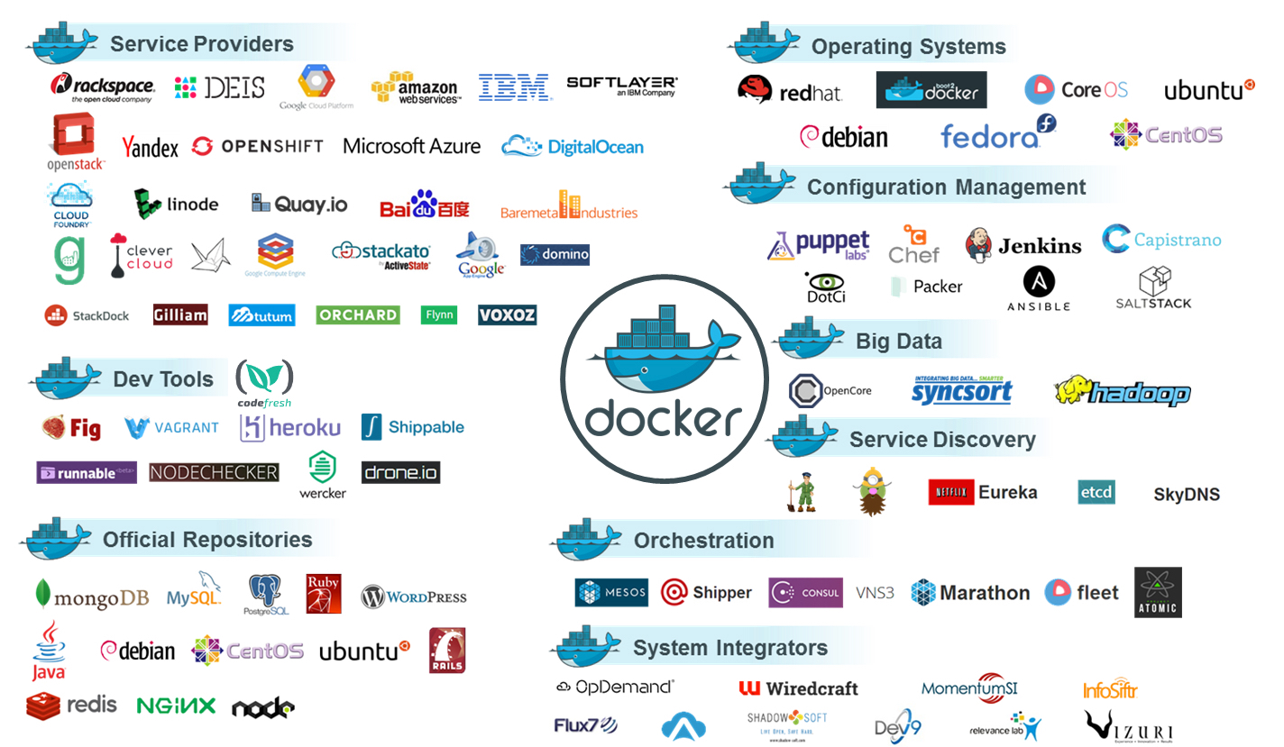
https://codefresh.io/docker-tutorial/migrating-to-docker/
Notes:
Since containers become more and more popular, the whole ecosystem around Docker containers is constantly changing and has evolved enormously.

Slide 5
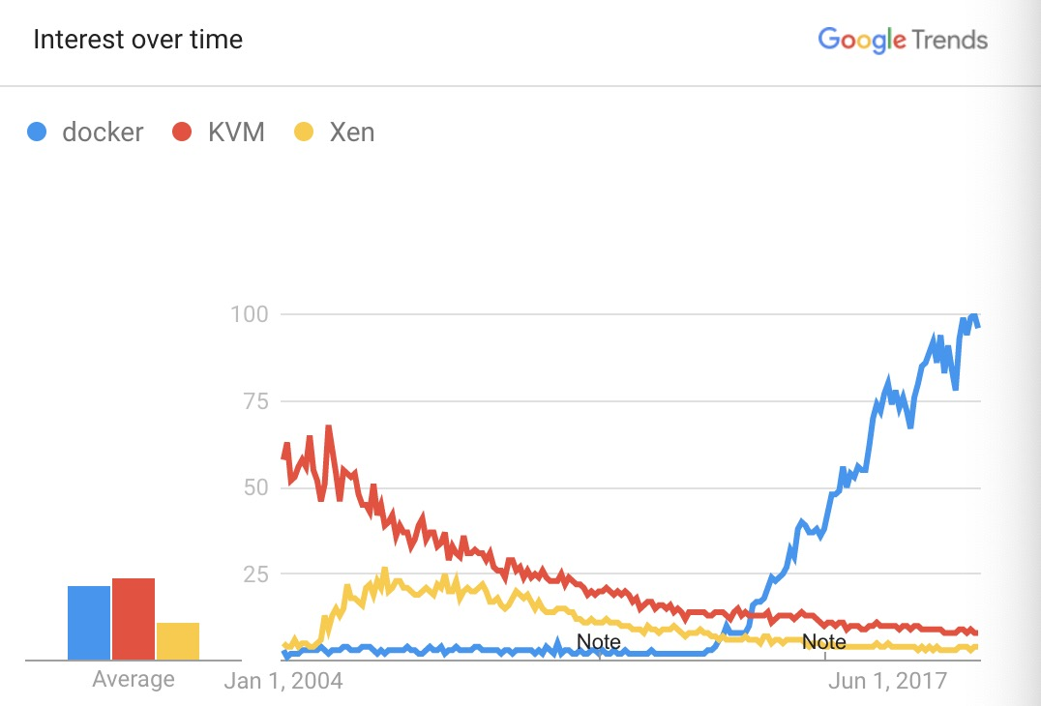
Notes:
This figure shows the increased popularity of Docker Container over KVM and Xen. In past years, the interest in KVM and Xen gradually drops while the interest in Docker Container has increased at a very fast rate.

Slide 6
Container vs. Virtual Machine
App
App
App
Bins/Lib
Bins/Lib
Bins/Lib
App
App
App
Guest
OS
Guest
OS
Guest
OS
Bins/Lib
Bins/Lib
Bins/Lib
Container Engine
Virtual Hardware
Host OS
Hypervisor
Infrastructure
Infrastructure
Container
Virtual machine
Shallower virtualization stack, less overhead while still providing application isolation
Notes:
So why do many companies pay much attention to container technologies? Let’s look at the architecture comparison between a container and a VM. There are two major differences between these two technologies. First, a container is more lightweight than a VM. A container includes only the executables and its dependencies and shares the same OS with others , while a VM contains a full set of OS. Second, the hypervisor is necessary in a VM environment to translate a VM instruction into an instruction that can be executed by the host, but it is not required for containers. Since a container runs on top of the host Operating system, container has shallower virtualization stack, less overhead while still providing application isolation.

Slide 7
Docker Containers
kernel
Capability
Namespace
Cgroups
VFS
sys_nice
uts
ipc
cpu
sys
proc
chown
pid
mnt
cpuset
…
…
setgid
user
net
memory
setuid
Hardware
Storage
CPU
RAM
Docker containers share the same OS kernel and are isolated through namespaces and control groups (cgroups)
Notes:
Because of sharing the host OS, containers rely on several OS mechanisms to realize isolation, especially namespace and resource control group. Namespaces create restricted views of the host system to isolate containers from each other. Typical namespaces include the PID namespace, the user namespace, the mount namespace, the UTS namespace, and the network namespace. For example, the PID namespace allows processes in a container to have virtual PIDs starting with PID1.The real PIDs in the host OS are mapped to the virtual PIDs but are hidden from the container. Control groups isolate the resource usage, such as CPU, memory, disk, and network, of containers. Processes belonging to the same container form a resource control group and share the same resource budget.

Slide 8
Preliminaries - cgroups
CPU isolation
Mask – specify on which CPUs a container can run
Limit – the maximum amount of CPU allocation
Share – the relative weight in CPU allocation
Memory isolation
Hard limit – the upper bound on memory allocation, beyond which swapping is triggered
Soft limit – If system has free memory, containers can use more memory than soft limit. But if there is memory shortage, containers that are beyond their soft limit first reclaim memory
Notes:
In our work, we mainly focus on CPU isolation and memory isolation. Cgroups use Mask, Limit and Share to precisely control the CPU allocation to each container. Mask specify on which CPUs a container can run. Limit sets up an upper bound on the amount of CPU resources a container can consume. Share reflects the relative weight of containers when competing for shared CPU resources; And Cgroups use two types of memory limits to control memory allocation. Hard limit sets the absolute upper bound on a container’s memory usage. If a container’s memory exceeds this hard limit, the container either is killed or starts swapping. Soft limit sets a soft limit on container memory. If system has free memory, containers can use more memory than soft limit. But if there is memory shortage, containers that are beyond their soft limit first reclaim memory. Although namespaces and cgroups let us isolate containers from each other, the isolation is still weak due to kernel sharing.

Slide 9
While weaker isolation between containers helps attain near-native performance, it creates an important semantic gap
Notes:
While weaker isolation between containers helps attain near-native performance, it creates an important semantic gap.

Slide 10


Application
The absence of the virtual hardware abstraction allows containers to observe the total available resources on a host
Containers are only limited to access a subset of system resources due to resource capping or multiplexing
System admin
Notes:
On the one hand, containers usually have limited access to resources. System administrators often control the amount of the resources allocated to a container through resource control groups. On the other hand, the absence of the virtual hardware abstraction allows containers to observe the total available resources on a host, though they can only access a subset of the resources.

Slide 11
Many applications behave differently when containerized due to the gap between resource availability and constraints
Notes:
Many applications behave differently when containerized due to the gap between resource availability and constraints

Slide 12



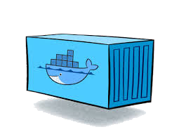

Resource Availability vs. Constraints
kubernetes
Create a container with 2 cores
Create 3 containers with 2 cores
cpu_share=2048
cpu_share=2048
cpu_share=2048
cpu_share=2048
I own 8 cores
T
T
T
T
T
T
T
T
T
T
T
T
T
T
T
T
T
T
T
T
T
T
T
T
T
T
T
T
T
T
T
T
Oversubscribed !!
Notes:
For example, Java virtual machine detects the available CPU cores and memory in the host before launching a Java program and automatically configure the number of GC threads and heap size. If a container is restricted to use 2 cores via CPU share, the Java program started in the container would launch 8 GC threads since there are 8 cores visible to the container. If many of such containers are launched, each believing that they have access to 8 cores, eventually the physical CPU would be over-subscribed, leading to interference and unpredictable performance degradations.

Slide 13
Resource Availability vs. Constraints
kubernetes
Create a container with 2 cores
cpu_share=2048
I own 2 cores
T
T
Underutilized !!
Notes:
However, if users are informed of such resource constraints and statically configure Java programs to launch 2 GC threads, instead of 8, host CPU could be underutilized if CPU is not highly contended. Next, we show how severe and widespread the problem is.

Slide 14
Resource Discovery in Native Linux
Containerized applications detect resource availability through the OS kernel
Many runtime systems use the sysconf in the GNU C library (glibc) to probe system resource
sysconf queries sysfs to determine the number of online CPUs and available memory size
Notes:
Most containerized applications detect resource availability through the OS kernel. For example, many programming runtimes, including the JVM and OpenMP, acquire information on available resources through the standard sysconf interface in Glibc. And sysconf queries sysfs in order to determine the number of online CPUs and available memory size. Unfortunately, the sysconf interface and the sysfs pseudo filesystem in the Linux kernel are not container aware and always report the total resource availability in stead of the per-container resource constraints.

Slide 15
The Prevalence of the Issue
Analysis of the top 100 application images on DockerHub.
More than 60% of the top 100 apps on DockerHub automatically configure app based on detected resource availability and are affected by the semantic gap
Notes:
To estimate the severity of the problem, we manually examined the top100 application images in DockerHub. Specifically, we looked into the source code of applications and runtimes to see if they rely on the Linux kernel to report resource availability for auto-configuration. More than 60% of the top 100 apps on DockerHub automatically configure app based on detected resource availability and are affected by the semantic gap.

Slide 16
CPU Oversubscription
Oversubscribing CPU leads to considerable performance degradation
Notes:
We take Java programs as an example to study performance degradation the semantic gap can cause. We collocated 5 docker containers on a machine with 20 cores. All containers were configured with a CPU limit of 10 cores and an equal CPU share. Therefore, the effective CPU capacity of each container is 4 cores. Each container ran the same program from the Dacapo benchmarks. Java 8 is container oblivious and detects all 20 cores. Java 9 adds container awareness by detecting static CPU limit and hence discovers 10 cores. We also evaluated hand-optimized JVM 8 and 9, which are informed of the effective CPU capacity, 4 cores. The results show that hand-optimized JVMs with perfect knowledge on resource availability significantly outperformed the existing JVMs by as much as 50%. The container awareness in JVM9 based on static CPU configuration is not effective.

Slide 17
Memory Oversubscription
6.3
95.3
27.1

Oversubscribing memory can lead to program crashes or more severe degradation
Notes:
Next, we show that incorrectly configuring memory leads to more severe consequences. We placed one container on a machine with 128GB memory and set its hard limit on memory to 1GB and the soft limit to 500MB. The vanilla JVM 8 automatically sets the heap size to 32GB, which is one quarter of the physical memory; JVM 9 sets the heap to 256MB, which is one quarter of the container’s hard memory limit. The two hand-optimized JVMs, i.e., hard_JVM8 and soft_JVM8, set the maximum heap size to the hard limit and the soft limit, respectively. As the results show, Auto_JVM9 with the awareness of the hard memory limit, even can lead to the crash of benchmark H2 due to an out-of-memory error. Overall, setting heap size according to either the hard limit or soft limit can have an order of magnitude better performance than without container awareness. It suggests that the heap size should be configured according to the actual memory usage of the Java program.

Slide 18
Problem Statement
Objective
Bridge the semantic gap between application-observed resource availability and the actual resource allocation
Build elastic apps that efficiently utilize variable resources
Challenges
How to determine a container’s real-time, actual resource allocation given various resource management schemes, e.g., limits, shares and resource affinity?
How to develop a general method to export such information to apps?
How can apps be made elastic, leveraging variable resource allocation?
Notes:
We have used two examples to demonstrate that it is important to make applications aware of the container resource constraints. These motivate us to bridge the semantic gap between application-observed resource availability and the actual resource allocation and build elastic apps that efficiently utilize variable resources. So the challenges lie in How to determine a container’s real-time, actual resource allocation given various resource management schemes, e.g., limits, shares and resource affinity? How to develop a general method to export such information to apps? How can apps be made elastic, leveraging variable resource allocation? Next, we elaborate on the design of an adaptive resource view for containers and how to build elastic apps based on the resource view.

Slide 19
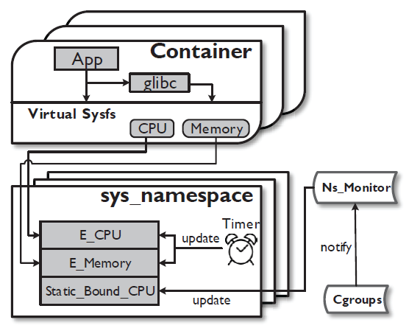
Adaptive Per-container Resource View
System architecture that enables the resource view :
a new sys_namespace, a virtual sysfs, and a system-wide daemon Ns_Monitor.
Expose the effective capacity to user apps via the virtual sysfs
Track config changes
Maintain the effective capacity
Notes:
To bridge the semantic gap in containers, we develop a per-container view of real-time resource allocation. The adaptive resource view is continuously updated to reflect the effective capacity of a container. The Figure illustrates the system architecture that enables the resource view. It consists of three components a new sys_namespace, a virtual sysfs, and a system-wide daemon Ns_Monitor. The sys_namespace maintains the effective capacity of CPU and memory allocated to a container. The virtual sysfs provides an interface connecting the sys_namespace with user space applications. And Ns_Monitor tracks changes in cgroups settings,including container creation/termination and adjustments to resource constraints, and updates the corresponding sys_namespaces.

Slide 20
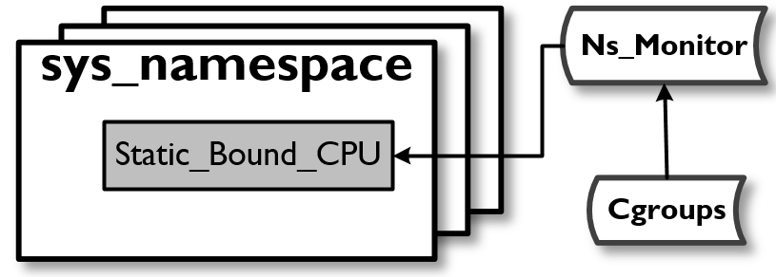
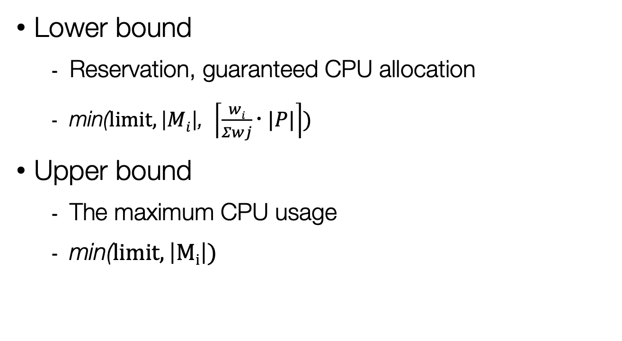
Effective CPU– Static Bounds
Lower bound
Reservation, guaranteed CPU allocation
$\text{min}\text{(}limit,\left|Mi\right|\text{, }\left\lceil \frac{wi}{Σwj} |P|\right\rceil )$
Upper bound
The maximum CPU usage
$\text{min}\text{(}limit,\left|Mi\right|)$
The lower and upper bounds do not change unless administrator reconfigures the container
Notes:
To calculate the effective CPU of containers, we first need to determine the lower and upper bounds of effective CPU, which refer to the reservation and limit of a container’s CPU allocation. The share w determines the portion of the total CPU capacity that is guaranteed to be allocated to a container, if other constraints (CPU Mask and limit) permit. The lower bound on effective CPU count is rounded up to the closest integer. And The upper bound is the minimum of CPU Mask and limit. The lower and upper bounds do not change unless administrator reconfigures the container.

Slide 21
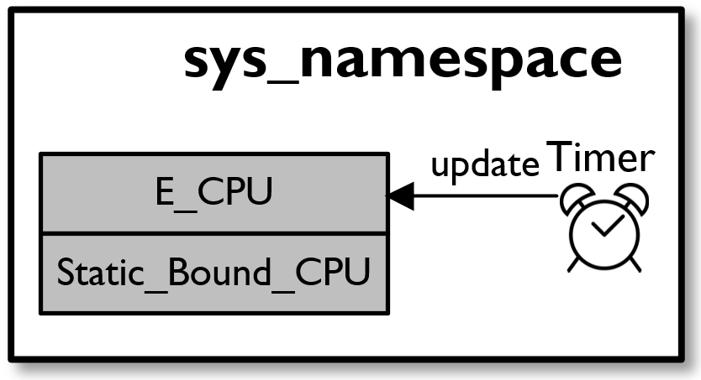

Effective CPU - Dynamic CPU Adjustment
Periodic CPU adjustment
[lower bound, upper bound]
Effective CPU = # of CPU a container can fully utilize
Expressed as a discrete CPU count
If $pslack$ $>0$then
if $\frac{ui}{{E_CPU}_{i}t}>95\%$and ${E_CPU}_{i}<{UPPER_CPU}_{i}$ then $E_CPUi++$
end if
Else
if $E_CPUi$ > ${LOWER_CPU}_{i}$then
${E_CPU}_{i}−−$
end if
End if
Notes:
Expressing effective CPU as discrete CPU count offers two advantages. First, existing studies have shown that, for a variety of workloads, it is more efficient to execute threads on a few stronger, dedicated CPUs than running them on a large number of shared CPUs, on which each thread only gets a slice of CPU time. Exporting effective CPU in the form of an equivalent number of dedicated CPUs allows user space applications to appropriately determine thread-level parallelism. Second, this design is compatible with applications that probe system resources based on CPU count.
The simple idea behind the dynamic CPU adjustment algorithm is to opportunistically increase the CPU count if there is slack or idle CPU cycles in the host and the CPU count is still below the limit. When host CPU is fully utilized, containers which are using more than their guaranteed amount of CPU voluntarily decrease their CPU count.

Slide 22
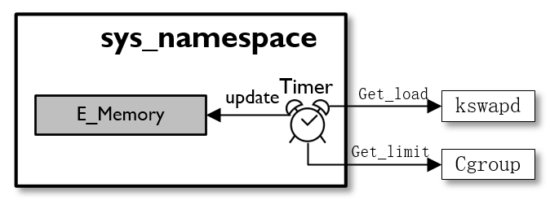
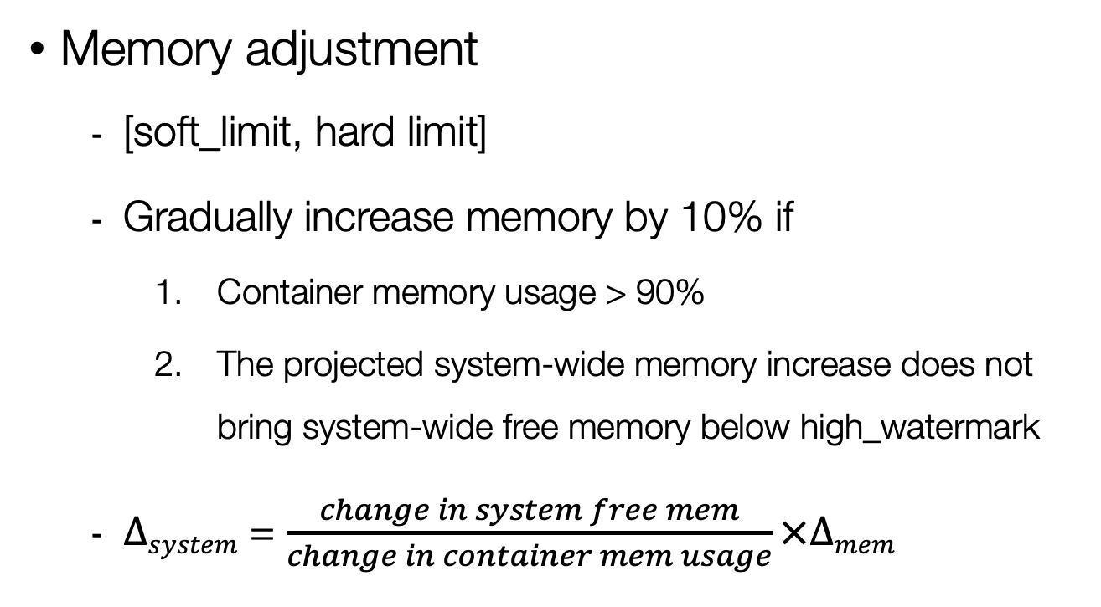
Effective Memory
Memory adjustment
[soft_limit, hard limit]
Gradually increase memory by 10% if
Container memory usage > 90%
The projected system-wide memory increase does not bring system-wide free memory below high_watermark
$Δsystem$ = $\frac{change in system free mem}{change in container mem usage}×Δmem$
Notes:
A container’s effective memory fall in the range of soft limit and hard limit. When booted, a container’s effective memory is initialized to its soft limit and upper bounded by its hard limit. The heuristic used in adjusting memory is to increase a container’s memory in incremental steps as long as system-wide available memory does not fall below high_watermark, a threshold used by kernel daemon kswapd to determine swapping. If any swapping activity is detected, a container’s effective memory is shrunk to its soft limit. To predict system-wide memory change due to the memory increment of a particular container, we monitor the ratio of system-wide free memory change and the change in memory usage in this container, and conservatively predict that the proposed memory increment in this container will lead to proportional changes in system free memory. If the projected change in system free memory is acceptable, container memory is incremented.

Slide 23
Building Elastic Applications
Method
Instruct applications to check resource availability in per-container virtual sysfs and adjust program-level resource management accordingly
CPU elasticity - adjust thread-level parallelism
Memory elasticity – adjust memory bounds in runtime systems
Notes:
Next , I will demonstrate how to leverage the per-container resource view to enable elasticity in some representative applications. We Instruct applications to check resource availability in per-container virtual sysfs and adjust program-level resource management accordingly. To enable CPU elasticity, we dynamically adjust the degree of parallelism in response to varying CPU allocation. To enable Memory elasticity, we just adjust memory bounds in runtime systems.

Slide 24
Dynamic Parallelism – HotSpot JVM
Only wake up a subset of GC threads
Set # of active threads to effective CPU
The process of a Parallel GC
Notes:
HotSpot is a widely adopted JVM that use multiple threads to perform parallel garbage collection (GC) on the heap space. HotSpot implements a centralized GCTaskQueue, from where individual GC threads fetch GC tasks. This design is key to enabling dynamic work assignment. When the GCTaskQueue is empty, all GC threads are put to sleep. They are woken up when the next GC starts and GCTaskQueue is refilled with GCtasks. This design allows a variable number of GC threads to be activated/woken up at each GC. This Figure shows how to integrate effective CPU into the process of parallel GC. For illustration, we only show the process of a minor GC while major GCs can be modified in a similar way to use dynamic parallelism. At the beginning of each GC,the parallel garbage collector first determines the number of GC threads to activate. The existing design, called dynamic GC threads, calculates the number of active threads based on the number of Java application threads and the size of the heap. To truly enable elasticity, we only wake up a subset of GC threads of each GC Set # of active threads to effective CPU.

Slide 25

Dynamic Parallelism – OpenMP
Parallel region
Parallel region
Master thread
gomp_dynamic_max : $n_thread=n_onln−loadavg$
gomp_dynamic_max : $n_thread=E_CPU$
Notes:
OpenMP is equipped with an interface to the host OS to determine number of threads for each parallel region. However, this interface is deprecated as there is no reliable way to calculate the average load. We conveniently modify the interface to use effective CPU to determine thread-level parallelism.

Slide 26
Elastic Memory – HotSpot Heap Management
The structure of JVM heap
Adaptive heap sizing algorithm
Dynamically change the committed size
Expand or shrink the heap based on feedbacks of GCs.
Used
Free
Committed
Reserved
Notes:
HotSpot JVM divides heap into three parts: used, committed and reserved. Used space is the where objects are stored; committed space is a super set of used memory and may include memory that is allocated to the JVM but is currently free; reserved space, similar to a virtual address space, is the maximum expandable heap size, which is usually set according to the size of physical memory. Scaling JVM heap is essentially to adjust the committed space.

Slide 27
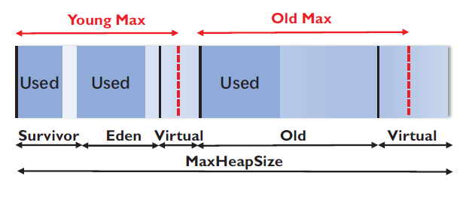
Elastic Memory – cont’d
Scale up
Set reserved memory to effective memory and rely on the sizing algorithm to expand committed space
Scale down
Trigger GC to free memory if: 1) new memory size is smaller than used and 2) adjustment is needed to maintain the ratio of young
and old generations
Notes:
Making memory allocation elastic is more challenging. Therefore, we focus on enabling elastic memory for runtime systems that are already equipped with dynamic memory allocation. So heap expansion is straightforward. We set reserved memory to effective memory and rely on the sizing algorithm to expand committed space. And if new memory size is smaller than used or adjustment is needed to maintain the ratio of young and old generations ,we trigger GC to free memory.

Slide 28
Evaluation
Experimental Settings
Hardware
Server | PowerEdge R730
CPU | dual 10-core Intel Xeon 2.30 GHz processors
RAM | 128GB
Storage | 1TB SATA hard drive
Software
System | CentOS 7 64bit
Kernel | 4.12.3
Docker | Version 17.06.1
Benchmarks | Dacapo, PECjvm2008, HiBench, NAS parallel benchmarks
Notes:
These are our Experimental Settings. Docker in version 17 was used.

Slide 29
Methodology
Study various workload consolidation scenarios to evaluate
The (performance) benefits of per-container resource view
How well do applications adapt to variable resource availability
Evaluated approaches
Vanilla: original JVM 8 and OpenMP without container awareness
Dynamic: JVM 8 and OpenMP with dynamic threads enabled and JVM 8 with adaptive heap sizing
JVM 9 and JVM 10: The new versions of JVMs that add container awareness. JVM 9 detects static CPU limit and affinity; JVM 10 detects static CPU share
Adaptive: Our proposed elastic apps based on effective CPU and memory
Notes:
Because we did not observe measurable overhead associated with creating and updating sys_namespace, our focus is on evaluating the performance benefits of per-container resource view and how well do applications adapt to variable resource availability. Performance comparison was made between the original JVM 8 and OpenMP(denoted as vanilla) and the optimized versions that use the adaptive resource view(denoted as adaptive). Inaddition, we evaluate the effectiveness of the existing dynamic parallelism schemes in HotSpot and OpenMP(denoted as dynamic) and the recently released JVMs with container awareness(e.g.,JVM9andJVM10).

Slide 30
Improvement on Application Performance
Lower is better
Higher is better
49%
18%
Notes:
We begin with a well tuned environment with five containers running five copies of the same Java benchmark. The figure shows the performance of DaCapo and SPECjvm2008 benchmarks due to different JVMs. The adaptive JVM with effective CPU clearly outperformed the vanilla JVM by as much as 49% in DaCapo and by 18% in SPECjvm 2008, The existing dynamic Gc threads scheme in JVM improved performance over the vanilla JVM with static Gc threads. Since it imposes a minimum amount of work for a GC thread to process, it effectively mitigated over-threading. However, as the number of containers increases,its performance gain would diminish because the increasing competition from other containers does not affect the heap size to GC thread ratio.

Slide 31
Improvement on GC time
More than 80%
Notes:
As shown in this figure ,most performance gain was due to improved GC time.

Slide 32
Improvement with varying CPU availability
More than 70%
Notes:
JVM10 further improves container awareness by considering CPU shares of a container. However,JVM10’s algorithm based on static CPU shares does not allow a container to dynamically adjust its CPU count according to the actual CPU usage in the host. We create a realistic scenario in which a mixture of containers with different CPU usages are collocated. The figure shows that the adaptive JVM outperforms JVM 10 in GC performance for most cases, by as much as 42%. Compared with the vanilla JVM, container awareness in JVM10 led to significant reduction in GC time.

Slide 33
Results on Different Versions of JVM
20
40
60
80
100
140
120
Number of GC threads in sunflow
Notes:
Why do our solution outperform JVM 10? We can see the number of GC threads in sunflow. Based on static CPU shares, JVM 10 limited the number of GC threads to 2 even when other containers became idle. The vanilla JVM configured 15 GC threads throughout the test, according to the number of online CPUs in the host. In contrast , our adaptive JVM varied the number of Gc threads based on effective CPUs.

Slide 34
Improvement on OpenMP
2.5x worse
More than 70%
Notes:
This is the improvement on OpemMP. Our adaptive approach achieved significantly better performance compared with static or dynamic. The dynamic approach of Openmp had the worst performance. This is because the high system-wide load limits the number of threads in containers, even they each are guaranteed a fair share.

Slide 35
Results on Elastic Heap
Can’t expend
(high load)
Expend quickly
Expend
(usage > 90%)
200
400
600
800
1000
200
400
600
800
1000
200
400
600
800
1000
1400
Vanilla JVM(Single)
Elastic JVM(Single)
Elastic JVM(Multiple)
Notes:
We wrote a Java micro-benchmark with controlled memory demand. When we only run a container with vanilla JVM, the vanilla JVM initialized the heap to be one quarter of the hard limit,i.e.,around10GB,and the adaptive sizing algorithm quickly expanded the heap. The elastic JVM started with a smaller initial heap size and ramped up slowly until the used space approached to 90% of effective memory. Eventually, both the vanilla JVM and the elastic JVM converged to the hard limit. The third figure shows the results when five such containers are collocated. the vanilla JVM failed to complete any of the micro-benchmarks because of causing memory thrashing as the aggregate demand exceeding the physical memory size. In comparison, the elastic JVM was able to complete all benchmarks and determined an appropriate heap size(i.e.,24GB) for each container.

Slide 36
Conclusions
Problem: We identified an important semantic between application-observed resource availability and container resource constraints that can lead to degraded performance and erroneous behaviors in containerized applications
Solution: A per-container resource view
Real-time updates on the actual resource allocation
A general sysfs interface to export the view on resource allocation to apps without changing application source code
A demonstration of building elastic apps
Results: Performance improvement for Java and OpenMP applications.
Limitations: Elasticity is only possible for applications that are already equipped with a dynamic threading/memory allocation scheme
Notes:
To conclude, We identified an important semantic between resource availability and constraints that can lead to containerized applications performing inefficiently. This motivate us to created a new sys_namespace to propose per-container view of resources and developed a virtual sysfs to expose resources view to user space application. The Experiment results showed consistent performance improvement for Java and OpenMP applications. However, our system is still inconvenient for applications or runtime systems without mechanisms to alter thread-level parallelism or memory allocation at runtime.

Slide 37
Thanks!
Questions?

