Slide 1


Towards Exploiting CPU Elasticity via
Efficient Thread Oversubscription
Hang Huang¹, Jia Rao², Song Wu¹, Hai Jin¹, Hong Jiang², Hao Che², and Xiaofeng Wu²
¹ Huazhong University of Science and Technology
² The University of Texas at Arlington
June 22 2021
Notes:
Hello, everyone:
I am Hang Huang. Today, I will be presenting our work “Towards Exploiting CPU Elasticity via
Efficient Thread Oversubscription”. This work comes from the collaboration between Huazhong University of Science and Technology and the University of Texas at Arlington.

Slide 2
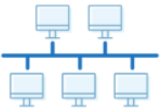




Elasticity
The ability of a system to adapt to workload changes
High availability and reliability
Facilitating growth
Automation
Cost-effectiveness
Memory
Network
CPU
Disk
CLOUD SERVER
Notes:
At first, Let’s take a look at what Elasticity is and what advantages it can offer for us. Elasticity, as one of the central attributes of modern cloud computing, is the ability of a system to adapt to workload changes by growing or shrinking system resources(e.g. CPU, network, Memory and disk). So elasticity help match system capacity with users’ demand and brings many advanced features: High availability and reliability, Facilitating growth, Automation, cost-effectiveness
标题
1、cr
2、light

Slide 3








Elasticity in the Cloud
Cloud providers support on-the-fly resource reconfiguration
Notes:
Modern cloud providers already support elasticity and implements the on-the-fly resource reconfiguration for existing virtualization techniques, such as virtual machines (VMs) and containers.

Slide 4



CPU Elasticity
CPU is mainly an execution vehicle
Provision or deprovision quickly
Loading or saving little context
Virtual Machine
Container
vCPU
vCPU
vCPU hot-plug
Cgroup
Notes:
Among reconfigurable cloud resources, memory or storage needs to be reclaimed before it can be re-allocated to other users. However, CPU is mainly an execution vehicle with a small amount of data storage (i.e., registers and caches). It can be quickly provisioned or deprovisioned and only loading or saving little context. It is most suitable for elastic resource management. Therefore, traditional virtual machine achieve CPU elasticity based on vCPU hot-plug. Users can hot-add and hot-remove vCPUs for virtual machines. While containers achieve CPU elasticity just based on Cgroups. Users can change cgroups setting for containers at runtime to changes their CPU capability.

Slide 5
Unlocking CPU Elasticity is Non-trivial
Goal: # of threads = # of cores
Core
Thread
Best Performance
Add two core
Wasted
Remove two core
Competition
Notes:
However, developing applications that can effectively utilize a varying number of CPU cores during its execution is non-trivial. Traditional applications always match the number of threads to the number of cores to achieve best performance. However, when the number of cores varies at runtime, applications may suffer two problems. On the one hand, when the number of CPUs scales up, the applications will waste the additional CPU resources because of lack of enough concurrency(or threads). On the other hand, when CPUs scale down, maintaining more threads than CPU cores is believed to incur large overhead.
FIXME: Add legend for threads and cores
红色不好，曲线线程 不要用红色

Slide 6
Explore Thread Oversubscription
Goal: # of threads =# of threads can scale
Utilize additional cores
Notes:
In our work, we explore thread oversubscription as a general approach to exploiting CPU elasticity. Users always launch an optimal number of threads for an application regardless of the availability of CPUs in the cloud. The optimal degree of concurrency is determined offline as the maximum number of threads an application can use until it stops scaling. Provisioning sufficient concurrency allows the application to take advantages when more cores are available.

Slide 7
There are still prohibitive overheads due to excessive context switches, loss of locality, and contentions for shared resources.
Notes:
However, when CPU is in short supply, there are still prohibitive overheads due to excessive context switches, loss of locality, and contentions for shared resources.
暗红色 →不好的

Slide 8
Applications with Thread Oversubscription
Applications suffer as much as 25x performance slowdown
Notes:
We studied how different multi-threaded programs perform with and without thread oversubscription. The benchmarks were from PARSEC, NPB , and SPLASH2, and tested with two settings – 1) 8 threads on 8 cores, an exact one-to-one thread-to-core mapping; 2) 32 threads on 8 cores, an oversubscription ratio of 4. As shown in the figure, The first and second groups from the left include benchmarks that do not suffer or even benefit from thread oversubscription. In contrast, benchmarks from the third group suffer as much as 25x performance slowdown with oversubscription. The results suggest that thread oversubscription is already a viable approach to exploiting CPU elasticity for certain applications despite concerns about the potential overhead. However, thread oversubscription is still inefficient for a large number of applications.

Slide 9
Scheduling Oversubscribed Threads
Context switches : load and save threads states
Involuntary -- time slice expires
Voluntary -- yields CPU or blocks
Runqueue
Completely Fair Scheduler
T0
T1
T2
Running Thread
T
select
T3
T4
T5
context
switch
running
T6
T7
T8
smaller
larger
vRuntime
Notes:
Next, we introduce how oversubscribed threads are scheduled on a single core. Modern OSes employ fair-sharing algorithms to schedule threads on the same core. Each thread is assigned a time slice. Each time Completely Fair Scheduler select the thread with smallest virtual runtime as the next running threads. When the scheduler try to run another threads, context switches occurs in order to load and save threads state. Context switches occur involuntarily or voluntarily. Involuntary context switches happens on two occasions. For compute-bound workloads, threads are switched each time a regular time slice expires. For I/O-bound or blocking workloads, context switches occur no more often than the minimum time slice. In Linux’s default completely fair scheduler, the regular time slice is 3𝑚𝑠, and the minimum time slice is 750 𝜇𝑠. Voluntary switching happens when a thread yields CPU or blocks on an event (e.g., blocking on synchronization or waiting for I/O completion).

Slide 10
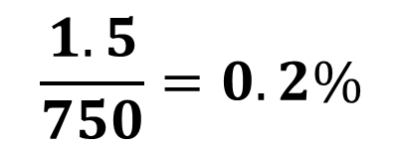
The Direct Cost of Context Switching
Direct cost: relatively stable at 1.5 𝜇s
(a) Pure computation
(b) with synchronization
$$\frac{1.5}{750}=0.2\%$$
Notes:
As oversubscribing threads on a single core causes more context switches, we study the cost of each context. We write a micro-benchmark that iterates for a fixed number of times. At each iteration, the benchmark performs some arbitrary computation or atomic instructions. We started with one thread and increased the thread count across different runs. We configure threads to yield CPU to trigger a context switch after they finish the minimum time slice (750 𝜇𝑠) in Linux. Results show that the per context switch cost is relatively stable at 1.5 𝜇𝑠 on our Intel-based platform. Since for compute-bound workloads, each thread is guaranteed a minimum time slice (750 𝜇𝑠), and there is one context switch per 750 𝜇𝑠, the overall cost to the benchmark execution time is only 0.2%, and it does not increase with the number of threads. Furthermore, oversubscription does not add additional overhead to the benchmark because of synchronization.

Slide 11
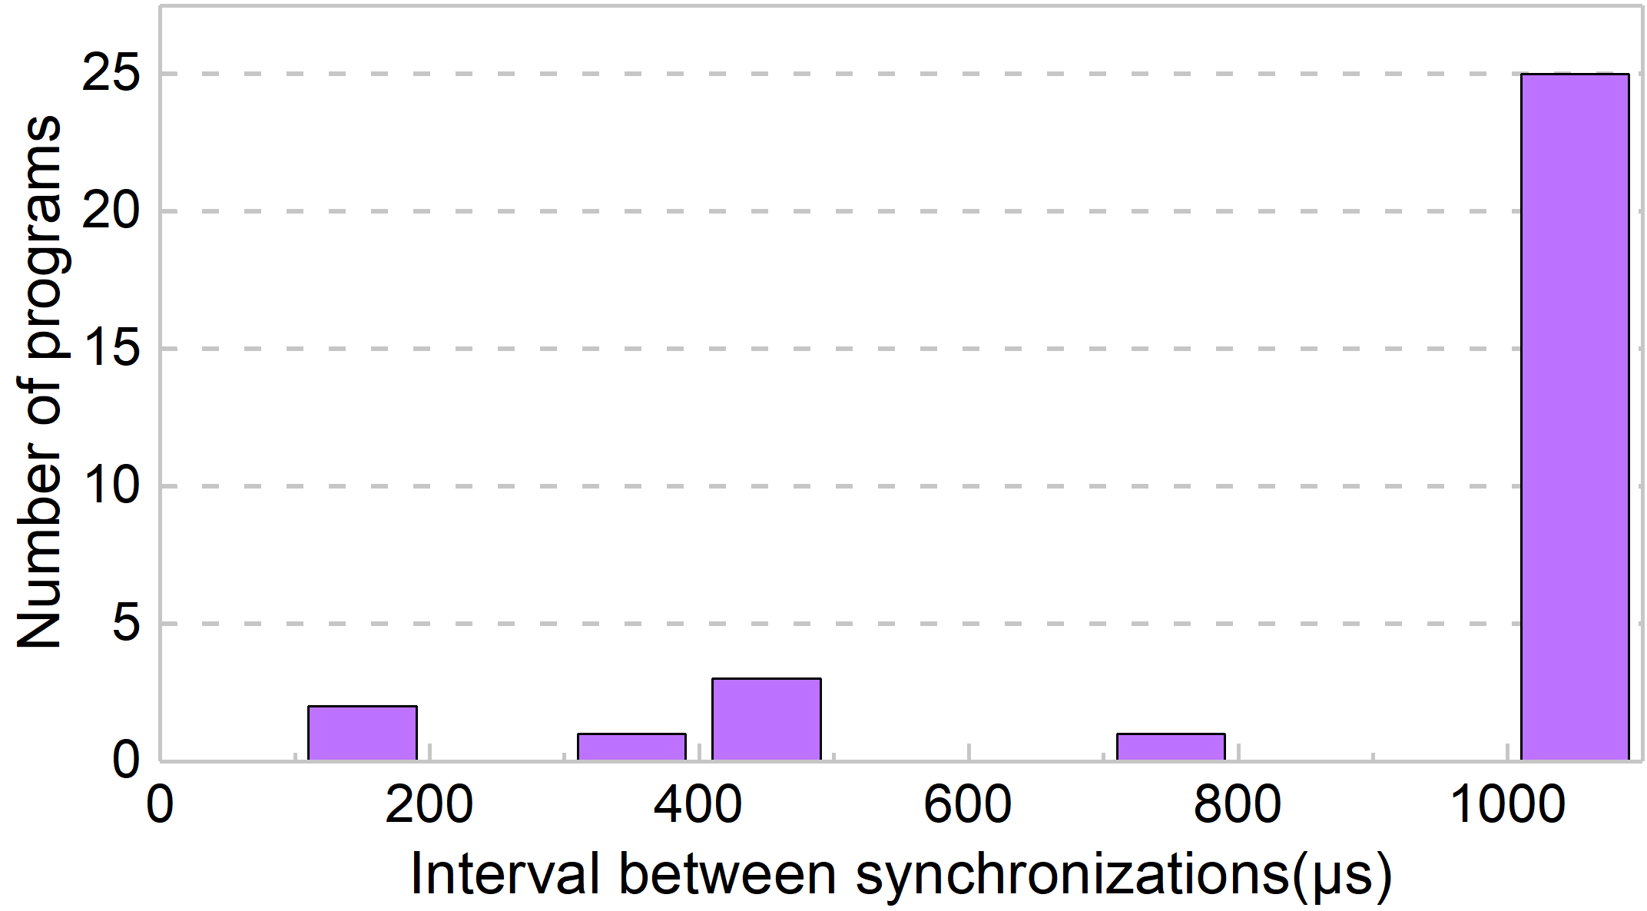
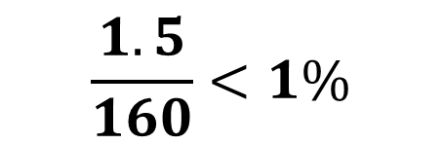
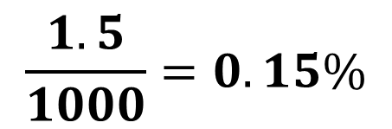
The Frequency of Context Switching
Most applications perform context switches no more often than every 1000 𝜇𝑠
$$\frac{1.5}{1000}=0.15\%$$
$$\frac{1.5}{160}<1\%$$
Notes:
For workloads that block (voluntary switch), the frequency of context switching depends on the interval between synchronization, The frequency of synchronization increases with the number of threads because the work that should be done before each synchronization is less with more threads. Figure 3 shows the interval between two synchronizations in the PARSEC, SPLASH2, and NPB benchmarks. Since not all (only failed) synchronizations lead to context switches, the frequency of context switching is no higher than synchronization frequency. As shown in the figure, most applications perform context switches no more often than every 1000 𝜇𝑠, resulting in a CS overhead of 0.15%. The most frequent context switch could occur in facesim which has a synchronization interval of 160 𝜇𝑠. Nevertheless, the CS overhead is still less than 1%.
蓝色

Slide 12
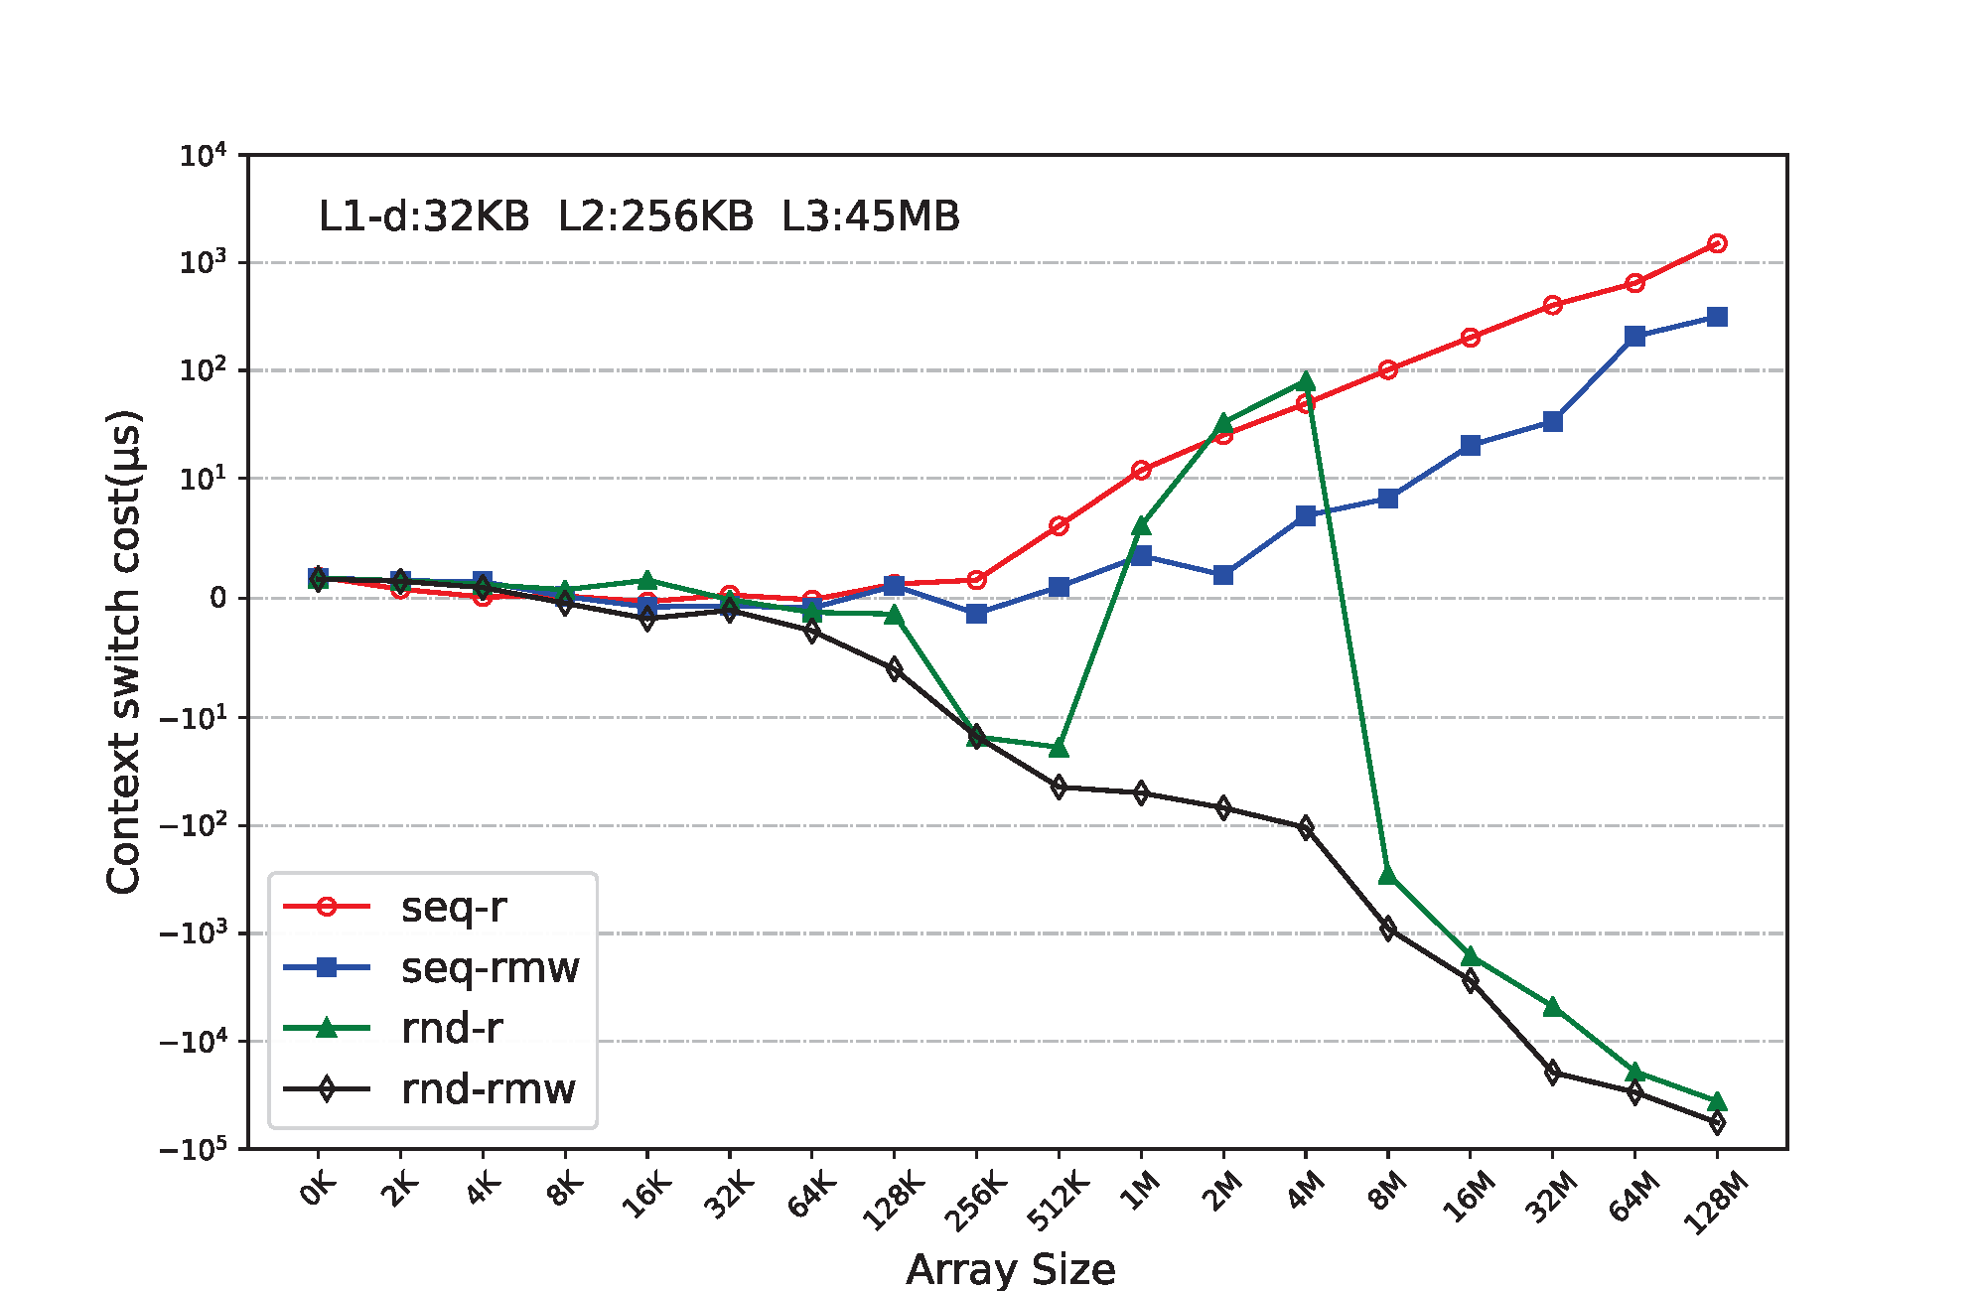
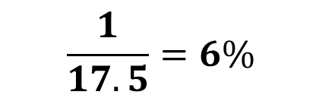

The Indirect Cost of Context Switching
The indirect cost is calculated as $\frac{\text{t}\text{o}\text{ver}\text{−}\text{t}\text{seria}l}{\# of CS}$
The overhead is less than 6%
Improving the effectiveness of TLB for random access
$$\frac{1}{17.5}=6\%$$
beneficial
Notes:
Another concern is the effect of context switching on cache performance. We modified the micro-benchmark so that each thread traverses a sub-array between context switches. By varying the total array size, we alter the working set size of the program. The indirect cost is calculated by the execution time of two threads minus the execution time of one threads then divided by the number of context switches. All threads were pinned on the same core. A negative cost indicates that thread oversubscription helps improve performance. The four access patterns are: 1) sequential read (seq-r), 2) sequential read-modify-write (seq-rmw), 3) random read (rnd-r), and 4) random read-modify-write (rnd-rmw). There are two observations : For sequential access patterns, the hardware prefetcher is more effective for a single thread as its access pattern is more predictable, and the overhead due to the indirect cost is less than 6%. For random access pattern, thread oversubscription could improve the performance. Realistic workloads are a combination of sequential and random accesses, and contain a mix of reads and writes. Contrary to what was believed previously, the results suggest that thread oversubscription should benefit caching performance in most cases with a worst-case performance penalty of 6%.

Slide 13

The direct and indirect costs of context switching are negligible or even beneficial to most programs without inter-thread synchronization.
Notes:
To summary, the direct and indirect costs of context switching are negligible or even beneficial to most programs without inter-thread synchronization.

Slide 14
Managing Oversubscribed Threads
Blocking synchronization: fast userspace mutex (futex)
void futex(void* addr1, FUTEX WAIT, int val ...)
Calling thread is suspended (“goes to sleep”)
void futex(void* addr1, FUTEX WAKE, int val)
Waking up at most val threads waiting on addr1
Notes:
Then, we shows mechanisms designed for managing threads are inefficient for managing oversubscribed threads. Blocking synchronization, such as mutex, semaphore, and condition variable, puts a caller thread into sleep if it fails to acquire a lock or does not meet a certain condition. The thread is later woken up when the lock becomes available or the condition is met. As thread sleep/wakeup needs to be handled by the OS kernel, the OS kernel supports Fast userspace mutex (futex) for implementing blocking synchronization. The futex itself is a variable at the user level. Successful synchronization returns directly from the user space. Thread with unsuccessful synchronization calls futex wait to traps into the kernel and goes to sleeps. The sleeping threads can be woken up while the lock holder release the lock and calls futex wake.

Slide 15
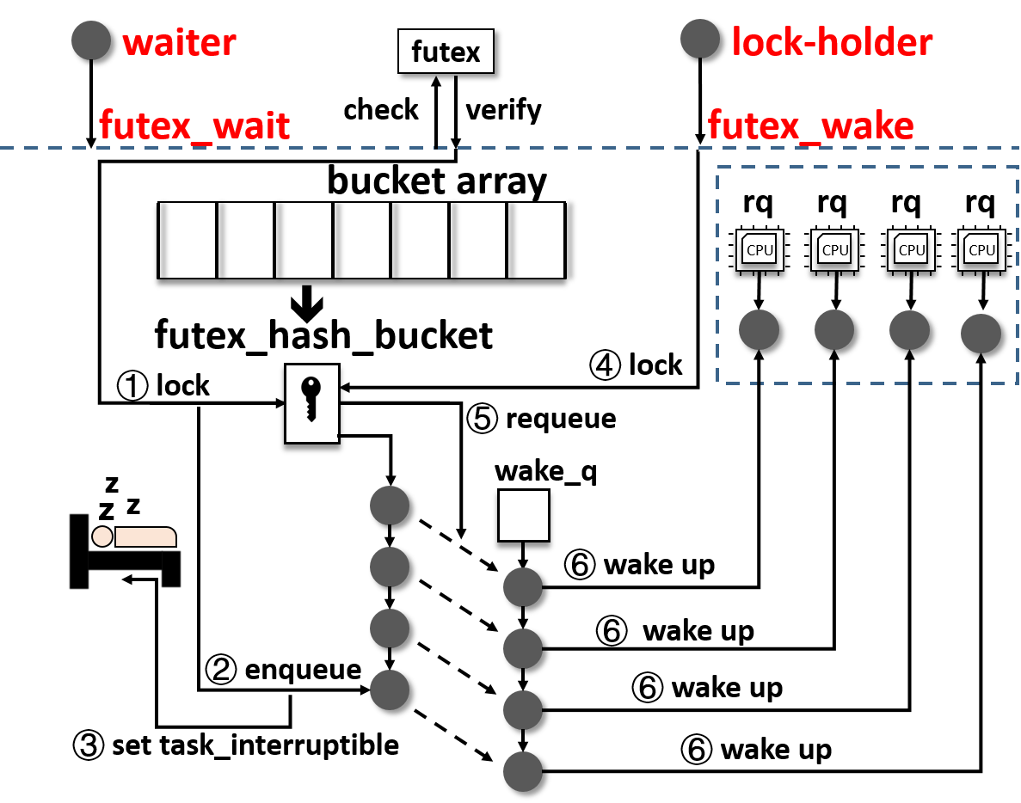
Thread Sleep/Wakeup with Futex
Notes:
As shown in Figure, the waiter thread invokes futex_wait and starts the sleep process. It first acquires the lock that protects the futex_hash_bucket queue, where it will be sleeping. The waiter is then removed from the CPU runqueue, enqueued on the sleep queue, and its runtime state is changed from “runnable” to “sleep” (TASK_INTERRUPTIBLE). When the user-level lock is released, the lock holder acquires the lock on the hash bucket and moves one or more waiters from the sleep queue to a temporary wakeup queue wake_q, from where the waiter(s) awaken. The lock holder is responsible for awakening the waiters one at a time, which includes selecting a core for this waiter and enqueuing it to the new runqueue.

Slide 16
The Inefficiency with Futex
Complex wakeup process
Runqueue locking
Preemption
Serialization
Unnecessary migrations
Frequent stat transitions
Fluctuating load
Notes:
The sleep and wakeup process can be quite expensive when threads are oversubscribed. The wake up operation first selects the most idle core and inserts the awakening thread to its runqueue. This operation requires runqueue locking , and the kernel needs to check preemption for the waking thread. When there are many more threads than cores and a large number of threads are awakening, runqueue locking and the possible preemption of a recently awakened thread not only cause serialization but also incur cascading performance degradation. Moving waiters from the bucket queue to the temporary wake_q queue adds additional serialization. Thread sleep and wakeup involve frequent state transitions between “runnable” and “sleep”, and lead to fluctuating load. Therefore, Linux performs many unnecessary thread migration to balance load across.

Slide 17
Managing Oversubscribed Threads - cont'd
Busy-waiting synchronization : fast lock acquisition at the cost of wasting CPU cycles on spinning
Pthread_spin_lock--glibc
/*** Program Code ***/
do{
atomic_spin_nop ();
val = atomic_load_relaxed (lock);
}while (val != 0);
/*** Assembly code ***/
.L2:
movl $0, %eax
call atomic_spin_nop@PLT
call atomic_load_relaxed@PLT
cmpl $0, -20(%rbp)
jne .L2
Sync_right--lu
/*** Program Code ***/
do while (isync(iam) .eq. 1)
!$omp flush(isync)
end do
/*** Assembly code ***/
.L10:
cmpl $1, %eax
jne .L9
jmp .L10
Notes:
Compared with blocking synchronization, busy-waiting synchronization (spinning) provides fast lock acquisition at the cost of wasting CPU cycles on spinning. The busy-waiting threads repeatedly checks to see if a condition is met without relinquishing the processor.

Slide 18

The Inefficiency with Spinning
Spinning cause cascading performance collapse
Waste CPU resource
lock-holder preemption (LHP)
T1
T2
T1
T2
CPU
T4 waste CPU resources
T3
T4
T3
T4
CPU
T1
T2
T5
T2
CPU
T2 is preempted by T5
T3
T4
T3
CPU
Notes:
when threads are oversubscribed and spinning threads are placed with other threads doing useful work, spinning can burn the CPU time that can be used for useful work. Oversubscription also exacerbates the lock-holder preemption (LHP) problem. A waiter thread may exhaust its time slice doing spinning before becoming the lock holder who will soon be preempted.

Slide 19
The large slowdowns we observe are due to the inefficiencies that arise in the OS kernel when managing a large number of threads on a single core.

Slide 20
Virtual Blocking (VB)
VB adds a flag thread_state to each thread to indicate whether the thread is blocked (1) or not (0)
CPU#1
CPU#2
futex_wait
❶ check futex
⬇
thread_state=1
a
b
c
❷ enqueue bucket
d
e
⬇
a
a
❸ enqueue rq
futex_wake
thread_state=0
❺ dequeue bucket
❹ Check thread_state
running thread
a
b
c
☺
runnable thread
leave futex
sleeping thread
(thread_state==1)
Notes:
VB adds a flag thread_state to each thread to indicate whether the thread is blocked (1) or not (0). VB still preserves the futex_ hash_bucket queue in futex in order to preserve the order threads is put to sleep as well as their wakeup order. However, threads are not put into real sleep after the thread is enqueued to the bucket queue. VB inserts the threads to the end of CPU runqueue to keep active. However, blocked threads are skipped during CPU scheduling until thread_state is cleared. If all threads on a core are blocked, which is not uncommon under thread oversubscription, each thread takes turns to briefly run on CPU to check if its flag has been cleared. Since threads are not put into real sleep, When a thread is awakened by futex_wake, its thread_state is cleared and it is removed from the futex_hash_bucket queue. After thread_state turns to 0, a thread resumes normal scheduling and is “awakened” from virtual blocking

Slide 21
The Benefits of VB
No changes to user applications
Blocking synchronization and sleep queue management is made simple
Avoid system load fluctuation
Notes:
VB required no changes to user applications or libraries. The sleep and wake-up process is preety simple. VB also avoids the influence of frequent blocking on system load and reduce threads migrations.
对齐要一致

Slide 22
Busy-waiting Detection
Common features of a spin loop
Includes backward conditional branches;
Each iteration is quite short.
During spinning, branching is predictable with many backward branching until moving onto the next code segment.
Notes:
Although there are various kinds of busy-waiting implementations, they share a common feature -- a spin loop is a small code segment that is repeated for many times. Specifically, 1) spin loops are typically backward conditional branches; 2) each iteration is quite short, taking only a few cycles to execute; 3) during spinning, branching is predictable with hundreds of thousands backward branching until moving onto the next code segment.
统一二层

Slide 23

Busy-waiting Detection
Detect futile spinning in an application
Deschedule the spinning thread
CPU
BWD
LBRs
read
(LBRs&PMCs)
cur
periodically check the LBRs and PMCs
 BW
PMCs
skip cur & resched_cpu
record the number of TLB misses and cache misses
record the from and to virtual addresses of branches.
Notes:
BWD seeks to detect futile spinning in an application and deschedule the spinning threads so that CPU cycles can be spent on critical threads. BWD employs the the last branch records (LBRs) and hardware performance counters (PMCs) as well as a high resolution timer to detect spinning. The LBRs record the from and to virtual addresses of the recently completed branches. PMCs record the number of TLB misses and cache misses. a high resolution timer on each core to periodically check the LBRs and PMCs. If the readings of LBRs and PMCs indicate spinning, the timer forces the thread or vCPU currently running on the core to be descheduled.

Slide 24

Experimental Settings:
Hardware
Server | Dell T630 server
CPU | Dual 18-core Intel Xeon 2.10 GHz processors with hyper-threading enabled
RAM | 128GB
Storage | 1TB SATA hard drive
Software
System | Ubuntu 16.04 64bit
Kernel | 5.1.12
Docker | Version 18.06.1
Benchmarks | PARSEC, SPLASH-2, NAS parallel benchmarks, Memcached
Notes:
These are our Experimental Settings. Docker 18.06.1 was used as the containers technology and KVM was the virtual machine technology.

Slide 25
Methodology
Study various workload consolidation scenarios to evaluate
The (performance) benefits of virtual blocking (VB)
The (performance) benefits of virtual blocking (BWD)
Evaluated approaches
8T (vanilla): 8 threads running on 8 cores in vanilla Linux
32T (vanilla): 32 threads running on 8 cores in vanilla Linux, an oversubscription ratio of 4
32T (optimized): 32 threads running on 8 cores with our proposed optimizations

Slide 26
The improvement due to VB
Lower is better
17%
56.7%
Notes:
First, we show how much benefit VB can bring to realistic benchmarks in over-subscribed scenarios. The benchmarks were run in containers configured with two set-tings: 8 cores or 8 hyper-threads on 4 cores. The figure shows the results of application that are suffered from oversubcription. While experiments with and without hyperthreading achieved different performance,t he trend was similar across all benchmarks. Thread oversubscription introduced 5.5% to 56.7% performance slowdown under vanilla Linux. The culprits were the loss of CPU utilization and excessive thread migrations across cores. In comparison, VB helped attain performance close to the baseline without oversubscription (i.e., 8 threads on 8 cores), except for fluidanimate. The reason is that the number of locks influidanimate scales with the thread count, thereby inevitably inflicting higher overhead with more threads. Notably,VB outperformed the baseline in freqmine, ocean, cg, and mg, suggesting that VB could be an effective approach for improving the efficiency of blocking synchronization in non-oversubscribed scenarios.

Slide 27
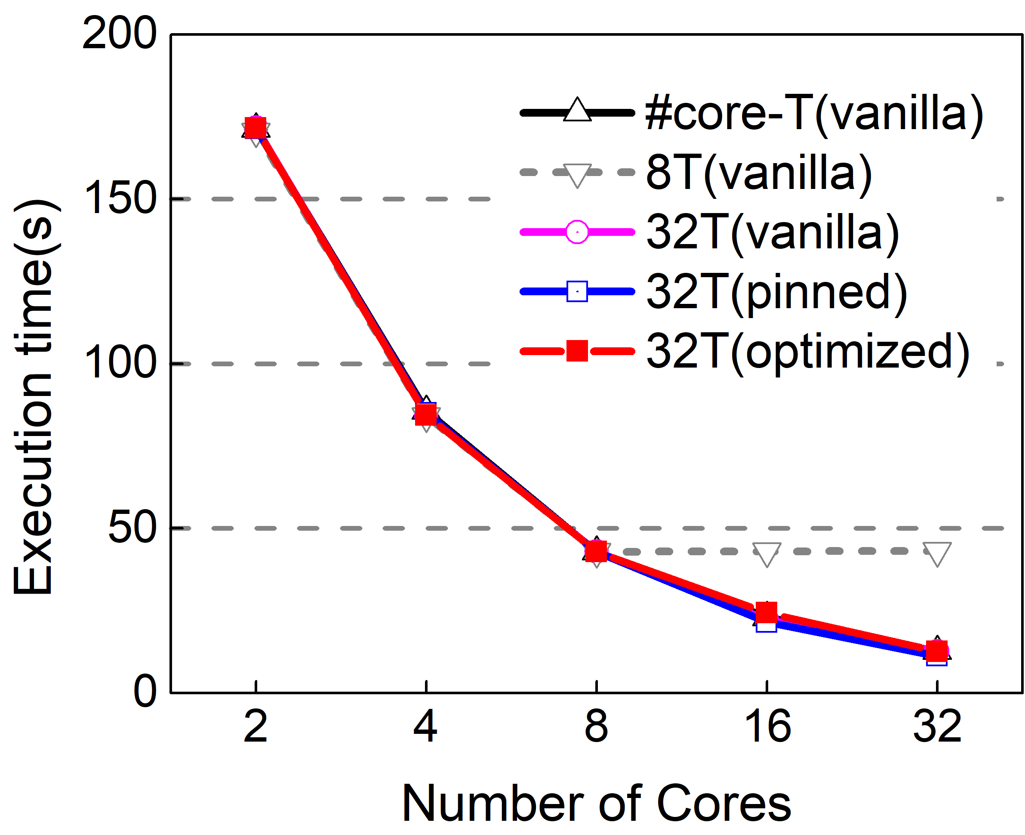
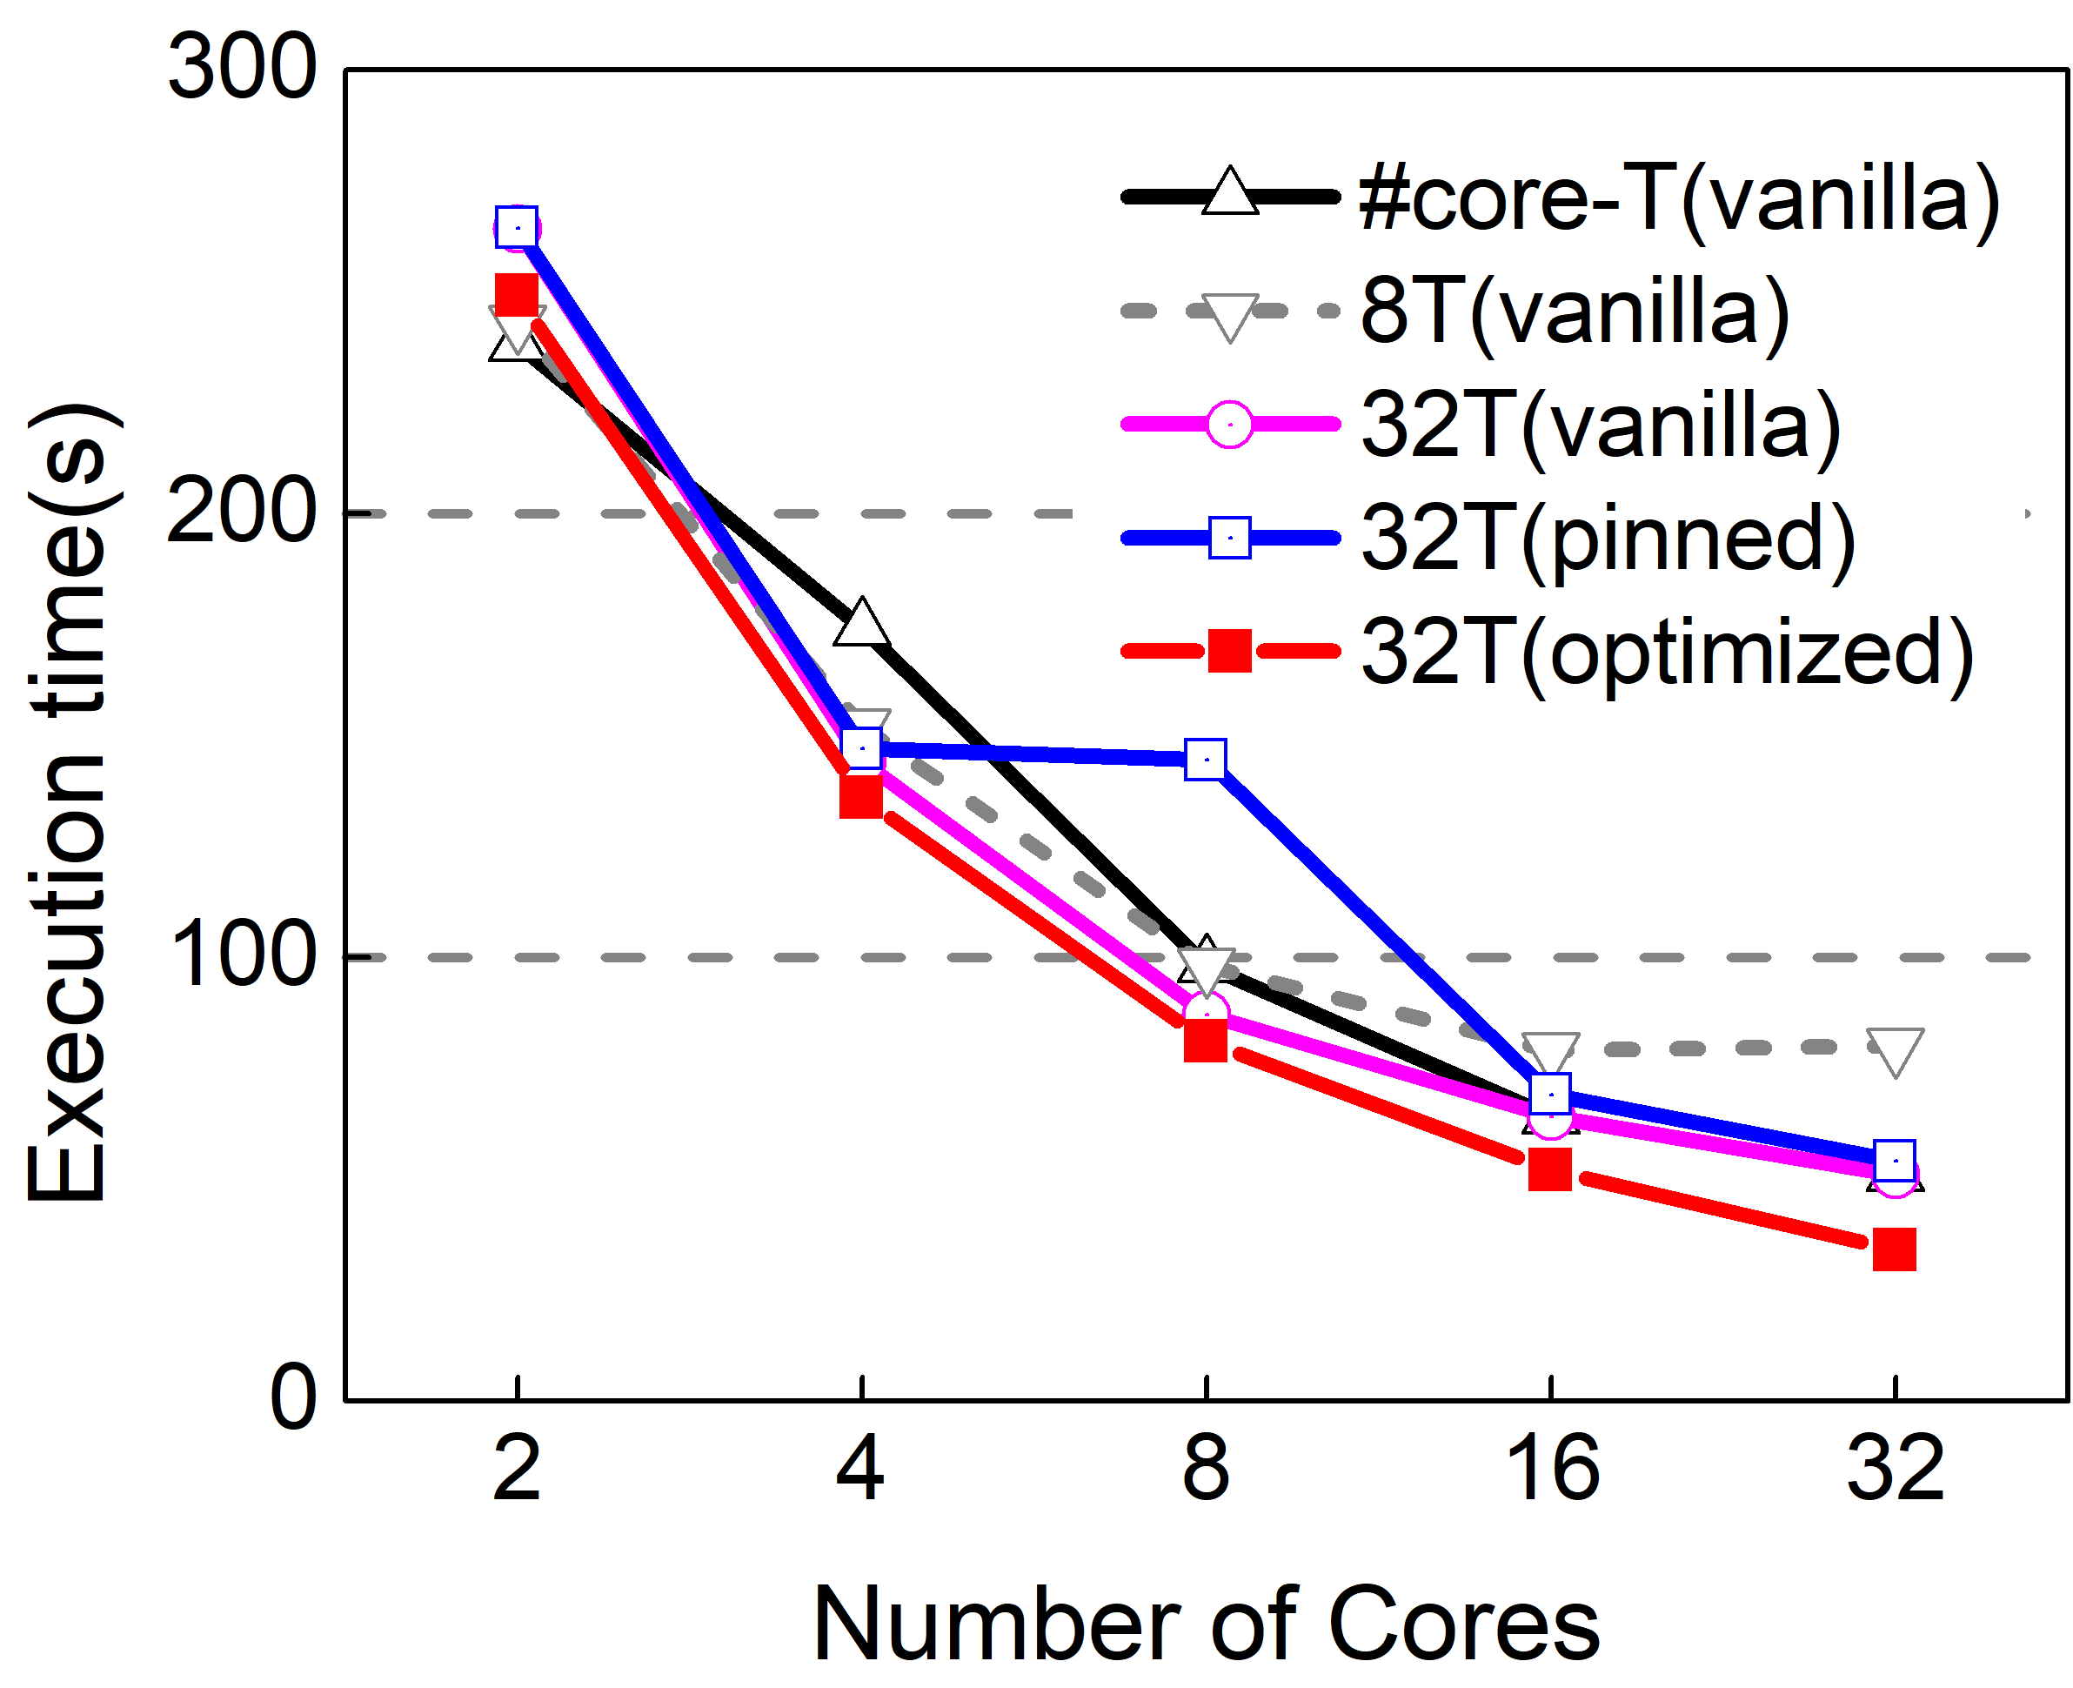
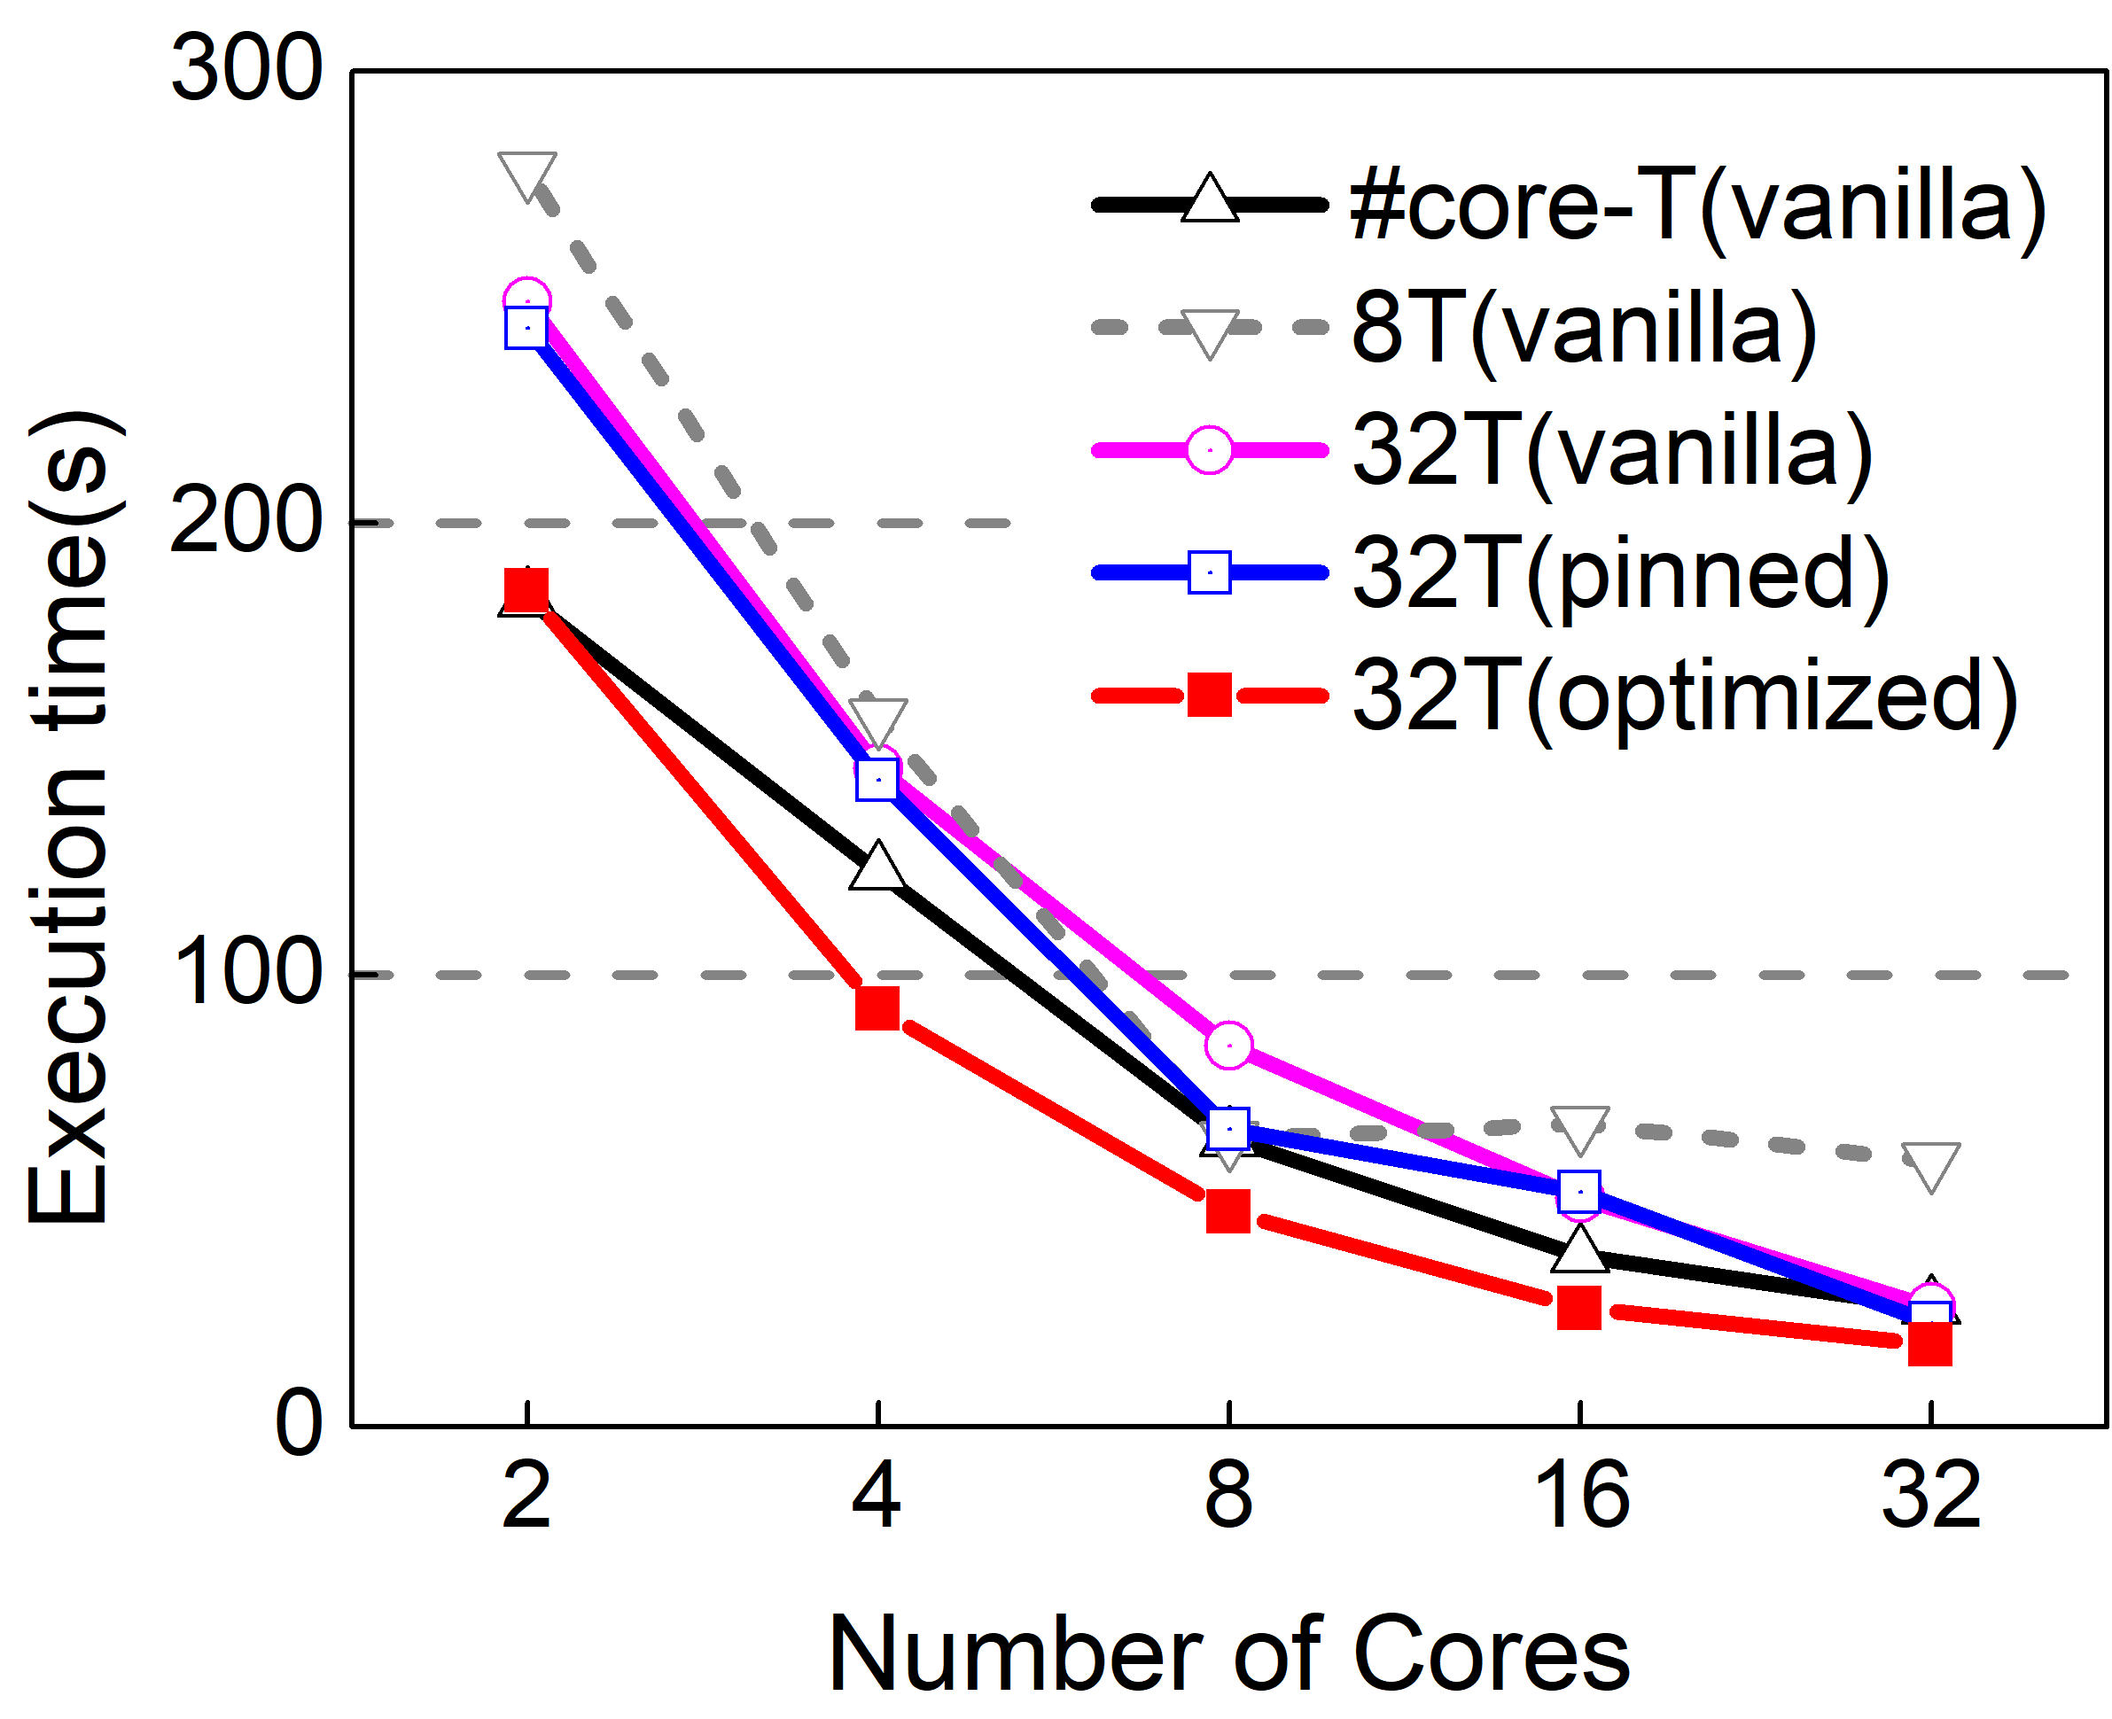
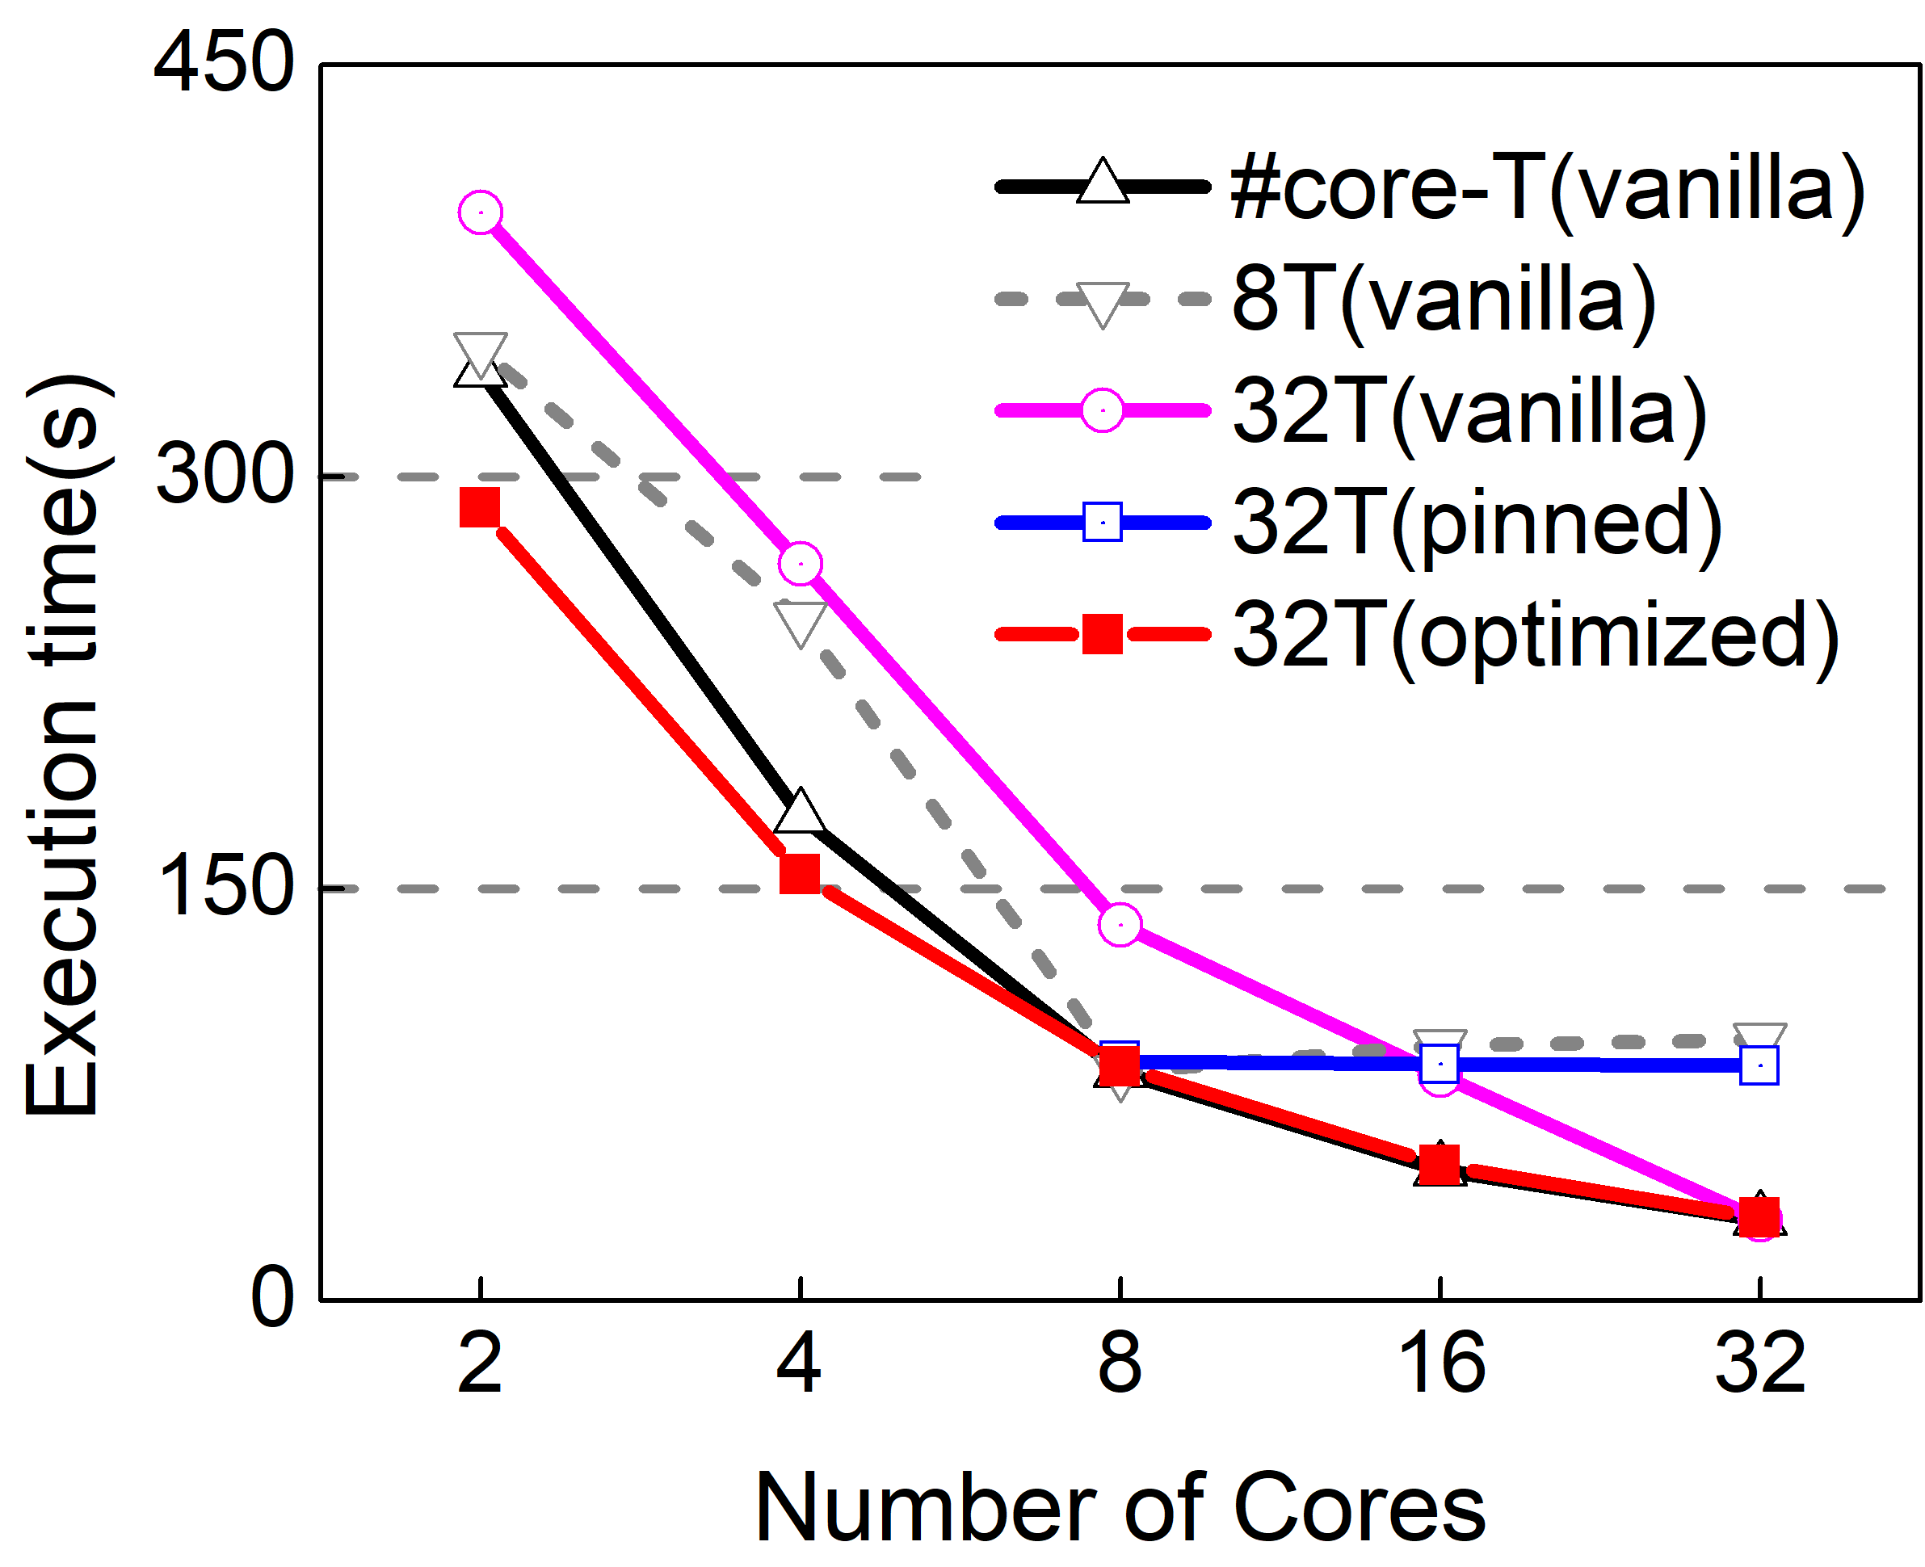
Improvement with runtime adaptation
EP (unaffected)
Facesim (benefited)
CG (affected)
Streamcluster (affected)
Notes:
We then dynamically varied the number of available cores and evaluated how oversubscribed threads exploit CPU elasticity. We chose four benchmarks with distinct characteristics and allocated 8 cores at startup, while varying the number ofcores from 2 to 32 at runtime. Ep did not suffer much from oversubscription and benefited greatly from it. Compared to provisioning 8 threads, ep with 32 threads can better utilize 32 cores, achieving a 51% performance gain. Streamcluster, and cg always suffered from oversubscription in vanilla Linux. With VB, running 32 threads was never worse than running 8threads, and always better than with pinning method. Facesim is a bit different. In some cases, it benefited from oversubscription even in vanilla Linux. VB was able to further improve its performance by as much as 34%, while pinning threads to cores can hurt performance as tasks are not evenly distributed among threads. There are two fundamental limitations of pinning: 1) it is unable to deal with varying CPU count and needs to re-pin threads when CPU count changes. In most applications we tested, programs crashed when CPU count decreased. 2) pinning turns off all migrations even real load imbalance occurs.

Slide 28
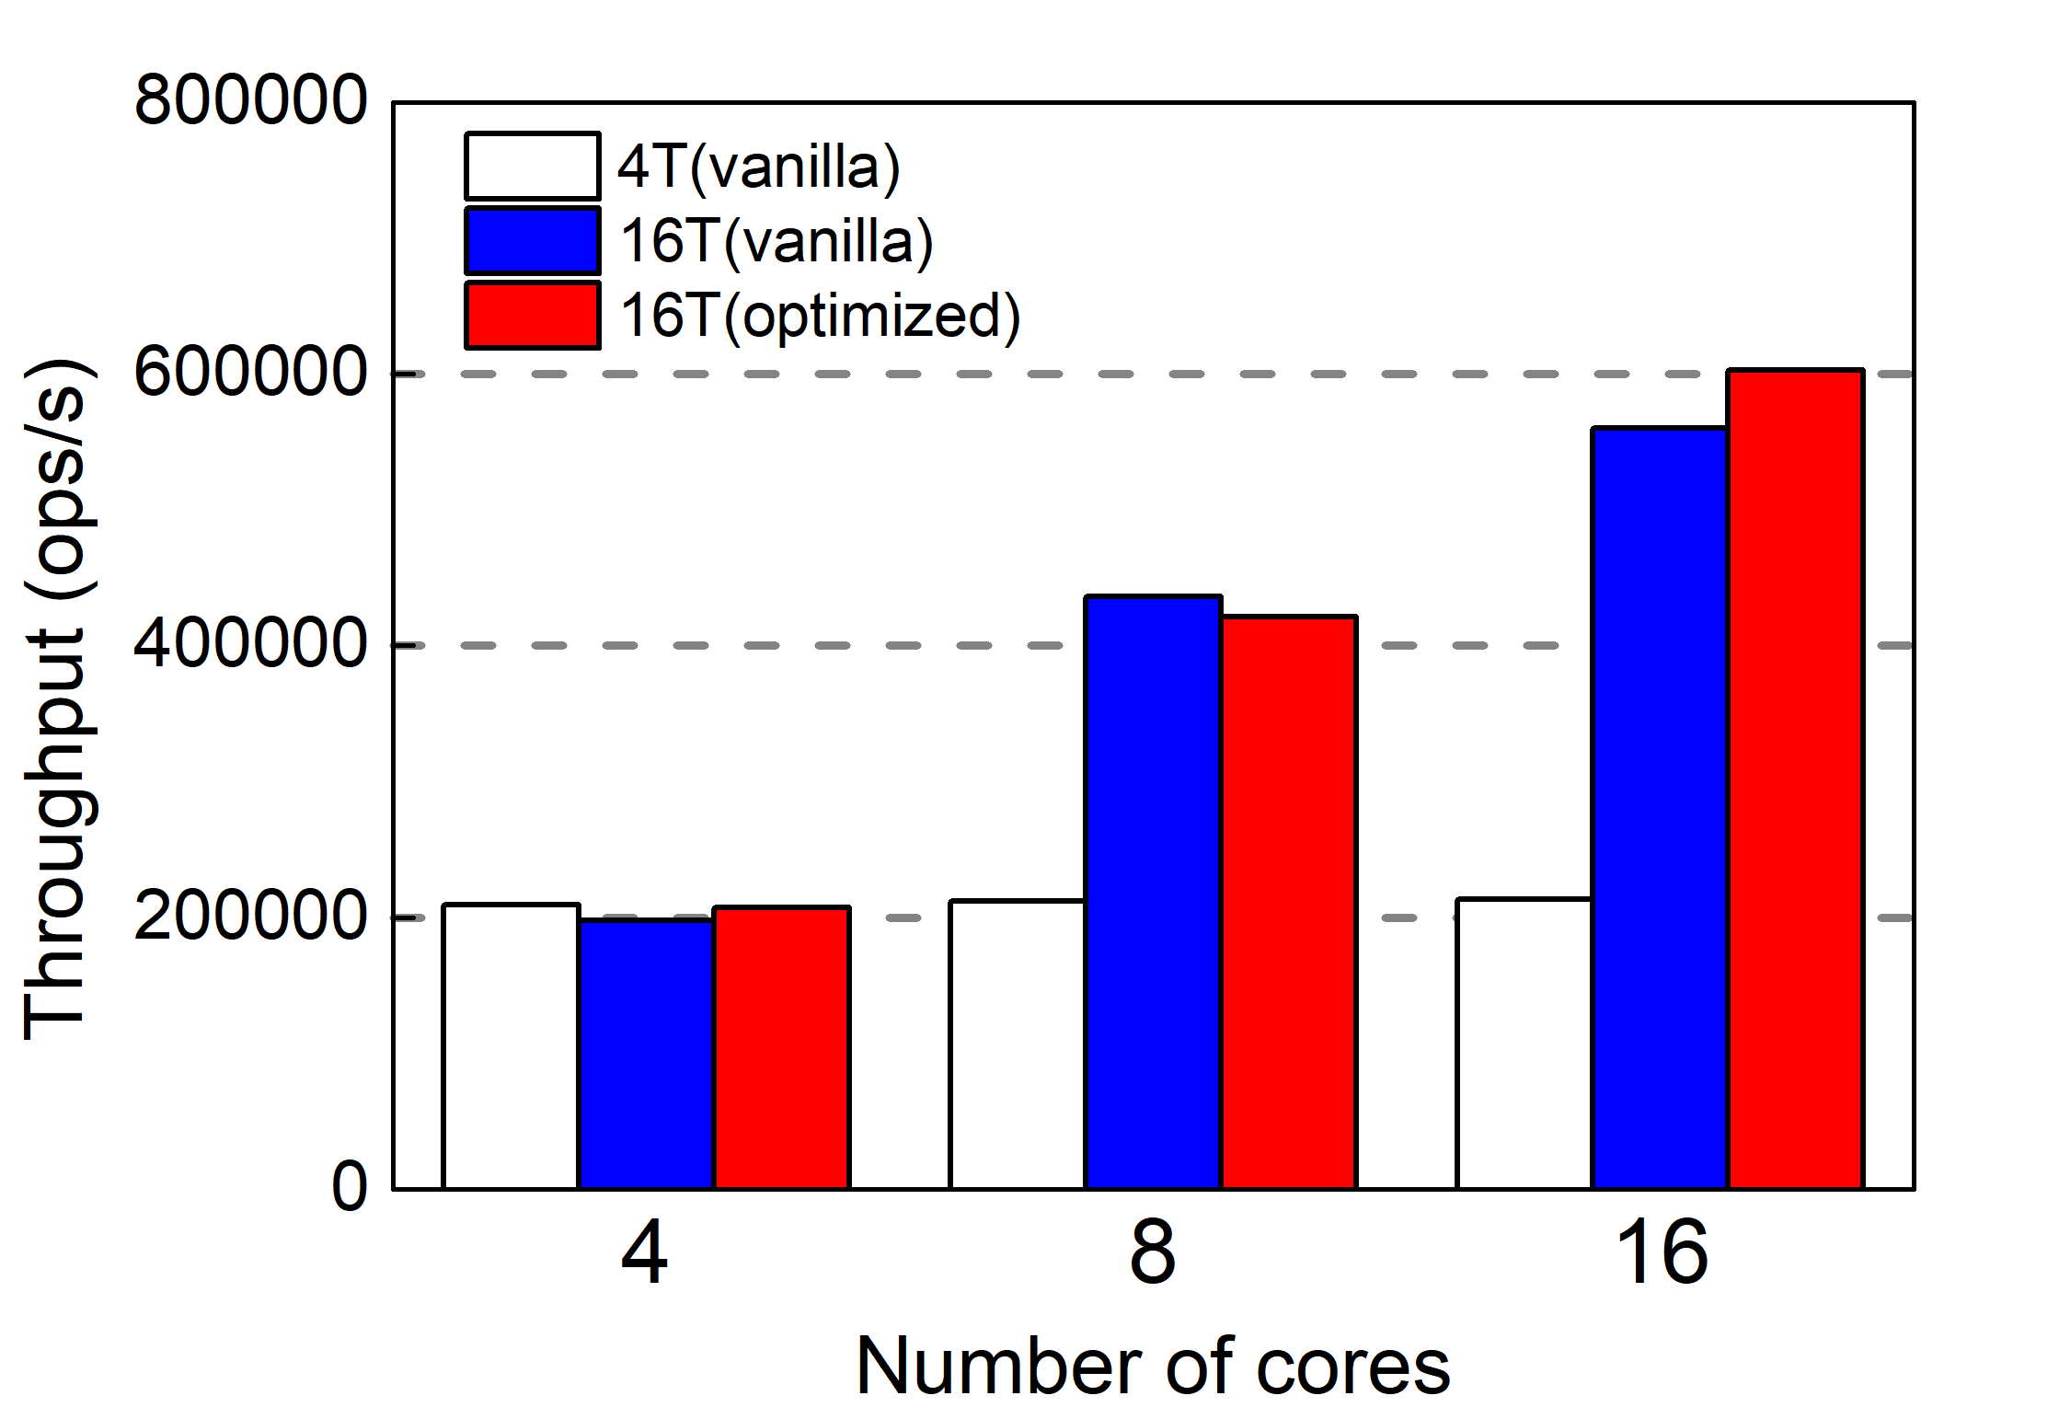
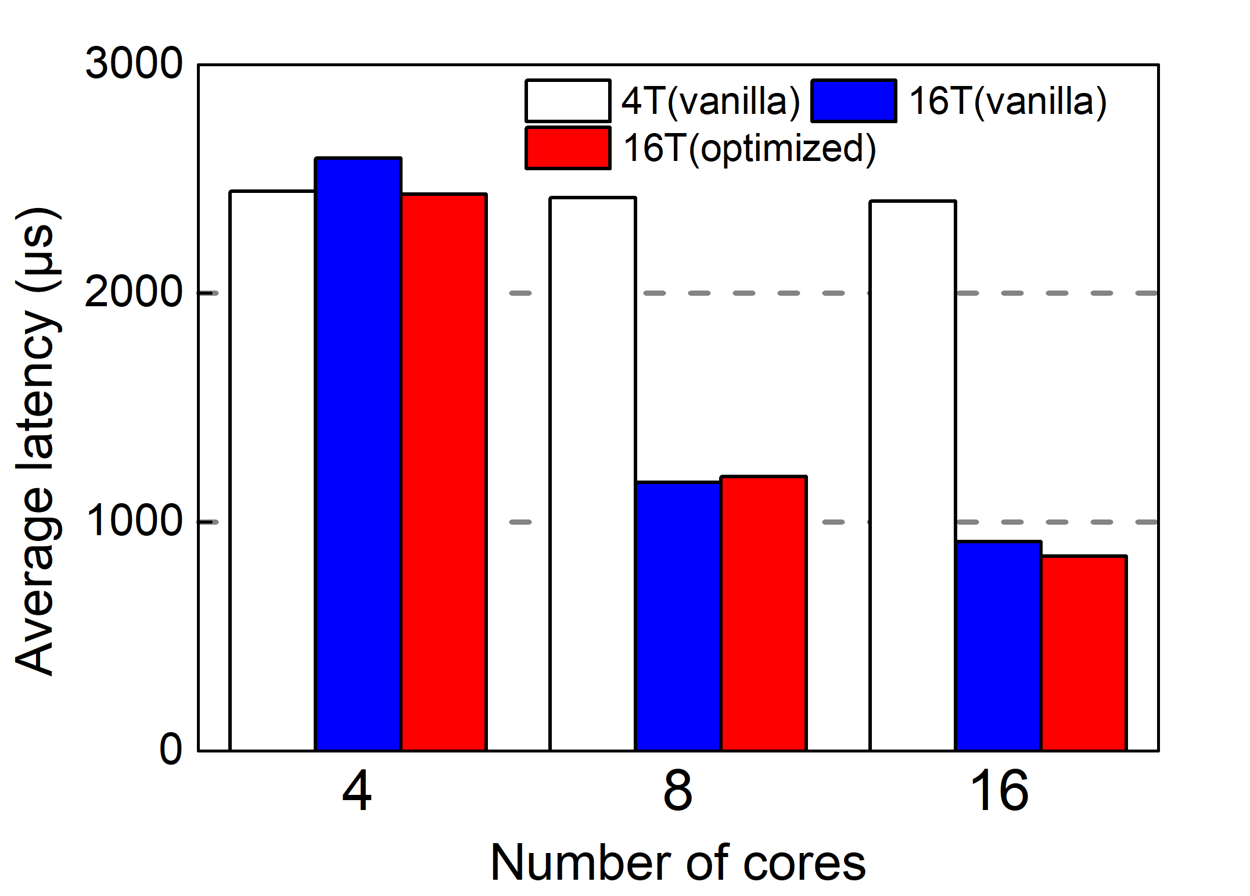
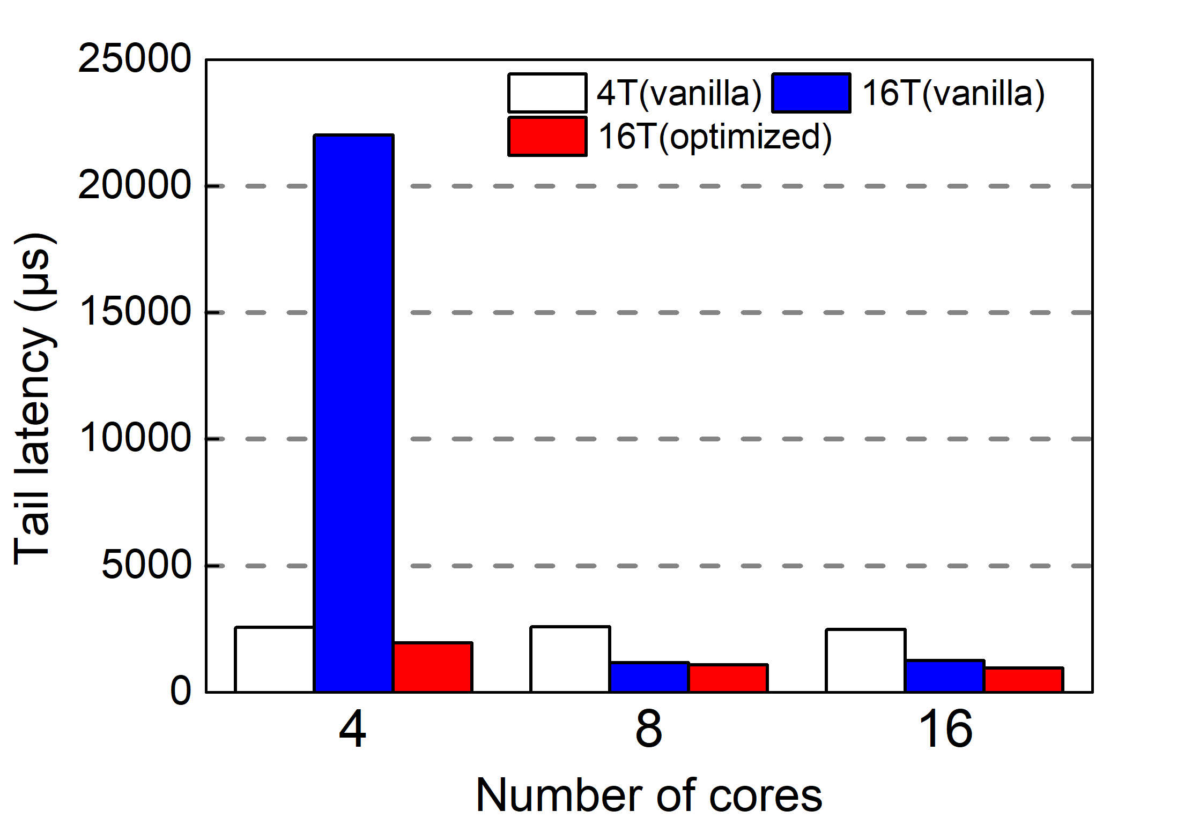
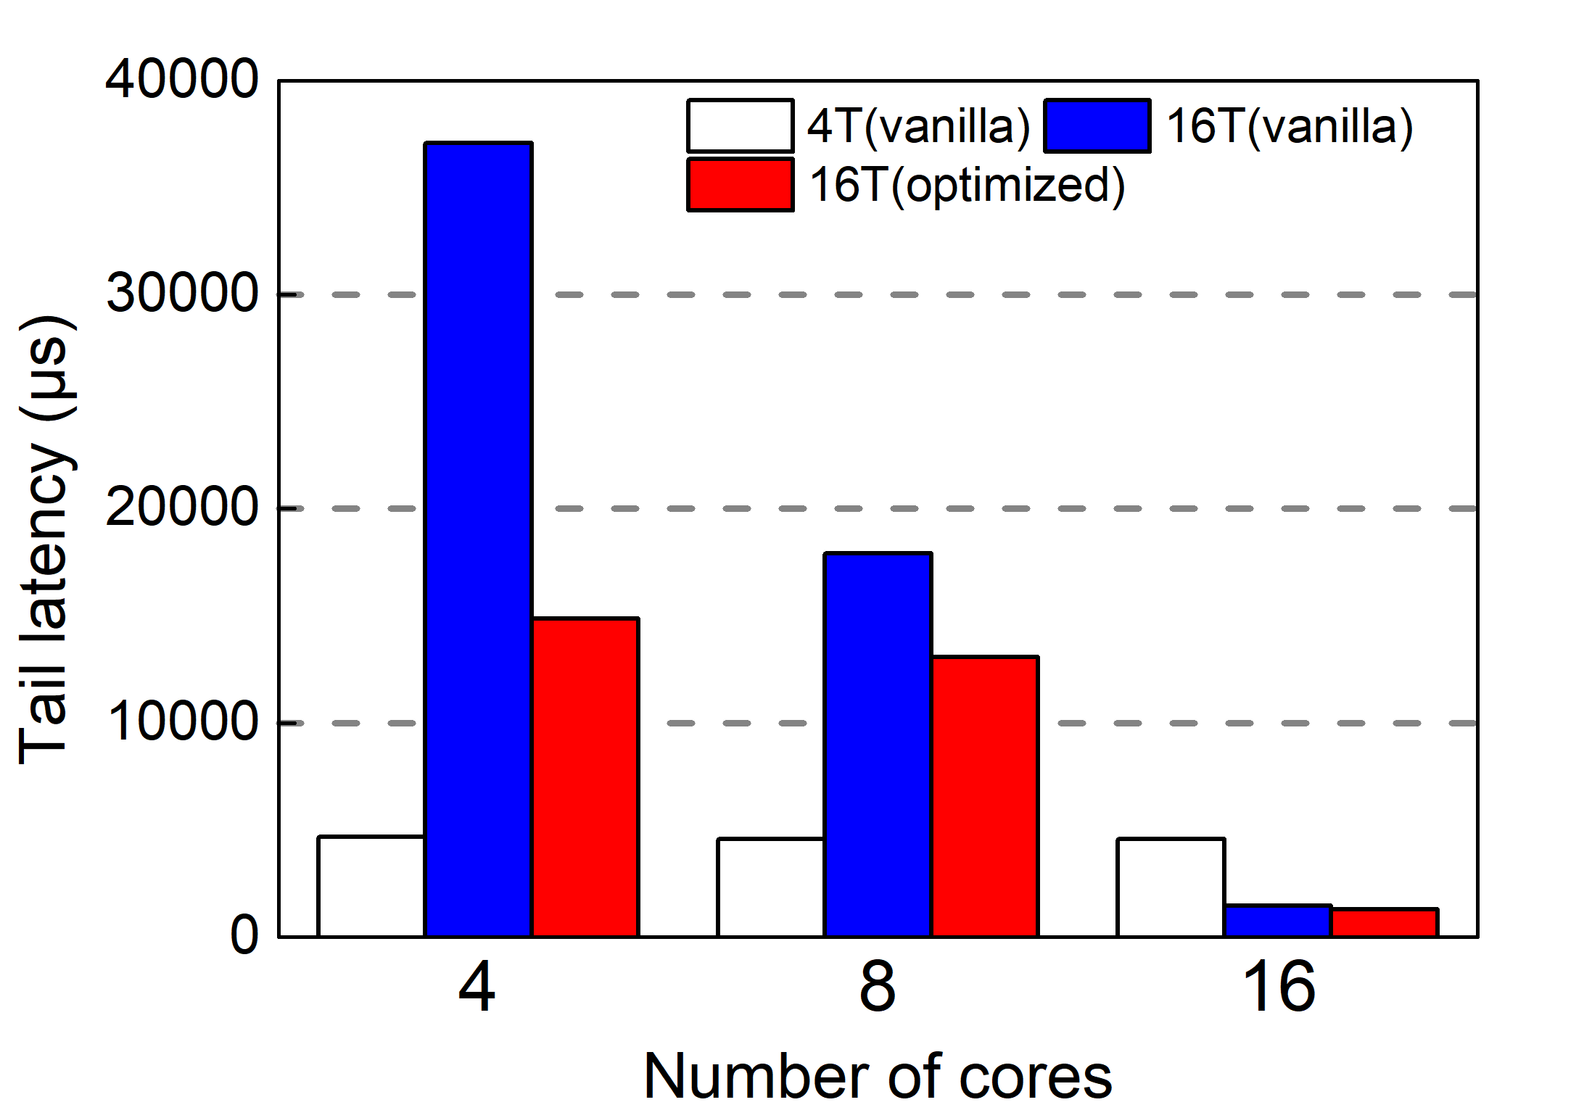
Improvement in Memcached Server
Throughout
Average latency
95th Percentile Tail
99th Percentile Tail
60%
92%
Notes:
Compared to conventional parallel programs, cloud workloads usually employ loosely-coupled threads and event-based notification mechanisms for thread coordination. Memcached is a widely used high-performance, distributed memory caching system. It employs the libevent library, which is based on epoll, to synchronize worker threads. Initially, Memcached worker threads call epoll\_wait and block to wait for incoming requests. Workers are awakened upon the arrival of client requests. Besides epoll, memcached also relies on pthreads mutex to protect the hash table it uses for key-value pairs lookup from concurrent updates. Similar to the changes made in futex, we implemented VB in epoll by removing the sleep queue and emulating sleeping via schedule skipping. Since memcached uses both epoll and futex, VB was enabled for both blocking mechanisms. We used mutilate to stress test the performance of the memcached server. The baseline had 4 worker threads while the oversubscribed scenarios had 16 threads. We evaluated three core settings: 4, 8, and 16 cores and with 16 workers the oversubscription ratio was 4, 2, and 1, respectively. The Figure shows the benefit of VB in improving the average, the tail latencies ,and the throughput of the memcached server. Oversubscription led to 8x increase in tail latencies. In contrast, VB effectively reduced the tail latency by 92\% and 60\%,
文字就好

Slide 29
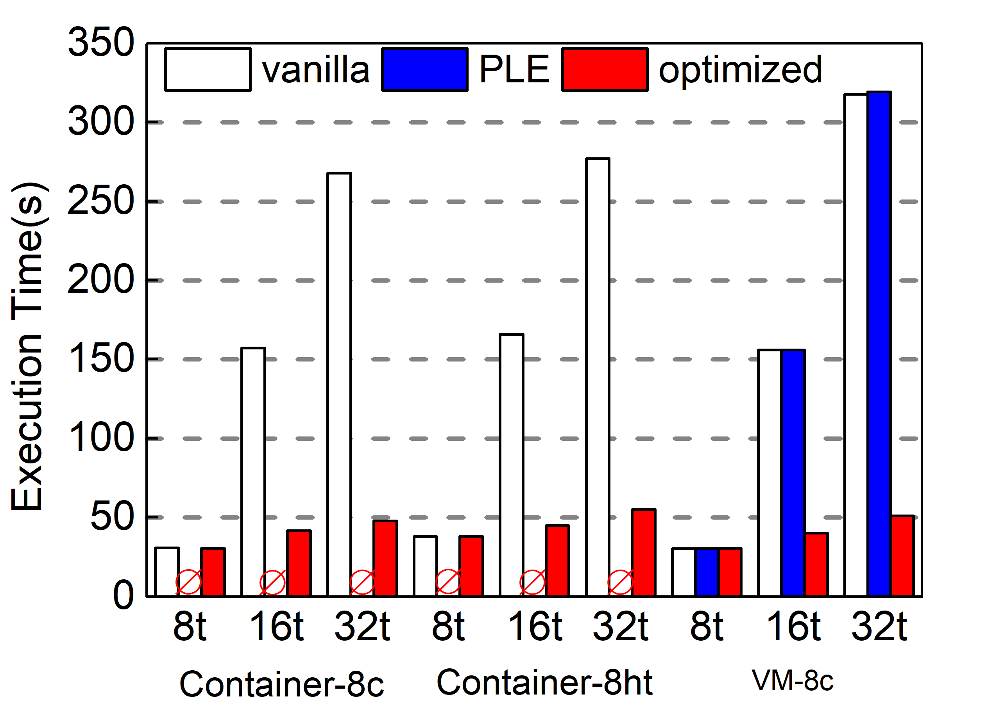
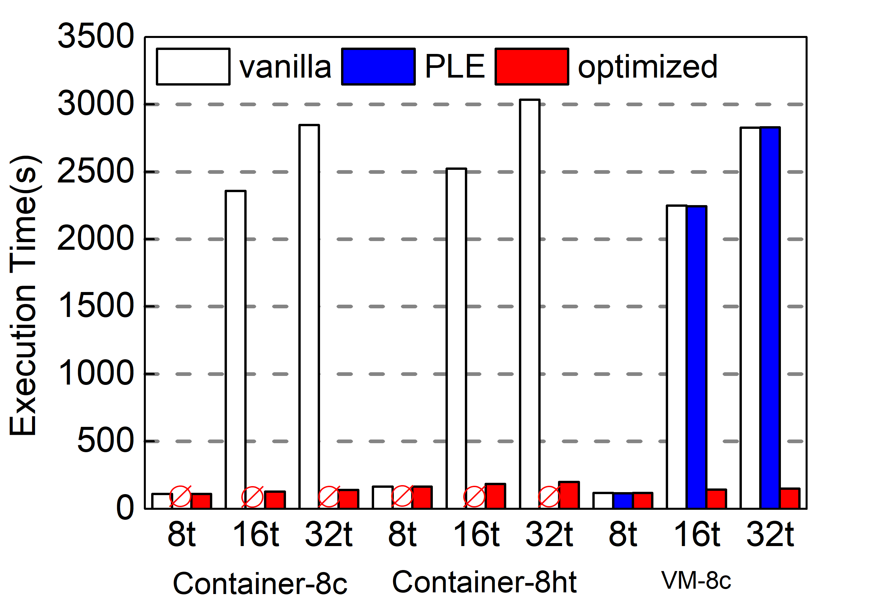
The Improvement due to BWD
Volrend
Lu
Notes:
We tested BWD with two applications with customized busy-waiting algorithms. The Figures show the result of lu from NPB and volrend from SPLASH-2, We made two observations: First, BWD was able to effectively bring the performance under oversubscription close to that without oversubscription, in both container and VM tests. PLE was not effective for user-customized spinning. Second, BWD inflicted some slowdown compared to the baseline and the slowdown worsened as the oversubscription ratio increased. The overhead is due to two reasons: 1) BWD may have false positives and mistakenly stop looping used in non-synchronization functions; 2) BWD detects spinning at fixed intervals (every 100 us). As the number of threads increases, the aggregate amount of spinning would increase. Nevertheless, BWD is significantly more efficient than the vanilla Linux and contains oversubscription overhead to an acceptable level.
粉色换蓝色

Slide 30
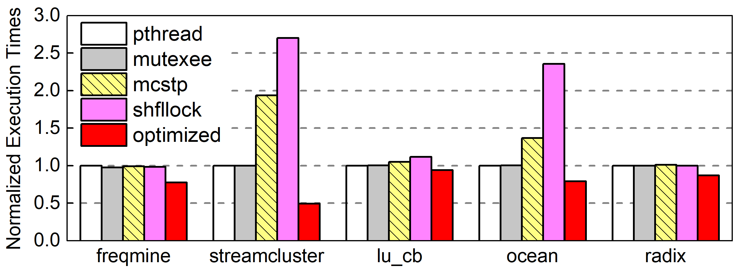
Comparison with SHFLLOCKS
5.4x
Notes:
SHFLLOCKS is a recently proposed lock design that decouples lock acquisition from a lock policy enforcement. It allows threads in the waiter queue to implement various locking policies and optimizations. An important feature of SHFLLOCKS is to allow waiter threads to adjust their lock policies, i.e., NUMA-awareness and efficient parking/wakeup strategies. SHFLLOCKS manages both the active and passive waiters in the same queue to decrease memory footprint, and enables lock stealing and shuffling to efficiently wake up waiters. This design improves fairness and throughput under over-subscription. We performed a comparison between SHFLLOCKS and our approach as well as the two spin-then-park algorithms. The results indicate that spin-then-park algorithms still suffered drastic slowdowns when threads are oversubscribed while our approaches, VB and BWD, are up to 5.4x more efficient. The culprit was that these spin-then-park algorithms still rely on the futex interface for sleeping in the OS kernel, which may cause severe slowdowns under oversubscription. SHFLLOCKS performed even worse in this case. In an oversubscribed scenario, simultaneously waking up a large number of threads causes unnecessary migrations across cores. Not only does SHFLLOCKS have no optimizations for bulk wakeups but its NUMA-awareness may hurt performance as it always wakes up threads from the same socket, causing load flucturations.

Slide 31
Conclusions
Motivation:
We explore thread over-subscription to exploit CPU elasticity and identify two kernel issues that lead to inefficiencies in managing oversubscribed threads.
Solution:
Virtual blocking
Busy-waiting detection
Results:
Our solution achieves an efficiency close to that in under-subscribed scenarios while preserving the capability to expand to more CPUs.
Limitations :
Our solution is most effective for strong scaling with a fixed problem size.
Notes:
To conclude,

Slide 32
Thanks!
Questions?

