Slide 1



PVM: Efficient Shadow Paging for Deploying Secure Containers in Cloud-native Environments
Hang Huang✻, Jiangshan Lai✮🎙, Jia Rao✧, Hui Lu✧, Wenlong Hou ✮, Hang Su ✮, Quan Xu✻, Jiang Zhong✻, Jiahao Zeng✻, Xu Wang ✮, Zhengyu He ✮, Weidong Han✻, Jiang Liu✻, Tao Ma✻, Song Wu §
✻
✮
✧
§
jiangshan.ljs@antgroup.com
Notes:
Hello, everyone:
I am Jiangshan Lai, the joint first author from ant group. Today, I will be presenting our work “PVM: Efficient Shadow Paging for Deploying Secure Containers in Cloud-native Environments”. This work comes from the collaboration between Alibaba group, ant group, the University of Texas at Arlington, and Huazhong University of Science and Technology.

Slide 2
Cloud-native and Containers
The Cloud Native Computing Foundation provides the official definition:
Cloud-native technologies empower organizations to build and run scalable applications in modern, dynamic environments such as public, private, and hybrid clouds.
Containers are used in cloud-native environments for:
Flexibility: ease of management.
Portability: fast and cross-platform deployment.
Excellent scalability.
Minimal resource utilization.
Notes:
At first, let‘s take a look at the realm of cloud-native computing and containers. As organizations embrace the cloud, they are compelled to reassess their software development strategies. In response, cloud-native has arisen, empowering organizations to execute scalable applications and fully leverage the capabilities of clouds. When it comes to implementing cloud-native architectures, containers have emerged as one of the most important technologies. Containers help to package applications and gained widespread popularity because of their flexibility, portability, minimal resource utilization, and excellent scalability.

Slide 3
Container vs. Secure Container
To address the increasing security challenges, secure containers are designed with stronger isolation and security.
Container
Secure Container
App
App
Bins/lib
Bins/lib
microVM
Guest Kernel
Host Kernel
Cgroups
Namespaces
LSMs (e.g. Capability, AppArmor)
Virtual Hardware
Hypervisor
Infrastructure
Infrastructure
Host kernel sharing
Narrow attack surface
Defense in depth
Notes:
However, traditional containers, such as runc containers, share the same kernel as the host operating system, which opens up opportunities for attackers to compromise the entire system. Although system-level mechanisms like namespaces, capabilities, seccomp, and apparmor help enhance container isolation and security, they are insufficient to meet the security requirements in the public cloud. As a result, secure containers, which consist of a traditional container and a lightweight virtual machine that hosts it, have gained increasing popularity in production systems. Secure containers provide strong isolation and compatibility with legacy applications.

Slide 4
Hardware-Assisted Single-Level Virtualization
Hardware virtualization extensions (e.g. Intel VT-x) provide efficient single-level virtualization support, enabling secure containers to achieve comparable performance on Bare-Metal instances.
CPU Virtualization
Memory Virtualization
non-root mode
CR3
ring3
guest user
Guest Page Tables
(GPT)
ring0
guest kernel
Guest Linear Address
(GVA)
vm-exit
vm-entry
Guest Physical Address
(GPA)
EPT Base Pointer (EPTP)
ring0
read
Extended Page Table
(EPT)
Host Physical Address
(HPA)
VMCS
KVM
write
root mode
Two CPU operating mode with full ring level for host and guest.
Two pagetables for guest address translation.
Notes:
With the assistance of hardware virtualization extensions, secure containers are capable of achieving comparable performance when running on physical machines or cloud bare-metal instances. For instance [Action #1] Intel CPUs equipped with VT-x support offer two operation modes that operate at the full ring level, facilitating quick switches between the host and guest. Moreover, [Action #2] VT-x provides a extended page table to enhance the fast translation of guest virtual addresses to host physical addresses.

Slide 5
Hardware-Assisted Nested Virtualization
2-Level nested virtualization requires more complex and costly software efforts, especially for the L0 hypervisor.
Secure Container
VM-Entry
L2
Container
VM-Exit
L1
vm-entry
vm-exit
VMCS12
EPT12
VM-Entry
shadowing
VMCS01
VMCS02
EPT01
EPT02
a transition between 𝐿2 and 𝐿1 requires an exit to 𝐿0, doubling the number of world switches compared to that in single-level virtualization
Notes:
However, running secure containers in a Cloud VM is still a challenging topic, as the hardware virtualization extensions only has a single level of architectural support for virtualization. Therefore, enabling the execution of secure containers within a VM (also known as 2-level nested virtualization) requires more complex and costly software efforts, especially for the L0 hypervisor. Moreover, hardware-assisted nested virtualization involves complex and expensive transitions between multiple hypervisors and guest VMs. For example, any privileged instruction from 𝐿2 will first be trapped by 𝐿0 (via a VM Exit). Since the privileged instruction needs to be handled by 𝐿2’s hypervisor, i.e., 𝐿1, 𝐿0 forwards the trap to 𝐿1 and uses VM Entry to switch to 𝐿1, which in turn handles the injected trap. Upon the completion of trap handling, 𝐿1 attempts to resume running 𝐿2 using the VM Entry instruction. As the VM Entry is a privileged instruction, 𝐿1 is trapped by 𝐿0 again, where the VM Entry instruction is executed in the root mode to finally resume 𝐿2. a transition between 𝐿2 and 𝐿1 requires an exit to 𝐿0, doubling the number of world switches compared to that in single-level virtualization, To avoid excessive L0 exits, VMCS shadowing allows L1 to maintain a software-based VMCS_12 that is not directly used for running L2. Despite these optimizations, nested virtualization remains expensive.

Slide 6
Nested vs Single-Level
Nested virtualization remains expensive, especially for memory-intensive workloads
The performance slowdown is substantial, reaching up to two orders of magnitude.
Notes:
We conducted performance tests using LMbench, Kbuild,and SPECjbb2005 within one or multiple secure containers and compared the performance of single-level virtualization (the secure container running in a regular VM) with that of 2-level nested virtualization (the secure container running in an 𝐿2 guest). As shown in the figure, while nested virtualization introduces additional world switches for handling privileged instructions, its overhead for workloads that do not involve intensive memory access is negligible with the help of VMCS shadowing. However, when dealing with memory-intensive workloads like frequent updates to page tables, virtual address translations, and especially simultaneous memory accesses, the performance slowdown is substantial, reaching up to two orders of magnitude. In what follows, we discuss memory virtualization and analyze its overhead.

Slide 7
Nested Memory Virtualization (SPT-on-EPT)
SPT-on-EPT: Using shadow page tables (SPT) in 𝐿1, while still allowing 𝐿0 to use the EPT hardware.
L2 (non-root mode ring3)
L1 (non-root mode ring3)
L2 (non-root mode ring0)
L1 (non-root mode ring0)
KVM PF Handler
❹ fix
SPT12
⑨ iret
⑧ fix
④ inject #PF
PF Handler
VMCS12
𝐿2 page fault can lead to 4n + 8 world switches and 2n + 4 exits to 𝐿0
⑦ vm_resume L2
(real entry)
⑤/❺ resume L2
❼ vm_resume L2
(real entry)
EPT
CR3
①/❶ #PF
L0 (root mode ring0)
resume L1 ③/❸
VMCS02
EPTP= EPT01
CR3 = SPT12
②/❷ inject #PF
VMCS01
EPTP= EPT01
CR3 = GPT1
⑥/❻ update & reload VMCS02
Notes:
To support 2-level nested memory virtualization, three dimensional page tables are required: one for the 𝐿2 guest, one for the 𝐿1 guest hypervisor, and one for the 𝐿0 host hypervisor. One straightforward approach to achieve this is by using shadow page tables (SPT) in 𝐿1, while still allowing 𝐿0 to use the EPT hardware, called SPT-on-EPT. As illustrated in the Figure, a page fault from 𝐿2 can trigger two phases of page table updates : 1) The first phase updates 𝐿2’s GPT2; and 2) the second phase updates 𝐿1’s GPT1 and SPT12. More specifically, in the first phase, an access to an absent GVA𝐿2 in GPT2 triggers an 𝐿2 page fault and an exit to 𝐿0(➀)[Action #1], which injects the page fault to 𝐿1 by writing 𝑉𝑀𝐶𝑆01 (➁) and resumes executing 𝐿1 (➂)[Action #2]. The 𝐿1 hypervisor recognizes that this is an 𝐿2 page fault and injects it to 𝐿2’s 𝑉𝑀𝐶𝑆12 (➃) and attempts to resume 𝐿2. Resuming 𝐿2 needs to trap back to 𝐿0 (➄), which updates 𝑉 𝑀𝐶𝑆02 (➅) before finally resuming 𝐿2 using 𝑉 𝑀𝐶𝑆02 (➆)[Action #3]. The page fault handler in 𝐿2 updates GPT2 with new page table entries mapping GVA𝐿2 to GPA𝐿2 (➇) and finally returns to user (➈)[Action #4]. To add more complexity to this process – since GPT2 is read-only, every update to GPT2 needs assistance from 𝐿1. Hence, step ➇ could further cause multiple rounds of switches between 𝐿2 and 𝐿1 via 𝐿0,depending on the number of page table level. es. In the first phase, 𝐿0 can be involved up to 2𝑛 + 2 times with 4𝑛 + 4 world switches (where 𝑛 is the number of 𝐿2 page table level. The following access to GPA𝐿2 , which was added to GPT2 during the first phase, triggers a page fault in 𝐿1 since GPA𝐿 is absent from GPT1 and hence SPT12. The second phase handles this 𝐿1 page fault and updates SPT12. As shown in Figure, the second phase follows the same steps as the first phase (➊-➐), except for two differences. First[Action#5], at step ➍ the 𝐿1 kernel handles the page fault and updates SPT12. Second[Action#6], step ➐ returns directly to 𝐿2 user space without involving the 𝐿2 guest kernel. In the second phase, there are four more world switches, including trapping to 𝐿0 twice. [Action#7]in the worst-case scenario, in which both GPT2 and SPT12 need to be updated, and assuming an n-level GPT2, an 𝐿2 page fault can lead to 4n + 8 world switches and 2n + 4 exits to 𝐿0 and [Action#6]in the worst-case scenario, in which both GPT2 and SPT12 need to be updated, and assuming an n-level GPT2, an 𝐿2 page fault can lead to 4n + 8 world switches and 2n + 4 exits to 𝐿0.

Slide 8
Nested Memory Virtualization (EPT-on-EPT)
EPT-on-EPT: The state-of-the-art nested memory virtualization approach for KVM leverages the architectural support for 2-dimensional page tables in EPT.
L2 (non-root mode ring3)
L1 (non-root mode ring3)
L2 (non-root mode ring0)
L1 (non-root mode ring0)
③ iret
PF Handler
① GPT2
#PF
EPT12 (RO)
𝐿2 page fault can lead to 2n + 6 world switches and n + 3 exits to 𝐿0
EPT_violation Handler
❹ fix
② fix GPT2
❽
resume L2
❿ vm_resume L2
(real entry)
❺
EPT violation
⓫
EPT violation again
⓭ vm_resume L2
(real entry) again
EPT
❶
EPT violation
❼
resume L1
CR3
L0 (root mode ring0)
⓬ fix EPT02
resume L1 ❸
VMCS02
EPTP= EPT02
CR3 = GPT2
❷ inject EPT violation
VMCS01
EPTP= EPT01
CR3 = GPT1
❻ emulation
❾ update & reload VMCS02
Notes:
The state-of-the-art nested memory virtualization approach for KVM leverages the architectural support for 2-dimensional page tables in EPT, called EPT-on-EPT. As illustrated in Figure, 𝐿2 has its own GPT2, which maps GVA𝐿2 to GPA𝐿2 . 𝐿0 exposes EPT capabilities to 𝐿1, which creates and maintains an EPT12 table mapping GPA𝐿2 to GPA𝐿1. Same as SPT-on-EPT, 𝐿0 manages EPT01, mapping GPA𝐿1 to HPA. Because MMU only supports one EPT table, 𝐿0 compresses EPT01 and EPT12 into one, EPT02, mapping GPA𝐿2 to HPA. Therefore, 𝐿0 can run 𝐿2 using 𝐿2’s GPT2 and EPT02. [Action#1] The EPT-on-EPT approach allows 𝐿2 to freely update GPT2 without any traps to 𝐿0, but needs multiple world switches to build and update EPT02. The update of EPT02 also involves two phases: The first phase updates EPT12 and EPT01 (➊-➓). The update of EPT is emulated by 𝐿0 – by making EPT12 read-only to 𝐿1. Hence, step ➎-➐ may repeat multiple times – depending on the number of page table levels in EPT12. Thus, the first phase traps to 𝐿0 𝑛 + 2 times with 2𝑛 + 4 world switches. The second phase updates EPT02 (11 - 13), by compressing EPT01 and EPT12 (built in the first phase). It adds one more 𝐿0 trap and two more world switches. In summary, a page fault from 𝐿2 triggers 2n + 6 world switches and exit to 𝐿0 for n + 3 times Compared to SPT-on-EPT, EPT-on-EPT is more efficient in terms of fewer number of world switches and 𝐿0 traps. a page fault from 𝐿2 triggers 2n + 6 world switches and exit to 𝐿0 for n + 3 times. However, our measurements showed that world switches in nested virtualization (1.3 μs) is an order of magnitude more expensive than those in single-level virtualization (0.105 μs).

Slide 9
EPT-on-SPT vs EPT-on-EPT
EPT-on-EPT is more efficient interms of fewer number of world switches and 𝐿0 traps
world switches in nested virtualization (1.3 μs) is an order of magnitude more expensive than those in single-level virtualization (0.105 μs)
Notes:
We used a memory-intensive micro-benchmark running in 𝐿2 to sequentially allocate 1 MB memory spaces and access pages within the allocated regions one by one. We varied the number of benchmark instances from 1 to 16. EPT-on-EPT significantly outperformed SPT-on-EPT in all cases. However, a considerable performance gap persisted between EPT-on-EPT and single-level memory virtualization (EPT only), and this gap widened as concurrency levels increased. We quantified the cost of world switches in EPT-on-EPT and EPT only. We quantified the cost of world switches in EPT-on-EPT and EPT only. Our measurements showed that world switches in nested virtualization (1.3 μs) is an order of magnitude more expensive than those in single-level virtualization (0.105 μs)

Slide 10
Challenges and Opportunities
Performance:
EPT-on-EPT still brings many costly world switches, leading to high overhead.
Security:
The modification to L0 hypervisor expand the attack surface, thereby posing potentially security risks to all L1 hypervisors and L2 guests.
Compatibility:
Existing nested virtualization is incompatible with emerging technologies such as AMD SEV and Intel TDX.
Notes:
While EPT-on-EPT is the state-of-the-art nested memory virtualization approach, it has several drawbacks that prevent it from being adopted in production cloud systems. First, EPT-on-EPT still leads to a large number of costly world switches between various levels of hypervisors and VMs, leading to poor performance. Second, nested virtualization upon EPT-on-EPT heavily relies on the 𝐿0 hypervisor (e.g., maintaining EPT02 and forwarding traps between 𝐿2 and 𝐿1). A “fat” host hypervisor increases security risks by expanding the attack surface for cloud providers. Third, nested virtualization is incompatible with emerging technologies such as AMD SEV and Intel TDX. This motivates us to develop a more efficient nested virtualization framework, which assumes no support from hardware virtualization and supports unmodified L0 host hypervisor.

Slide 11
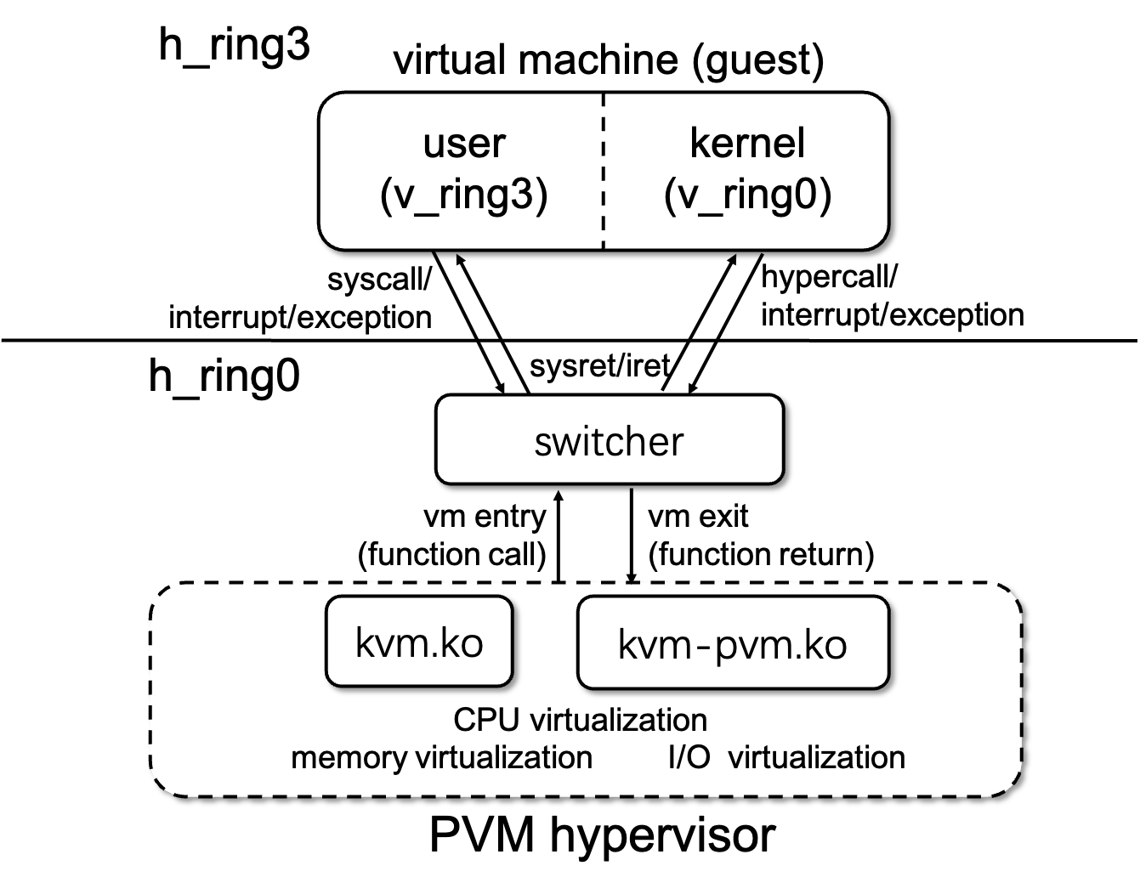
PVM - Architecture Overview
A high-performance, pagetable-based nested virtualization framework
built upon the KVM hypervisor: the L2 guest, the switcher, and the L1 guest hypervisor.
L2 Guest: features secure containers and the para-virtualized kernel.
Switcher: “switching” the worlds.
L1 Hypervisor: customize virtualization.
Notes:
PVM, is a high-performance, pagetable-based nested virtualization framework built upon the KVM hypervisor. The over-arching goals of PVM are to 1) enable nested virtualization with any IaaS clouds without affecting the security, flexibility, and complexity of the cloud platform; 2) avoid costly exits to the host hypervisor and devise efficient world switching mechanisms. The figure depicts the architecture of PVM, which comprises three key components: the 𝐿2 guest, the switcher, and the 𝐿1 guest hypervisor, or the PVM hypervisor. [Action#1]The 𝐿2 guest operates entirely within the hardware Ring 3 (i.e., h_ring3 in the non-root mode) with the least privilege. It features secure containers in virtual Ring 3 (i.e., v_ring3) and the paravirtualized 𝐿2 guest kernel in virtual Ring 0. 2) [Action#2]The switcher is responsible for“switching” the worlds between the 𝐿1 guest hypervisor, the 𝐿2 guest user, and the 𝐿2 guest kernel. The world switches can be triggered by a set of events, such as system calls, hypercalls, and interrupts/exceptions. 3) [Action#3]the PVM hypervisor comprises two (loadable) kernel modules: kvm.ko, which incorporates traditional KVM core functionality to ensure compatibility with the upper software stack, and kvm-pvm.ko, which incorporates the core PVM functionality, i.e.,a customized virtualization implementation using a function pointer vector of KVM.

Slide 12
PVM - Switcher
The Switcher comprises efficient and concise assembly code and data structures that map to identical addresses within the L1 hypervisor, L2 guest user, and L2 guest kernel address spaces.
world switching: VM-Exit
world switching: VM-Entry
Guest
Guest
❶syscall/
hypercall
①interrupt/
exception
msr_lstar
idtr
② iret
syscall entry
syscall entry
idt entries
idt entries
enter_guest
enter_guest
to_hypervisor
to_hypervisor
switcher
Switcher
switcher
① function call
Hypervisor
②/❷ ret
Hypervisor
Notes:
The Switcher comprises efficient and concise assembly code and data structures that map to identical addresses within the L1 hypervisor, L2 user, and L2 kernel address spaces, and facilitates state transitions between them. there are three key elements in switcher: 1) a per-CPU syscall entry to handle syscall requests between the 𝐿1 guest hypervisor, the 𝐿2 guest user, and the 𝐿2 kernel; 2) a per-CPU switcher state, similar to VMCS, which saves and restores 𝐿2 guest and 𝐿1 host states during world switches; and 3) customized interrupt descriptor table (IDT) handlers for capturing interrupts/exceptions. Without hardware support, an 𝐿2 guest traps to the 𝐿1 hypervisor in two ways: syscall/hypercall and interrupt/exception. In PVM, hypercalls in the 𝐿2 guest kernel are implemented through the invocation of syscalls. [Action#1]When an 𝐿2 guest executes a syscall instruction or an interrupt/exception occurs, [Action#2]the CPU transitions to h_ring0 and enters the switcher through a pre-defined handler in CPU registers (e.g., MSR_LSTARor IDTR). Inside the switcher, the to_hypervisor function performs the world switch from the 𝐿2 guest user (or kernel) to the 𝐿1 hypervisor. [Action#3]The switch function saves the 𝐿2 guest states and restores the 𝐿1 host states to/from the per-CPU switcher state. Once the exit has been completed, as shown in the right figure, the enter_guest function in the 𝐿1 hypervisor rebuilds the 𝐿2 guest context by saving the 𝐿1 host states and restoring the 𝐿2 guest states to/from the per-CPU switcher state.

Slide 13
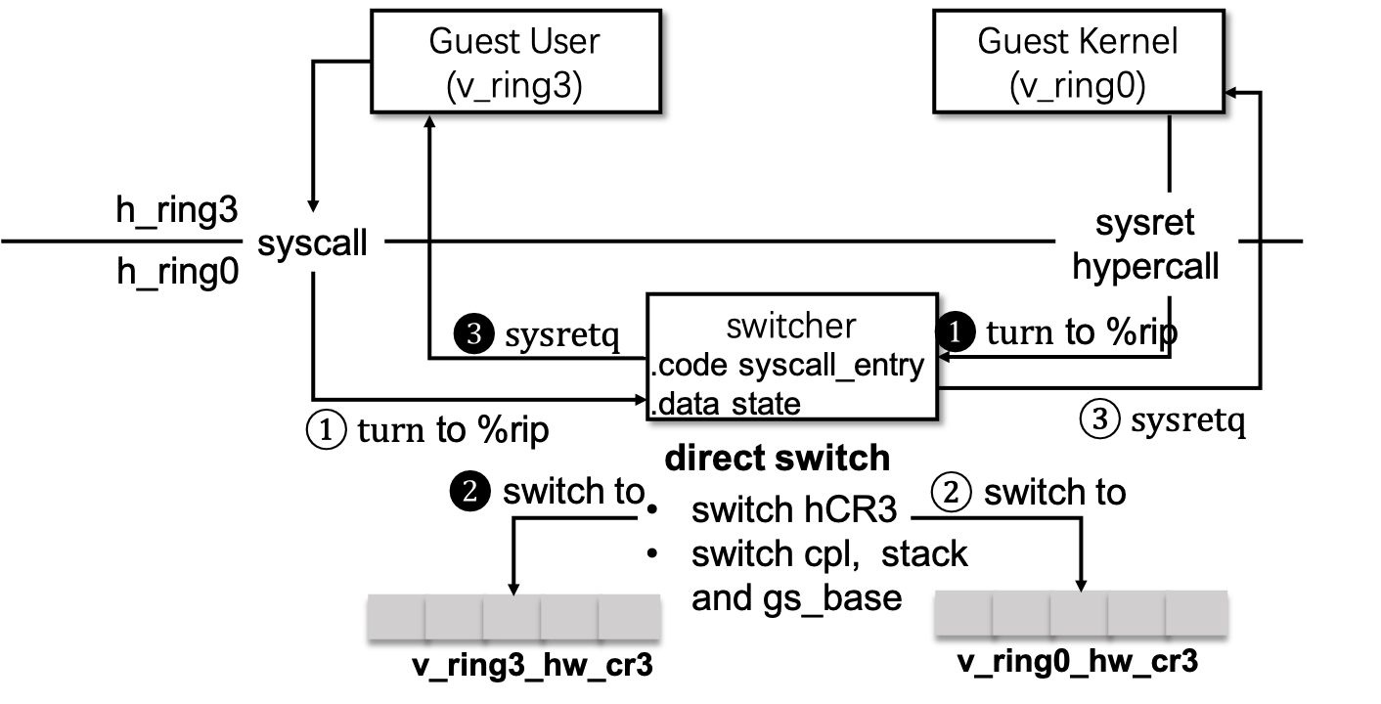
PVM – Direct switch
This direct switch mechanism allows guests to achieve fast user/kernel switches due to syscalls without hypervisor inter
Save one world switch (to hypervisor) per syscall/sysret
Notes:
PVM has also devised a novel direct switch mechanism in the switcher, to allows 𝐿2 guests to achieve fast user/kernel switches due to syscalls without hypervisor intervention. Specifically, when an 𝐿2 guest user invokes a syscall from h_ring3, the CPU transitions to h_ring0 and enters switcher. Switcher emulates the syscall instruction by 1) saving the state of the 𝐿2 guest user; 2) restoring the state of the 𝐿2 guest kernel; and 3) constructing a syscall frame where the 𝐿2 guest kernel can invoke the requested syscall function. At the end of the syscall emulation, switcher directly switches to the 𝐿2 guest kernel for executing the syscall. To enable direct switch for sysret, PVM uses a sysret hypercall in the 𝐿2 guest kernel to return a syscall. The sysret hypercall will enter the switcher (no traps to the 𝐿1 hypervisor), which switches the execution worlds anddirectly returns the 𝐿2 guest user. This helps save one world switch to hypervisor per syscall/sysret.

Slide 14
PVM – CPU Virtualization
PVM supports 64-bit mode with paging mode enabled, while emulates for other modes via KVM.
PVM manages virtual privileged register for the guest, e.g. CR0~4
Trap and emulate all sensitive instructions and privileged instructions.
Guest
privileged
instruction
sensitive
instruction
pv_ops
#GP exception
hypercall
switcher
PVM hypervisor
KVM inst
emulator
Notes:
As 𝐿2 guest vCPU works on h_ring3, access to privileged registers and segment states, and the execution of privileged CPU instructions must be intercepted by the PVM hypervisor. PVM adopts a hybrid approach based on instruction emulation, and paravirtualization for CPU virtualization. PVM currently focuses on supporting the 64-bit mode with paging for 𝐿2 guest vCPUs. when an 𝐿2 vCPU executes a privileged instruction, it leads to a general protection exception and triggers an exit to the 𝐿1 hypervisor. The PVM hypervisor employs an instruction simulator to emulate instruction execution for the 𝐿2 guest. Non-privileged but sensitive instructions also need to be restricted because of their capability to modify/observe privileged host state. PVM uses the Linux paravirtualization (PV) mechanism – initially proposed by Xen - to capture and handle any sensitive instructions even though x86 is not fully virtualizable.

Slide 15
PVM – Memory Virtualization
PVM uses separate shadow page tables for the guest user and kernel, preventing any access from the guest user to the guest kernel address.
Guest
L4
Guest
L3
Guest
L2
Guest
L1
Guest
Guest
Page
CR3
write-protect
(level, access, gfn …)
Host
Host
Page
CR3
L4
Shadow
L3
Shadow
L2
Shadow
L1
Shadow
Translate GVA to the specified HPA
Notes:
PVM seeks to handle memory virtualization of an 𝐿2 guest exclusively by and within the 𝐿1 hypervisor and employs a software-based approach, i.e., shadow page tables (SPT). To distinguish between v_ring0 and v_ring3, both residing at h_ring3, PVM uses separate page tables for isolating the 𝐿2 guest user and kernel. However, as previous discussed, both SPT (single memory virtualization) and SPT-on-EPT (2-level nested memory virtualization) incur significant poor overhead due to a large number of expensive world switches. To address this challenge, PVM devises a new and highly-efficient SPT approach with various optimizations, called PVM-on-EPT,

Slide 16
PVM – Memory Virtualization
PVM-on-EPT: exclusively handles of 𝐿2 page faults within 𝐿1, requires no modifications to L0 hypervisor.
L1 (non-root mode ring3)
v_ring3
v_ring0
⑥ fix
GPT2 (RO)
PF Handler
⑦
iret hypercall
①/❶
#PF
𝐿2 page fault only lead to 2n + 4 world switches and n + 3 exits to 𝐿1 (0.179 μs)
iret ❺
⑤ iret
⑩ iret
L1 (non-root mode ring0)
②/❷ vm exit
switcher
③ inject #PF
⑧ handle iret
Hypercall Handler
PVM PF Handler
④/❹ vm_entry
⑨ vm_entry
prefault
❸ fix
SPT12
EPT
CR3
L0 (root mode ring0)
VMCS01
EPTP= EPT01
CR3 = GPT1/SPT12
Notes:
As shown in the figure, the 𝐿2 guest operates its guest page table (GPT2), mapping GVA𝐿2 to GPA𝐿2 , while the 𝐿1 hypervisor maintains the guest shadow page table (SPT12) for 𝐿2, mapping GVA𝐿2 to GPA𝐿1. To ensure that any updates from GPT2 are synchronized with SPT12, GPT2 is made read-only to 𝐿2. Finally, to run the 𝐿2 guest, the underlying host 𝐿0 hypervisor simply uses both SPT12 and EPT01 (which maps GPA𝐿1 to HPA) to translate GVA𝐿2 to HPA. Since EPT01 for an 𝐿1 VM appears identical to that of other regular VMs, the 𝐿0 hypervisor remains unaware of the nested memory virtualization within 𝐿1, and thus, requires no modifications to support PVM-on-EPT.
When an 𝐿2 page fault occurring from the guest user space[Action#1]，it traps to the 𝐿1 hypervisor via the switcher (➀-➁) with one world switch. Action#2]The page fault handler of the PVM hypervisor injects the page fault back to 𝐿2 (➂) and switches to the 𝐿2 kernel via one world switch (➃-➄). Then, the 𝐿2 kernel starts updating GPT2(➅). As GPT2 is read-only, each update needs the assistance of 𝐿1, causing 2n world switches between the 𝐿2 kernel and 𝐿1. After all related page table entries in GPT2 have been updated, the 𝐿2 guest kernel returns (➆ via the iret hypercall). [Action#3]Instead of returning to the 𝐿2 guest user via direct switch, PVM adopts a prefault optimization and switches to 𝐿1 (with one world switch), which proactively updates SPT12 (➇), preventing future traps due to subsequent page faults on SPT12 due to the missing of the corresponding GVA𝐿2 recently updated in GPT2. Finally, 𝐿1 returns to 𝐿2 guest user with one more world switch. [Action#4]In summary, an 𝐿2 page fault causes 2n + 4 world switches under PVM-on-EPT, fewer than EPT-on-EPT which triggers 2n + 6 world switches. Note that, PVM-on-EPT exclusively handles of 𝐿2 page faults within 𝐿1, while EPT-on-EPT heavily relies on 𝐿0. Although PVM-on-EPT only saves two world switches compared to EPT-on-EPT, the world switches in PVM-on-EPT are substantially cheaper. The world switches in PVM entail state transitions within switcher and ring level changes in the non-root mode while those in EPT-on-EPT require state transitions across the non-root and root mode. Our measurements show that it takes on average 0.179 μs to perform a world switch in PVM, almost an order of magnitude cheaper than that in EPT-on-EPT and close to that in single-level virtualization.

Slide 17
PVM – Memory Virtualization
PCID mapping : eliminates TLB flushes
hypervisor leverages unused PCID (32-63) for guest
percpu PCID allocator manages the maps of gPCID
and hPCID (encoded into hardware CR3)
Fine-grained locking mechanism: fast SPT updates
reducing the sequential execution time caused by “mmu_lock”
Category SPT related data into three sub-groups (inter-shadow
pages , intra-shadow pages, reverse mappings), and use
separate locks
Notes:
VM adopts serval optimizations on PVM-on-EPT. A process context identifiers (PCID) mapping mechanism that eliminates TLB flushes for 𝐿2. It assigns unused PCID values (e.g.,32-63) from 𝐿1 to the 𝐿2 guest. This allows the TLB hardware to recognize individual SPTs for each process in 𝐿2, thereby eliminating TLB flushes during world switches. In addition, a traditional SPT approach relies on a global read-write lock, namely “mmu_lock”, to serialize updates to SPT data structures. In contrast, PVM employs a fine-grained locking mechanism that provides more precise data protection and enables greater concurrency in handling page faults.

Slide 18
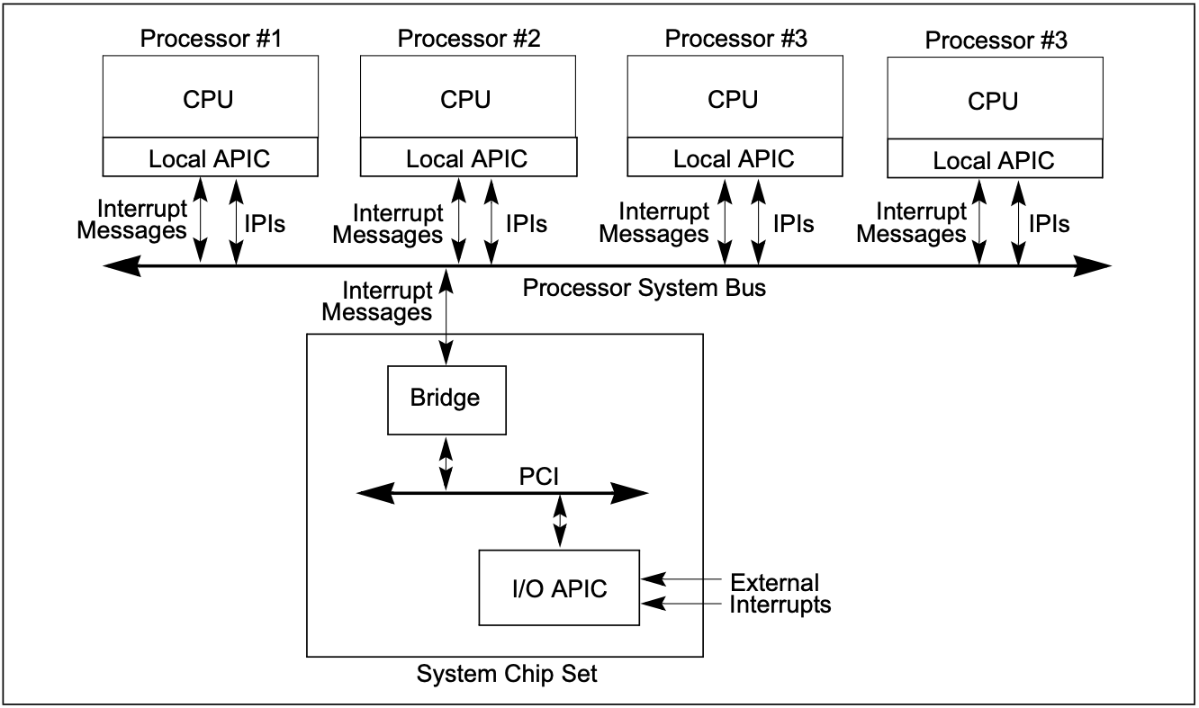
PVM – Interrupt Virtualization
IOAPIC/LAPIC emulation based on KVM
Guest Interrupt capturing:
Always enable hardware interrupts during guest runtime
Introduce an 8-byte shared data structure between an guest and the hypervisor to virtualize RFLAGS.
Interrupt handling:
Customized IDT entries.
Notes:
In case of interrupt virtualization. PVM need to capture all interrupts for an 𝐿2 guest, so the PVM hypervisor enables hardware interrupts at h_ring3, where the 𝐿2 guest operates. PVM also introduces an 8-byte shared data structure between an 𝐿2 guest and the 𝐿1 hypervisor to virtualize RFLAGS.IF, so that the 𝐿1 hypervisor is able to directly query interrupt configuration inside an 𝐿2 guest. PVM relies on 𝐿0 solely for interrupt injection to 𝐿1 and adopts software-based interrupt virtualization afterwards. If an interrupt occurs while an 𝐿2 guest is running, the default interrupt descriptor table (IDT) handler for this 𝐿2 guest, which is pointed by the hardware IDTR register located in the 𝐿2 guest address space, cannot handle it appropriately. To address this issue, PVM maps a customized IDT at the address to where the IDTR points in the 𝐿2 address space. The customized IDT initiates a transition to the PVM hypervisor (equivalent to a VM exit from 𝐿2 to 𝐿1) to handle the interrupt.

Slide 19
Evaluation
Experimental Settings
Hardware
Server | ecs.ebmg6.26xlarge and ecs.g6.26xlarge
CPU | two Intel Xeon Platinum CPUs (i.e., model 8269CY with 26 cores at 2.50GHz and hyperthreading enabled)
RAM | 385GB
Storage | 500 GB SATA SSD
Software
System | Anolis OS 7.9
Host/Guest Kernel | 4.19.91
Runtime | Rund
Benchmarks | LMbench, PECjbb2005, Kbuild, Parsec 3.0, Cloud Bench Suit
Notes:
We compared PVM with two existing approaches: hardware-assisted and shadow page table based (software) approaches in both single-level (bare-metal) and nested (2-level) virtualization. Without loss of generality, we conducted the experiments using Intel processors. We used two Intel x86 instances from Alibaba Cloud – 1) a bare-metal instance and 2) a general-purpose (VM) instance with identical software and hardware configurations. Each instance was configured with two Intel Xeon Platinum CPUs,385 GB RAM, and a 500 GB SATA SSD. The bare-metal instance was equipped with Intel virtualization technology (VT), supporting VMX root and non-root modes, EPT, and VMCS Shadowing. The VM instance had no hardware virtualization support and did not colocate with other VMs.

Slide 20
Results on VM-Entry/Exit
The round-trip latency (μs) of VM exits/entries with KPTI enabled/disabled:
Configurations | kvm (BM) | pvm (BM) | kvm (NST) | pvm (BM)
Hypercall | 0.46/0.46 | 0.54/0.54 | 7.43/7.87 | 0.48/0.48
Exception | 1.66/1.65 | 1.67/1.65 | 9.20/9.01 | 2.21/2.2
MSR access | 0.87/0.87 | 2.53/2.51 | 8.18/8.47 | 2.88/2.86
CPUID | 0.54/0.54 | 0.6/0.59 | 7.1/7.16 | 0.51/0.51
PIO | 3.79/3.39 | 4.91/4.54 | 29.34/28.27 | 12.94/12.03
KVM (NST) triggered two expensive exits to the 𝐿0 hypervisor for each privileged 𝐿2 guest operation, while PVM needed one and less expensive VM exit to the 𝐿1 guest hypervisor
Notes:
We used a set of micro-benchmarks to perform privileged guest operations to trigger VM exits and measured the round-trip time until VM entries, both with KPTI enabled/disabled. The table lists the average round-trip latency under five privileged guest operations: no-op hypercall, invalid opcode exception, MSR access of MSR_CORE_PERF_GLOBAL_CTRL, CPUID,port-mapped I/O (PIO). In single-level virtualization, VM exits/entries were efficiently handled by hardware: pvm (BM) offered performance comparable to kvm (BM) in most guest operations, except for MSR access.[Action #1] It is due to KVM’s capability to directly access MSR registers in non-root mode, avoiding VM exits. In nested virtualization, PVM significantly outperformed hardware-assisted approaches: pvm (NST), compared to kvm (NST), This clearly demonstrates the benefit of PVM’s software-based VM exit/entry: kvm (NST) triggered two expensive exits to the 𝐿0 hypervisor for each privileged 𝐿2 guest operation, while PVM needed one and less expensive VM exit to the 𝐿1 guest hypervisor. From these results, we did not discern any considerable impact from KPTI on VM exits/entries.

Slide 21
Results on System Calls
The Execution time (μs) of syscall get_pid with KPTI enabled/disabled:
Configurations | Optimization | Syscall (μs)
kvm-ept (BM) |  | 0.22/0.06
kvm-spt (BM) |  | 2.09/0.06
pvm (BM) | none | 1.91/1.91
 | direct-switch | 0.29/0.29
kvm (NST) |  | 0.23/0.06
pvm (NST) | none | 1.93/1.93
 | direct-switch | 0.3/0.3
The direct-switch can reduce PVM’s overhead, narrowing the syscall execution time gap between PVM and KVM.
Notes:
To test PVM’s efficiency in handling guest syscalls, we measured the execution time of the get_pid syscall. This syscall is simple and mostly involves a user/kernel transition. We analyzed two PVM variants: one with direct switching and the other without. Compared with hardware-assisted approaches, PVM noticeably slowed down syscall execution without direct switching, [Action #1]However, the direct switching feature can reduce PVM’s overhead, narrowing the syscall execution time gap between PVM and its hardware-assisted. [Action#2]We observed that with KPTI disabled, both kvm-ept (BM) and kvm (NST) executed the get_pid syscall faster due to reduced world switches between the guest user and kernel. However, this improvement was not observed in PVM, this is because PVM does not reduce its world switches. After a system call completes via sysret, there remains the necessity to exit either to switcher or to the PVM hypervisor. We are in the process of developing an advanced direct switching optimization that can return sysret at h_ring3.

Slide 22
Results on Page Faults
We used a micro-benchmark to repeatedly allocate and release 1MB of memory in a guest’s virtual address space and access the allocated data at page granularity to stress-tested memory virtualization
Notes:
We used a micro-benchmark to repeatedly allocate and release 1MB of memory in a guest’s virtual address space and access the allocated data at page granularity. This benchmark caused frequent updates to the guest page table and thus stress-tested memory virtualization. To examine scalability, we adjusted the number of benchmark processes from 1 to 32 within a single container. pvm (NST) significantly outperformed kvm-ept (NST), and the performance gap widened with increasing concurrency. [Action #1]By applying the fine-grained page table locking optimization alone, PVM achieves superior scalability; the use of prefault and PCID mapping further enhances PVM’s performance.

Slide 23
Results on Real-world Application
We ran multiple instances of the same real-world applications , each in a separate secure container, and varied the concurrency level from 1 to 16.
↓ 74%
Kbuild
Blogbench
specjbb2005
fluidanimate
Notes:
We continued the evaluation of PVM using four representative real-world applications with distinct characteristics: 1) Kbuild builds the Linux kernel from the source involving a mixture of compute and file I/O; 2) Blogbench is a filesystem benchmark that reproduces the load of a busy file server; 3) SPECjbb2005 is a Java benchmark involving he use of a Java virtual machine ; 4) Fluidanimate is a benchmark with a large dataset selected from the PARSEC benchmark suite. We ran multiple instances of the same benchmark, each in a separate secure container, and varied the concurrency level from 1 to 16. For all applications, PVM offered performance close to the hardware-assisted approach for single-level virtualization. Further, the performance of kvm-ept (NST) collapsed in all cases when concurrency was high, suggesting that the 𝐿0 hypervisor became the bottleneck. [Action #2]PVM even outperformed the hardware-assisted approach in fluidanimate due to more efficient handling of the HALT instruction.

Slide 24
Cloud Adoption
PVM has been adopted by Alibaba Cloud, a major IaaS cloud provider, as an alternative to bare-metal instances for hosting secure container.
Deployment:
operates more than 100K secure containers with over 400K vCPUs on a daily.
Adoption:
led to a 36% user shift from bare-metal instances to general-purpose instances for secure container hosting and substantial cost-savings for cloud tenants.
Performance:
an average performance boost of 22.6% for Spark workloads compared to bare-metal servers (PVM servers are quipped with newer generation processors).
Notes:
PVM has been adopted by Alibaba Cloud, a major IaaS cloud provider, as an alternative to bare-metal instances for hosting secure containers. Presently, PVM operates more than 100K secure containers with over 400K vCPUs on a daily basis. The adoption of PVM has continued to grow over the past year. It has led to a 36% user shift from bare-metal instances to general-purpose instances for secure container hosting and substantial cost-savings for cloud tenants. Notably, there has been a steady migration of Spark–based in-memory data processing and analytics workloads from bare-metal servers to PVM servers with nested virtualization. These PVM servers have shown an average performance boost of 22.6% for Spark workloads compared to bare-metal servers. It is worth noting that the PVM servers are equipped with newer generation processors than the bare-metal ones in Alibaba Cloud.

Slide 25
Conclusion
A comprehensive analysis of state-of-the-art nested virtualization that reveals the drawbacks of hardware-assisted approaches.
The design and implementation of pvm, a guest hypervisor, and a general framework for nested virtualization.
Optimizations for world switches, concurrent shadow page table updates, and guest page fault handling
Notes:
To conclude, We made a comprehensive analysis of state-of-the-art nested virtualization that reveals the drawbacks of hardware-assisted approaches and motivates the hybrid software-hardware nested architecture, as well as decoupling nested VMs from the host hypervisor.We introduce PVM, a minimal, high-performance, and software-based hypervisor for nested virtualization. PVM does not assume any hardware virtualization support and thus is portable to any cloud systems based on KVM. With optimizations for world switches, concurrent shadow page table updates, and guest page fault handling, PVM is the only viable approach with superior performance than hardware-assisted nested virtualization. PVM has been adopted in Alibaba Cloud for hosting secure containers, providing a more performant and cost-effective option for cloud users

Slide 26
Thanks!

