Slide 1



PVM: Efficient Shadow Paging for Deploying Secure
Containers in Cloud-native Environments
Hang Huang✻, Jiangshan Lai✮, Jia Rao✧, Hui Lu✧, Wenlong Hou ✮, Hang Su ✮,
Quan Xu✻, Jiang Zhong✻, Jiahao Zeng✻, Xu Wang ✮, Zhengyu He ✮,
Weidong Han✻, Jiang Liu✻, Tao Ma✻, Song Wu §
✻
✮
✧
§
jiangshan.ljs@antgroup.com

Slide 2







Cloud native and containers
Cloud-native applications
Highly scalable, flexible, and resilient
Often appear as microservices
Run in containers
Containers
Lightweight and efficient
Lack of isolation
Dev/Ops
CD/CI
Cloud-native
Microservices
Orchestration
Run within virtual machines (VMs) for strong isolation, a.k.a., secure containers

Slide 3


Hosting containerized applications in clouds
Secure container
Secure container
Secure container
Secure container
Secure container
Secure container
Secure container
Secure container
Kubernetes
Bare-metal
Bare-metal
VM
VM
Hosting secure containers in VMs leased from clouds: Low cost, reconfigurable, and elastic
Need nested virtualization!

Slide 4
Single-level virtualization
Non-root Mode
Guest Virtual Address
(GVA)
Guest Page Tables
(GPT)
Syscalls
#PF
Ring3
Guest user
Ring0
Guest kernel
External interrupt
Privileged inst.
Hypercall
VMX inst.
VM Exit
VM Entry
Guest Physical Address
(GPA)
read
Extended Page Table
(EPT)
Ring0
KVM
VMCS
write
Host Physical Address
(HPA)
Root Mode
CPU Virtualization
Memory Virtualization

Slide 5
Nested (2-level) virtualization
Privileged inst.
L2 (non-root mode): lightweight VM running in an L1 VM
Secure Container
VM Entry
VMCS12
VM Exit
L1 (non-root mode): guest hypervisor running in a cloud VM
VM Exit
shadowing
EPT12
VM-Entry
VMCS01
VMCS02
L0 (root mode): host hypervisor on a bare-metal machine
EPT01
EPT02
World switch:
The switching of both the execution modes (e.g., non-root vs. root) and address spaces

Slide 6
Nested Memory Virtualization
EPT-on-EPT: Multiplex 3 page tables (L2, L1, and L0) onto 2-dimensional EPT hardware
L2 (non-root mode ring3)
L1 (non-root mode ring3)
L2 (non-root mode ring0)
L1 (non-root mode ring0)
GPT2
EPT12
GVA(L2) -> GPA (L2)
GPA(L2) -> GPA (L1)
EPT02
EPT01
GPA(L2) -> HPA
GPA(L1) -> HPA
MMU uses GPT2 and EPT02 to translate L2’s virtual address to host physical address
L0 (root mode ring0)
VMCS02
VMCS01
One page fault from L2 triggers two phases of page table updates

Slide 7
EPT-on-EPT: Phase 1
Phase 1
Update GPT2
L2 (non-root mode ring3)
L1 (non-root mode ring3)
③ iret
① #PF
L1 (non-root mode ring0)
L2 (non-root mode ring0)
GPT2
EPT12
② fix
PF Handler
GVA(L2) -> GPA (L2)
GPA(L2) -> GPA (L1)
EPT02
EPT01
GPA(L2) -> HPA
GPA(L1) -> HPA
L0 (root mode ring0)
VMCS02
VMCS01
Involve no world switch

Slide 8


EPT-on-EPT: Phase 2
Phase 2.1
Update EPT12 and EPT01
L2 (non-root mode ring3)
L1 (non-root mode ring3)
L2 (non-root mode ring0)
L1 (non-root mode ring0)
GPT2
EPT12
VMCS12
GVA(L2) -> GPA (L2)
GPA(L2) -> GPA (L1)
Phase 2.2
Update EPT02
EPT02
EPT01
GPA(L2) -> HPA
GPA(L1) -> HPA
L0 (root mode ring0)
Trap to L0 for up to n+3 times with 2n+6 world switches
VMCS02
VMCS01

Slide 9
Nested virtualization – performance overhead
Lower is better
5
552
Nested virtualization incurs up to two orders of magnitude performance overhead for memory-intensive and concurrent workloads

Slide 10
Nested virtualization - takeaways
High overhead
Costly traps to L0
Involvement of L0
Increased L0 complexity
Enlarged L0 attack surface
A potential performance bottleneck
Limited adoption in production clouds
Exposing hardware virtualization support to L1 affects cloud management
non-root ring3
L1 User
L2 User
non-root ring0
L1 Kernel
L2 Kernel
root ring0
L0

Slide 11
PVM design: objectives
Avoid expensive traps to L0
Handle syscalls and L2 memory virtualization entirely within L1
Support unmodified L0
Fully compatible with cloud management
High performance
Comparable to hardware-assisted nested virtualization
L1: Self-contained, assuming
no hardware virtualization support
L2 User
non-root ring3
L1 User
Other ordinary
VMs
L2 Kernel
non-root ring0
L1 Kernel
root ring0
L0
L0: Oblivious of nested virtualization inside L1
PVM: a software-based nested virtualization approach independent of the host hypervisor

Slide 12
PVM design: overview
L2 guest
h_ring3
user
(v_ring3)
kernel
(v_ring0)
L2 guest runs entirely at ring3 featuring a para-virtualized kernel.
syscall/
interrupt/exception
hypercall/
interrupt/exception
sysret/iret
L1 VM
switcher
h_ring0
Switcher enables efficient world switches.
VM entry
(function call)
VM exit
(function return)
kvm.ko
kvm-pvm.ko
PVM hypervisor handles CPU, memory, and I/O virtualization.
PVM hypervisor on a cloud VM

Slide 13
PVM: L1-to-L2 world switches via switcher
VM-Exit
L2
VM-Entry
L2
Guest
Guest
❶syscall/
hypercall
①interrupt/
exception
② iret
msr_lstar
idtr
syscall entry
syscall entry
idt entries
idt entries
enter_guest
enter_guest
L1
L1
to_hypervisor
to_hypervisor
Switcher
switcher
switcher
②/❷ ret
① function call
Hypervisor
Hypervisor

Slide 14




PVM: direct switch
Guest User
(v_ring3)
Guest Kernel
(v_ring0)
h_ring3
sysret hypercall
syscall
h_ring0
$$\text{❸} \text{sysretq}$$
switcher
$$❶ \text{turn} \text{to}\text{ \%}\text{rip}$$
$$① \text{turn} \text{to}\text{ \%}\text{rip}$$
$$\text{③} \text{sysretq}$$
direct switch
❷ switch to
switch hCR3
switch cpl, stack and gs_base
② switch to
v_ring3_hw_cr3
v_ring0_hw_cr3
Save one world switch (to hypervisor) per syscall/sysret

Slide 15
PVM memory virtualization
PVM-on-EPT: L1 maintains a shadow page table SPT12 for L2
L2 (virtual ring3)
L1 (non-root mode ring3)
L2 (virtual ring0)
L1 (non-root mode ring0)
GPT2
SPT12
MMU
GVA(L2) -> GPA (L2)
GVA (L2) -> GPA (L1)
EPT01
MMU
GPA (L1) -> HPA
L0 (root mode ring0)
VMCS01

Slide 16
PVM memory virtualization
PVM-on-EPT: L1 maintains a shadow page table SPT12 for L2
Phase 1
Update GPT2
① #PF
L2 (virtual ring3)
L1 (non-root mode ring3)
L2 (virtual ring0)
L1 (non-root mode ring0)
④ vm entry
switcher
PVM
PF Handler
⑤ iret
② vm exit
GPT2
SPT12
⑥ fix
⑦ iret hc
PVM
HC Handler
PF Handler
GVA(L2) -> GPA (L2)
EPT01
GVA(L2) -> GPA (L1)
③ inject #PF
GPA(L1) -> HPA
No L0 involvement!
Trap to L1 for up to n+1 times with 2n+2 world switches
L0 (root mode ring0)
VMCS01

Slide 17
PVM memory virtualization
PVM-on-EPT: L1 maintains a shadow page table SPT12 for L2
Phase 2
Update SPT2
L2 (virtual ring3)
L1 (non-root mode ring3)
L2 (virtual ring0)
L1 (non-root mode ring0)
switcher
⑨ iret
PVM
PF Handler
GPT2
SPT12
⑦ iret hc
PVM
HC Handler
PF Handler
⑧ prefault
GVA(L2) -> GPA (L2)
EPT01
GVA(L2) -> GPA (L1)
GPA(L1) -> HPA
L0 (root mode ring0)
Trap to L1 for one more time with 2 world switches
VMCS01

Slide 18
PVM-on-EPT vs. EPT-on-EPT
World switches
2n+4 vs. 2n+6
# of traps to L0
0 vs. n+3
Avg. cost of world switches
0.179 μs (PVM L2-L1) vs. 1.3 μs (NST L2-L0-L1) vs. 0.103 μs (BM L1-L0)
World switches (L1-to-L2) due to PVM memory virtualization are almost an order of magnitude cheaper than that in state-of-the-art

Slide 19
Additional optimizations
An optimized PCID mapping mechanism
Avoid unnecessary TLB flushes during world switches
Fine-grained shadow page table locking
Allow concurrent page fault handling
Optimizations are user-specific and only take effect in L1, requiring no changes to the host hypervisor

Slide 20
Evaluation
PVM as a host hypervisor on a bare-metal machine
PVM performance in single-level virtualization
PVM as a guest hypervisor in a VM on Alibaba Cloud
Benefits of PVM in nested virtualization
Metrics
Cost of VM-exit/entry
System call performance (direct switch)
Cost of page fault handling
Application performance

Slide 21
Evaluation: VM-Entry/Exit
The round-trip latency (μs) of VM exits/entries
Configurations | kvm (BM) | pvm (BM) | kvm (NST) | pvm (NST)
Hypercall | 0.46 | 0.54 | 7.43 | 0.48
Exception | 1.66 | 1.67 | 9.20 | 2.21
MSR access | 0.87 | 2.53 | 8.18 | 2.88
CPUID | 0.54 | 0.6 | 7.1 | 0.51
PIO | 3.79 | 4.91 | 29.34 | 12.94
For each privileged L2 guest operation:
KVM (NST) triggered two expensive exits to the L0 hypervisor
PVM needed one less expensive VM exit to the L1 guest hypervisor
Lower is better

Slide 22
Evaluation: system calls (direct switch)
The Execution time (μs) of syscall get_pid:
Configurations | Optimization | Syscall (μs)
kvm-ept (BM) |  | 0.22
pvm (BM) | none | 1.91
 | direct-switch | 0.29
kvm (NST) |  | 0.23
pvm (NST) | none | 1.93
 | direct-switch | 0.3
Lower is better

Slide 23
Evaluation: Page fault handling
To stress-test memory virtualization, a micro-benchmark repeatedly allocated/released memory and accessed the allocated data
Lower is better
PVM(NST)
PVM(BM)
KVM(BM)

Slide 24
Cloud Adoption
Adopted by Alibaba Cloud
100K PVM-enabled secure containers with 500K vCPUs daily
36% users switch from bare-metal instances to general-purpose instances
PVM offers comparable performance with bare-metal servers

Slide 25
Conclusion
We introduce PVM: a software-based approach for nested virtualization
Assume no hardware support
Support unmodified L0 and avoid expensive L0 trap
Two key designs in PVM
Efficient world switches via Switcher
Efficient shadow page table for nested memory virtualization
PVM achieves superior performance than hardware-assisted nested virtualization
Comparable performance with single-level virtualization
PVM has been adopted in Alibaba Cloud
Thank you!

Slide 26
Backup slides …

Slide 27
PVM CPU Virtualization
Guest
A hybrid approach based on instruction emulation and paravirtualization
Privilege Instruction
Sensitive Instruction
pv_ops
#GP exception
hypercall
switcher
Privilege/sensitive instructions are captured via #GP exceptions or paravirtualization
PVM Hypervisor
KVM Instruction
Emulator

Slide 28
IO virtualization
VM-exit
Inject Interrupt to L1
L2 Interrupt occurs
L0
IDTR
Switcher
Guest CPU Entry Area
L1
VMCS12
Customized
IDT
Guest
IDT
shadowing
L0
Trap to PVM
VMCS02
PVM Hypervisor
L1
Inject to L2
Default KVM interrupt handling – multiple L0 traps
PVM interrupt handling – zero L0 involvement

Slide 29
Evaluation: VM-Entry/Exit
The round-trip latency (μs) of VM exits/entries with KPTI enabled/disabled:
Configurations | kvm (BM) | pvm (BM) | kvm (NST) | pvm (NST)
Hypercall | 0.46/0.46 | 0.54/0.54 | 7.43/7.87 | 0.48/0.48
Exception | 1.66/1.65 | 1.67/1.65 | 9.20/9.01 | 2.21/2.2
MSR access | 0.87/0.87 | 2.53/2.51 | 8.18/8.47 | 2.88/2.86
CPUID | 0.54/0.54 | 0.6/0.59 | 7.1/7.16 | 0.51/0.51
PIO | 3.79/3.39 | 4.91/4.54 | 29.34/28.27 | 12.94/12.03
For each privileged L2 guest operation:
KVM (NST) triggered two expensive exits to the L0 hypervisor
PVM needed one less expensive VM exit to the L1 guest hypervisor
Lower is better

Slide 30
Evaluation: system calls (direct switch)
The Execution time (μs) of syscall get_pid with KPTI enabled/disabled:
Configurations | Optimization | Syscall (μs)
kvm-ept (BM-) |  | 0.22/0.06
kvm-spt (BM) |  | 2.09/0.06
pvm (BM) | none | 1.91/1.91
 | direct-switch | 0.29/0.29
kvm (NST) |  | 0.23/0.06
pvm (NST) | none | 1.93/1.93
 | direct-switch | 0.3/0.3
Lower is better
Direct switch via switcher significantly reduces PVM’s syscall overhead:
PVM achieves comparable performance as the hardware-assisted approach, e.g., kvm(NST)

Slide 31
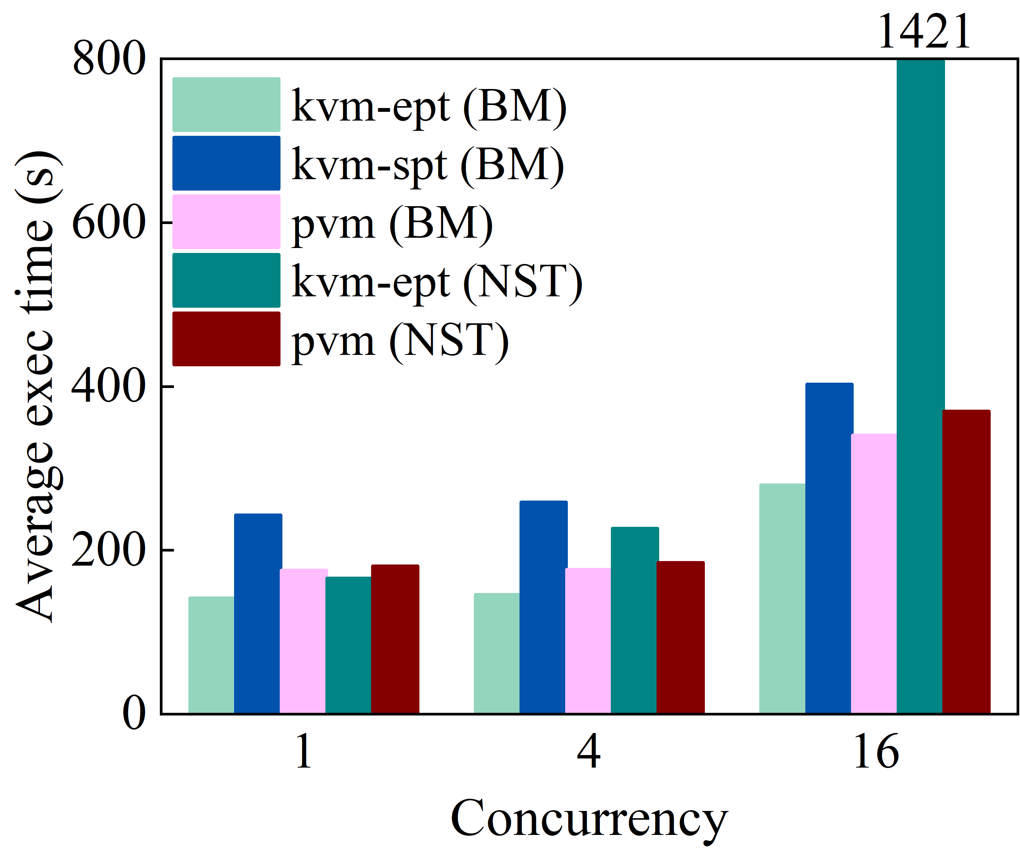
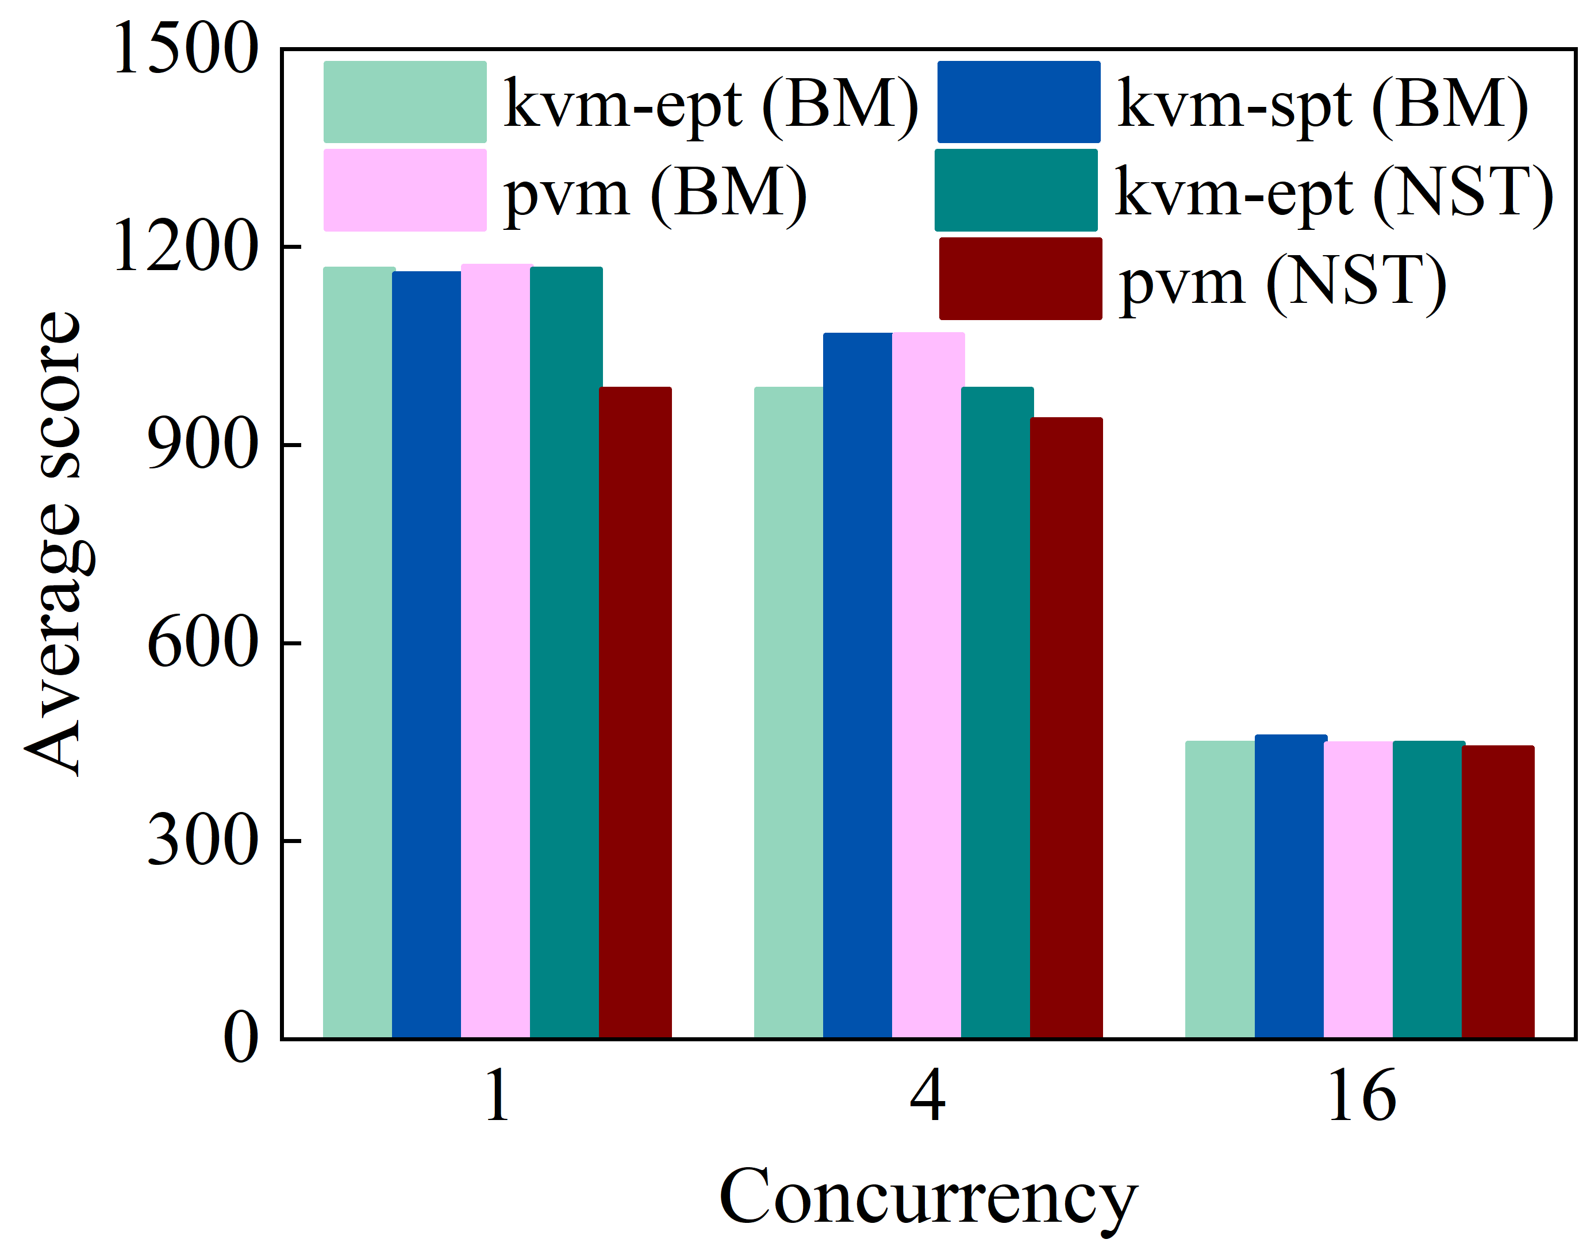
Evaluation: Results on Real-world Applications
Multiple instances run in separate secure containers
↓ 74%
Lower is better
Higher is better
Kbuild
Blogbench

Slide 32
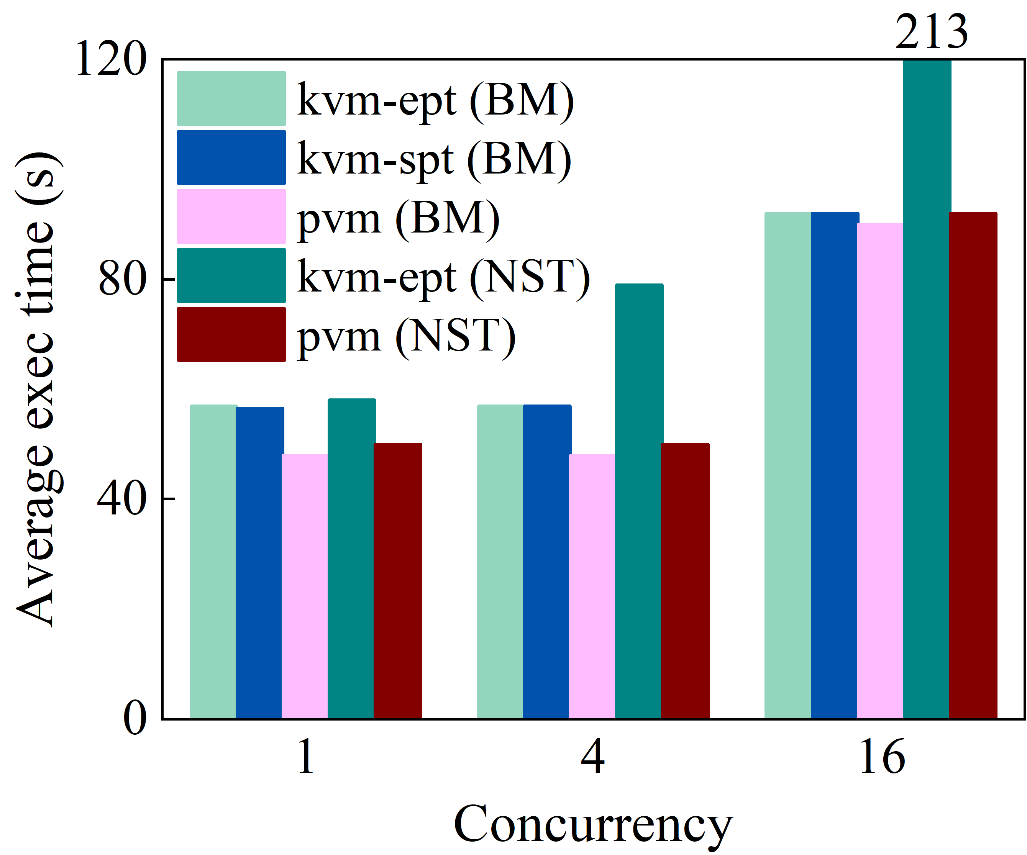
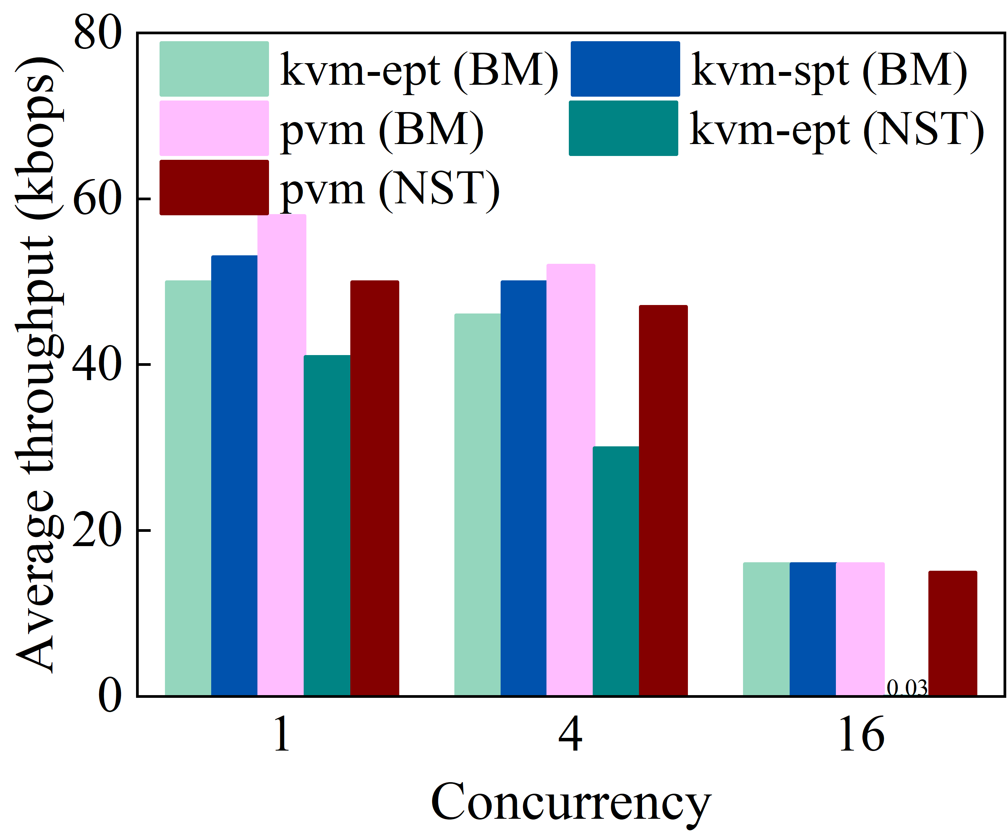
Evaluation: Results on Real-world Applications
Multiple instances run in separate secure containers
Higher is better
Lower is better
Specjbb2005
Fluidanimate

Slide 33
Evaluation configurations
Hardware
Server | ecs.ebmg6.26xlarge and ecs.g6.26xlarge
CPU | 2 x Intel Xeon Platinum CPUs (i.e., 26 cores at 2.50GHz and hyperthreading on)
RAM | 385 GB
Storage | 1 x 500 GB SATA SSD
Software
System | Anolis OS 7.9
Host/Guest kernel | 4.19.91
Runtime | Rund
Benchmarks | LMbench, PECjbb2005, Kbuild, Parsec 3.0, Cloud Bench Suit

Slide 34
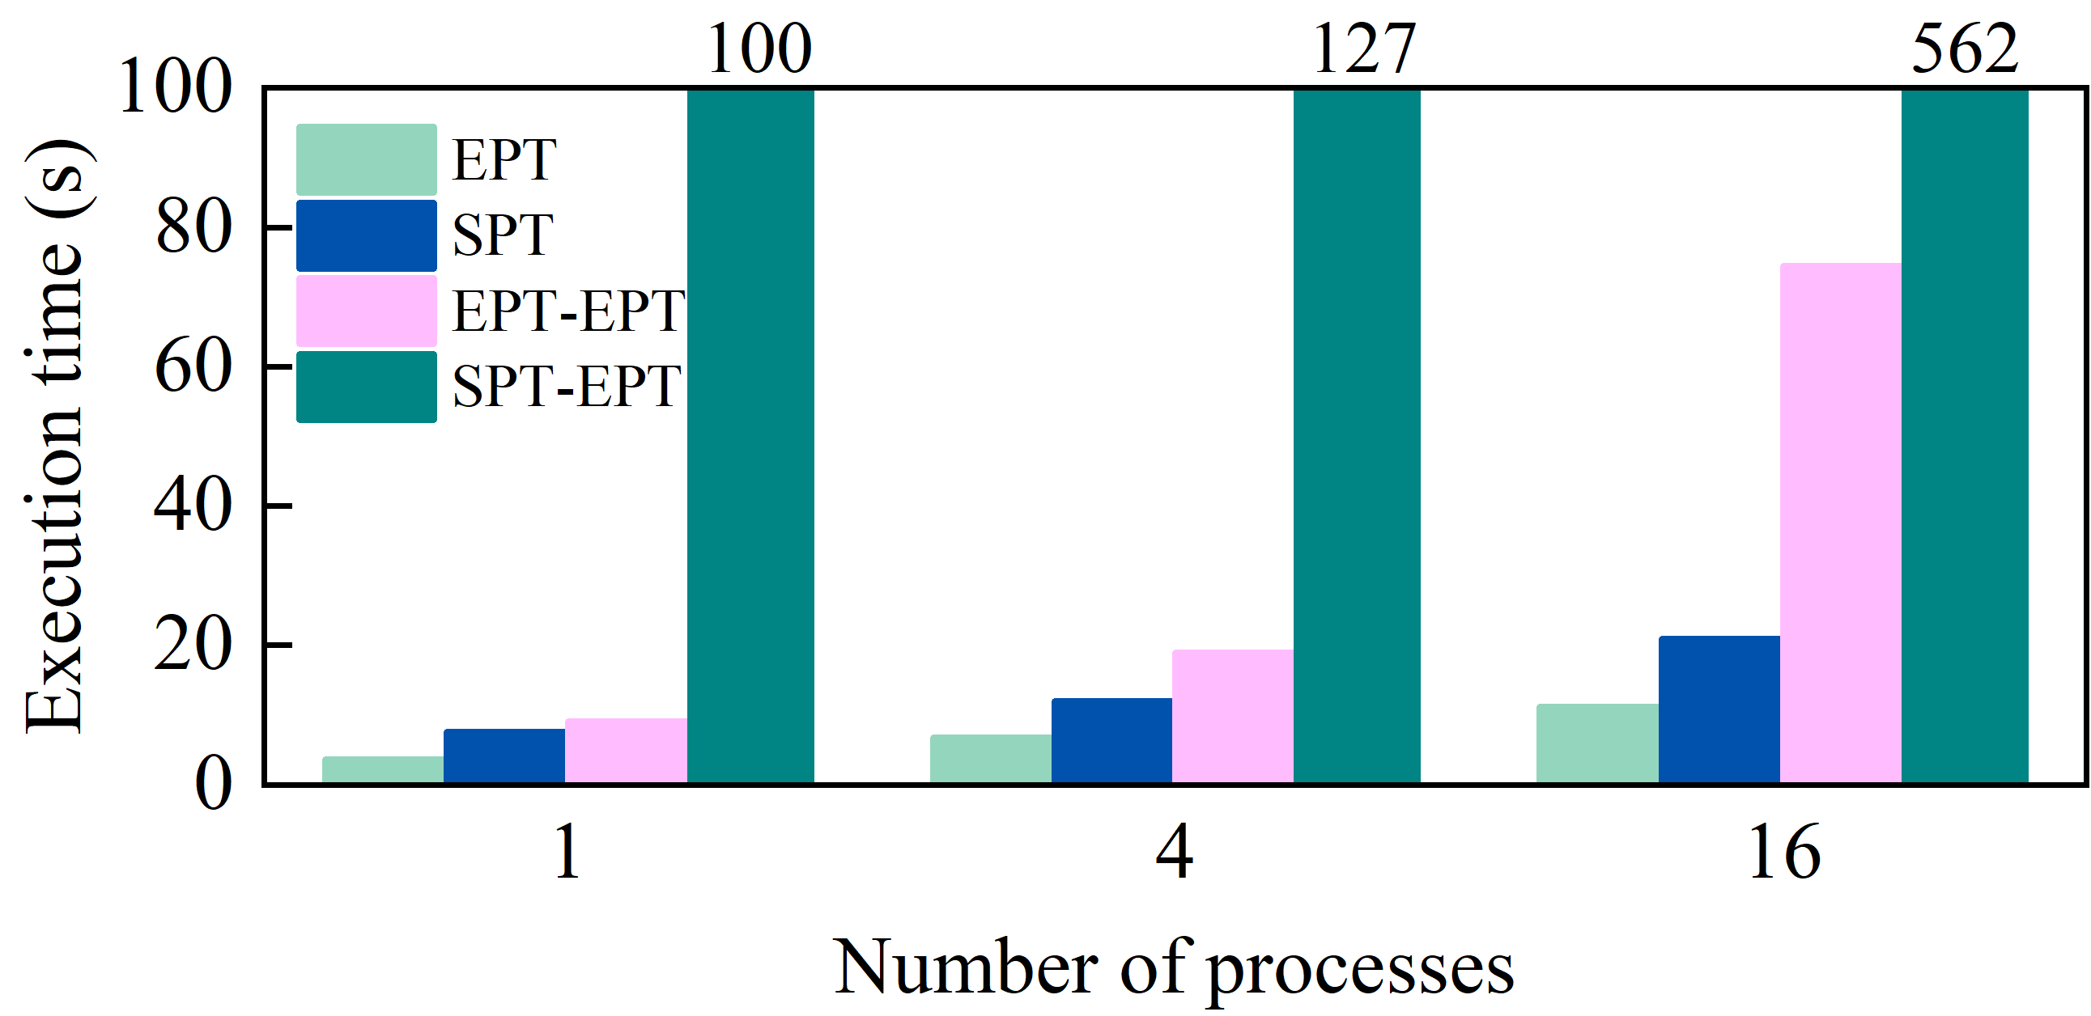
Performance Comparison: EPT-on-SPT vs EPT-on-EPT
The lower the better
EPT-on-EPT is more efficient in terms of fewer number of world switches and 𝐿0 traps
world switches in nested virtualization (1.3 μs) is an order of magnitude more expensive than those in single-level virtualization (0.105 μs)

