Slide 1
ECE 551
Digital Design And Synthesis
Fall ‘09
Counters are Common
Shifters/Rotators
Parameters
Proper SM Coding
Random Misc Stuff

Slide 2
Administrative Matters
Readings
  Cummings paramdesign paper for hdlcon (posted on class website)

Slide 3
What Have We Learned?
Sequential elements (flops & latches) should be inferred using non-blocking “<=“ assignments
Combinational logic should be inferred using blocking “=“ statements.
Blocking and non-Blocking statements should not be mixed in the same always block.
Plus 5 other guidelines of good coding outlined in the Cummings SNUG paper.

Slide 4
Engineers are paid to think, Pharmacists are paid to follow rules
Counters are commonly needed blocks.
rst_n
Increment logic & mux are combinational ➔ blocking
Flop is seqential. ➔ non-blocking
0
R
+1
comb
cnt[7:0]
1
en
clk
8-bit counter with reset & enable

Slide 5
Pill Counter
module pill_cnt(clk,rst_n,en,cnt);
input clk,rst_n;
output [7:0] cnt;
reg [7:0] nxt_cnt,cnt;
always @(posedge clk, negedge rst_n)
if (!rst_n)
cnt <= 8’h00;
else
cnt <= nxt_cnt;
always @(en or cnt)
if (en)
nxt_cnt = cnt + 1; // combinational
else
nxt_cnt = cnt; // so use blocking
endmodule
Nothing wrong with this code
Just a little verbose. Use DF?
module pill_cnt(clk,rst_n,en,cnt);
input clk,rst_n;
output [7:0] cnt;
reg [7:0] cnt;
wire [7:0] nxt_cnt;
always @(posedge clk, negedge rst_n)
if (!rst_n)
cnt <= 8’h00;
else
cnt <= nxt_cnt;
assign nxt_cnt (en) ? cnt+1 : cnt;
endmodule
Notes:
Verbose: dai dong

Slide 6
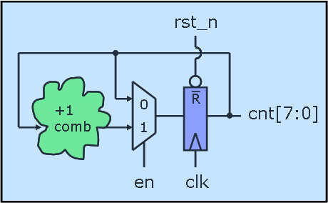
I.Q. Counter (the rebel engineer)
module iq_cnt(clk,rst_n,en,cnt);
input clk,rst_n;
output [7:0] cnt;
reg [7:0] cnt;
always @(posedge clk or negedge rst_n)
if (!rst_n)
cnt <= 8’h00;
else if (en)
cnt <= cnt + 1; // combinational
endmodule
What 2 rules are broken here?
Code infers combinational using a non-blocking assignment
We are using an if statement without a pure else clause
Is this OK?
Notes:
avoid using nonblocking assignments: simulation performance.
In Munkymorgy's example, after the always block triggers, you will evaluate the right-hand-side (RHS) of all of the equations, go back to the top of the always block, update the LHS of the equations, which will again trigger the always block, which will again force the simulator to evaluate the RHS of the equations, go to the top of the always block, then update the LHS of the equations. For larger blocks, this could cause multiple iterations through the always block, with the corresponding simulation penalty.
In your simple 1-line example, there is no internal simulation penalty, but there may be cross-assignment penalties elsewhere.

Slide 7
Ring Counter
module ring_counter (count, enable, clock, reset);
output reg [7: 0] count;
input enable, reset, clock;
always @ (posedge clock or posedge reset)
if (reset == 1'b1) count <= 8'b0000_0001;
else if (enable == 1’b1) begin
case (count)
8’b0000_0001: count <= 8’b0000_0010;
8’b0000_0010: count <= 8’b0000_0100;
…
8’b1000_0000: count <= 8’b0000_0001;
default: count <= 8’bxxxx_xxxx;
endcase
end
endmodule
What do you think of this code?

Slide 8
Ring Counter (a better way)
module ring_counter (count, enable, clock, reset_n);
output reg [7: 0] count;
input enable, reset, clock;
always @ (posedge clock or negedge reset_n)
if (!reset_n) count <= 8'b0000_0001;
else if (enable == 1'b1) count <= {count[6:0], count[7]};
endmodule
Use vector concatenation in this example to be more explicit about desired behavior/implementation
  More concise
  Does not rely on synthesis tool to be smart and reduce your logic for you.
Notes:
Them vi du, trang 227
Advanced digital design with the Verilog HDL

Slide 9
Rotator
module rotator (Data_out, Data_in, load, clk, rst_n);
output reg [7: 0] Data_out;
input [7: 0] Data_in;
input load, clk, rst_n;
always @ (posedge clk or negedge rst_n)
if (!rst_n) Data_out <= 8'b0;
else if (load) Data_out <= Data_in;
else if (en) Data_out <= {Data_out[6: 0], Data_out[7]};
else Data_out <= Data_out
endmodule
Think what this code implies…How will it synthesize?
What would such a block be used for?

Slide 10
Shifter
always @ (posedge clk) begin
if (rst) Data_Out <= 0;
else case (select[1:0])
2’b00: Data_Out <= Data_Out; // Hold
2’b01: Data_Out <= {Data_Out[3], Data_Out[3:1]}; // ÷ by 2
2’b10: Data_Out <= {Data_Out[2:0], 1’b0}; // X by 2
2’b11: Data_Out <= Data_In; // Parallel Load
endcase
end
endmodule
Think what this code implies…How will it synthesize?
Is the reset synchronous or asynchronous?
There is no default to the case, is this bad?
Why was the MSB replicated on the ÷ by 2

Slide 11
Aside (a quick intro to parameters)
parameter ➔ like a local `define
  Defined locally to the module
  Can be overridden (passed a value in an instantiation)
  There is another method called defparam (don’t ever use it) that can override them
localparam ➔ even more local than parameter
  Can’t be passed a value
  defparam does not modify
  Only available in Verilog 2001

Slide 12
Aside (a quick intro to parameters)
module adder(a,b,cin,sum,cout);
parameter WIDTH = 8; // default is 8
input [WIDTH-1:0] a,b;
input cin;
output [WIDTH-1:0] sum;
output cout;
assign {cout,sum} = a + b + cin
endmodule
module alu(src1,src2,dst,cin,cout);
input [15:0] src1,src2;
…
//////////////////////////////////
// Instantiate 16-bit adder //
////////////////////////////////
adder #(16) add1(.a(src1),.b(src2),
.cin(cin),.cout(cout),
.sum(dst));
…
endmodule
Instantiation of module can override a parameter.

Slide 13
Aside (a quick intro to parameters)
Examples:
parameter Clk2q = 1.5,
Tsu = 1,
Thd = 0;
parameter IDLE = 2’b00;
parameter CONV = 2’b01;
parameter ACCM = 2’b10;
module register2001 #(parameter SIZE=8)
(output reg [SIZE-1:0] q, input [SIZE-1:0] d,
input clk, rst_n);
always @(posedge clk, negedge rst_n)
if (!rst_n) q <= 0;
else q <= d;
endmodule
Read Cummings
paramdesign paper for hdlcon posted on class website
Verilog 2001 allows definition in module header

Slide 14
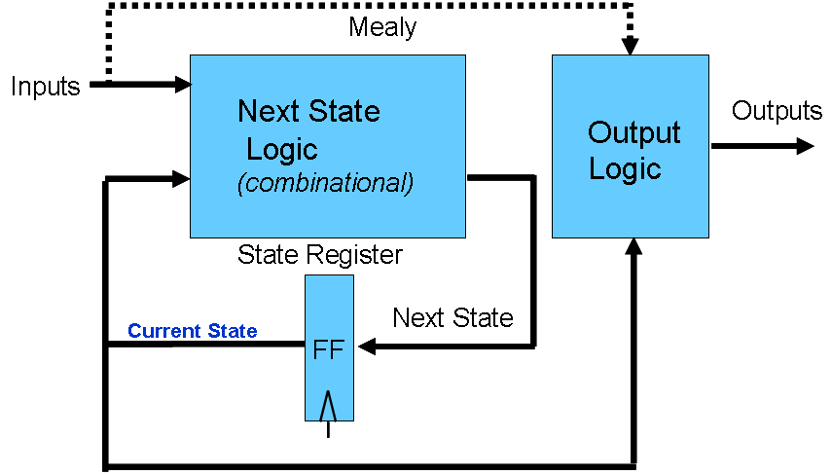
State Machines
State Machines:
Next State and output logic are combinational blocks, which have outputs dependent on the current state.
The current state is, of course, stored by a FF.
What is the best way to code State Machines?:
  Best to separate combinational (blocking) from sequential (non-blocking)
  Output logic and state transition logic can be coded in same always block since they have the same inputs
  Output logic and state transition logic are ideally suited for a case statement

Slide 15
State Diagrams
b=0 / Y=1
a=0 / Y=1
a=1 / Y=1
Inputs, a and b are 0,
unless specified otherwise
Outputs Y and Z are 0,
unless specified otherwise.
Is this Mealy or Moore?
a = 0
S0
a = 1/
Z = 1
S1
rst = 1
b = 1/ Z = 1, Y=1
S2
Lets code this

Slide 16
SM Coding
always @ (state,a,b)
case (state)
S0 : if (a) begin
nxt_state = S1;
Z = 1; end
else
nxt_state = S0;
S1 : begin
Y=1;
if (b) begin
nxt_state = S2;
Z=1; end
else
nxt_state = S1;
end
S2 : nxt_state = S0;
endcase
endmodule
module fsm(clk,rst,a,b,Y,Z);
input clk,rst,a,b;
output Y,Z;
parameter S0 = 2’b00,
S1 = 2’b01,
S2 = 2’b10;
reg [1:0] state,nxt_state;
always @(posedge clk, posedge rst)
if (rst)
state <= S0;
else
state <= nxt_state;
What problems do
we have here?

Slide 17
SM Coding (2nd try of combinational)
always @ (state,a,b)
nxt_state = S0; // default to reset
Z = 0; // default outputs
Y = 0; // to avoid latches
case (state)
S0 : if (a) begin
nxt_state = S1;
Z = 1;
end
S1 : begin
Y=1;
if (b) begin
nxt_state = S2;
Z=1; end
else nxt_state = S1;
end
default : nxt_state = S0;
endcase
endmodule
Defaulting of assignments and having a default
to the case is highly recommended!

Slide 18
SM Coding Guidlines
Keep state assignment in separate always block using non-blocking “<=“ assignment
Code state transition logic and output logic together in a always block using blocking assignments
Assign default values to all outputs, and the nxt_state registers. This helps avoid unintended latches
Remember to have a default to the case statement.
  Default should be (if possible) a state that transitions to the same state as reset would take the SM to.
  Avoids latches
  Makes design more robust to spurious electrical/cosmic events.

Slide 19
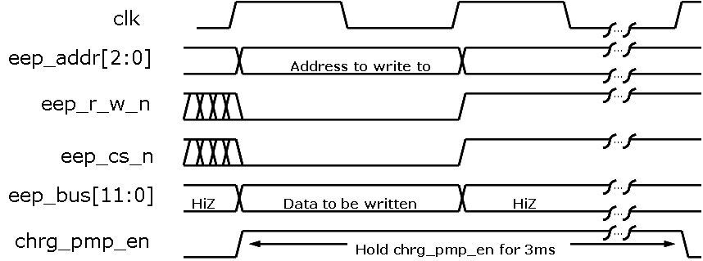
SM Interacting with SM
A very common case is a state that needs to be held for a certain time.
  The state machine in this case may interact with a timer (counter).
BUS
Cycle
wr_eep
--/clr_tm
ChrgPmp
Enable
IDLE
clr_tm
por_n
tm_eq_3ms/
wrt_done
R
tm_eq_3ms
+1
comb
0
tm_eq_3ms/inc_tm
1
Multiple levels of interaction between SM’s
inc_tm
clk

Slide 20
EEPROM Write SM Example [1]
module eeprom_sm(clk,por_n,wrt_eep,
wrt_data,eep_r_w_n,eep_cs_n,
eep_bus,chrg_pmp_en,wrt_done);
parameter IDLE = 2’b00,
BUS = 2’b01,
CHRG = 2’b10;
input clk,por_n,wrt_eep;
input [11:0] wrt_data; // data to write
output eep_r_w_n,eep_cs_n;
output chrg_pmp_en; // hold for 3ms
inout [11:0] eep_bus;
reg [13:0] tm; // 3ms => 14-bit timer
reg clr_tm,inc_tm,bus_wrt;
reg [1:0] state,nxtState;
//// implement 3ms timer below ////
always @(posedge clk or
posedge clr_tm)
if (clr_tm) tm <= 14’h0000;
else if (inc_tm) tm <= tm+1;
//// @4MHZ cnt of 2EE0 => 3ms ////
assign tm_eq_3ms = (tm==14’h2EE0) ?
1’b1 : 1’b0;
//// implement state register below ////
always @(posedge clk or
negedge por_n)
if (!rst_n) state <= IDLE;
else state <= nxtState;
Notes:
2EE0= 2 16³ + 14 16² + 14 16= 8192 + 3584 + 224 = 12000
1200 x 1/ 4 M = 3ms

Slide 21
EEPROM Write SM Example [2]
//// state transition logic & ////
//// output logic ////
always @(state,wrt_eep,tm_eq_3ms)
begin
nxtState = IDLE; // default all
bus_wrt = 0; // to avoid
clr_tm = 0; // unintended
inc_tm = 0; // latches
chrg_pmp_en = 0;
case (state)
IDLE : if (wrt_eep)
nxtState = BUS;
BUS : begin
clr_tm = 1;
bus_wrt = 1;
nxtState = CHRG;
end
default : begin // is CHRG
inc_tm = 1;
chrg_pmp_en=1;
if (tm_eq_3ms)
begin
wrt_done = 1;
nxtState = IDLE;
end
else nxtState = CHRG;
end
endcase
end
assign eep_r_w_n = ~bus_wrt;
assign eep_cs_n = ~bus_wrt;
assign eep_bus = (bus_wrt) ?
wrt_data : 12’bzzz;
endmodule
Are there optimizations
that can be made?

Slide 22
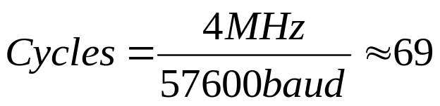
USART (RS232) Example
LSB
MSB
Start
Bit
(fixed period low)
(like 57600 baud)
Payload goes out
little endian
must have at least 1 period of high at end
(stop bit)
Assume we have a 4MHz clock running our digital system
We want to make a RS232 transmitter with a baud rate of 57,600
How many clock cycles do we hold each bit?
69 = 7’b1000101

Slide 23
USART Example
module usart_tx(clk,rst_n,strt_tx,tx_data,tx_done,TX);
input clk, rst_n, strt_tx; // start_tx comes from Master SM
input [7:0] tx_data; // data to transmit
output TX; // TX is the serial line
output tx_done; // tx_done asserted back to Master SM
.
.
.
endmodule;
Go over HW3 problem statement

Slide 24
Random Misc Topics
Next slides are a bunch of stuff I wasn’t sure
where to put, but seemed like good information.

Slide 25
Mux With case
module Mux_4_32_(output [31:0] mux_out, input [31:0] data_3, data_2, data_1, data_0, input [1:0] select, input enable);
reg [31: 0] mux_int;
// choose between the four inputs
always @ ( data_3 or data_2 or data_1 or data_0 or select)
case (select) (* synthesis parallel_case *)
2’b00: mux_int = data_0;
2’b01: mux_int = data_1;
2’b10: mux_int = data_2;
2’b11: mux_int = data_3;
endcase
// add the enable functionality
assign mux_out = enable ? mux_int : 32'bz;
endmodule
Case statement implies priority unless use parallel_case pragma
Synthesis directive:
Lets the synthesis tool know to use parallel (mux) scheme when synthesizing instead of
priority encoding. Called an attribute in the IEEE spec

Slide 26
Encoder With case
module encoder (output reg [2:0] Code, input [7:0] Data);
always @ (Data)
// encode the data
case (Data)
8'b00000001 : Code = 3’d0;
8'b00000010 : Code = 3’d1;
8'b00000100 : Code = 3’d2;
8'b00001000 : Code = 3’d3;
8'b00010000 : Code = 3’d4;
8'b00100000 : Code = 3’d5;
8'b01000000 : Code = 3’d6;
8'b10000000 : Code = 3’d7;
default : Code = 3‘bxxx; // invalid, so don’t care
endcase
endmodule
How do we think it will
synthesize?

Slide 27
Priority Encoder With casex
module priority_encoder (output reg [2:0] Code, output valid_data,
input [7:0] Data);
assign valid_data = |Data; // "reduction or" operator
always @ (Data)
// encode the data
casex (Data)
8'b1xxxxxxx : Code = 7;
8'b01xxxxxx : Code = 6;
8'b001xxxxx : Code = 5;
8'b0001xxxx : Code = 4;
8'b00001xxx : Code = 3;
8'b000001xx : Code = 2;
8'b0000001x : Code = 1;
8'b00000001 : Code = 0;
default : Code = 3'bxxx; // should be at least one 1, don’t care
endcase
endmodule

Slide 28
Seven Segment Display
module Seven_Seg_Display (Display, BCD, Blanking);
output reg [6: 0] Display; // abc_defg
input [3: 0] BCD;
input Blanking;
parameter BLANK = 7'b111_1111; // active low
parameter ZERO = 7'b000_0001; // h01
parameter ONE = 7'b100_1111; // h4f
parameter TWO = 7'b001_0010; // h12
parameter THREE = 7'b000_0110; // h06
parameter FOUR = 7'b100_1100; // h4c
parameter FIVE = 7'b010_0100; // h24
parameter SIX = 7'b010_0000; // h20
parameter SEVEN = 7'b000_1111; // h0f
parameter EIGHT = 7'b000_0000; // h00
parameter NINE = 7'b000_0100; // h04
a
f
b
g
e
c
d
Defined constants – can make code more understandable!

Slide 29
Seven Segment Display [2]
always @ (BCD or Blanking)
if (Blanking) Display = BLANK;
else
case (BCD)
4’d0: Display = ZERO;
4’d1: Display = ONE;
4’d2: Display = TWO;
4’d3: Display = THREE;
4’d4: Display = FOUR;
4’d5: Display = FIVE;
4’d6: Display = SIX;
4’d7: Display = SEVEN;
4’d8: Display = EIGHT;
4’d9: Display = NINE;
default: Display = BLANK;
endcase
endmodule
Using the defined constants!

Slide 30
Inter vs Intra Statement Delays
Inter-assignment delays block both evaluation and assignment
  #4 c = d;
  #8 e = f;
Intra-assignment delays block assignment but not evaluation
  c = #4 d;
  e = #8 f;
Blocking statement is still blocking though, so evaluation of next statements RHS still does not occur until after the assignment of the previous expression LHS.
  What?? How is it any different then? Your confusing me!

Slide 31
Inter vs Intra Statement Delays (Blocking Statements)
module inter();
integer a,b;
initial begin
a=3;
#6 b = a + a;
#4 a = b + a;
end
endmodule
module intra();
integer a,b;
initial begin
a=3;
b = #6 a + a;
a = #4 b + a;
end
endmodule
Compare these two
modules
Yaa, Like I said, they
are the same!
Or are they?
Time | Event
0 | a=3
6 | b=6
10 | a=9
Time | Event
0 | a=3
6 | b=6
10 | a=9

Slide 32
Intra Statement Delays (Blocking Statements)
module inter2();
integer a,b;
initial begin
a=3;
#6 b = a + a;
#4 a = b + a;
end
initial begin
#3 a=1;
#5 b=3;
end
endmodule
module inter2();
integer a,b;
initial begin
a=3;
b = #6 a + a;
a = #4 b + a;
end
initial begin
#3 a=1;
#5 b=3;
end
endmodule
Time | Event
0 | a=3
3 | a=1
6 | b=2
8 | b=3
10 | a=4
Time | Eval Event | Assign Event
0 | nxt_b= 6 | a=3
3 | -- | a=1
6 | nxt_a=7 | b=6
8 | -- | b=3
10 | -- | a=7

Slide 33
Non-Blocking: Inter-Assignment Delay
Delays both the evaluation and the update
always @(posedge clk) begin
b <= a + a;
# 5 c <= b + a;
# 2 d <= c + a;
end
initial begin
a = 3; b = 2; c = 1;
end
Time | Event
0 | clk pos edge
0 | b=6
5 | c=9
7 | c=12

Slide 34
Non-Blocking: Inter-Assignment Delay
Delays both the evaluation and the update
always @(posedge clk) begin
b <= a + a;
c <= #5 b + a;
d <= #2 c + a;
end
initial begin
a = 3; b = 2; c = 1;
end
Time | Event
0 | clk pos edge
0 | b=6
2 | d=4
5 | c=5
This is more like modeling the Clk2Q delay of a Flop
(it captures on rising edge, but has a delay till output)

Slide 35
Intra-Assignment Review
module bnb;
reg a, b, c, d, e, f;
initial begin // blocking assignments
a = #10 1; // a will be assigned 1 at time 10
b = #2 0; // b will be assigned 0 at time 12
c = #4 1; // c will be assigned 1 at time 16
end
Note: In testbenches I mainly find blocking inter- assignment delays to be the most useful. Delays really not used outside of testbenches that much during the design process.
initial begin // non-blocking assignments
d <= #10 1; // d will be assigned 1 at time 10
e <= #2 0; // e will be assigned 0 at time 2
f <= #4 1; // f will be assigned 1 at time 4
end
endmodule

