Slide 1
ECE 551
Digital Design And Synthesis
Fall ‘09
For Loops & Synthesis
Generate Statements
Use of X in Synthesis
Synthesis Pitfalls
Coding for Synthesis

Slide 2
Administrative Matters
HW4 Due
HW5 Assigned (Due Friday, 11/13)
  Synthesize A2D with script (individual)
  Simulate gate level A2D (individual)
  Code PWM peripheral (as team)

Slide 3
For Loops & Synthesis
Can a For Loop be synthesized?
  Yes, if it is fixed length
  The loop is “unrolled”
reg [15:0] countmem [0:7];
integer x;
always @(posedge clk) begin
for (x = 0; x < 8; x = x + 1) begin
countmem[x] <= countmem[x] +1;
end
end
How do you think this code would synthesize?

Slide 4
For Loops & Synthesis
+1
+1
+1
…
16
16
16
clk
clk
clk
16
16
16
countmem[0]
countmem[1]
countmem[7]
These loops are unrolled when synthesized
  That’s why they must be fixed in length!
  Loop index is type integer but it is not actually synthesized
  Example creates eight 16-bit incrementers.
What if loop upper limit was a parameter?

Slide 5
Unnecessary Calculations
Expressions that are fixed in a for loop are replicated due to “loop unrolling.”
Solution: Move fixed (unchanging) expressions outside of all loops.
for (x = 0; x < 8; x = x + 1) begin
for (y = 0; y < 8; y = y + 1) begin
index = x*8 + y;
value = (a + b)*c;
mem[index] = value;
end
end
This is just basic common sense, and applies to any language (in a programming language you would be wasting time, not hardware).
Yet this is a common mistake
Which expressions should be moved?

Slide 6
More on Loops & Synthesis
A loop is static (data-independent) if the number of iterations is fixed at compile-time
Loop Types
  Static without internal timing control
    Combinational logic
  Static with internal timing control (i.e. @(posedge clk))
    Sequential logic
  Non-static without internal timing control
    Not synthesizable
  Non-static with internal timing control (i.e. @(posedge clk))
    Sometimes synthesizable, Sequential logic

Slide 7
Static Loops w/o Internal Timing
Combinational logic results from “loop unrolling”
Example
  always@(a) begin
  andval[0] = 1;
  for (i = 0; i < 4; i = i + 1)
  andval[i + 1] = andval[i] & a[i];
  end
What would this look like?
For registered outputs:
  Change sensitivity list ‘a’ with ‘posedge clk’

Slide 8
Static Loops with Internal Timing
If a static loop contains an internal edge-sensitive event control expression, then activity distributed over multiple cycles of the clock
  always begin
  for (i = 0; i < 4; i = i + 1)
  @(posedge clk) sum <= sum + i;
  end
What does this loop do?
Does it synthesize?...Yes, but…

Slide 9
Non-Static Loops w/o Internal Timing
Number of iterations is variable
  Not known at compile time
Can be simulated, but not synthesized!
Essentially an iterative combinational circuit of data dependent size!
always@(a, n) begin
andval[0] = 1;
  for (i = 0; i < n; i = i +1)
  andval[i + 1] = andval[i] & a[i];
  end
What if n is a parameter?

Slide 10
Non-Static Loops with Internal Timing
Number of iterations determined by
  Variable modified within the loop
  Variable that can’t be determined at compile time
Due to internal timing control—
  Distributed over multiple cycles
  Number of cycles determined by variable above
Variable must still be bounded
always begin
continue = 1’b1;
  for (; continue; ) begin
  @(posedge clk) sum = sum + in;
  if (sum > 8’d42) continue = 1’b0;
  end
end
Can this be synthesized?
What does it synthesize to?
Who really cares!
This is a stupid way to do it!
Use a SM.

Slide 11
Any loop with internal timing can be done as a SM
Previous example didn’t really even require a SM.
This code leaves no question how it would synthesize.
module sum_till (clk,rst_n,sum,in);
input clk,rst_n;
input [5:0] in;
output [5:0] sum;
always @(posedge clk or negedge rst_n)
if (~rst_n)
sum <= 6’h00;
else if (en_sum)
sum <= sum + in
assign en_sum = (sum<6’d43) ? 1’b1 : 1’b0;
endmodule
RULE OF THUMB:
If it takes you more than 15 seconds to conceptualize how a piece of code will synthesize, then it will probably confuse Synopsys too.

Slide 12
FSM Replacement for Loops
Not all loop structures supported by vendors
Can always implement a loop with internal timing using an FSM
  Can make a “while” loop easily
  Often use counters along with the FSM
All synthesizers support FSMs!
Synopsys supports for-loops with a static number of iterations
condition
condition
State3

Slide 13
Generated Instantiation
Generate statements ➔ control over the instantiation/creation of:
    Modules
    UDPs & gate primitives
    continuous assignments
    initial blocks & always blocks
Generate instantiations resolved during “elaboration” (compile time)
    When module instantiations are linked to module definitions
    Before the design is simulated or synthesized – this is NOT dynamically created hardware
Notes:
for compile time, usually check design syntax, for elaboration time, compiled code (took place during compilation phase) will be converted to machine understandable format, for run time, usually run simulation!
convenient when the same operation or module instance is repeated for multiple bits of a vector, or when certain Verilog code is
conditionally included based on parameter definitions

Slide 14
Generate-Loop
A generate-loop permits making one or more instantiations (pre-synthesis) using a for-loop.
module gray2bin1 (bin, gray);
parameter SIZE = 8; // this module is parameterizable
output [SIZE-1:0] bin; input [SIZE-1:0] gray;
genvar i;
generate
for (i=0; i<SIZE; i=i+1) begin: bit
assign bin[i] = ^gray[SIZE-1:i]; \\ Data Flow replication
end
endgenerate
endmodule
Does not exist during simulation of design
Typically name the generate as reference

Slide 15
Generate Loop
Is really just a code replication method. So it can be used with any style of coding. Gets expanded prior to simulation.
module replication_struct(i0, i1, out);
parameter N=32;
input [N-1:0] i1,i0;
output [N-1:0] out;
genvar j;
generate
for (j=0; j<N; j=j+1)
begin : xor_loop
xor g1 (out[j],in0[j],in1[j]);
end
endgenerate
endmodule
Hierarchical reference to these instantiated gates will be:
…xor_loop[0].g1
…xor_loop[1].g1
.
.
.
…xor_loop[31].g1
Structural replication

Slide 16
Generate-Conditional
A generate-conditional allows conditional (pre-synthesis) instantiation using if-else-if constructs
module multiplier(a ,b ,product);
parameter a_width = 8, b_width = 8;
localparam product_width = a_width+b_width;
input [a_width-1:0] a; input [b_width-1:0] b;
output [product_width-1:0] product;
generate
if ((a_width < 8) || (b_width < 8))
CLA_multiplier #(a_width,b_width) u1(a, b, product);
else
WALLACE_multiplier #(a_width,b_width) u1(a, b, product);
endgenerate
endmodule
These are parameters, not variables!

Slide 17
Generate-Case
A generate-case allows conditional (pre-synthesis) instantiation using case constructs
See Standard 12.1.3 for more details
module adder (output co, sum, input a, b, ci);
parameter WIDTH = 8;
generate
case (WIDTH)
1: adder_1bit x1(co, sum, a, b, ci); // 1-bit adder implementation
2: adder_2bit x1(co, sum, a, b, ci); // 2-bit adder implementation
default: adder_cla #(WIDTH) x1(co, sum, a, b, ci);
endcase
endgenerate
endmodule
Of course case selector has to be deterministic at elaborate time, can not be a variable. Usually a parameter.

Slide 18
Synthesis Of x And z
Only allowable uses of x is as “don’t care”, since x cannot actually exist in hardware
  in casex
  in defaults of conditionals such as :
    The else clause of an if statement
    The default selection of a case statement
Only allowable use of z:
  Constructs implying a 3-state output
    Of course it is helpful if your library supports this!

Slide 19
Don’t Cares
x, ?, or z within case item expression in casex
  Does not actually output “don’t cares”!
  Values for which input comparison to be ignored
  Simplifies the case selection logic for the synthesis tool
casex (state)
3’b0??: out = 1’b1;
3’b10?: out = 1’b0;
3’b11?: out = 1’b1;
endcase
state[1:0]
00
01
11
10
state[2]
0
1 | 1 | 1 | 1
0 | 0 | 1 | 1
1
out = state[0] + state[1]

Slide 20
Use of Don’t Care in Outputs
Can really reduce area
case (state)
3’b001: out = 1’b1;
3’b100: out = 1’b0;
3’b110: out = 1’b1;
default: out = 1’b0;
endcase
state[1:0]
00
01
11
10
state[2]
0
0 | 1 | 0 | 0
0 | 0 | 0 | 1
1
case (state)
3’b001: out = 1’b1;
3’b100: out = 1’b0;
3’b110: out = 1’b1;
default: out = 1’bx;
endcase
state[1:0]
00
01
11
10
state[2]
0
x | 1 | x | x
0 | x | x | 1
1

Slide 21
Unintentional Latches
Avoid structural feedback in continuous assignments, combinational always
  assign z = a | y;
a
z
y
  assign y = b | z;
b
Avoid incomplete sensitivity lists in combinational always
For conditional assignments, either:
  Set default values before statement
  Make sure LHS has value in every branch/condition
For warning, set hdlin_check_no_latch true before compiling

Slide 22
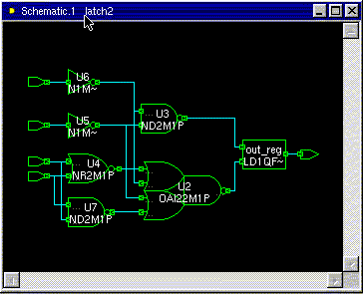
Synthesis Example [1]
module Hmmm(input a, b, c, d, output reg out);
always @(a, b, c, d) begin
if (a) out = c | d;
else if (b) out = c & d;
end
endmodule
a|b enables latch
How will this synthesize?
Area = 44.02
Either c|d or c&d are passed through an inverting mux depending on state of a / b

Slide 23
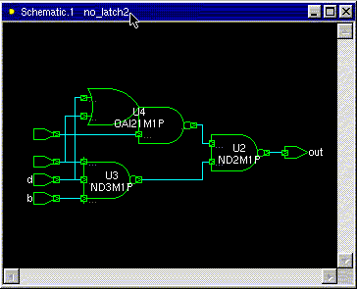
Synthesis Example [2]
module Better(input a, b, c, d, output reg out);
always @(a, b, c, d) begin
if (a) out = c | d;
else if (b) out = c & d;
else out = 1’b0;
end
endmodule
Perhaps what you meant was that if not a or b then out should be zero??
Area = 16.08
Does synthesize better…no latch!

Slide 24
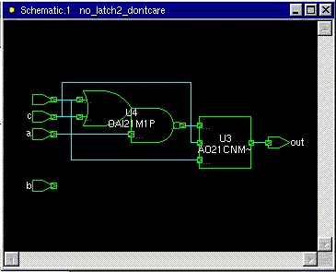
Synthesis Example [3]
module BetterYet(input a, b, c, d, output reg out);
always @(a, b, c, d) begin
if (a) out = c | d;
else if (b) out = c & d;
else out = 1’bx;
end
endmodule
Area = 12.99
But perhaps what you meant was if neiter a nor b then you really don’t care what out is.
Hey!, Why is b not used?

Slide 25
Gated Clocks
Use only if necessary (e.g., for low-power)
  Becoming more necessary with demand for many low power products
This clock arrives later than the system clock it was derived from. We just created a min-delay problem. (race condition) (shoot through)
clk
clk_en
Min_delay_slack = clk2q – T_{Hold} – Skew_Between_clks

Slide 26
Gated Clocks
Gated clock domains can’t be treated lightly:
1.) Skew between domains
2.) Loading of each domain. How much capacitance is on it? What is its rise/fall times
3,) RC in route. Is it routed in APR like any old signal, or does it have priority?
Clocks are not signals…don’t treat them as if they were.
1.) Use clock tree synthesis (CTS) within the APR tool to balance clock network (usually the job of a trained APR expert)
2.) Paranoid control freaks (like me) like to generate the gated domains in custom logic (like clock reset unit). Then let CTS do a balanced distribution in the APR tool.
Our guest lecturer will cover some of this material….

Slide 27
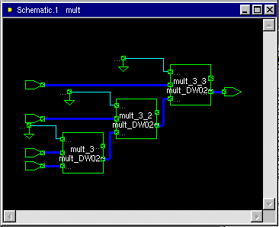
Chain Multiplier
module mult(output reg [31:0] out,
input [31:0] a, b, c, d);
always@(*) begin
out = ((a * b) * c) * d;
end
endmodule
Area: 47381
Delay: 8.37

Slide 28
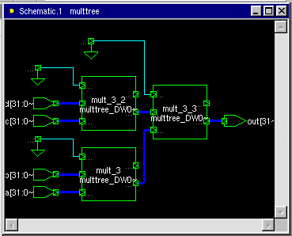
Tree Multiplier
module multtree(output reg [31:0] out,
input [31:0] a, b, c, d);
always@(*) begin
out = (a * b) * (c * d);
end
endmodule
Area: 47590
Delay: 5.75 vs 8.37

Slide 29
Multi-Cycle Shared Multiplier
module multshare(output reg [31:0] out,
input [31:0] in, input clk, rst);
reg [31:0] multval;
reg [1:0] cycle;
always @(posedge clk) begin
if (rst) cycle <= 0;
else cycle <= cycle + 1;
out <= multval;
end
always @(*) begin
if (cycle == 2'b0) multval = in;
else multval = in * out;
end
endmodule

Slide 30
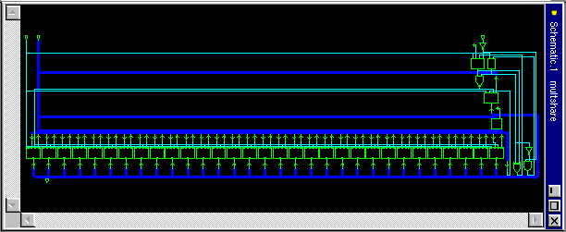
Multi-Cycle Shared Multiplier (results)
Area: 15990 vs 47500
Delay: 4*3.14
4 clocks, minimum period 3.14

Slide 31
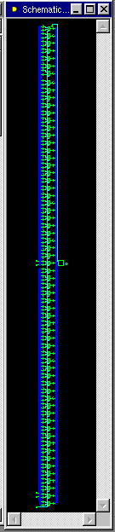
Shared Conditional Multiplier
module multcond1(output reg [31:0] out,
input [31:0] a, b, c, d, input sel);
always @(*) begin
if (sel) out = a * b;
else out = c * d;
end
endmodule
Mutually exclusive use of the multiply
Area: 15565
Delay: 3.14

Slide 32
Selected Conditional Multiplier [1]
module multcond2(output reg [31:0] out,
input [31:0] a, b, c, d, input sel);
wire [31:0] m1, m2;
assign m1 = a * b;
assign m2 = c * d;
always @(*) begin
if (sel) out = m1;
else out = m2;
end
endmodule

Slide 33
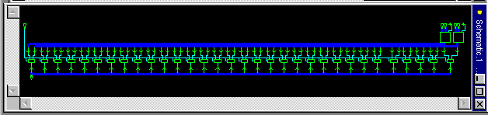
Selected Conditional Multiplier [1]
Area: 30764 vs. 15565
Delay: 3.02 vs. 3.14
Why is the area larger and delay lower?

Slide 34
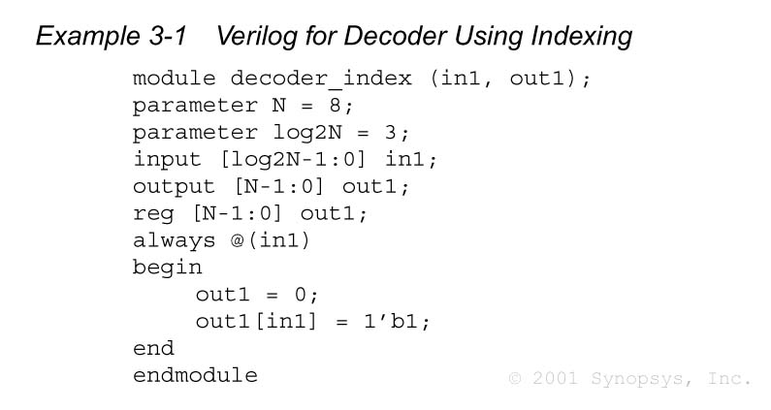
Decoder Using Indexing
What does synthesis do?
Think of Karnaugh Map

Slide 35
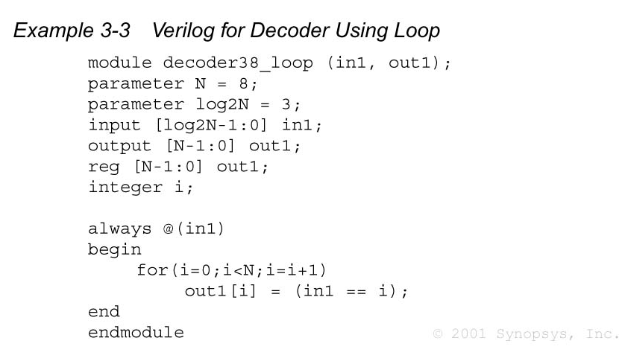
Decoder Using Loop
For this implementation how are we directing synthesis to think?
Assign each bit to digital comparator result

Slide 36
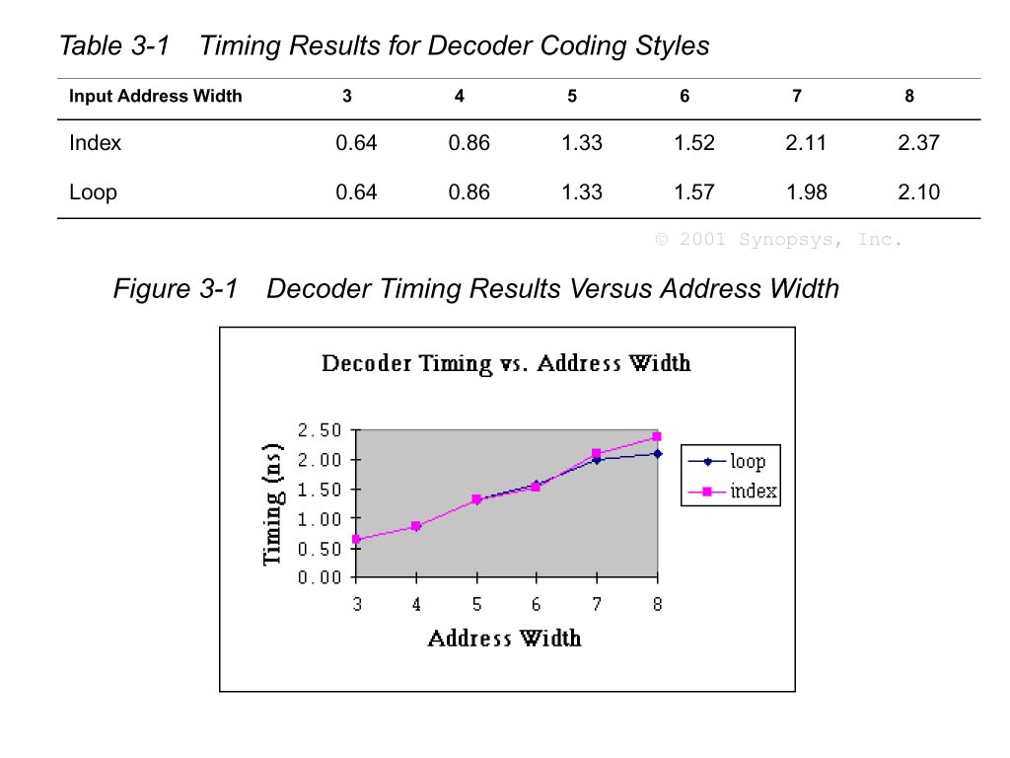
Decoder Verilog: Timing Comparison
Loop method
Starts to look advantageous

Slide 37
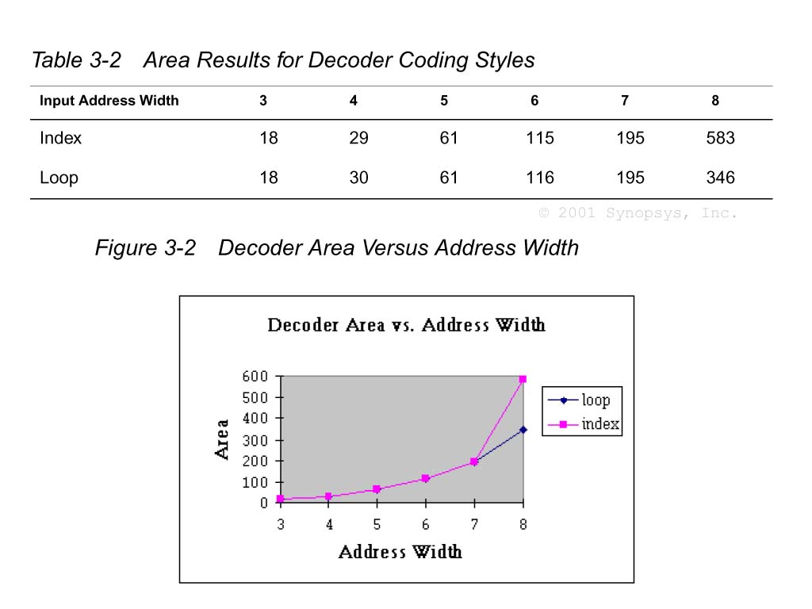
Decoder Verilog: Area Comparison
Loop method
Starts to look advantageous

Slide 38
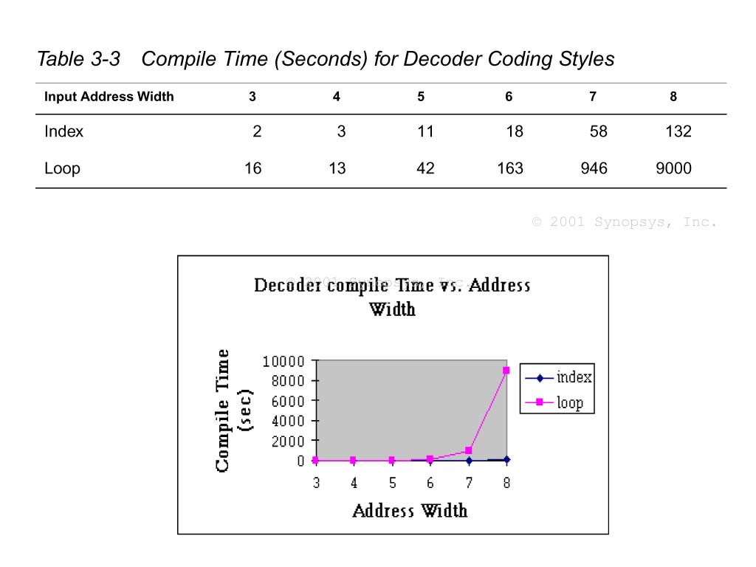
Decoder Verilog: Compile Time Comparison
Holy Mackerel Batman!
What is synthesis doing?
Why is it working so long and hard?
Looking for shared terms

Slide 39
Late-Arriving Signals
After synthesis, we will identify the critical path(s) that are limiting the overall circuit speed.
It is often that one signal to a datapath block is late arriving.
This signal causes the critical path…how to mitigate?:
  Circuit reorganization
    Rewrite the code to restructure the circuit in a way that minimizes the delay with respect to the late arriving signal
  Logic duplication
    This is the classic speed-area trade-off. By duplicating logic, we can move signal dependencies ahead in the logic chain.

Slide 40
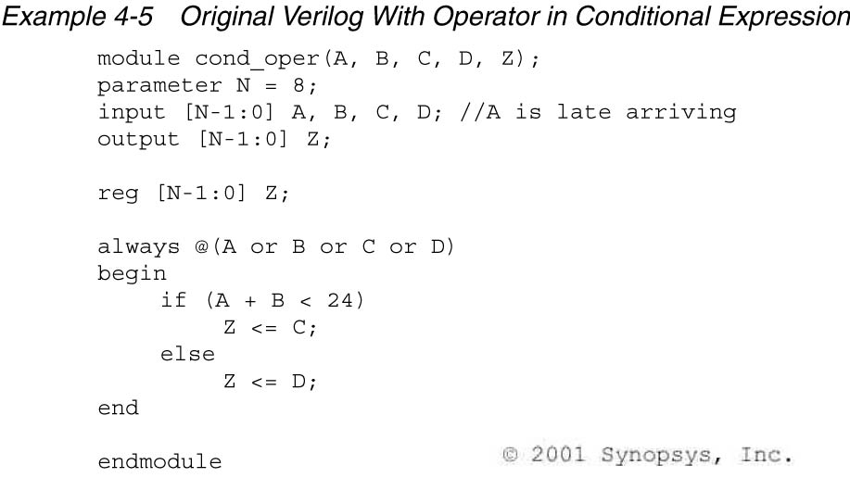
Logic Reorganization Example [1]

Slide 41
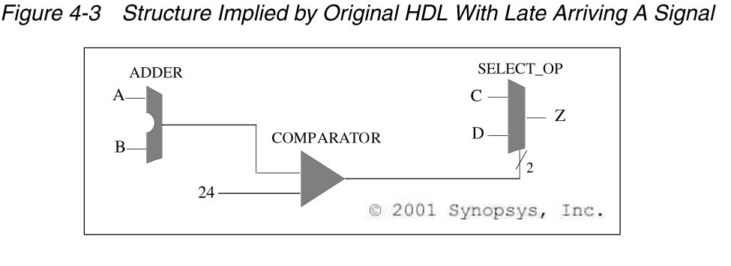
Logic Reorganization Example [2]
What can we do if A is the late-arriving signal?

Slide 42
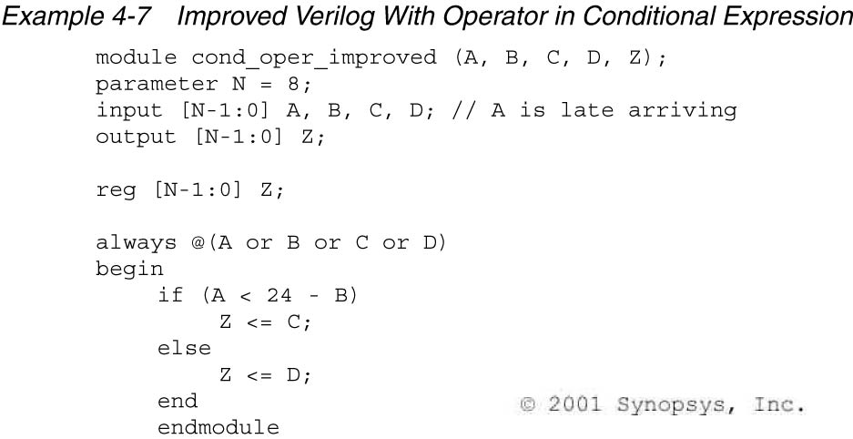
Logic Reorganization Example [3]
That’s right! We have to do the math, and re-arrange the equation so the comparison does not involve and arithmetic operation on the late arriving signal.

Slide 43
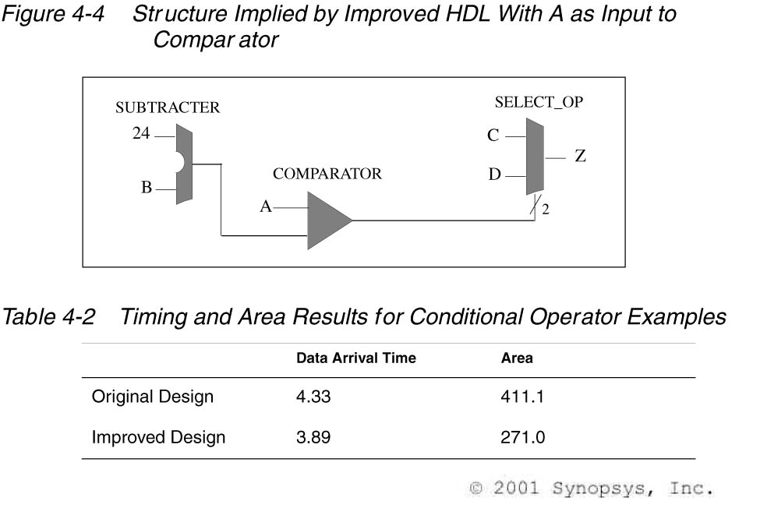
Logic Reorganization Example [4]
Why the area improvement?
Synopsys didn’t spend so much effort upsizing gates to try to make transisitons faster. This new design is faster, lower area, and lower power

Slide 44
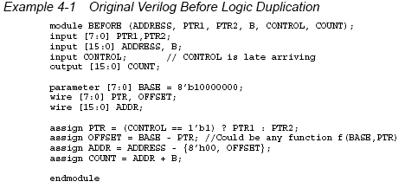
Logic Duplication Example [1]

Slide 45
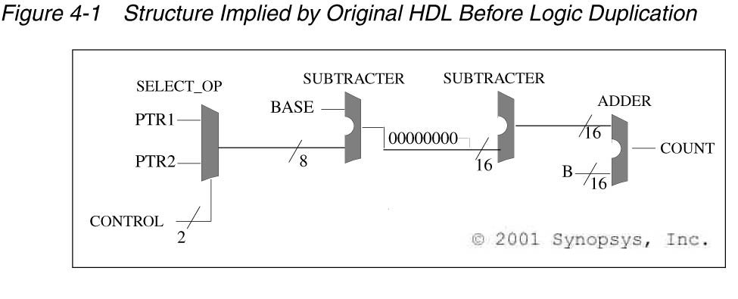
Logic Duplication Example [2]
What if control is the late arriving signal?

Slide 46
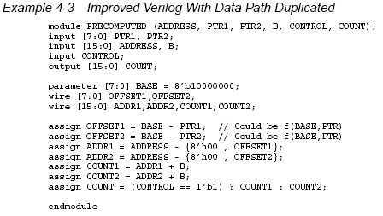
Logic Duplication Example [3]

Slide 47
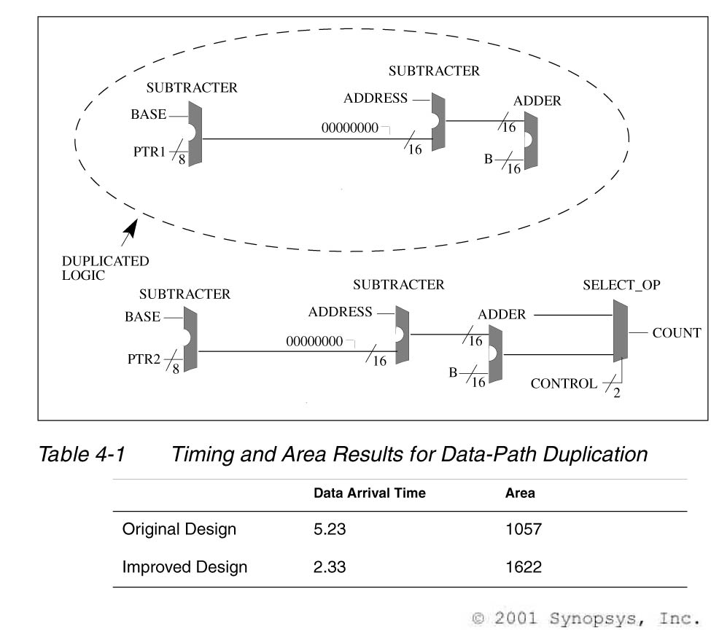
Logic Duplication Example [4]

Slide 48
Exercise
Assume we are implementing the below code, and cin is the late arriving signal? How can we optimize the resulting hardware for speed? At what cost?
reg [3:0] a, b;
reg [4:0] y;
reg cin;
y = a + b + cin;

Slide 49
Exercise
Revise to maximize performance wrt late
reg [3:0] state;
reg late, y, x1, x2, x3;
case(state)
SOME_STATE:
if (late) y = x1;
else y = x2;
default:
if (late) y = x1;
else y = x3;
endcase
Actually, there is nothing you can really do here. This is simple boolean logic, and synopsys already does a good job optimizing for late arriving.
Coding optimizations often apply more to larger functions (like arithmetic operations, & comparisons). Than to boolean logic.

Slide 50
Mixing Flip-Flop Styles (1)
What will this synthesize to?
module badFFstyle (output reg q2, input d, clk, rst_n);
reg q1;
always @(posedge clk)
if (!rst_n)
q1 <= 1'b0;
else begin
q1 <= d;
q2 <= q1;
end
endmodule
If !rst_n then q2 is not assigned…
It has to keep its prior value

Slide 51
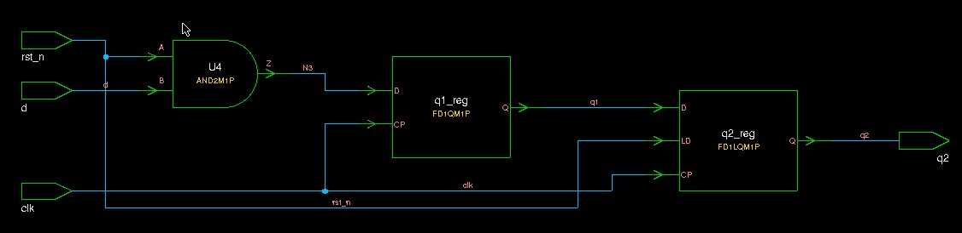
Flip-Flop Synthesis (1)
Area = 59.0
Note: q2 uses an enable flop (has mux built inside)
enabled off rst_n

Slide 52
Mixing Flip-Flop Styles (2)
module goodFFstyle (output reg q2, input d, clk, rst_n);
reg q1;
always @(posedge clk)
if (!rst_n) q1 <= 1'b0;
else q1 <= d;
always @(posedge clk)
q2 <= q1;
endmodule
Only combine like flops (same reset structure) in a single always block.
If their reset structure differs, split into separate always blocks as shown here.

Slide 53
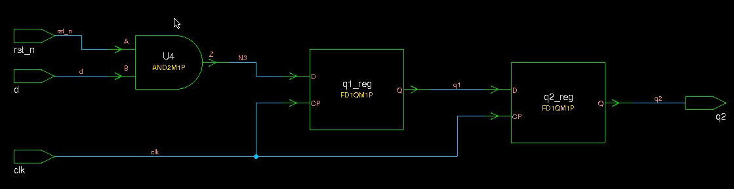
Flip-Flop Synthesis (2)
Area = 50.2 (85% of original area)
Note: q2 is now just a simple flop as intended

Slide 54
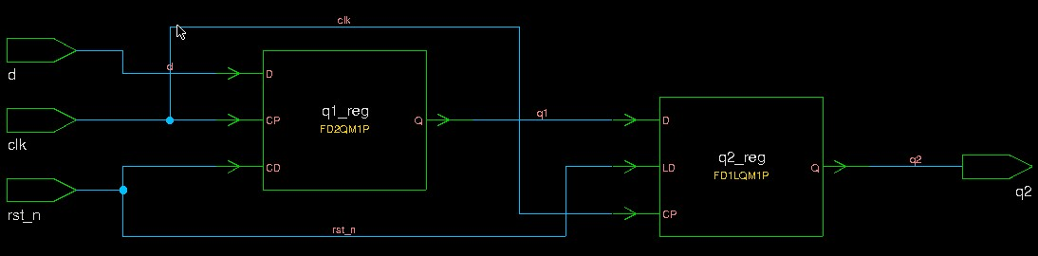
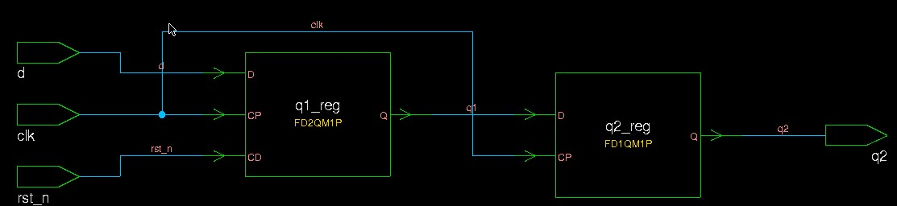
Flip-Flop Synthesis (3)
Note asynch area less than synch, and cell count less (less interconnect)
Using asynchronous reset instead
  Bad (same always block): Area = 58.0
  Good (separate always block): Area = 49.1

