Slide 1
ACSE4.4 - LOGISTIC
Machine Learning Mini-project

Slide 2
Outline
1. How did you organize yourselves as a group working remotely
2. Analysis and processing of the input data
3. Which approach was used for validation and hyper-parameter selection
4. Experiments that were tried but were not successful
5. More detailed description of the approach(es) selected by the group for final submission(s)
6. Conclusions and recommendations

Slide 3
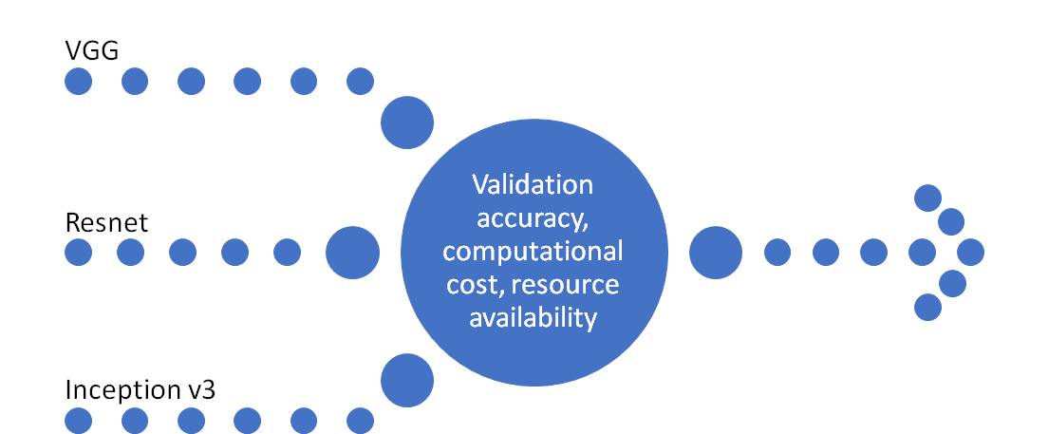
Workflow
SqueezeNet
Microsoft Teams
Resnet50
ResNet101
Wide Resnet50 v2
Wide Resnet101 v2
Discussions and task division
Final submission
GoogleNet
Meetings
Github
Q&A
Code sharing
Choose Network
Find better hyper-parameters

Slide 4
Processing input data
We used pretrained models, which require images at least of size 224x224
Resized input images to 224x224 in order to increase the classification accuracy
More than 1800 images in the training set were grayscale
Made all the input sizes uniform to have 3 channels(RGB) for all images
Some classes corresponded to the same object/animal
Applied data augmentation to enable the classifier to focus on critical features (e.g. colours)
We needed to split the dataset into training and validation set
Created a custom dataset where we could transform the data and apply the split

Slide 5
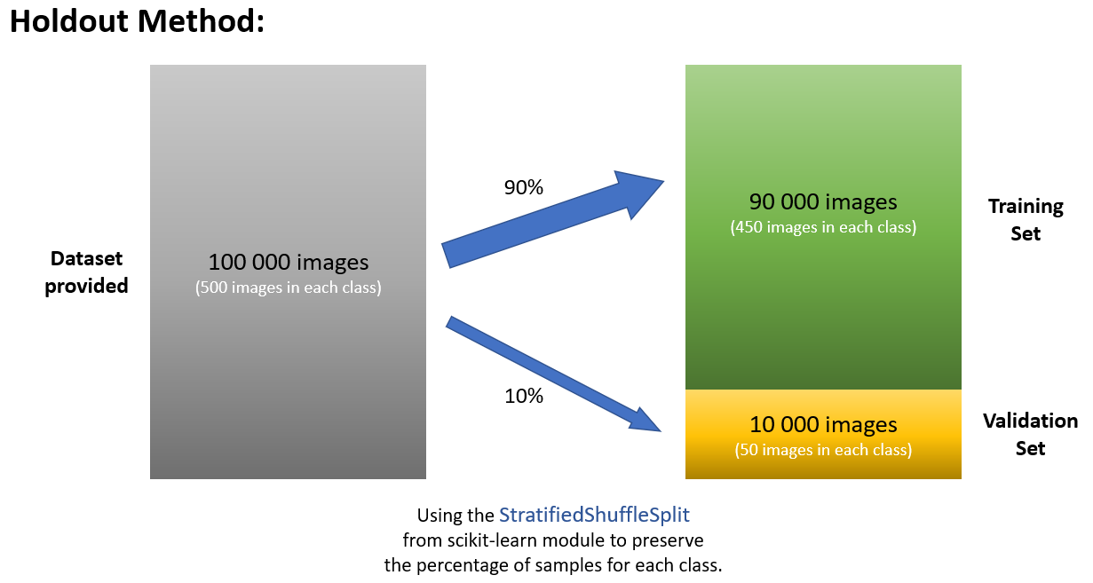
Approaches
Validation data:
Hyper parameters:
(batch size, learning rate, momentum, weight decay)
Learning speed equation
depends on hyper - parameters:
v = momentum * v
- learning_rate * decay of weights
Approaches: control variables

Slide 6
Comparison experiments
AlexNet
Resnet
Comments
1
Too low validation accuracy
AlexNet could not achieve 40%
Resnet could achieve more than 65%
2
Convergence stalled after a few epochs
AlexNet’s validation accuracy stalled at 30-35%
Resnet’s at ~66%
3
Encountered overfitting
Resnet’s validation loss started increasing after 5 epochs

Slide 7
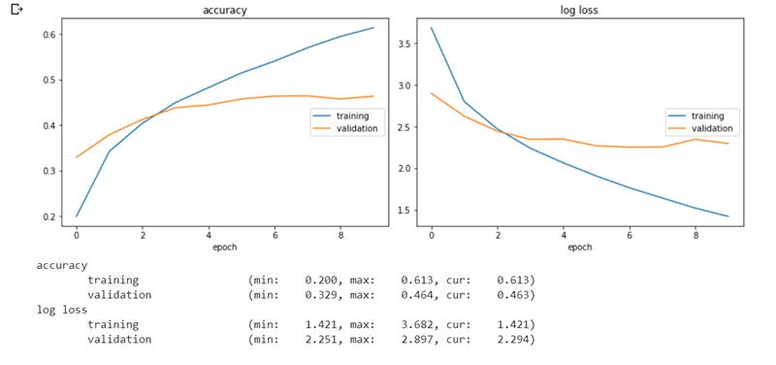
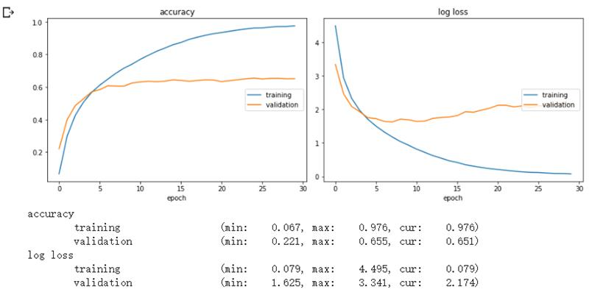
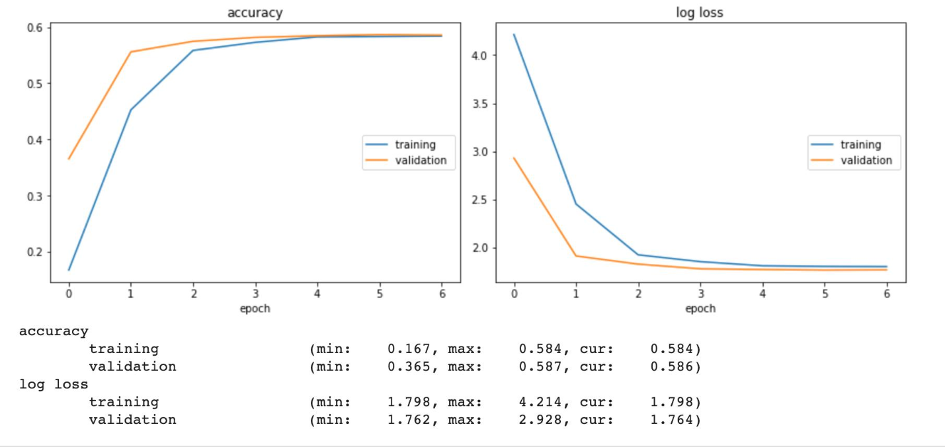
Unsuccessful Experiments
and model choosing
AlexNet (46.3%)
Wide Resnet 50 (65.1%)
Resnet 50 (58.1%)

Slide 8
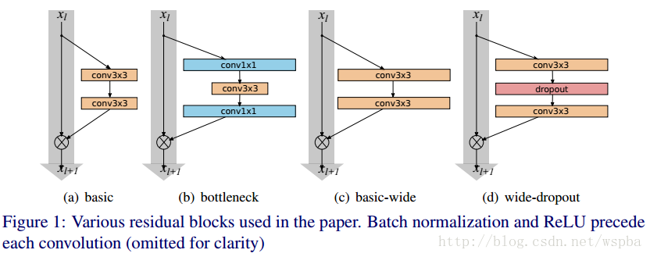
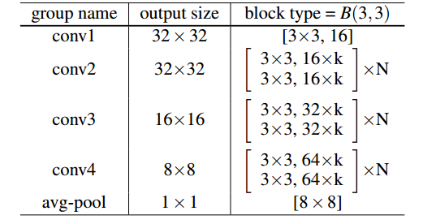
ResNet - Various residual blocks
ResNet: (a) (b)
Wide ResNet: (c)(d)
Wide ResNet increase the network wide on k

Slide 9
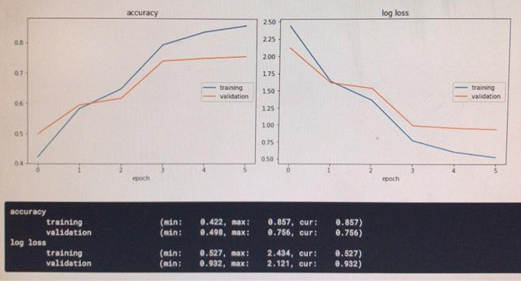
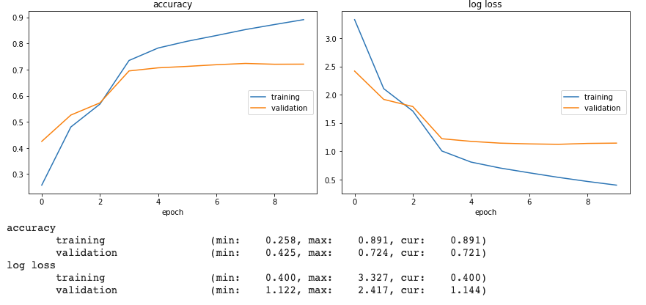
ResNet101 （our best result）
Training accuracy: 85.7%
Validation accuracy: 75.6%
Improvement: more epoches
Wide Resnet 101_v2

Slide 10
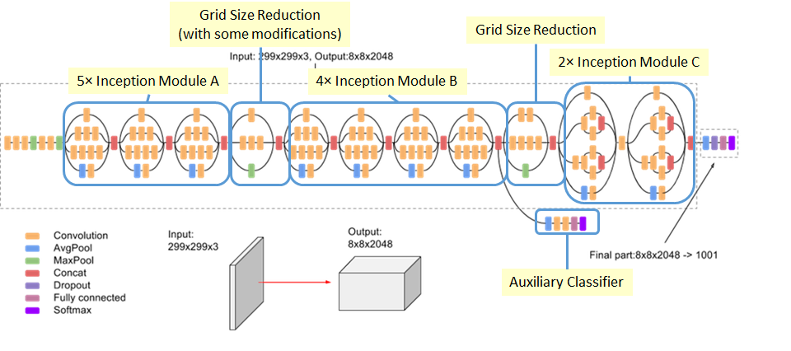
Inception V3 - 3 Inception Modules
Inception_v3 uses factorising convolutions to reduce the number of connections/ parameters without decreasing the network efficiency.

Slide 11
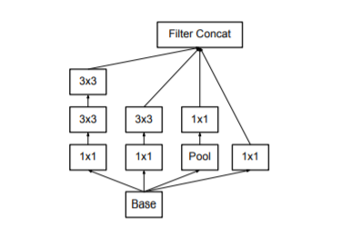
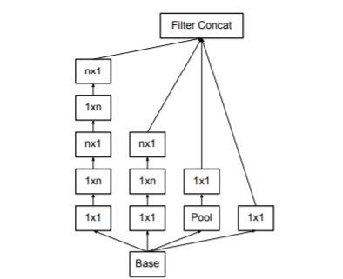
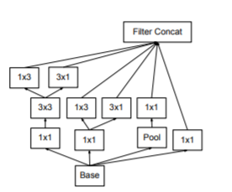
Inception Module C
Inception Module A
This architecture is used on the coarsest (8 × 8) grids to promote high dimensional representations
Inception modules where each 5 × 5 convolution used in GoogLeNet is replaced by two 3 × 3 convolution
Inception Module B
Inception modules after the factorization of the n × n convolutions. n=7 is chosen.

Slide 12
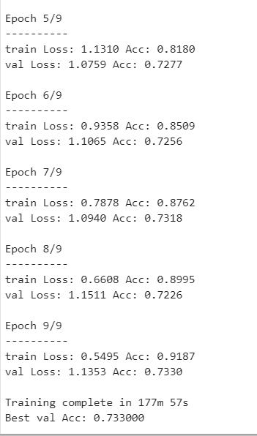
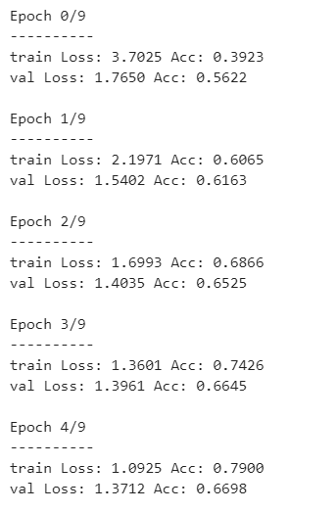
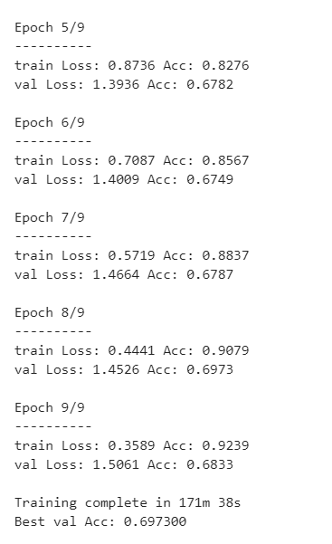
Inception v3 (Comparison of different hyper-parameters)
Momentum = 0.1
Momentum = 0.9

Slide 13
Results and hyper-parameters selection
 | Inception v3 | ResNet50 | ResNet101 | WideResNet50 | WideResNet101
Batch Size: | 64 | 128 | 64 | 64 | 32
Learning Rate: Adaptive: Decay 0.1 each 2 epoches to minimum 0.0001 | 0.01 (no adaptive) | 0.1 | 0.1 | 0.1 | 0.256
Weight Decay: | 0 | 2e-4 | 2e-4 | 1e-8 | 1e-8
Momentum: | 0.1 | 0.9 | 0.9 | 0.9 | 0.2
Validation accuracy | 73% | 70% | 76% | 68% | 72%

Slide 14
Shortcut and Future work
Dataset restriction -- Try more data augmentation methods
Experiment, GPU and time limitation -- Find better hyper-parameters
Low generalization ability -- Ensembling.The idea is to obtain a prediction from a series of models, and combine those predictions to produce a final answer.
Only use existing network - Adjust the network (add more layer, changed the layers to squeeze)
Single validation approach used - Implement more sophisticated validation approach (e.g: k-fold validation, Monte-carlo validation)

Slide 15
Fine-tuning--still have long way to go!
Freeze some layers(e.g. only update weight and bias on bn and fc layers), add or remove some layers of the pretrained model
Find the most appropriate learning rate and use different learning rates on different layers. We can try the method below:
Over the course of an epoch, start out with a small learning rate and increase to a higher learning rate over each mini-batch, resulting in a high rate at the end of the epoch. Calculate the loss for each rate and then, looking at a plot, pick the learning rate that gives the greatest decline.
Try diverse optimisers (e.g., RMSprop for Inception_V3, Adam for ResNet)
Run random search on variant hyperparameters(batch_size, weight_decay and so on). Stage the search from coarse (wide hyperparameter ranges, training only for 1-5 epochs), to fine (narrower rangers, training for many more epochs).

