Slide 1


FlavorSphere CSE204: Project-I
Guided By :Prof. Mohini Darji,
Prof. Aishwariya Budhrani
Team Members :Tirth Dalal(23DCS018)
Kashish Gandhi(23DCS028)
Harmit Jetani(23DCS040)
Department of Computer Science & Engineering,
Devang Patel Institute of Advance Technology and Research (DEPSTAR)

Slide 2
Content of the Presentation
ABSTRACT
INTRODUCTION
LITERATURE REVIEW
SYSTEM ANALYSIS
TECHNOLOGY STACK
SYSTEM DESIGN/Architecture Diagram
TESTING
RESULTS
CHALLENGES FACED
CONCLUSION AND FUTURE SCOPE
REFERENCES
DEPARTMENT OF COMPUTER SCIENCE & ENGINEERING, DEPSTAR

Slide 3

Abstract
FlavorSphere is a mobile app designed to simplify nutrition tracking and meal planning. It offers personalized meal suggestions based on dietary preferences and health goals. Users can discover recipes, filter them by nutritional content, and track daily nutrient and calorie intake.
FlavorSphere addresses the lack of integrated solutions for recipe discovery, nutritional tracking, and meal planning, combining these features into one user-friendly platform. Built using Flutter for the frontend, Firebase for authentication and database management, and the Edamam API for recipe data, the app ensures seamless functionality. Its intuitive design and real-time tracking empower users to make informed dietary choices and maintain a healthy lifestyle.

Slide 4
Introduction
Project Overview: FlavorSphere is a mobile application designed for tracking nutrients, calories, and offering personalized recipe recommendations tailored to user preferences and dietary needs.
Objectives:
Provide a seamless experience for food intake tracking.
Discover personalized recipes to manage health efficiently.

Slide 5
Literature Review
Research on Nutritional Tracking Apps:
Studies emphasize a growing demand for personalized nutrition solutions. Existing apps focus mainly on calorie counting and diet management.
Existing Solutions and Market Analysis:
Applications like MyFitnessPal and Yummly offer similar functionalities but lack deep customization and integration with local ingredients and recipes.

Slide 6
SYSTEM ANALYSIS
Functional Requirements:
Daily intake tracking, personalized recipes, external database integration
Non-Functional Requirements:
Responsiveness, user-friendliness, and scalability

Slide 7



Technology Stack
Tools and Technologies Used:
Flutter for cross-platform development, Firebase for authentication and backend storage,
Edamam API for recipe and nutritional data.
Why These Tools Were Selected:
Flutter was chosen for its efficiency in building cross-platform apps,
while Firebase offers scalable and real-time backend support.

Slide 8
System Design
Use Case Diagram:
Roles (Admin, Regular User) and interactions
Architecture Diagram:
Client-server model, Firebase usage
Database Design:
User profiles, food logs, recipes linked via unique IDs
UI/UX Design:
Minimalist design, intuitive navigation

Slide 9
Implementation
Frontend Development:
Flutter-based responsive UI for Android/iOS
Backend & API Integration:
Firebase for secure logins, Edamam API for dietary data

Slide 10
Testing
Testing Methodology:
Combination of unit testing, integration testing, and UI testing.
Types of Testing:
Unit tests for login and food tracking.
UI tests to ensure smooth navigation and responsiveness.
Tools Used:
Flutter Test and Firebase Emulator Suite for testing functionalities and integrations.

Slide 11
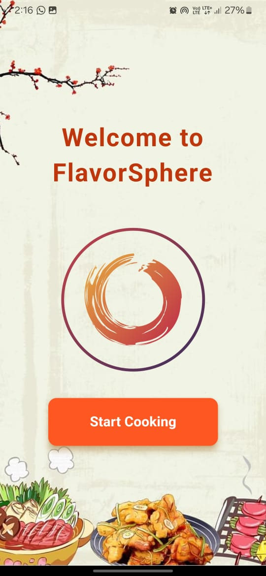
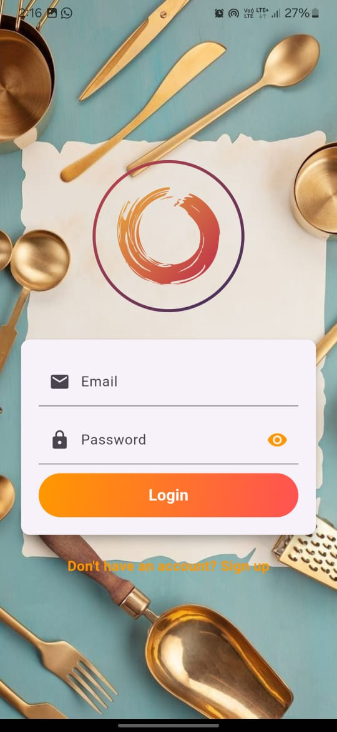
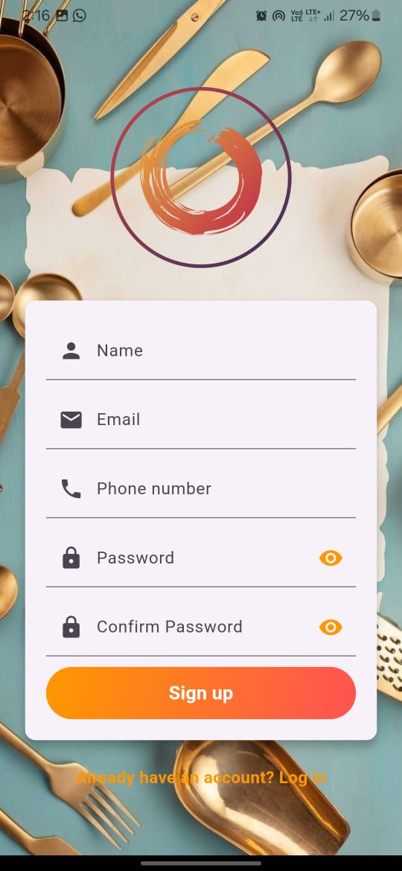
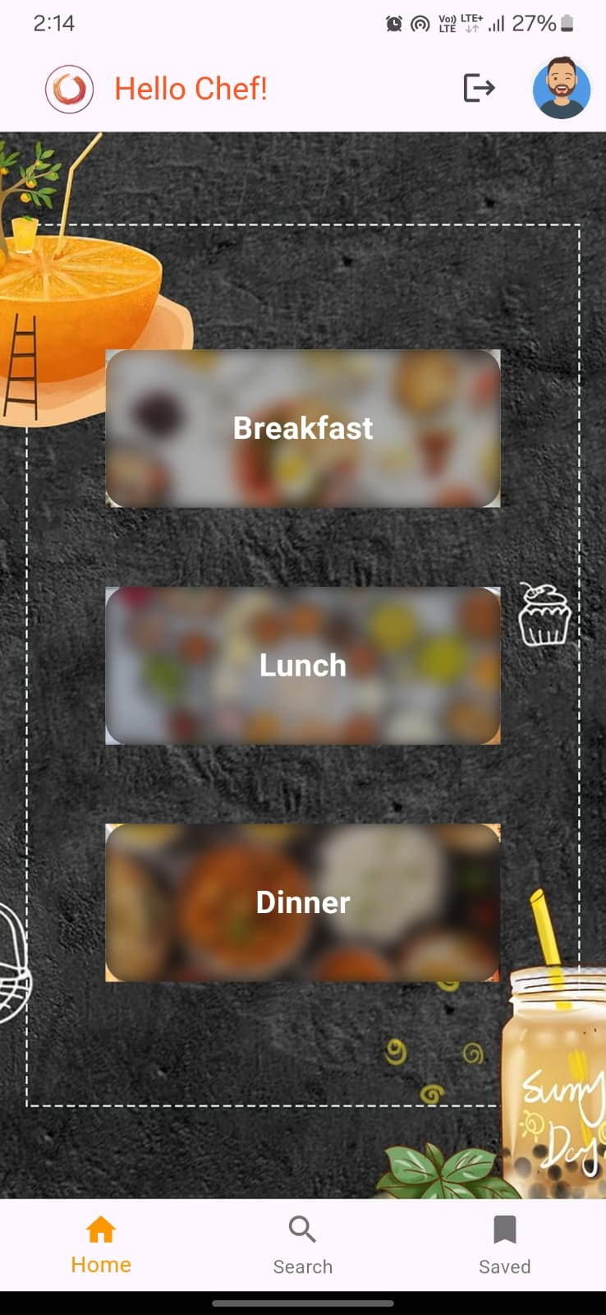
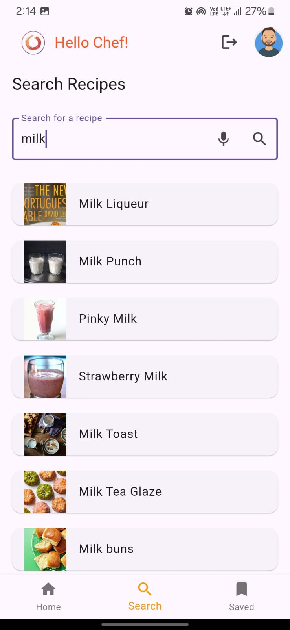
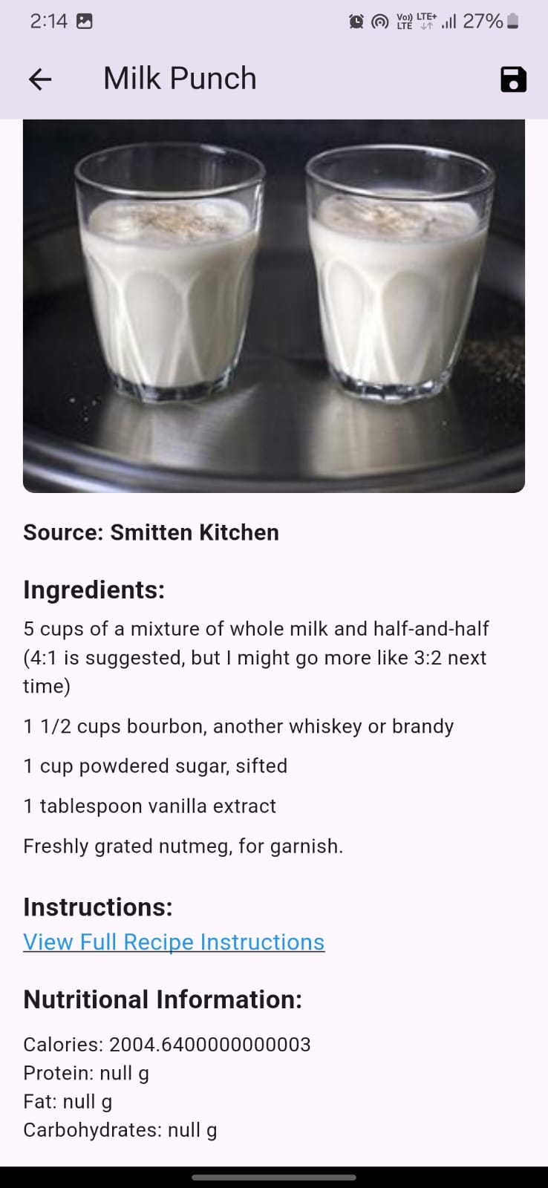
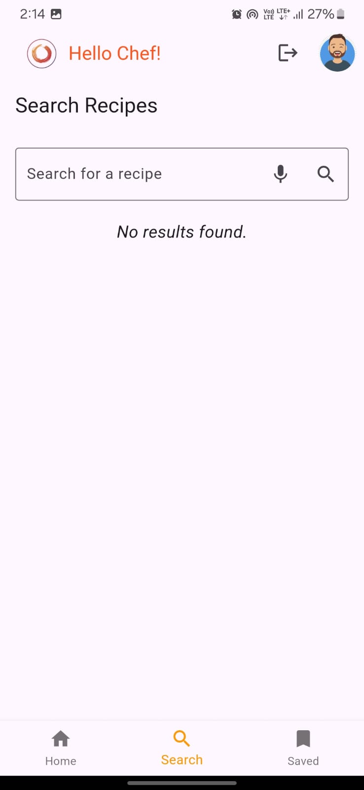
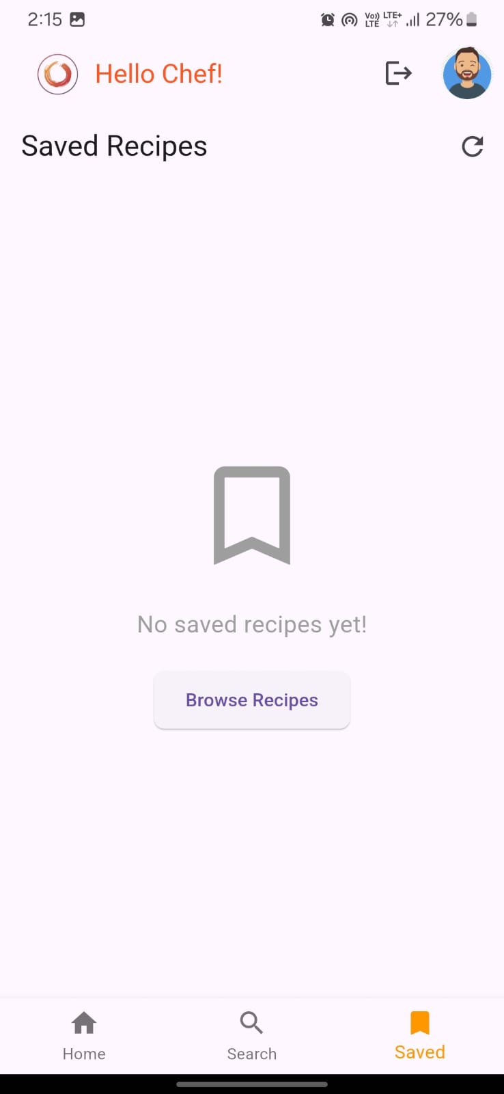
Results
Result:

Slide 12
Challenges Faced
Technical Challenges:
Integrating external APIs and ensuring real-time data synchronization.
Non-Technical Challenges:
Developing an intuitive user interface that caters to diverse user needs.

Slide 13
Conclusion and Future Scope
Conclusion: FlavorSphere successfully provides a comprehensive solution for nutritional tracking and personalized recipe discovery, with seamless integration of Firebase and external APIs.
Future Enhancements:
AI-driven recipe suggestions.
Integration of barcode scanning for food items.
Fitness tracking features.

Slide 14
References
Edamam API Documentation. Retrieved from https://developer.edamam.com
Firebase Documentation. Retrieved from https://firebase.google.com/docs
Flutter Documentation. Retrieved from https://flutter.dev/docs
Nutritional Tracking Apps: A Review. International Journal of Health Informatics, 2023.
MyFitnessPal Official Website. Retrieved from https://www.myfitnesspal.com
•Yummly Official Website. Retrieved from https://www.yummly.com

Slide 15
Thank You

