Slide 1
Harmonia
~ Handy & Responsive Monitor API ~

Slide 2
What is Harmonia?
“Harmonia” is a character from Greek mythology and the daughter of “Ares” (“Mars”, in Roman region), who is closely associated with the laboratory of Vehicle Robotics.
She is the god of harmony, which is exactly the concept that this repository is working on to harmonize all agents and other systems.
This repository consists of following .NET projects.
Harmonia.Core (common functions, classes, and configuration)
Harmonia.RCL (“Razor Class Library” which includes web map API and UI design framework)
samples (parent and child process)
The user interface will be written using .NET Blazor, but the agent processes can be in any language.
GitHub: https://github.com/husty530/harmonia
Author: Takumi Yamashita (husty530@gmail.com)

Slide 3
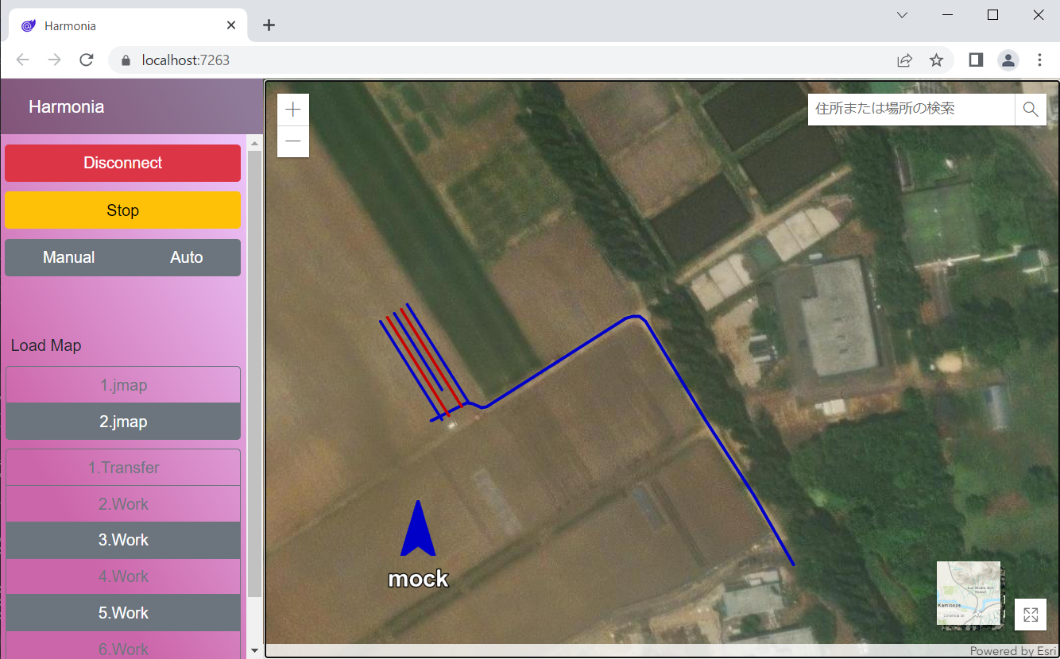
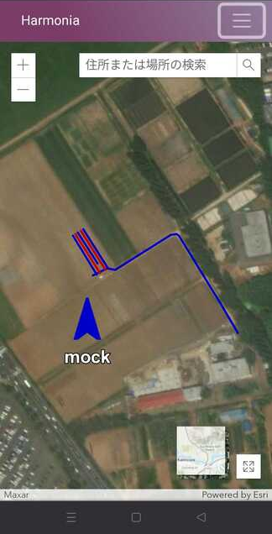
Why Harmonia?
Handy
web interface
Responsive
data binding
Harmonia can monitor every agent state by redirecting standard input / output of the child process.
This repository provides an easy way to create a unified monitoring system.
Agent’s state is described as a Dictionary<str, str>, therefore it can flexibly interconvert with JSON, XML, CSV, etc., and you don’t need to consider any constraints in the design of the child process side.

Slide 4
System Architecture
User Application
Console
Server
Browser
Harmonia.RCL
UI Components
@inject ArcGisJsInterop
@inject Dictionary<ID, Agent>
ArcGIS
Harmonia.Core
* Dispose()
* Start()
* Stop()
* Set(key, value) * Get<T>(key)
Agent
Serializer
Console
Socket
JSON
XML
Separator
ROS
gRPC
Child Process
harmonia.json
load configuration

Slide 5

About Std Input/Output Redirect
Harmonia.Core serves as a standard input/output redirector.
The OS standard CLI would start if you simply launch the child process.
CLI
Parent Process
“Redirect” means that the parent process hijack standard input/output of the child process.
Child Process
For detailed implementation references:
https://github.com/husty530/subprocess

Slide 6

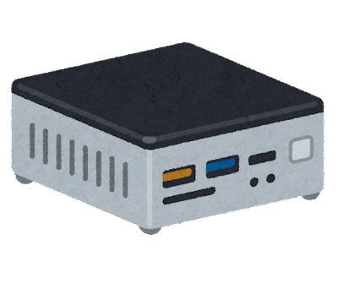

Use case
Local server application which monitors a single agent
Web Browser Interface
https://x.x.x.x:vv
Simply launch.
Access the user interface via private network.
Server
Harmonia
Child Process

Slide 7
Use case
Remote server application which monitors multiple agents
Web Browser Interface
https://x.x.x.x:vv
Client
Client
Server
Server
Server
Designed for multi-stage configurations.
Stack custom layers recursively.
Harmonia
Harmonia
Harmonia
Child Process
Child Process

