Slide 1
CI/CD roadmap

Slide 2
Continuous Integration
“Continuous Integration is a software development practice where members of a team integrate their work frequently, usually each person integrates at least daily - leading to multiple integrations per day. Each integration is verified by an automated build (including test) to detect integration errors as quickly as possible.”
- Martin Fowler

Slide 3
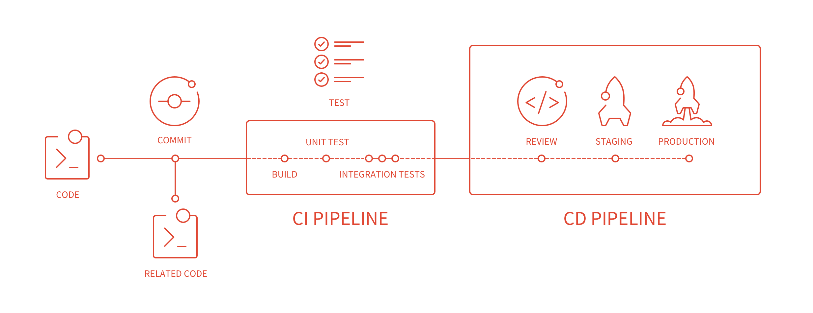
Basic Flow

Slide 4
Steps

Slide 5
Feature code check-in
Pushed to “X” branch
CI triggered
CI checkout branch
Compiles it
Test it
CI Updates
Uploads artifacts into binary repo
Notifies about health
Scan it

Slide 6
Benefits
Using version control will help in keeping references of
Production Code
Current development
Releases tags
Independent development of Features & POCs
Code review before merging (Pull Requests)
Blame

Slide 7
“Continuous Integration doesn’t get rid of bugs, but it does make them dramatically easier to find and remove.” Martin Fowler
Maintain a single source repository (git -> Bitbucket)
Automate the build (Build scripts)
Make your build self-testing (Unit / Integration / UI testing)
Every commit should build on an integration machine (Teamcity Build agent)
Keep the build fast
Test in a clone of the production environment
Make it easy for anyone to get the latest executable version
Everyone can see what’s happening (Teamcity artifacts)
Automate Deployments
Benefits

Slide 8
Continuous Delivery vs Continuous Deployments

Slide 9
Release pipeline
Development
Test
Production
Continuous Integration
Continuous delivery
Approval gate
Continuous deployment

Slide 10
Delivery
Deployments
Continuous delivery is about putting the release schedule in the hands of the business, not in the hands of IT
Deploying to UAT or Beta environments for QAs, Business or demos
Continuous deployment implies continuous delivery the converse is not true
Releasing any given deployed build to production

Slide 11
Tools

Slide 12














