Slide 1
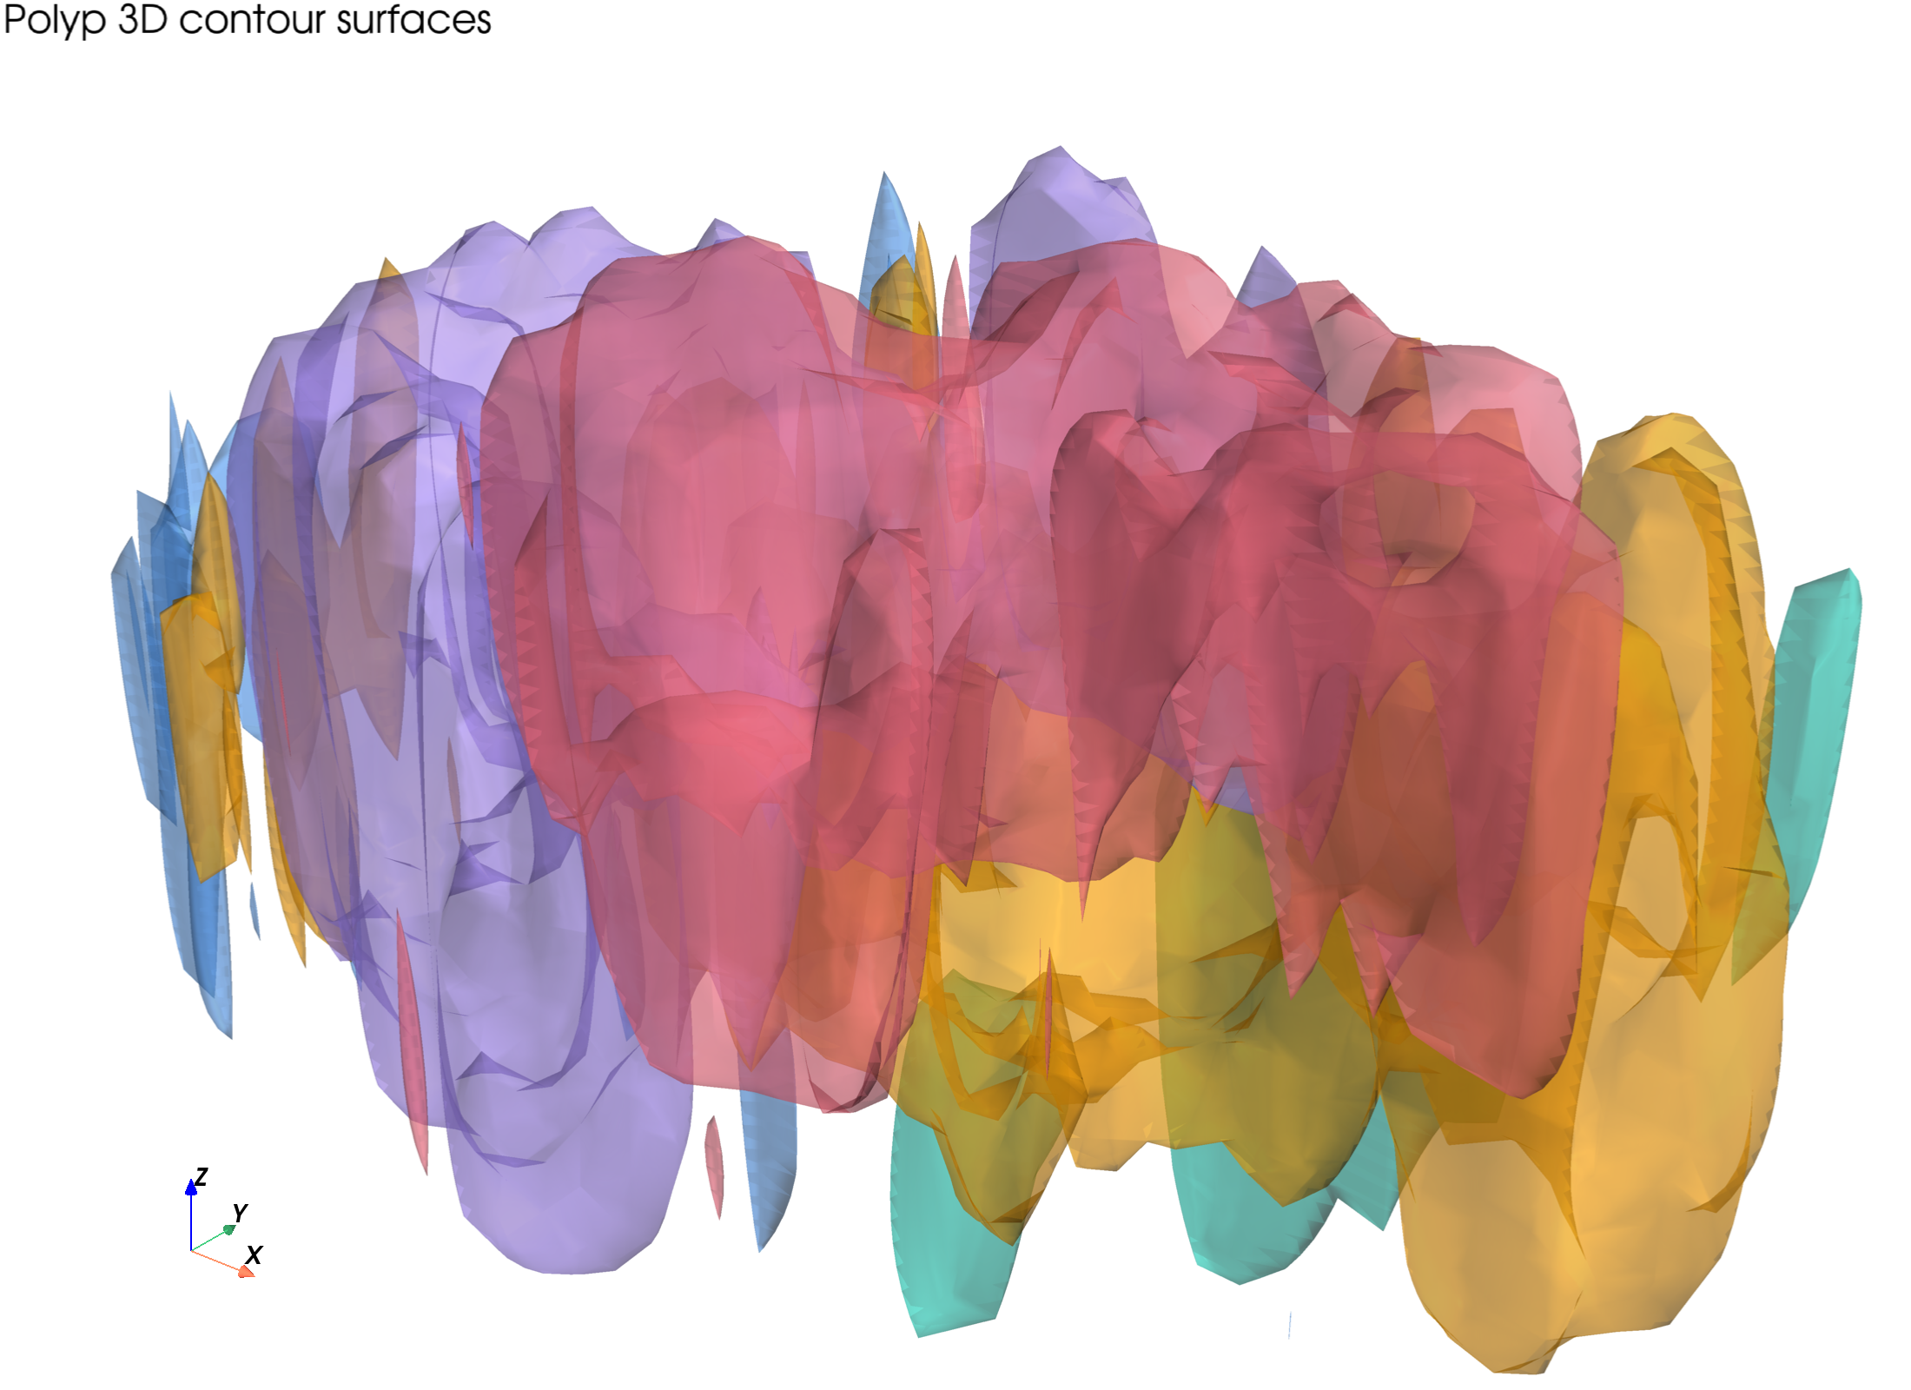
HISTOSEG 3D HARVEST MEMO
Polyp 24-gene harvest
First biological readout from a 32-slice spatial reconstruction.
2.785M
32
5
aligned cells
slices
structures
Draft research artifact for manuscript shaping; external evidence supports marker context, not causality.

Slide 2
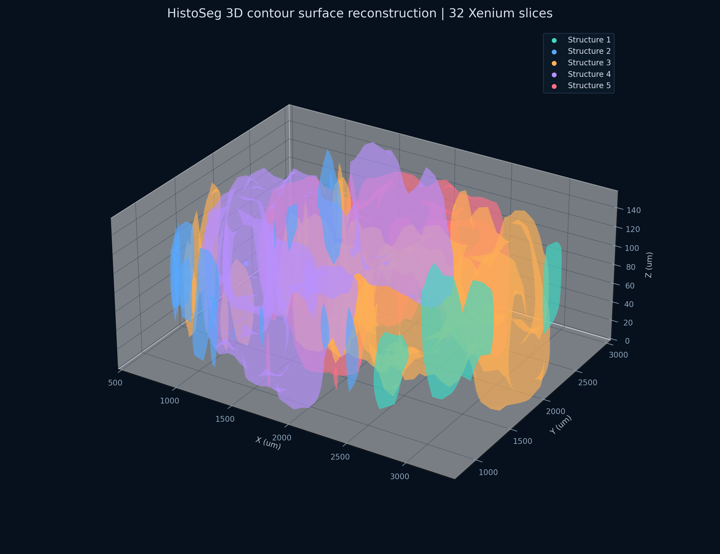
FIGURE 1 SETUP
A full-stack 3D object, not a single-slice vignette
The post-merge validation converted the 32-slice polyp stack into a sampled, browser-shareable 3D cell cloud while preserving contour structure context.
2,785,128
valid aligned cells in source Parquet
300,000
sampled WebGL points for validation HTML
500k
warning threshold fired as intended
Inputs: aligned_leiden_3d_cells.parquet and post_merge_validation_20260503/leiden_3d_cells_300k_main.html.

Slide 3
WORKING BIOLOGICAL MODEL
The 24-gene panel resolves four interpretable compartments
Structure labels remain numeric, but the marker geometry now supports a concrete, testable interpretation map.
Structure 5
Structure 3
Stromal-immune niche
Epithelial differentiation/proliferation
GREM1/FAP/ACTA2/COL1A1 with PTPRC/CD3D/CD3E/MS4A1/CD79A
MUC2/OLFM4/MKI67; OLFM4 behaves as a boundary signal
Structure 4
Structure 2
Epithelial/stem-like compartment
Macrophage/perivascular-associated
LGR5 and EPCAM peak here by top05 fraction-inside
C1QA, PDGFRA, and CD68 strongest; LYZ supportive but distributed
Derived from top05 fraction-inside and signed-distance matrices in the starter-panel batch.

Slide 4
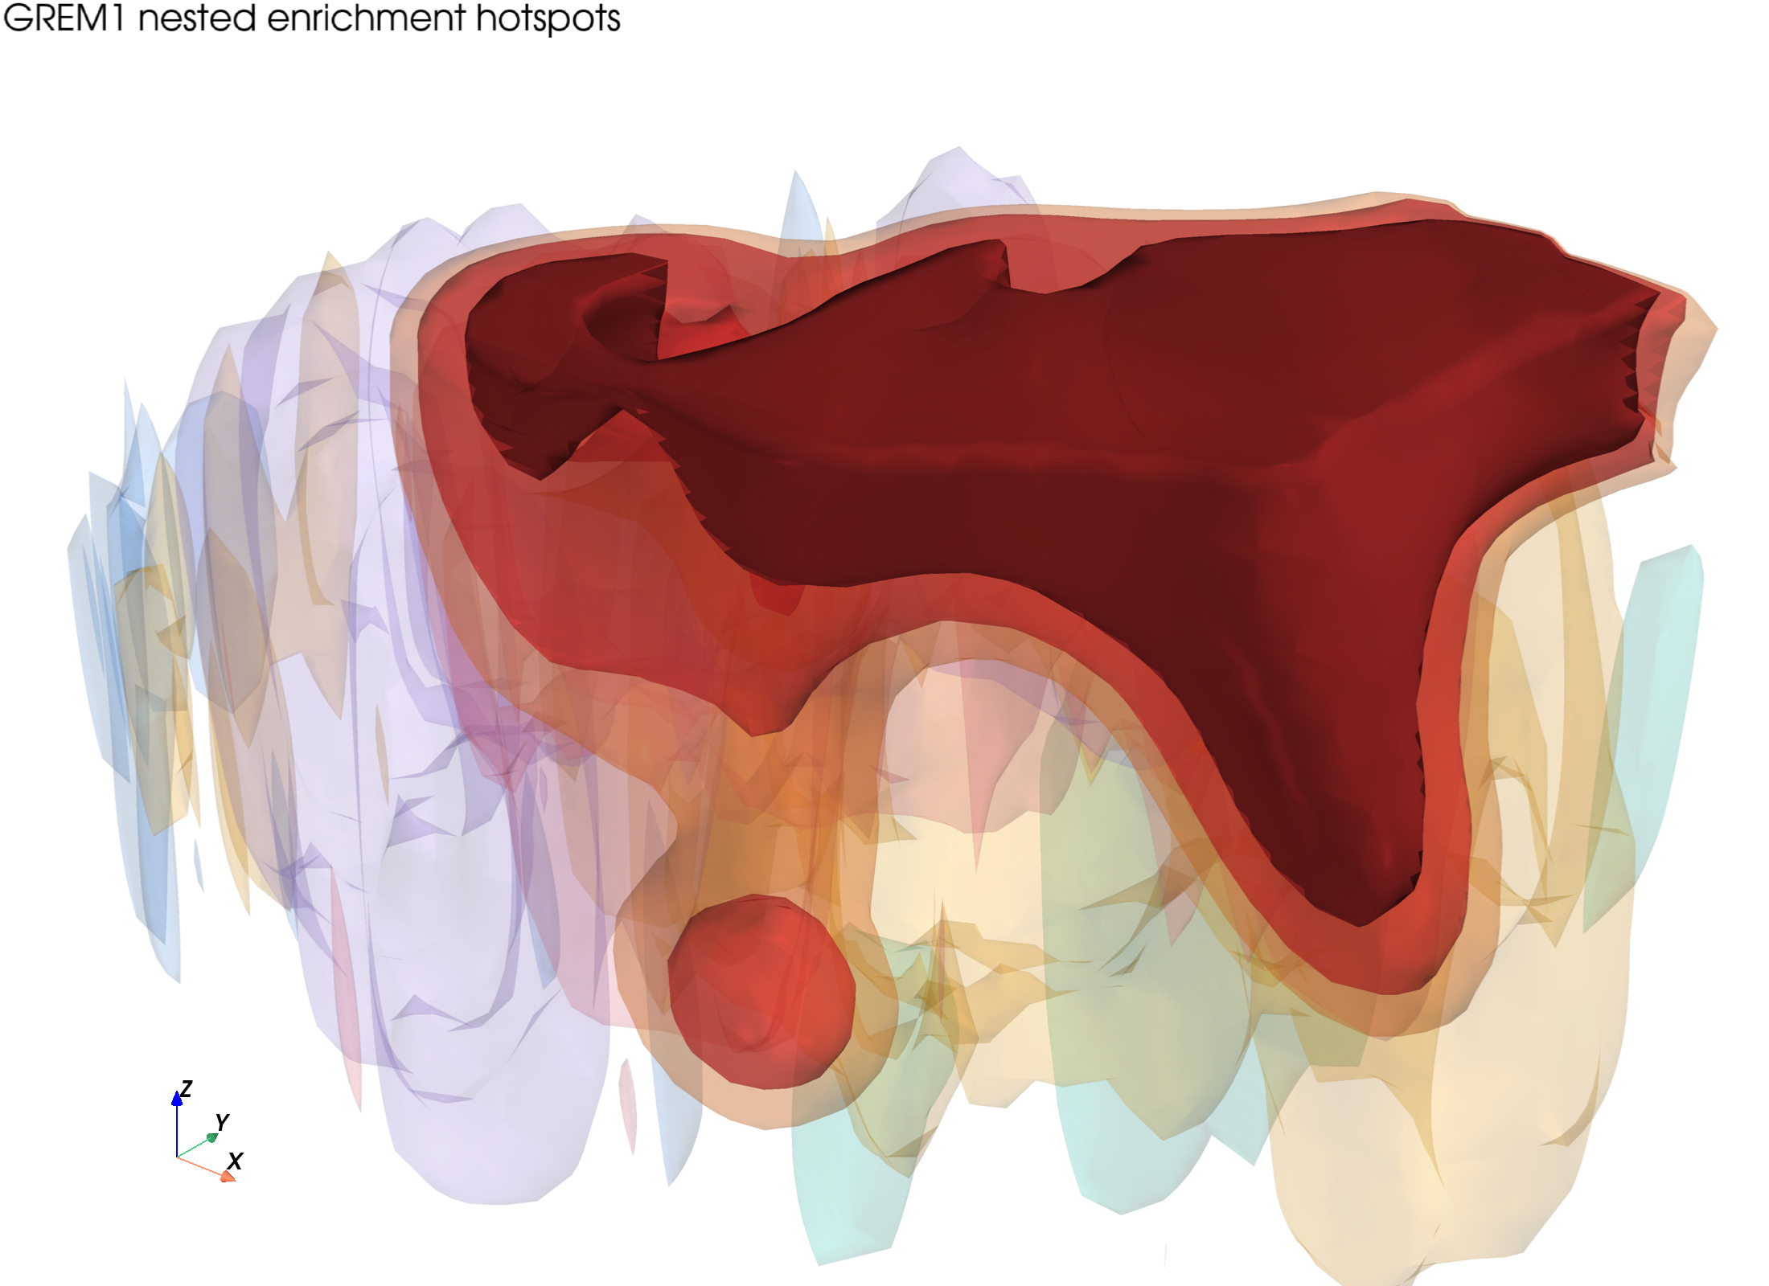
CORE CLAIM 1
Structure 5 is stromal-immune, not purely stromal
The same 3D contour embeds activated fibroblast, ECM, contractile, T-cell, and B-cell markers.
Gene
Fraction
SDF (um)
Read
CD3E
0.876
-35
T-cell receptor complex
CD3D
0.873
-35
T-cell receptor complex
PTPRC
0.872
-35
pan-leukocyte signal
GREM1
0.862
-35
BMP antagonist stromal niche
MS4A1
0.805
-25
B-cell marker
FAP
0.793
-35
activated fibroblast protease
COL1A1
0.767
-25
ECM collagen
Numbers: top05 fraction-inside and signed distance for Structure 5.

Slide 5
CORE CLAIM 2
Structure 3 carries epithelial differentiation and proliferation
MUC2 anchors secretory epithelium; MKI67 adds proliferation; OLFM4 is real but sits at a Structure 3/5 interface.
Gene
Fraction
SDF (um)
Read
MUC2
0.603
-10
secretory/goblet epithelial signal
OLFM4
0.550
-5
differentiation/interface marker
MKI67
0.331
50
proliferative fraction near Structure 3
The strongest Structure 3 read is epithelial state, not immune or stromal enrichment.
Caveat: OLFM4 is slightly Structure 5-dominant by fraction and should be called boundary-distributed.

Slide 6
CORE CLAIM 3
Structure 4 is the epithelial/stem-like pole
LGR5 and EPCAM peak together in Structure 4, separating this compartment from the MUC2-heavy Structure 3 state.
Marker context
LGR5: R-spondin/Wnt receptor; intestinal epithelial stem-cell marker in UniProt annotation.
EPCAM: epithelial adhesion and mucosal barrier context.
0.579
The spatial claim comes from HistoSeg; marker identity comes from curated external resources.
LGR5 top05 fraction-inside in Structure 4
-5 um
LGR5 signed distance: embedded/near-boundary
0.415
EPCAM top05 fraction-inside in Structure 4
Interpretation: epithelial/stem-like compartment; pair with Structure 3 in manuscript panels.
External marker context: UniProt reviewed entries and Human Protein Atlas gene pages.

Slide 7
CORE CLAIM 4
Structure 2 is macrophage/perivascular-associated
C1QA, PDGFRA, and CD68 peak here; LYZ supports the myeloid direction but remains distributed.
Gene
Fraction
SDF (um)
Read
C1QA
0.270
30
classical complement / macrophage-lineage
PDGFRA
0.224
45
mesenchymal-perivascular receptor
CD68
0.157
80
macrophage / phagolysosomal marker
LYZ
0.148
80
supportive myeloid signal; not dominant
Why not call it purely macrophage?
The PDGFRA component gives the structure a stromal/perivascular axis.
Signed distances are positive for the top05 hotspot, so this is association/adjacency more than deep embedding.
Good manuscript language: macrophage/perivascular-associated compartment.
This wording preserves the biology without overstating direct contact or lineage identity.

Slide 8
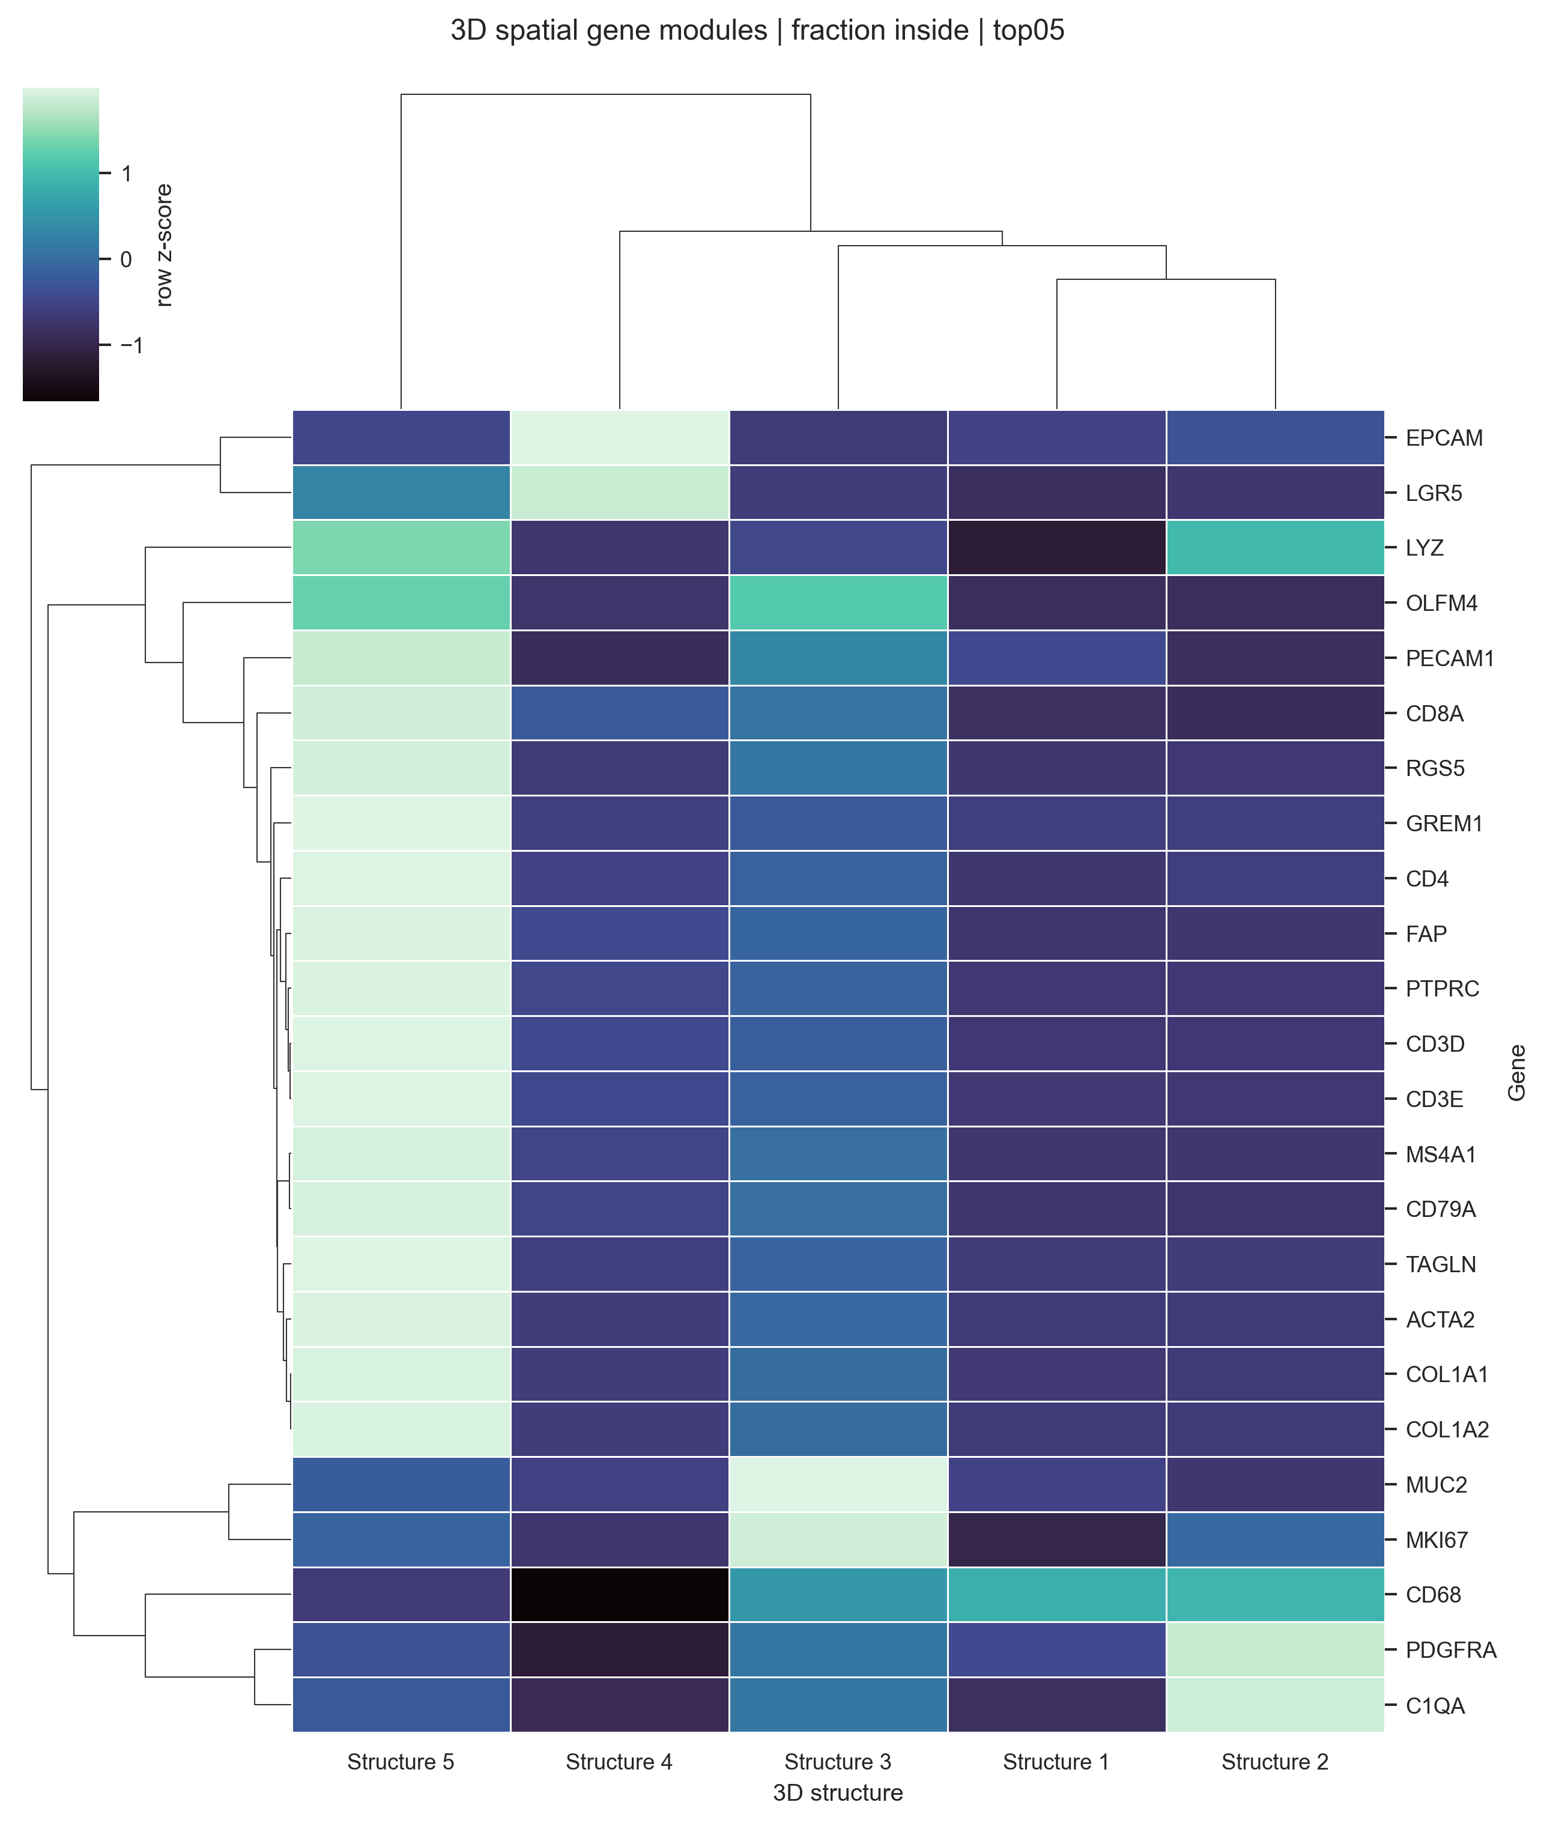
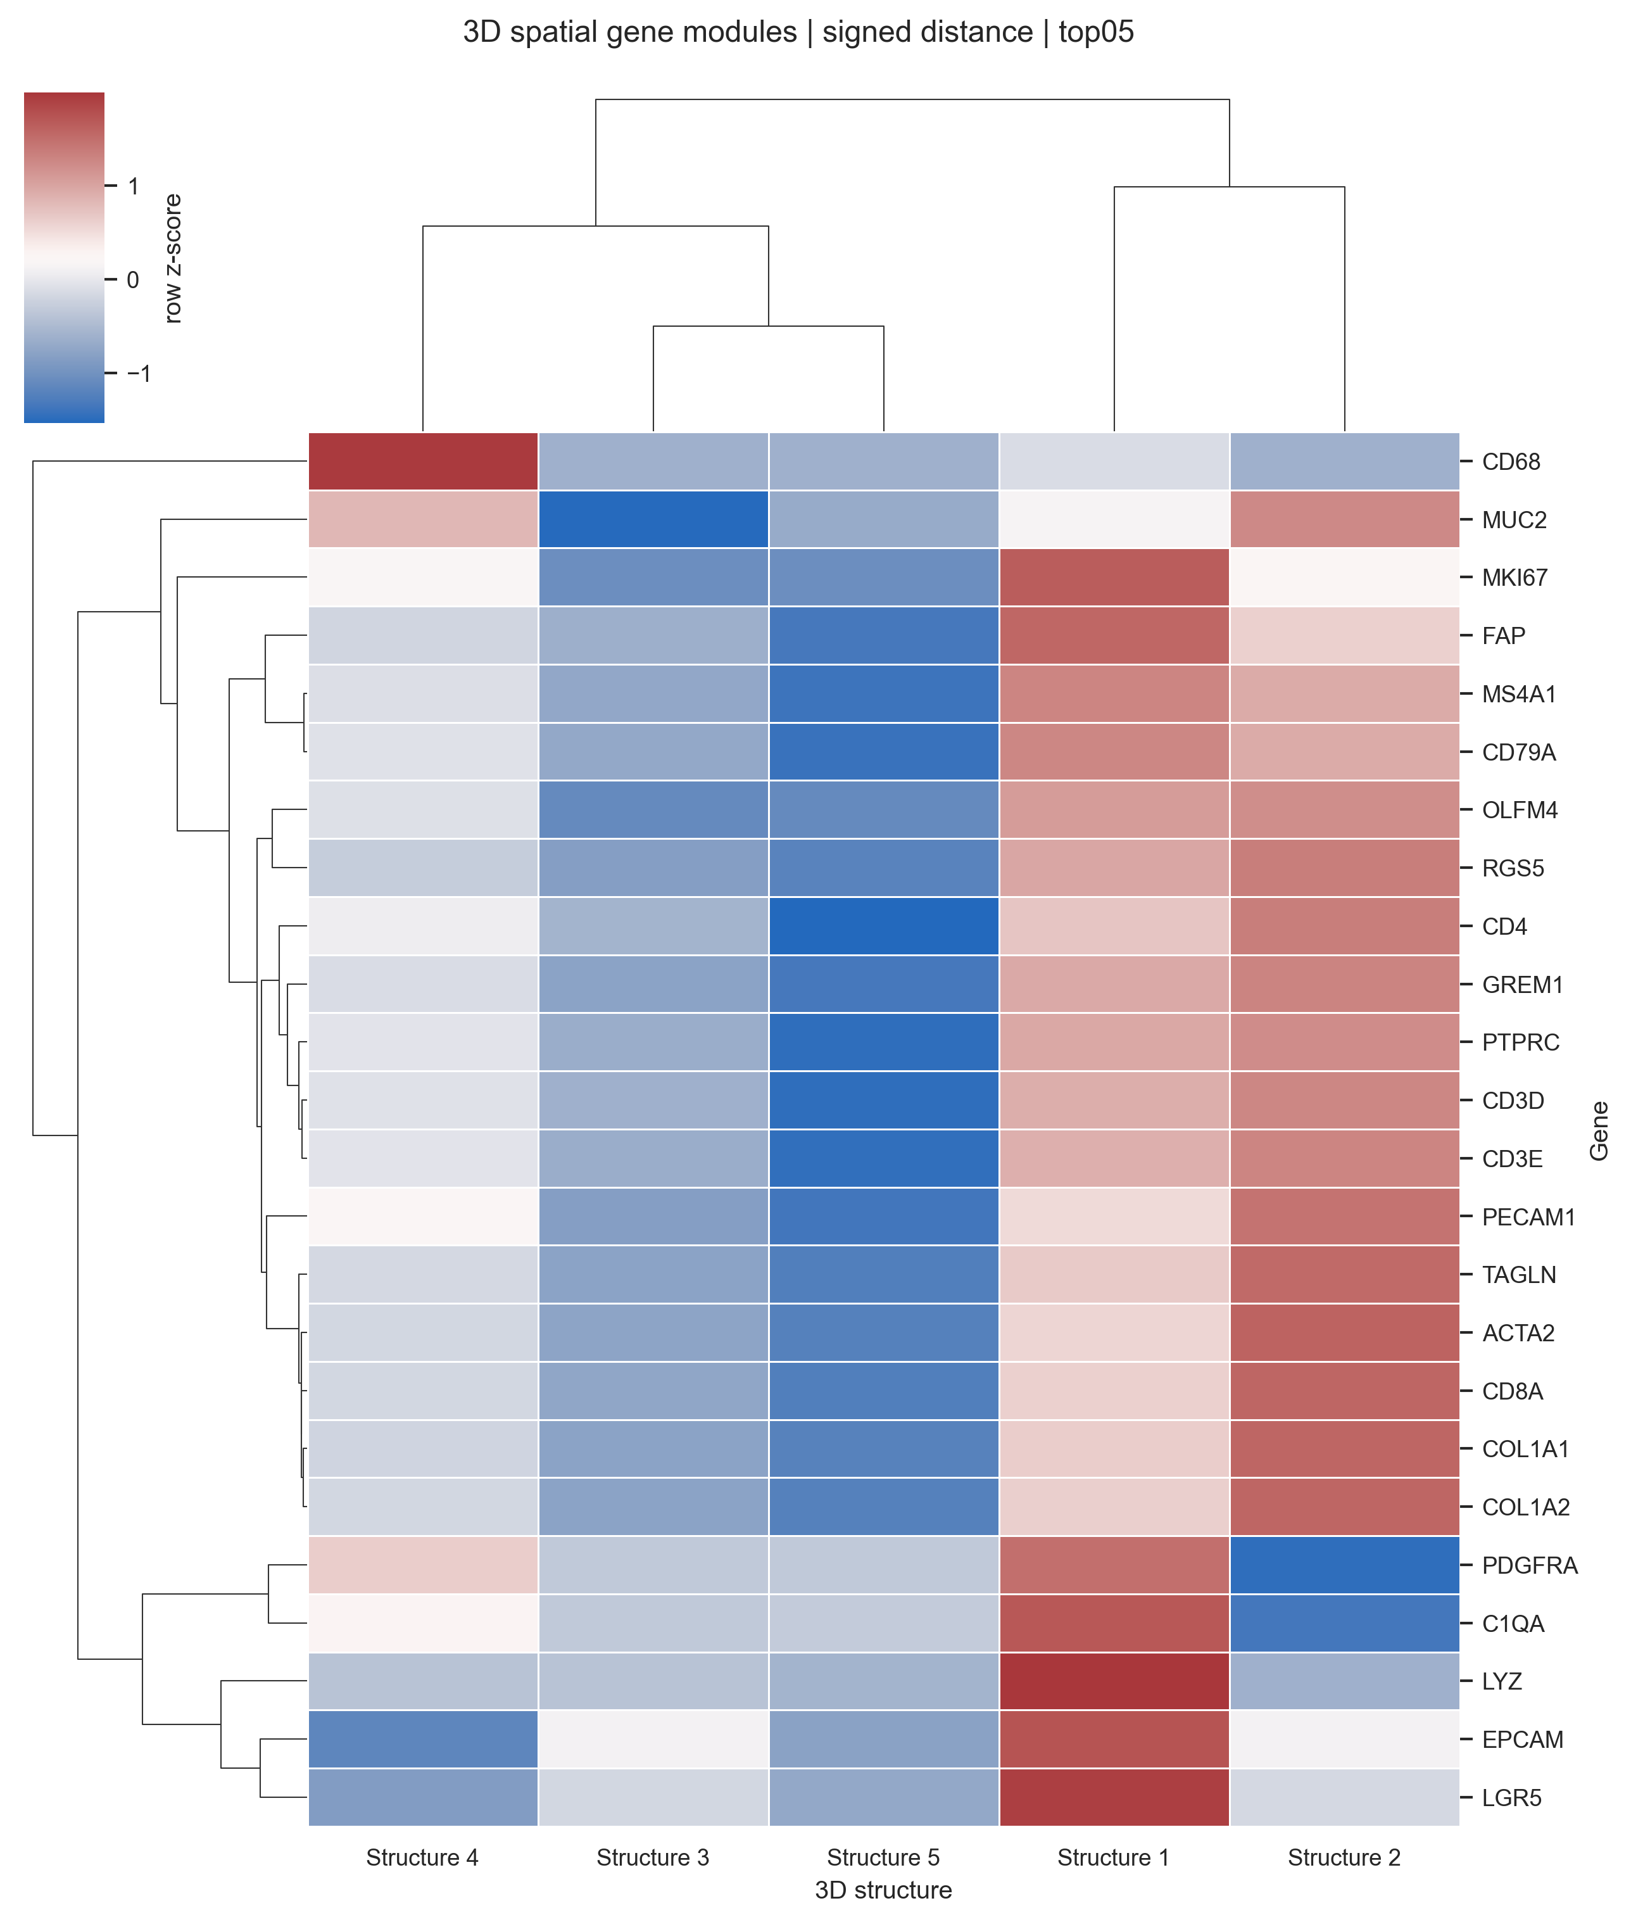
FIGURE 2 EVIDENCE
The matrix view makes the compartment calls auditable
Fraction-inside and signed-distance clustermaps should sit side-by-side: occupancy and embedding are related, but not interchangeable.
Fraction inside, top05
Signed distance, top05
Post-merge validation images are embedded in the deck; raw validation HTML/Parquet remain outside the repo.

Slide 9
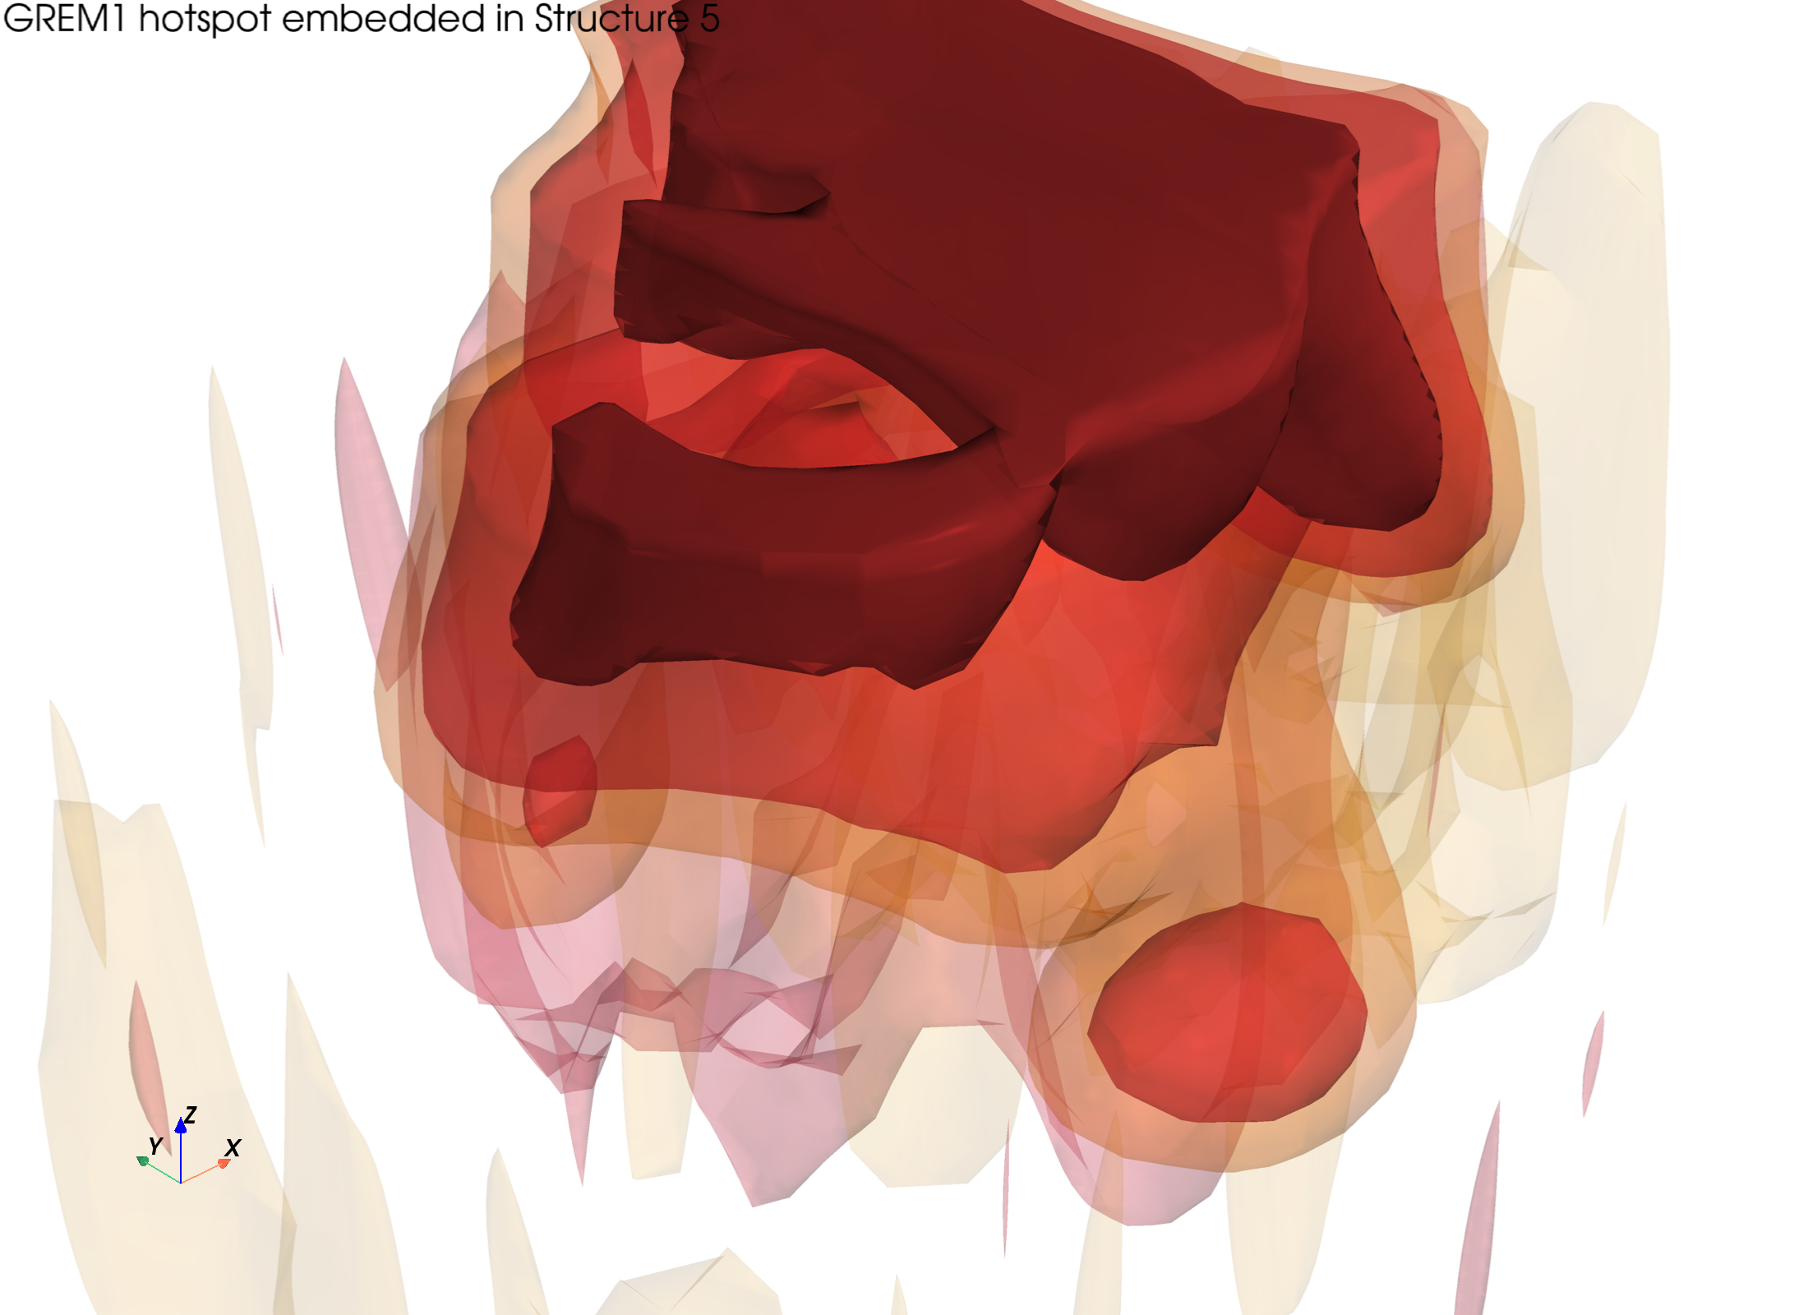
FIGURE 3 LANDING
GREM1 is the hero topology panel
It links the visual nested hotspot, the Structure 5 SDF embedding, and the stromal-immune compartment claim.
0.862
GREM1 top05 fraction-inside in Structure 5
-35 um
GREM1 signed-distance embedding
Pair with FAP/ACTA2/COL1A1 and PTPRC/CD3D/CD3E/MS4A1/CD79A to make the niche argument.
Next manuscript action: histology review of Structure 5 boundaries and a small table of boundary-distributed markers.

