Slide 1
Operational Coordination Platform for Outreach and Engagement
Milestone 2
Team 1 Members: Adam, Samuel, Tyler, Masoud
Course: IT 4983
Date: 03/24/2026

Slide 2
Team Introduction
Adam – IT Major
Samuel – IT Major
Tyler – IT Major
Masoud – IT Major

Slide 3
Project Summary
Improve coordination of outreach and engagement events
Current system lacks formal, centralized view
Lack of structure creates inefficiencies
Goal: centralized coordination platform

Slide 4
Current Challenges
No centralized system
Unclear task ownership
Missed or unclear deadlines
Limited visibility across events
Need a dedicated tool to coordinate event planning

Slide 5
Tool Criteria
Usability
Task Visibility / Creation
Ease of Use / Implementation
Price

Slide 6



Tool Evaluation
Microsoft Planner – task management, built in Microsoft 365.
Asana – advanced but complex, steeper learning curve
Trello – simple but limited, lacks reporting
All can work, but which tool best solves the team’s problems?

Slide 7

Microsoft Planner Pros
Bundled in Office 365
Integrates with other Office 365 tools (To Do, Outlook, etc.)
Performs tasks well
Simple to use, little time to perform tasks
Notifications for upcoming/missed tasks

Slide 8
Microsoft Planner Cons
No way to designate primary owner / supporting staff
Primary owner could be designated using a label for the owner of the task
No notifications for tasks that are unassigned

Slide 9
Asana Pros
Starter plan includes Timeline/Gantt, Calander
Scalability with higher tiers
No user limit in starter plan

Slide 10
Asana Cons
Paid tier necessary for implementation
More training for nontechnical staff
Outside of Windows platform involvement
Goals, portfolios not included in starter tier
Recommended tier costs 10.99 per user/month

Slide 11
Trello Pros
Free to start – no cost for basic use
Visual intuitive – Kanban boards are easy to understand at glance
Mobile friendly – Staff can update tasks from their phones

Slide 12
Trello Cons
No built-in notifications - no automatic reminders when deadlines are approaching
Scales poorly - Gets clustered and hard to manage when working with multiple events simultaneously
No role-based permissions- Anyone on the board can edit or delete anything, which is a risk for a government office.

Slide 13
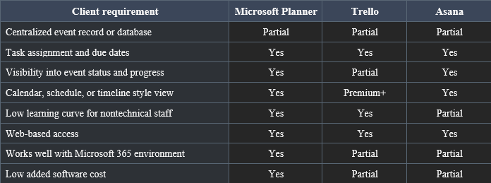
Recommendation
Use Microsoft Planner for task management
Easy to use
Cost-effective
Works with Microsoft 365

Slide 14
Next Steps
Finalize deliverables
Prepare for POC
Demonstrate
Address feedback

