Slide 1
Operational Coordination Platform for Outreach and Engagement
Milestone 3
Team 1 Members: Adam, Samuel, Tyler, Masoud
Course: IT 4983
Date: 04/23/2026

Slide 2
Team Introduction
Masoud Khelghati
Adam Hutcheson
Tyler Higgins
Samuel Ekema
All team members are IT majors
Experience in research, system analysis, and tools

Slide 3
Project Summary
Improve coordination of outreach and engagement events
Current system lacks formal, centralized view
Lack of structure creates inefficiencies
Goal: centralized coordination platform

Slide 4
Tool Criteria
👤 Usability
✔ Ease of Use
📊 Task Visibility & Creation
💰 Cost
Microsoft Planner is the best choice for the team.

Slide 5


Why Microsoft Planner?
Included in Microsoft 365
Integrates with other Microsoft 365 tools
Efficient and simple task tracking
User-friendly
Automatic notifications
Meets almost all the team’s needs
Can be used on mobile

Slide 6
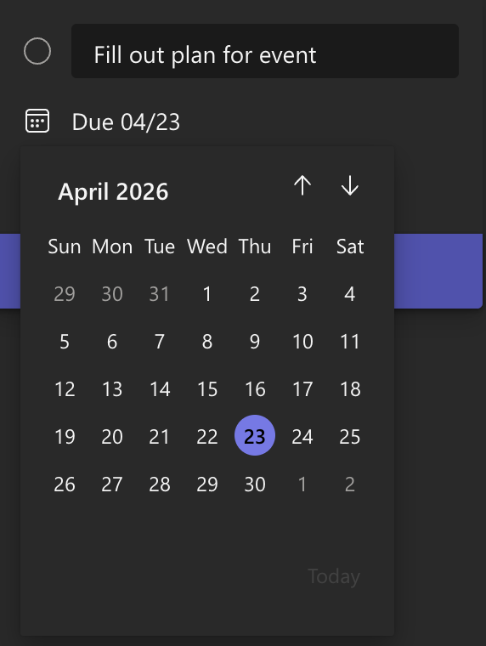
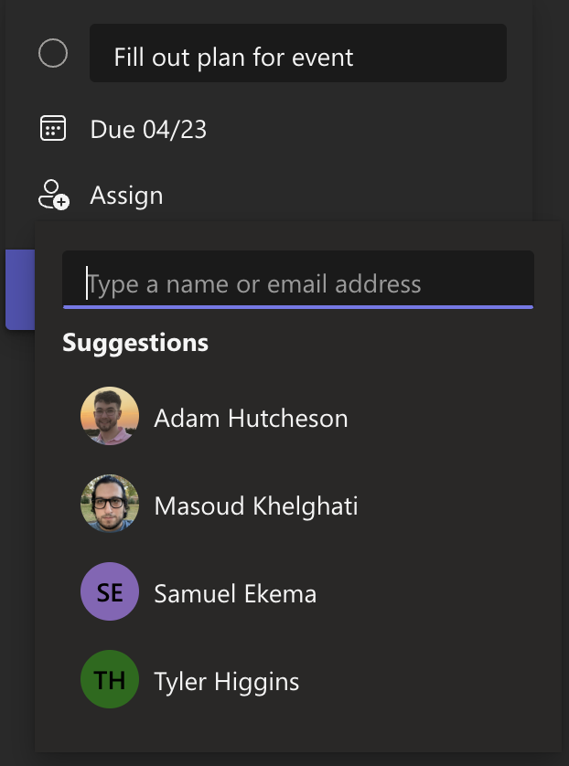
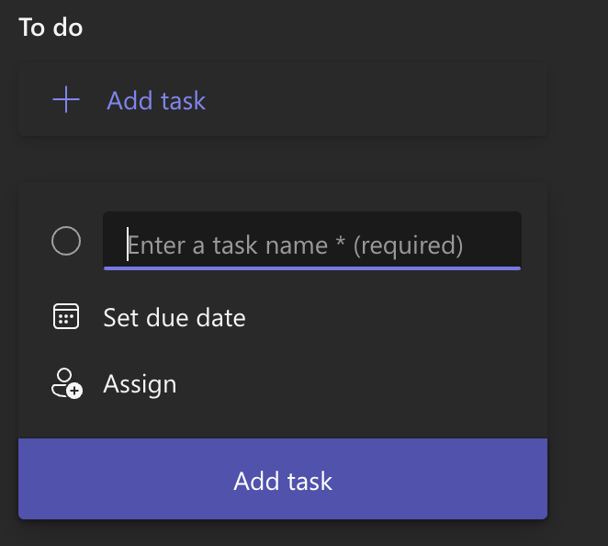
Task creation is easy!

Slide 7
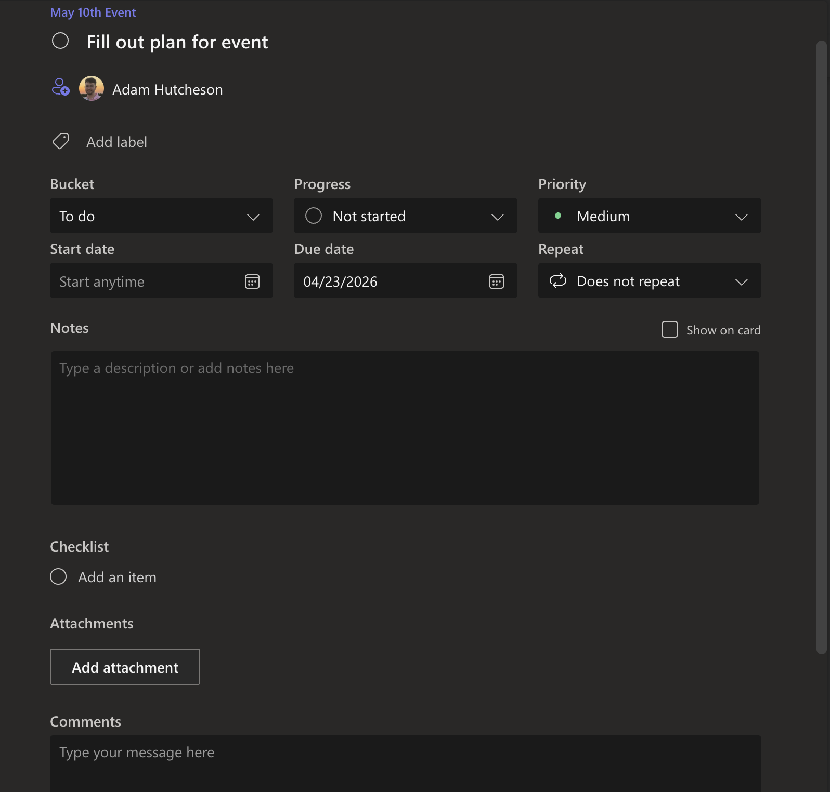
Task Details
Can be put into categories (“buckets”)
Progress tracking
Priority
Start/Due date
Repeating tasks
Subtasks (”checklist”)

Slide 8
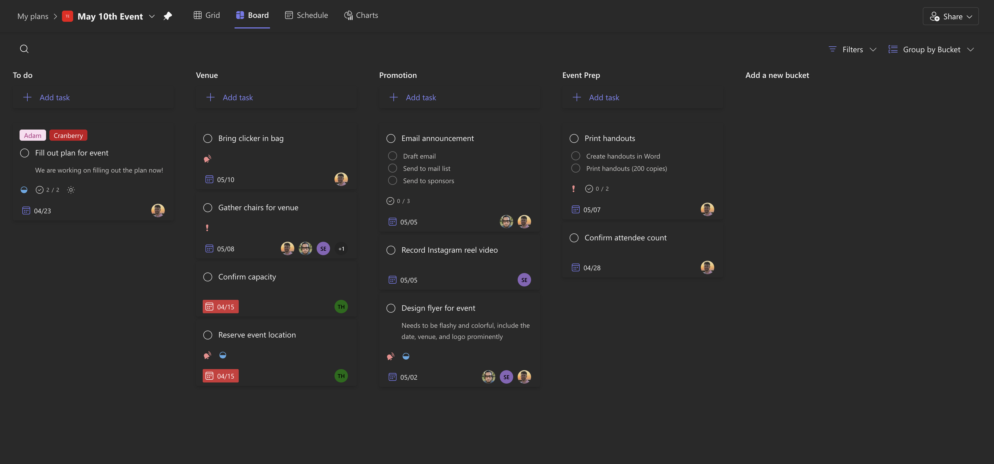
Board View
Default view
Sorted into columns based on bucket

Slide 9
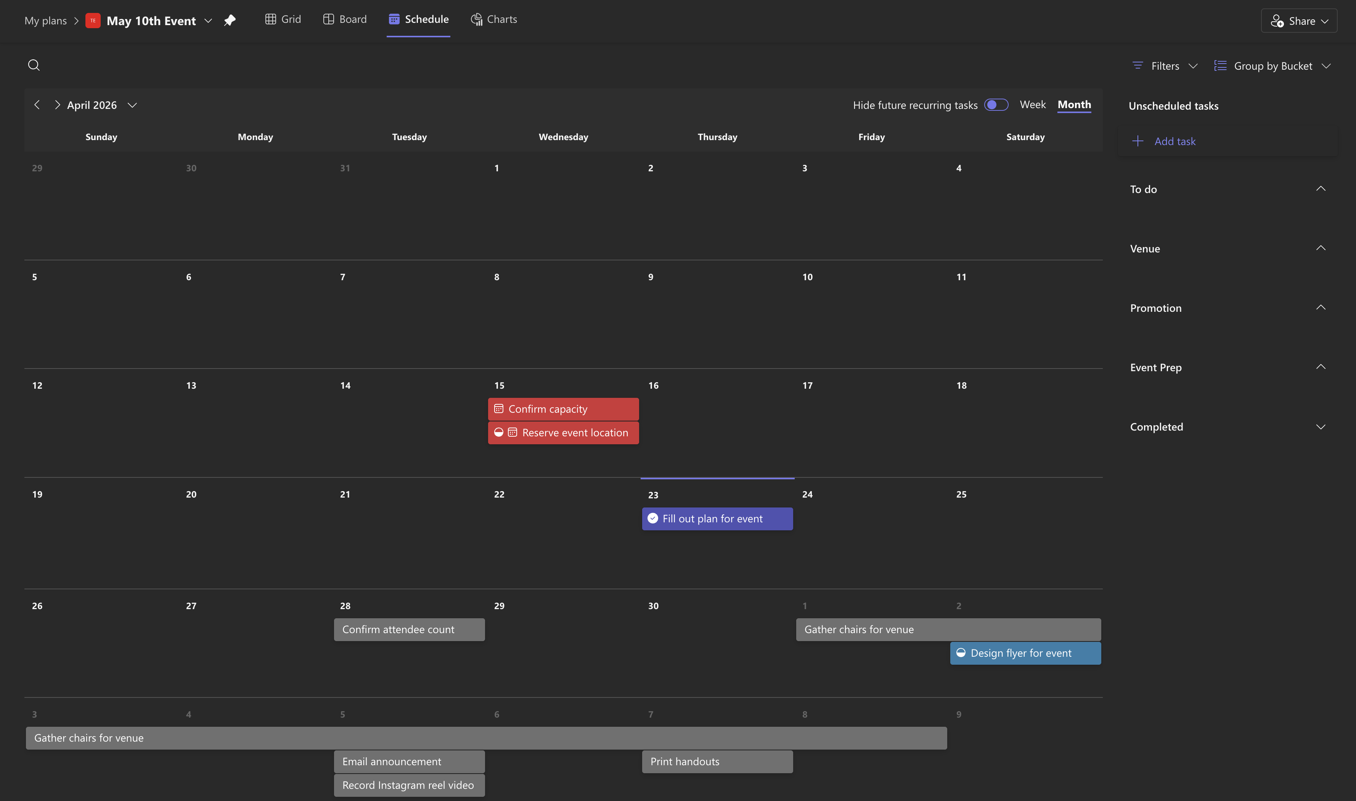
Schedule (calendar) View
Shows tasks on calendar
Shows length of task if start date is used

Slide 10
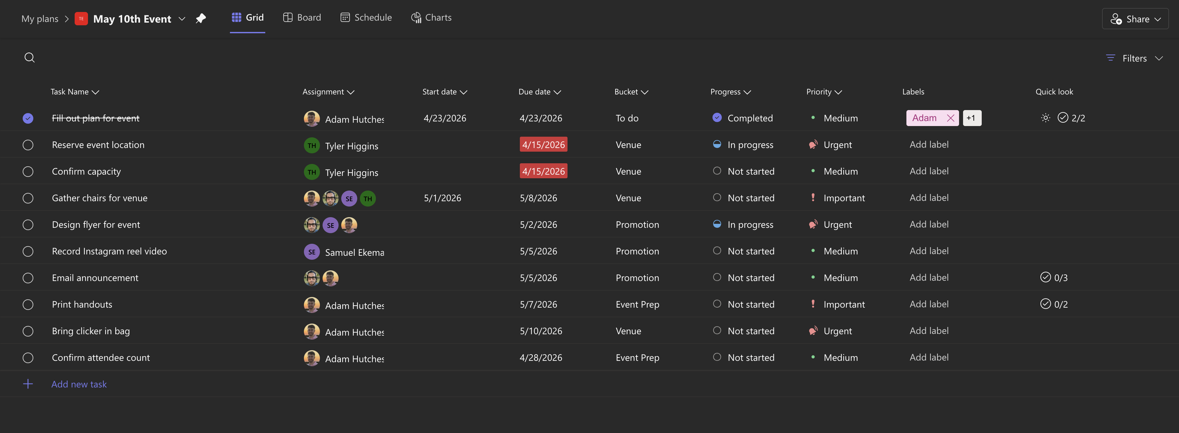
Grid View
More compact
Can sort by clicking on category

Slide 11
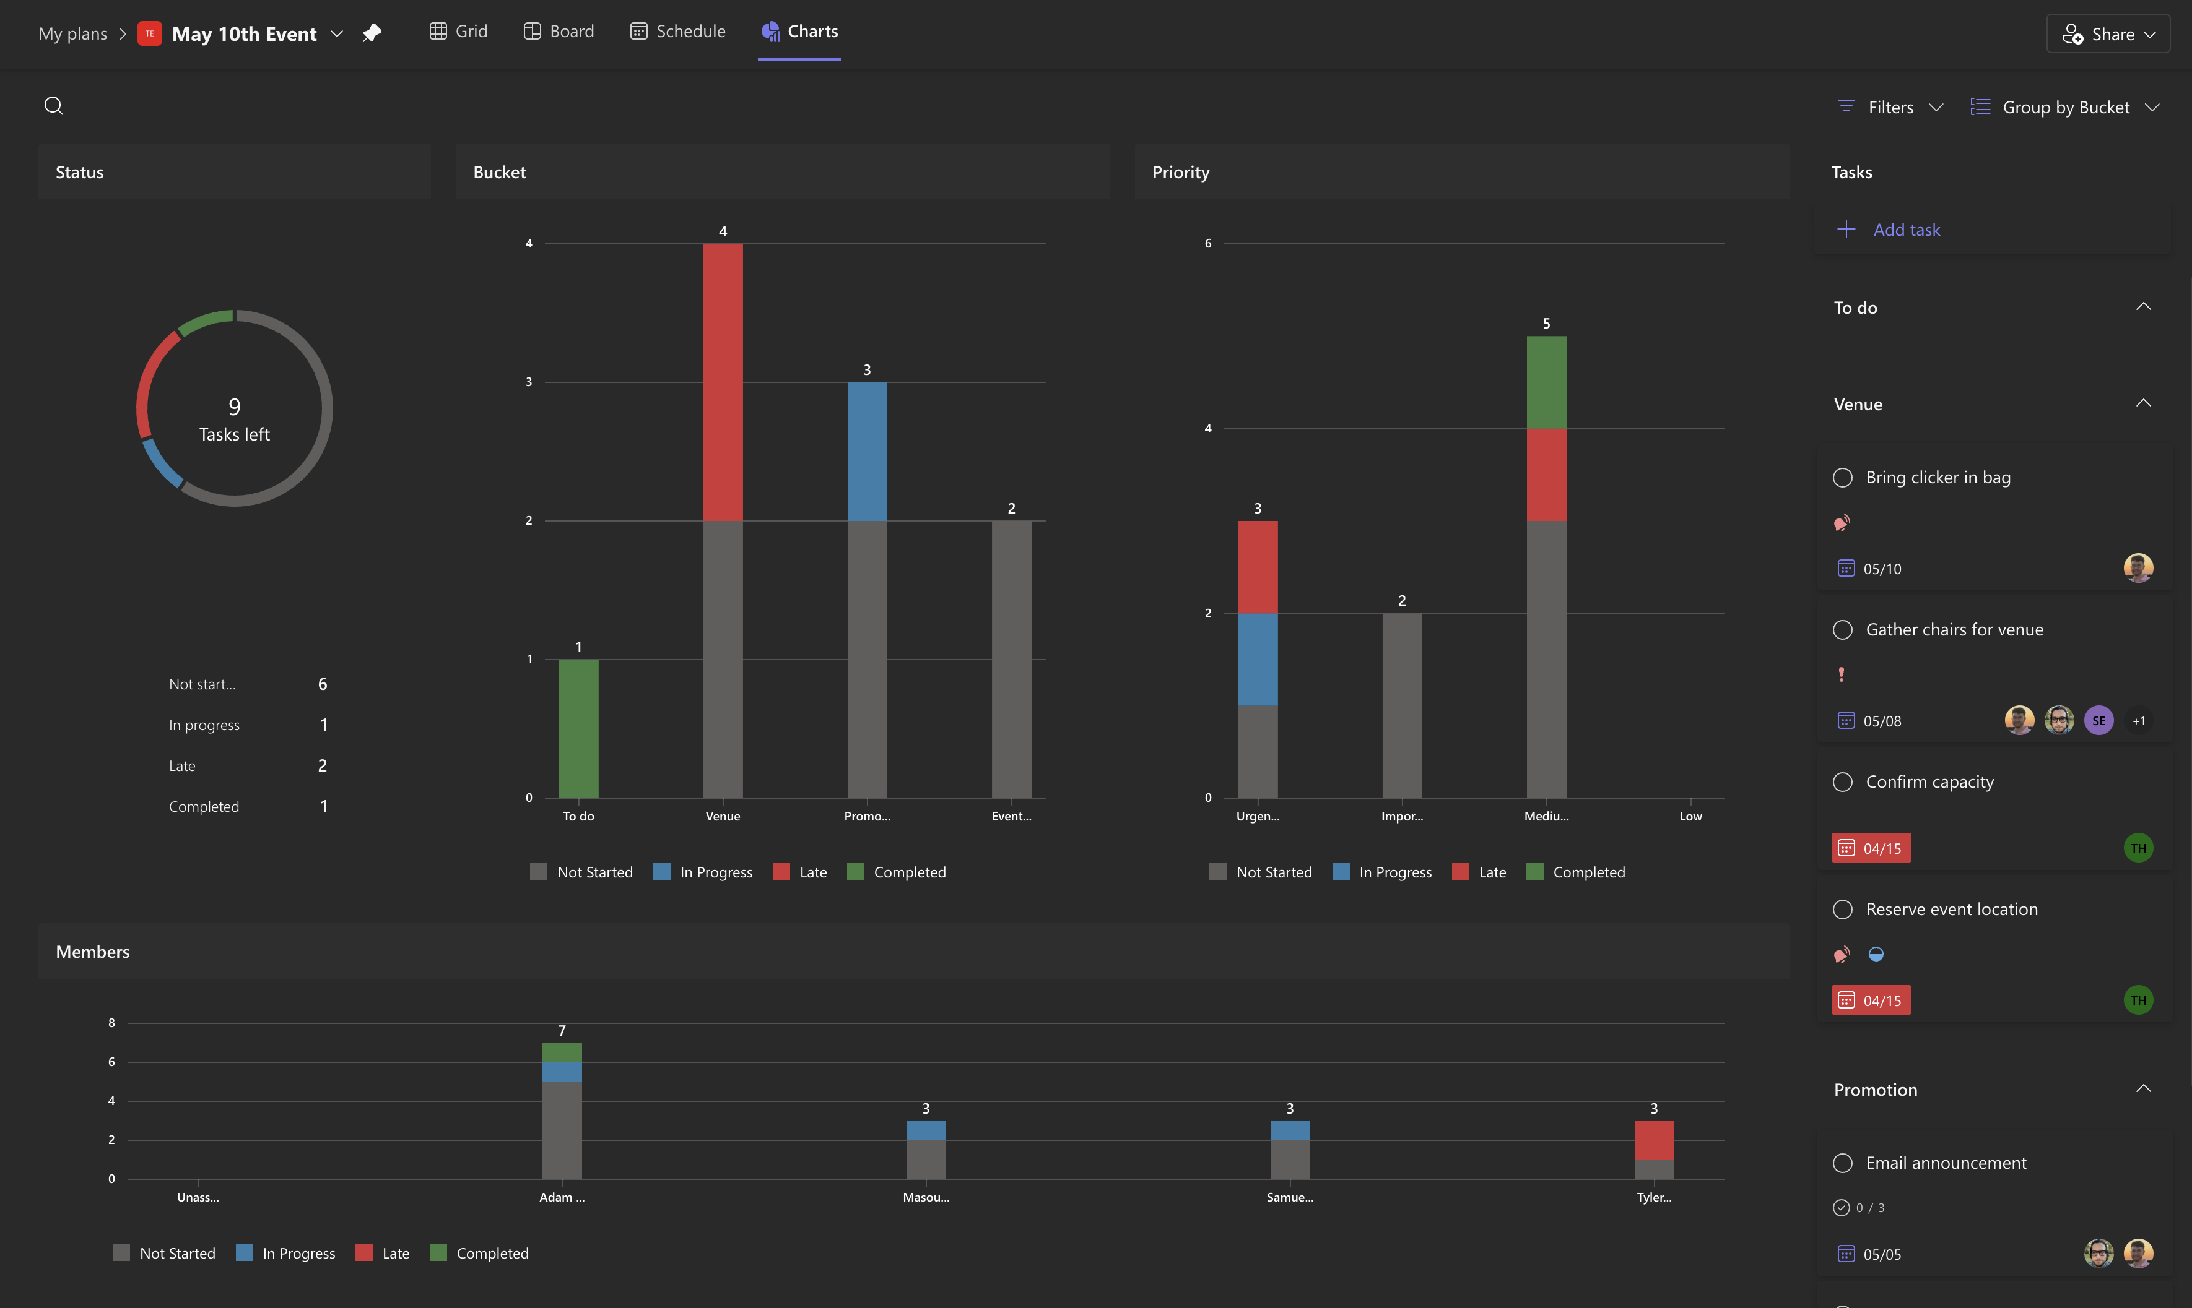
Chart View
Shows status of tasks, grouped by overall status, bucket assignment, priority, and member assignment
Great for seeing progress

Slide 12
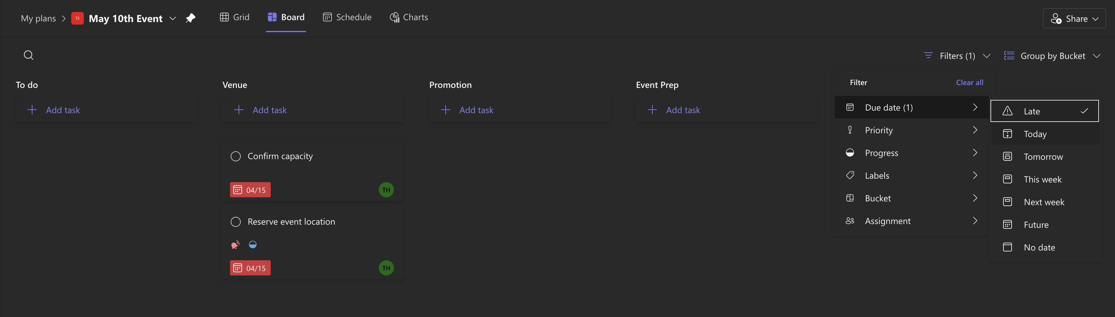
Views
All views can be filtered by:
due date
priority
progress
label
bucket
member assignment

Slide 13
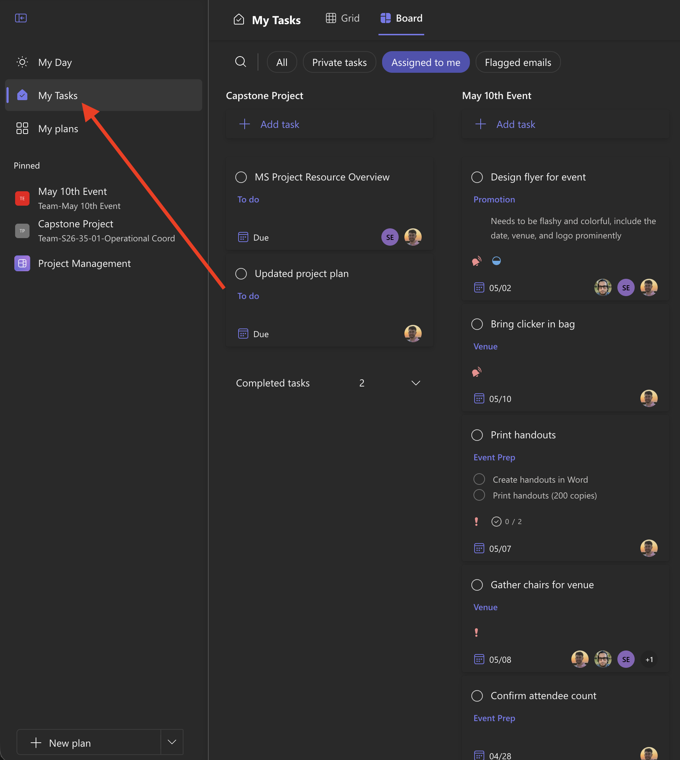
Seeing your own tasks
To quickly view your assigned tasks, click the “My Tasks” button in the sidebar

Slide 14
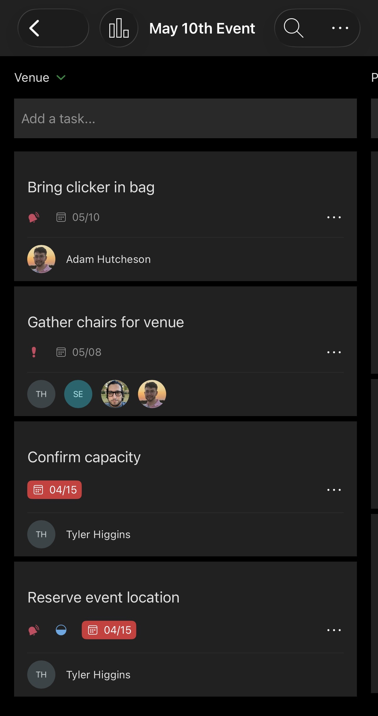
It works on phones!
App is available on iPhone App Store or Play Store for Android
Functions the same, slightly more difficult to use

