Slide 1

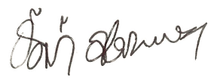

NIGMS Award for
2020
Sergiu Carpov* Nicolas Gama*
Mariya Georgieva*
* Inpher, Switzerland
Track 1: Secure Multi-Label Tumor Classification using Homomorphic Encryption
Arif Harmanci, PHD
Miran Kim, PHD
December 19, 2020

Slide 2
NIGMS Award for
2020
Fook Mun Chan*
Jun Jie Sim*
Chao Jin*
Wei Zhuang Zhou*
Benjamin Hong Meng Tan*
Khin Mi Mi Aung*
*Institute for Infocomm Research, A*STAR
Track 1: Secure Multi-Label Tumor Classification using Homomorphic Encryption
Arif Harmanci, PHD
Miran Kim, PHD
December 19, 2020

Slide 3
NIGMS Award for
2020
Wen-jie Lu*
Zhicong Huang*
Cheon Hong*
Yiping Ma**
Fuping Qu*
*Alibaba Gemini Lab, Alibaba Security
**University of Pennsylvania
Track 1: Secure Multi-Label Tumor Classification using Homomorphic Encryption
Arif Harmanci, PHD
Miran Kim, PHD
December 19, 2020

Slide 4
NIGMS Award for
2020
Seungwan Hong *
Jai Hyun Park*
Wonhee Cho *
Hyeongmin Choe*
Sumin Kim*
Jung Hee Cheon **
*Department of Mathematical Sciences , Seoul National University, Seoul, South Korea
**Seoul National University and Cryptolab
Track 1: Secure Multi-Label Tumor Classification using Homomorphic Encryption
Arif Harmanci, PHD
Miran Kim, PHD
December 19, 2020

Slide 5
NIGMS Award for
2020
Seungmyung Lee*
Seungwoo Jung*
Yongdae An*
Jungho Moon*
*Desilo Inc.
Track 1: Secure Multi-Label Tumor Classification using Homomorphic Encryption
Arif Harmanci, PHD
Miran Kim, PHD
December 19, 2020

Slide 6
NIGMS Award for
2020
Yongha Son*
Kyoohyung Han*
Jung Hoon Sohn*
Jinhyck Jeong*
*Samsung SDS.
Track 1: Secure Multi-Label Tumor Classification using Homomorphic Encryption
Arif Harmanci, PHD
Miran Kim, PHD
December 19, 2020

Slide 7
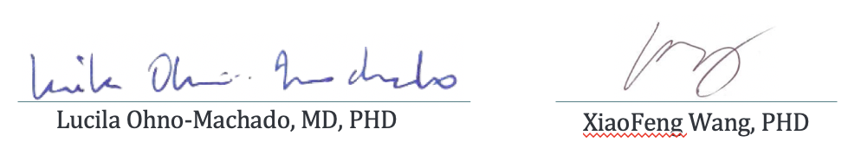

NIGMS Award for
2020
Yao Zhang*
Huanran Xue*
Huaming Rao*
Yong Cheng *
Chen Hou*
Zhikai Chen*
Bo Zhang*
^{Yangyu Tao*}
*Tencent
Track 2: Privacy –preserving clustering of single-cell transcriptomics data in SGX
February 20, 2021

Slide 8
NIGMS Award for
2020
Yuan Chen*
Cong Wang**
Jianfeng Zhu***
Leqian Zheng**
Yajin Zhou*
Kui Ren*
*Zhejing University
**City University of Hong Kong
***Hangzhou MiShu Technology
Track 2: Privacy –preserving clustering of single-cell transcriptomics data in SGX
February 20, 2021

Slide 9
NIGMS Award for
2020
Sergiu Carpov* Nicolas Gama*
Mariya Georgieva*
* Inpher, Lausanne, Switzerland
Track 3: Differentially private federated learning for cancer prediction model
Arif Harmanci, PHD
Miran Kim, PHD
February 20, 2021

Slide 10
NIGMS Award for
2020
Ninghui Li*
Tainhao Wang*
Zitao Li**
Bolin Ding**
*Purdue University
**Alibaba Group
Track 3: Differentially private federated learning for cancer prediction model
Arif Harmanci, PHD
Miran Kim, PHD
February 20, 2021

Slide 11
NIGMS Award for
2020
Constance Beguier*
Iqraa Meah*
Eric W. Tramel*
Jean Ogier du Terrail*
Mathieu Andreux*
* Owkin
Track 3: Differentially private federated learning for cancer prediction model
Arif Harmanci, PHD
Miran Kim, PHD
February 20, 2021

Slide 12
NIGMS Award for
2020
Md Momin Al Aziz*
Noman Mohammed*
Monowar Anjum*
* Data Security and Privacy lab, University of Manitoba
Track 3: Differentially private federated learning for cancer prediction model
Arif Harmanci, PHD
Miran Kim, PHD
February 20, 2021

