Slide 1
Perspectives on the
State’s Tax Structure
Presented to:
Senate Select Committee on
Recovery, Reform, and Realignment
Hon. Sam Blakeslee, Chair
February 2, 2011
www.lao.ca.gov

Slide 2
Background:
Taxes in California
State and Local Governments Rely Predominantly On the Following Four Taxes:
  Personal income tax (PIT)
  Sales and use tax (SUT)
  Corporate tax (CT)
  Property tax
For the State, Revenues From the First Three Taxes Comprise 95 Percent of Proposed 2011-12 General Fund Revenues

Slide 3
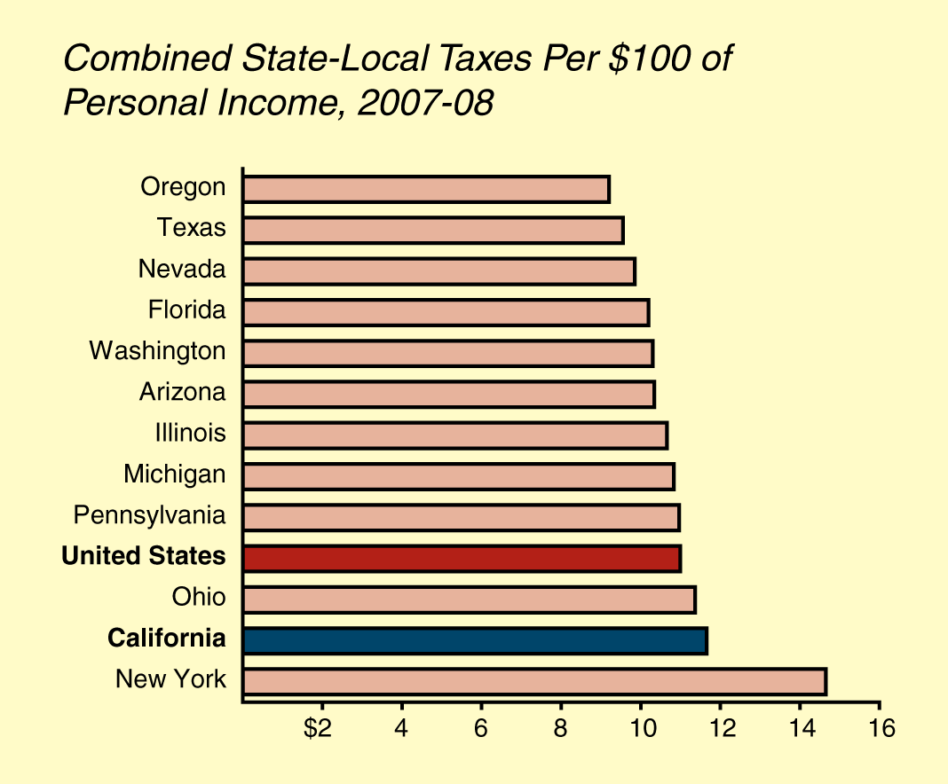
Background:
Tax Burden—Aggregate

Slide 4
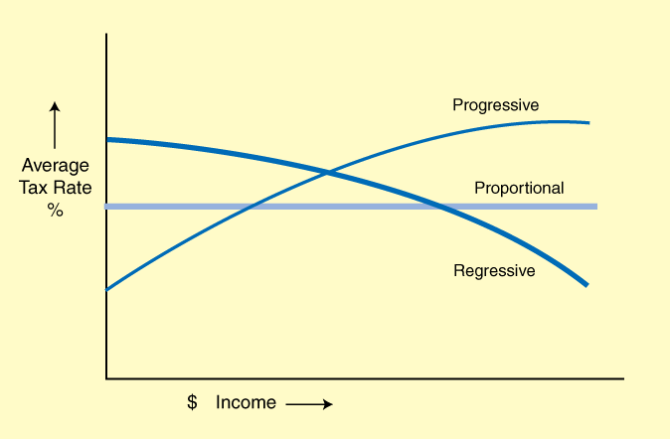
Background:
Progressivity and Regressivity

Slide 5
Background:
Tax Incidence
Important Difference Between Who Pays a Tax And Who Bears the Burden of the Tax (Incidence)
  Corporations legally owe taxes, but the burden is borne by workers, consumers, and owners of capital
  Retailers legally owe sales taxes, but the burden is borne in large part by consumers
Economic Perspectives
  General agreement on who bears PIT and SUT
  Differing views on CT and, to some degree, on the property tax

Slide 6
What Criteria Do You Use to
Judge a Tax System?
Reliability (Growth and Stability)
Broad-Based Levies
Impact on Economic Activity
Equity Considerations
Administrative Feasibility

Slide 7
How Our Tax System Stacks Up—
The Positive
“Robust” System
  Grows roughly in line with the economy
Broad-Based Taxes, Levied on:
  Income
  Consumption
  Wealth (property tax)

Slide 8
How Our Tax System Stacks Up—
The Negative
Major Volatility
High Marginal Rates
Challenges to Tax Bases
  SUT (services and remote sales)
  Tax expenditures
  Tax gap

Slide 9
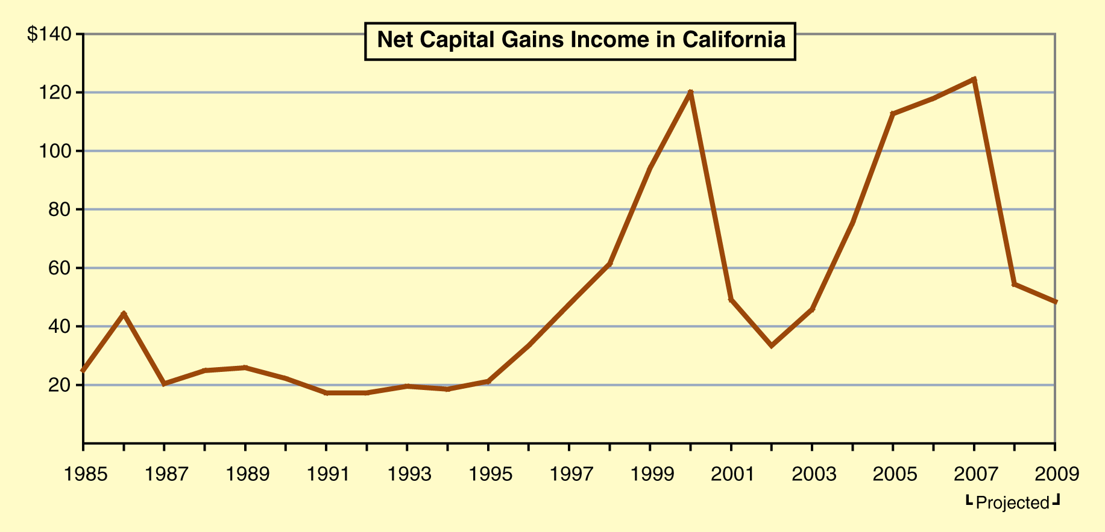
Volatility—
Capital Gains Are the Main Story
(In Billions)

Slide 10
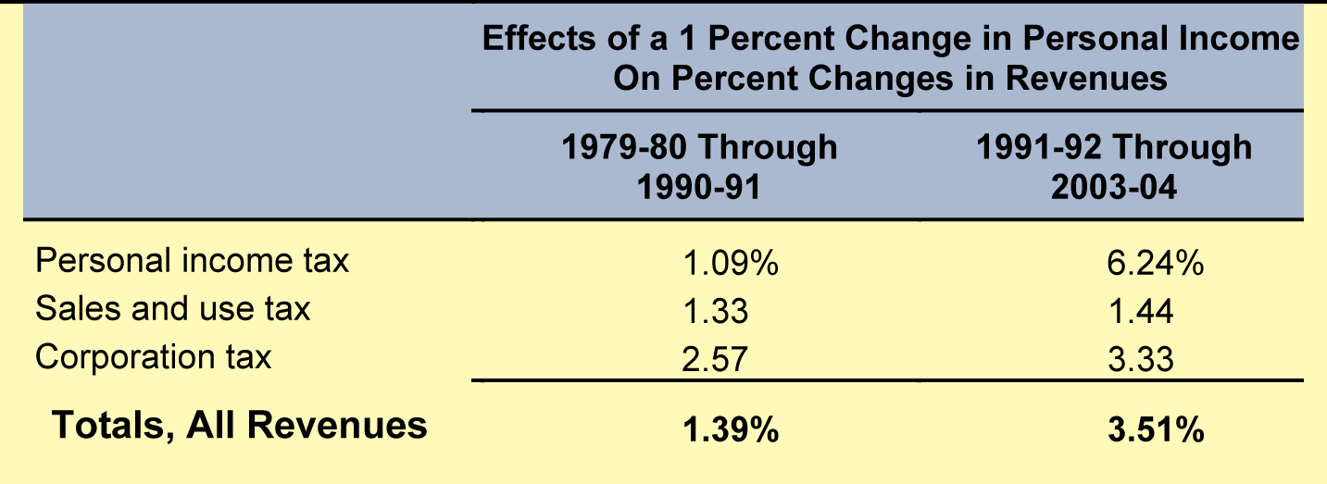
Volatility—
Impact on State Revenues

Slide 11
Volatility—
Impact on the State Budget
Boom/Bust in PIT Revenues Complicated Our Budgeting Process Enormously
Problems in Late 1990s and Mid-2000s
  Surge of revenues one-time or ongoing?
  Over-committed ongoing spending programs
  Failure to set aside revenues
Result: Huge Operating Shortfalls

Slide 12
Addressing Volatility:
Budget Management Options
Most Effective Tool: Set Aside Above-Average Revenue Growth in Reserves
State Has Taken Action in This Regard
  Proposition 58
  ACA 4 on 2012 ballot

Slide 13
Addressing Volatility:
Revising the Revenue System
Reduce PIT Rates on Capital Gains
Reduce Progressivity of Rate Structure
Rebalance Mix of Taxes Away From PIT
Income Averaging on Capital Gains/
Stock Options

Slide 14
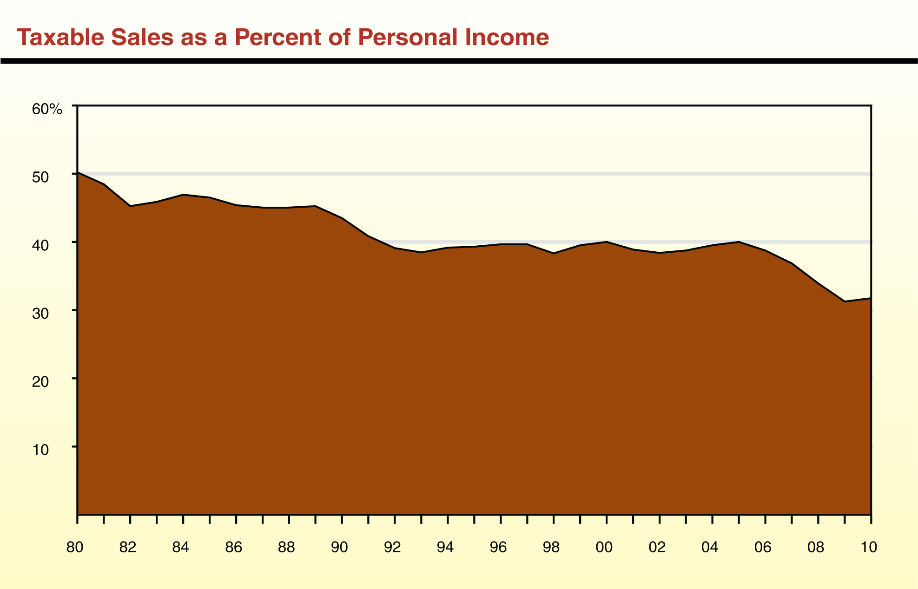
Base Broadening—
Declining Sales Tax Base

Slide 15
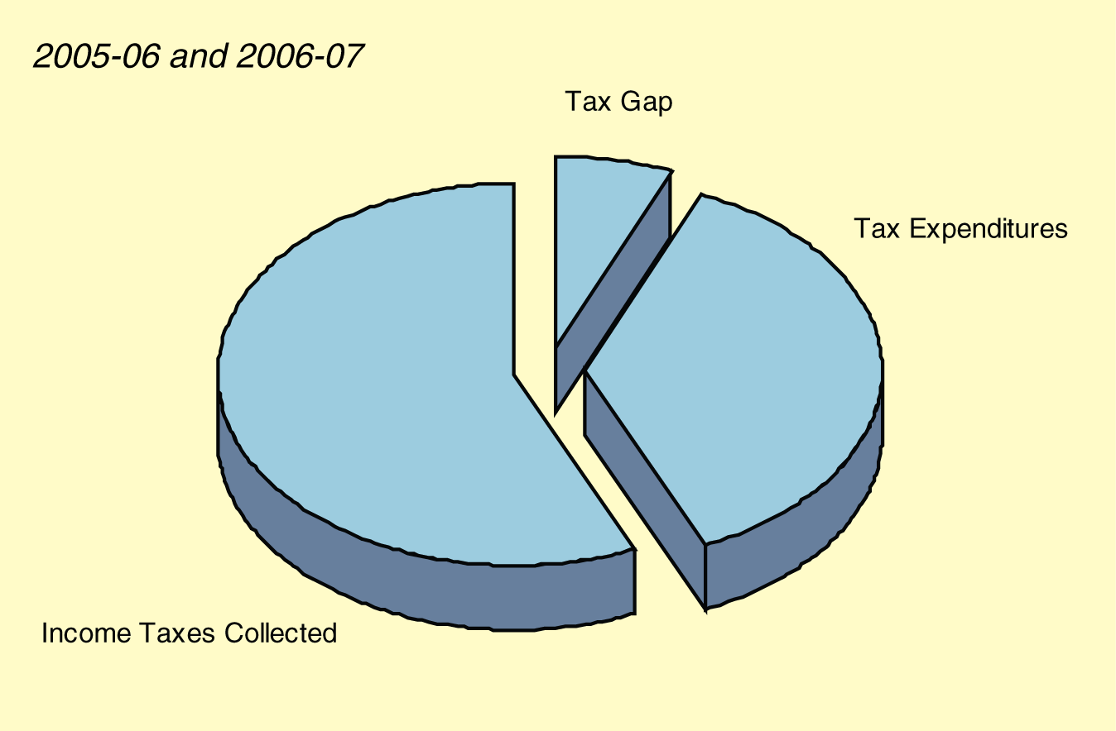
Base Broadening—
Inroads on Income Tax Base

Slide 16
Base Broadening—
High Marginal Rates
PIT—One of the Highest Rate in the Country
SUT—Highest Uniform Rate
In the Country
CT—One of the Highest in the Country

Slide 17
Addressing Base Broadening—
Expand Sales Tax to Include Services
Turn Tax on All Tangible Goods Into
More of a Tax on Consumption
  Lower rate
  Exclude “intermediate” business purchases
  More equitable treatment of economic activity
Issues
  How inclusive? Will it apply to: Housing? Schooling? Medical?

Slide 18
Addressing Base Broadening—
Expand Income Tax Base
Reduce/Eliminate Tax Expenditure Programs (TEPs) and Lower Rates
Many TEPs Result in:
  Distortions
  Inequitable treatment among taxpayers

Slide 19
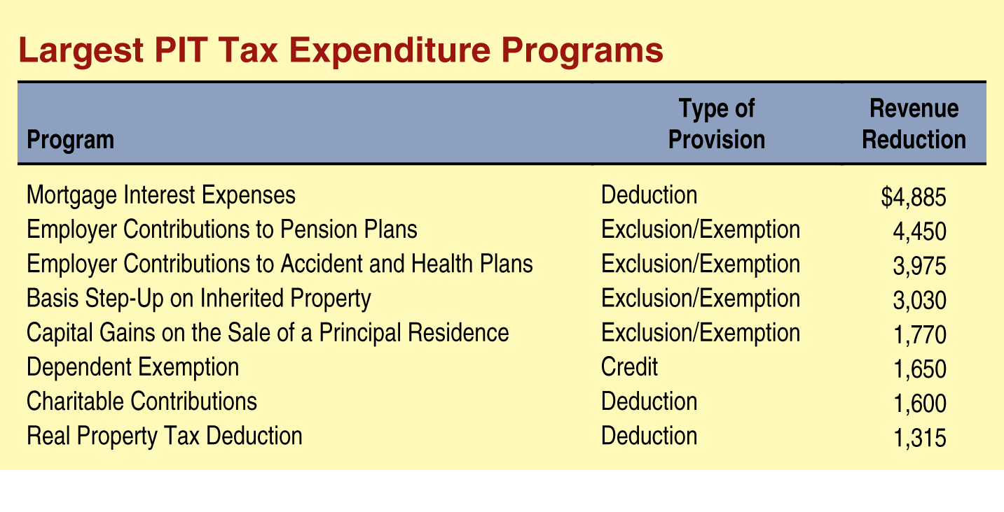
Addressing Base Broadening—
Tackling Tax Expenditures
2006-07
(In Millions)

Slide 20
Conclusion
The State Has a Sound Tax System
Improvements Should Be Focused on:
  Reducing volatility
  Keeping bases as broad as possible and
  rates as low as possible

