Slide 1
Itss software development
EcoBike Application
Group 1

Slide 2
Team 1
No. | Team member | Student ID | Assignment | Contribution
1 | Dinh Huu Dai | 20194735 | Team leader, refining documentation, backend implementation | 35%
2 | Pham Thanh Bien | 20194731 | Preparing documentation, implementing backend | 35%
3 | Nguyen Quoc Anh | 20194726 | Preparing documentation, implementing frontend | 30%

Slide 3

Content of presentation
1. Requirements Analysis
2. Design
3. Design considerations
4. Design pattern
5. Demo

Slide 4
Requirements Analysis

Slide 5
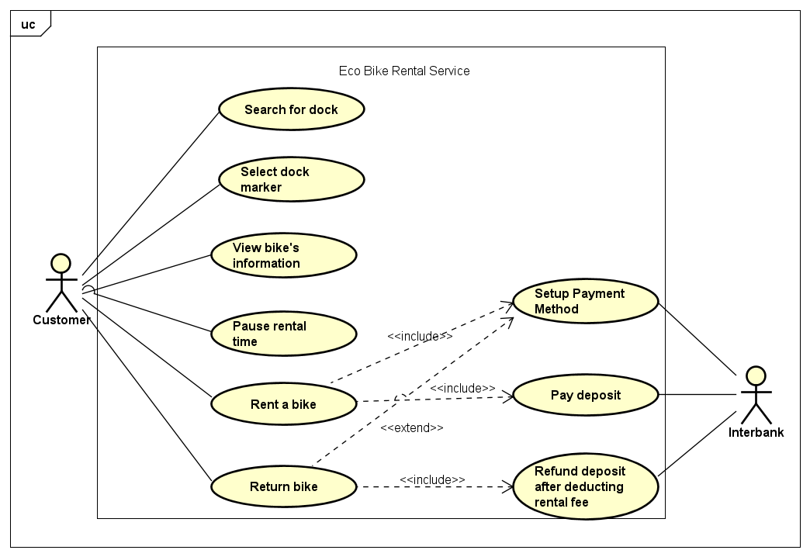
Usecase Diagram

Slide 6
Design
How we design the architecture of application

Slide 7

Class Diagram

Slide 8
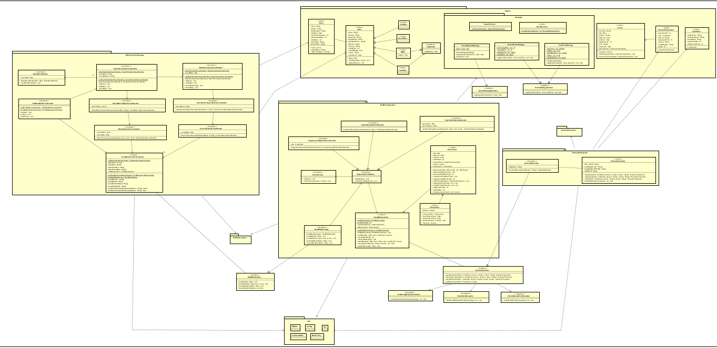
General Class Diagram

Slide 9
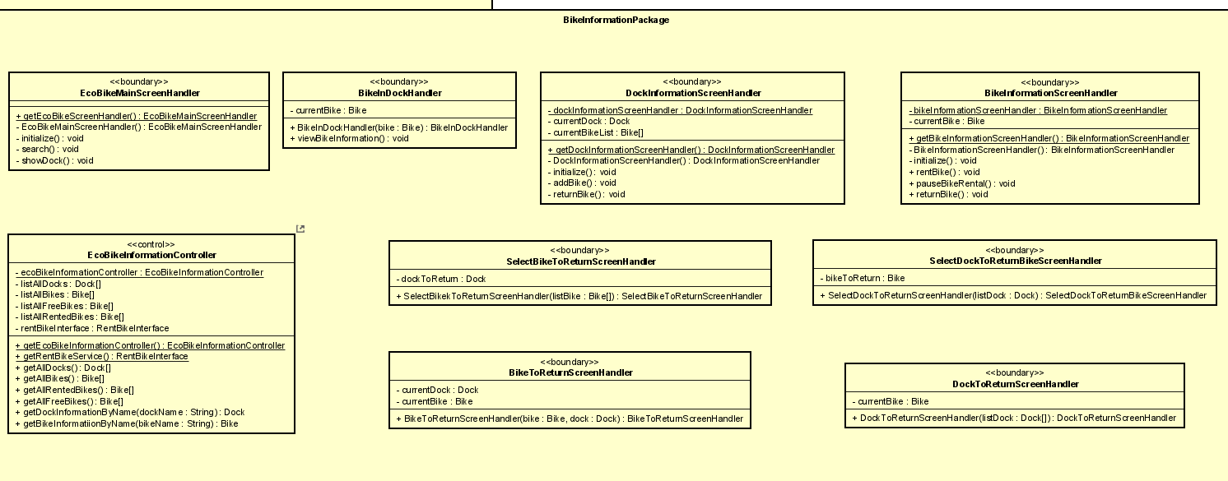
Class Diagram for Package BikeInformation

Slide 10
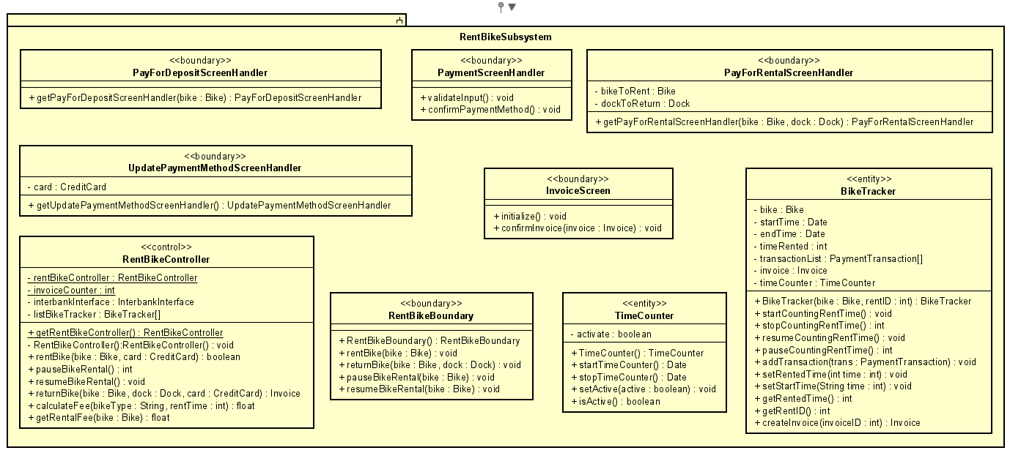
Class Diagram for Subsystem RentBike

Slide 11
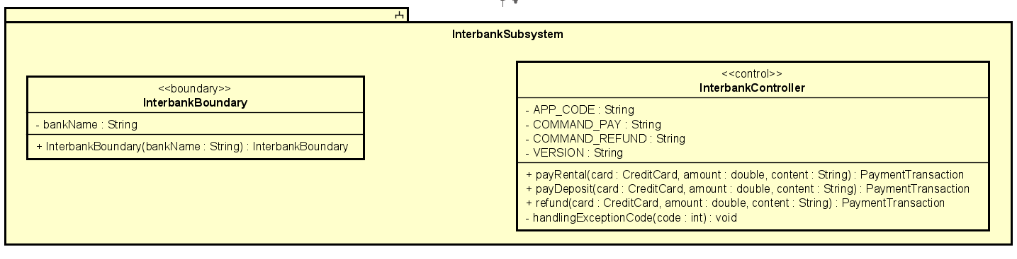
Class Diagram for Subsystem InterBank

Slide 12
Interaction diagram

Slide 13
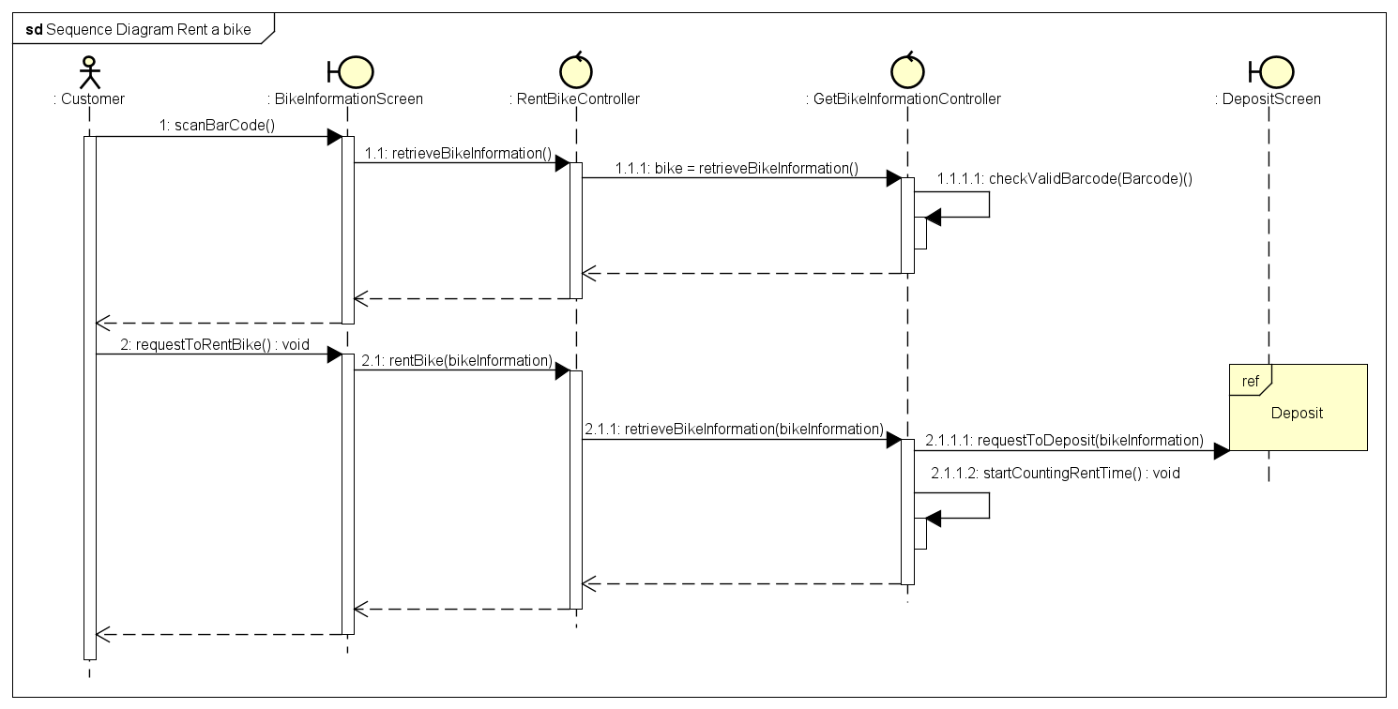
Sequence Diagram for RentABike UseCase

Slide 14
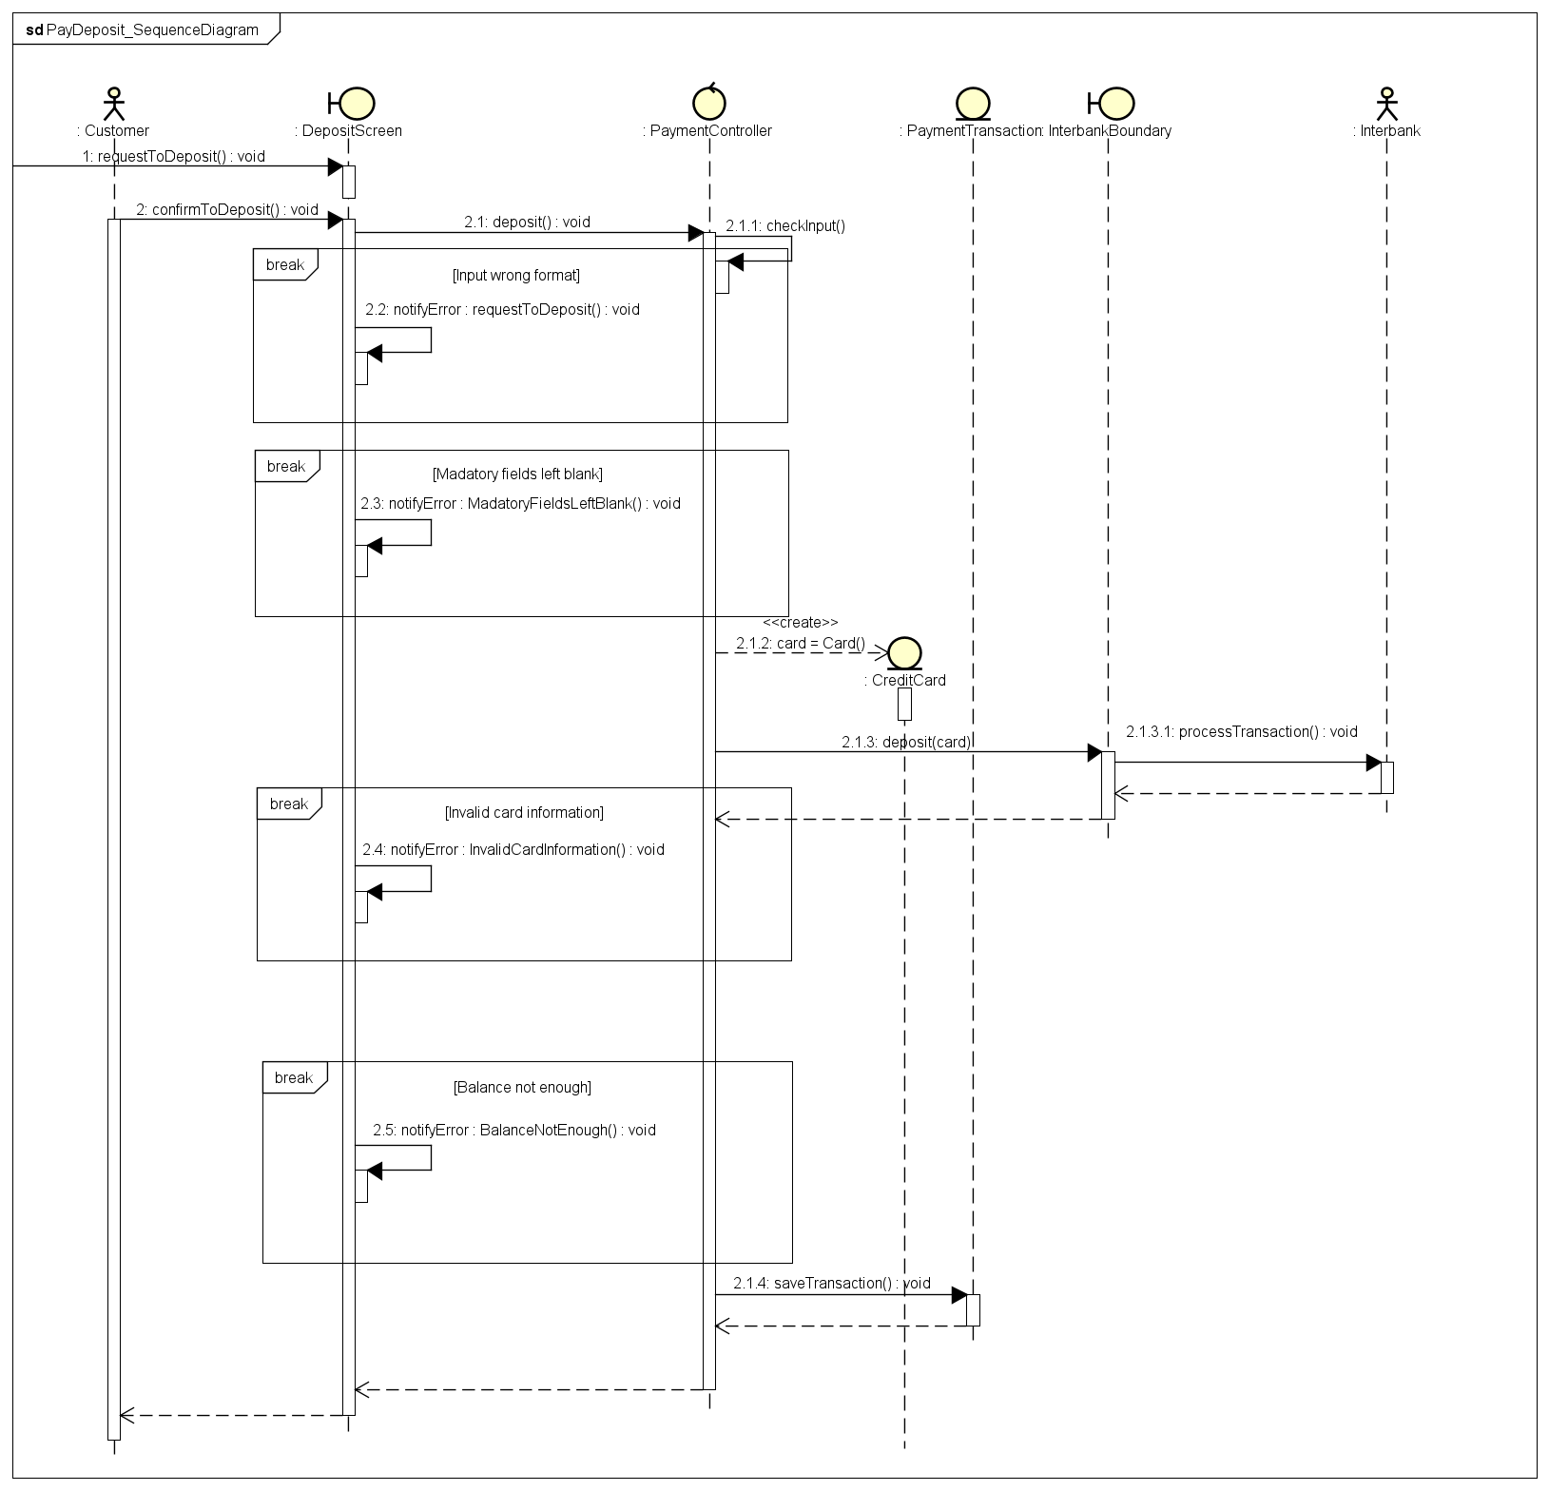
Sequence Diagram for Deposit UseCase

Slide 15
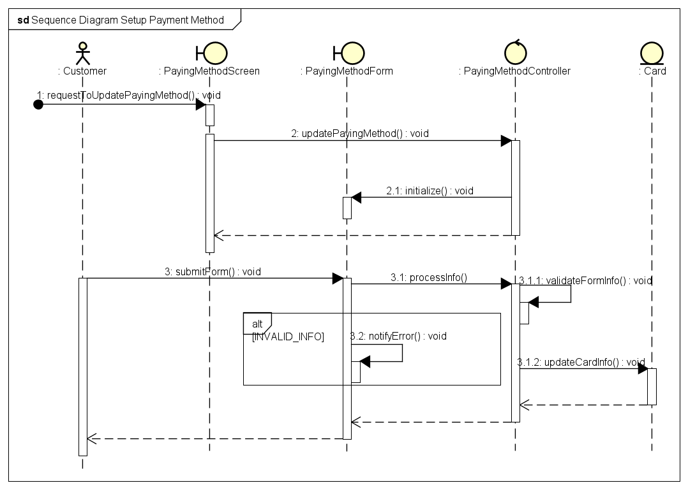
Sequence Diagram for SetupPaymentMethod UseCase

Slide 16
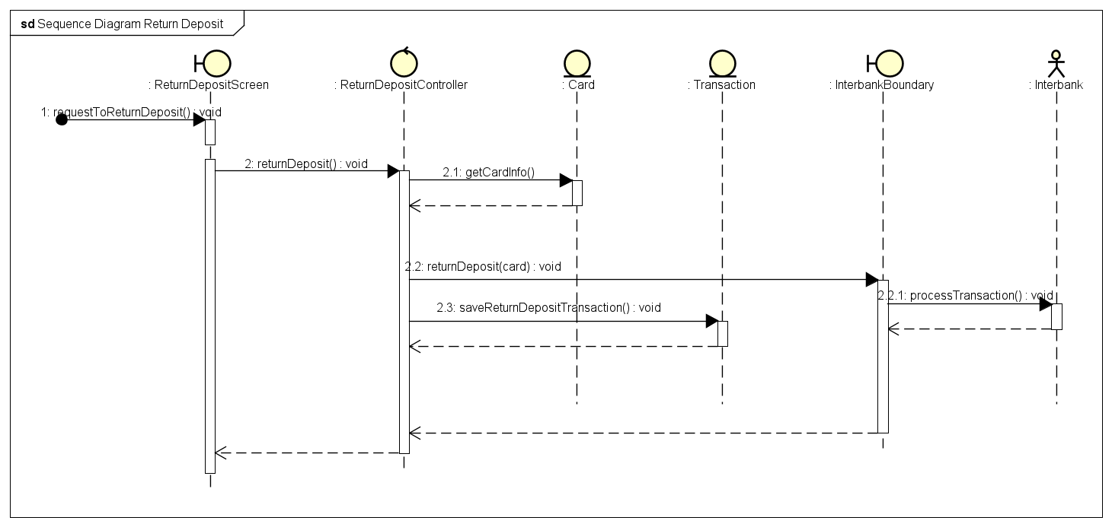
Sequence Diagram for ReturnBike UseCase

Slide 17
Sequence Diagram for ReturnDeposit UseCase

Slide 18
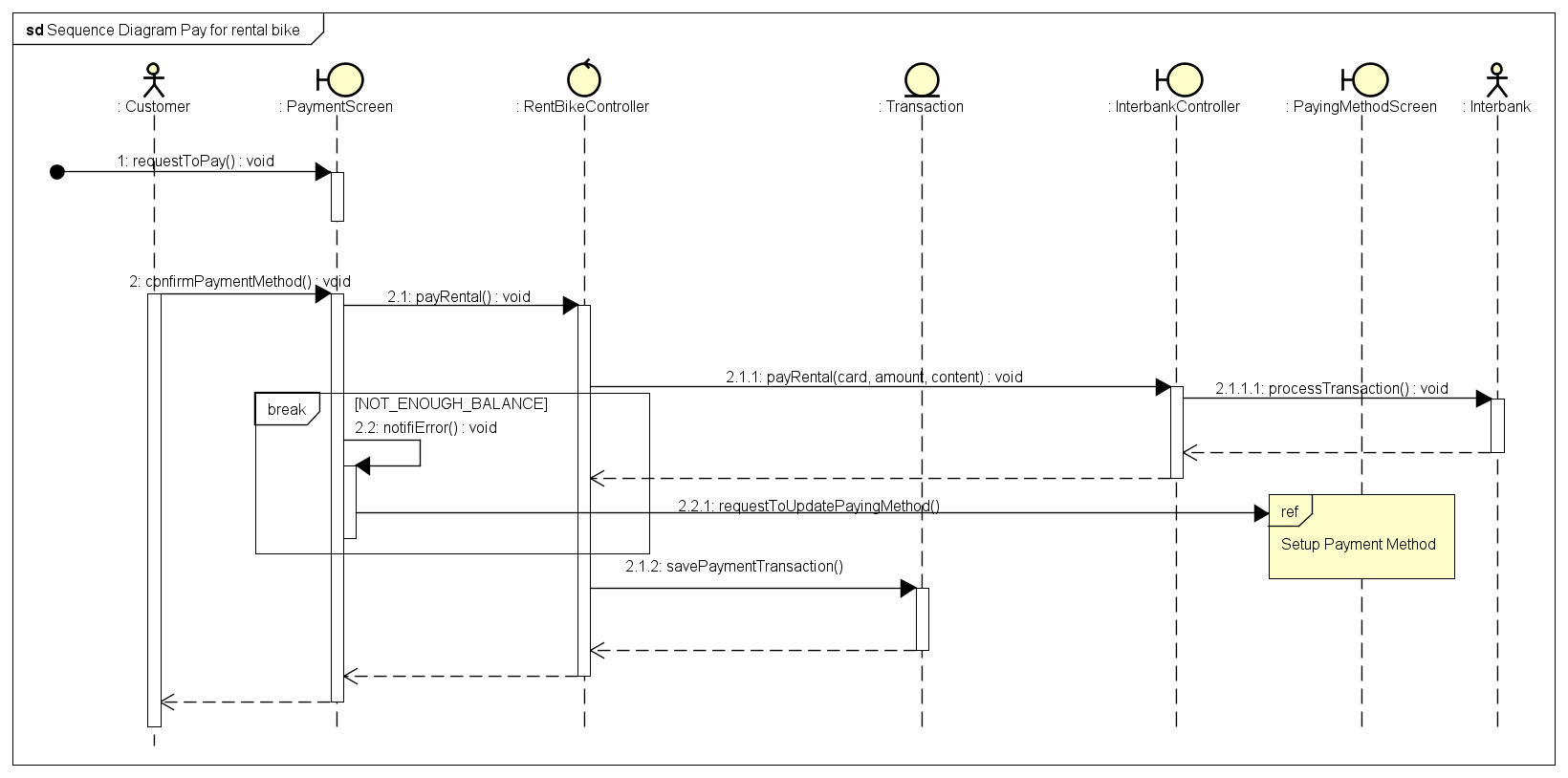
Sequence Diagram for PayForRental UseCase

Slide 19
Database Design

Slide 20
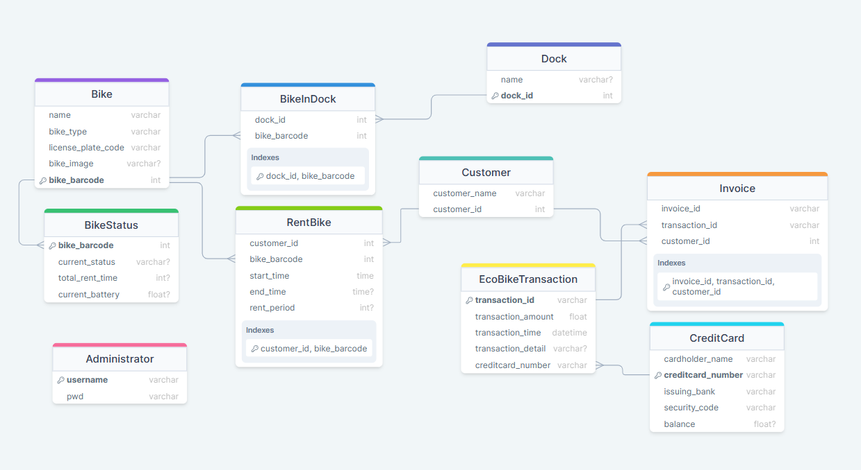
Database Design

Slide 21
Design Considerations
Problems we met in our design and how we tackle them

Slide 22
Coupling
Content coupling: Our modules are self-contained and don’t rely on other modules to operate
Common coupling: We only use static with Singleton pattern to share the controller instance between boundaries to control the flow of the programs. Some constants exist in the system, but only with careful usage shared between the related modules
Control coupling: Our methods are designed to carry out only one specific task, so no control coupling existed
Stamp coupling: In module RentBikeServiceController, the Bike entities was used as an argument for the calculateFee method, which only need bikeType and totalRentTime as arguments
Data coupling: Boundaries need data to render GUI, which is acceptable

Slide 23
Cohesion
Sequential cohesion: Mainly; output of this element is input of another element (E.g. Controllers vs Boundaries)
Logical cohesion: There are some specific classes used for reading information (E.g. Class for reading database)
Coincidental cohesion: The only visible coincidental cohesion in our project might be the class Configs, which contains some constant share between some controllers and entities
Temporal cohesion: In our project, we put all controllers into a Controller package, screen handlers into a View package, which might be considered temporal cohesion
Information cohesion: All methods are to perform database queries or manipulate json string

Slide 24
Tech stack
Programming Language
Database
UML
GUI

Slide 25
Design Patterns
Software design patterns we have applied in the application

Slide 26
Design pattern used
Façade : We use InterbankInterface for communication between software and interbank subsystem. It decrease the overall complexity of our application and provides an easier interface for communication
Singleton: We use Singleton pattern for screen handler so that we do not need to create a new instance of screen handler each time we change the screen
Observer: The observer pattern is used to observe the change in the dock so each time a bike is rented or returned, the GUI can be updated accordingly without having to query the database. We only need to store the status back to the database

Slide 27
Demo
How our application functions

Slide 28
Thank you!

