Slide 1
From Fragile to Agile Software Architecture
Downloadable Figures
Kirk Knoernschild, Bill Holz
Notes:
Presenter's Name
Presenter's Name

Slide 2
Figure 1
The Goal of Architecture
Architecture
Goal of Architecture
Impact of Change
Impact of Change
Design
Architecture & Design
Cost of Change
Cost of Change
Source: Gartner
ID: 384267

Slide 3
Figure 2
Big Architecture Upfront
Requirements
Design
Implementation
Test
Software Architecture Document
This document details every technical aspect of the system
1,000 Pages
Knowledge-Increasing Activities
Source: Gartner
ID: 384267

Slide 4
Figure 3
The Ivory Tower
Services
Architect's Ivory Tower
Modules
Lack of Transparency
Lack of Understanding
Increase Transparency & Understanding
Depth
Breadth
Packages
Classes
Code
Development Team
Development Team
Source: Gartner
ID: 384267

Slide 5
Figure 4
Three Pillars of Architecture
Architects
Architect
Architecture
Social Pillar
Process Pillar
Structural Pillar
Architecture is an activity performed by people
Teams follow a process to create architecture
The architecture must possess structural integrity
Source: Gartner
ID: 384267

Slide 6
Figure 5
Continuous Architecture
Refactoring
Software Architect
Constraints
Corrects
Ideas
Developers
Source: Gartner
ID: 384267

Slide 7
Figure 6
Componentized Architecture
Functional Behavior
Build and Test
Packaged Application
Application Server
Source: Gartner
ID: 384267

Slide 8
Figure 7
Microservices Architecture
Functional Behavior
Build and Test
Packaged Services
IaaS/PaaS
Source: Gartner
ID: 384267

Slide 9
Figure 8
Structural Architectural Agility
Functional Behavior
Build and Test
Packaged Application
Application Server/IaaS/PaaS
Proxy component
Refactor this component
Service
Source: Gartner
ID: 384267

Slide 10
Figure 9
Architecture All the Way Down
Granularity
Coarse
Fine
Packages/ Namespaces
Services
Modules
Classes
Architecture All the Way Down
Source: Gartner
ID: 384267

Slide 11
Figure 10
Views of a System
Classes
Packages
Modules
A
B
C
Source: Gartner
ID: 384267

Slide 12
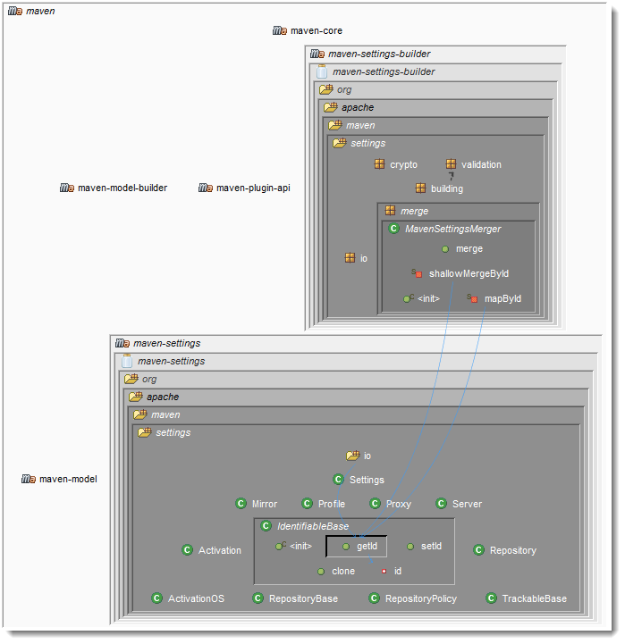
Figure 11
Generated Architecture Diagram
Source: Gartner
ID: 384267

Slide 13
Figure 12
Exposing an API and Encapsulating Implementation
This mess is highly visible
This mess is encapsulated
Source: Gartner
ID: 384267

