Slide 1

ONBOARDING PRESENTATION
Name: Nguyen Thien Nhan (NGT)
Position: .NET Associate Engineer
Coach: + Nguyen Tran Vong (TVN)
+ Tran Minh Phuoc (MPT)
Devision Manager Zindel Dominik (DZI)

Slide 2
Table of content
Who am I?
What have I learnt in ELCA?
What did I do in ELCA?
Demo Final Exercise
Feedback

Slide 3
WHO AM I
Name: Nguyen Thien Nhan
VISA: NGT
Position: .NET Associate Engineer
Start date: April 2, 2018
Study in: Bach Khoa University

Slide 4
WHAT HAVE I LEARNT IN ELCA?
Onboarding training:
Basic Know-How:
C#, .NET framework
Object-oriented programming
Coding best practice
Multi-tier architecture, Multilingual
Design Pattern
b) Backend:
SQL
Concurrent update, Transaction
Unit Test
Entity framework
Frontend:
Angular + TypeScript
ASP.NET Web API
2. PIM Tool Final Exercise

Slide 5
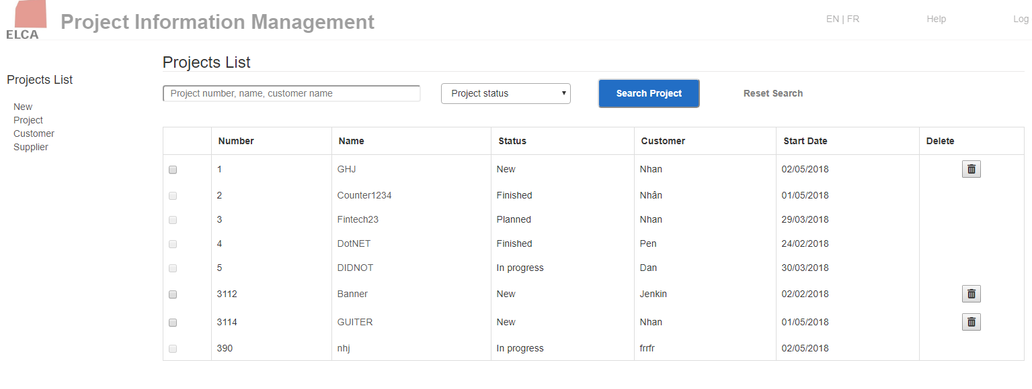
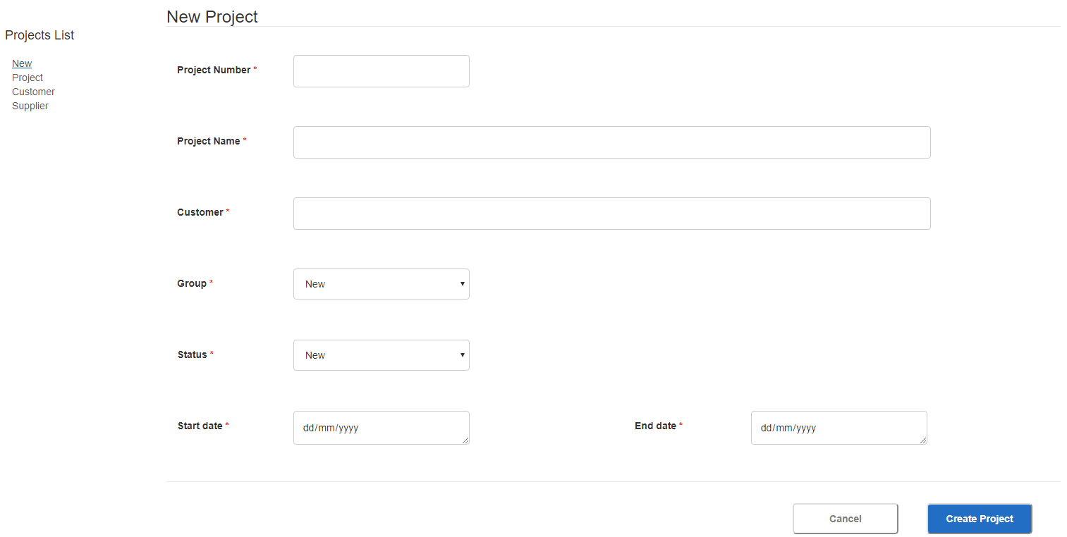
WHAT DID I DO IN ELCA?

Slide 6



PIM TOOL ARCHITECTURE
SQL Database
Angular Application
CLIENT
Controller
Repository
Data Access Object
WEB API
Data Transfer Object

Slide 7
DEMO PIM TOOL FINAL PROJECT

Slide 8
FEEDBACK
In ELCA Company:
Work environment is very good for staff
The Onboard Training program is extremely effective and thorough with newcomer
Effective teamwork
It is possible to apply the learned technology and knowledge to the actual project
Everyone is very friendly and sociable
Guided enthusiastically when having the problem
Having a lot of the funny events
Project development processing are very professional

Slide 9
Nguyen Thien Nhan
NGT
ngt@elca.vn

