Slide 1
atWare Hackathon 24-25/Jan/2015
HCMC University of Technology
Make people smile!
Presenter:
Le Cong Hau
Tran Van Phuc
Nguyen Huu Thang

Slide 2
Contents
Introduction
Implementation
Extension
Demo

Slide 3
Introduction
User
User
User
Ask!
User
User
User
User
User
User
User
User
User

Slide 4
Introduction
User
User
User
Answer!
User
User
User
User
User
User
User
User
User

Slide 5
Introduction
User
User
User
Answer!
User
User
User
User
User
User
User
User
User

Slide 6

Introduction
Ask!
User

Slide 7

Introduction
Answer!
User

Slide 8

Introduction
Good Answer!
User

Slide 9
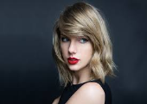
Introduction
A | B
What is your favourite food?
Who is your idol? (B receives random question) | Taylor Swift !

Slide 10


Implementation
Interesting Answer!
User
What is your favourite food?
 | Taylor Swift !

Slide 11

Introduction
Chat
User
User
Friends in real life

Slide 12
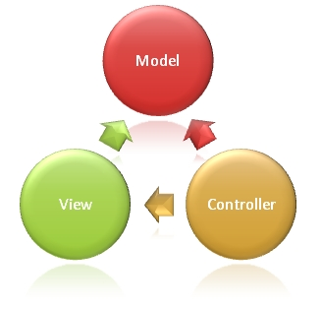
Implementation
Server-side language: php.
Database: MySQL.
Using MVC model :

Slide 13
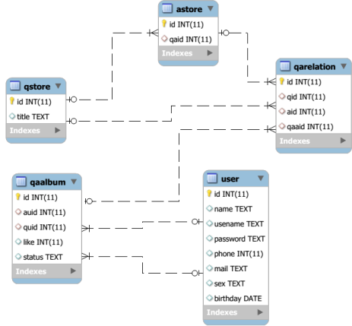
Implementation
Database Design:

Slide 14
Implementation
Design View (html).
Implement Controller (php)

Slide 15
Extension
At first steps, we only implement text question. And later version, we will implement image question, video question.
Add more Yes/No question, multichoice
Login using social network account
Facebook app

Slide 16
Demo

Slide 17
Question and Answer
Thank you for your attention!

