Slide 1
Import University information from excel
Import with exactly data
One or more row have same information with existed university in database
Import missing require fields

Slide 2
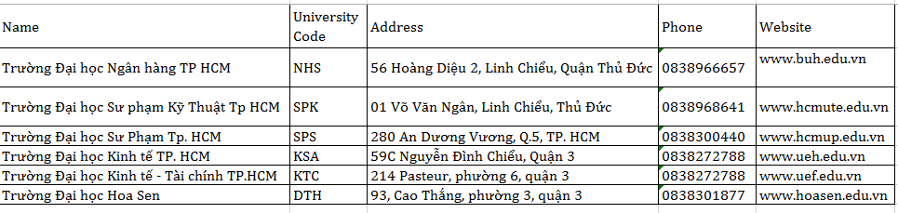
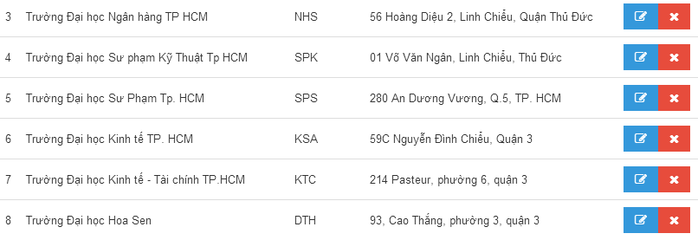
Import with exactly data
Success

Slide 3
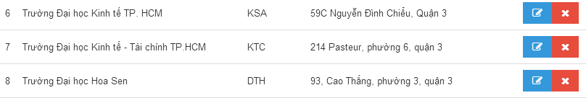
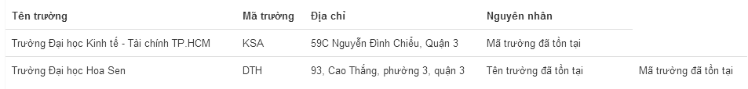
One or more row have same information with existed university in database
Data in system
Data in excel
Error

Slide 4
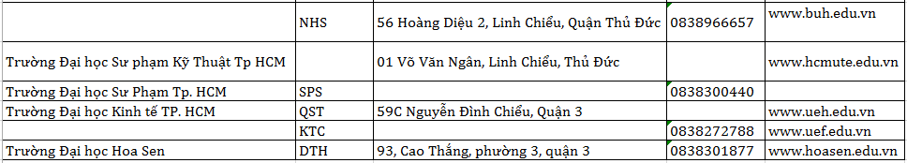
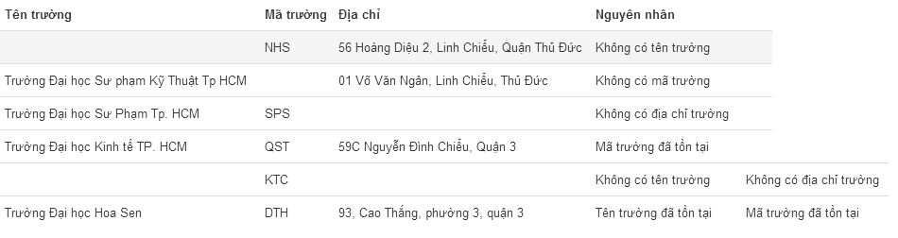
Import missing require fields
Data in excel
Error

