Slide 1
Java Getting Started
Source: w3school

Slide 2
Java If ... Else
Java Conditions and If Statements
Less than: a < b
Less than or equal to: a <= b
Greater than: a > b
Greater than or equal to: a >= b
Equal to a == b
Not Equal to: a != b
Source: w3school

Slide 3
Java If ... Else
Java has the following conditional statements:
Use if to specify a block of code to be executed, if a specified condition is true
Use else to specify a block of code to be executed, if the same condition is false
Use else if to specify a new condition to test, if the first condition is false
Use switch to specify many alternative blocks of code to be executed
Source: w3school

Slide 4
The if Statement
Use the if statement to specify a block of Java code to be executed if a condition is true.
Syntax
if (condition) {
// block of code to be executed if the condition is true
}
Example
if (20 > 18) {
System.out.println("20 is greater than 18");
}
Example
int x = 20;
int y = 18;
if (x > y) {
System.out.println("x is greater than y");
}
Source: w3school

Slide 5
The else Statement
Use the else statement to specify a block of code to be executed if the condition is false.
Syntax
if (condition) {
// block of code to be executed if the condition is true
} else {
// block of code to be executed if the condition is false
}
Example
int time = 20;
if (time < 18) {
System.out.println("Good day.");
} else {
System.out.println("Good evening.");
}
// Outputs "Good evening."
Source: w3school

Slide 6
The else if Statement
Use the else if statement to specify a new condition if the first condition is false.
Syntax
if (condition 1) {
// block of code to be executed if the condition is true
} if (condition 2) {
// block of code to be executed if the condition is true
} else {
// block of code to be executed if the condition is false
}
Example
int time = 22;
if (time < 10) {
System.out.println("Good morning.");
} else if (time < 18) {
System.out.println("Good day.");
} else {
System.out.println("Good evening.");
}
// Outputs "Good evening."
Source: w3school

Slide 7
Short Hand if...else
There is also a short-hand if else, which is known as the ternary operator because it consists of three operands.
It can be used to replace multiple lines of code with a single line, and is most often used to replace simple if else statements:
Syntax
variable = (condition) ? expressionTrue : expressionFalse;
Example
int time = 20;
String result = (time < 18) ? "Good day." : "Good evening.";
System.out.println(result);
Source: w3school

Slide 8
Java Switch
Instead of writing many if..else statements, you can use the switch statement.
Syntax
switch(expression) {
case x:
// code block
break;
case y:
// code block
break;
default:
// code block
}
Source: w3school

Slide 9
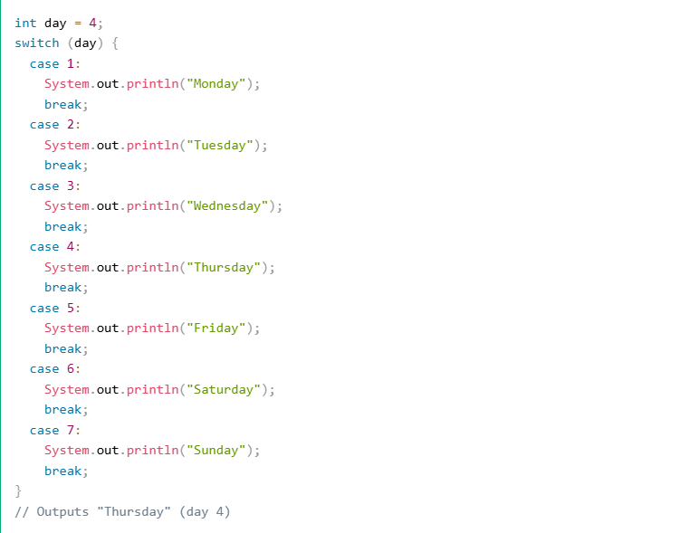
Java Switch
Source: w3school

Slide 10
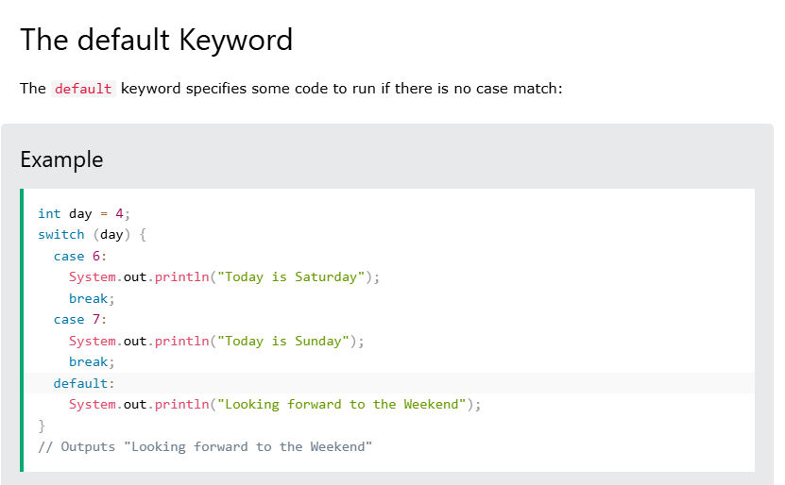
Java Switch
Source: w3school

Slide 11
Java While Loop
Loops can execute a block of code as long as a specified condition is reached.
Loops are handy because they save time, reduce errors, and they make code more readable.
The while loop loops through a block of code as long as a specified condition is true:
Syntax
while (condition) {
// code block to be executed
}
Example
int i = 0;
while (i < 5) {
System.out.println(i);
i++;
}
Source: w3school

Slide 12
Java Do/While Loop
The do/while loop is a variant of the while loop. This loop will execute the code block once, before checking if the condition is true, then it will repeat the loop as long as the condition is true.
Syntax
do {
// code block to be executed
}
while (condition);
Example
int i = 0;
do {
System.out.println(i);
i++;
}
while (i < 5);
Source: w3school

Slide 13
Java For Loop
When you know exactly how many times you want to loop through a block of code, use the for loop instead of a while loop:Syntax
for (statement 1; statement 2; statement 3) {
// code block to be executed
}
Statement 1 is executed (one time) before the execution of the code block.
Statement 2 defines the condition for executing the code block.
Statement 3 is executed (every time) after the code block has been executed.
Example
for (int i = 0; i < 5; i++) {
System.out.println(i);
}
Source: w3school

Slide 14
Java Break and Continue
Java Continue
You have already seen the break statement used in an earlier chapter of this tutorial. It was used to "jump out" of a switch statement.
The break statement can also be used to jump out of a loop.
This example stops the loop when i is equal to 4:
for (int i = 0; i < 10; i++) {
if (i == 4) {
break;
}
System.out.println(i);
}
Source: w3school

Slide 15
Java Break and Continue
Java Continue
The continue statement breaks one iteration (in the loop), if a specified condition occurs, and continues with the next iteration in the loop.The break statement can also be used to jump out of a loop.
This example skips the value of 4:
for (int i = 0; i < 10; i++) {
if (i == 4) {
continue;
}
System.out.println(i);
}
Source: w3school

