Slide 1
Java Methods
Source: w3school

Slide 2
Method
A method is a block of code which only runs when it is called.
You can pass data, known as parameters, into a method.
Methods are used to perform certain actions, and they are also known as functions.
Why use methods? To reuse code: define the code once, and use it many times.
Source: w3school

Slide 3
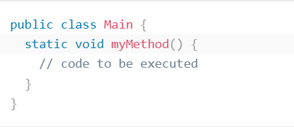
Create a Method
A method must be declared within a class. It is defined with the name of the method, followed by parentheses ()
Create a method inside Main:
Example Explained
myMethod() is the name of the method
static means that the method belongs to the Main class and not an object of the Main class. You will learn more about objects and how to access methods through objects later in this tutorial.
void means that this method does not have a return value. You will learn more about return values later in this chapter
Source: w3school

Slide 4
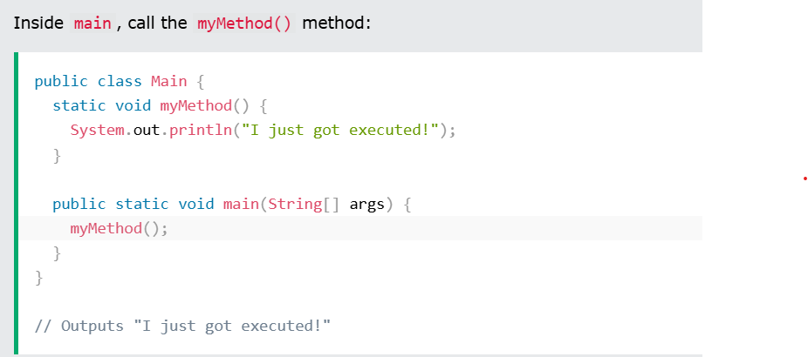
Call a Method
To call a method in Java, write the method's name followed by two parentheses () and a semicolon;
In the following example, myMethod() is used to print a text (the action), when it is called:
Source: w3school

Slide 5
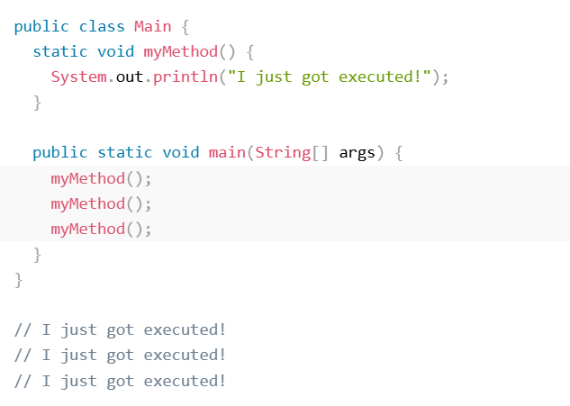
Call a Method
A method can also be called multiple
Source: w3school

Slide 6
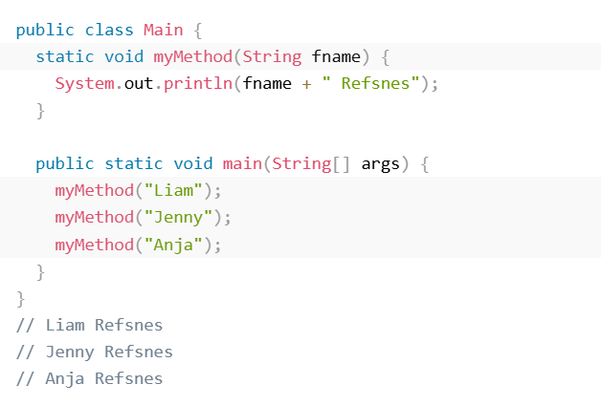
Parameters and Arguments
Information can be passed to methods as a parameter. Parameters act as variables inside the method.
Parameters are specified after the method name, inside the parentheses. You can add as many parameters as you want, just separate them with a comma.
The following example has a method that takes a String called fname as parameter. When the method is called, we pass along a first name, which is used inside the method to print the full name:
Source: w3school

Slide 7
Parameters and Arguments
When a parameter is passed to the method, it is called an argument. So, from the example above: fname is a parameter, while Liam, Jenny and Anja are arguments.
Source: w3school

Slide 8
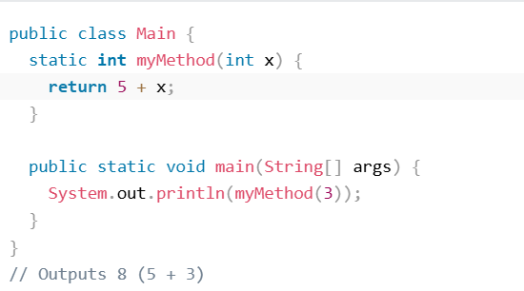
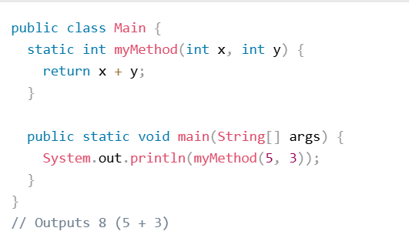
Java Return
If you want the method to return a value, you can use a primitive data type (such as int, char, etc.) instead of void, and use the return keyword inside the method:
Source: w3school

Slide 9
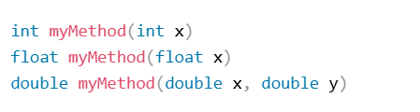
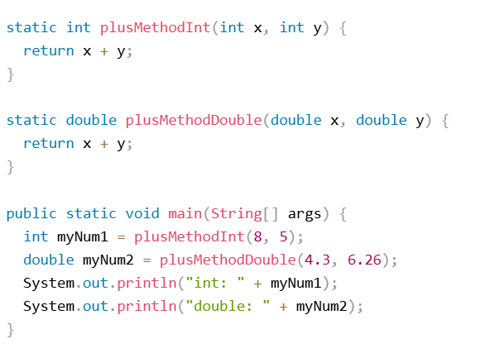
Method Overloading
With method overloading, multiple methods can have the same name with different parameters:
Consider the following example, which has two methods that add numbers of different type:
Source: w3school

Slide 10
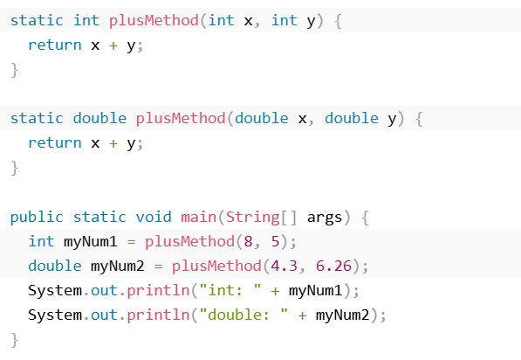
Method Overloading
Instead of defining two methods that should do the same thing, it is better to overload one.
In the example below, we overload the plusMethod method to work for both int and double:
Source: w3school

