Slide 1
Personal Project Report
Topic: Segment Tree data structure in competitive programming
Instructor: Ph.D. Vũ Đức Minh
Student: Lê Hữu Trung

Slide 2
Table of contents
I. What is a Segment Tree?
II. Structure of Segment Tree.
III. Pseudo code.
IV. Implementation.
V. Conclusion.

Slide 3
I. What is a Segment Tree?
A powerful data structure for range query.
Is a full binary tree and normally built on an array.
The internal node store the information of its left and right child.
Require linear amount of memory (maximum 4n).
Answer a query in O(logn).

Slide 4
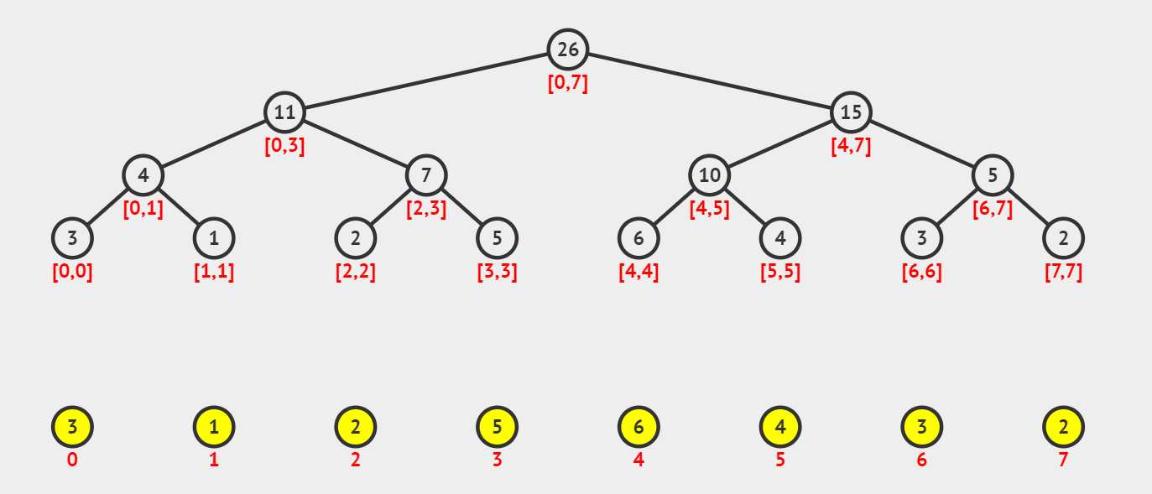
I. What is a Segment Tree?
A basic Segment Tree to get Sum on a segment.

Slide 5
II. Structure of Segment Tree.
1. Representation of Segment Tree.
Leaf Nodes are the elements of the input array.
Each internal node represents some merging of the leaf nodes. The merging may be different for different problems.
Often represented by an array, for each node at index i, the left child is at index 2i + 1, right child at 2i + 2.

Slide 6
II. Structure of Segment Tree.
1. Representation of Segment Tree.
Leaf Nodes are the elements of the input array.

Slide 7
II. Structure of Segment Tree.
1. Representation of Segment Tree.
Each internal node represents some merging of the leaf nodes.

Slide 8
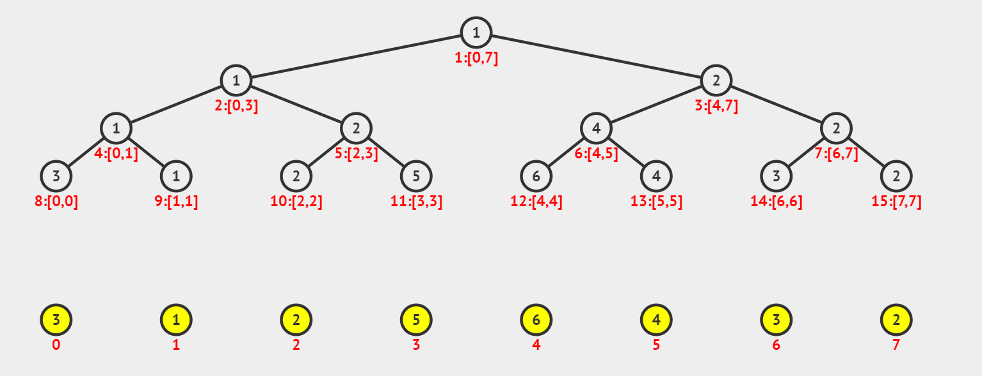
II. Structure of Segment Tree.
1. Representation of Segment Tree.
The merging may be different for different problems.

Slide 9
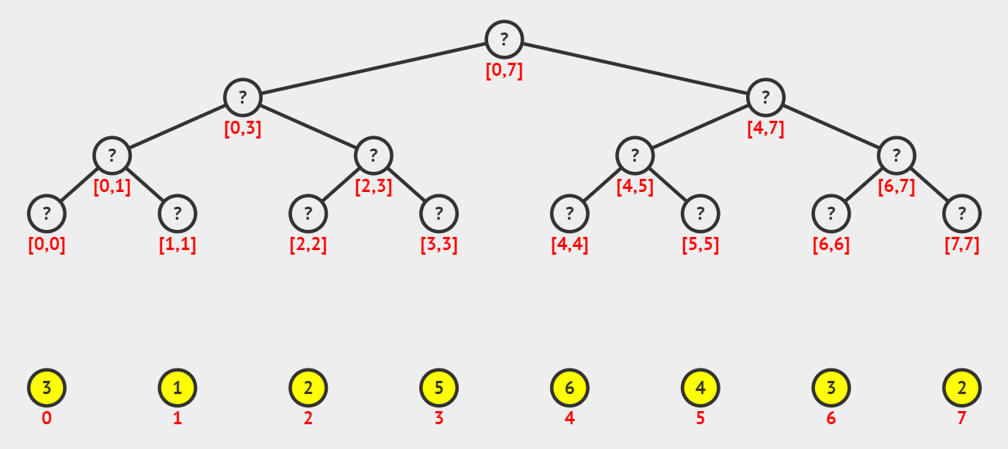
II. Structure of Segment Tree.
2. Construction of Segment Tree from the given array.

Slide 10
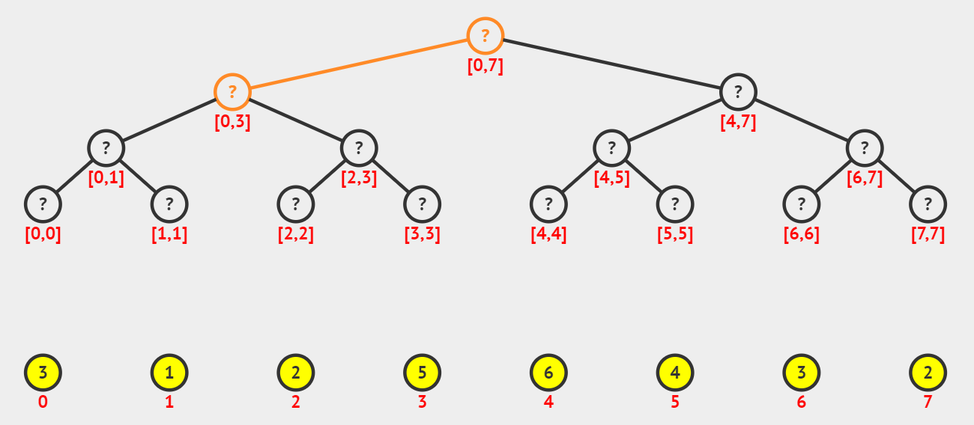
II. Structure of Segment Tree.
2. Construction of Segment Tree from the given array.

Slide 11
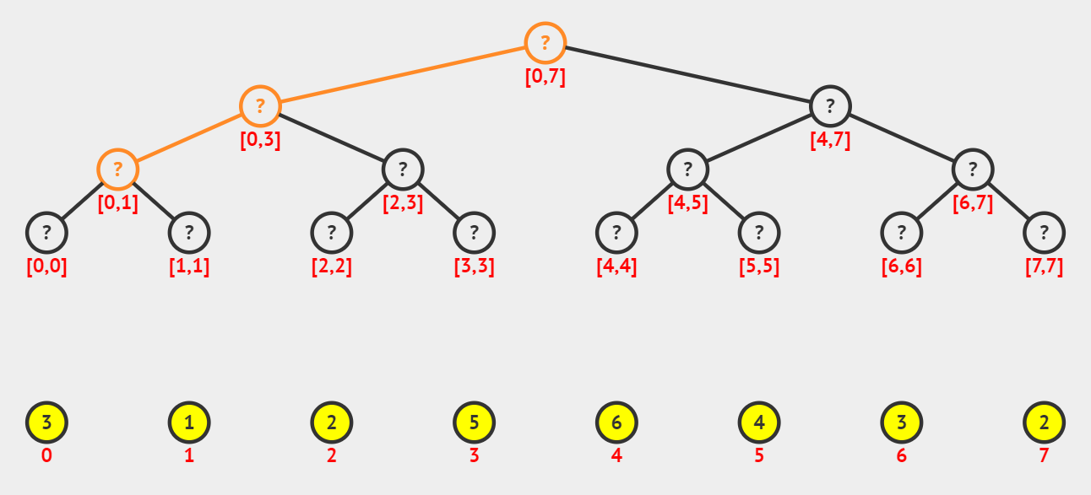
II. Structure of Segment Tree.
2. Construction of Segment Tree from the given array.

Slide 12
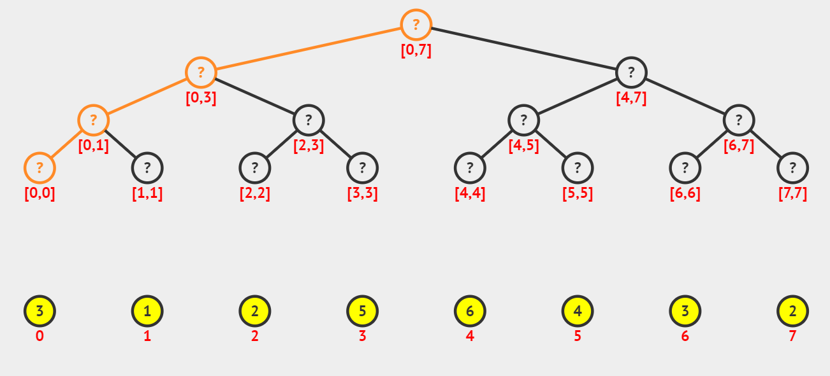
II. Structure of Segment Tree.
2. Construction of Segment Tree from the given array.

Slide 13
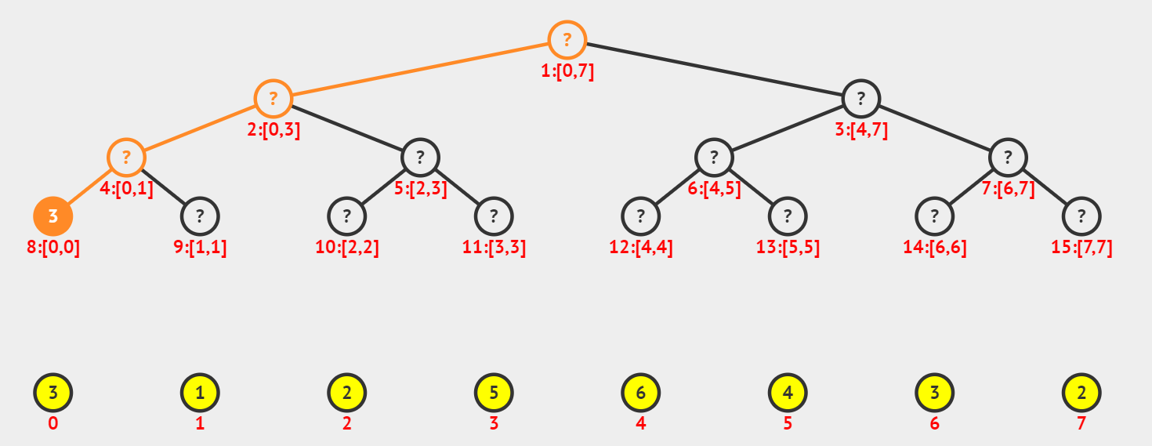
II. Structure of Segment Tree.
2. Construction of Segment Tree from the given array.

Slide 14
II. Structure of Segment Tree.
2. Construction of Segment Tree from the given array.

Slide 15
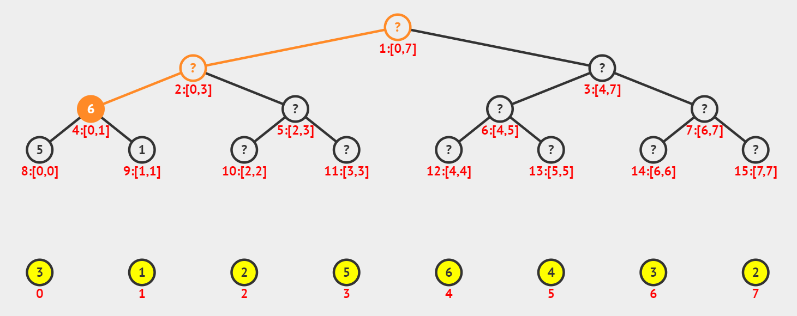
II. Structure of Segment Tree.
2. Construction of Segment Tree from the given array.

Slide 16
II. Structure of Segment Tree.
3. Total size of the array representing Segment Tree.
If n is a power of 2 the size of the Segment Tree is 2n - 1
If n is not a power of 2, then the size of the tree will be 2x – 1 where x is the smallest power of 2 greater than n
2.2^⌈log2n⌉ - 1

Slide 17
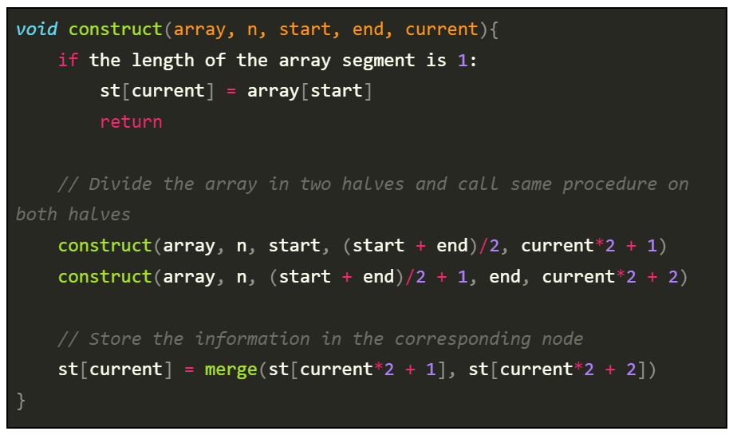
III. Pseudo code.
1. Construct Segment Tree.

Slide 18
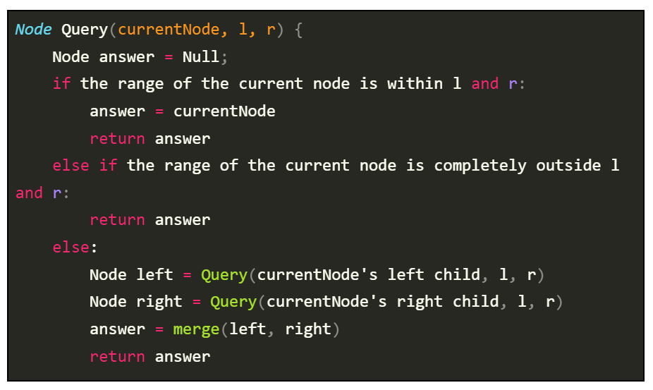
III. Pseudo code.
2. Query a given range.

Slide 19
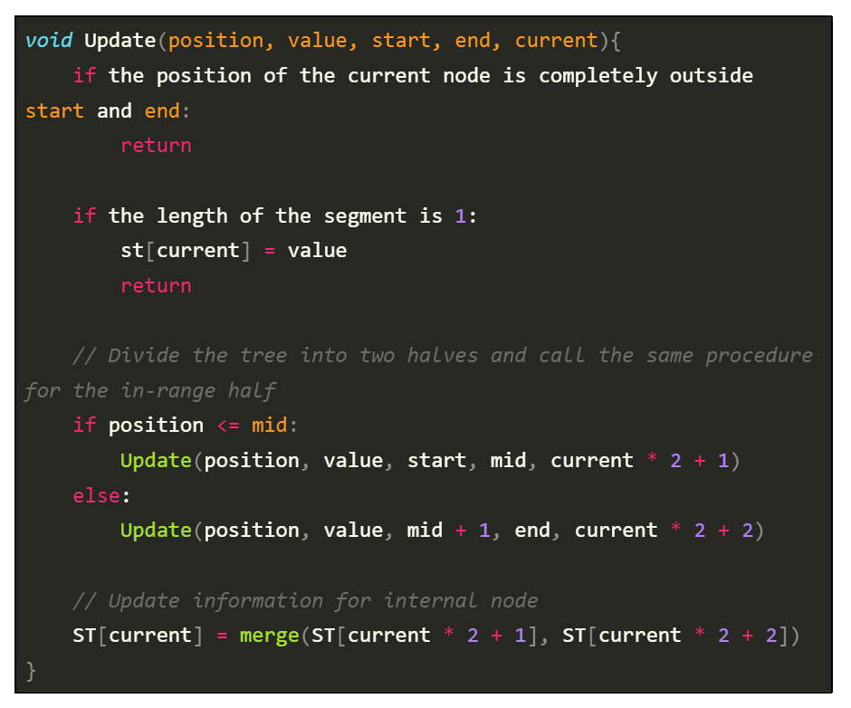
III. Pseudo code.
3. Update a value.

Slide 20
IV. Implementation.

Slide 21
V. Conclusion.
Through this project, I have:
Learnt Segment Tree.
Learnt how to carry on a report.
Improved programming skill.
Improved self-learn skill.

Slide 22
Thanks for listening!
If you have any questions please keep it for yourself. I’m not Google :))

