Slide 1
MobileNets: Efficient Convolutional Neural Networks for Mobile Vision
Applications
Andrew G. Howard Menglong Zhu Bo Chen Dmitry Kalenichenko
Weijun Wang Tobias Weyand Marco Andreetto Hartwig Adam
Google Inc.
Speaker : Wade
Date : 2018/08/23

Slide 2
Outline
Relate work
Main idea
Experiments

Slide 3
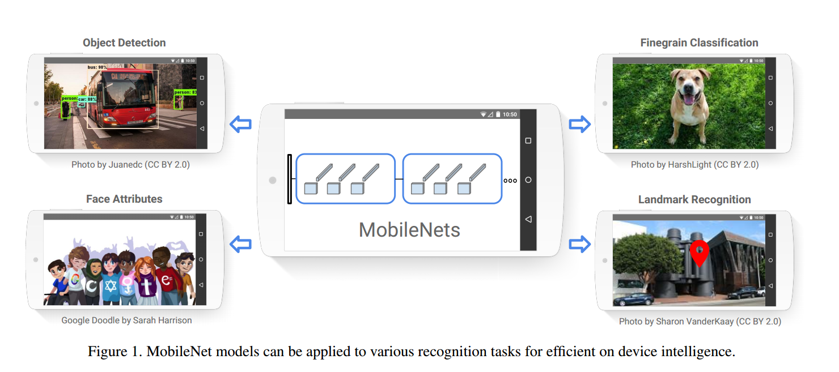

Slide 4
What’s the “Right” Neural Network for Use in a
Gadget?
Sufficiently high accuracy
Low computational complexity
Low energy usage
Small model size

Slide 5
Related Work
Quantization, pruning, decomposition and distillation
Small network, Squeezenet, Xception network

Slide 6
Techniques for Small Deep Neural Networks
Remove Fully-Connected Layers
Kernel Reduction ( 3x3 -> 1x1 )
Channel Reduction
Depthwise Separable Convolutions

Slide 7
Key Idea : Depthwise Separable Convolution!
The MobileNet model is based on depthwise separable convolutions which is a form of factorized convolutions which factorize a standard convolution into a depthwise convolution and a 1× 1 convolution called a pointwise convolution

Slide 8
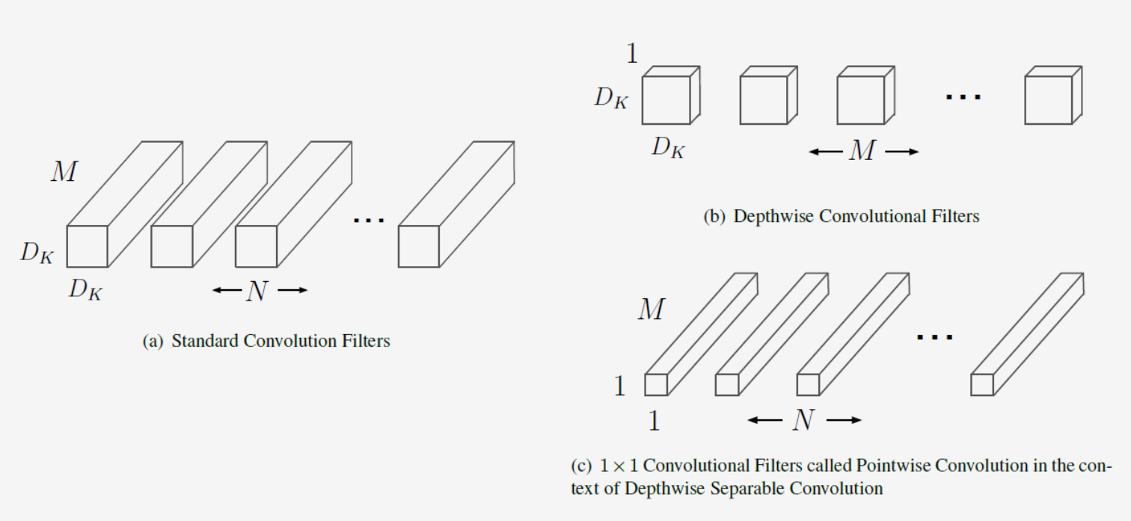
Standard Convolution vs Depthwise Separable Convolution

Slide 9
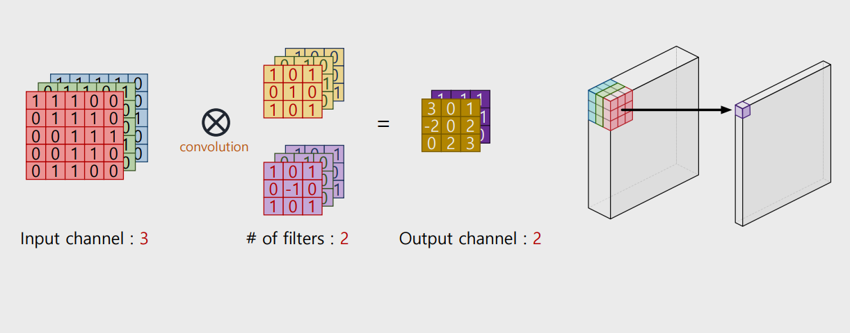
Recap – Convolution Operation
http://cs231n.github.io/convolutional-networks/

Slide 10
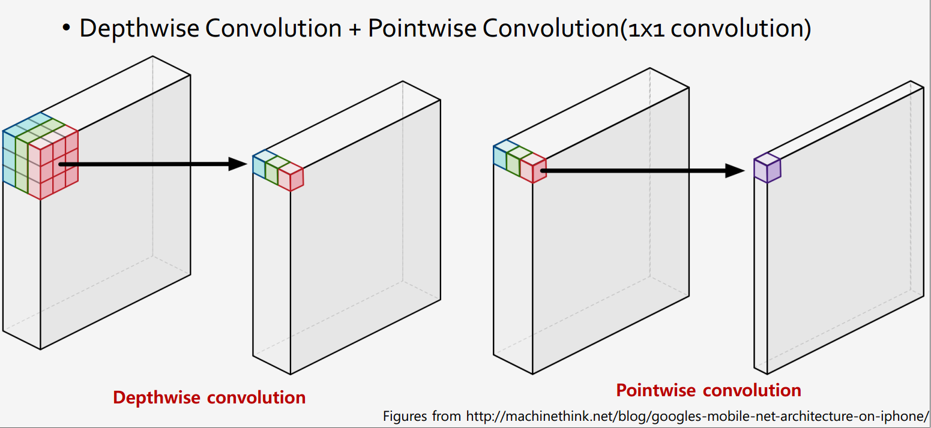
Depthwise Separable Convolution

Slide 11
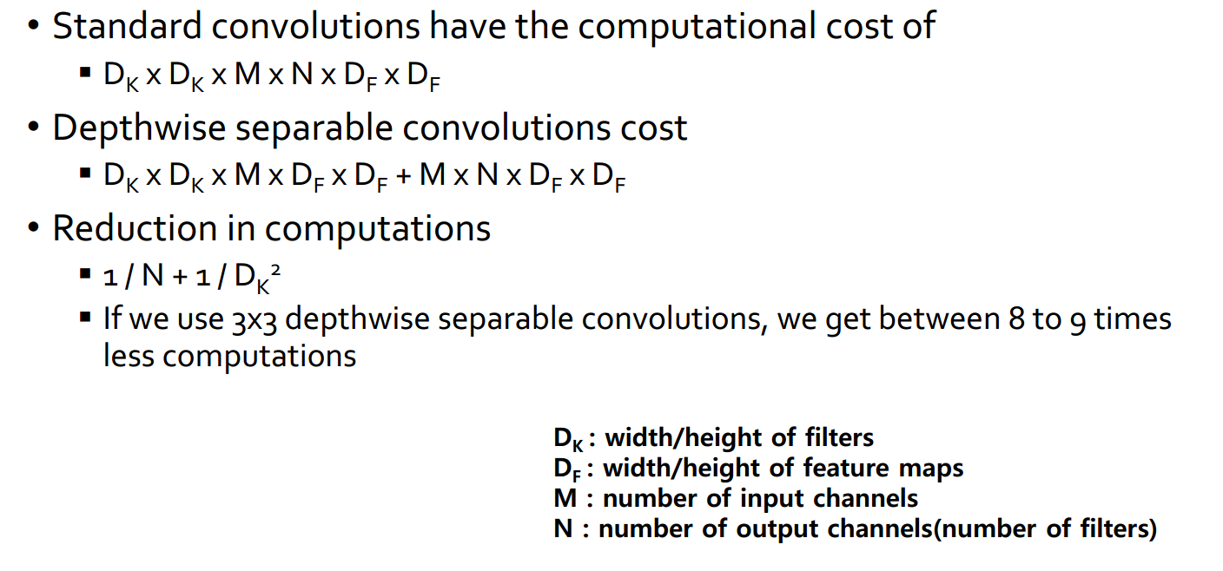
Standard Convolution vs Depthwise Separable Convolution

Slide 12
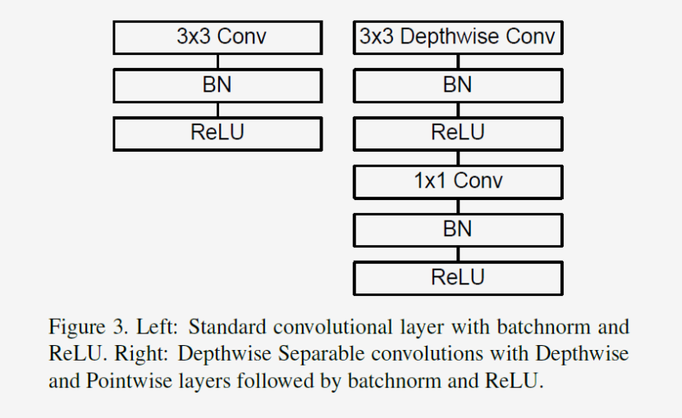
Depthwise Separable Convolutions

Slide 13
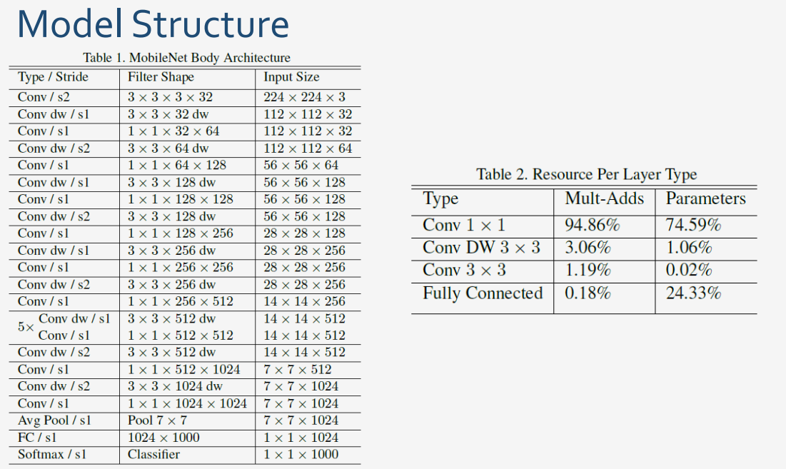

Slide 14
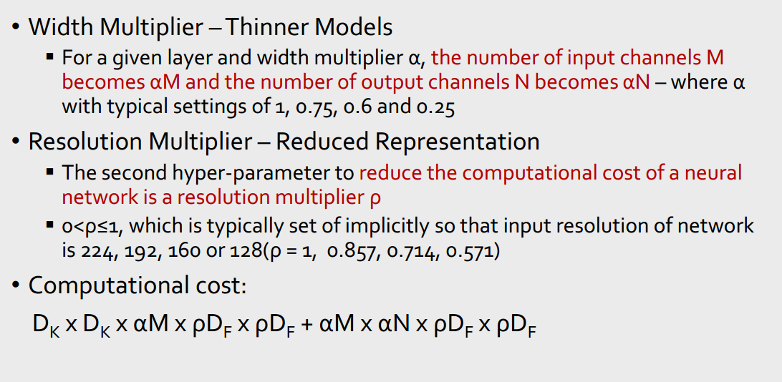
Width Multiplier & Resolution Multiplier

Slide 15
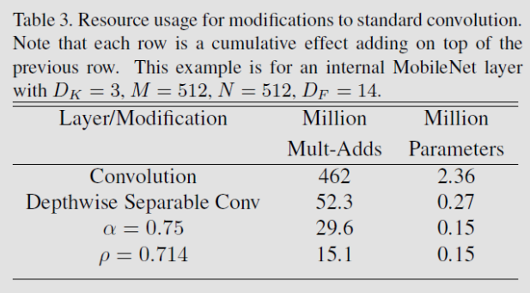
Width Multiplier & Resolution Multiplier
input feature map of size 14 × 14 × 512 with a kernel K of size 3 × 3 × 512 × 512

Slide 16
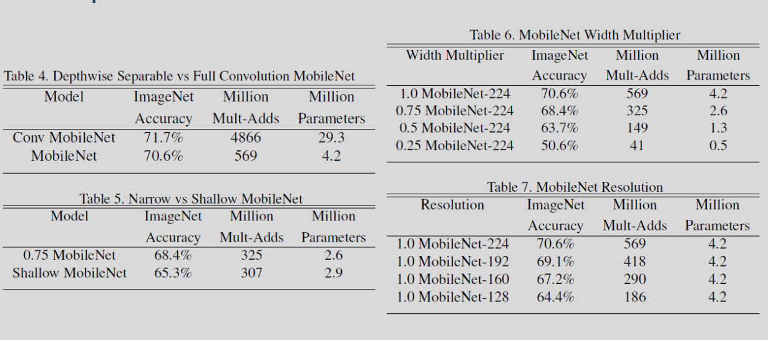
Experiments
Shallow or deep. The full network has a group of 5 layers in the middle that you can leave out.

Slide 17
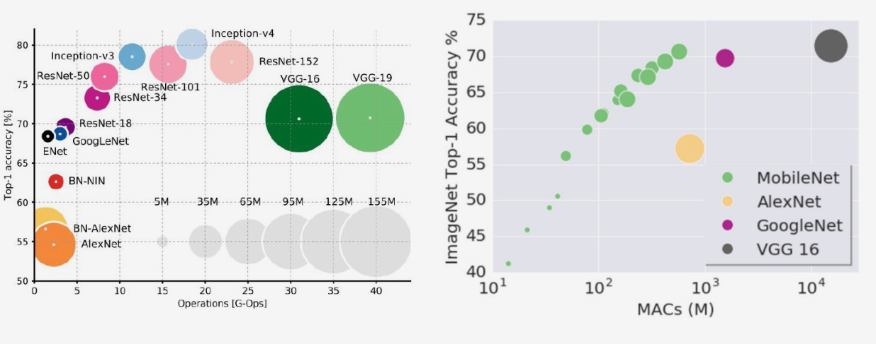
Model Shrinking Hyperparameters

Slide 18
MobileNetV2: Inverted Residuals and Linear Bottlenecks
Mark Sandler Andrew Howard Menglong Zhu Andrey Zhmoginov Liang-Chieh Chen
Google Inc.

Slide 19
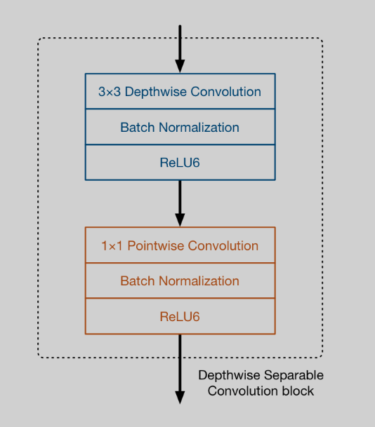
Mobilenet v1, Recap
Consists of a regular 3×3 convolution as the very first layer, followed by 13 times the above building block
From: http://machinethink.net/blog/mobilenet-v2/

Slide 20
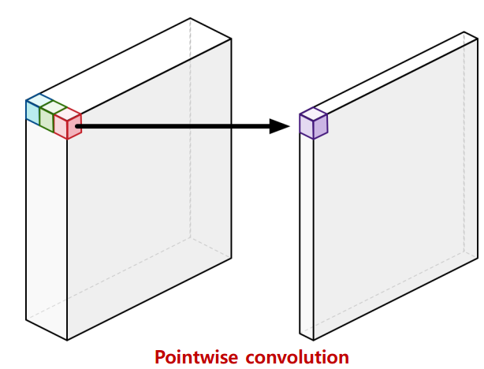
Motivation
Projects data with a high dimensions (channels) into a tensor with a much low dimensions.
For example, the depthwise layer may work on a tensor with 144 channels, which the projection layer will then shrink down to only 24 channels.

Slide 21
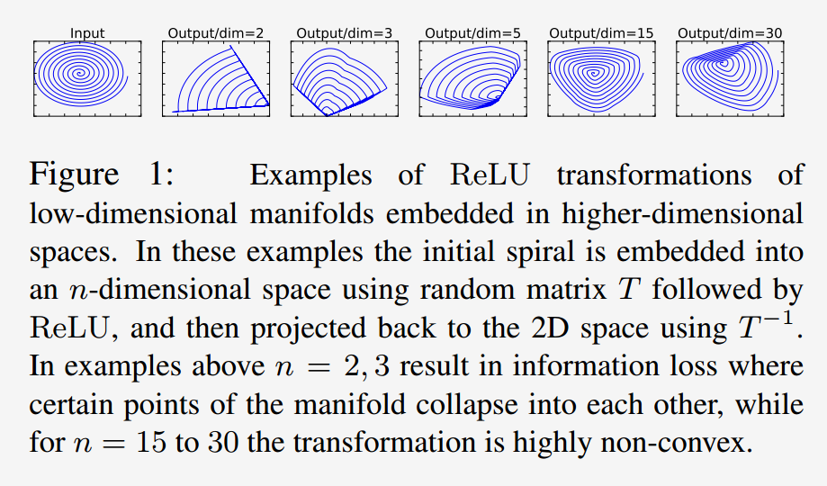
Motivation

Slide 22
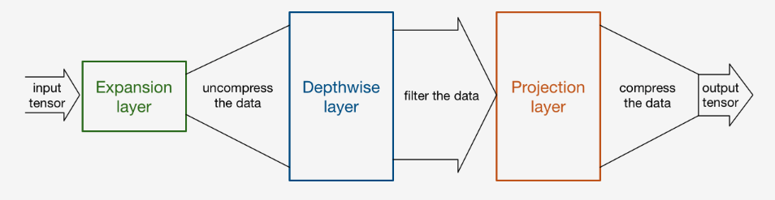
Main idea
This module takes as an input a low dim compressed representation which is first expanded to high dim and filtered with a lightweight depthwise convolution.

Slide 23
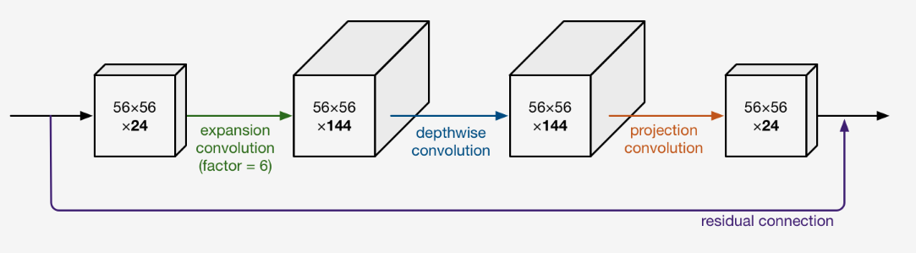
Expansion layer
expansion factor default is 6
From: http://machinethink.net/blog/mobilenet-v2/

Slide 24
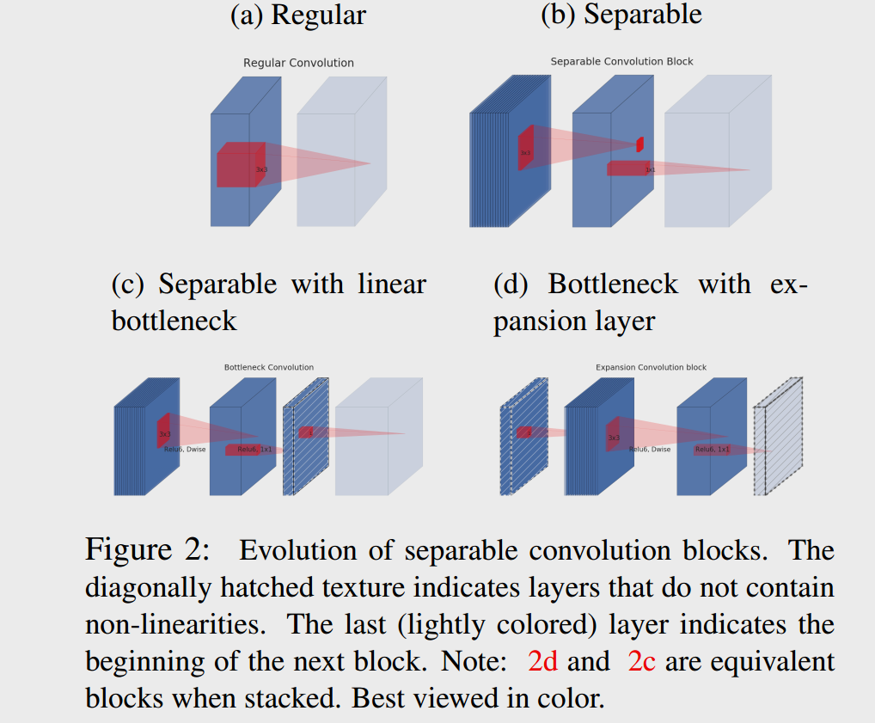

Slide 25
Residual
We want to improve the ability of a gradient to propagate across multiplier layers
The residual connection is only used when the number of channels going into the block is the same as the number of channels coming out of it, which is not always the case as every few blocks the output channels are increased.

Slide 26
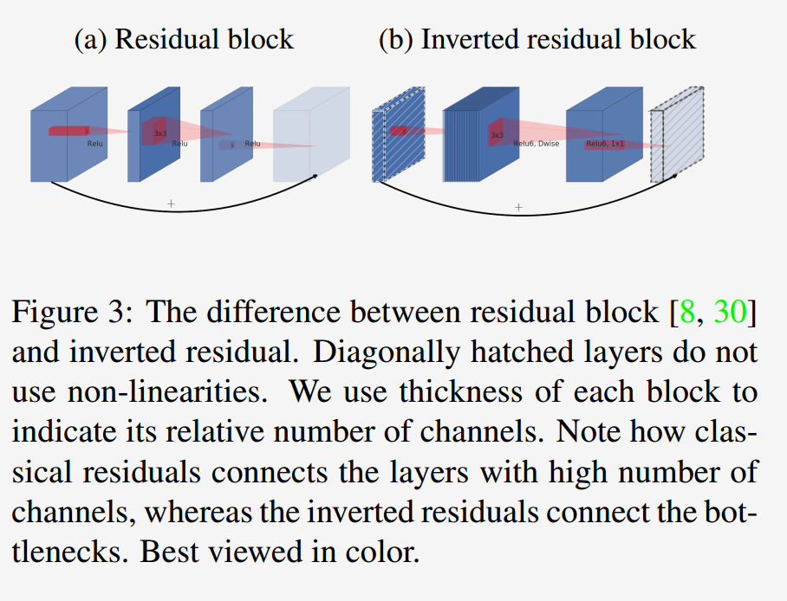
Residual

Slide 27
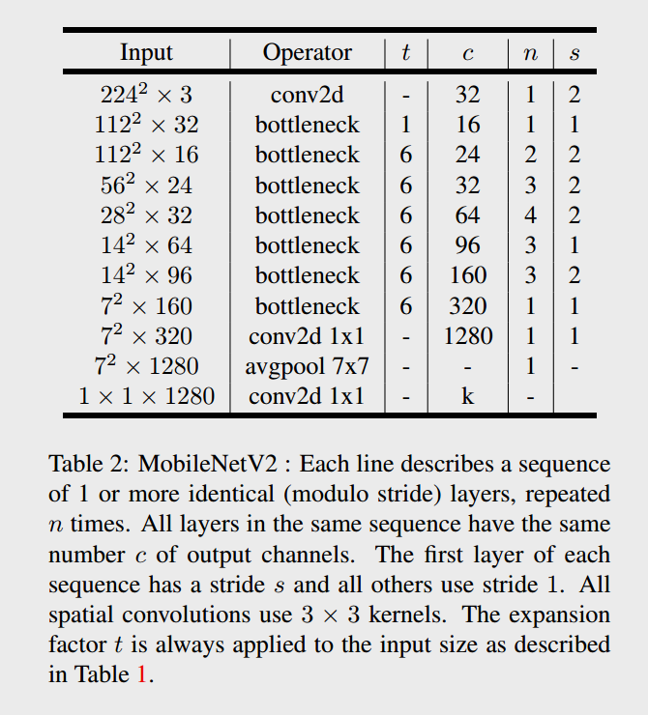
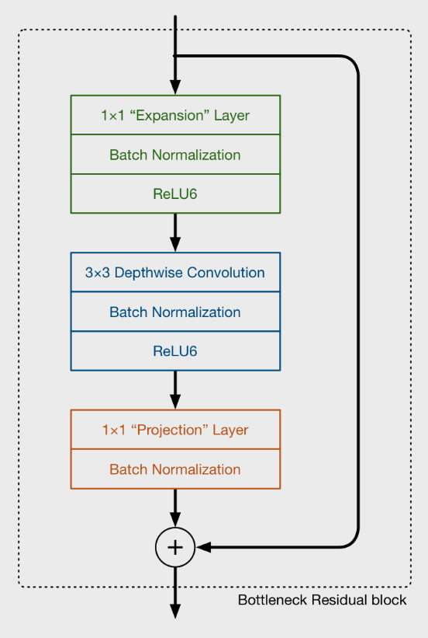
Model Architecture

Slide 28
Importance of linear bottlenecks
experiments shown in Figure 6a indicate that linear bottlenecks improve performance, providing support that non-linearity destroys information in low-dimensional space.

Slide 29
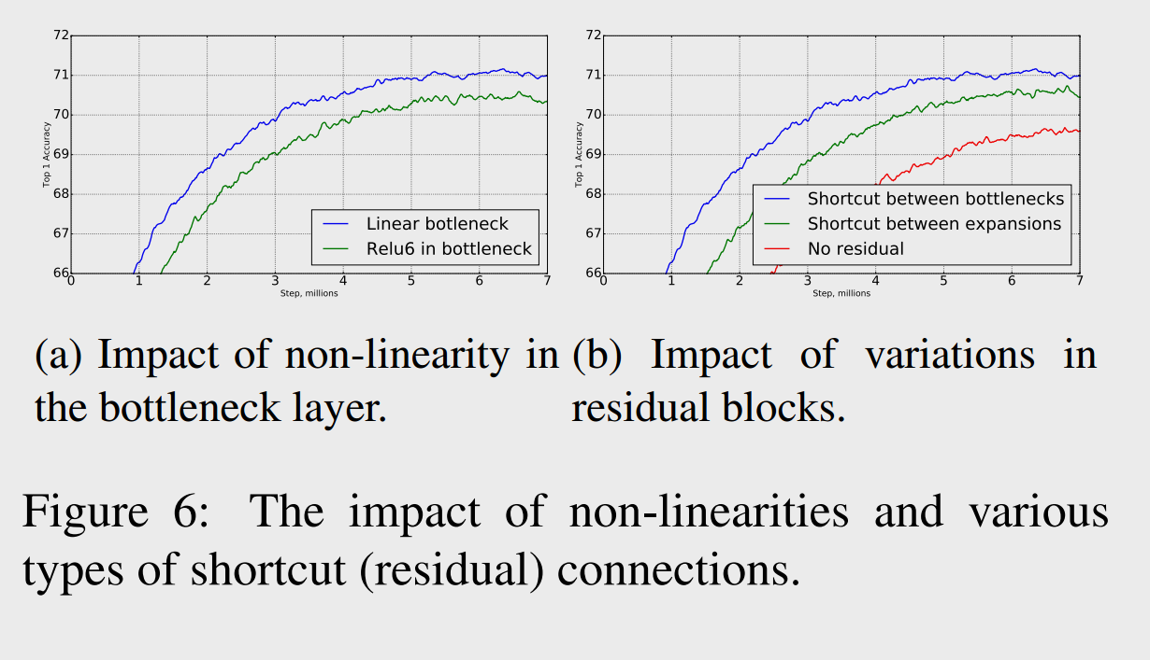
Importance of linear bottlenecks

Slide 30
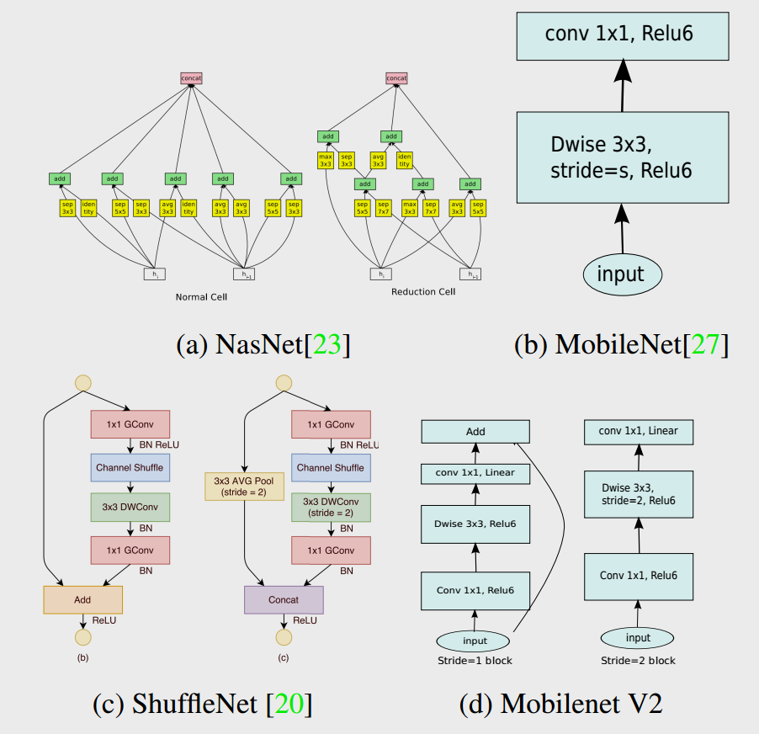

Slide 31
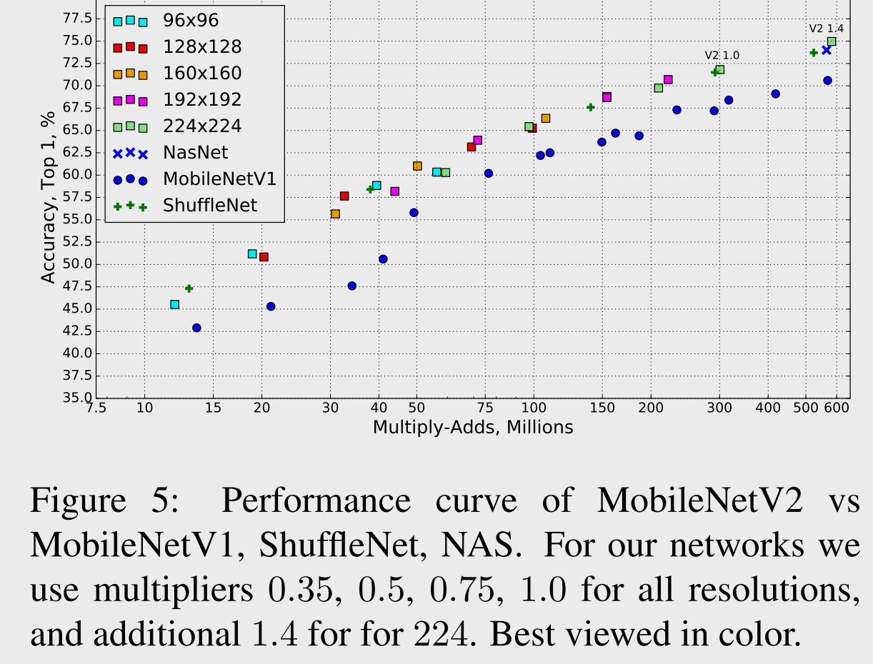

Slide 32
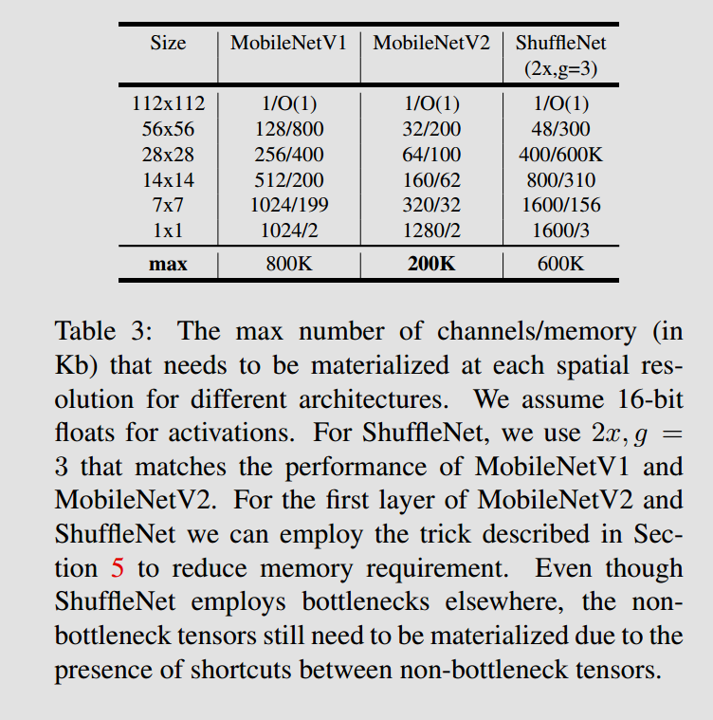

Slide 33
Battle of the versions
multiply-accumulate operations
Version MACs (millions) Parameters (millions)
MobileNet V1 569 4.24
MobileNet V2 300 3.47
maximum FPS (frames-per-second)
Version iPhone 7 iPhone X iPad Pro 10.5
MobileNet V1 118 162 204
MobileNet V2 145 233 220

Slide 34
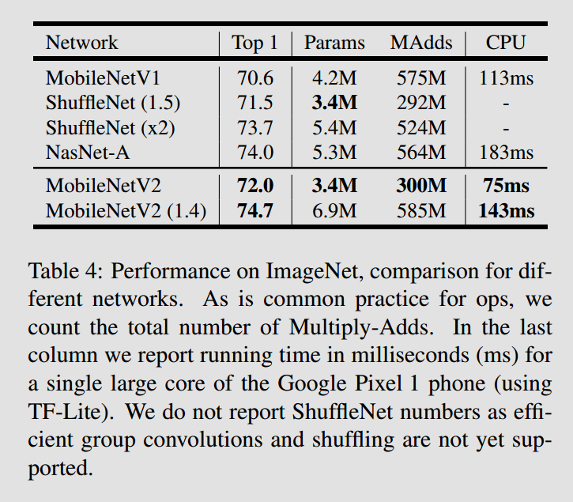
ImageNet Classification

Slide 35
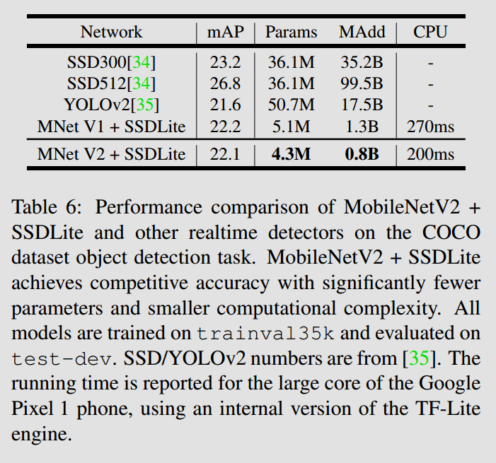
Object Detection

