Slide 1




BACKGROUND & PROBLEM CONTEXT
Tiêu điểm hôm nay
The real estate market: A core economic pillar.
Challenge: Determining true property value is difficult due to complex factors (location, legal status, amenities).
The solution: Leveraging Data Science to analyze listings and provide objective valuations.
Goal: Enhance market transparency and support effective decision-making.
Real Estate Price
Analysis
Team Members:
Nguyễn Gia Huy (SE201725)
Trần Cảnh Nhật Minh (SE203377)
Nguyễn Xuân Bình (SE204049)
Đặng Thái Nguyên (SE201652)

Slide 2







RESEARCH QUESTION & OBJECTIVES
Research Question: "How can data analysis and machine learning tools be applied to interpret influencing factors and accurately predict real estate prices based on spatial characteristics and amenities?"
Objective 1 (Analysis): Explore relationships between prices and physical/spatial attributes.
Objective 2 (Prediction): Build a reliable forecasting model to provide reference prices and aid in negotiation.

Slide 3







DATASET OVERVIEW
Scope: 4 major markets (Ha Noi, Da Nang, Ho Chi Minh City, Binh Duong).
Sources:
Listing Data: Web Crawling from batdongsan.com.vn.
Spatial Data: OpenStreetMap (OSM) for infrastructure/amenities.
- Raw Data Size: 39 variables.
4 Main Groups: Listing Metadata, Geographical Location, Property Characteristics, External Amenities.

Slide 4




DATA PREPARATION & SQL EXTRACTION PLAN
Standardization: Converted text attributes (price, area) to numerical formats.
Deduplication & Cleaning: Standardized district names and removed duplicate listings.
Boundary Filtering: Kept prices between 500 million and 60 billion VND, and areas from 15m² to 1000m².
Feature Selection: Reduced to the 17 most vital features (e.g., price_total, area, num_floors, num_schools_1km).

Slide 5
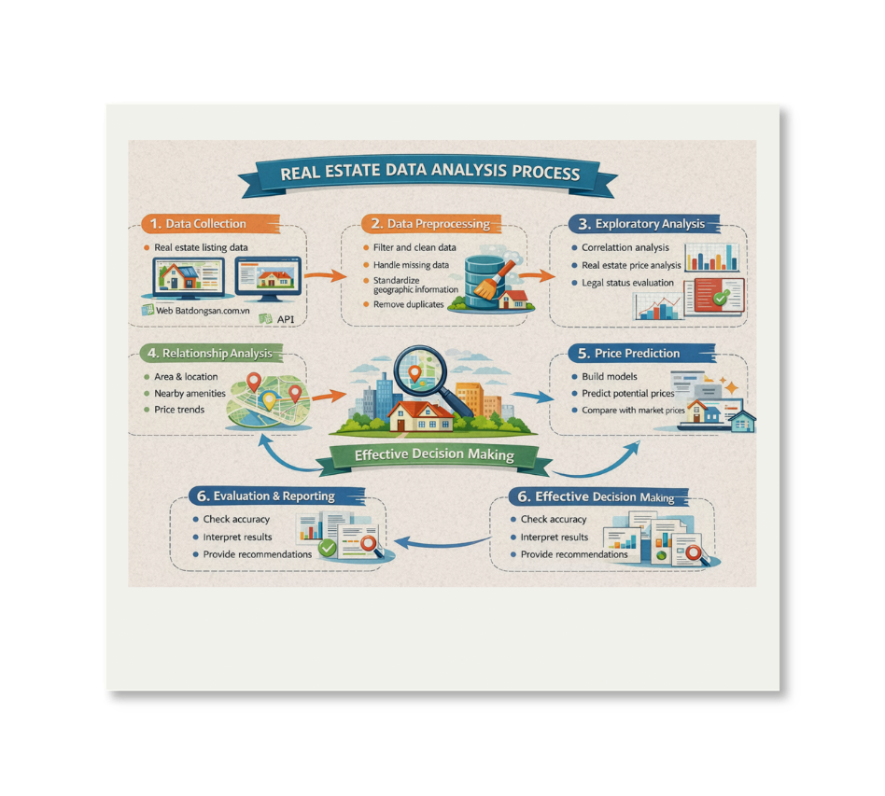

METHODOLOGY & WORKFLOW
OSEMN
Framework: OSEMN Workflow
(Obtain -> Scrub -> Explore -> Model -> iNterpret)
Core Technologies:
Database: SQL
Analysis & Processing: Python (Pandas, Numpy)
Visualization: Matplotlib, Seaborn
Machine Learning: Scikit-learn, CatBoost, XGBoost, LightGBM
Deployment: Streamlit, Folium (Interactive Map)

Slide 6

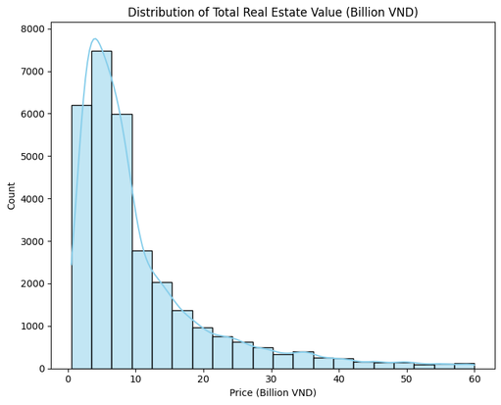


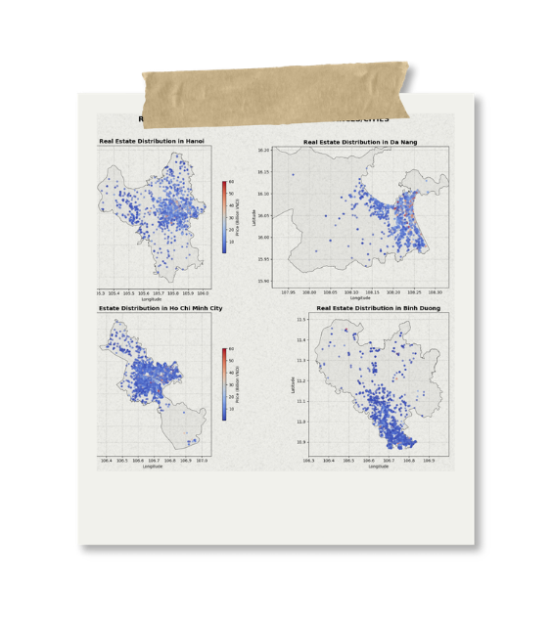
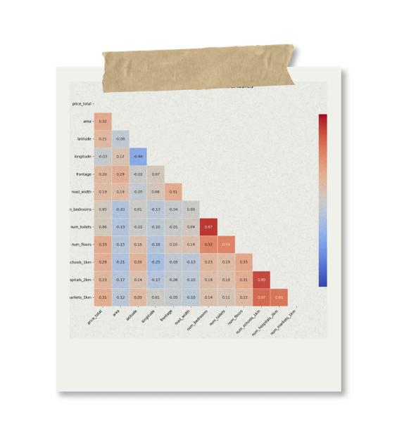


EXPLORATORY DATA ANALYSIS (EDA) & STATISTICS
Price Distribution: Right-skewed, heavily concentrated in the 1-10 billion VND segment.
Regional Differences: HCMC & Hanoi command the highest prices; Da Nang & Binh Duong are more stable.
Key Correlations:
Positive correlation between Area and Asset Value.
Extremely strong correlation (0.80) between utility infrastructure (schools/hospitals) and property presence.

Slide 7


MODELLING / REGRESSION ANALYSIS
Preprocessing Pipeline: Missing value imputation, One-Hot Encoding, StandardScaler (80:20 Train/Test split).
Initial Linear Analysis (Ridge Regression):
Confirmed distinct market trends (Central districts and Villas have huge positive weights).
Accuracy limitation: R-squared only reached 0.57 due to complex non-linear relationships.
ML Experimentation: Evaluated 15 different Machine Learning algorithms to capture non-linear market patterns.

Slide 8
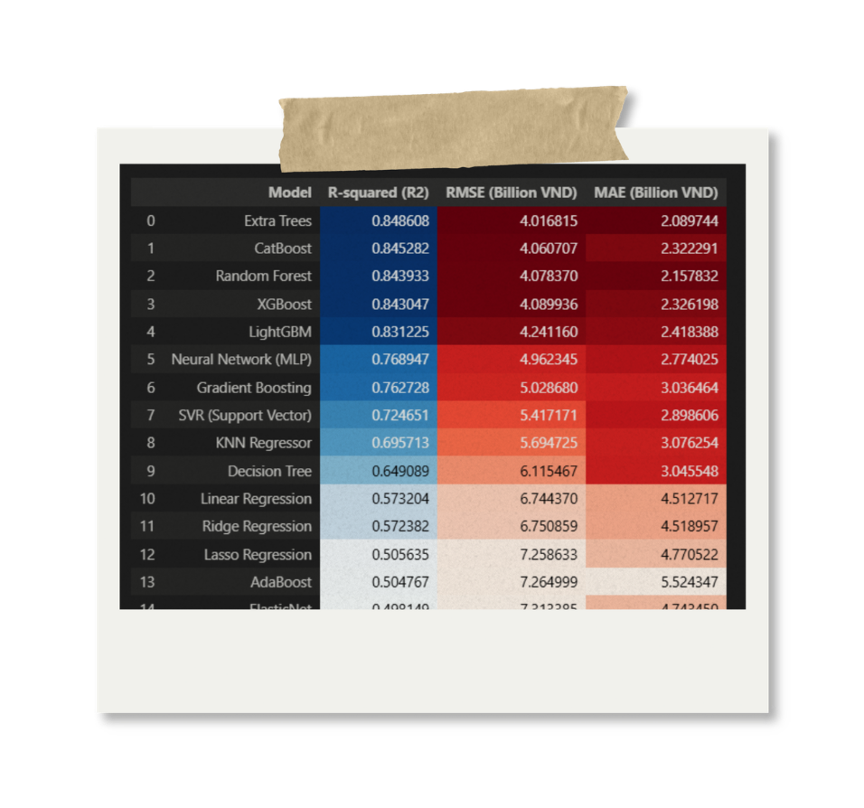





KEY RESULTS & VISUALIZATIONS
The Best Model: Extra Trees (Extremely Randomized Trees)
Performance: Highest R-squared score (0.84) and lowest error rates.
Practical Deployment:
Built an interactive Streamlit Web App.
Users click a location on a Folium map -> API fetches live amenity data -> Extra Trees model instantly predicts the price.

Slide 9
DISCUSSION, LIMITATIONS, AND INSIGHTS
Insights: Successfully quantified the immense financial value of urban infrastructure and external amenities.
Limitations:
Model trains on 'Asking Prices', which may differ from final transaction contracts.
Lacks 'soft' variables (interior quality, Feng Shui, developer reputation).
Future Work: Implement Natural Language Processing (NLP) to read and extract sentiment/details from listing text descriptions.

Slide 10




CONCLUSION & AI USAGE REFLECTION
Conclusion: Successfully completed a full Data Science lifecycle resulting in a highly accurate ML model and a practical Web App tool.
AI Usage Reflection (Gemini & ChatGPT):
Used for project ideation, research framing, and deciding on data features.
Assisted heavily in technical debugging: SQL data cleaning, Python EDA charts, and ML model tuning.
Supported report formatting (LaTeX) and Dashboard layout generation.
Accelerated learning and optimized project quality.

