Slide 1
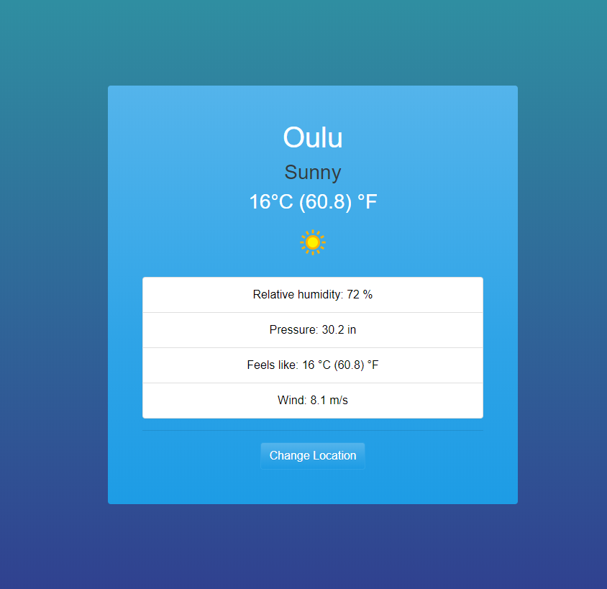
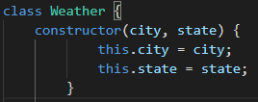
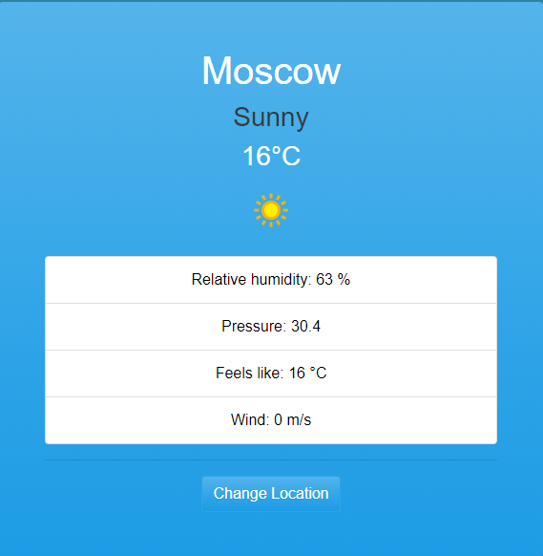
Weather Forecast
Huy Bui
Information Technology, Software Engineering
Introduction
Weather forecast is my first and also the only project i do during this summer . The idea was common if you was a new programmer. The material for this project is a book named Eloquent JavaScript and an api i used on weatherapi.com. This website has the ability to update about the weather condition of cities around the world with many parameters. In addition you can change from city to city to view their weather condition as well
FIGURE 1. Weather board
Objectives
My priority objective for this one is to understand how a website work as well as acknowledge myself from this project. From there i can set a better goal for myself in order to self-develoop
Methods
The Project use 3 programming languages: HTML , CSS . JavaScript. Object-Oriented Programming is the main part in this project
FIGURE 2. OOP(Weather class)
The class above is to create the weather class and init city and state parameters. There are also other classes as well but you may have to wait to see it
Results
The web technically working. The only problem it have is less feature and need to improve in uprading the website. It can show now only 4 parameters : temperature , pressure , wind speed and the general status of that city during the recent day. It will need to put more effort in it
FIGURE 3. Complete website
Conclusions
In conclusion, this is a simple and website and it didn’t take too much time for other to spend in this website but for me it is a bit difference. To be honest, i leanrned many things through this project including working with API , debugging and OOP as well. It been a good time for me to know new thing and know where i am at
References
https://www.youtube.com/watch?v=wPElVpR1rwA&t=1214s
https://www.youtube.com/watch?v=GXrDEA3SIOQ&t=630s
https://www.weatherapi.com/
Project
ECTS credits: 10
Date of publication: 2012, Spring / Summer / Autumn
Instructor

