Slide 1
SIP: Secure Information Provider
Pallavi Arora and Huy Nguyen
WiSeR – Wireless System Research Group
Department of Computer Science
University of Houston, TX, USA
COSC 7388 Project Presentation

Slide 2
Agenda
Smart phone: a threat to privacy
Attacker model
Applicability
Existing Work
System architecture
Evaluation
Conclusion and future work

Slide 3

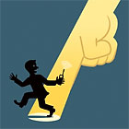
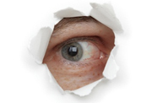
Smart phone a threat to privacy
Grand Jury Investigation Targets Smartphone Privacy: treat the responsibility with respect.
Paul Wilson of Dallas: "No way will a game have access to my contact list or call log. Next they'll want me to send them a key to my house so they can go through my bank and tax statements."

Slide 4
What kind of information do smartphone apps collect?
Contacts
Location history
Times of past meetings and future appointments
Photographs and videos, access to camera (in some case)
Details of who the user contacted and when, whether it was via voice, e-mail, SMS, IM, or social networking -- often including a verbatim transcript of the message.
Virtually anything that you have on the phone.

Slide 5
What can go wrong ,in wrong hands?
Contact list
Lead to lost friendships, missed business opportunities, or a ruined marriage.
Appointment calendar
Could inadvertently disclose a medical condition
Location data
Let burglars know when you're away from home
Tell pedophiles what route your children walk to school.

Slide 6
Attacker model
Semihonest:
Honest and can correctly process and respond to messages, but are curious in that they may attempt to determine the identity of a user based on what they “see”
Honest But curious:
All parties are curious, in that they try to ﬁnd out as much as possible about the other inputs despite following the protocol.

Slide 7
How about a Big Daddy? Who?
Government
Electronic Frontier Foundation
App Developers
Request only those permissions that are absolutely necessary for the app.
Disclose in detail why your apps need certain permissions.
Establish trust early, and maintain that trust by giving users fine-grained control over their own data.
Our solution a trusted Middle guy.
Not feasible for all third party applications.
Can’t save from the phone company.

Slide 8
Scope
Services tolerant/invertible to perturbed results.
Tolerant: indifferent to low noise levels
Recommendation services.
Music, videos
Services like Reddit ( social news website).
Invertible: can remove noise completely from result
Location based services.

Slide 9
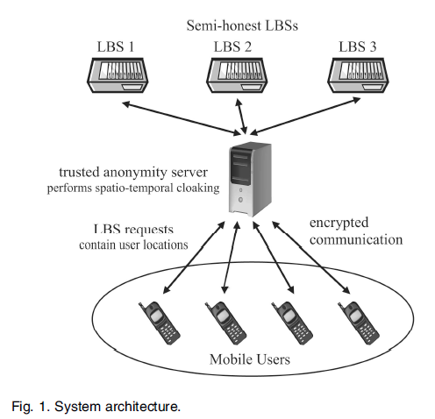


Existing work
“Protecting Location Privacy with Personalized k-Anonymity: Architecture and Algorithms”

Slide 10
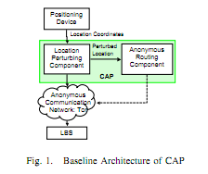
Existing work
CAP: A Context-Aware Privacy Protection System for Location-Based Services
“Context aware” perturbation
Various-grid length Hilbert Curve (VHC)-mapping
privacy protection
LBS accuracy

Slide 11
Existing work
Homomorphic Encryption
Algebraic operation performed on the plaintext is equivalent to another (possibly different) algebraic operation performed on the ciphertext.

Slide 12
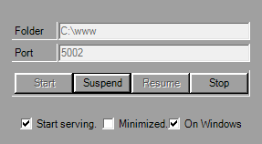
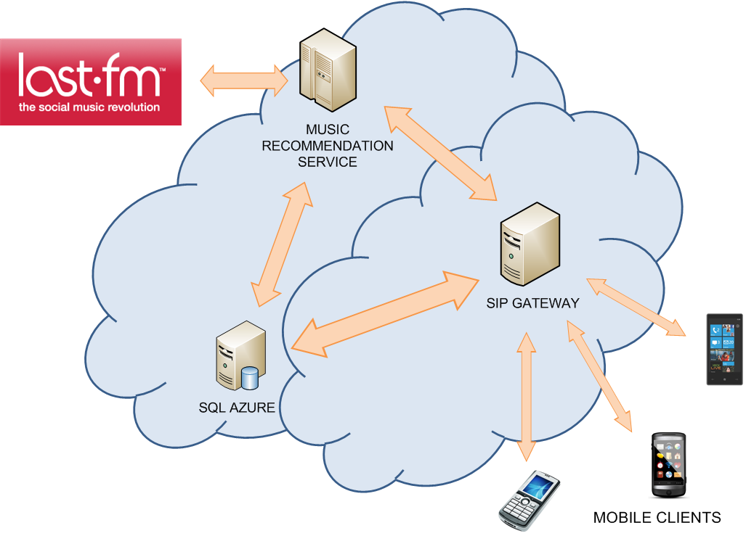

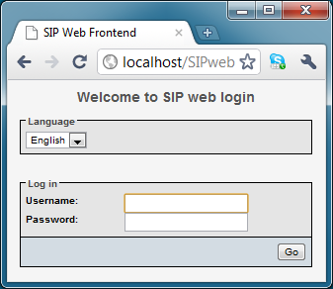
System architecture
SIP Server
SIP Web Portal

Slide 13
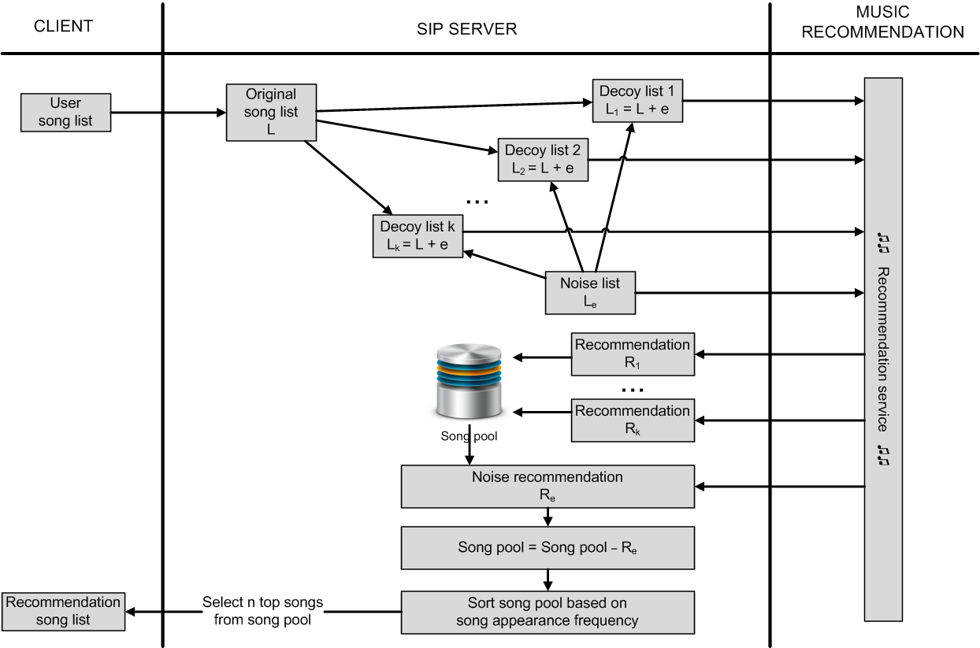
Cloaking mechanism

Slide 14
Demo Session

Slide 15
Evaluation
Song similarity index
SI(s1, s2) = (a + b)w + c
Evaluation scenarios
With/without SIP service
Varying system parameters
a = 1 if (s1.genre == s2.genre)
b = 1 if (s1.album == s2.album)
c = γ / (α + β + γ)
α = no. of genres of artist1, but not artist2
β = no. of genres of artist2, but not artist1
γ = no. of genres of both artists

Slide 16
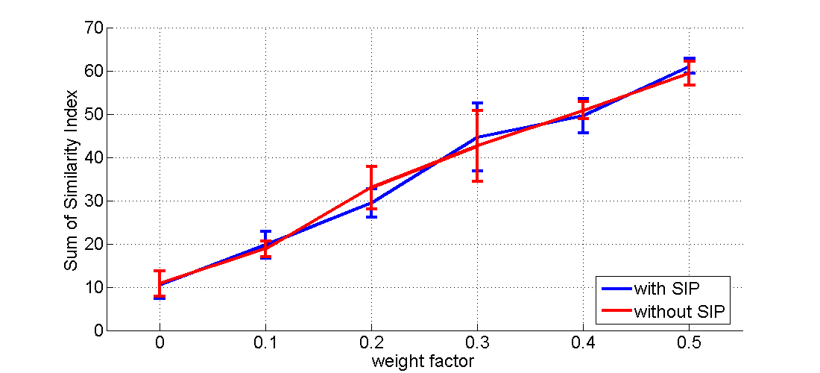

Eval 1: weight factor
Exp Setup
noise = 20%
w [0, 0.5]
decoy = 5
list size = 5
round = 10

Slide 17
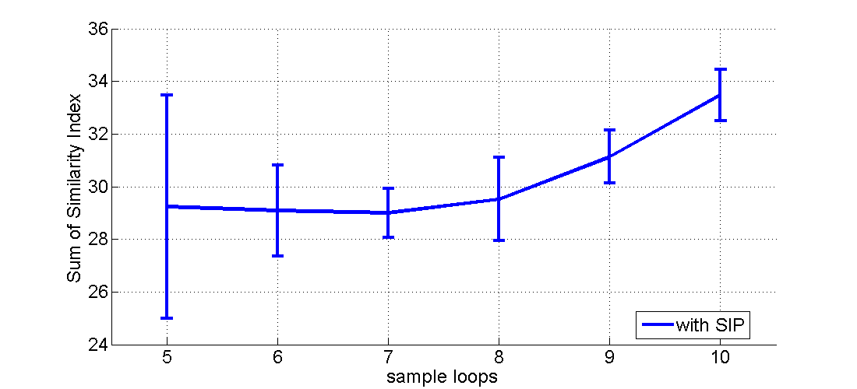
Eval 2: number of decoys
Exp Setup
noise = 20%
w = 0.2
decoy [5, 10]
list size = 5
round = 10

Slide 18
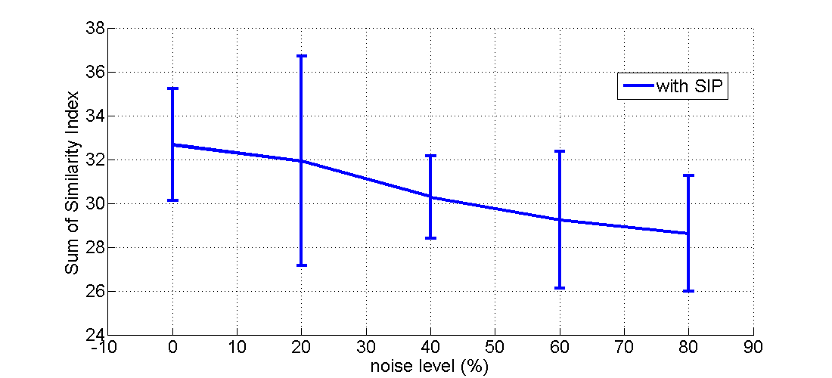
Eval 3: noise level
Exp Setup
noise [0,0.8]
w = 0.2
decoy = 5
list size = 5
round = 10

Slide 19
Contribution
Pallavi
Literature research
Client implementation
Cloaking mechanism
Song similarity algorithm
Huy
Server implementation
Music service implementation
Evaluation
Cloaking mechanism

Slide 20
Challenges
Project idea (innovative!!)
Limited programming ability of WP7 SDK
No phone settings/user info access
No TCP/IP socket connection supported (yet)
Workstation is behind firewall
Cannot connect to SQL Azure DB
Slow and unstable last.fm server
Frequently crashes the evaluation

Slide 21
Conclusion and future work
Protect user privacy w/o scarifying service performance
Applicable for other types of services
Evaluation proves system efficiency
Future work:
Extend the application pool
Devise rigorous mathematical formulation
Compare against other algorithms

Slide 22
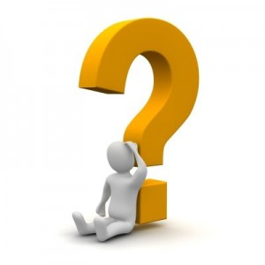
THANK YOU FOR YOUR ATTENTION
http://wireless.cs.uh.edu/

Slide 23
References
“Why users don't trust mobile apps” originally appeared at InfoWorld.com.
Finding Similar Music Artists for Recommendation, Abhay Goel, Prerak Trivedi, USC Viterbi.
Protecting Location Privacy with Personalized k-anonymity: Architecture and Algorithms, B. Gedik,Ling Liu
CAP: A Context-Aware Privacy Protection System for Location-Based Services, Aniket Pingley et al.

