Slide 1
Mastery Project
Yin HU 02/08

Slide 2
Background
Invisible Cities Charpter2
Memory
Desire
Sign
thin
Trading
Fedora

Slide 3
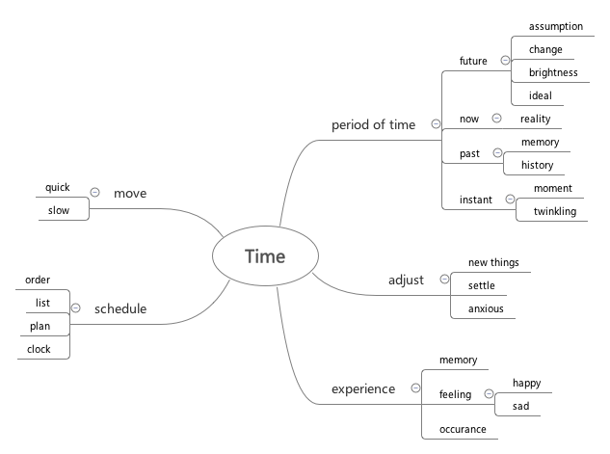
Mindmap

Slide 4
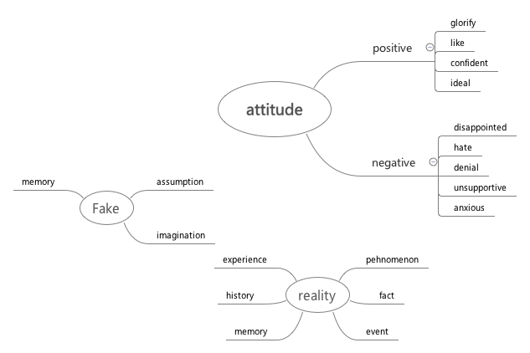
Domain map

Slide 5
Precedents
City
Time
Time-lapse photography
Long Exposure photography

Slide 6

Design Process
Places
Speed
Guy
Attitude
Time

Slide 7
Show the city
Contain the element of time
e.g: Movement
History
Schedule…..
Choose a place
Capture the moment
Notes:
Fast paced life

Slide 8
Choose a place
Capture the moment
Grand Central Terminal
Move & still
Notes:
is a commuter，rapid transit, and intercity railroad terminal
Extremely busy
has a long history, was built a hundred years ago
Witness the passing of time
Itself contains some elements related to time, for example ,the famous clock, the timetable

Slide 9
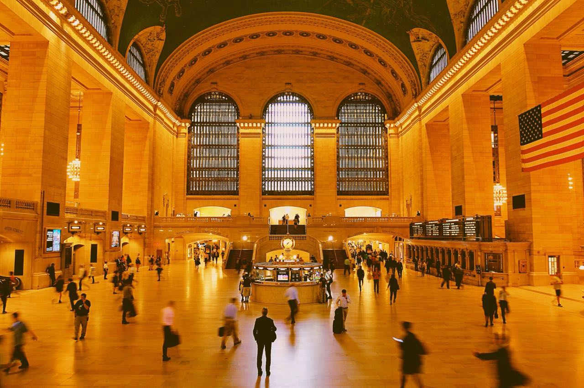
Notes:
Dimly lighted
The one in the center is still
People around him is walking
And I capture the blurred image

Slide 10
Thanks
Yin HU 02/08

