Slide 1
Meeting June 19

Slide 2
Heuristic Approach 1
load[][]: number of paths on all physical links.
maxload (of path): maximum value of loads allowed on links.
Set of pairs: P. Each pair SD has input: k shortest paths k_paths and output: paths_out as selected paths.
While (exists pair in P with no paths) {
Iterate through all pairs in P.
For each pair SD {
Iterate through k_paths {
Remove p from k_paths.
Check if adding a path p, the maximum load of load[][] is not over maxload value.
If so, add p to paths_out.
Go to next pair.
}
}
If (all pairs in P: k_paths = empty) {
Remove pairs that have at at least 1 paths.
maxload = maxload + 1
}
}

Slide 3
Heuristic Approach 2
load[][]: amount of data on all physical links.
maxload (of path): maximum value of loads on links comprising a path.
While (exist pairs with demand > 0)
{
Sort all pair by demand, highest demand first.
Pick the pair with highest demand: SD
For SD: Pick the path p with lowest maxload.
Assign an amount of chunk to the path.
Subtract chunk from pair SD’s demand.
Update all links’ load and all paths’s maxload.
}
Heuristic 1 vs. Heuristic 2:
Load on Heuristic 1 is number of paths, Load on Heuristic 2 is amount of data.
In Heuristic 1, there is a given maxload values. Maximum value of load on links is not over this value. No such maxload value is in Heuristic 2.

Slide 4
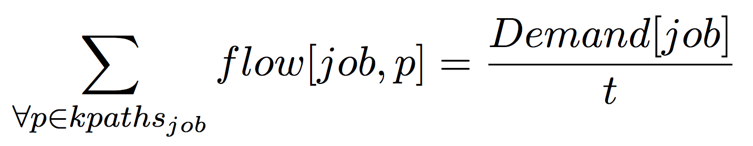
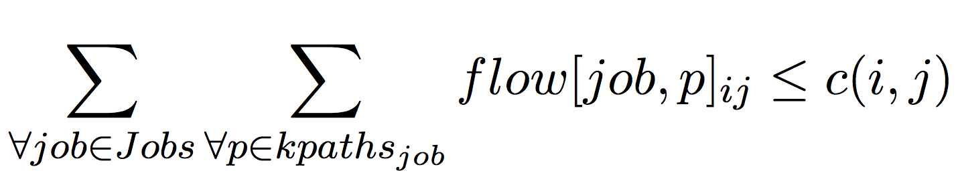
Optimization Model
Minimize transfer time: t
Subject to:
Total flows of a job:
Link capacity:

Slide 5
Experiments and Results
Patterns
Number of nodes: 512 – 4096 nodes.
1 MPI/PAMI rank per node.
Most of the experiments used Heuristic 1.

Slide 6
Overall
1K nodes, 8 MB per pairs, 91 experiments, 3 patterns.

Slide 7
Varying partitions, number of sources, destinations, keeping constant sources-destinations ratio (1:8)
Setup
Heuristic 1
Same message sizes (8 MB/pair).
Disjoint
Overlap
Subset

Slide 8
Total amount of data on physical links
1K nodes, Disjoint pattern, 8 MB/pair.

Slide 9
Varying partitions, number of sources, destinations, keeping constant sources-destinations ratio (1:8)
Set up:
Heuristic 2
Different message sizes (64 KB – 8 MB).
Disjoint
Overlap
Subset

Slide 10
Varying sources-destinations ratio
Setup:
Heuristic 1
2048 nodes totals, 64 sources.
1 Ranks/node, 8 MB/pair.
Disjoint
Overlap
Subset

Slide 11
Varying sources-destinations distance
Set up
Heuristic 1
2048 nodes totals, 256 sources.
1 Ranks/node, 8 MB/pair.
Disjoint
Overlap
Subset

Slide 12
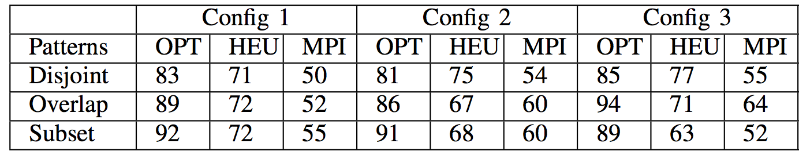
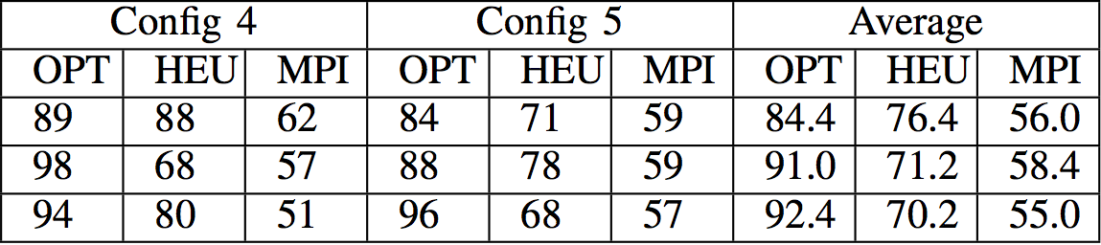
Results
Random pairing between sources and destinations.

Slide 13
Results
Efficacy of message sizes

Slide 14
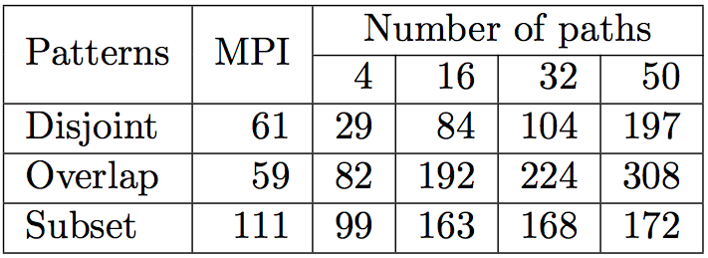
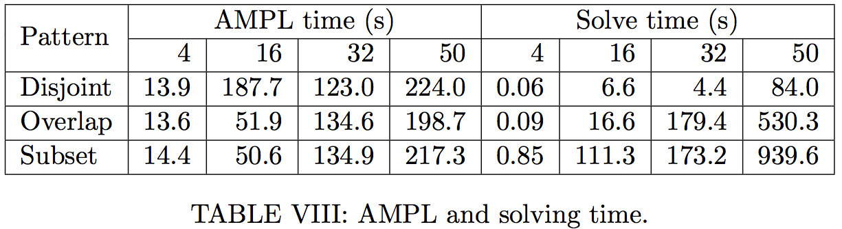
Results
Efficacy of number of paths fed into solvers

Slide 15
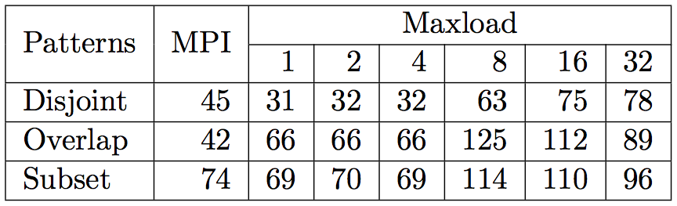
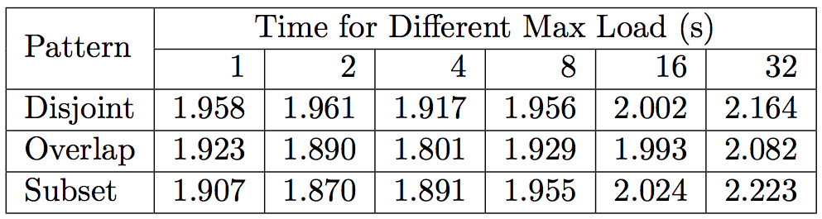
Results
Efficacy of maxload value

Slide 16
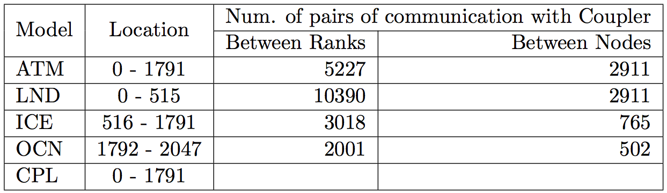
Results
Community Earth System Model (CESM)

Slide 17
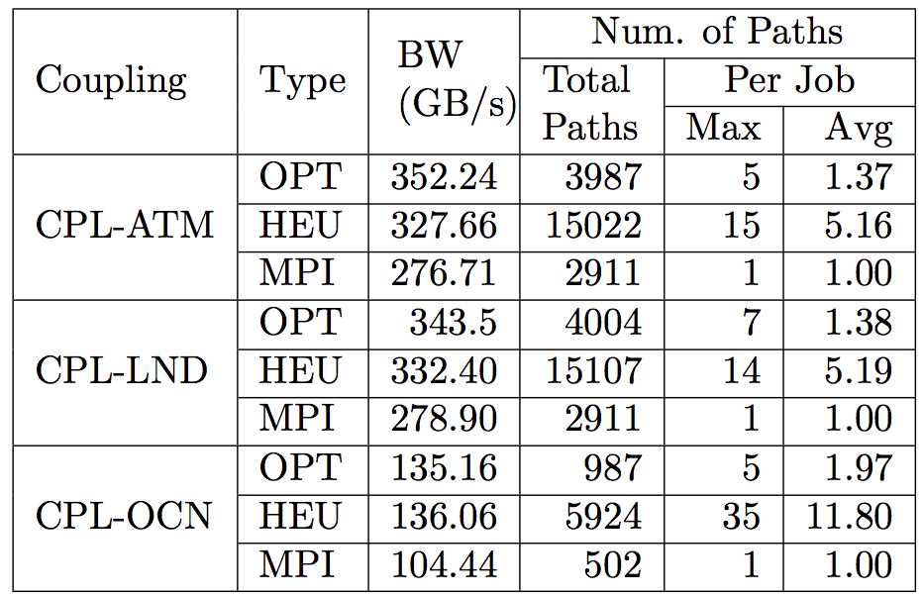
Results
Community Earth System Model (CESM)
Optimization and Heuristic 2 were used.

