Slide 1
Weekly meeting at ANL

Slide 2
Update Sept 29th 2014
Paper: Andy’s comments, 2 weeks extension.
CCMS: 96-node configuration in 128-node partition (2x2x4x4x2)
32 nodes for ATM (0-31)
32 nodes for OCN (32-63)
32 nodes for CPL (64-96)
ATM and OCN talk to CPL concurrently: point to point
Default MPI: 32 links are shared. Performance is ½ of default bandwidth (850MB/s vs. 1.7GB/s)
Optimization: no shared links: 1.7GB/s.

Slide 3
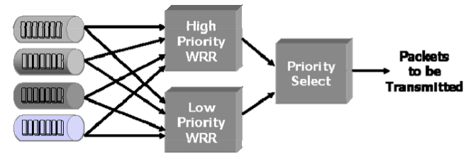
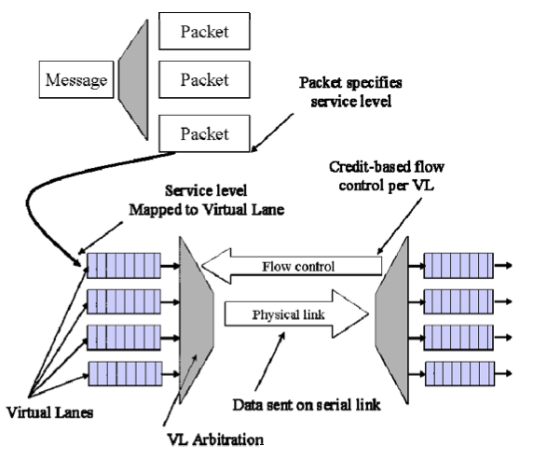

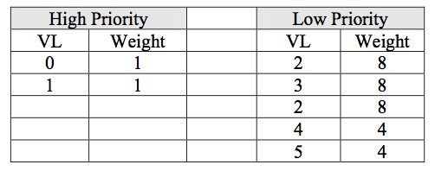
Update Sept 29th 2014 (cont.)
QoS on InfiniBand:

Slide 4
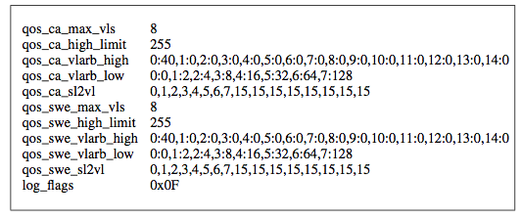
Update Sept 29th 2014 (cont.)
OpenSM
opensm.conf can be used to set values.

Slide 5
Update Sept 29th 2014 (cont.)
Papers:
3 papers from OSU
Small messages vs. Large messages.
Single virtual lanes vs. Multiple virtual lanes.
IO vs. application communication.
Application comm flows are always in SL0 with higher priority than other flows such as I/O, vis, analysis.

Slide 6
Update Oct 10
Visualize nodes of MCT.
Reorganize code to be able to work on different machines.
Generate graph
If physical link exists.
If not, sort by distance and choose the closest ones.
Need to test on real system to know if it is good.

Slide 7
Update Oct 17
Submitted paper, submission issue. Sent email to ask.
Topology: from coord [x,y,z] to [group, cabinet, chasis, blade]
Group = X, cabinet = y/3, chasis = y%3, blade = z
Still work on graph generation.
QoS model with Todd on next Tuesday. Need to discuss before the meeting.

Slide 8
Update Oct 21
Working on a project document for optiq.
QoS is not parameter. Results of the model already give us proportional bandwidth for each job/flow.
We need another model that incorporate QoS constraints.

Slide 9
Update Oct 24
Fixed the submission errors.
Created a QoS model that work for QoS on a link.
Next steps:
Read and execute flow on BG/Q.

Slide 10
Update Oct 28
Design bandwidth-shared data movement:
Based on QoS mechanism in InfiniBand.
The model produces constant proportional bandwidth for each flow.
Example: Total bandwidth is 2GB/s, 4 flows on the link. Basic message size to send out: S bytes.
Flow_id | Bandwidth | % | Data size send out
0 | 1GB/s | 50% | 5S
1 | 0.5 GB/s | 25% | 2.5S
2 | 0.3 GB/s | 15% | 1.5S
3 | 0.2 GB/s | 10% | 1S

Slide 11
Update Oct 28
Globally calculate movement paths of a message.
Split a message on each link based on the proportional bandwidth given.
Know exactly how much data to be sent/received at a node.

Slide 12
Update Oct 28
Each message:
Job Id.
Offset in the origin message.
Buffer of the message.
Size of the message.
Each node:
Know the size of incoming messages.
Know the proportional bandwidth of each flow on each outgoing arc.
Has a virtual lane (a queue) for each outgoing flow on an outgoing arc.
When receiving a message:
Break it into messages if necessary and put the messages into an appropriate virtual lane.
Check virtual lanes:
Checking all virtual lanes sequentially.
If there is any message, send out with the appropriate size.
When a message is entirely sent out, remove it from the queue.

Slide 13
Update on Dec 5th
CESM: IO problem.
Data is 1D, 2D, 3D format, multiple variables. I/O includes 2 steps:
Data rearrangement:
M to N data movement: from set of M processes which have data to N I/O processes.
Use MPI_Alltoallv: sparse data.
80% of the I/O time.
File writing.
Approaches proposed:
Improve Alltoall_v for sparse data: remove unnecessary syn, use PAMI for certain situations. This will improve the MPI_Alltoallv in general, not application specific.
Holistic solution:
Data arrangement:
Use the math model to optimize data movement.
Create a logical data arrangement in each node, so we do not need to exchange unnecessary data.
Move data as scheduled by the model to the destinations and offsets as logical model.
File write:
Using hdf5 instead of pnetcdf4 to avoid data linearizing when writing to file.
Meeting with Paul next Monday, Venkat to send the pi lib and related code base…
Extend the problem to multiple models with different I/O and data rearrangement freq.

Slide 14
Update on Dec 5th
Thesis:
Path length (#hops):
Graph partitioning:
Coarsening
256 nodes, 32 first nodes send data to 32 last nodes.
32 nodes per supernode => 8 supernodes.
Create superarcs, mapping jobs, solve to have superpaths.
Uncoarsening/refine:
Is working on.

Slide 15
Update on Dec 19th
Implement: multiple paths data movement.
Single job, simple rput: ~1.7GB/s
0 to 1.
No copy, 1MB.
Single job, simple rput with 7 hops (0-1-3-5-7-6-4-2): ~1.1GB/s.
32 nodes.
Pipeline, window size: 16KB.
2 jobs, simple rput, 7 hops: ~600MB/s per job.
(0-1-3-5-7-6-4-2), (2-4-6-7-5-3-1-0).
Multiple jobs, simple rput:
256 – 4 data movement.
Error!

Slide 16
Update Jan 19, 2015
Implemented 256 to 4 nodes data movement:
Every node in 256 nodes transfers 1M of data to all 4 dests (32, 96, 160, 224).
Path computing: 180,000 microseconds.
Data movement (PAMI + pipeline): ~45,000 microseconds.
The data movement only: 20GB/s.
Alltoallv: 110K microsecond or 9GB/s.
Performance investigation:
Reduce path computing to 16,000 microseconds.
On-fly path computing and data movement: 60K microsecond or 16GB/s.
Potentially we can get more. Need to do more investigation.
Generalized to m to n data movement algorithm using BFS.

Slide 17
Update Jan 19, 2015
Weird issue:
If initialize PAMI after most of the memory allocations, we can get better performance.
This week:
Clean code for Paul.
Model.
More on performance improvement.
Upcoming conferences:
Cluster (Feb 27)
Thesis:
June 26: file for graduation.
July 24: submit defended/approved thesis.

Slide 18
Update Jan 22, 2015
Path-based model: k shortest paths between 2 nodes:
Yen’s algorithm 1972 – one of the earliest.
The paths may share arcs.
Tests:
256 nodes partition, 256 sources, 4 dests (32, 96, 160, 224).
Experiment:
Generated k shortest paths.
Feed the k shortest paths to the model. Output: a number of paths selected by the model to produce the highest possible thoughtput.
Read the paths, compare max load, max number of hops.
Get the paths, execute on BG/Q.
3 cases:
k shortest paths.
At most k shortest paths that not over h hops.
At most k disjoint shortest paths that not over h hops.
k = 1, 2, 4, 8, 16, 32. h = 8.

Slide 19
Tests:
k shortest paths:
 | Paths by Yen’s alg |  | Selected paths by the model
k | Max_load | Max_hops | Max_load | Max_hops
1 | 51 | 8
2 | 98 | 8 | 41 | 8
3 | 141 | 8 | 40 | 8
4 | 179 | 8 | 39 | 8
8 | 362 | 8 | 40 | 8
16 | 798 | 8 | 40 | 8
32 | 1451 | 8 | 39 | 8

Slide 20
Tests:
K disjoint shortest paths:
Performance for both cases are similar to heuristic algorithm (20GB/s).
 | Paths by Yen’s alg |  | Selected paths by the model
k | Max_load | Max_hops | Max_load | Max_hops
1 | 55 | 8
2 | 92 | 8 | 40 | 8
3 | 132 | 8 | 40 | 8
4 | 171 | 8 | 39 | 8

