Slide 1
Locating Source of Heat using SLAM on Turtlebot3 Burger Robot
By Huy Le

Slide 2
What are we doing?
Program a robot to survey an unknown environment
Build a map as the robot surveys the environment
Find the hottest area in the map and navigate to that location
Let the robot execute these points autonomously

Slide 3
How will we achieve our goal?
Implement Simultaneous Localization and Mapping, or SLAM, onto a ground mobile robot
Use Robot Operating System, or ROS, as our middleware for robotics programming
  We use ROS2 Foxy distribution

Slide 4
What kind of Robot is it?
Turtlebot3 model Burger by ROBOTiS
Ground mobile Robot with differential wheels
Hardware:
  Raspberry Pi 4
  OpenCR 1.0 (arduino board)
  Dynamixel Servos
  360 degree Lidar and temperature sensor

Slide 5
What kind of Robot is it? Cont.
OpenCR1.0 Arduino board additional included sensors: Gyroscope, Accelerometer, magnetometer
Modded to include Temperature Sensor

Slide 6
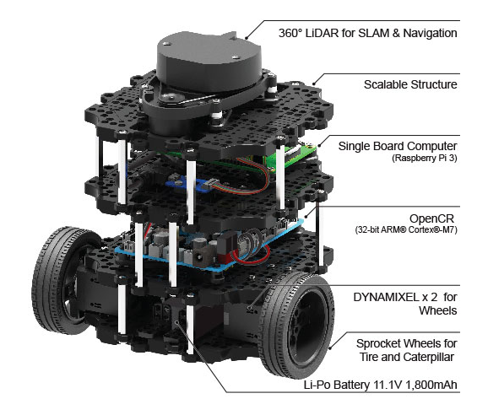
TurtleBot3 Burger
https://www.robotis.us/turtlebot-3-burger-us/

Slide 7
What is SLAM?
Generates a map and localize robot within map simultaneously
Allows for efficient navigation
  predetermine path before navigating
Various types of SLAM
  RGB, Acoustic, LiDAR, and more
    We use LiDAR

Slide 8
What is ROS?
Project led by Keenan Wyrobek and Eric Berger while at Stanford in starting 2006
  Aimed to reduce development time in robotic projects
  Released ROS 1.0 in 2010; ROS2 in 2017
Open source middleware that provides tools to program hardware
Highly Scale-able, reduces re-work
Has simulation tools
Notes:
Reduce development time by
scalability, lots of smaller pieces to build an application
easier to debug, one node crash does not crash others

Slide 9
ROS crash course
Graph structure made of Nodes
Nodes are scripts written in Python or C++
  Components of the robot
  Instructions for a task
3 modes of communication between Nodes
  Communicate through wireless network by multicasting

Slide 10
ROS crash course cont.
Nodes communicate through Topics, Services, or Actions
The messages sent between nodes are called interfaces
  Must be the same between nodes
Interfaces are like structs in C/C++ but embedded into a text file
  Can contain primitive data types and other interfaces

Slide 11
ROS crash course… Topics
Uses .msg interface
Publisher publishes to a Topic continuously
Subscriber subscribes to Topic and listens
Kind of like tuning into a radio station

Slide 12
ROS crash course… Topics
https://docs.ros.org/en/foxy/Tutorials/Beginner-CLI-Tools/Understanding-ROS2-Nodes/Understanding-ROS2-Nodes.html

Slide 13
ROS crash course… Services
Uses .srv interface
Server waits for a client request
When client sends a request, server responds immediately

Slide 14
ROS crash course… Services
https://docs.ros.org/en/foxy/Tutorials/Beginner-CLI-Tools/Understanding-ROS2-Services/Understanding-ROS2-Services.html

Slide 15
ROS crash course… Actions
Uses .action interface
Better usage for long tasks
Client sends request to server
Server responds with feedback, or status updates, while executing task
ex) tell robot to move forward for 10 minutes

Slide 16
ROS crash course… Actions
https://docs.ros.org/en/foxy/Tutorials/Beginner-CLI-Tools/Understanding-ROS2-Actions/Understanding-ROS2-Actions.html

Slide 17
ROS crash course… Transforms
Positions and orientations of robot’s components represented as coordinated frame
Transform tree structure is built of parent and child frames
  One parent for 0 to unlimited children
  Position/Orientation of a frame is relative to its parent
Transforms can be broadcasted or listened to

Slide 18
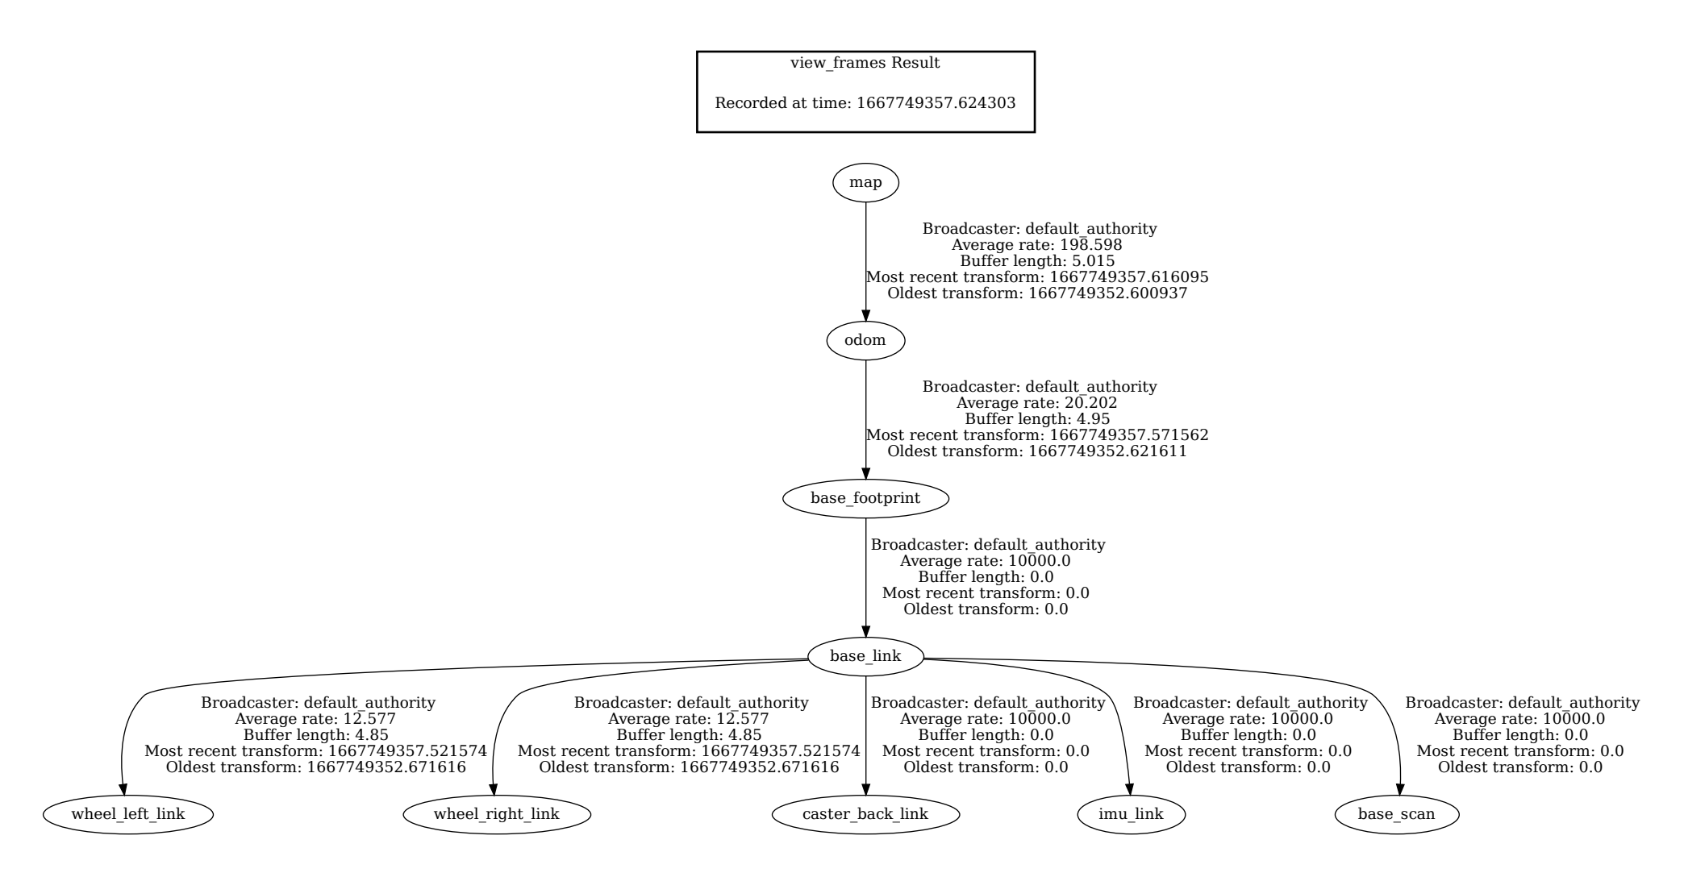
Our Transform Tree

Slide 19
Additional Tools
Use 3 additional packages by ROBOTiS
  turtlebot3_bringup (modded)
    Provides firmware for OpenCR1.0
    Publishes all sensor values
  turtlebot3_cartographer
    Provides mapping and map data of environment
  turtlebot3_navigation2
    Used for robot navigation when map is provided
  https://github.com/ROBOTIS-GIT/turtlebot3/tree/foxy-devel

Slide 20
What I Authored
4 nodes
  tb3_map_server.py
  tb3_status.py
  circle_around.py
  robot_world.py
A few interfaces for node communication

Slide 21
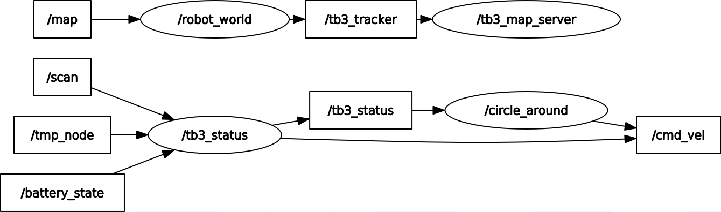
Authored node graph
Ovals are nodes
  Pointed to are subscribers
  Pointing to are publishers
Rectangles are topics (not listed are services)

Slide 22
circle_around node
Responsible for robot movement
  Finds a wall and moves along wall in parallel
  Uses lidar values to determine movement
  Follows finite state machine
Additional responsibilities
  telling robot_world node when to begin mapping
  Wait for tb3_map_server node to send client request

Slide 23
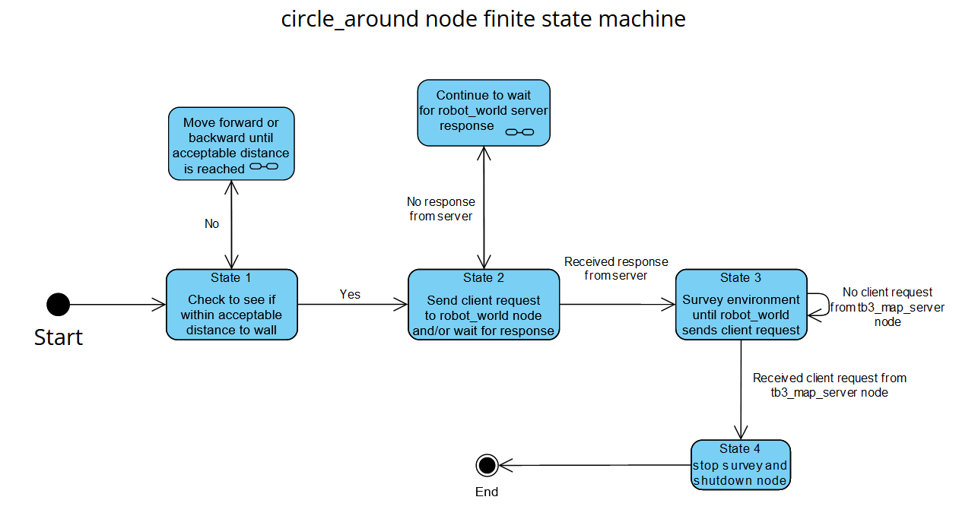
circle_around node cont.

Slide 24
tb3_map_server node
Responsible for launching cartographer and navigation packages at the right time
  Cartographer request from circle_around
  Navigation start when robot survey is done
Track robot position by subscribing to robot_world node
  Based on location, determines when navigation should be launched
Saves map as a .pgm image file
Follows finite state machine

Slide 25
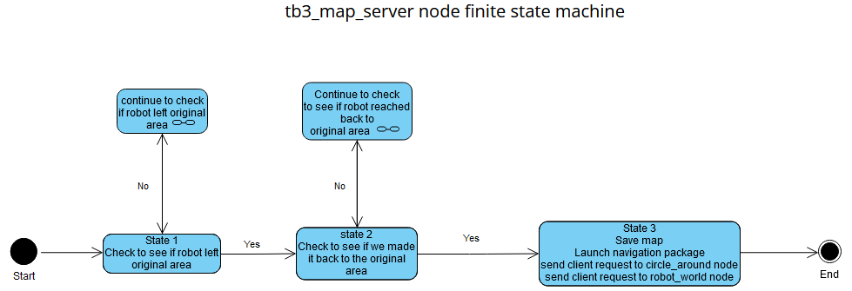
tb3_map_server node cont.

Slide 26
robot_world node
Request temperature reading from tb3_status node
Subscribe to map topic provided by cartographer package
  Cartographer puts map frame above odometry frame as parent
    Creates transform for robot in map
    Allows for localizing robot within the map
    Localizing is tracked by odometry

Slide 27
robot_world node cont.
Keeps track of… and publish
  Starting location
  Robot location
The map is dynamic
  Map is an array
  Locations must be processed
Keep tabs of hot spots and their coordinates
Output a map in a text file for troubleshooting

Slide 28
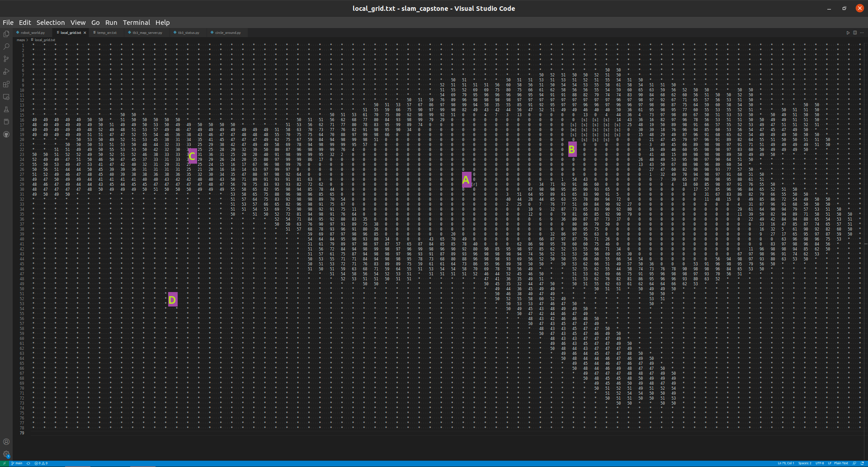
robot_world node cont.

Slide 29
tb3_status node
Check for a tolerance due to a bug in the bringup package, stops robot if outside
Subscribes to tmp_node to provide robot_world node temperature when requested
Simplifies lidar data for robot_world
Prints robot status to terminal for monitoring
  Lidar values, battery %, current temperature, etc.

Slide 30
To do
Add output image and live image
Add video
Talk about bugs and inefficiencies
  https://github.com/ROBOTIS-GIT/turtlebot3/issues/847
  Posted Mar22, ghosted Apr22, picked up sept22
Future work
Acknowledgements

Slide 31
Sources used in this presentation
https://en.wikipedia.org/wiki/Robot_Operating_System
https://nu-msr.github.io/me495_site/lecture05_tf.html
https://docs.ros.org/en/foxy/index.html

