Slide 1
NextJs Workshop Demo

Slide 2
Members
Join implementing
  Chien Phung
  Hai Nguyen
  Hien Nguyen
  Thien Le
  Quan Ho
  Tung Nguyen
  Hieu (left)
  Huy Chenh
Join discussing
  Khoa Tran
  Huong
  Nhon Vuong

Slide 3
Project Scope
Build a car selling website that allows users to
  Search for a car by brand, model, year, name, or category
  View details information of a car
  Register to sell a car
  Order a car
  View order list

Slide 4







Technical Stack

Slide 5
Advantages of NextJS
Next.js is a robust JavaScript framework builds upon React
  Page routing
  Dynamic component
  Prefetching
Pre-Rendering Options
  Static page generation
    A better load time
  Server-side rendering
    Search engines can easily index and crawl content
SEO advantages

Slide 6
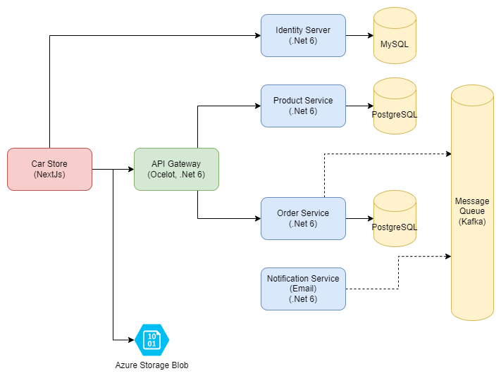
Architecture Overview

Slide 7
Deployment
Expectation
  Using K8s
  CI/CD pipeline
Actual
  Front-end: Vercel
  Back-end: Azure web app

Slide 8
It’s time for a Real Demo

