Slide 1
THESIS DEFENSE · 2026
IoT-Based Smart Home
System for Elderly Care
A full-stack platform combining ESP32 hardware, Clean Architecture backend, machine-learning anomaly detection, and a hybrid AI assistant.
STUDENT
SUPERVISOR
Tu Dinh Huy
Le Duy Tan, Ph.D.
ID ITITIU21213
International University — VNU-HCM
2026

Slide 2
02
AGENDA
THESIS DEFENSE · ITITIU21213
Presentation Roadmap
01
Motivation & Problem
06
Web & Mobile UI
Aging Vietnam, gaps in commercial smart-home tech
Vite dashboard and Flutter app for caregivers
02
Research Goals
07
AI & ML Subsystem
Three research questions and implementation targets
Alfred + Isolation Forest, accuracy & inference latency
03
System Architecture
08
Validation & Security
4-layer IoT stack: hardware → cloud → backend → UI
April 2026 layer validation; auth, MQTT-TLS, rate limits
04
Hardware Design
09
Limitations & Future
ESP32 node, sensor suite, custom 2-layer PCB
What's left, what comes next
05
Backend
Flask + Clean Architecture, MQTT, REST + Socket.IO
2 / 20

Slide 3
03
PART 1 — MOTIVATION
THESIS DEFENSE · ITITIU21213
Why an Open Smart-Home for Elderly Care?
THE PROBLEM
BY 2050
Coverage gaps in solo living
~14%
Elderly prefer home — but a fall, racing heart, or overheated room may go unnoticed between family visits.
Closed commercial ecosystems
of Vietnam's population
Off-the-shelf smart-home products lock data in proprietary clouds with no anomaly alerting and no BLE health-sensor support.
will be aged 65 or older
No room-aware view for caregivers
Source: GSO, 2019
Existing apps don't show where devices are within a floor plan, making spatial situational awareness hard.
MY GOAL: an affordable, open-source, full-stack platform for continuous elderly monitoring.
3 / 20

Slide 4
04
PART 2 — RESEARCH GOALS
THESIS DEFENSE · ITITIU21213
Research Questions & Objectives
RQ 1
RQ 2
RQ 3
Sensing reliability
ML on small data
Local LLM as UX
Can a low-cost IoT system reliably monitor environmental and physiological signals in a household?
Can a simple unsupervised ML model (Isolation Forest) provide useful anomaly detection on a small dataset?
Can a locally hosted LLM serve as a practical interface for elderly users and caregivers?
IMPLEMENTATION GOALS
✓
ESP32 sensor node + custom PCB
✓
Flask backend (Clean Architecture)
✓
BLE heart-rate bridge
✓
Web dashboard + Flutter mobile app
✓
Alfred AI assistant (3 modes)
✓
Isolation Forest anomaly pipeline
4 / 20

Slide 5
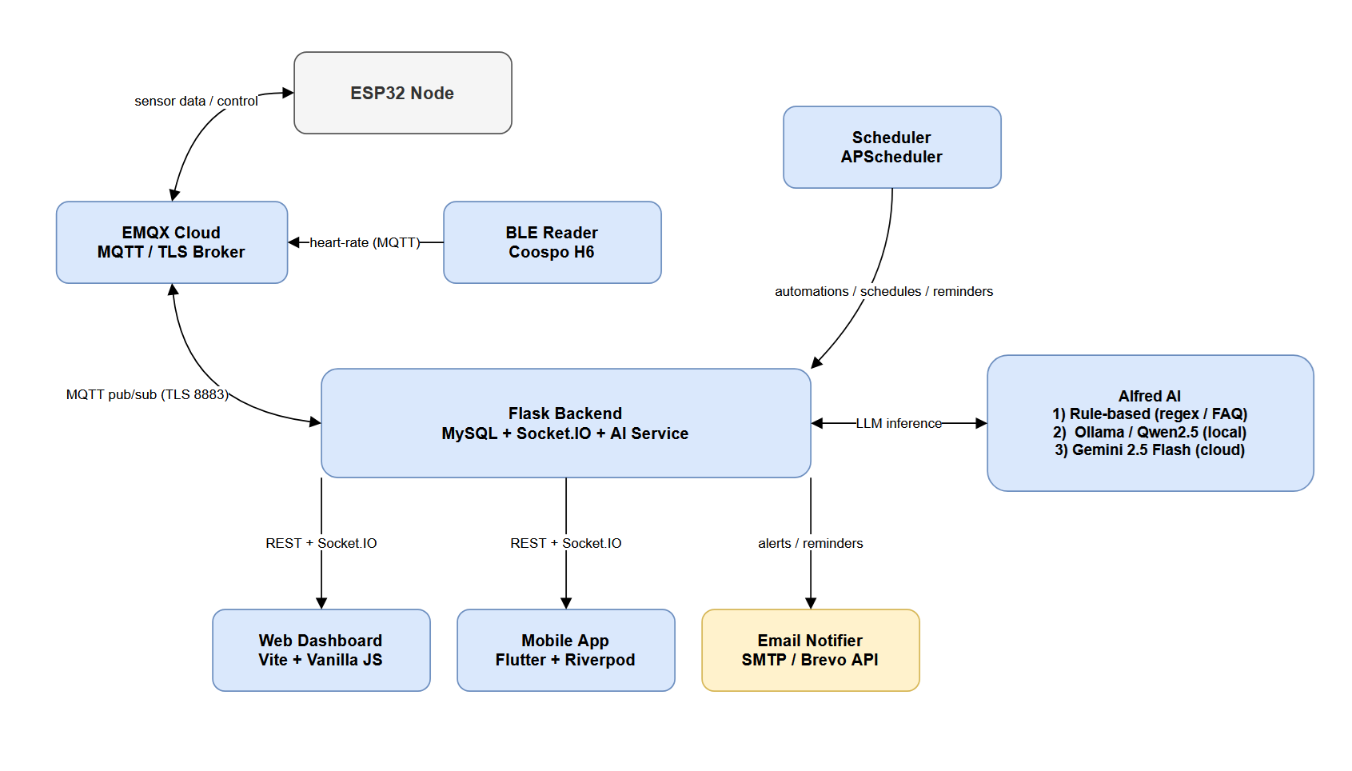
05
PART 3 — SYSTEM ARCHITECTURE
THESIS DEFENSE · ITITIU21213
Four-Layer IoT Stack
Hardware → Cloud broker → Backend → Web/Mobile UI
L1
Hardware
ESP32-WROOM-32 + DHT11, LDR, PIR, 2 relays. Telemetry every 5s over TLS-MQTT.
L2
Communication
EMQX Cloud MQTT broker (TLS port 8883). home/sensors/# and home/control/<code>.
L3
Backend
Flask + Clean Architecture. REST, Socket.IO, APScheduler, MQTT listener → ORM → MySQL.
L4
Presentation
Vite web SPA + Flutter mobile. Bearer-token auth, Socket.IO room isolation, real-time updates.
Figure 1 — System architecture (data + control flow)
5 / 20

Slide 6
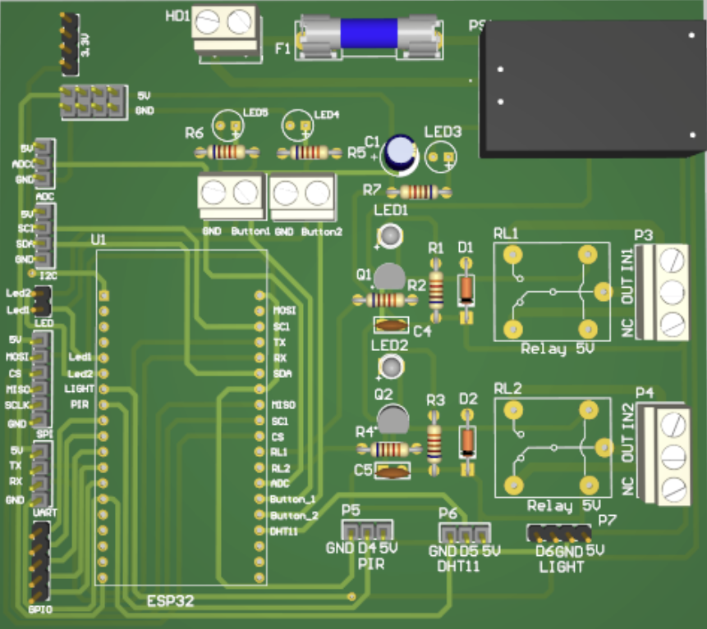
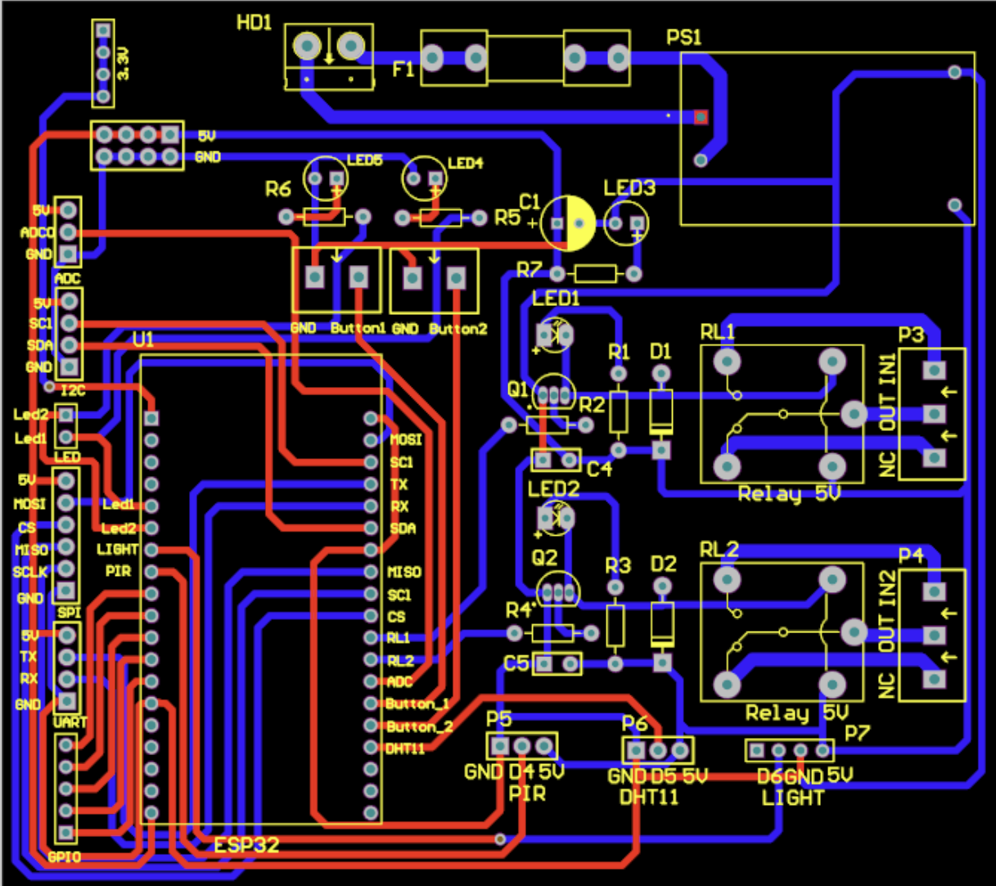
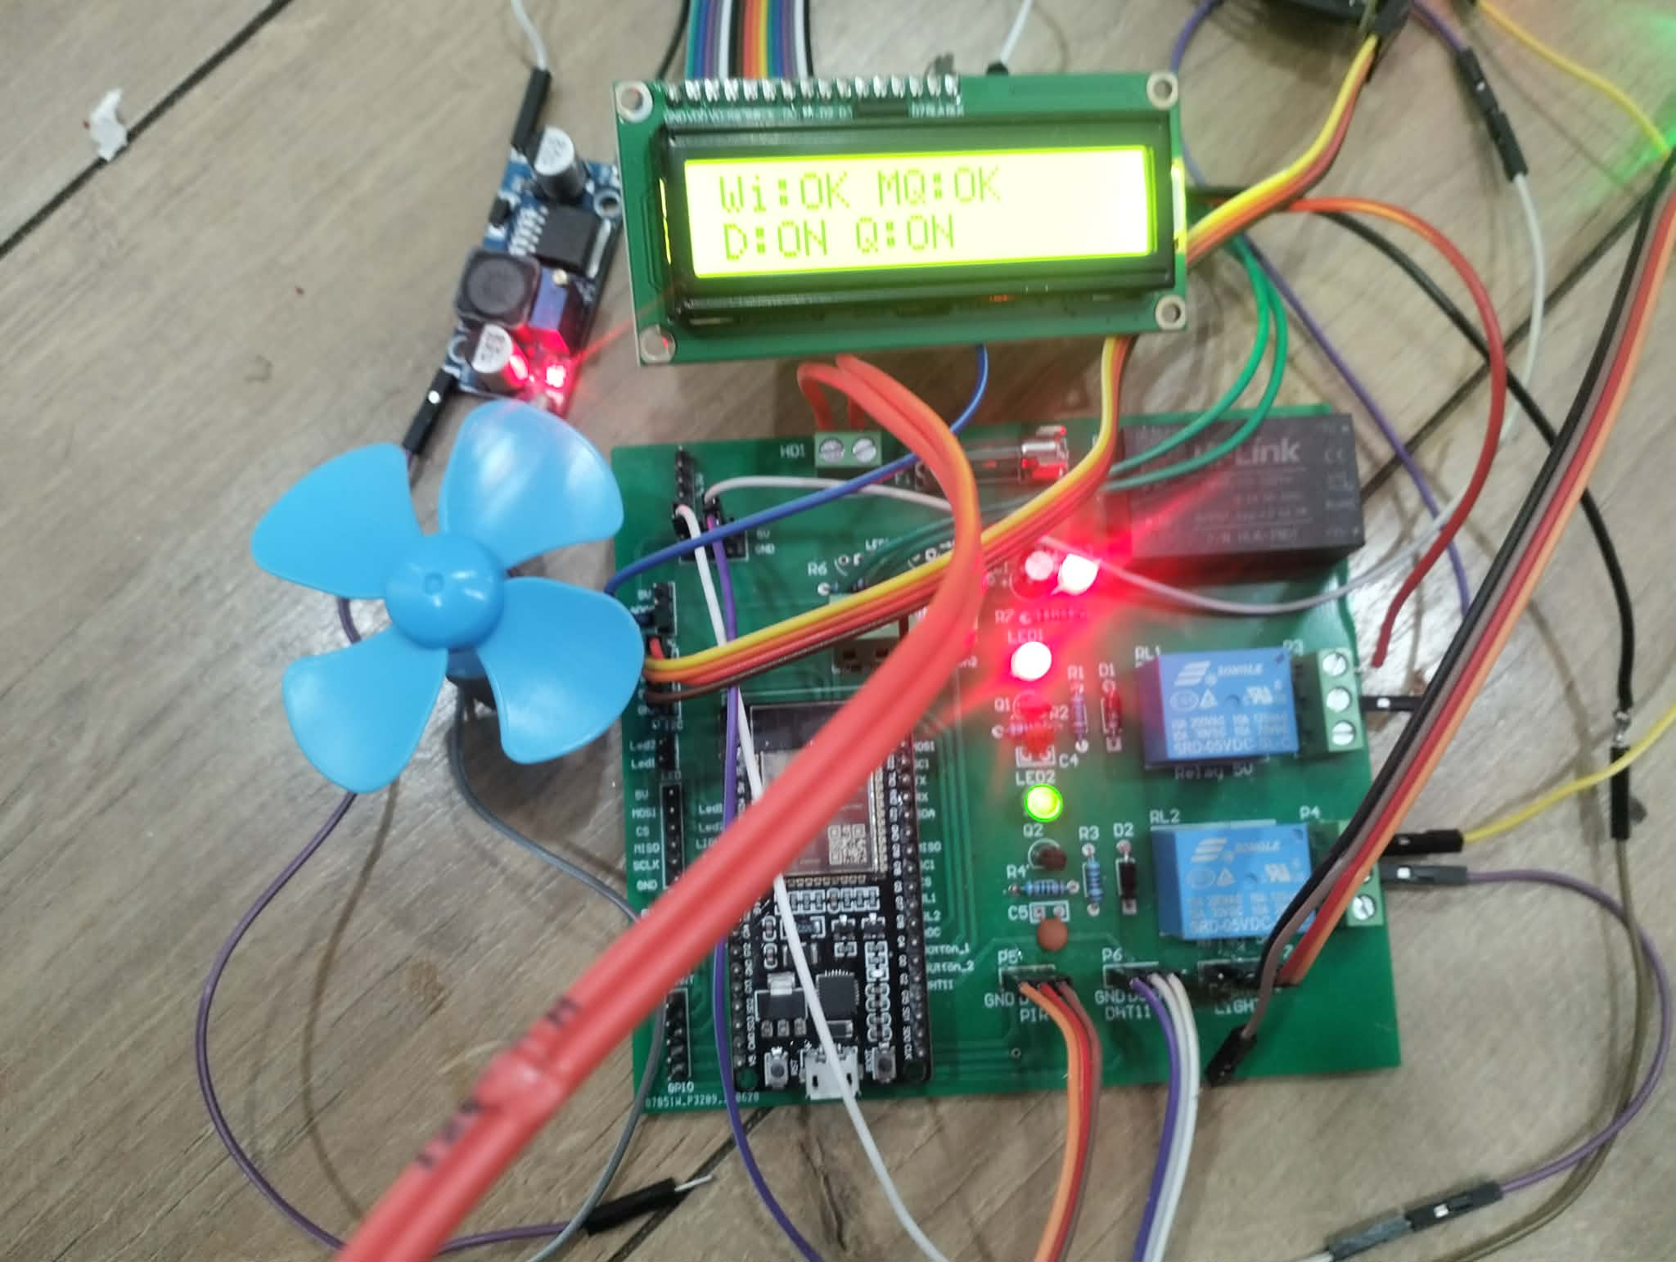
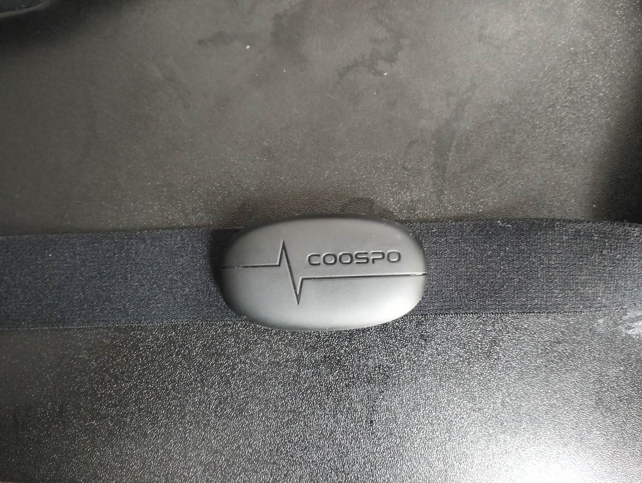
06
PART 4 — HARDWARE DESIGN
THESIS DEFENSE · ITITIU21213
ESP32 Node & Custom PCB
Coospo H6
BLE GATT 0x2A37
PCB 3D Render
Copper Layout (Altium)
Working prototype with LCD status
BPM bridge via Python (bleak)
240 MHz
5 sensors
16×2 LCD
41 parts
Dual-core ESP32-WROOM-32 with hardware AES/TLS
DHT11 · LDR · PIR · Coospo H6 · 2 relays
I²C local status display (SDA 21 / SCL 22)
Custom 2-layer PCB · 24 component types · Altium
Note: Wi-Fi and BLE cannot run concurrently on ESP32 → dedicated Python BLE bridge republishes BPM to MQTT.
6 / 20

Slide 7
07
PART 5 — BACKEND
THESIS DEFENSE · ITITIU21213
Flask + Clean Architecture (5 Layers)
Domain (innermost)
Presentation
Device entities, abstract port interfaces. Zero framework imports — pure Python.
Infrastructure
Use Cases
Gateways
DeviceUseCase, AlertUseCase, SensorUseCase, AIUseCase, ReminderUseCase.
Use Cases
Gateways
Domain
MQTT listener/publisher, Socket.IO emitter, email notifier (SMTP / Brevo).
Infrastructure
SQLAlchemy ORM — 16 tables (users, devices, rooms, sensor_data, alerts, health, reminders).
Presentation
Flask blueprints — auth, device, room, alert, patient, reminder, ai, map, admin APIs.
Inward dependency rule: outer layers depend on inner abstractions.
7 / 20

Slide 8
08
PART 5 — API SURFACE
THESIS DEFENSE · ITITIU21213
REST + Socket.IO + MQTT
30+ endpoints, real-time push, scheduled jobs, signed-token auth
REST API
SOCKET.IO REAL-TIME
CROSS-CUTTING
30+
User-scoped event rooms — pushed only to the authenticated user.
Auth
Signed bearer tokens (itsdangerous, 7-day lifetime). @auth_required decorator.
device_status
ON/OFF state changes
REST endpoints
Rate limits
sensor_update
5-second telemetry burst
500 req/day · login 10/min · register 5/min (Flask-Limiter).
› auth — login, register, password reset
alert
Anomaly / system alert
› device — control, telemetry, history
Scheduler
› rooms / map — floors, polygons, devices
hr_alert
Heart-rate spike (Isolation Forest)
› patient — profile, HRV, health records
APScheduler — automation rules, cron schedules, medicine reminders.
› alerts — list, ACK, delete, severity filter
ai_mood
Alfred mood/persona update
› reminders — medicine schedules, dispatch
ai_advice
Alfred contextual advice push
Docs
› ai — Alfred chat, mood, advice
Swagger UI at /api/docs (OpenAPI 3.0).
› admin — caregiver CRUD, role gating
8 / 20

Slide 9
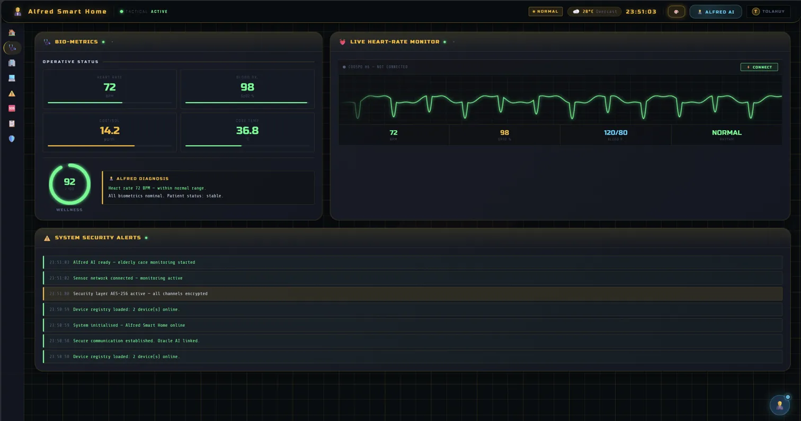
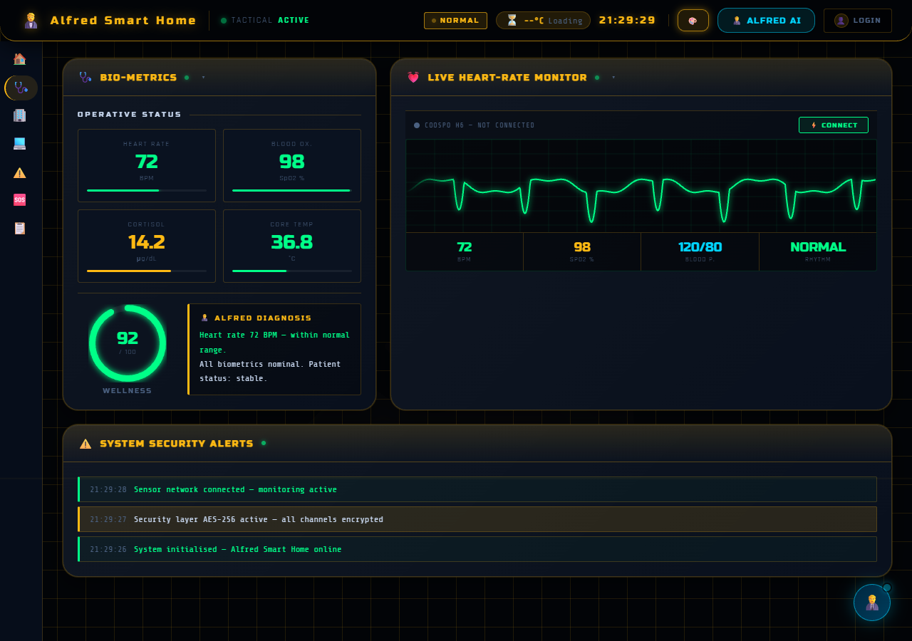
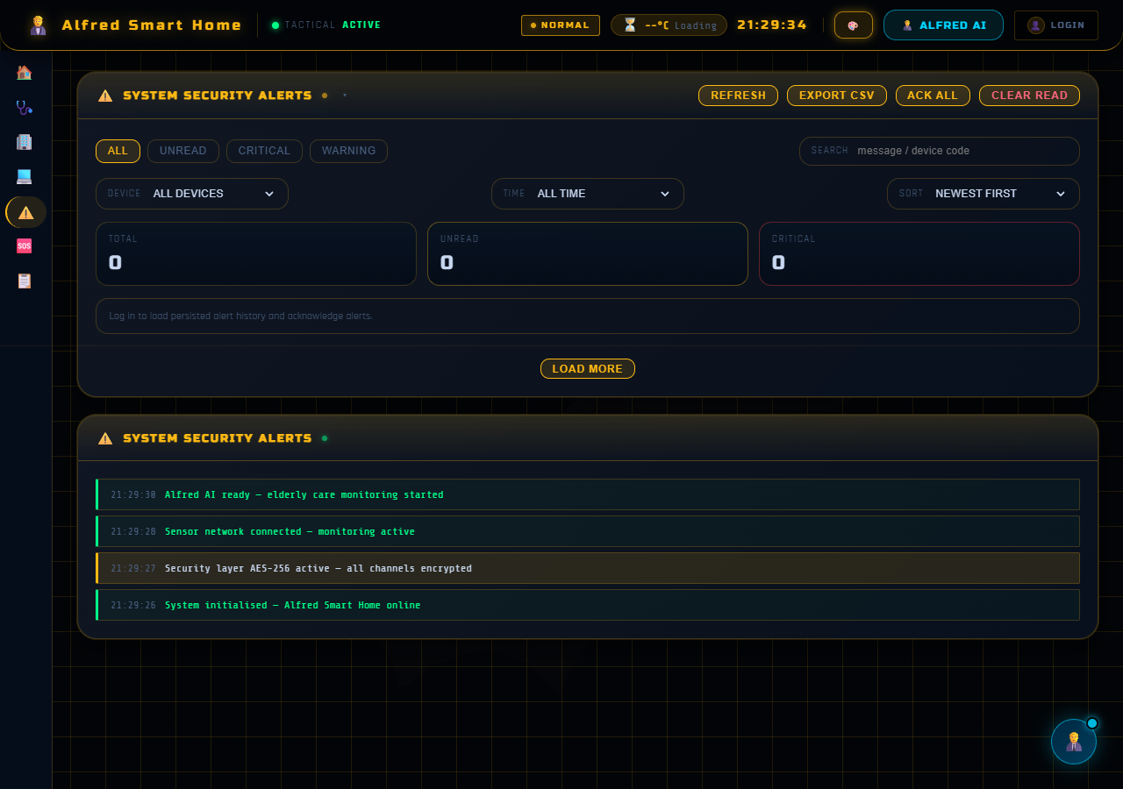
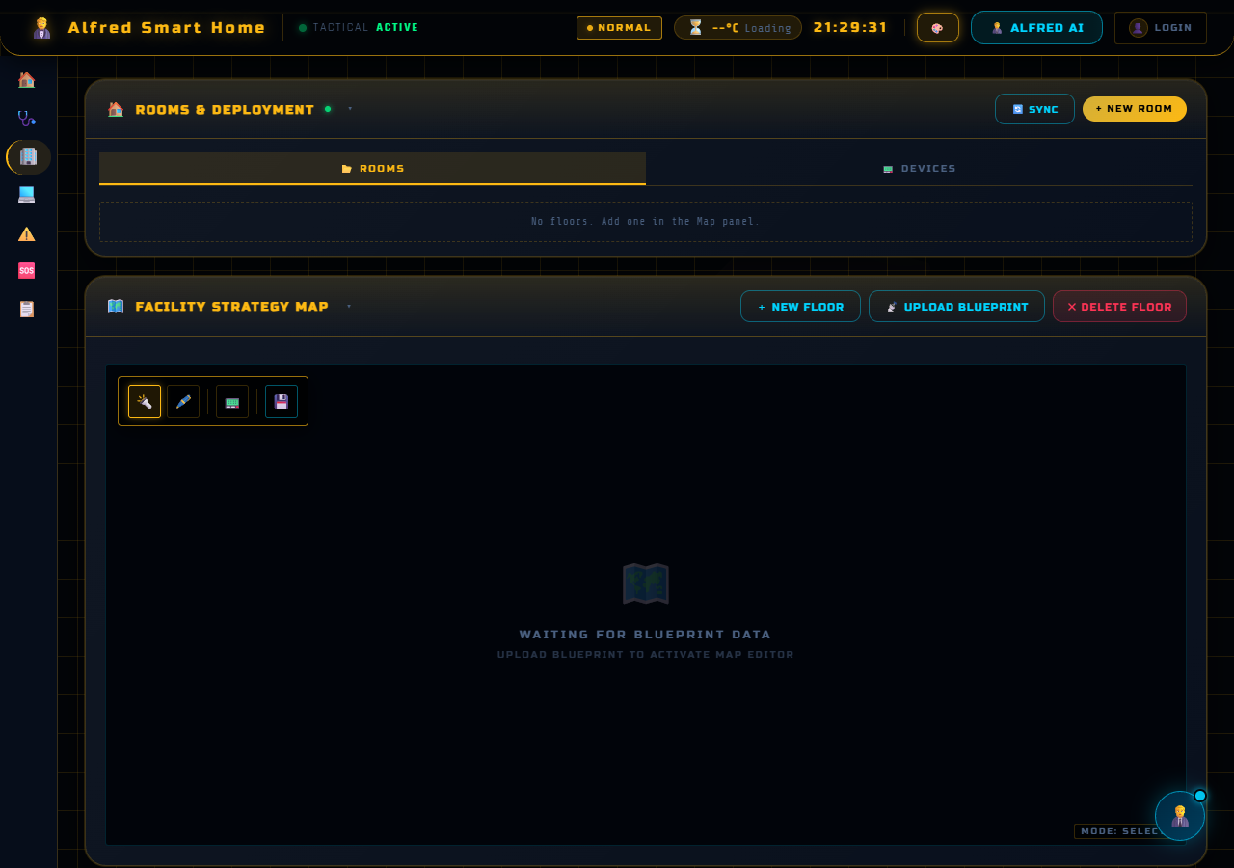
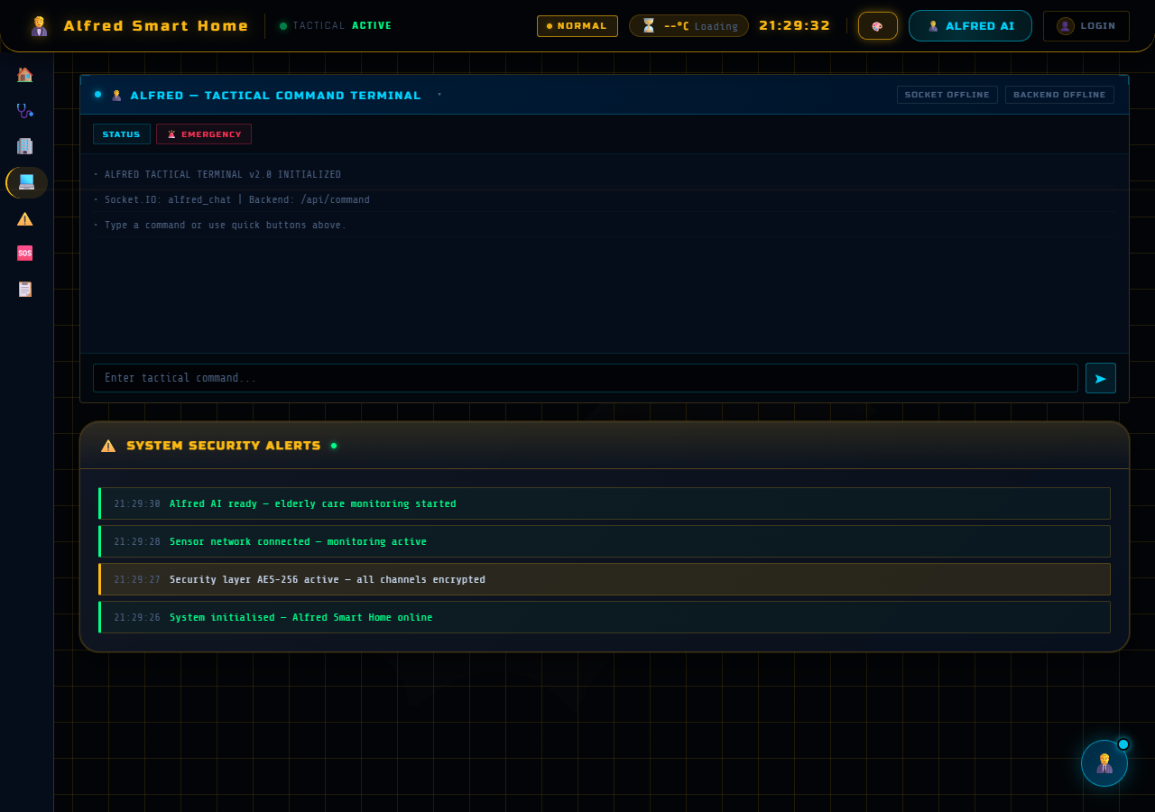
09
PART 6 — WEB DASHBOARD
THESIS DEFENSE · ITITIU21213
Vite + Vanilla JS Dashboard
🩺
Health Monitor
BPM time-series with risk colors. HRV — RMSSD, SDNN, pNN50.
🚨
Alert Management
Severity filters, per-alert ACK/delete, bulk-clear. CSV export.
🗺
Room Configuration
Polygon draw tool, floor tabs, drag-drop device assignment.
Main Dashboard — bio-metrics, live BPM chart, alerts feed
💡
Device Command
MQTT toggle controls, last-seen status, real-time state feedback.
👥
Care Staff (admin)
Caregiver CRUD, patient-caregiver linkage, role gating.
Health
Alerts
Rooms
Command
9 / 20

Slide 10
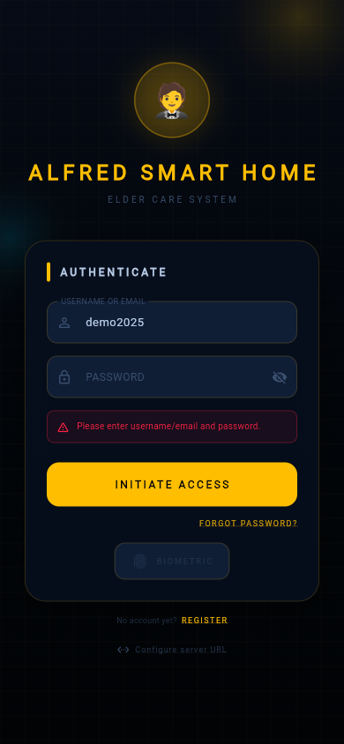
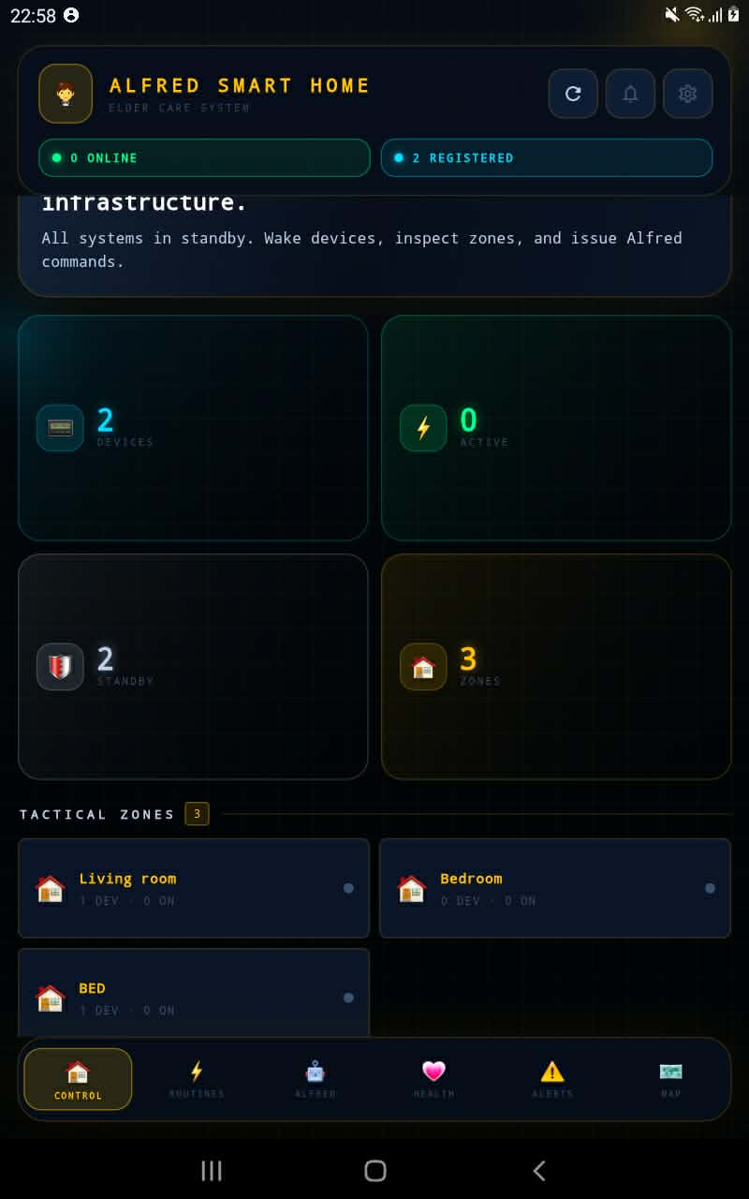
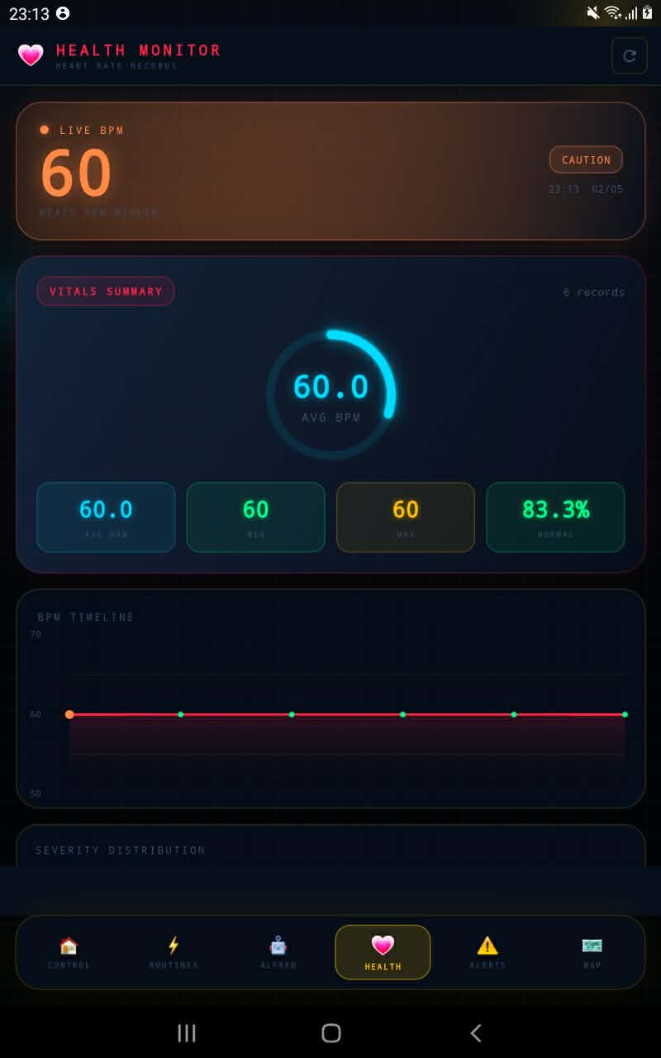
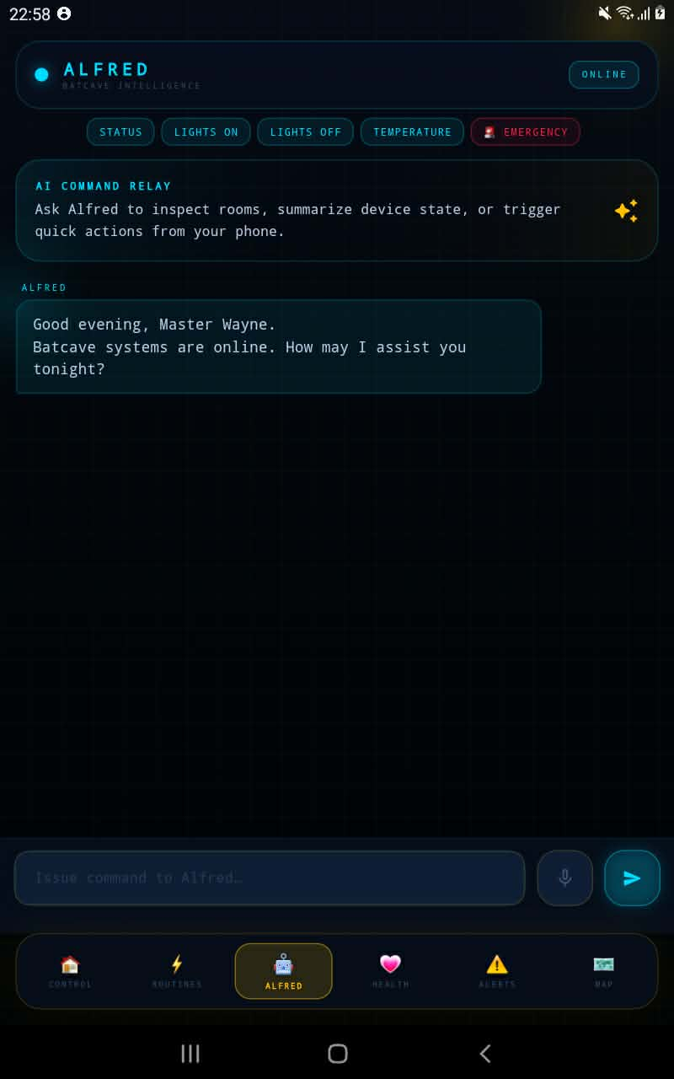
10
PART 6 — MOBILE APP
THESIS DEFENSE · ITITIU21213
Flutter Cross-Platform App
Same auth flow and Socket.IO model as web — Android + iOS
Login & Auth
Device Control
Health Monitor
Alfred Chat
Voice input
Map screen
3-mode AI
April 2026 ✓
speech_to_text — reduces typing for elderly
Floor-plan polygons + device markers
Rule / Ollama LLM / Gemini fallback
Static analysis + tests + UI flows passed
10 / 20

Slide 11
11
PART 7 — AI SUBSYSTEM
THESIS DEFENSE · ITITIU21213
Alfred — Hybrid AI Assistant
Three backend inference modes + a frontend overlay that compares them
RULE
LLM (DEFAULT)
CONTEXT-ENRICHED PROMPT
< 50 ms
1 – 4 s
Rule mode
Ollama qwen2.5:3b
Live sensor state (T/H/L/PIR)
Pattern-matching engine for device toggles. Deterministic and offline-safe.
Local LLM with full context. No cloud, full privacy.
Device list & current ON/OFF
Patient profile (name, conditions)
Persona instruction
CLOUD
OVERLAY
< 1 s
frontend
Recent conversation memory
Gemini 2.5 Flash
Compare mode
Google Gemini for complex queries. Auto-fallback to Ollama on error.
Calls all three sequentially, auto-selects the best reply.
Personalisation
Alfred addresses the user by their registered patient name. Voice input via Web Speech API and speech_to_text.
11 / 20

Slide 12
12
PART 7 — ML ANOMALY DETECTION
THESIS DEFENSE · ITITIU21213
Isolation Forest on Heart-Rate Stream
PERFORMANCE ON 2,000-SAMPLE SYNTHETIC TEST SET
4 RISK LEVELS
91%
62%
✓
△
▲
!
Normal
Elevated
High
Critical
RECALL
PRECISION
ALERT PIPELINE
BLE Coospo H6
›
MQTT bridge
›
Isolation Forest
›
DB + Socket.IO
›
Web + Mobile
HRV Pipeline
Inference Cost
Training Data
RMSSD, SDNN, pNN50 computed from continuous BPM stream. Detects chronic autonomic deterioration over time.
<1 ms per sample · O(T log n) · 300 trees. Not a runtime bottleneck — runs in real time on commodity hardware.
2,000-sample synthetic held-out test set. Single feature: heart rate (BPM). scikit-learn implementation.
12 / 20

Slide 13
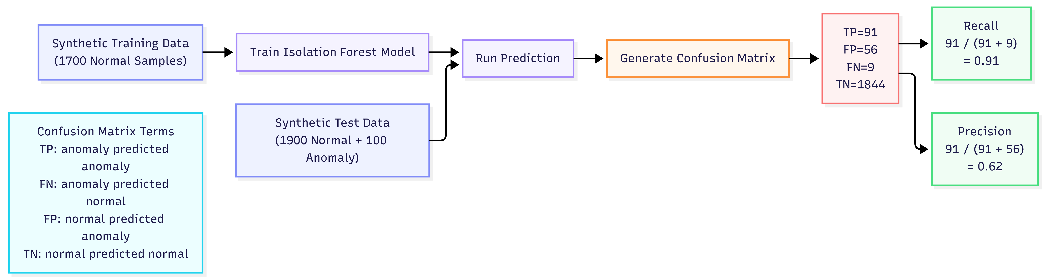
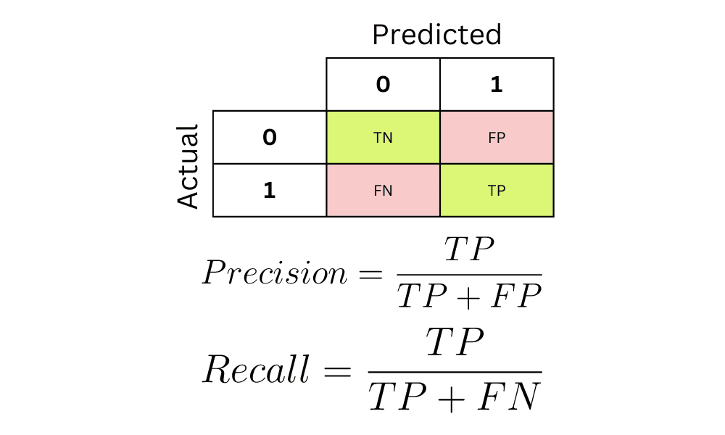
13
PART 7 — ML METHODOLOGY
THESIS DEFENSE · ITITIU21213
How Precision & Recall Were Computed
From synthetic train/test split to confusion matrix to the headline metrics
Figure 2 — Training & evaluation pipeline (1700 train · 2000 test)
Training set
Test set
Why these metrics
RESULT ON 2,000-SAMPLE TEST
1,700 normal-only samples. Isolation Forest is unsupervised — anomalies aren't shown during training.
1,900 normal + 100 anomalous = 2,000 samples held out. Class imbalance ~5%.
Accuracy is misleading at 5% imbalance. Recall captures missed anomalies; precision measures false-alarm rate.
TP
91
FP
56
anomaly → anomaly
normal → anomaly
FN
9
TN
1,844
anomaly → normal
normal → normal
Precision = TP / (TP + FP) = 91 / 147 = 0.62
Recall = TP / (TP + FN) = 91 / 100 = 0.91
13 / 20

Slide 14
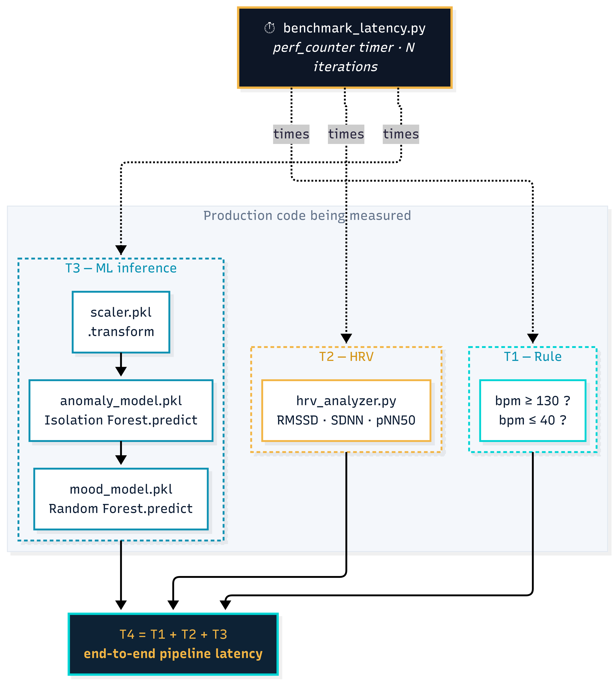
14
PART 7 — ML INFERENCE LATENCY
THESIS DEFENSE · ITITIU21213
Measured Pipeline Latency
Real benchmark — perf_counter timer over N iterations · backend/tools/benchmark_latency.py
MEASURED LATENCIES
T1
Rule check
T2
HRV computation
~1 µs
0.13 ms
if bpm ≥ 130 / ≤ 40
RMSSD · SDNN · pNN50
T3
ML inference
T4
Total pipeline
40.6 ms
40.8 ms
scaler + anomaly + mood
T1 + T2 + T3 end-to-end
Figure 3 — Benchmark architecture (timer wraps production code)
Numpy-optimized path: T3 drops to 39.01 ms (–4 %)
1–4 s
Alfred LLM (Ollama qwen2.5:3b)
<50 ms
Alfred Rule mode (pattern match)
~17,000
DB rows/day per node (5 s bundle)
14 / 20

Slide 15
15
PART 8 — VALIDATION
THESIS DEFENSE · ITITIU21213
Validation Results — April 2026
Every layer passed repository validation
Firmware
Backend
✓
✓
Compiled & deployed to physical ESP32-WROOM-32
pytest critical modules — PASS
Both relays (light/fan) verified web + mobile
Signed bearer-token auth — PASS
Sensor data confirmed in DB in real time
Rate-limit configuration — PASS
I²C LCD boot status, Wi-Fi/MQTT, relay state ✓
Ownership scoping (device/history) — PASS
Web
Mobile
✓
✓
Vite production build — PASS
Static analysis (Flutter analyze) — PASS
Socket room-join + HRV endpoints — PASS
Automated tests — PASS
Alert ACK/delete + admin role gating — PASS
Alfred patient-name greeting — PASS
Map device-position stability — PASS
Key UI flows + API integration — verified
Isolation Forest: 91% recall · 62% precision on 2,000-sample synthetic test set
15 / 20

Slide 16
16
PART 8 — SECURITY
THESIS DEFENSE · ITITIU21213
Security Implementation
🔐
Authentication
🔑
Password Storage
⏱
Rate Limiting
Signed bearer tokens (itsdangerous, 7-day lifetime). @auth_required on all protected endpoints.
Werkzeug salted hashes. Plaintext never stored or logged anywhere.
Global 500/day, 100/hr. Login 10/min · 50/hr. Register 5/min.
🛡
SQL Injection
🔒
MQTT Security
🌐
CORS
SQLAlchemy ORM with parameterised queries. No raw SQL string concatenation anywhere.
EMQX TLS port 8883, per-topic ACL, credentials in local secrets header.
Explicit origins whitelist — all other origins return 403 on preflight.
KNOWN GAP: Flask API served over HTTP in thesis LAN. HTTPS via Nginx + Let's Encrypt is required before production deployment.
16 / 20

Slide 17
17
PART 9 — LIMITATIONS
THESIS DEFENSE · ITITIU21213
Honest Limitations
What this thesis does and does not yet establish
01
Synthetic ML data only
02
No fall detection
Isolation Forest's 91%/62% recall/precision describes synthetic distribution. Not validated on real patient records.
MPU-6050 accelerometer integration is not in the current scope.
03
HTTP-only LAN prototype
04
Single-node testing
Flask API served over HTTP — bearer tokens unprotected on untrusted networks. TLS hardening deferred.
Only one ESP32 node tested — multi-room, multi-node scalability not measured.
05
No structured usability study
06
Prototype-level auth flows
Formative observations only — no task-completion metrics or elderly participant sample.
Account cancel and password reset are prototype-level. One-time tokens, session revocation, audit trails needed before deployment.
17 / 20

Slide 18
18
PART 9 — FUTURE WORK
THESIS DEFENSE · ITITIU21213
Roadmap Beyond This Thesis
HTTPS production
NEAR TERM
Fall detection
NEAR TERM
Real patient data
MEDIUM TERM
Nginx + Let's Encrypt; Docker Compose already provided.
MPU-6050 accelerometer + Random Forest classifier.
Partner with geriatric clinic to retrain Isolation Forest.
Push notifications
NEAR TERM
ESP32-side timing
NEAR TERM
Usability pilot
MEDIUM TERM
Firebase Cloud Messaging for medicine reminders.
Firmware-level timestamps for sensor → MQTT publish latency. Backend-side pipeline already measured.
Task-completion rate with elderly users + caregivers.
Multi-tenancy
LONG TERM
Camera occupancy
LONG TERM
Auth hardening
NEAR TERM
Per-household data isolation, multi-resident caregiver dashboard.
ESP32-CAM + TensorFlow Lite for person detection.
One-time reset tokens, session revocation, audit trail.
18 / 20

Slide 19
19
CONCLUSION
THESIS DEFENSE · ITITIU21213
What This Thesis Delivered
RQ 1 ✓
RQ 2 ✓
RQ 3 ✓
Sensing reliability
ML on small data
Local LLM as UX
Low-cost IoT system (ESP32, MQTT, Flask) reliably monitors environmental and physiological signals — firmware and backend validated in lab.
Isolation Forest achieves 91% recall, 62% precision on synthetic test set. Clinical validation on real data is required before deployment.
Alfred (Ollama qwen2.5:3b + Gemini fallback) provides a practical LLM interface. Voice input reduces barrier for elderly users.
FIVE TECHNICAL LAYERS DELIVERED
Hardware PCB (Altium, 41 parts)
Flask Clean Architecture backend
ML anomaly pipeline (Isolation Forest)
Vite web dashboard
Flutter mobile app
1
2
3
4
5
PRIMARY OUTSTANDING TASK
ESP32 firmware-side timing + real patient data collection — both required to move from validated prototype to clinically deployable system. Backend pipeline latency already benchmarked (T4 = 40.8 ms).
19 / 20

Slide 20
Thank You.
QUESTIONS · DISCUSSION · FEEDBACK
Tu Dinh Huy · ITITIU21213
Supervisor: Le Duy Tan, Ph.D. · International University — VNU-HCM
2026

