Slide 1
An Implementation Project

Slide 2
Democratic Election under Byzantine presence
Huy Doan - Asad Malik

Slide 3
The Problem
Leader election is fundamental
Harder under Byzantine faults
Multi-choice Byzantine is even harder

Slide 4
Approach
Instead of direct leader election, study Byzantine Social Choice (BSC) and Byzantine Social Welfare (BSW)
BSC: agree on one top candidate
BSW: agree on a ranking of candidates

Slide 5
BSW
Pairwise Comparison
PlacePlurality
Borda Count
Kemeny-Young
Pruned Kemeny
Distance: number of pairs in which the rankings differ
Ex: r = abc, r’ = cba
=> diff(r, r’) = 3

Slide 6
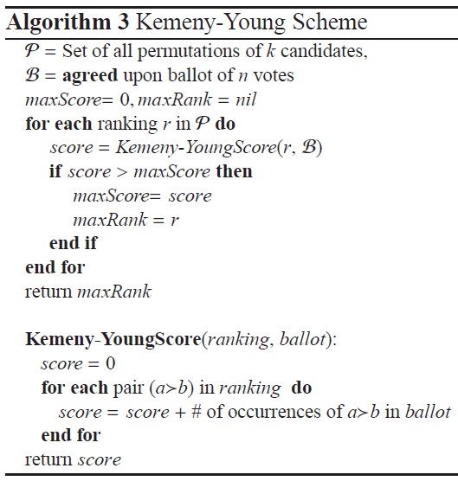
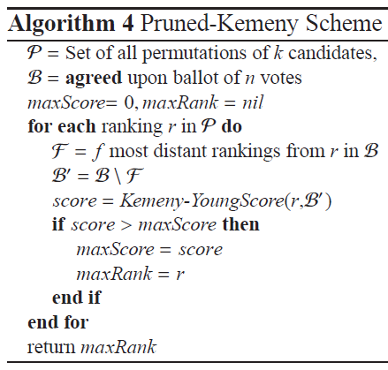
BSW Schemes

Slide 7
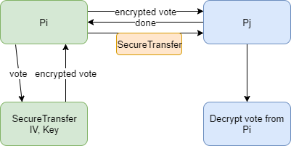
Implementation Details
Processes exchange votes

Slide 8
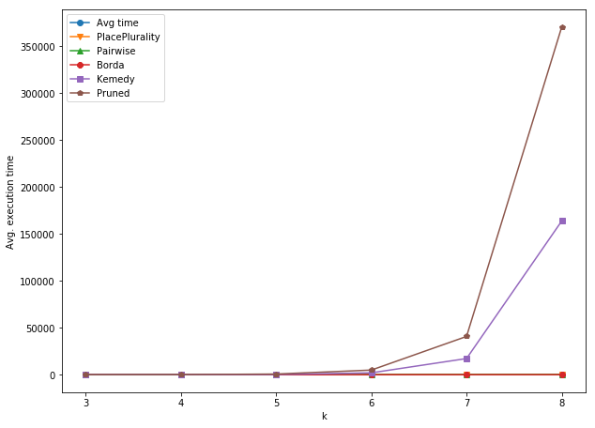
Performance
Execution time of different schemes

Slide 9
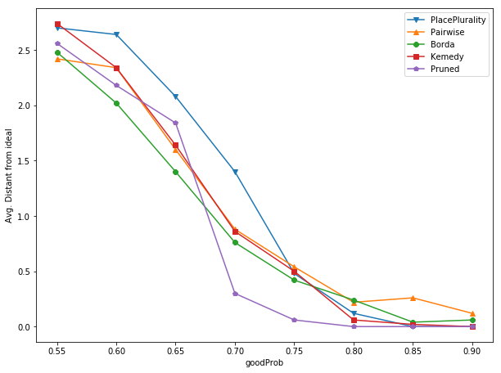
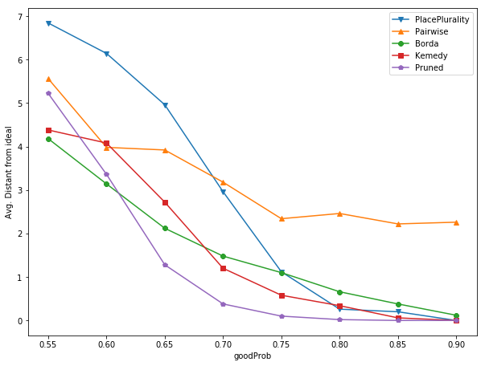
Results
k=3
k=5
Ranking quality of different schemes

Slide 10
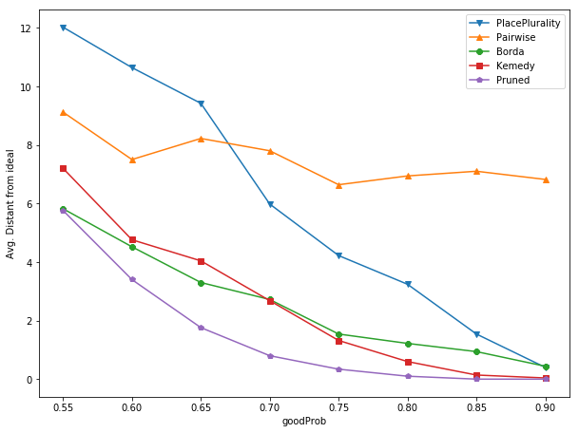
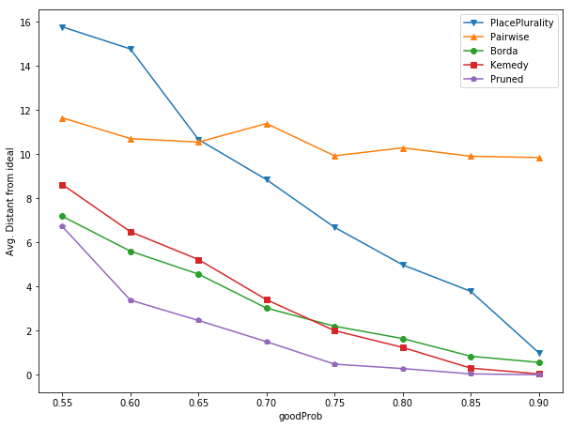
Results (cont.)
k=7
k=8
Ranking quality of different schemes

Slide 11
Future Work
Standard Byzantine Agreement for BSC
Approximation for Kemeny-Young and Pruned Kemeny
Parallelism using GPUs

Slide 12
Conclusion
Pruned-Kemeny converges to ideal fastest
Trade-off: Performance vs Accuracy
RMI is great for inter-process communication

