Slide 1
Group 12 presentation
Car in maze problem

Slide 2
Who are we ?
Nguyen The An
Nguyen Van Huy
Nguyen Ngoc Khanh
Bui Hong Nhat
Tran Tuan Phong

Slide 3
Table of Contents
I. Problem description
II. Algorithms
Detailed description: purpose, formulation, ...
How we come up with the algorithms and implement them
III. Analysis
IV. Conclusions
Results comparison, quantitative performance
What we have learned, possible extensions and difficulties

Slide 4
I
Problem Description
How the problem be formulated?

Slide 5
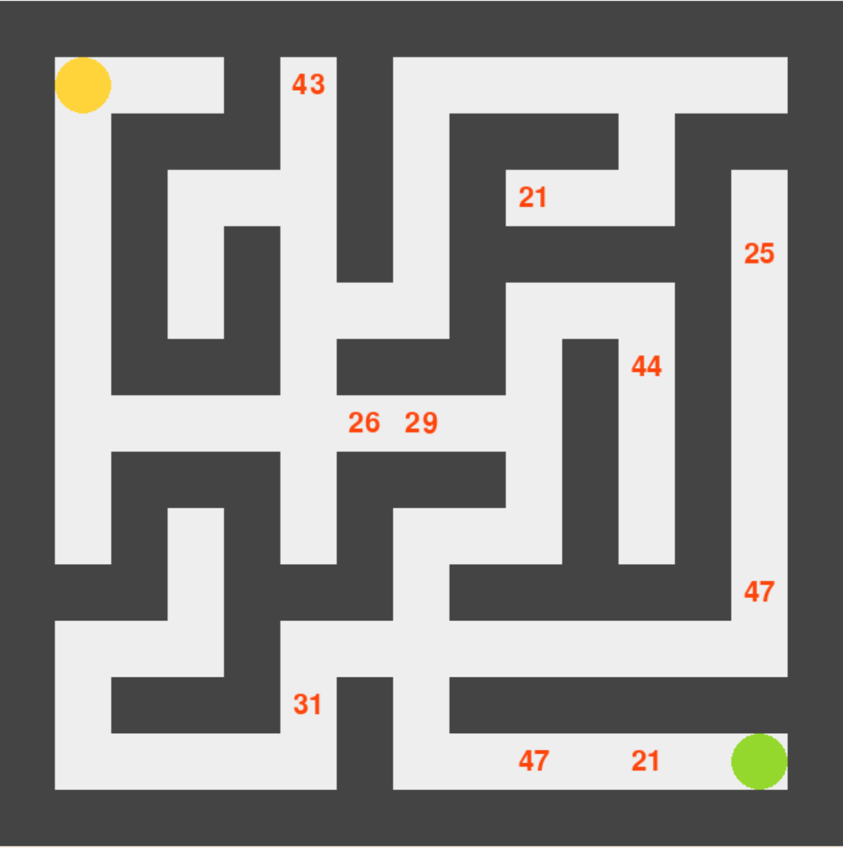
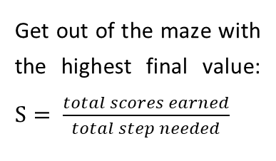
Environment: The maze
Properties
Random number of score cells and coordinate
Random scores
Fixed start and end cell
Start point
Score cells
Clear cells
Goal:
Get out of the maze with the highest final value: $S= \frac{total scores earned}{total step needed}$
Wall cells
End point
Visualized by pygame 2.0.2

Slide 6
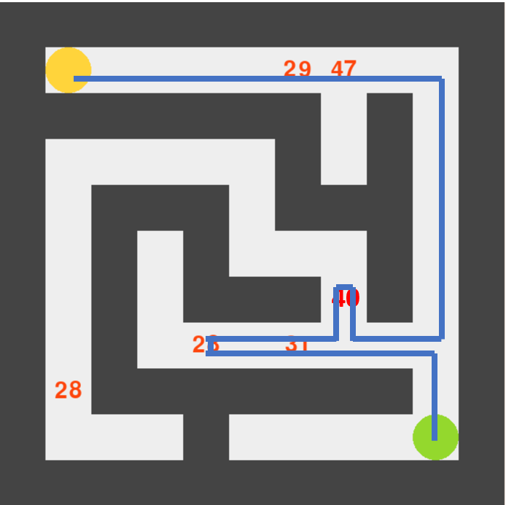
The car agent
Specificities:
The car can go a longer road to take the score and come back to the end.
When increase the size and the number of score cells, the problem become much more complicated
The car knows:
Position of start cell and end cell
8 adjacent tiles
Position of score cells
The car can do:
Move to next cell in 4 directions
Collect the score

Slide 7
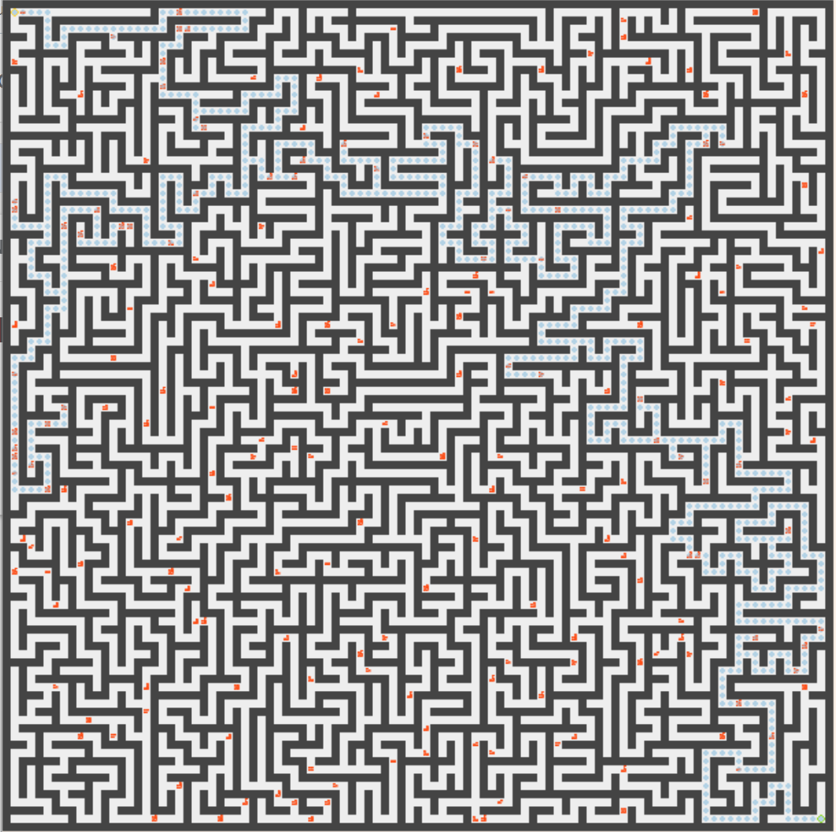
A 101x101 maze with 200 number of score cells!
Seems very complicated, but our algorithm can solve it under 2 seconds!!

Slide 8
II. Algorithms

Slide 9
Our approach
Foundation of idea
Only one direct path between two cells
Final path is based on the main path, with some extra paths
Main path
Divide problem into two
First part: Discover the maze, find all paths from start cell to a score cell or end cell.
Second part: From those paths, find some extra paths that will be added to main path.
Extra paths

Slide 10

First part: Discover
0
1
2
3
Main problem
4
Discover the maze, find all paths from start cell to a score cell or end cell here
i.e: every score cells is a goal
5
6
7
8
0
Idea
1
4
Every clear cell is a node in a tree
Can apply basic search methods
2
5
3
6

Slide 11
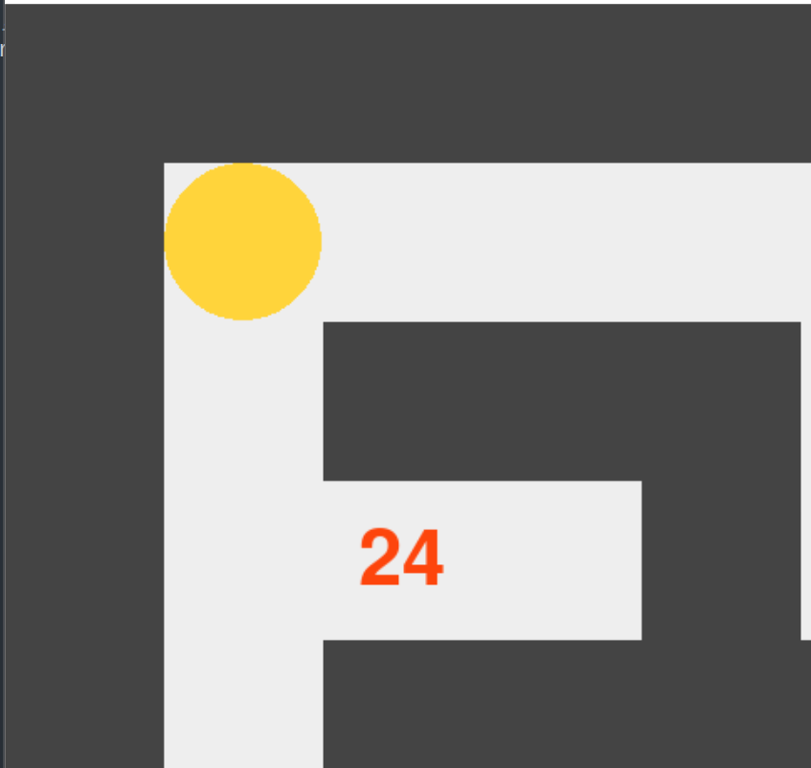




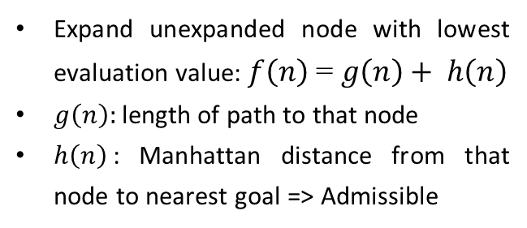







First part: Discover
$f_{1}\left(A\right)$ = 1 + 4 = 5
$$fringe$$
$f_{1}\left(B\right)$ = 2 + 1 = 3
A
$f_{2}\left(A\right)$ = 1 + 3 = 4
DFS and BFS
$f_{2}\left(B\right)$ = 2 + 2 = 4
Searching in DFS or BFS ways, when meet a goal, save the whole path to it
Stop when there is no goal left
B
$$f_{1}\left(n\right)$$
$$f_{2}\left(n\right)$$
A* search
A
Expand unexpanded node with lowest evaluation value: $f\left(n\right)$ = $g\left(n\right)+ h\left(n\right)$
$g\left(n\right):$length of path to that node
$h\left(n\right)$: Manhattan distance from that node to nearest goal => Admissible
$$expand B$$
B
$$fringe$$

Slide 12
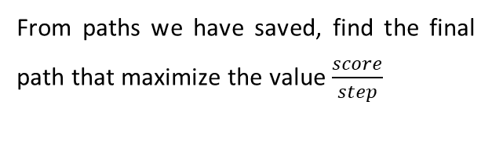
Second part
Greedy algorithm
Main idea:
Base on main path and all paths to the score we have saved
At each step, add an extra path with highest value (among all extra paths and the main path) to the main path
Stop when the main path has highest value => Optimal path
Main problem
From paths we have saved, find the final path that maximize the value $\frac{score}{step}$
Brute Force
First approach
Base on main path
Save all combinations of scores and compare
This can cause Combinatorial explosion, as branching factor can be hundreds

Slide 13
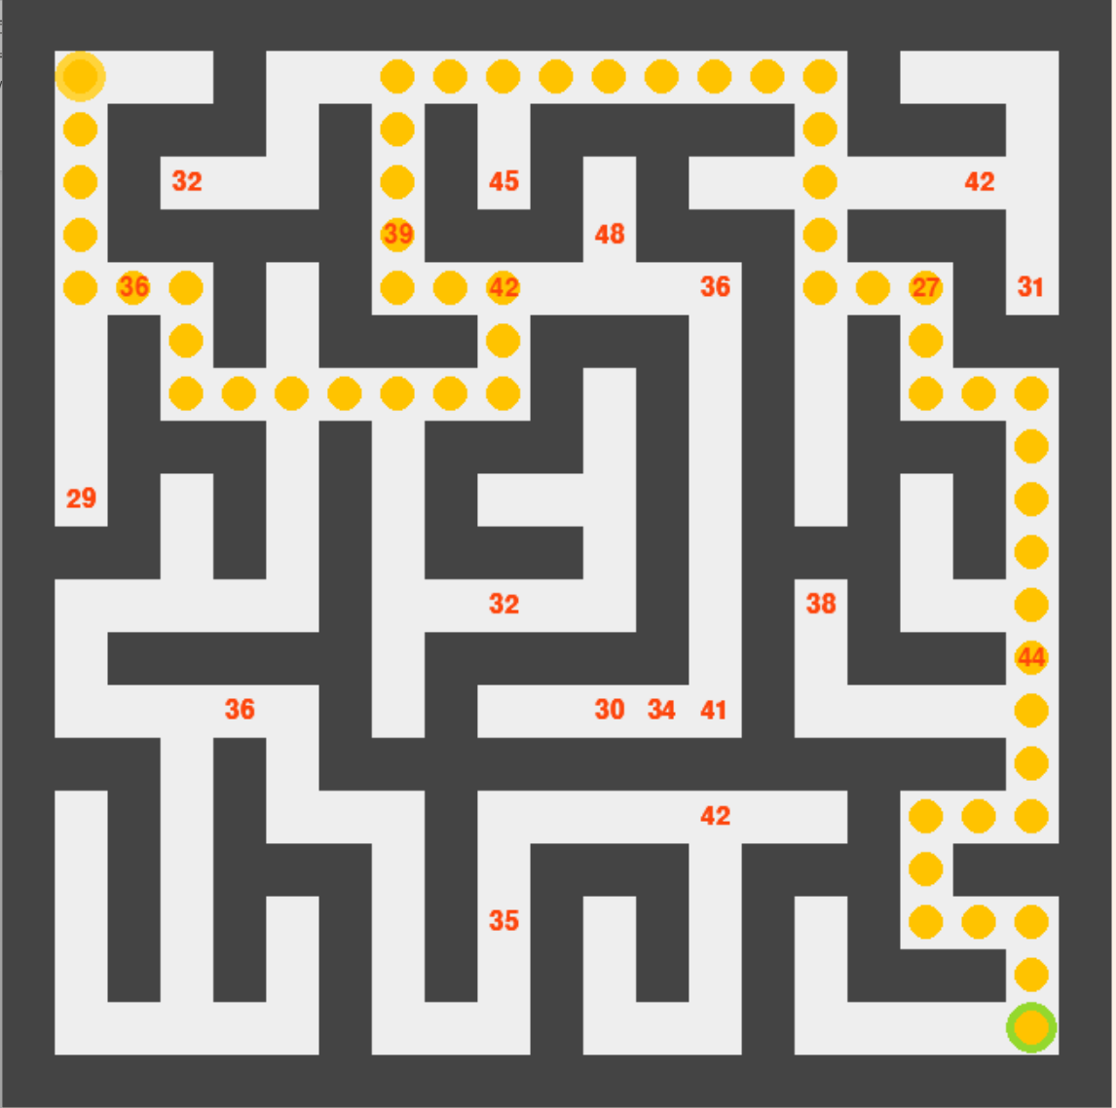

Slide 14
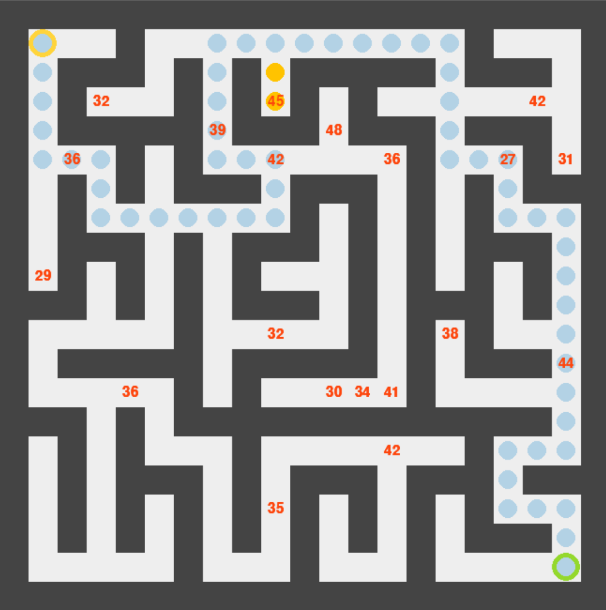

Slide 15
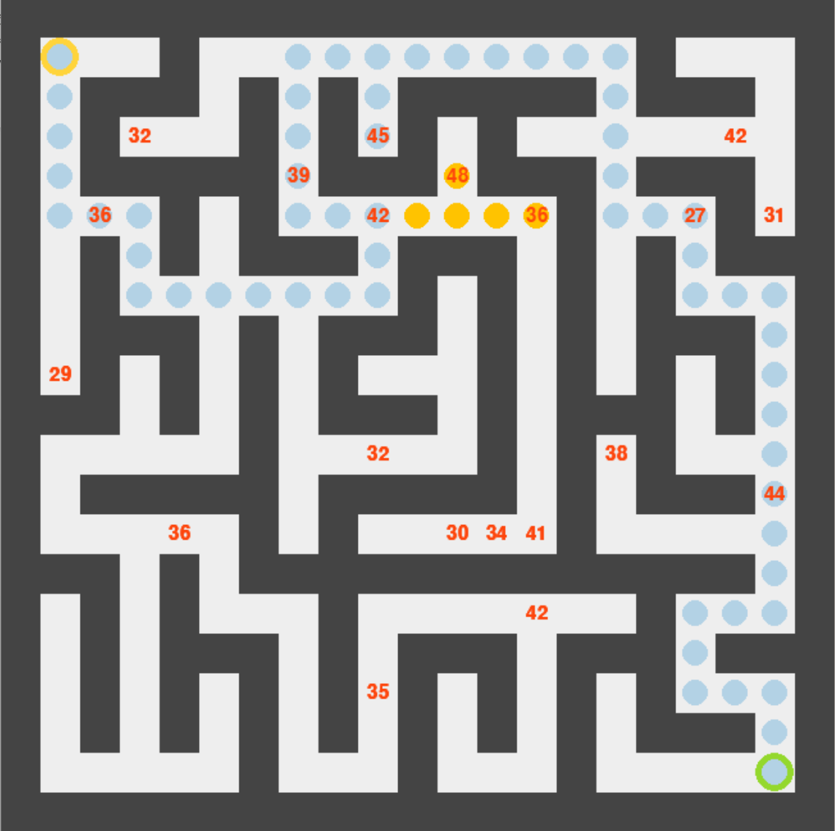

Slide 16
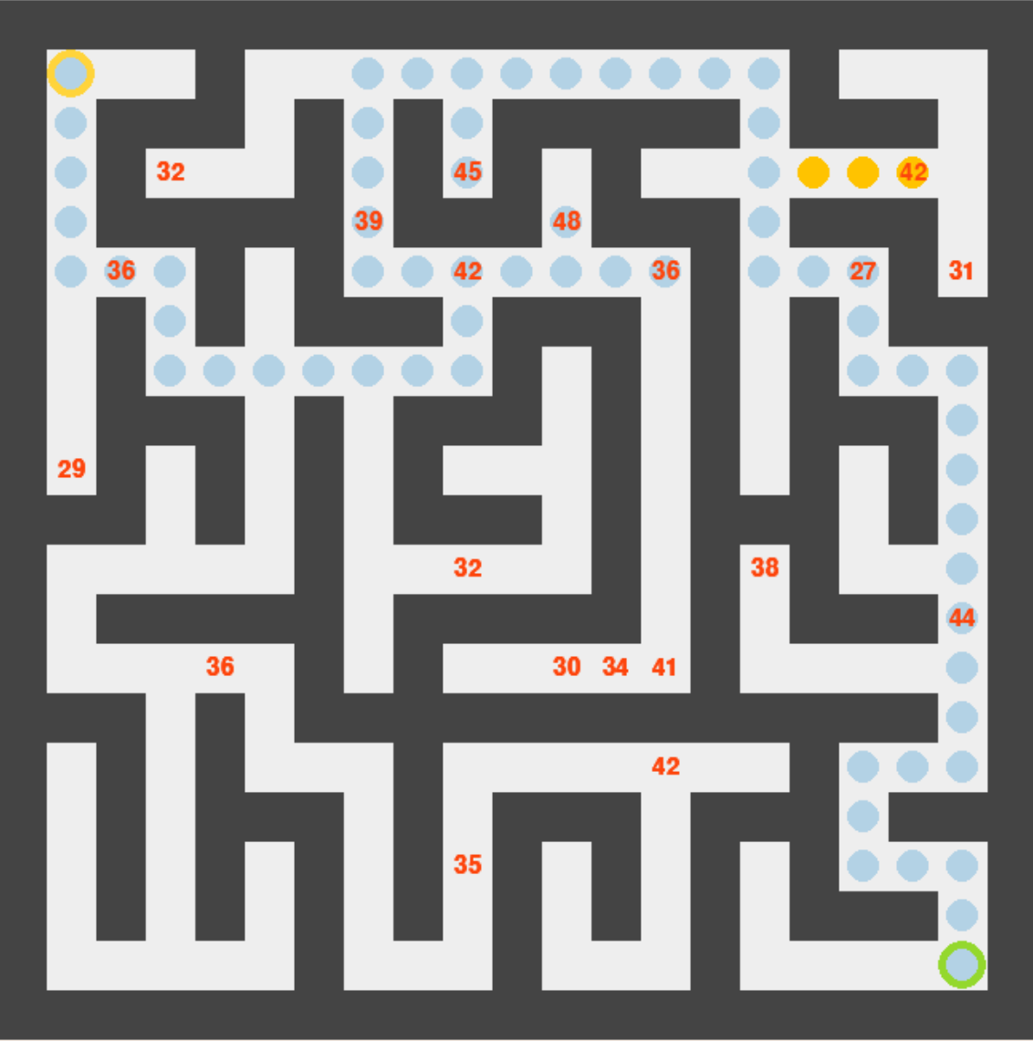

Slide 17
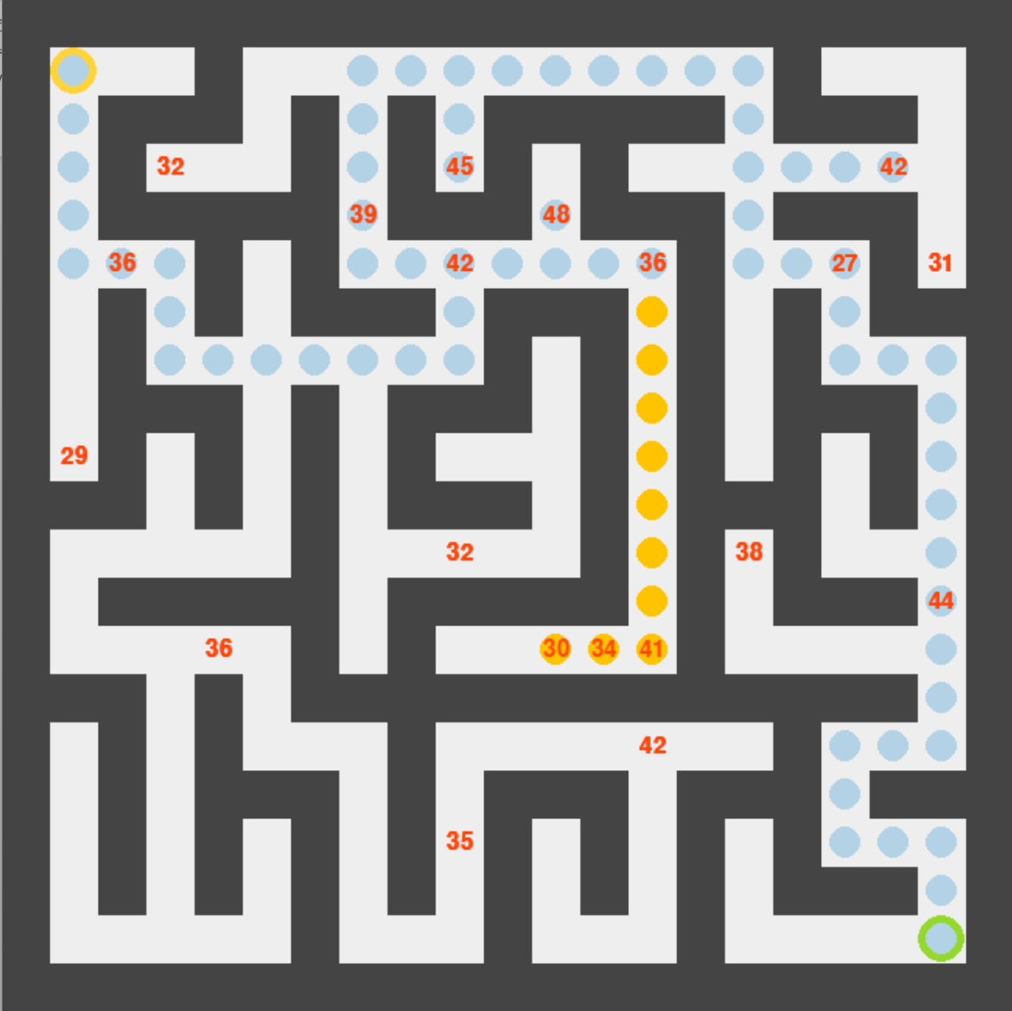

Slide 18
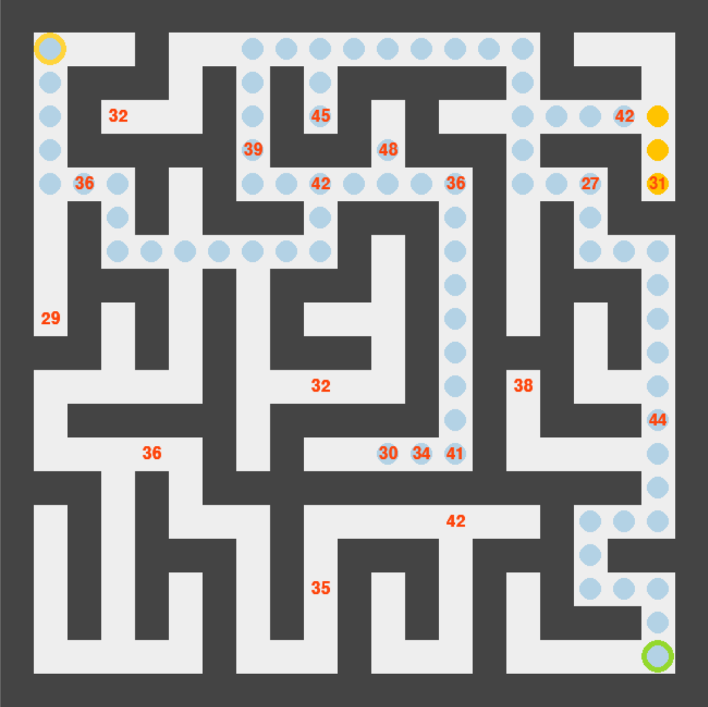

Slide 19
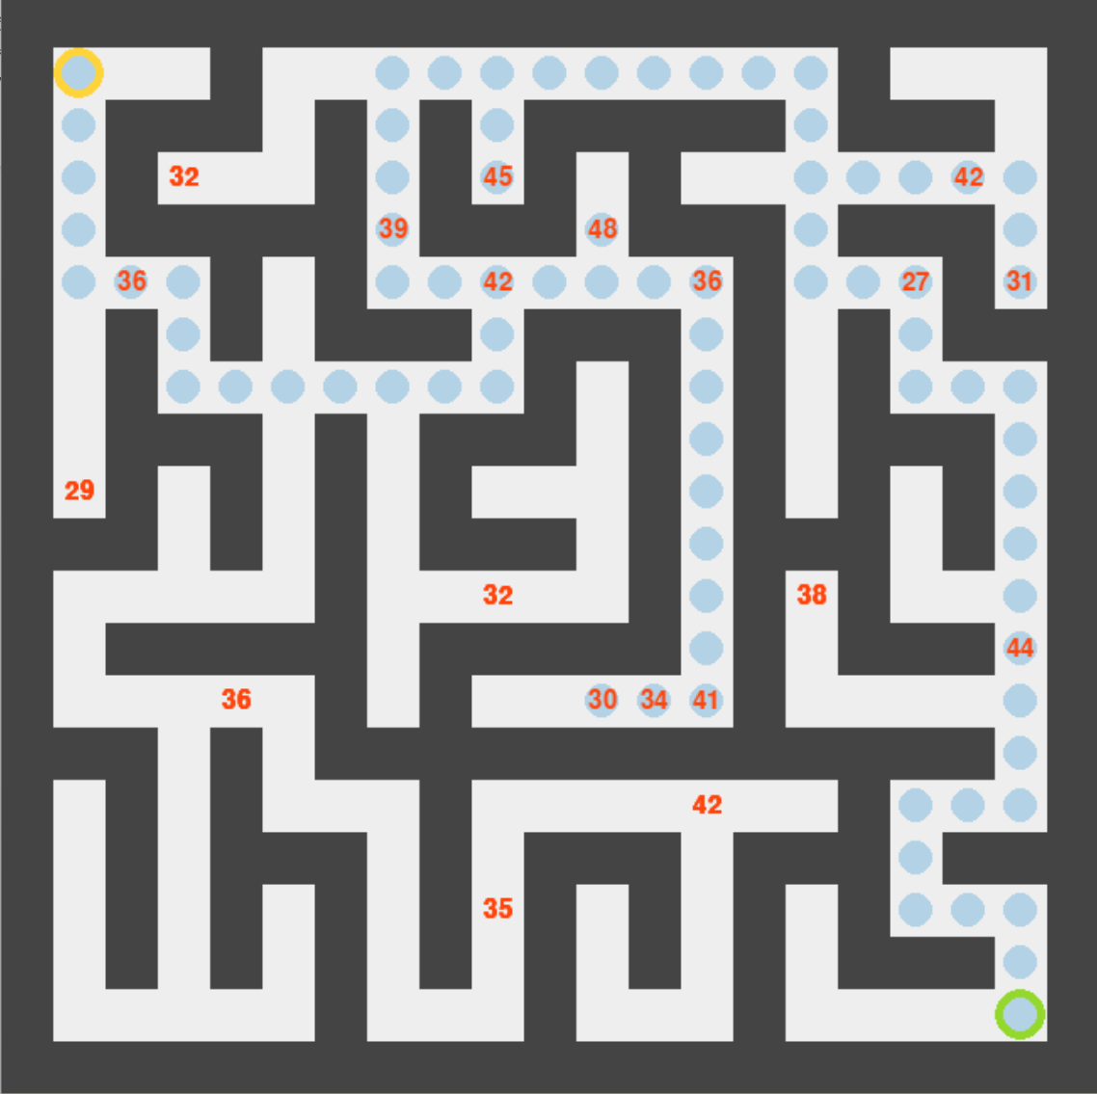

Slide 20
Second part
Greedy algorithm
Main idea:
Base on main path and all paths to the score we have saved
At each step, add an extra path with highest value (among all extra paths and the main path) to the main path
Stop when the main path has highest value => Optimal path
It is optimal
Proved clearly in the report
Main problem
From paths we have saved, find the final path that maximize the value $\frac{score}{step}$
Brute Force
First approach
Base on main path
Save all combinations of scores and compare
This can cause Combinatorial explosion, as branching factor can be hundreds

Slide 21
III
Analysis
Analyze results, explaining..

Slide 22
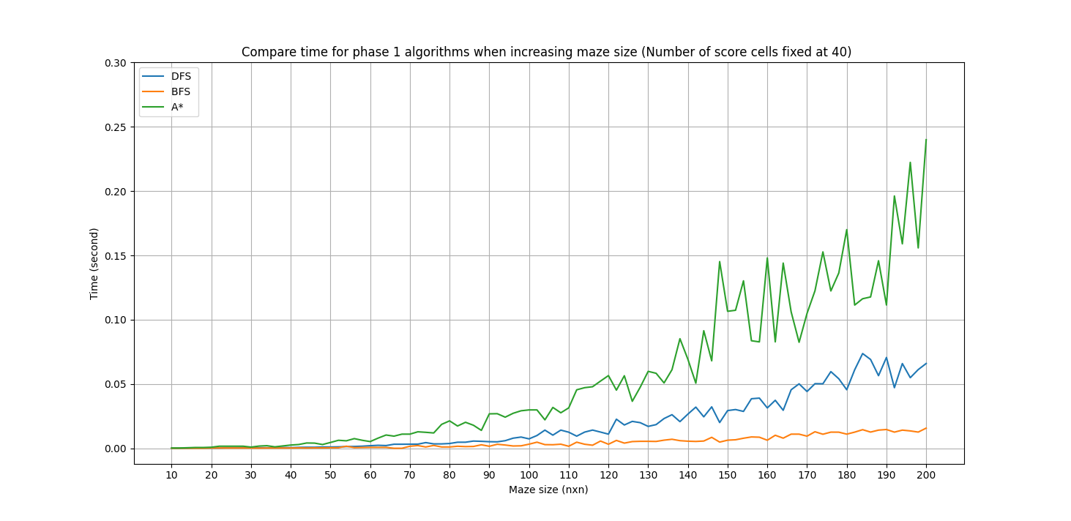
First part

Slide 23
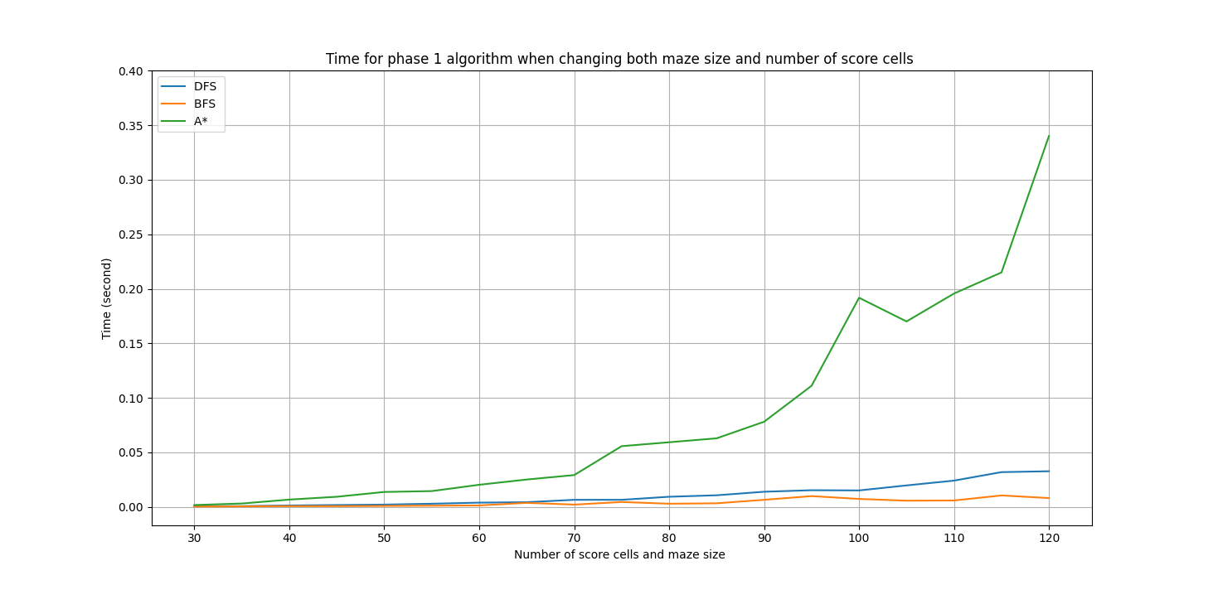
First part

Slide 24
Explaination
Time complexity
A* is far more slower than BFS and DFS
Many goal state
Don’t know current goal state
Need to compute many evaluation functions
BFS is slightly faster than DFS
Don’t need to backtrack

Slide 25
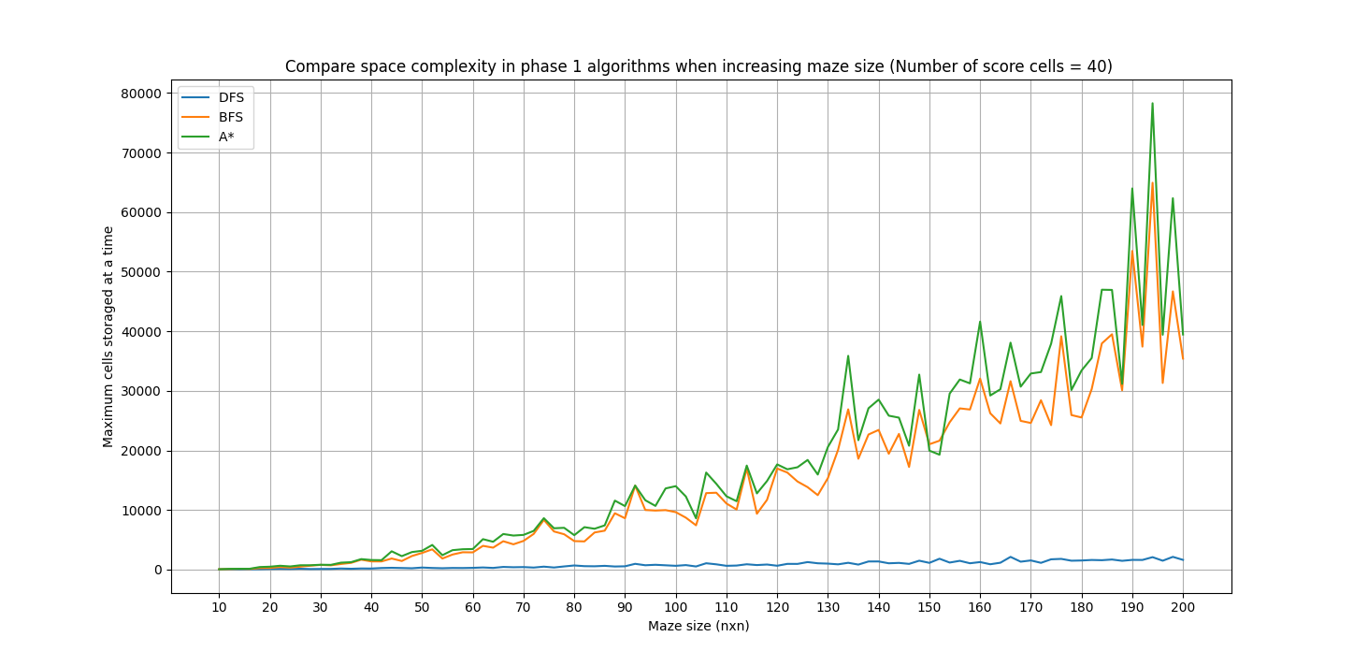
First part

Slide 26
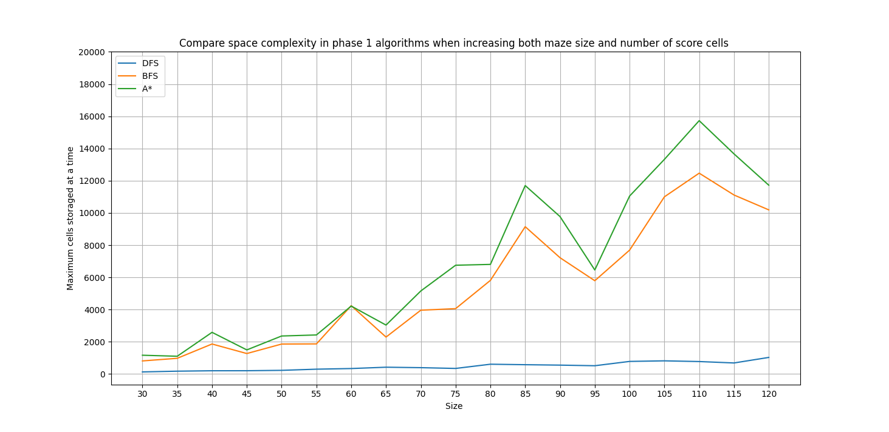
First part

Slide 27
Explaination
Time complexity
A* is far more slower than BFS and DFS
Many goal state
Don’t know current goal state
Need to compute many evaluation functions
BFS is slightly faster than DFS
Don’t need to backtrack
Space complexity
A* is slightly higher than BFS
DFS saves a lot of space

Slide 28
Second part
Size | Number of score cells | Number of instances | Average actual time complexity |  | Average actual space complexity
 |  |  | Greedy(s) | Brute-force(s) | Greedy(cells) | Brute-force(cells)
20x20 | 20 | 10 | 0.0002 | 0.0034 | 128 | 5243
25x25 | 25 | 10 | 0.0006 | 0.2376 | 193 | 13530
30x30 | 30 | 10 | 0.0016 | 1.2964 | 258 | 22316
35x35 | 35 | 10 | 0.0018 | 2.0340 | 259 | 18872
40x40 | 40 | 10 | 0.0024 | 17.3328 | 518 | 38339
45x45 | 45 | 10 | 0.0044 | 275.7459 | 601 | 57032
50x50 | 50 | 10 | 0.0118 | can’t solve | 915 | can’t solve
80x80 | 80 | 10 | 0.0340 | can’t solve | 12425 | can’t solve
100x100 | 100 | 10 | 0.0788 | can’t solve | 12426 | can’t solve
120x120 | 120 | 10 | 0.1634 | can’t solve | 14043 | can’t solve
=> Greedy performs extremely good !

Slide 29
IV. Conclusions

Slide 30
Conclusions
Extensions
Algorithm:
Extensions
First part:
Time efficient: BFS
Space efficient: DFS
Overall: DFS
Second part: Greedy
Can solve really big problem in small time
Implement algorithm for the whole problem: A*..
Create more ideal maze
Difficulties:
Achievement:
Hard to find heuristic function
Hard to control the random of maze
Team work skills
Programming skills
Analytic skills

Slide 31

Thank you!

