Slide 1


ASSIGNMENT 01
ADY201m
Group 006
May 18 2023
1

Slide 2



Huy Duong Tran
Hoang Viet Nguyen
2
2

Slide 3
1
REQUIREMENT
2
ASSIGN TASK
CONTENT
3
DATA EXPLORING
4
QUERIES
5
DEMO & REFERENCES
© Copyright FPT Software – Level of Confidentiality
© Copyright FPT Software – Level of Confidentiality
4

Slide 4
1. REQUIREMENT
Problem 1: Find the total number of crimes recorded in the CRIME table.
Problem 2: List community areas with per capita income less than 11000.
Problem 3: List all case numbers for crimes involving minors?
Problem 4: List all kidnapping crimes involving a child?(children are not considered minors for the purposes of crime analysis)
Problem 5: What kind of crimes were recorded at schools?
Problem 6: List the average safety score for all types of schools.
Problem 7: List 5 community areas with highest % of households below poverty line.
Problem 8: Which community area(number) is most crime prone?
Problem 9: Use a sub-query to find the name of the community area with highest hardship index.
Problem 10: Use a sub-query to determine the Community Area Name with most number of crimes?
© Copyright FPT Software – Level of Confidentiality
6

Slide 5
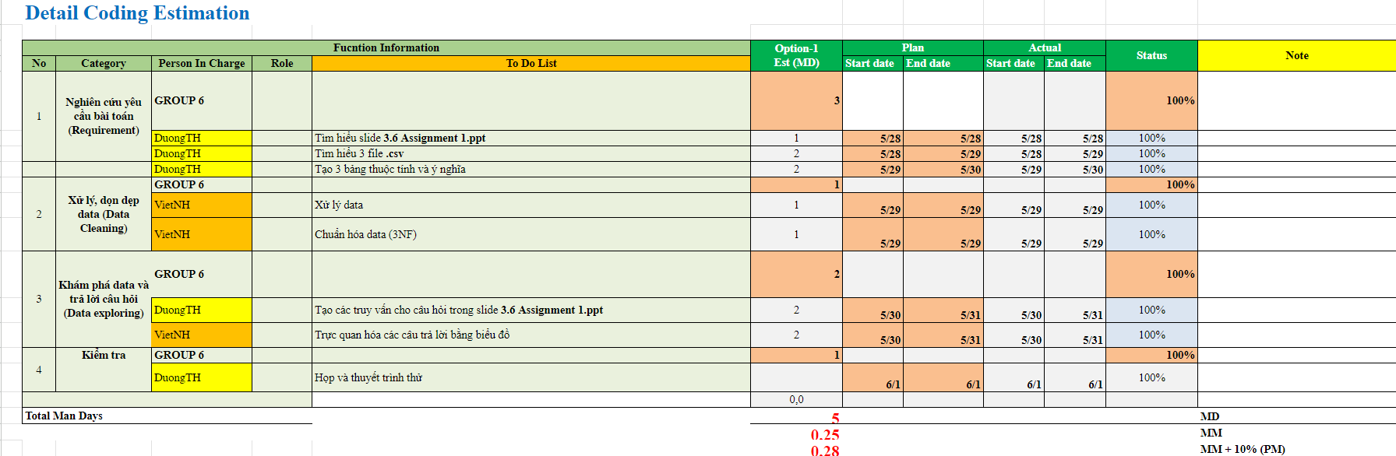
2. ASSIGN TASK
ESTIMATION
© Copyright FPT Software – Level of Confidentiality
7

Slide 6
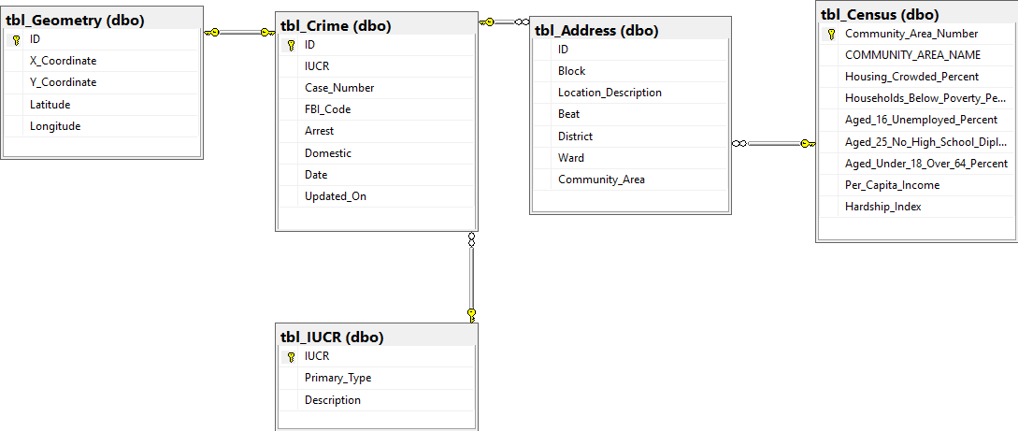
2. DATA EXPLORING
DATA CLEANING & SPLITING
IMPORT TO DB
PLOTTING
PANDAS
PYODBC
IMPORT FLAT FILE
POWERSHELL (BULKING INSERT)
USING POWER BI
NULL VALUES: FIND THE REASON BEHIND THEM THEN DEAL WITH IT.
(EX: MANY CASES DO NOT HAVE SPECIFIC COORDINATES, ONLY AREAS )
DERIVED VALUES: DROP COLUMNS (AXIS = 1)
© Copyright FPT Software – Level of Confidentiality

Slide 7


2. DATA EXPLORING
DATA CLEANING & SPLITING
IMPORT TO DB
PLOTTING
PANDAS
PYODBC
IMPORT FLAT FILE
POWERSHELL (BULKING INSERT)
USING POWER BI
FOR SMALL .CSV FILES: JUST IMPORT FLAT FILE IN AZURE STUDIO
FOR LARGE .CSV FILES: BULKING INSERT USING POWERSHELL
8
© Copyright FPT Software – Level of Confidentiality

Slide 8
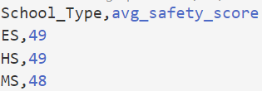
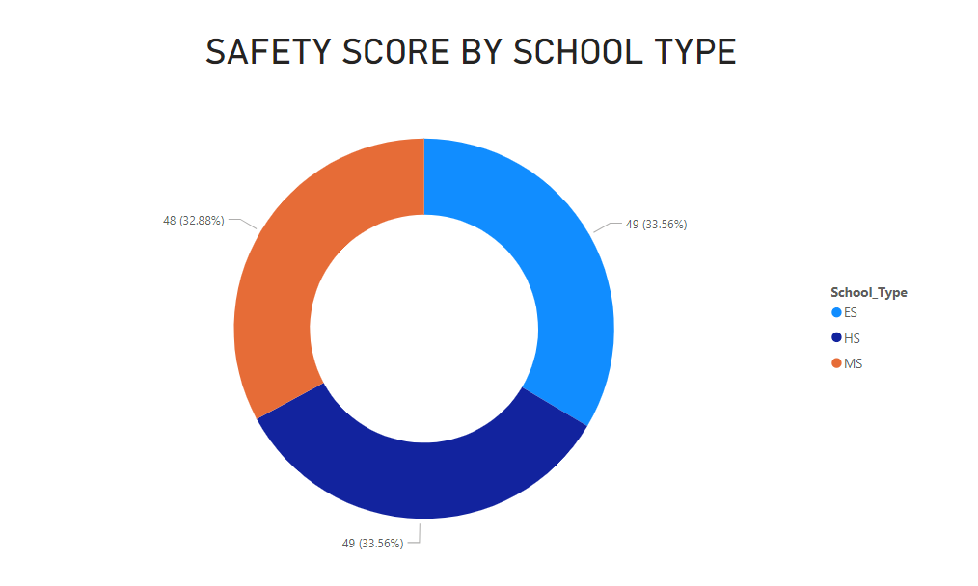
2. DATA EXPLORING
DATA CLEANING & SPLITING
IMPORT TO DB
PLOTTING
PANDAS
PYODBC
IMPORT FLAT FILE
POWERSHELL (BULKING INSERT)
USING POWER BI
CREATE QUERY.SQL AND READ IT
SAVING IT TO PANDAS DATAFRAMES
WRITE THE RESULT TO .CSV
POWER BI IMPORT DATA FROM OUTPUT.CSV
PLOTTING
8
© Copyright FPT Software – Level of Confidentiality

Slide 9
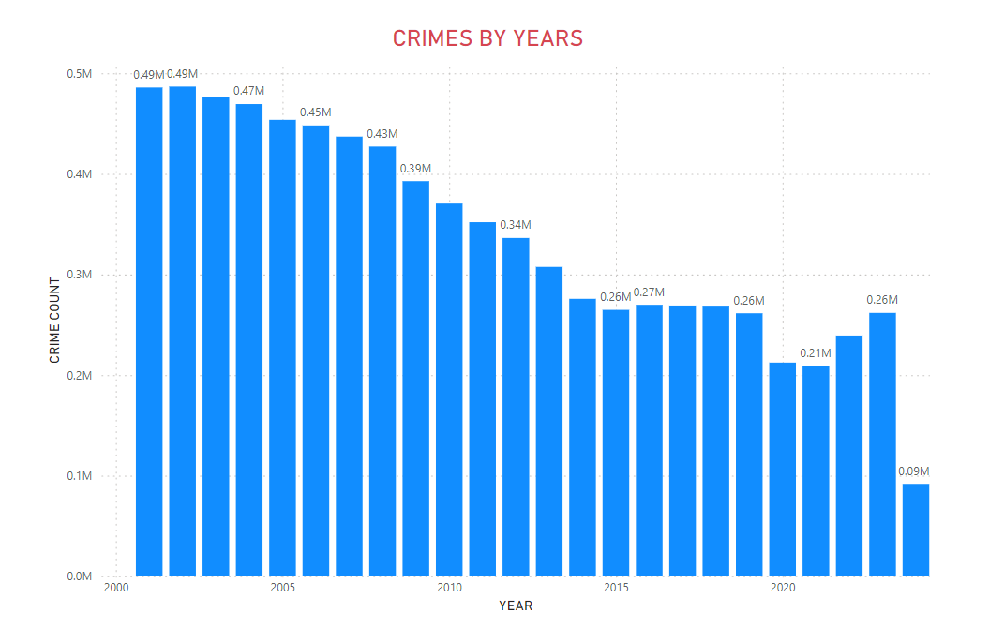

4. QUERIES
4.1. Find the total number of crimes recorded in the CRIME table.
11

Slide 10
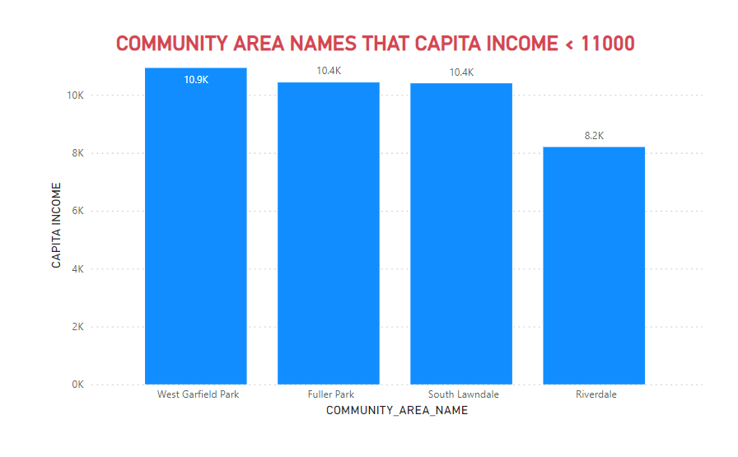
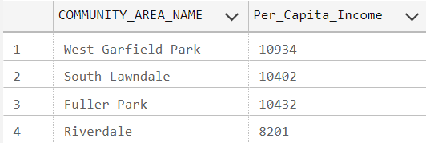
4. QUERIES
4.2. List community areas with per capita income less than 11000.
11

Slide 11
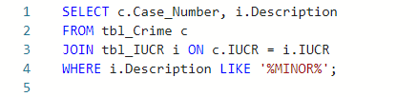
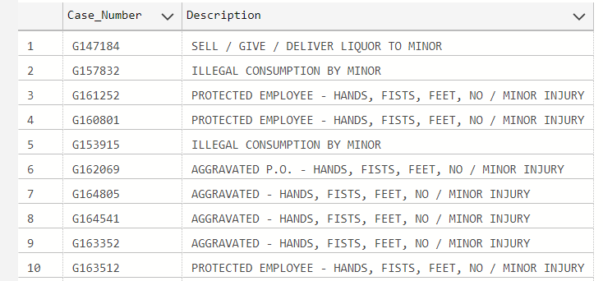
4. QUERIES
4.3. List all case numbers for crimes involving minors?
11

Slide 12
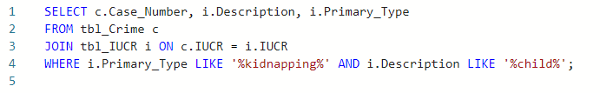
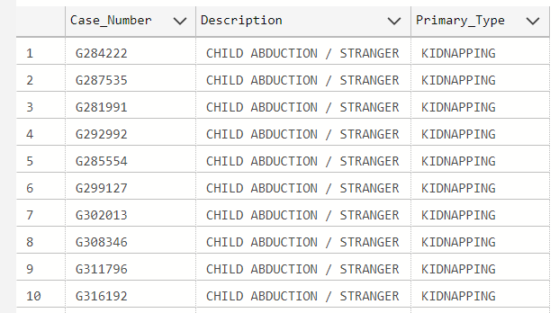
4. QUERIES
4.4. List all kidnapping crimes involving a child?(children are not considered minors for the purposes of crime analysis)
11

Slide 13
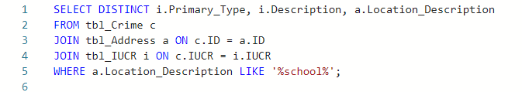
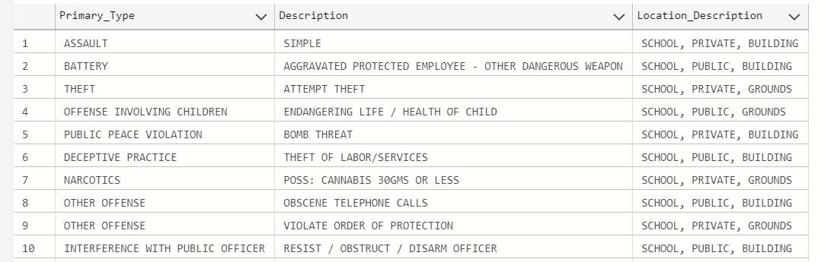
4. QUERIES
4.5. What kind of crimes were recorded at schools?
11

Slide 14
4. QUERIES
4.6. List the average safety score for all types of schools.
11

Slide 15
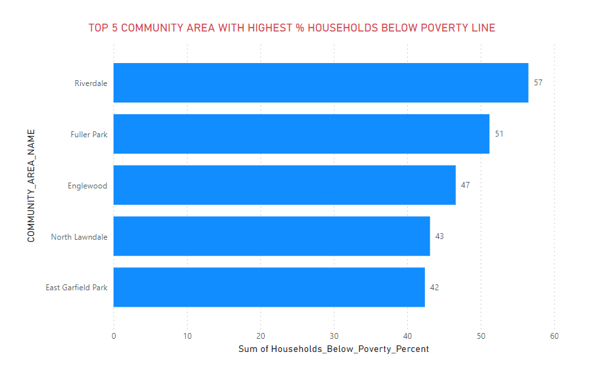
4. QUERIES
4.7. List 5 community areas with highest % of households below poverty line
11

Slide 16
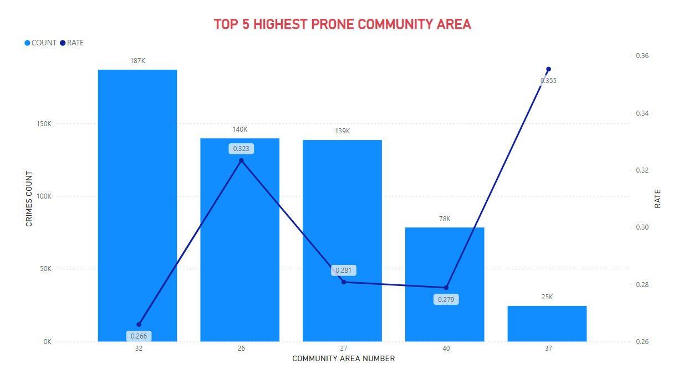

4. QUERIES
4.8. Which community area(number) is most crime prone?
11

Slide 17
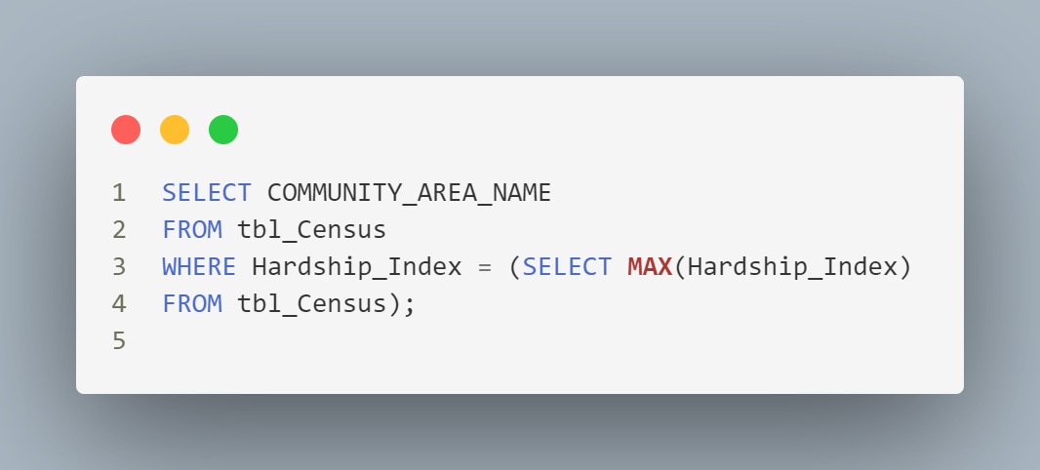

4. QUERIES
4.9. Use a sub-query to find the name of the community area with highest hardship index.
11

Slide 18
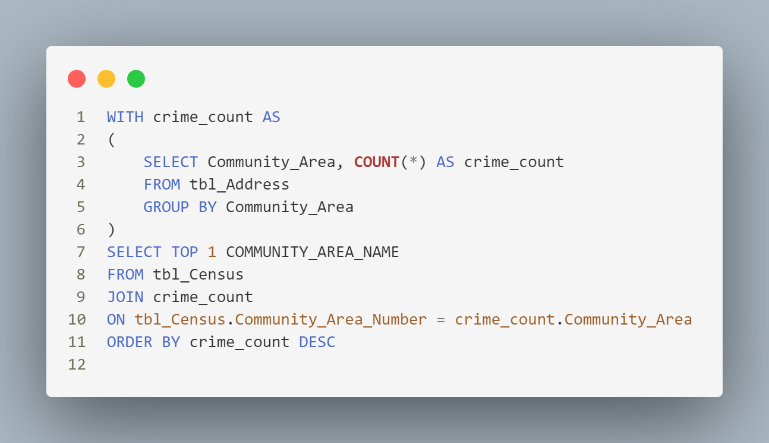

4. QUERIES
4.10. Use a sub-query to determine the Community Area Name with most number of crimes?
11

Slide 19
5. DEMO + REFERENCES
High-Performance Techniques for Importing CSV to SQL Server using PowerShell
Github Copilot + GEMINI
13

Slide 20

THANKS FOR WATCHING
14

