Slide 1


LAB 3
CHICAGO PUBLIC SCHOOL
Group 006
May 18 2023
1

Slide 2



Huy Duong Tran
Hoang Viet Nguyen
2
2

Slide 3
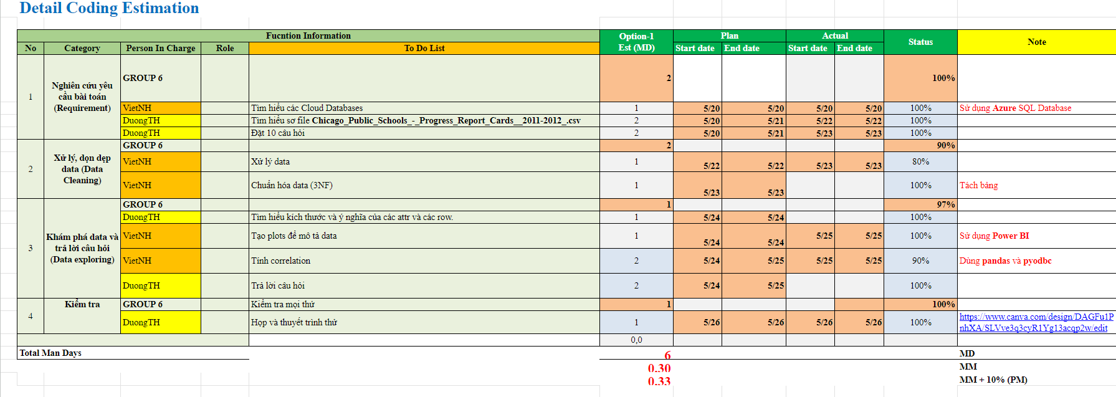
ESTIMATION
2
2

Slide 4
1
REQUIREMENT
2
DATA CLEANING
CONTENT
3
DATA EXPLORING
4
QUERIES
5
DEMO
© Copyright FPT Software – Level of Confidentiality
© Copyright FPT Software – Level of Confidentiality
3

Slide 5
PIPELINE
REQUIREMENT
CREATE DB
(AZURE)
DATA CLEANING
QUERIES
VISUALIZING
(POWER BI)
DATA EXPLORING
© Copyright FPT Software – Level of Confidentiality
4

Slide 6
1. REQUIREMENT
Ask questions
answer questions to find inside
Mining insights from data
Determine analysis goals
Prepare well for reality
Understand the problem that needs to be solved
© Copyright FPT Software – Level of Confidentiality
5

Slide 7
2. DATA CLEANING
MISSING VALUES
There are many null and NDA (No Data Available) in the table.
DROP if the whole row is null
KEEP otherwise
(the case where the whole row is null is because this type of school doesn’t have this attr, such as ES Schools don’t have MS score)
ORDINARY DECODING
Ordinary decoding for columns has sequential division
(ex: healthy_school_cerified : Yes: 1, No: 0)
DERIVED COLUMNS: JUST DROP
ONE-VALUED COLS: DROP AND SAVE IN TEMP VARs
6

Slide 8
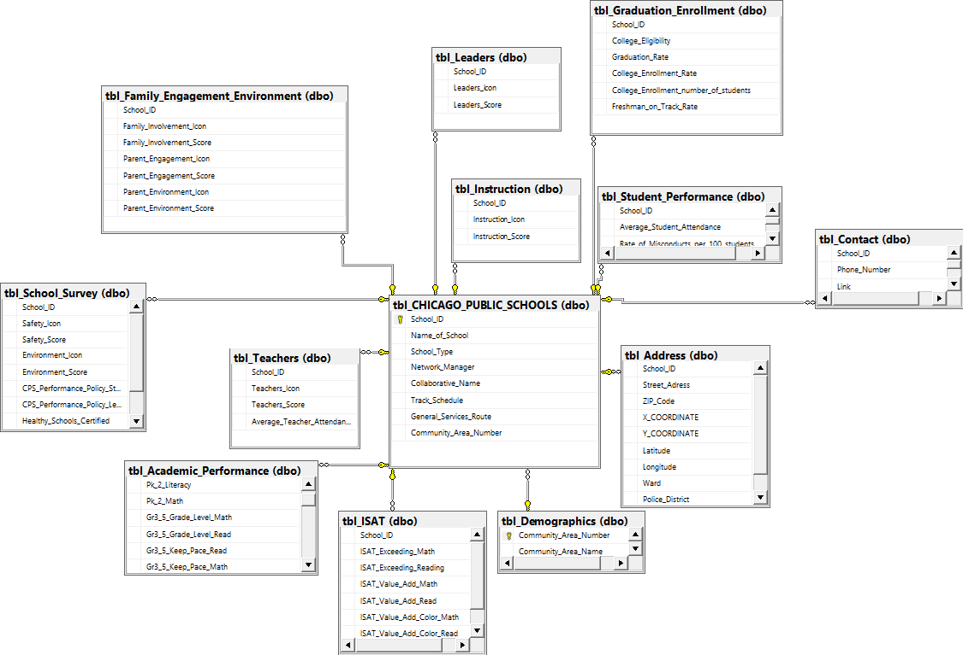
2. DATA CLEANING
NORMALIZING
THIRD NORMAL FORM (3NF)
Find dependencies
Split into 12 tables, set PKs and FKs
CREATE <new_table>
INSERT INTO <new_table SELECT attrs from <origin>
DROP attrs from <origin>
8

Slide 9
3. DATA EXPLORING
FIND COLs SIZING AND MEANING
The data table consists of 566 rows and 79 columns
Row numbers correspond to the number of schools listed
Columns number corresponds to the information attributes collected about each school
Determine the scope and level of analysis detail
9

Slide 10
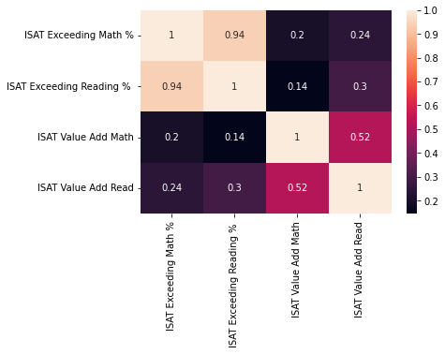
3. DATA EXPLORING
FIND CORRELATIONS
CREATE CORRELATION MATRIX
IDENTIFY FEATURES
PLOTTING
CHOOSE NUMERIC ATTRS TO CALCULATE CORRELATION
PYODBC
PANDAS.CORR()
USING SEABORN
MATPLOTLIB
10

Slide 11
4. QUERIES
1. Choose 5 schools with the highest ISAT average scores
The CTE (Common Table Expression) declaration is named tmp
Use the AVG function and the get_school_info function
SELECT TOP 5<Columns>
FROM <Table>
GROUP BY <Columns>
ORDER BY <Columns> DESC
11

Slide 12
SHORTCOMING & ORIENTATION
Still having school_type properties which cause more empty values from another type
Correlation calculations are still sketchy
SPLIT DATA AND TRY TO CONVERT TO NUMERIC
FIND MORE CORRELATIONS
12

Slide 13
5. DEMO + REFERENCES
Chicago Public Schools
Correlation
Github Copilot + GEMINI
13

Slide 14

THANKS FOR WATCHING
14

