Slide 1


LAB 04
ADY201m
Group 006
June 10 2024
1

Slide 2



Huy Duong Tran
Hoang Viet Nguyen
2
2

Slide 3
1
REQUIREMENT
2
ASSIGN TASK
CONTENT
3
DATA EXPLORING
4
MODELING
5
DEPLOY
6
DEMO & REFERENCES
© Copyright FPT Software – Level of Confidentiality
© Copyright FPT Software – Level of Confidentiality
3

Slide 4
1. REQUIREMENT
SUPPORT DISASTER RESPONSE PIPELINE
TARGET: RELIEF ORGANIZATIONS CLASSIFY AND PROCESS MESSAGES RECEIVED.
DESCRIBE: IN THE CONTEXT OF NATURAL DISASTERS OR EMERGENCIES.
SOLUTION: DEVELOP AN INFORMATION PROCESSING PIPELINE.
4

Slide 5
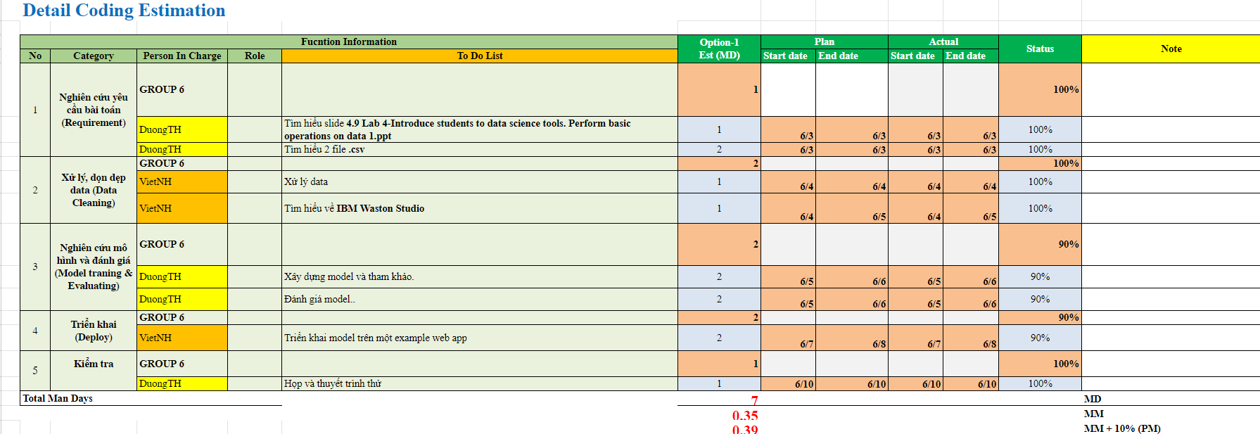
2. ASSIGN TASK
ESTIMATION
© Copyright FPT Software – Level of Confidentiality
5

Slide 6



3. DATA EXPLORING
TPU VM V3-8
© Copyright FPT Software – Level of Confidentiality
6

Slide 7


3. DATA EXPLORING
DATA CLEANING & SPLITING
IMPORT TO DB
PLOTTING
PANDAS
SQLALCHEMY
GET COLUMNS NAMES (STRING SLICING)
SPLITTING
(DELIMITER = ‘;’)
DISASTER_CATEGORIES.CSV
GET DECODED VALUES (THE LAST CHARACTER)
© Copyright FPT Software – Level of Confidentiality
7

Slide 8
3. DATA EXPLORING
DATA CLEANING & SPLITING
IMPORT TO DB
PLOTTING
PANDAS
SQLALCHEMY
CLEANED DISASTER_CATEGORIES
DISASTER_MESSAGES
JOIN THESE TWO DATA FRAMES WE WILL GET THE ENTIRE DATAFRAME WITH ALL THE NEEDED FEATURES FOR MACHINE LEARNING
© Copyright FPT Software – Level of Confidentiality
8

Slide 9
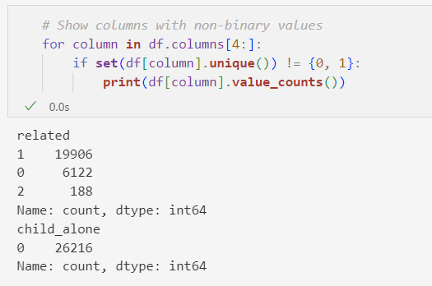
THE COLUMN RELATED HAS VALUE = 2, AND CHECK MORE I CAN SEE THAT, ALL OTHER CATEGORY COLUMN = 0 WHEN RELATED = 2
THE COLUMN CHILD_ALONE ONLY HAS 0 VALUES ​​SO IT CAN BE ELIMINATED
9
© Copyright FPT Software – Level of Confidentiality

Slide 10

3. DATA EXPLORING
DATA CLEANING & SPLITING
IMPORT TO DB
PLOTTING
SQLA.CREATE_ENGINE
IMPORT FLAT FILE (.CSV)
BULKING INSERT (POWER SHELL)
SPEED: 3 > 2 > 1
EASY TO USE: 2 > 1 > 3
CONTROL DATA TYPES: 1=3 >2
8
© Copyright FPT Software – Level of Confidentiality
10

Slide 11
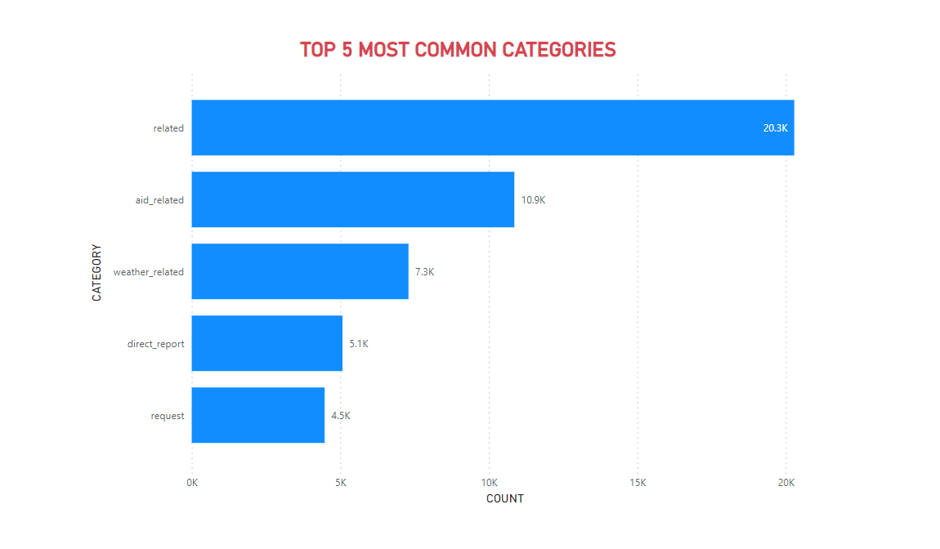
2. DATA EXPLORING
DATA CLEANING & SPLITING
IMPORT TO DB
PLOTTING
JSON
PLOTLY
QUERY
SAVE IN .CSV FILES
PLOTTING
8
© Copyright FPT Software – Level of Confidentiality
11

Slide 12


4. MODELING
COLLECTING DATA
PROCESSING DATA
DATA SEPARATION
RE
SYS
NLTK
SKLEARN.MODEL_SELECTION
TESTING SET
TRAINING SET
SAVE MODEL AND USE MODEL
MODEL BUILDING AND TRAINING
MODEL EVALUATION
PICKLE
SKLEARN.METRICS Y
SKLEARN.PIPELINE, SKLEARN.MODEL_SELECTION, SKLEARN.FEATURE_EXTRACTION.TEXT, SKLEARN.MULTIOUTPUT, SKLEARN.MULTICLASS, SKLEARN.SVM
NUMPY
12

Slide 13
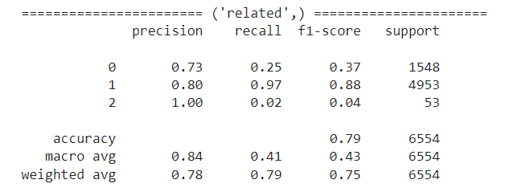
4.1 MODEL EVALUATION
13

Slide 14
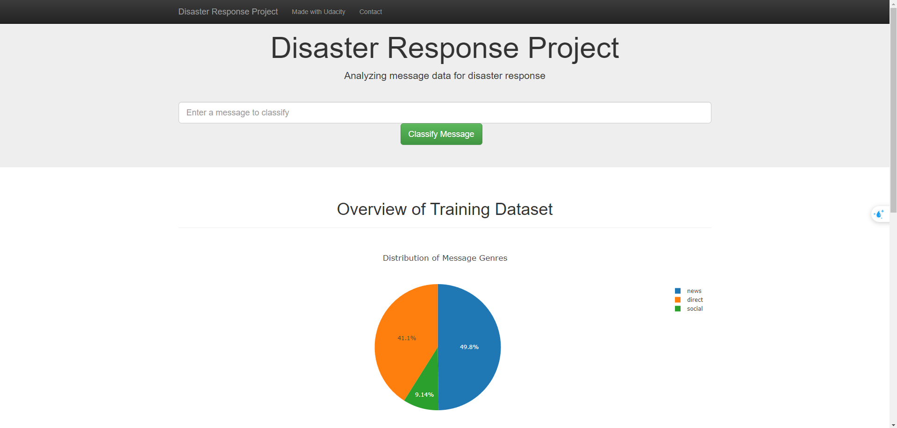
5. DEPLOY
14

Slide 15





5. DEPLOY
GRAPH JSON
PLOTLY
PANDAS
JSON
JOBLIB
GRAPH JSON
PLOTLY
SQLALCHEMY
JSON
MODEL.PKL
15

Slide 16
6. DEMO + REFERENCES
Disaster Response Pipeline - SIDHARTH KUMAR MOHANTY
Disaster Response Pipeline Project (Udacity - Data Scientist Nanodegree Program)
Stemming vs Lemmatization in NLP: Must-Know Differences
Github Copilot + GEMINI
16

Slide 17

THANKS FOR WATCHING
17

