Slide 1



pbi32-huyennguyen-global-super-store
View in Power BI
Last data refresh:
10/26/2021 3:24:29 PM UTC
Downloaded at:
1/6/2022 8:31:27 AM UTC

Slide 2
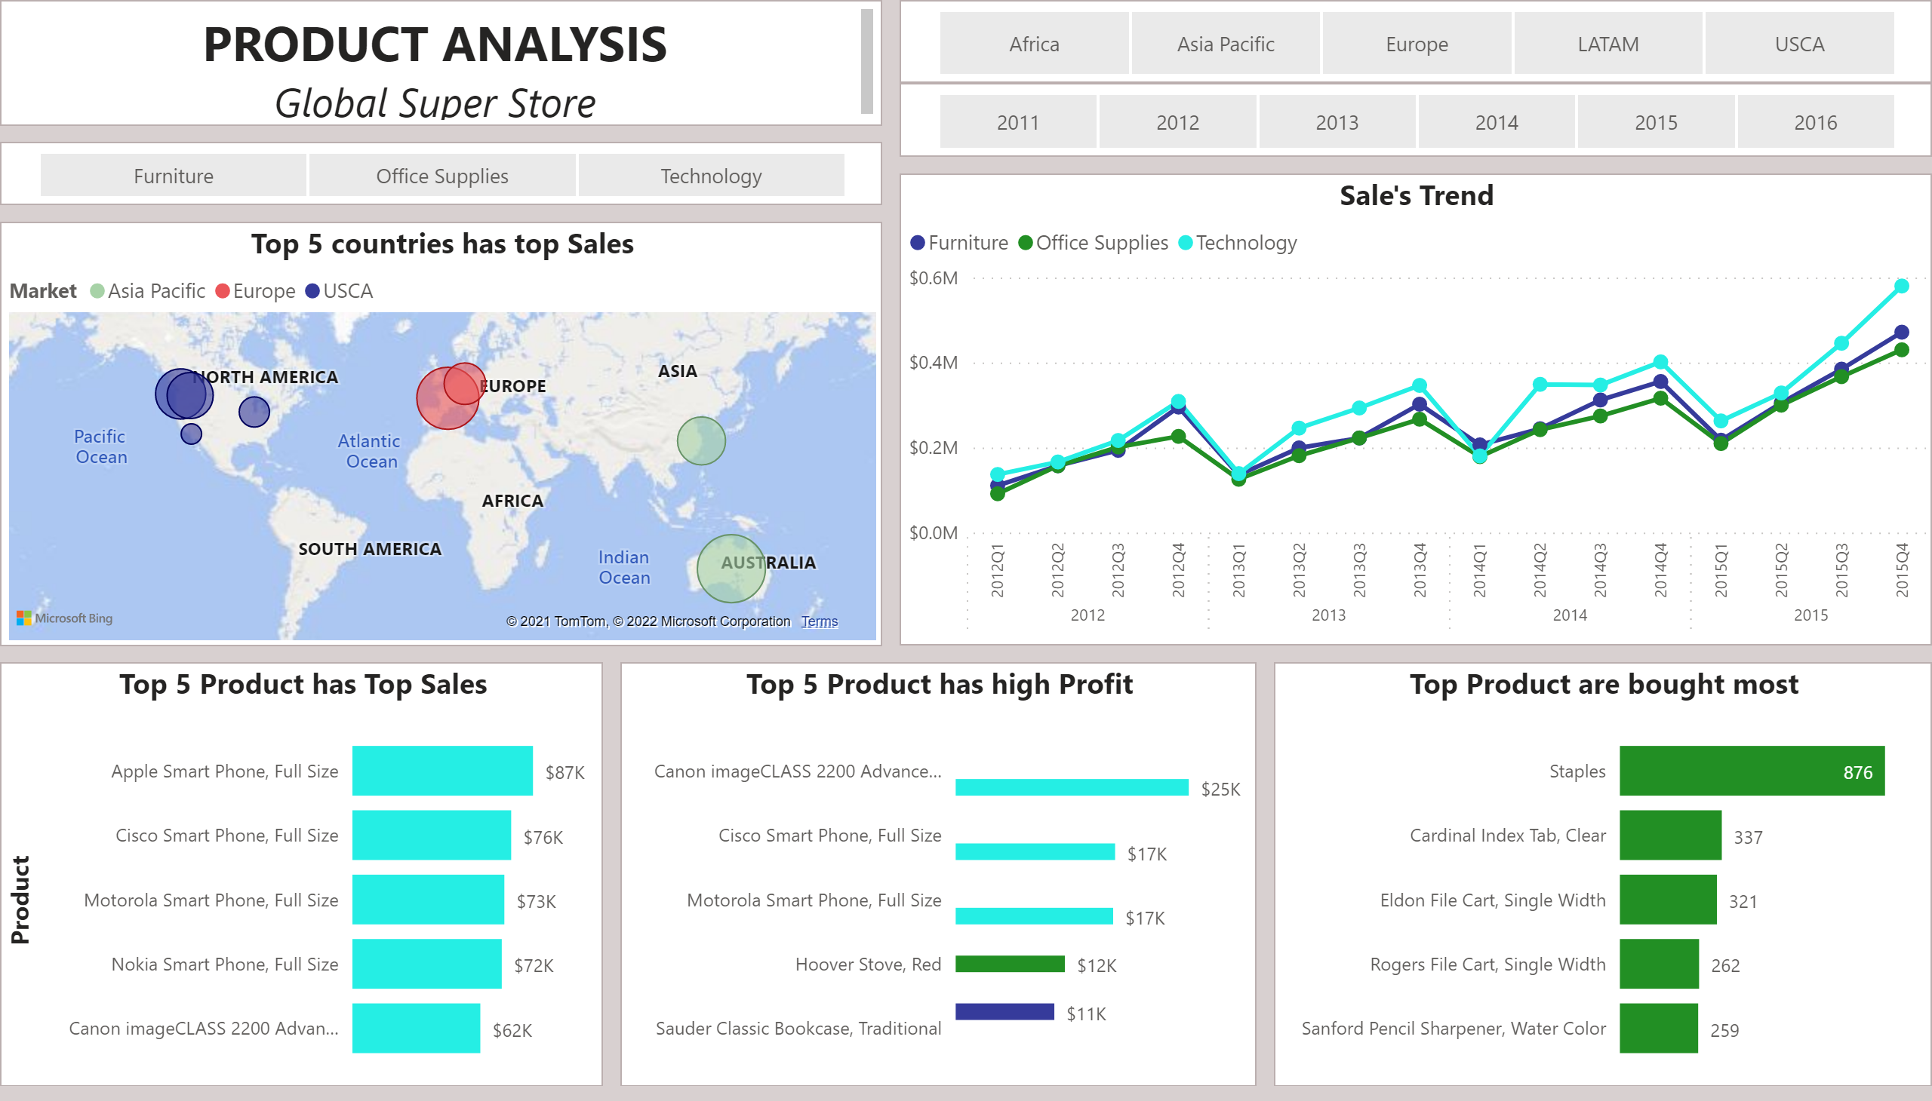
Product Analysis
Notes:
slicer
No alt text provided
slicer
No alt text provided
textbox
No alt text provided
Top 5 countries has top Sales
No alt text provided
slicer
No alt text provided
Top 5 Product has Top Sales
No alt text provided
Top 5 Product has high Profit
No alt text provided
Top Product are bought most
No alt text provided
Sale's Trend
No alt text provided

Slide 3
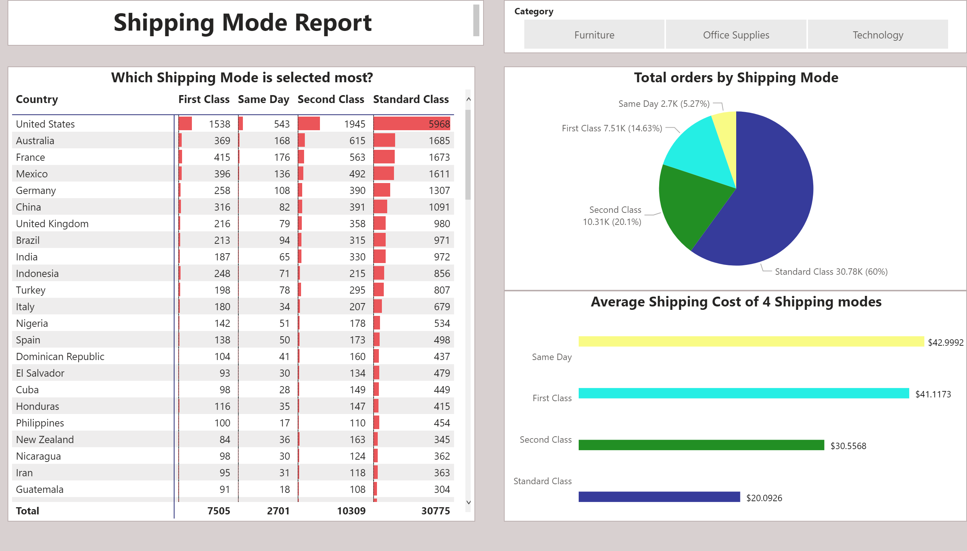
Shipping mode report
Notes:
Average Shipping Cost of 4 Shipping modes
No alt text provided
textbox
No alt text provided
slicer
No alt text provided
Total orders by Shipping Mode
No alt text provided
Which Shipping Mode is selected most?
No alt text provided

Slide 4
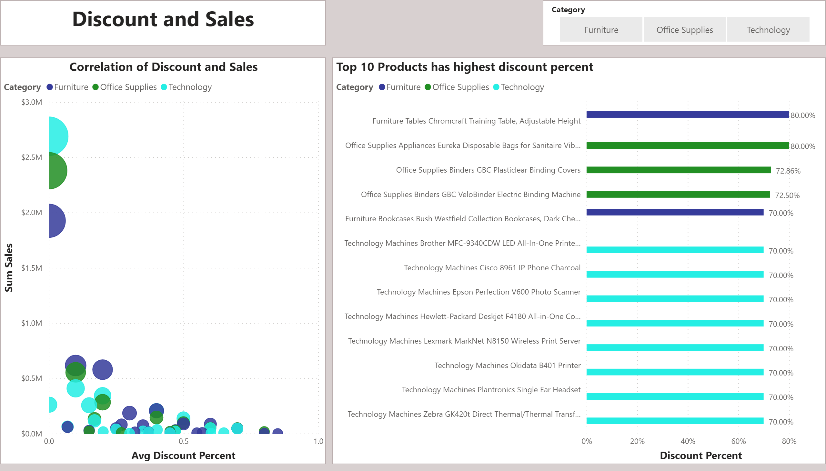
Correlation of discount and Sales
Notes:
Correlation of Discount and Sales
No alt text provided
Top 10 Products has highest discount percent
No alt text provided
slicer
No alt text provided
textbox
No alt text provided

Slide 5
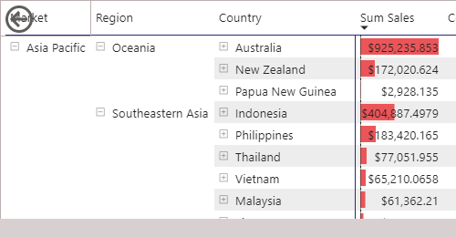
Where has high Sales?
Notes:
pivotTable
No alt text provided
actionButton
No alt text provided

