Slide 1

Biodiversity in Gippsland
before – after the Megafires 2019-20
Huyen-Anh Pham

Slide 2
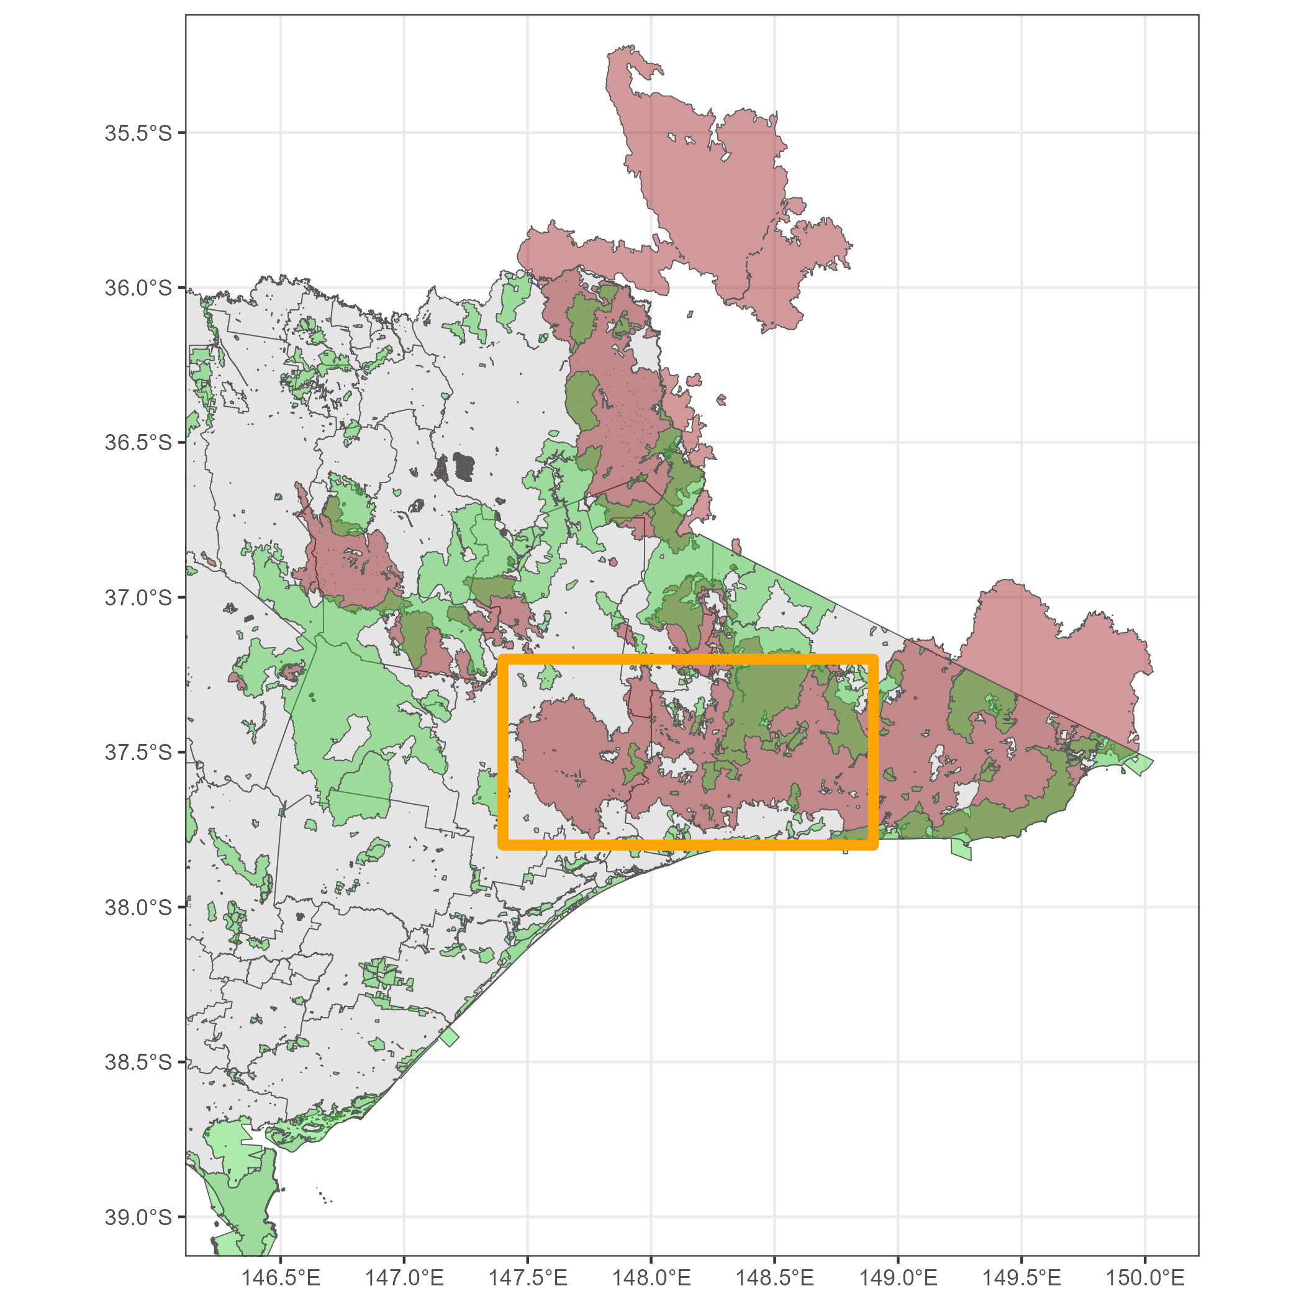
About
Program: NatureWatch
Project: Life After Fire
LAF Gippsland
The bushfires from Nov 2019 to Feb 2020
1.46M hectares were burnt across East Gippsland
Data collection: to support the recovery and protection of high conservation areas and threatened species.
Megafires 2019-20
Parks and Reservations
Notes:
Victorian National Parks Association
We’re a non-profit organization, working on nature preservation.
One of the VNPA projects I’m working under this one called “Life After Fire”
The story behind this:
There were mega bushfires back in 2019-2020
last for 3 months,
which damaged more than 1.4 Million hectares in Gippsland
Green are the Parks and Reservations areas, which we’re trying to protect.
Red marks the extension of the fires.
Orange box here is where we’re carrying out the project.
What do we do here? We collect data.
We go trekking, set up sensored camera, trying to capture animal sightings.

Slide 3
Goals
🎯Compare the biodiversity before vs. after the fires
between burnt vs. unburnt areas (fire severity)
across habitats (vegetation class)
time-since-fire (0-3, 3-6, 6-9, … months)
➡️ Plan
conservation
activities
Data
ALA occurrence
ID, species_group, occurrence_date, …
fire_start_date, fire_severity, …
vegetation_class
before_after, burn_unburnt, time_since_fire
sf
Fire History
Vegetation class
Fire History
Jan
2017
Nov
2019
Feb
2020
Jul
2021
ALA occurrence
Before
After
Notes:
The goal here is to compare the biodiversity before vs. after the megafires
between burnt vs. unburnt areas
across habitats
-> Design future activites
Using data from 3 sources:
Atlas of Living Australia species occurrence database
The other two: Fire History and Vegetation class are data from the Victoria government
(2) Fire History - Department of Environment and Climate Action
(3) Vegetation class - Department of Environment and Climate Action
3 datasets are weaved together using spatial operations.
We’d derive some additional attributes for later comparison purposes.
Here’ the time scope of the datasets: ALA species occurrence includes two periods: before, after

Slide 4
How?
🎯 Compare the biodiversity before vs. after the fires
Hill Numbers
considers both the number of species and their relative abundance
come in different "orders ":
q = 0: species richness, counting the number of species present.
q = 1: Shannon diversity, gives more weight to common species.
q = 2: Simpson diversity, strongly emphasizes the most dominant species and discounts rare ones.
Forest A
all the species are equally common
Forest B
one species dominates while the others are rare
 | Forest A | Forest B
Species Richness (q=0): | 3.00 | 3.00
Shannon Diversity (q=1): | 3.00 | 1.95
Simpson Diversity (q=2) | 3.00 | 1.48
-> same species richness, forest A is more diverse.
Standardising sampling periods and effort
work-in-progress
Notes:
So, how do we measure the biodiversity?
Biodiversity does not just mean there are many types of species within an area.
We use the Hill Numbers to consider both species richness and their relative abundance.
Forest A: all species are equally common
Forest B: the Orange species dominates.
Hill Number tell us: two forest have the same species richness, but forest A is more diverse.
Besides from the measurement, we also have to address the inherited arbitrary problem of species occurrence data
with standardizing sampling periods and effort procedures.

