Slide 1

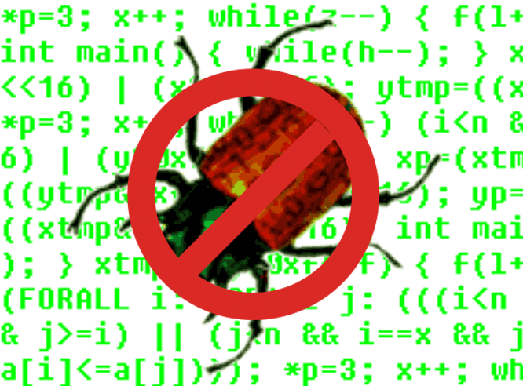
Grand Challenge Problem:
Model Check Concurrent Software
Edmund M. Clarke
Department of Computer Science
Carnegie Mellon University

Slide 2
Temporal Logic Model Checking
Model checking is an automatic verification technique for finite state concurrent systems.
Developed independently by Clarke, Emerson, and Sistla and by Queille and Sifakis in early 1980’s.
Specifications are written in propositional temporal logic.
Verification procedure is an exhaustive search of the state space of the design.

Slide 3
Advantages of Model Checking
No proofs!!!
Fast (compared to other rigorous methods such as theorem proving)
Diagnostic counterexamples
No problem with partial specifications
Logics can easily express many concurrency properties

Slide 4
Main Disadvantage
State Explosion Problem:
Too many processes
Complex data structures
Much progress has been made on this problem recently!

Slide 5

Basic Temporal Operators
The symbol “p” is an atomic proposition, e.g. “Device Enabled”.
Fp - p holds sometime in the future.
Gp - p holds globally in the future.
Xp - p holds next time.
pUq - p holds until q holds.

Slide 6
Model Checking Problem
Let M be a state-transition graph.
Let ƒ be the specification in temporal logic.
Find all states s of M such that M, s |= ƒ.
Efficient Algorithms: CE81, CES83

Slide 7
Combating the
State Explosion Problem
Binary Decision Diagrams can be used to represent state transition systems more efficiently. SMV
The partial order reduction can be used to reduce the number of states that must be enumerated. SPIN
Many techniques for alleviating state explosion:
  Abstraction.
  Compositional reasoning.
  Symmetry.
  Cone of influence reduction.
  Semantic minimization.

Slide 8
Model Checker Performance
Model checkers today can routinely handle systems with between 100 and 1000 state variables.
Systems with 10¹²⁰ reachable states have been checked. (Compare approx. 10⁷⁸ atoms in universe.)
By using appropriate abstraction techniques, systems with an essentially unlimited number of states can be checked.

Slide 9
Model Checking Systems
There are many successful examples of the use of model checking in hardware and protocol verification.
The fact that industry (INTEL, IBM, MOTOROLA) is starting to use model checking is encouraging.

Slide 10
Notable Example-
IEEE Futurebus⁺
In 1992 Clarke and his students at CMU used SMV to verify the IEEE Future+ cache coherence protocol.
They found a number of previously undetected errors in the design of the protocol.
This was the first time that formal methods have been used to find errors in an IEEE standard.
Although the development of the protocol began in 1988, all previous attempts to validate it were based entirely on informal techniques.

Slide 11
Grand Challenge:
Model Check Software !
What makes Software Model Checking different ?

Slide 12
What Makes Software Model Checking Different ?
Large/unbounded base types: int, float, string
User-defined types/classes
Pointers/aliasing + unbounded #’s of heap-allocated cells
Procedure calls/recursion/calls through pointers/dynamic method lookup/overloading
Concurrency + unbounded #’s of threads
Notes:
Laundry list – but we don’t have to address all of these aspects to be a success
We will address some, but not all
Lots of meaty problems for research

Slide 13
What Makes Software Model Checking Different ?
Templates/generics/include files
Interrupts/exceptions/callbacks
Use of secondary storage: files, databases
Absent source code for: libraries, system calls, mobile code
Esoteric features: continuations, self-modifying code
Size (e.g., MS Word = 1.4 MLOC)
Notes:
Laundry list – but we don’t have to address all of these aspects to be a success
We will address some, but not all
Lots of meaty problems for research

Slide 14
What Does It Mean to
Model Check Software?
Combine static analysis and model checking
Use static analysis to extract a model K from a boolean abstraction of the program.
Then check that f is true in K (K ² f), where f is the specification of the program.
² SLAM (Microsoft)
² Bandera (Kansas State)
² Java PathFinder (NASA Ames)
² MAGIC (CMU)

Slide 15
What Does It Mean to
Model Check Software?
2. Simulate program along all paths in computation tree
  ² Source code + backtracking (e.g., Verisoft)
  ² Source code + symbolic execution + backtracking (e.g., MS/Intrinsa Prefix)
3. Use finite-state machine to look for patterns in control-flow graph [Engler]
Notes:
A few of the possibilities, and there are others that people have looked at
Important to mention, however, that most existing work makes very
strong assumptions; there have been some successes, but there is
still plenty of interesting work to do

Slide 16
What Does It Mean to
Model Check Software?
4. Design with Finite-State Software Models
Finite state software models can act as “missing link”
between transition graphs and complex software.
  ² Statecharts
  ² Esterel

Slide 17
What Does It Mean to
Model Check Software?
5. Use Bounded Model Checking and SAT (Kroening)
Problem: How to compute set of reachable states? Fixpoint computation is too expensive.
Restrict search to states that are reachable from initial state within fixed number n of transitions
Implemented by unwinding program and using SAT solver

Slide 18
Key techniques for
Software Model Checking
Counterexample Guided Abstraction Refinement
(Kurshan, Yuan Lu, Ball et al.)
Predicate Abstraction (Graf and Saidi, Ball et al, Chaki et al, Kroening)

Slide 19
Counterexamples
Informal
Specification
Program
Transition System
Temporal Logic Formula
(CTL, LTL, etc.)
Safety Property:
bad state unreachable:
satisfied
Initial State

Slide 20
Counterexamples
Informal
Specification
Program
Transition System
Temporal Logic Formula
(CTL, LTL, etc.)
Safety Property:
bad state unreachable
Counterexample
Initial State

Slide 21
Counterexamples
Informal
Specification
Program
Transition System
Temporal Logic Formula
(CTL, LTL, etc.)
Safety Property:
bad state unreachable
Counterexample
Initial State

Slide 22
Existential Abstraction
Given an abstraction function h : S → S_{h}, the concrete states are grouped and mapped into abstract states :
M_{h}
Preservation Theorem ?
h
h
h
M

Slide 23
Simulation Relation
Assume N simulates M (M ≤ N)
Let f be a universal CTL* formula (ACTL*)
M
a
N
a
b
b
b
c
d
c
d
M |= f
N |= f

Slide 24
Preservation Theorem
Atomic formula f respects h if f does not distinguish concrete states within abstract state.
Theorem (Clarke, Grumberg, Long)
If ϕ is an ACTL* specification where the atomic formulas respect h, then M ≤ M_{h}.
Corollary Preservation Theorem applicable:
M_{h} |= ϕ implies M |= ϕ.
Converse implication is not valid !

Slide 25
Spurious Behavior
“red”
“go”
AGAF red
“Every path necessarily leads
back to red.”
Spurious Counterexample:
<go><go><go><go> ...
Artifact of the abstraction !

Slide 26
How to define
Abstraction Functions ?
Abstraction too fine
➔ State Explosion
Abstraction too coarse
➔ Information Loss
Automatic Abstraction Methodology

Slide 27
Automatic Abstraction
M_{h}
Spurious
Initial Abstraction
Spurious
counterexample
Refinement
Refinement
Validation or
Counterexample
Correct !
M
Original Model

Slide 28
CEGAR
CounterExample-Guided Abstraction Refinement
M and ϕ
generate initial
abstraction
M_{h}
M_{h} |= ϕ
model check
M_{h} |= ϕ
refinement
generate
counterexample T_{h}
stop
T_{h}
T_{h}
check if counter-
example spurious
is spurious
T_{h} is not spurious

Slide 29
CEGAR
Counterexample-Guided Abstraction Refinement
C
Predicate
abstraction
M_{h}
M_{h} |= ϕ
model check
M_{h} |= ϕ
refinement
new predicates
generate
counterexample T_{h}
stop
T_{h}
T_{h}
check if counter-
example spurious
is spurious
T_{h} is not spurious

Slide 30
Predicate Abstraction
Use predicate abstraction to prove assertions or safety properties
Successfully applied for verification of C programs (SLAM, MAGIC, BLAST)
Predicate abstraction produces over-approximation
Notes:
If the property holds on the abstract model it also holds on the original SpecC program.

Slide 31
Example for Predicate Abstraction
void main() {
bool p1, p2;
p1=TRUE;
p2=TRUE;
while(p2)
{
p1=p1?FALSE:nondet();
p2=!p2;
}
}
void main() {
int i;
i=0;
while(even(i))
i++;
}
+
p₁ ⇔ i=0
p₂ ⇔ even(i)
=
C program
Predicates
Boolean program
[Graf, Saidi ’97]
Notes:
Consider the SpecC program which has one integer variable i. The boolean program has the same control structure as that of the original C program. Note that this was a simple example which didn’t have any concurrency or bit vector
operators in it.
Each statement in the SpecC program is replaced by its affect on the predicates in the boolean program.

Slide 32
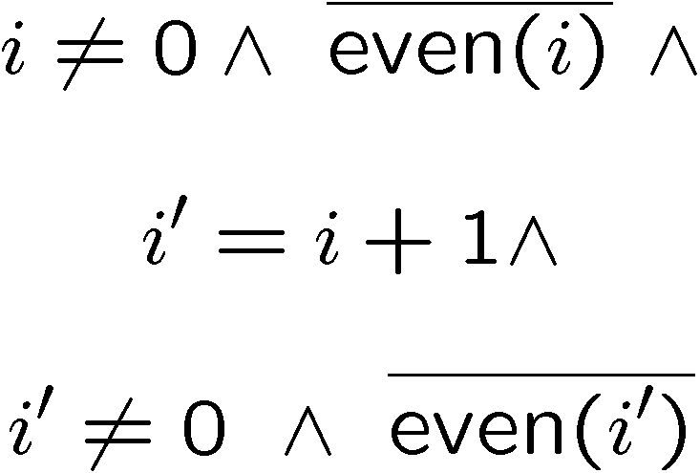
Using theorem prover for abstraction
Predicates
Basic Block
Formula
i++;
Query
p₁ | p₂
0 | 0
0 | 1
1 | 0
1 | 1
✗
p’₁ | p’₂
0 | 0
0 | 1
1 | 0
1 | 1
Notes:
Let us first look at the existing approach for abstracting a given basic block.
Suppose we are given 3 predicates. And a basic block . First convert the basic block into a formula by
by identifying the current and the next state variables. Let p_1, p_2, and p_3 denote the values of the variables before executing the basic block (also known as the current state) . And primed versions p1’ p2’ etc. denote the values after executing the basic block (the next abstract state). WE WAN’T TO KNOW WHAT ARE THE POSSIBLE TRANSITIONS FROM A GIVEN ABSTRACT STATE TO A NEXT ABSTRACT STATE.

Slide 33
Using theorem prover for abstraction
Predicates
Basic Block
Formula
i++;
Query
p₁ | p₂
0 | 0
0 | 1
1 | 0
1 | 1
p’₁ | p’₂
0 | 0
0 | 1
1 | 0
1 | 1
✓
… and so on …
Notes:
Let us first look at the existing approach for abstracting a given basic block.
Suppose we are given 3 predicates. And a basic block . First convert the basic block into a formula by
by identifying the current and the next state variables. Let p_1, p_2, and p_3 denote the values of the variables before executing the basic block (also known as the current state) . And primed versions p1’ p2’ etc. denote the values after executing the basic block (the next abstract state). WE WAN’T TO KNOW WHAT ARE THE POSSIBLE TRANSITIONS FROM A GIVEN ABSTRACT STATE TO A NEXT ABSTRACT STATE.

Slide 34
Problems with existing tools
Large number of expensive theorem prover calls – slow (2^{n} £ 2^{n} )
Theorem prover works on natural numbers, but programs uses bit-vectors ➔ false positives
Most theorem provers support only few operators
(+, -, <, ≤, …), no bitwise operators
Notes:
In practice one does not try all possible abstract transitions. Only a subset of all possible transitions is tried. The remaining transitions are added to the abstract model directly to ensure that we obtain an over-approximation.

Slide 35
Abstraction of a basic block
Use a SAT solver for computing abstraction of a basic block
Successfully used for abstraction of C programs
Create a SAT instance which relates:
  Initial value of predicates
  Basic block
  Final value of predicates
Notes:
Introduce a free variables for each predicate
Create a SAT instance which relates initial value of predicates, basic block, and the values of predicates after the execution of basic block

Slide 36
Abstraction of a basic block
+
+
Computing abstract transitions
Notes:
From each satisfying assignment we obtain an abstract transition.

Slide 37
Abstract transitions
Equation passed to the SAT solver
Satisfying assignments
(!p₁ & !p₂ & !p’₁ & p’₂) 00 ) 01
(!p₁ & !p₂ & p’₁ & p’₂) 00 ) 11
…………………and so on

Slide 38
Abstraction of a basic block
Use SAT solver!
Generate query equation with
predicates as free variables
Transform equation into CNF using
Bit Vector Logic
One satisfying assignment matches
one abstract transition
Obtain all satisfying assignments
= most precise abstract transition relation

Slide 39
Advantages of using SAT
This solves two problems:
Now can do all C operators,including *, /, %, <<, & etc.
Bit vector semantics taken into account
Use SAT solver!
Generate query equation with predicates as free variables
Transform equation into CNF using Bit Vector Logic
One satisfying assignment matches one abstract transition
Obtain all satisfying assignments = most precise abstract transition relation
No more
unnecessary spurious counterexamples!

Slide 40
CEGAR
Counterexample-Guided Abstraction Refinement
C
Predicate
abstraction
M_{h}
M_{h} |= ϕ
model check
M_{h} |= ϕ
refinement
new predicates
generate
counterexample T_{h}
stop
T_{h}
T_{h}
check if counter-
example spurious
is spurious
T_{h} is not spurious

Slide 41
CEGAR
Counterexample-Guided Abstraction Refinement
C
Predicate
abstraction
M_{h}
M_{h} |= ϕ
model check
M_{h} |= ϕ
refinement
new predicates
generate
counterexample T_{h}
stop
T_{h}
T_{h}
check if counter-
example spurious
is spurious
T_{h} is not spurious

Slide 42
CEGAR
Counterexample-Guided Abstraction Refinement
C
Predicate
abstraction
M_{h}
M_{h} |= ϕ
model check
M_{h} |= ϕ
refinement
new predicates
generate
counterexample T_{h}
stop
T_{h}
T_{h}
check if counter-
example spurious
is spurious
T_{h} is not spurious

Slide 43
CEGAR
Counterexample-Guided Abstraction Refinement
C
Predicate
abstraction
M_{h}
M_{h} |= ϕ
model check
M_{h} |= ϕ
refinement
new predicates
generate
counterexample T_{h}
stop
T_{h}
T_{h}
check if counter-
example spurious
is spurious
T_{h} is not spurious

Slide 44
Future research directions
Data Structures
Pointers
Concurrency
Object Oriented Software
Scaling up!!

Slide 45
References
Counterexample-Guided Abstraction Refinement. CAV’00 & JACM.
Modular Verification of Software Components in C. ICSE 2003
Predicate Abstraction with Minimum Predicates. CHARME 2003
Predicate Abstraction of ANSI-C Programs Using SAT. FMSD 2004
A Tool for Checking ANSI-C Programs , TACAS 2004
Joint Work with O. Grumberg, H.Veith, D. Kroening, Sagar Chaki, Natasha Sharygina, Karen Yorav, Himanshu Jain
QUESTIONS?

