Slide 1
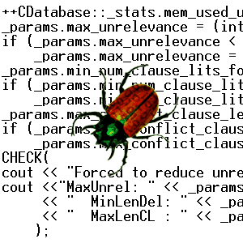

Lecture 1:
Model Checking
Edmund Clarke
School of Computer Science
Carnegie Mellon University

Slide 2

Cost of Software Errors
June 2002
“Software bugs, or errors, are so prevalent and so detrimental that they cost the U.S. economy an estimated $59.5 billion annually, or about 0.6 percent of the gross domestic product
…
At the national level, over half of the costs are borne by software users and the remainder by software developers/vendors.”
NIST Planning Report 02-3
The Economic Impacts of Inadequate
Infrastructure for Software Testing

Slide 3
Cost of Software Errors
“The study also found that, although all errors cannot be removed, more than a third of these costs, or an estimated $22.2 billion, could be eliminated by an improved testing infrastructure that enables earlier and more effective identification and removal of software defects.”

Slide 4

Model Checking
Developed independently by Clarke and Emerson and by Queille and Sifakis in early 1980’s.
Properties are written in propositional temporal logic.
Systems are modeled by finite state machines.
Verification procedure is an exhaustive search of the state space of the design.
Model checking complements testing/simulation.

Slide 5
Advantages of Model Checking
No proofs!!!
Fast (compared to other rigorous methods)
Diagnostic counterexamples
No problem with partial specifications / properties
Logics can easily express many concurrency properties

Slide 6
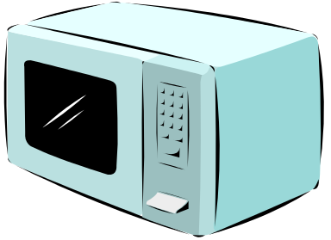
Model of computation
Microwave Oven Example
State-transition graph
describes system evolving
over time.
~ Start
~ Close
~ Heat
~ Error
st
Start
~ Close
~ Heat
Error
~ Start
Close
~ Heat
~ Error
~ Start
Close
Heat
~ Error
Start
Close
~ Heat
Error
Start
Close
~ Heat
~ Error
Start
Close
Heat
~ Error
Notes:
Say that simple examples can not demonstrate concurrency well.

Slide 7
Temporal Logic
The oven doesn’t heat up until the door is closed.
Not heat_up holds until door_closed
(~ heat_up) U door_closed

Slide 8
Basic Temporal Operators
The symbol “p” is an atomic
proposition, e.g. “heat_up” or “door_closed”.
Fp - p holds sometime in the future.
Gp - p holds globally in the future.
Xp - p holds next time.
pUq - p holds until q holds.

Slide 9
Model Checking Problem
Let M be a model, i.e., a state-transition graph.
Let ƒ be the property in temporal logic.
Find all states s such that M has property ƒ at state s.
Efficient Algorithms: CE81, CES83

Slide 10
The EMC System 1982/83
Preprocessor
Model Checker
(EMC)
Properties
State Transition Graph
10⁴ to 10⁵ states
True or Counterexamples

Slide 11
Model Checker Architecture
System Description
Formal Specification
State Explosion Problem!!
Validation
or
Counterexample
Model Checker

Slide 12

The State Explosion Problem
System Description
Combinatorial explosion of system
states renders explicit
model construction infeasible.
State Transition Graph
Exponential Growth of …
… global state space in number of concurrent components.
… memory states in memory size.
Feasibility of model checking inherently tied to handling state explosion.

Slide 13
Combating State Explosion
Binary Decision Diagrams can be used to represent state transition systems more efficiently.
→ Symbolic Model Checking 1992
Semantic techniques for alleviating state explosion:
  Partial Order Reduction.
  Abstraction.
  Compositional reasoning.
  Symmetry.
  Cone of influence reduction.
  Semantic minimization.

Slide 14
Model Checking since 1981
1981 Clarke / Emerson: CTL Model Checking
Sifakis / Quielle
1982 EMC: Explicit Model Checker
Clarke, Emerson, Sistla
1990 Symbolic Model Checking
Burch, Clarke, Dill, McMillan
SMV: Symbolic Model Verifier
McMillan
1998 Bounded Model Checking using SAT
Biere, Clarke, Zhu
2000 Counterexample-guided Abstraction Refinement
Clarke, Grumberg, Jha, Lu, Veith
10⁵
10¹⁰⁰
1990s: Formal Hardware Verification in Industry:
Intel, IBM, Motorola, etc.
10¹⁰⁰⁰

Slide 15
Model Checking since 1981
1981 Clarke / Emerson: CTL Model Checking
Sifakis / Quielle
1982 EMC: Explicit Model Checker
Clarke, Emerson, Sistla
1990 Symbolic Model Checking
Burch, Clarke, Dill, McMillan
SMV: Symbolic Model Verifier
McMillan
1998 Bounded Model Checking using SAT
Biere, Clarke, Zhu
2000 Counterexample-guided Abstraction Refinement
Clarke, Grumberg, Jha, Lu, Veith
CBMC
MAGIC

Slide 16
Grand Challenge:
Model Check Software !
What makes Software Model Checking different ?

Slide 17
What Makes Software Model Checking Different ?
Large/unbounded base types: int, float, string
User-defined types/classes
Pointers/aliasing + unbounded #’s of heap-allocated cells
Procedure calls/recursion/calls through pointers/dynamic method lookup/overloading
Concurrency + unbounded #’s of threads
Notes:
Laundry list – but we don’t have to address all of these aspects to be a success
We will address some, but not all
Lots of meaty problems for research

Slide 18
What Makes Software Model Checking Different ?
Templates/generics/include files
Interrupts/exceptions/callbacks
Use of secondary storage: files, databases
Absent source code for: libraries, system calls, mobile code
Esoteric features: continuations, self-modifying code
Size (e.g., MS Word = 1.4 MLOC)
Notes:
Laundry list – but we don’t have to address all of these aspects to be a success
We will address some, but not all
Lots of meaty problems for research

Slide 19
Grand Challenge:
Model Check Software !
Early attempts in the 1980s failed to scale.
2000s: renewed interest / demand:
Java Pathfinder: NASA Ames
SLAM: Microsoft
Bandera: Kansas State
BLAST: Berkeley
…
SLAM to be shipped to Windows device driver developers.
In general, these tools are unable to handle complex data structures and concurrency.

Slide 20
The MAGIC Tool:
Counterexample-Guided Abstraction Refinement
Memory
State
Abstract
Memory
State
Memory
State
Abstract
Memory
State
Abstraction
Memory
State
Memory
State
Memory
State
Memory
State
Memory
State
Abstraction maps classes of similar memory
states to single abstract memory states.
+ Model size drastically reduced.
Invalid counterexamples possible.
Memory
State

Slide 21
The MAGIC Tool:
Counterexample-Guided Abstraction Refinement
C Program
Abstraction
Abstract Model
Verification
Yes
Abstraction
Guidance
System OK
Improved
Abstraction
Guidance
No
Abstraction
Refinement
No
Counterexample
Valid?
Yes

Slide 22
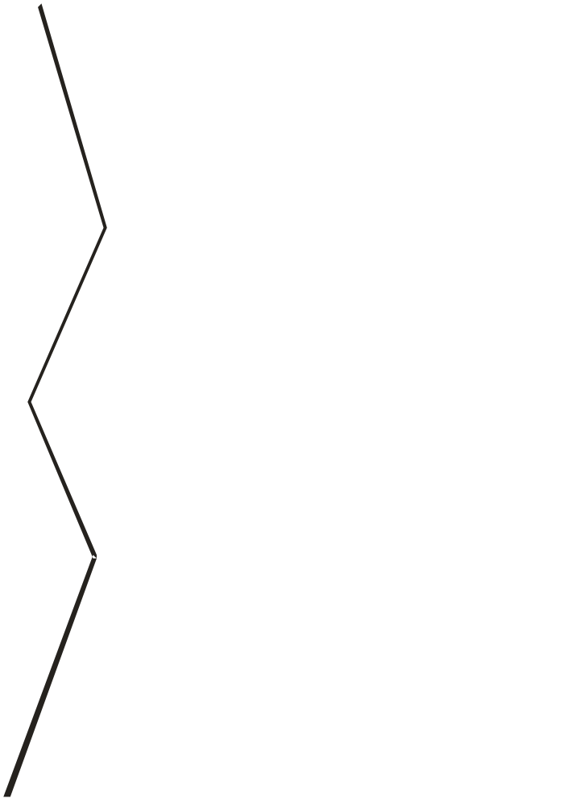
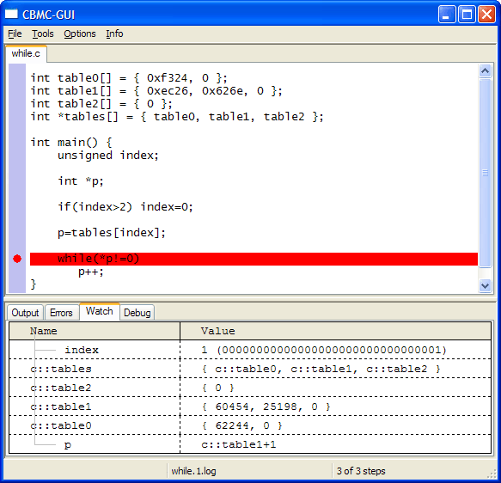
CBMC: Embedded Systems Verification
Method:
Bounded Model Checking
Implemented GUI to facilitate tech transfer
Applications:
  Part of train controller from GE
  Cryptographic algorithms (DES, AES, SHS)
  C Models of ASICs provided by nVidia

Slide 23
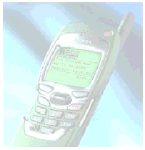
Case Study:
Verification of MicroC/OS
Real-Time Operating System
  About 6000 lines of C code
  Used in commercial embedded systems
    UPS, Controllers, Cell-phones, ATMs
Required mutual exclusion
in the kernel
  OS_ENTER_CRITICAL() and
  OS_EXIT_CRITICAL()
MAGIC and CBMC:
  Discovered one unknown bug related to the locking discipline
  Discovered three more bugs
  Verified that no similar bugs are present

