Slide 1
Introduction to Model Checking

Slide 2
Outline
Model checking
  Temporal logic
  Model checking algorithms
  Expressiveness and complexity
Symbolic model checking
  The “state explosion” problem
  Binary Decision Diagrams
  Computing fixed points with BDD’s
  Application

Slide 3

Propositional Linear Temporal Logic
Express properties of “Reactive Systems”
  interactive, nonterminating
For PLTL, a model is an infinite state sequence
Temporal operators
  “Globally”: G p at t iff p for all t’ ≥ t.
p
p
p
p
p
p
p
p
p
p
p...
G p...

Slide 4
Temporal operators...
  “Future”: F p at t iff p for some t’ ≥ t.
p
p
p
p
p
p
F p...
  “Until”: p U q at t iff
    q for some t’ ≥ t and
    p in the range [ t, t’ )
p
p
p
p
p
p
p
p
p
q
p U q...
  “Next-time”: X p at t iff p at t+1

Slide 5
Examples
Liveness: “if input, then eventually output”
G (input ⇒ F output)
Strong fairness: “infinitely send implies infinitely recv.”
GF send ⇒ GF recv
Weak until: “no output before input”
¬output W input
atomic props
infinitely often
p W q ≡
p U q ∨ G p

Slide 6
Safety v. Liveness
Safety
  Refutable by finite run
Liveness
  Refutable only by infinite run
  Every finite run extensible to satisfying run

Slide 7



PLTL semantics
Given an infinite sequence
  if φ is true in state s_{i} of σ.
  if φ is true in state s₀ of σ.
  if φ is valid.
A formula is an atomic proposition, or...
  true, p ∨ q, ¬p, p U q, X p

Slide 8









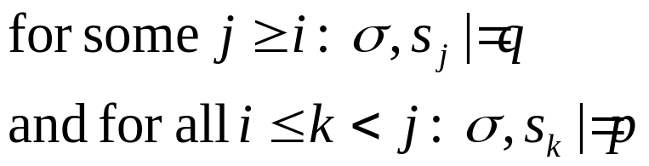
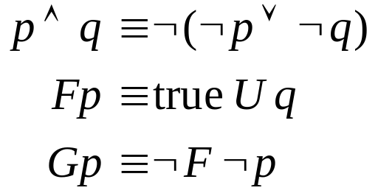
PLTL semantics...
Definition of satisfaction
  iff
  iff
  iff
  iff
  iff
Derived operators...

Slide 9
Model Checking (Clarke/Emerson, Queille/Sifakis)
G(p -> F q)
yes
temporal formula
MC
algorithm
no
p
p
q
q
finite-state model
counterexample
Model must now represent all behaviors

Slide 10
Kripke models
A Kripke model (S,R,L) consists of
  set of states S
  set of transitions R ⊆ S x S
  labeling L ⊆ S x AP
Kripke models from programs
repeat
p := true;
p := false;
end
¬p
p

Slide 11
Mutual exclusion example
N1,N2
turn=0
T1,N2
turn=1
N1,T2
turn=2
C1,N2
turn=1
T1,T2
turn=1
T1,T2
turn=2
N1,C2
turn=2
C1,T2
turn=1
T1,C2
turn=2
N = noncritical, T = trying, C = critical

Slide 12

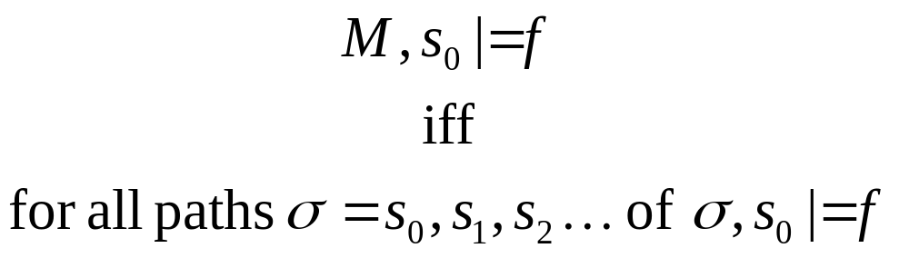
PLTL on Kripke models
A path in model M = (S,R,L) is a sequence
such that (s_{i},s_{i}+1) ∈ R.
p
s₀
s₁
p
s₂
s₃...
F p
p

Slide 13
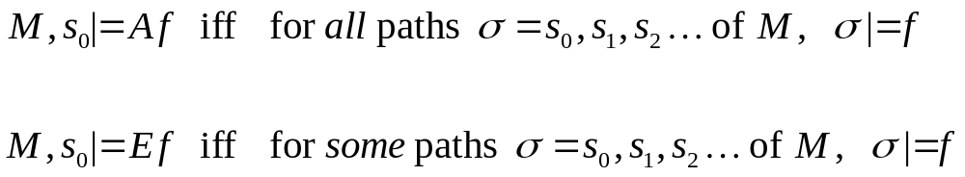
Branching time
Model of time is a tree, not a sequence
Path quantifiers
p
p
AF p
p

Slide 14
Computation Tree Logic
Every operator F, G, X, U preceded by A or E
Universal modalities...
AG p
AF p
p
p
p
p
p
p
p
p
p
p
. . .
. . .
. . .
. . .
. . .
. . .
. . .
. . .

Slide 15
CTL, cont...
Existential modalities
EG p
EF p
p
p
p
p
. . .
. . .
. . .
. . .
. . .
. . .
. . .
. . .

Slide 16
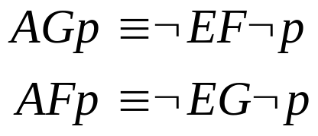
CTL, cont
Other modalities
  AX p, EX p, A(p U q), E(p U q)
Some dualities...
Examples: mutual exclusion specs...
  AG ¬ (C₁ ∧ C₂) mutual exclusion
  AG (T₁ ⇒ AF C₁) liveness
  AG (N₁ ⇒ EX T₁) non-blocking

Slide 17

CTL model checking
Model checking problem:
  Determine for given M, s₀ and f, whether
Simple algorithm:
  Inductive over structure of formula
  Backward propagation of formula labels
  O(f V(V + E))

Slide 18
Example
AG (T₁ ⇒ AF C₁)
N1,N2
turn=0
T1,N2
turn=1
N1,T2
turn=2
C1,N2
turn=1
T1,T2
turn=1
T1,T2
turn=2
N1,C2
turn=2
C1,T2
turn=1
T1,C2
turn=2

Slide 19
CES algorithm
Need only modalities EX, EU, EG.
  e.g.,
  Checking E(p U q) by backward BFS
  Checking EG p
p
BFS
q
p
SCC
EG p
SCC
SCC
Complexity = O(f (V + E))

Slide 20
CTL*
Contains both CTL and LTL
  path formulas
    p U q, G p, Fp, Xp, ¬p, p ∧ q
  state formulas
    A p, E p
p in LTL → A p in CTL*
Framework for comparing expressiveness
  Existential properties not expressible in PLTL
    e.g., AG EF p
  Fairness assumptions not expressible in CTL
    e.g., A (GF p → GF q)

Slide 21
Model checking complexities
CTL
*
=
PLTL
O(2^{f} (V+E))
CTL
O(f (V+E))
PSPACE COMPLETE
Note: all are linear in model size

Slide 22
Comparing CTL and LTL
Think of CTL formulas as approximations to LTL
  AG EF p is weaker than G F p
Good for finding bugs...
p
  AF AG p is stronger than F G p
p
p
Good for verifying...
CTL formulas easier to verify
So, use CTL when it applies...
8

Slide 23
Symbolic model checking
State explosion problem
  State graph exponential in program size
Symbolic model checking approach
  Boolean formulas represent sets and relations
  Use fixed point characterizations of CTL operators
  Model checking without building state graph
Sometimes can handle much larger sate space

Slide 24
Binary Decision Diagrams (Bryant)
Ordered decision tree for f = ab + cd
a
0
1
b
b
0
1
0
1
c
c
c
c
0
1
0
1
0
1
0
1
d
d
d
d
d
d
d
d
0
0
0
1
0
0
0
1
0
0
0
1
1
1
1
1

Slide 25
OBDD reduction
Reduced (OBDD) form:
a
1
0
0
b
1
c
1
0
1
0
d
0
1
Key idea: combine equivalent sub-cases

Slide 26
OBDD properties
Canonical form (for fixed order)
  direct comparison
Efficient apply algorithm
  build BDD’s for large circuits
f
fg
g
O(|f| |g|)
Variable order strongly affects size

Slide 27
Genealogy of model checking
Many ideas from logic influence development of model checking...
Logics of
Programs
Temporal/
Modal Logics
Tarski
ω-automata
S1S
μ-calc
CTL Model
Checking
ATV
LTL
MC
QBF
BDD
Symbolic
Model Checking

Slide 28
Logics of programs
Floyd/Hoare/Dijkstra
  Give precise definitions of programming languages
  Allows reasoning about programs (proofs/derivations)
  Pre-post conditions/ weakest precondition
    example: assignment axioms
{true} x :=y {x = y}
{P} x := y {P} (no x in P)

Slide 29
Concurrent programs
Pnueli
  Concurrent vs. sequential programming
  need to characterize execution sequences
  proposes use of temporal logic
sequential
concurrent
A
B
A
B
call
ret

Slide 30
Temporal and modal logics
Roots in philosophical logic
  Tense logic -- formalizing linguistic time
    “If a, then b before c”
  Modal logic -- reasoning about possibility
    “If I had run I would have caught my plane”
New use in computer science:
  characterize the interactions of parallel processes
G req ⇒ F ack

Slide 31
Genealogy
Floyd/Hoare
late ‘60’s
Logics of
Programs
Temporal/
Modal Logics
Aristotle 300’sBCE
Kripke ‘59
Pnueli, late 70’s

Slide 32
CTL Model checking
Reasoning about properties of non-deterministic programs
  branching time properties of programs
  fixed point characterizations (Tarski)
    every monotonic function has least/greatest fixed point
  key idea: apply to finite graphs, not infinite trees
    can directly calculate Tarski fixed points
Applications
  finite state machines in hardware
  protocols
  proved incorrectness of some published designs

Slide 33
Genealogy, cont
Logics of
Programs
Temporal/
Modal Logics
Tarski
50’s
CTL Model
Checking
Clarke/Emerson
Early 80’s
Some published circuits are proved incorrect

Slide 34
Decidable logics and automata
Büchi
  S1S -- reason about sets of natural numbers
  Automata on infinite words
    characterize set of models of formula
    example: sets that contain the odd numbers
  Deep connection between logics and automata
0,1
0
0,1
1

Slide 35
LTL model checking
Vardi and Wolper
  Apply Büchi’s technique to LTL
  Automaton construction yields optimal decision algorithm
Kurshan
  Specify properties directly as automata
    example: infinitely often p (GFp)
p
¬p
true

Slide 36
Genealogy
Logics of
Programs
Temporal/
Modal Logics
Büchi, 60
Tarski
ω-automata
S1S
CTL Model
Checking
ATV
LTL
MC
Kurshan
Vardi/
Wolper
mid 80’s

Slide 37
Symbolic Model Checking
State explosion problem
  graph model guarantees worst-case complexity
Characterize sets and relations by Boolean formulas
  compute Tarski fixed points directly on formulas
  Use BDD’s to represent formulas
    efficient canonical form

Slide 38
Mu-calculus
Park’s Mu-Calculus
  Logic of relations with fixed point operator
  Can express transitive closure
  Nicely characterizes what SMC can compute
    SMC algorithm for Mu-calculus
  Use to express symbolic algorithms for
    CTL, LTL model checking
    Automaton containment, etc...
  Note: bad specification logic, but good for describing algorithms
AFp = μQ. p ∨ AX Q

Slide 39
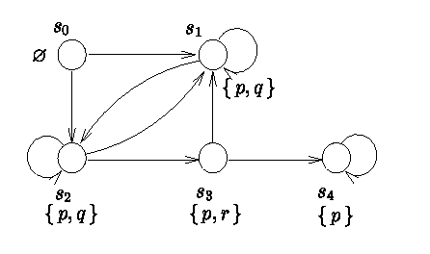
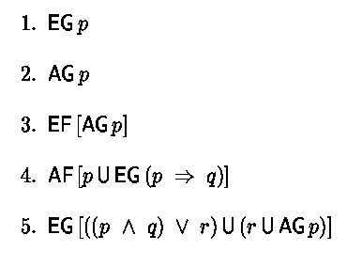
Exercise

Slide 40
Exercise

Slide 41
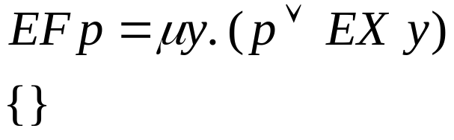
Exercise

Slide 42
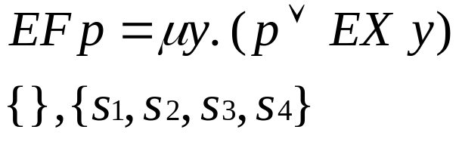
Exercise

Slide 43
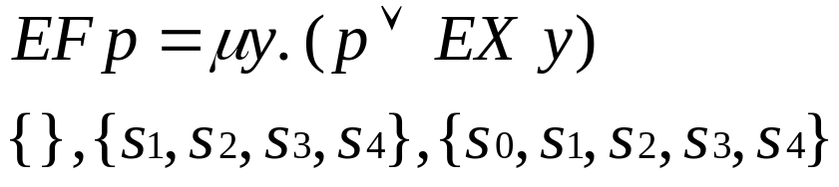
Exercise

Slide 44
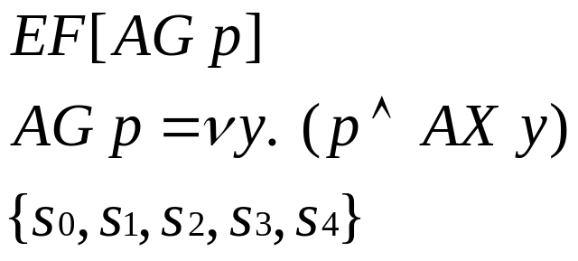
Exercise

Slide 45
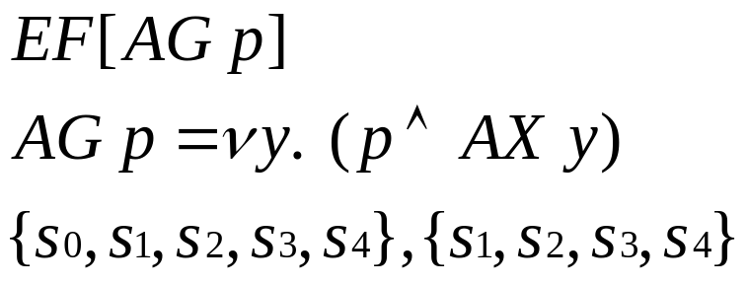
Exercise

Slide 46
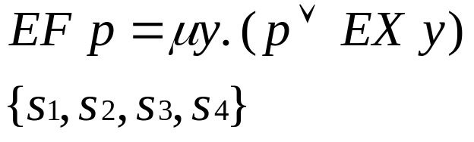
Exercise

Slide 47
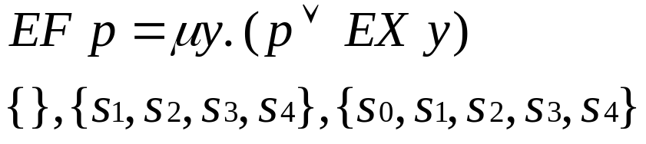
Exercise

Slide 48
Genealogy, cont.
Logics of
Programs
Temporal/
Modal Logics
Tarski
ω-automata
S1S
μ-calc
Park
60’s
CTL Model
Checking
ATV
LTL
MC
QBF
BDD
Bryant
mid 80’s
Symbolic
Model Checking
late 80’s
  Note first commercial application in 1990
    Encore Gigamax cache protocols

Slide 49
Applications
Hardware Design
  Encore Gigamax
  Intel instruction decoder
  SGI cache protocol chip
Other areas
  Avionics (TCAS)
  Chemical plant control
  Nuclear storage facilities (!)
Commercial tools
  Cadence, IBM, Synopsys

Slide 50
A convergence of research areas in logic
Many areas of logic have shaped the discourse in model checking
  Logics of programs
  Temporal/Modal logics
  Tarski fixed point theory
  Decidable logics -- S1S/automata
  Park’s mu-calculus
Much of this work is quite abstract, but has strongly influenced practical work in model checking

