Slide 1
Mid-term report
Hoàng Cao Huyền
v.huyenhoang@vinbrain.net

Slide 2
Classification problem
Segmentation problems
Architecture
Loss function
Some Techniques to improved results

Slide 3
Classification problem
Training pipleline
Dataset
Data
Train_loader
Test_loader
Val_loader
Model
Metric
Loss
Optimizer
Visualizer
Trainer
data
model
optimizer, metric, loss
visualize
….
train
Config file(config.py)
Dataset class
Model class
Loss function
Lr, epochs
…
evaluate
test

Slide 4
Classification problem
Model experiments
Configs:
Dataset: Cifar10 dataset CrossEntropy loss SGD Optimizer LRStep | Model | Parameters | Acc
 | CNN | 62006 | 0.4880
 | Resnet18 | 11,181,642 | 0.77
 | Resnet18-pretrained | 11,181,642 | 0.82
 | VGG16-pretrained | 134,301,514 | 0.88
 | Resnet50-pretrained | 25,567,042 | 0.85
 | Densenet121-pretrained | 6,964,106 | 0.82

Slide 5
Classification problem
Lr scheduler
Config: MenWomen Densenet121 Adam optimizer Img_size: 256 Batch_size: 16 - | Lr scheduler | Description | Result
 | StepLR |  | TODO
 | ReduceLROnPlateau
 | OneCycle
 | CosineAnnealingWarmStart

Slide 6
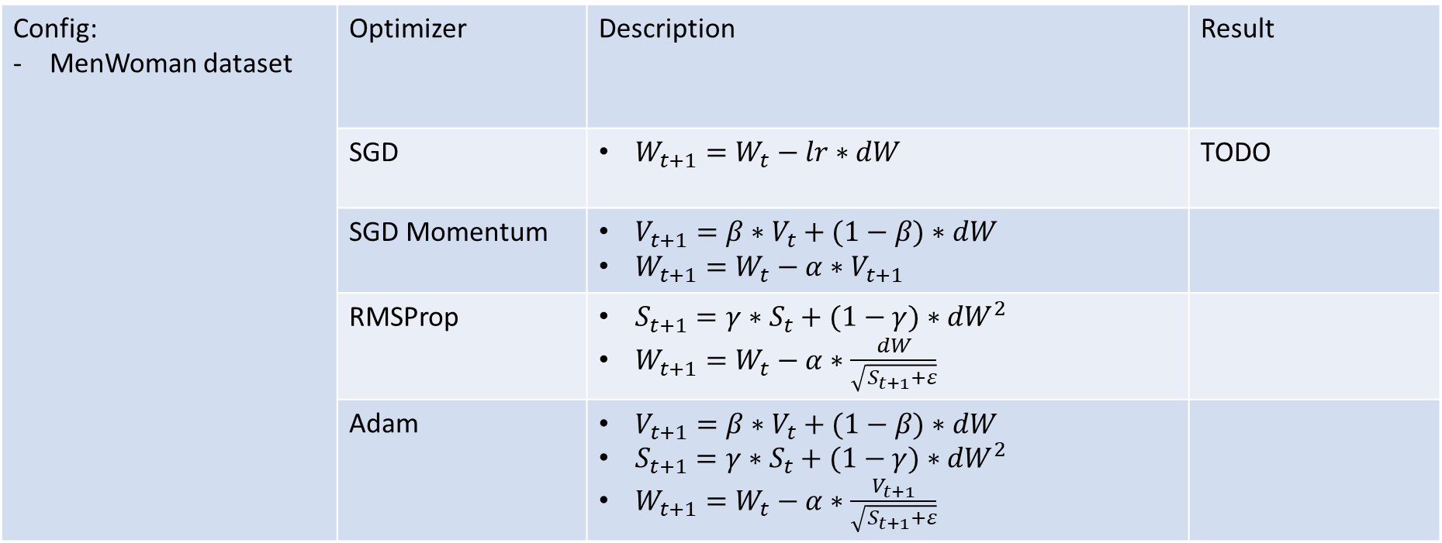
Classification problem
Optimizer
Config: MenWoman dataset | Optimizer | Description | Result
 | SGD | $W_{t+1}=W_{t}−lr∗dW$ | TODO
 | SGD Momentum | $V_{t+1}=β∗V_{t}+(1−β)∗dW$ $W_{t+1}=W_{t}−α∗V_{t+1}$
 | RMSProp | $S_{t+1}=γ∗S_{t}+(1−γ)∗{dW}^{2}$ $W_{t+1}=W_{t}−α∗\frac{dW}{\sqrt{S_{t+1}+ε}}$
 | Adam | $V_{t+1}=β∗V_{t}+(1−β)∗dW$ $S_{t+1}=γ∗S_{t}+(1−γ)∗{dW}^{2}$ $W_{t+1}=W_{t}−α∗\frac{V_{t+1}}{\sqrt{S_{t+1}+ε}}$

Slide 7
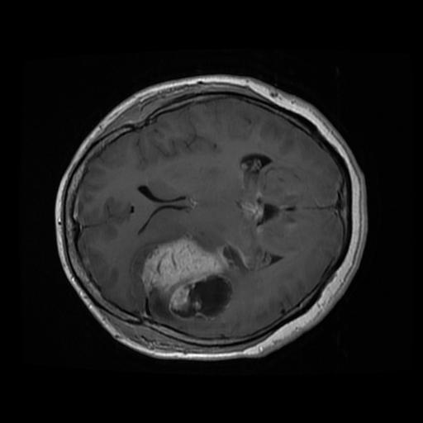

Segmentation problem
BrainTumor Dataset:
Training: 2144 images
Valid: 307 images
Testing: 613 images
No negative images

Slide 8
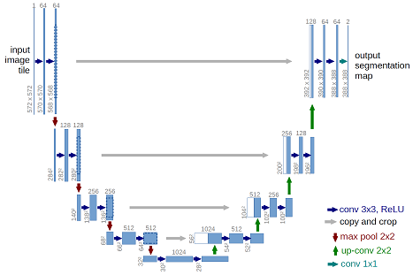
Classification problem
Architecture
- Unet

Slide 9
Classification problem
Architecture
Experiments
Config: BrainTumor Dataset Adam optimizer ReduceLROnPlateau-1e-4 Img_size: 256 Batch_size: 16 | Backbone | Result
 | VGG16 - VGG16 | 76.58
 | Resnet18 -Resnet18 | 78.19
 | Resnet18 - Dynamic unet | 77.87
 | Resnet18-VGG | 77.63
 | EfficientnetB0-VGG16 | 80.98

Slide 10
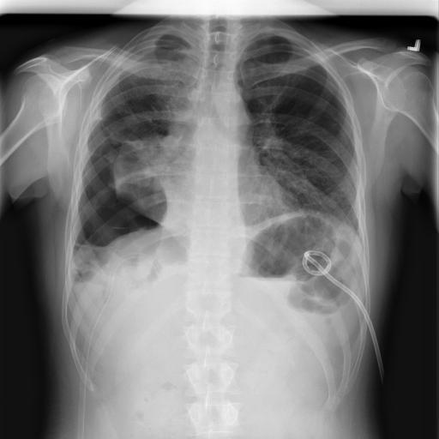

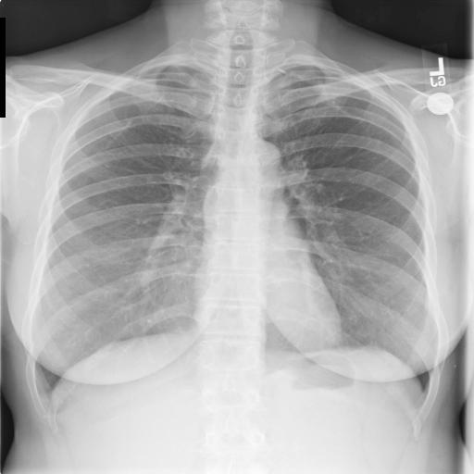

Classification problem
Pneumothorax Dataset - Imbalance data
- Training: 10672 images
- 2379 positive
8296 negative
Testing: 1372 images
- 290 positive
- 1082 negative
Training method:
First phases training with small positive rate
Next phases training with larger positive rate

Slide 11
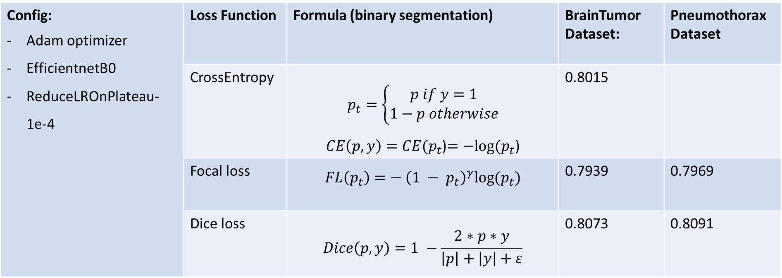
Segmentation problem
Loss function:
Config: Adam optimizer EfficientnetB0 ReduceLROnPlateau-1e-4 | Loss Function | Formula (binary segmentation) | BrainTumor Dataset: | Pneumothorax Dataset
 | CrossEntropy | $$p_{t}=\left\{\begin{aligned}p if y=1 \\ 1−p otherwise\end{aligned}\right.$$ $CE\left(p, y\right)=CE(p_{t}$)$=−log⁡(p_{t}$) | 0.8015
 | Focal loss | $$FL\left(p_{t}\right)=− {\left({1 − p}_{t}\right)}^{γ}log⁡(p_{t})$$ | 0.7939 | 0.7969
 | Dice loss | $$Dice\left(p, y\right)=1 −\frac{2∗p∗y}{\left|p\right|+\left|y\right|+ε}$$ | 0.8073 | 0.8091

Slide 12
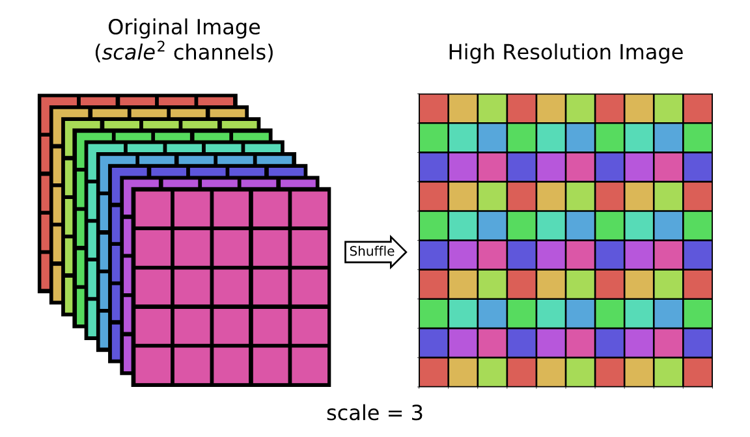
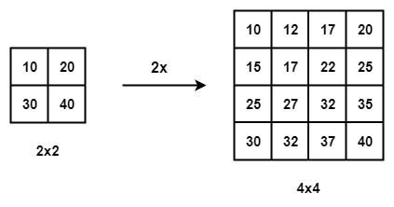
Segmentation problem
Segmentation problem
Some other techniques:
Bilinear upsampling
Pixel Shuffle
Model |  | Dice score
Resnet18-Resnet18 | Bilinear upsampling | 78.19
 | Pixel Shuffle | 80

Slide 13
Segmentation problem
Some other techniques:
Augmentation
Random flip, crop, blur, brightness
Model - backbone |  | Dice score
No augmentation | VGG16 | 78.57
 | Resnet18 | 79.59
 | densenet121 | 80.4
 | efficientnetB0 | 80.73
Augmentation | VGG16 | 78.49
 | Resnet18 | 82.24
 | densenet121 | 82.41
 | efficientnetB0 | 83.65

Slide 14
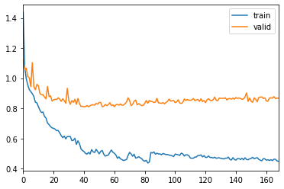
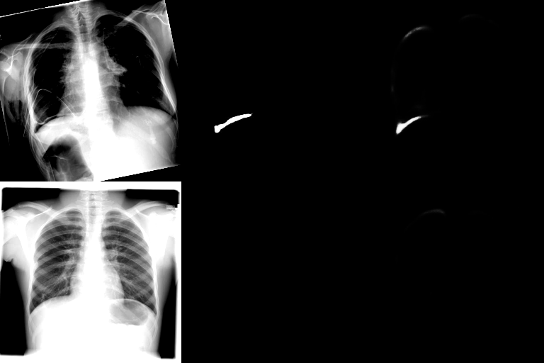
Segmentation problem
Segmentation problem
Visualize class
Visualuze learning curb
Visualize image

Slide 15
Classification problem
Next steps?
Attention
Other backbone

