Slide 1
Mid-term report
Experiments of the deep learning methods for the classification problem
Hoàng Cao Huyền
v.huyenhoang@vinbrain.net

Slide 2
Training pipeline
Dataset
Model
Optimizer, Loss, Metric
Experiments
Notes:
Số lượng class – distribution -

Slide 3
Training pipleline
Data
Train
Test
Val
Metric
Loss
Optimizer
Train:
Load train dataset
Train the model
Update lr_scheduler
Save loss, checkpoint, image
Config
Dataset class, argument
Metric class, argument
Model class, argument
Optimizer , argument
Lr scheduler , argument
Batch norm, num_epoch,…
Model
Trainer
Data
Net
Optimizer, loss, metric
lr-scheduler
visualizer
Dataset
evaluate
test
Visualizer

Slide 4
Parameters
Definition of data in Pytorch
Dataset – MenWoman example
Parameters
Configs
Function
Usage
path: path of data directory Folder structure: MenWoman |--men |--woman |--train.txt |--test.txt - transform: transformer apply for each images mode: String - value in ["train", "test"]
__init__(self, path, classes, transform , mode initialize variables load images, labels from data folder __len__(self):return length of dataset __getitem__(self, idx): image, label from given index apply transform to image
dataset = { "class":MenWomanDataset, "argument":{ "path":"/content/data" }
DatasetClass = configs.dataset["class"] args = configs.dataset["dataset_args"] dataset = DatasetClass(**args)

Slide 5
Parameters
Definition of data in Pytorch
Data
Parameters
Configs
Function
Usage
configs: dataset_configs: using for defining datasets split_train_val: ratio to split train-val Batch_size: using for show batch
__init__(self, configs): Define train_dataset, test_dataset Split train,valid dataset show_batch(self, mode , num_images , _class ): Show image follow batch or num_images Show image each _class caculate_num_per_labels(self, mode)
dataset = { "class":MenWomanDataset, "argument":{ "path":"/content/data" } Batch_size = 16 split_train_val = 0.7
data = Data(configs)

Slide 6
Parameters
Definition of the model class in Pytorch
New model
Parameter
Configs
Usage
Model class example
Parameters define models as input_channel, output_channel;
class CNN(nn.Module): def __init__(self, input_channel, output_channel): super(CNN, self).__init__() self.conv1 = nn.Conv2d(input_channel, 6, 5) self.pool = nn.MaxPool2d(2, 2) self.conv2 = nn.Conv2d(6, 16, 5) self.fc1 = nn.Linear(16*5*5, 120) self.fc2 = nn.Linear(120, 84) self.fc3 = nn.Linear(84, output_channel) def forward(self, x): x = self.pool(F.relu(self.conv1(x))) x = self.pool(F.relu(self.conv2(x))) x = x.view(-1, 16*5*5) x = F.relu(self.fc1(x)) x = F.relu(self.fc2(x)) x = self.fc3(x) return x
net = { "class":CNN, "net_args":{ "input_channel":3 } }
net_class = configs.net["class"] net_args = configs.net["net_args"] self.net = net_class(**net_args)

Slide 7
Classification problem
Parameters
Definition of the model calss in Pytorch
Transfer model
Parameters
Configs
Idea
model_base: base model to load Pretrained: using pretrained model or not fc_channel: channel of fully connected layes num_classes
Input image
Base model
(remove last layers)
from model.CNN import TransferNet from torchvision.models import resnet18 net = { "class": TransferNet, "net_args":{ "model_base": resnet50, "fc_channels":[1024], "pretrain": True, "num_classes":10 } }
Fully connected layers
output

Slide 8
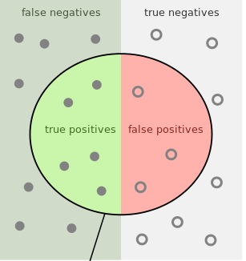
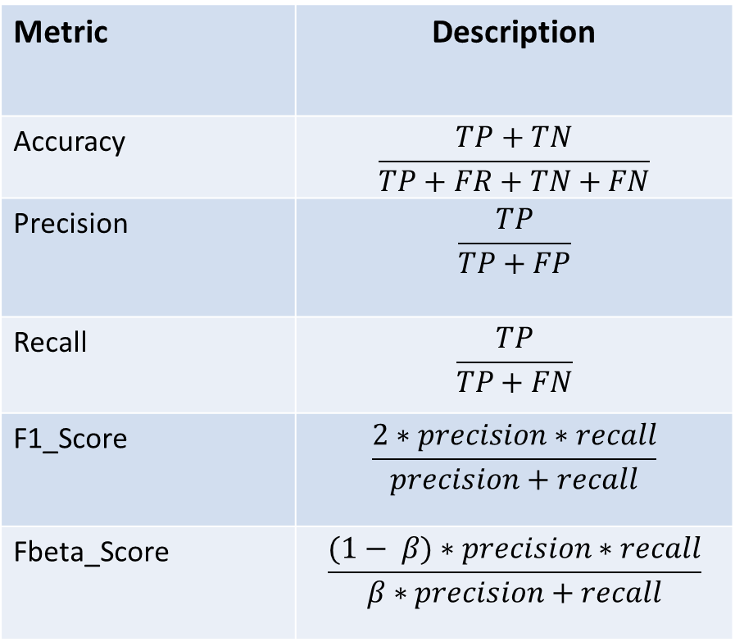
Metrics for the classification problem
Metric | Description
Accuracy | $$\frac{TP+TN}{TP+FR+TN+FN}$$
Precision | $$\frac{TP}{TP+FP}$$
Recall | $$\frac{TP}{TP+FN}$$
F1_Score | $$\frac{2∗precision∗recall}{precision+recall}$$
Fbeta_Score | $$\frac{(1− β)∗precision∗recall}{β∗precision+recall}$$
metric = { "class":Accuracy, "metric_args":{ "threshold": 0.5, "from_logits":True } }

Slide 9
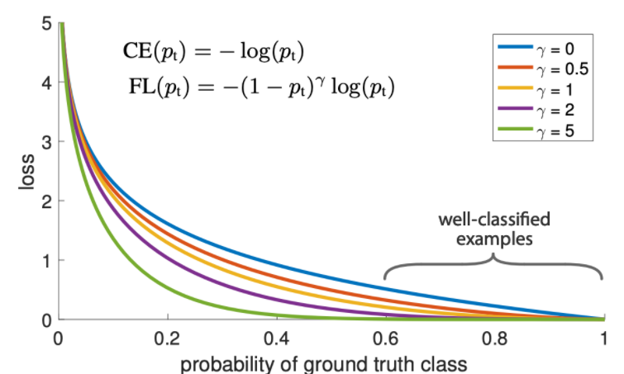
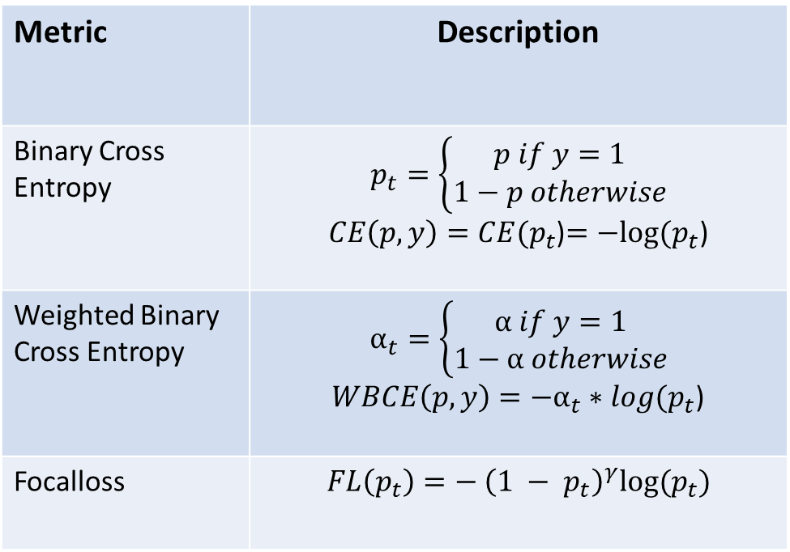
Loss function for the classification problem
Metric | Description
Binary Cross Entropy | $$p_{t}=\left\{\begin{aligned}p if y=1 \\ 1−p otherwise\end{aligned}\right.$$ $CE\left(p, y\right)=CE(p_{t}$)$=−log⁡(p_{t}$)
Weighted Binary Cross Entropy | $$α_{t}=\left\{\begin{aligned}α if y=1 \\ 1−α otherwise\end{aligned}\right.$$ $WBCE\left(p, y\right)=−α_{t}∗log⁡(p_{t}$)
Focalloss | $$FL\left(p_{t}\right)=− {\left({1 − p}_{t}\right)}^{γ}log⁡(p_{t})$$
loss_function = { "class": nn.BCEWithLogitsLoss, "loss_args":{ } }

Slide 10
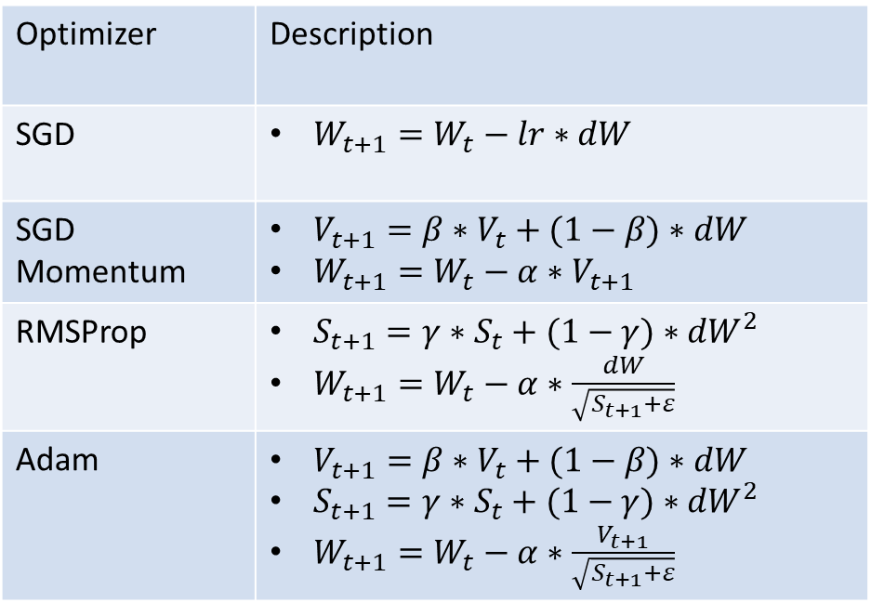
Optimizer for the classification problem
Optimizer
Optimizer | Description
SGD | $W_{t+1}=W_{t}−lr∗dW$
SGD Momentum | $V_{t+1}=β∗V_{t}+(1−β)∗dW$ $W_{t+1}=W_{t}−α∗V_{t+1}$
RMSProp | $S_{t+1}=γ∗S_{t}+(1−γ)∗{dW}^{2}$ $W_{t+1}=W_{t}−α∗\frac{dW}{\sqrt{S_{t+1}+ε}}$
Adam | $V_{t+1}=β∗V_{t}+(1−β)∗dW$ $S_{t+1}=γ∗S_{t}+(1−γ)∗{dW}^{2}$ $W_{t+1}=W_{t}−α∗\frac{V_{t+1}}{\sqrt{S_{t+1}+ε}}$
optimizer ={ "class": SGD, "optimizer_args":{ "momentum":0.9 } }

Slide 11
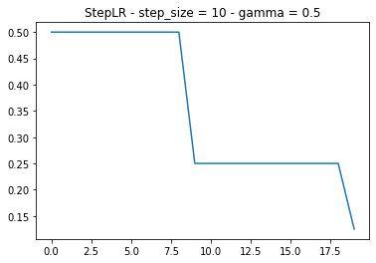
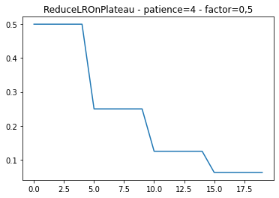
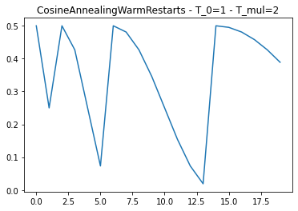
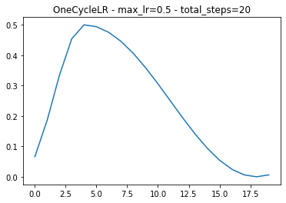
Optimizer for the classification problem
Learning rate scheduler
Target:
Update learning rate in training process to improve result

Slide 12
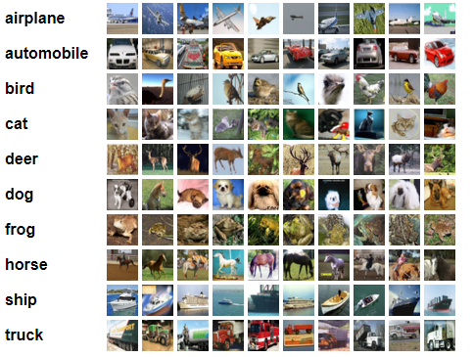
Experiments
Cifar10 dataset
Numer class |  | 10
Train | Number images per class | 3500
 | Numer image | 35000
Valid | Number images per class | 1500
 | Numer image | 15000
Test | Number images per class | 100
 | Numer image | 1000

Slide 13


Classification problem
MenWomen dataset
Numer class |  | 2
Train 2397 images | Men | 1017 (0.42%)
 | Woman | 1380 (0.57%)
Valid 600 images | Men | 255 (0.42%)
 | Woman | 345 (0.57%)
Test | Men | 146 (0.43%)
 | Woman | 187 (0.56%)

Slide 14
Experiments with different models
Configs - Dataset: Cifar10 - CrossEntropy loss - SGD Optimizer - LRStep | Models | Parameters | Acc
 | CNN | 62,006 | 0.49
 | Resnet18 | 11,181,642 | 0.77
 | Resnet18-pretrained | 11,181,642 | 0.82
 | VGG16-pretrained | 134,301,514 | 0.88
 | Resnet50-pretrained | 25,567,042 | 0.85
 | Densenet121-pretrained | 6,964,106 | 0.82
Configs - Dataset: Cifar10 - CrossEntropy loss - SGD Optimizer - LRStep | Models | Parameters | Acc
 | CNN | 62,006 | 0.49
 | Resnet18 | 11,181,642 | 0.77
 | Resnet18-pretrained | 11,181,642 | 0.82
 | VGG16-pretrained | 134,301,514 | 0.88
 | Resnet50-pretrained | 25,567,042 | 0.85
 | Densenet121-pretrained | 6,964,106 | 0.82
Comments:
Using pretrained models has better result
Deeper networks is better
Residual blocks and dense blocks improve result with small parameters

Slide 15
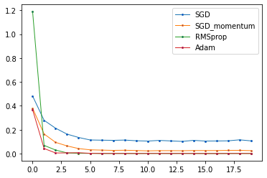
Experiments with different optimizers
Config: MenWoman dataset Densenet121 BCE loss Lr: 1e-4 StepLR Scheduler Epochs: 20 Batchsize:64 Kfold: 5 | Optimizer | Result
 | SGD | 0.9012
 | SGD Momentum | 0.9215
 | RMSProp | 0.9351
 | Adam | 0.9467

Slide 16
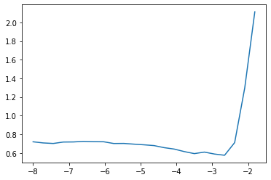
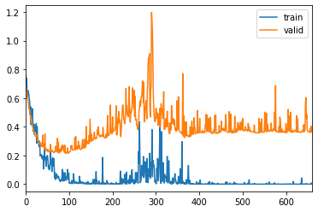
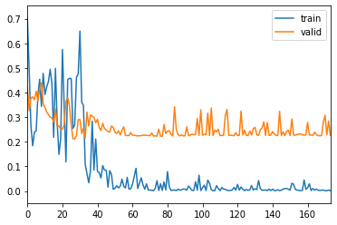
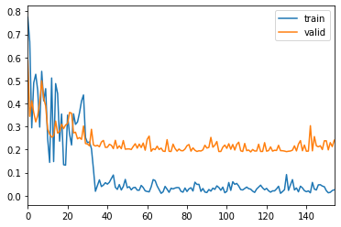
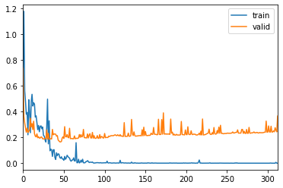
Experiments with different lr-scheduler
Config: MenWomen Densenet121 Adam optimizer BCE Loss Img_size: 256 Batch_size: 16 - LR: 1e-4 | Lr scheduler | Result
 | StepLR | 0.9505
 | ReduceLROnPlateau | 0.9507
 | OneCycle | 0.9403
 | CosineAnnealingWarmStart | 0.9351
OneCycle
CosineAnnealingWarmStart
ReduceLROnPlateau
StepLR

Slide 17
Future plan
Extend to Segmentation problem
Augmentation
Attention
…

