Slide 1
Mid-term report
Hoàng Cao Huyền
v.huyenhoang@vinbrain.net

Slide 2
Classification problem
Dataset
Model
Optimizer
Loss, Metric
Experiments
Notes:
Số lượng class – distribution -

Slide 3
Classification problem
Training pipleline
Data
Train
Test
Val
Metric
Loss
Optimizer
Train:
Load train dataset
Trainining
Update lr_scheduler
Save loss, checkpoint, image
Config
Dataset class, argument
Metric class , argument
Model class , argument
Lr scheduler
Batch norm, num_epoch,…
Model
Trainer
Data
Net
Optimizer, loss, metric
lr-scheduler
visualizer
Dataset
evaluate
test
Visualizer

Slide 4
Classification problem
Parameters
Data
Parameter:
Function
configs.dataset = { "class":MenWomanDataset, "argument":{ "path":"/content/data" }
Init(): Initial train, test dataset Split train, valid dataset Initial train,valid, test dataloader show_batch() split_train_val()

Slide 5
Classification problem
Parameters
Classification problem
Model
New model
Config
class CNN(nn.Module): def __init__(self, img_size = 32): super(CNN, self).__init__() self.conv1 = nn.Conv2d(3, 6, 5) self.pool = nn.MaxPool2d(2, 2) self.conv2 = nn.Conv2d(6, 16, 5) self.fc1 = nn.Linear(16*5*5, 120) self.fc2 = nn.Linear(120, 84) self.fc3 = nn.Linear(84, 10) def forward(self, x): x = self.pool(F.relu(self.conv1(x))) x = self.pool(F.relu(self.conv2(x))) x = x.view(-1, 16*5*5) x = F.relu(self.fc1(x)) x = F.relu(self.fc2(x)) x = self.fc3(x) return x
net = { "class":CNN, "net_args":{ "img_size":32 } }

Slide 6
Classification problem
Parameters
Classification problem
Model
Transfer model
Get layers from base model
Set required_grad parameters
Add fully connected layers
Define forward method
Config
from model.CNN import CNN, TransferNet from torchvision.models import resnet18 net = { "class": TransferNet, "net_args":{ "model_base": resnet50, "fc_channels":[1024], "pretrain": True, "num_classes":10 } }

Slide 7
Classification problem
Metric
class Accuracy: def __init__(self, threshold = 0.5, from_logits): self.threshold = threshold self.from_logis = from_logits def __call__(self, y_pred, y_true): if self.from_logis: y_pred, y_true = self._conversion(y_pred, y_true, self.threshold) return torch.mean((y_pred == y_true).float()) def _conversion(self, y_pred, y_true, threshold): if len(y_pred.shape) == len(y_true.shape) + 1: y_pred = torch.argmax(y_pred, dim = 1) if len(y_pred.shape) == len(y_true.shape) and y_pred.dtype == torch.float: y_pred = (y_pred > threshold).float() return y_pred, y_true
metric = { "class":Accuracy, "metric_args":{ "threshold": 0.5, "from_logits":True } }

Slide 8
Classification problem
Loss function, optimizer, lr_scheduler
optimizer ={ "class": SGD, "optimizer_args":{ "momentum":0.9 } }
loss_function = { "class": nn.BCEWithLogitsLoss, "loss_args":{ } }
lr_schedule = { "class": StepLR, "metric":None, "step_type":"epoch", "schedule_args":{ "step_size":5, "gamma":0.1, } }

Slide 9
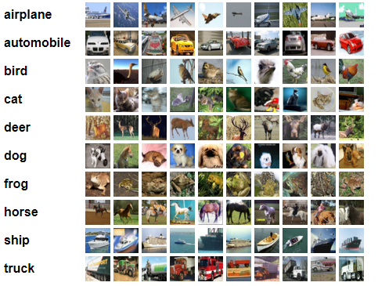
Classification problem
Experiments
Cifar10 dataset
Numer class |  | 10
Train | Number images per class | 3500
 | Numer image | 35000
Valid | Number images per class | 1500
 | Numer image | 15000
Test | Number images per class | 100
 | Numer image | 1000

Slide 10
Classification problem
Experiments
Model
Dataset: Cifar10 dataset CrossEntropy loss SGD Optimizer LRStep | Model | Parameters | Acc
 | CNN | 62006 | 0.4880
 | Resnet18 | 11,181,642 | 0.77
 | Resnet18-pretrained | 11,181,642 | 0.82
 | VGG16-pretrained | 134,301,514 | 0.88
 | Resnet50-pretrained | 25,567,042 | 0.85
 | Densenet121-pretrained | 6,964,106 | 0.82

Slide 11


Classification problem
Experiments
MenWomen dataset
Numer class |  | 2
Train 2097 images | Men | 890 (0.42%)
 | Woman | 1207 (0.57%)
Valid 900 images | Number images per class | 518 (0.42%)
 | Numer image | 382 (0.57%)
Test | Number images per class | 146 (0.43%)
 | Numer image | 187 (0.56%)

Slide 12
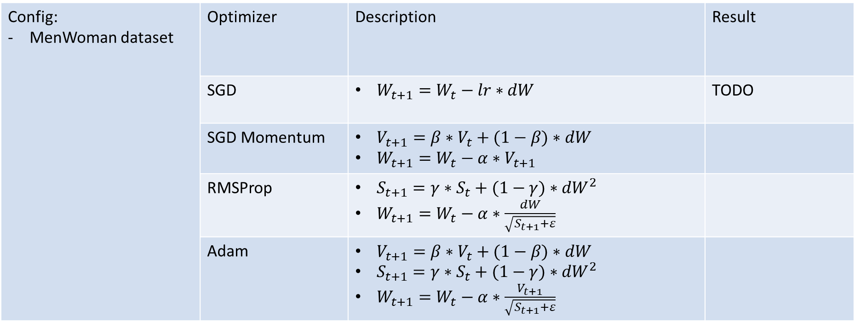
Classification problem
Experiments
Optimimzer
Config: MenWoman dataset | Optimizer | Description | Result
 | SGD | $W_{t+1}=W_{t}−lr∗dW$ | TODO
 | SGD Momentum | $V_{t+1}=β∗V_{t}+(1−β)∗dW$ $W_{t+1}=W_{t}−α∗V_{t+1}$
 | RMSProp | $S_{t+1}=γ∗S_{t}+(1−γ)∗{dW}^{2}$ $W_{t+1}=W_{t}−α∗\frac{dW}{\sqrt{S_{t+1}+ε}}$
 | Adam | $V_{t+1}=β∗V_{t}+(1−β)∗dW$ $S_{t+1}=γ∗S_{t}+(1−γ)∗{dW}^{2}$ $W_{t+1}=W_{t}−α∗\frac{V_{t+1}}{\sqrt{S_{t+1}+ε}}$

Slide 13

Classification problem
Experiments
Loss function
Config: MenWoman dataset | Optimizer | Description | Result
 | SGD | $W_{t+1}=W_{t}−lr∗dW$ | TODO
 | SGD Momentum | $V_{t+1}=β∗V_{t}+(1−β)∗dW$ $W_{t+1}=W_{t}−α∗V_{t+1}$
 | RMSProp | $S_{t+1}=γ∗S_{t}+(1−γ)∗{dW}^{2}$ $W_{t+1}=W_{t}−α∗\frac{dW}{\sqrt{S_{t+1}+ε}}$
 | Adam | $V_{t+1}=β∗V_{t}+(1−β)∗dW$ $S_{t+1}=γ∗S_{t}+(1−γ)∗{dW}^{2}$ $W_{t+1}=W_{t}−α∗\frac{V_{t+1}}{\sqrt{S_{t+1}+ε}}$

Slide 14
Classification problem
Experiments
Lr scheduler
Config: MenWomen Densenet121 Adam optimizer Img_size: 256 Batch_size: 16 - | Lr scheduler | Description | Result
 | StepLR |  | TODO
 | ReduceLROnPlateau
 | OneCycle
 | CosineAnnealingWarmStart

