Slide 1
DCTwin — Measured Results
Physics-based digital twin · safe weekly cooling optimization · live learning loop
Six consecutive weeks planned, safety-gated, deployed and measured — savings ramp 0 → 3.6% while every rack inlet stayed under the 26 °C cap.
Progress report v1 — June 2026

Slide 2
Headline results
Nov 8 – Dec 13 2024 planning weeks · all numbers measured
6 weeks
3.6%
0
consecutive weekly cycles: plan → safety-gate → expert approve → deploy → measure → learn
cooling-energy saving vs the as-operated baseline (week 6) — released stepwise by the safety gate
inlet-temperature violations across ALL deployed weeks — worst realised inlet 25.6 °C vs the 26 °C cap
0.1%
σ ↓ 86%
≤ 0.2 °C
twin prediction error on weekly energy by week 6 (was 1.33% in week 1 — calibration loop learning)
inlet-prediction uncertainty: 1.0 °C prior → 0.14 °C measured after six calibration weeks
inlet temperature prediction error every week — the safety-critical variable is the best-predicted one

Slide 3
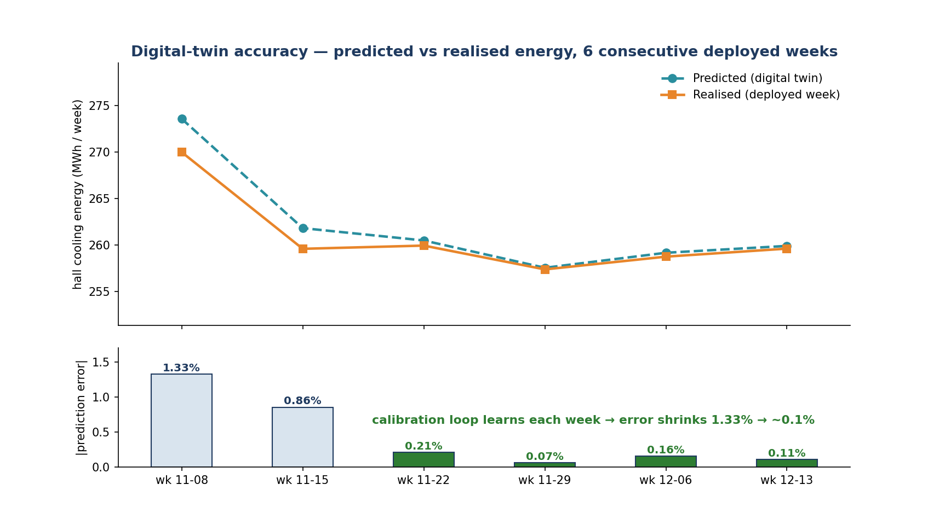
Result 1 — the twin predicts reality
Twin fidelity (measured)
Predicted vs realised weekly cooling energy. The residual learning loop drives prediction error from 1.33% to ~0.1% in six weeks.

Slide 4
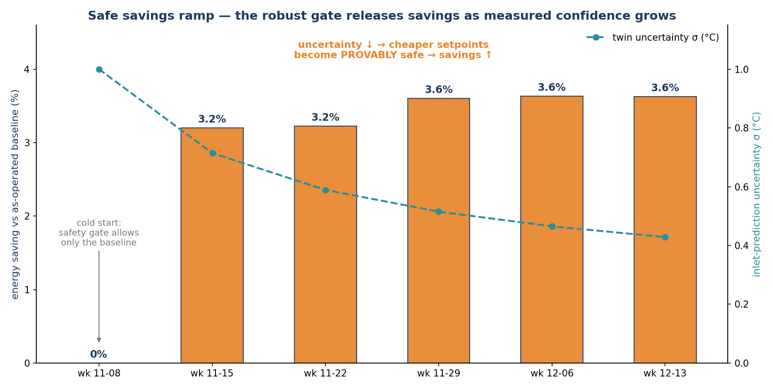
Result 2 — savings ramp, released by the safety gate
Energy savings (measured)
The robust gate only recommends savings it can PROVE safe under plant uncertainty. As measured uncertainty shrinks, provably-safe savings grow: 0 → 3.6%.

Slide 5
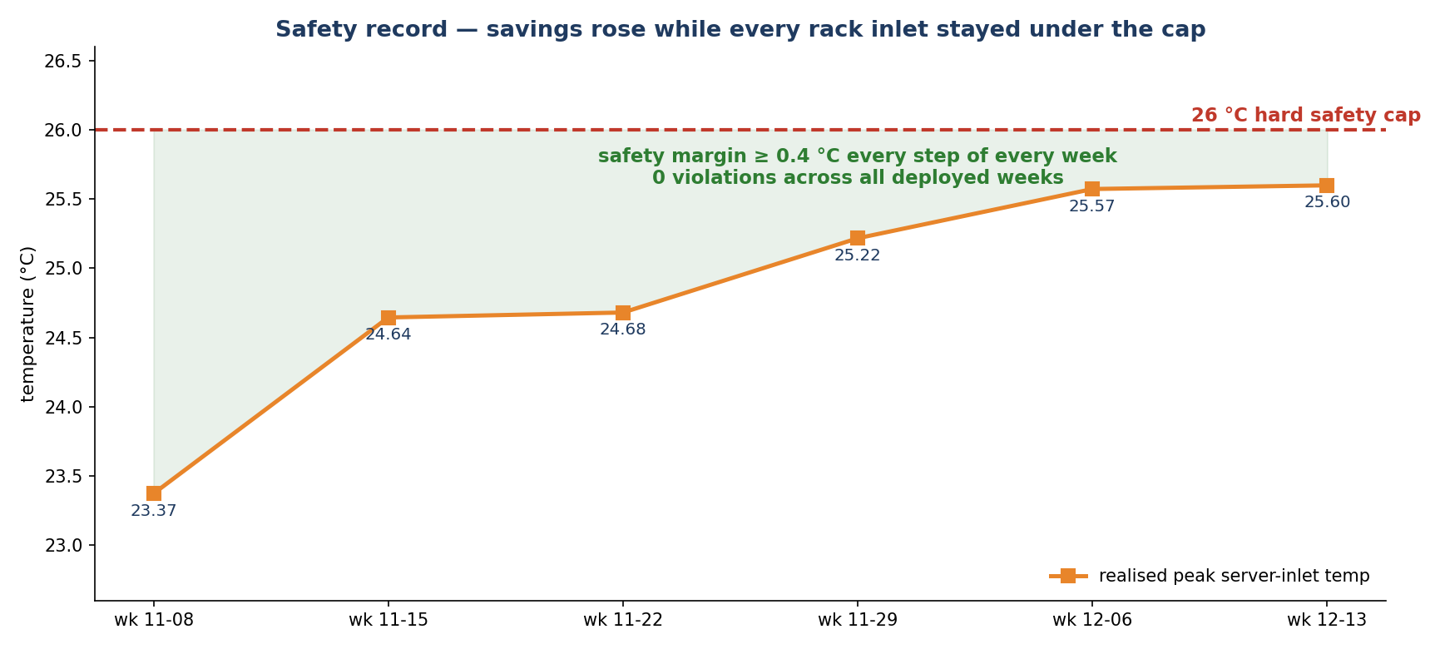
Result 3 — zero safety violations
Safety record (measured)
Realised peak server-inlet temperature per deployed week. Savings rose while the hard 26 °C cap was never breached — margin ≥ 0.4 °C at the worst step.

Slide 6
How these numbers are produced
The dual-loop framework (recap)
• Inner loop — planning in physics:
– EnergyPlus 9.5 (first-principles building physics) scores every candidate setpoint with a full-week simulation; a beam search finds the cheapest SAFE setpoints (CRAH supply temp · airflow · chilled-water temp → 45 actuators).
• Safety: three independent nets, uncertainty hedged exactly once:
– hard inlet ≤ 26 °C cap in the search · a robust re-check on deliberately degraded plants (worst-case must hold the cap) · a zero-tolerance deploy backstop.
• Outer loop — deploy & learn:
– expert approves → the week runs → realised KPIs feed a calibration that shrinks bias AND uncertainty → the gate releases more savings the next week. This is the ramp in Result 2.
• Honest scope: 'realised' currently comes from a perturbed-plant simulation stand-in (the BMS connector is the next milestone) — the loop, gates and learning are fully exercised end-to-end.

Slide 7
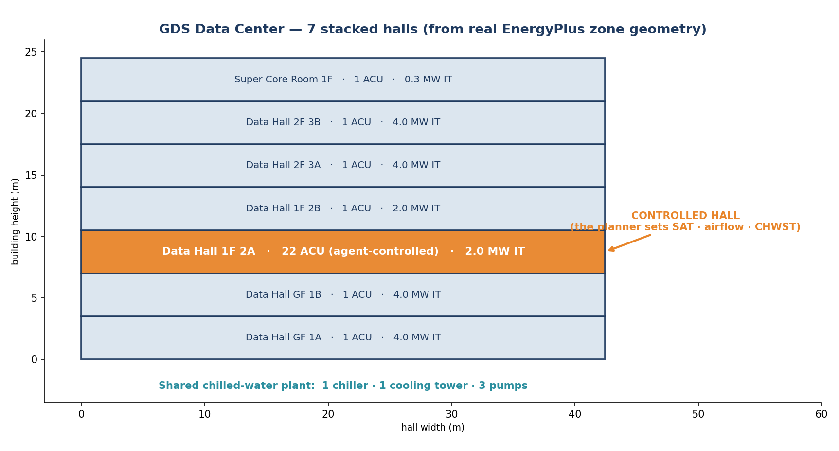
The plant being optimized
Physical model
From the real EnergyPlus model: 7 stacked halls; the controlled hall (1F 2A) has 22 agent-controlled CRAHs and 2.0 MW of IT load; one shared chilled-water plant.

Slide 8
Why the optimization is trustworthy
Verified physics, measured uncertainty
• Well-posed physics (verified by sweep): airflow moves hall cooling energy by 15.5%, chilled-water temp by 3.4% — the search has a real, physical gradient (it was 0.07% before this was fixed).
• The energy optimum sits on a thermal cliff — and the gate sees it:
– minimum airflow + warm chilled water is cheapest but fragile: a 7%-degraded plant pushes inlets past 26 °C. The robust gate measures this on real worst-case simulations and substitutes the cheapest PROVABLY-safe alternative.
• Uncertainty is measurement-driven, never guessed:
– the worst-case ensemble width scales with measured prediction error (empirical-Bayes posterior, floored at a physical ±2% weekly drift bound) — confidence must be earned by deployed weeks.
• 311 automated tests (unit + real-EnergyPlus integration); every safety layer is regression-tested.

Slide 9
Engineering since the 3rd draft
What enabled the results
• Fixed the robust gate's uncertainty accounting (it double-hedged and deadlocked at cold start — no plan could ever be approved). Savings are now released stepwise, safely.
• Safety-ladder substitution: when the optimum is fragile, the planner recommends the cheapest robust alternative along the CHEAP axis (chilled-water first ~3% energy span, airflow last ~15%) instead of blocking.
• Operator planning context in the web app: past + forecast IT-load and weather, previous-week setpoints — visible before launching a plan.
• Operational hardening: hung-run watchdogs (recovery in minutes, not hours), duplicate-deploy protection, cancel/delete, live progress streaming.
• Full review + reproducible agent test harness committed alongside the code.

Slide 10
Limitations & next step
Honest scope
• Realised data is simulation-stand-in (perturbed plant), not yet building telemetry — the learning loop is proven end-to-end, its inputs are not yet field data.
• Rack-inlet recirculation is calibrated to an assumption (10%), not measured rack sensors — the safety margin is conservative by construction until calibrated.
• Weather uses the matched historical file, not a forecast; week-to-week IT load is nearly flat in this hall (~1.3%), so weather dominates.
• Next milestone (Tier A): connect the BMS —
– shadow mode first (recommend-only, compare against real telemetry for several weeks), then close the loop. The deployment seam is a single adapter call; approval gates, realised-KPI capture and calibration ingest are already built and tested.

Slide 11
Summary
• Six consecutive measured weeks: the physics twin predicts weekly cooling energy to ~0.1% and the safety-critical inlet temperature to ≤0.2 °C.
• Savings ramped 0 → 3.6% — released by the robust gate exactly as fast as measured confidence allowed, never faster.
• Zero safety violations: every rack inlet under the 26 °C cap, every step, every week.
• The framework is ready for its real-world test: shadow-mode connection to the building management system.

