Slide 1
DCTwin — Digital Twin Dual-Loop Control
4th draft · full technical & operational report
Physics-based weekly cooling optimization, measured over six deployed weeks: savings 0 → 3.6% · prediction error 1.33% → 0.1% · zero safety violations
June 2026

Slide 2
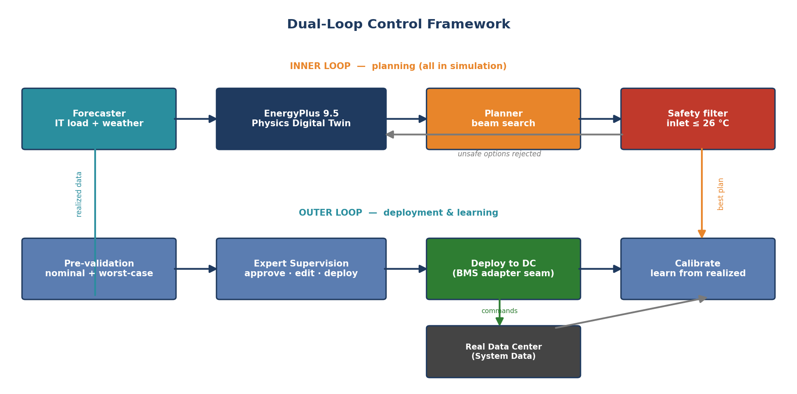
The framework — two nested loops
Matches the original optimization-plan diagram box-for-box
Inner loop: forecast → EnergyPlus physics → beam search → safety filter. Outer loop: pre-validation → expert gate → (shadow) deploy → measure → learn.

Slide 3
Headline results (all measured)
Weeks of 2024-11-08 … 12-13
6 weeks
3.6%
0
consecutive cycles: plan → gate → approve → shadow-deploy → measure → learn
energy saving vs as-operated baseline, released stepwise by the safety gate
inlet violations — worst realised inlet 25.60 °C vs the 26 °C hard cap
0.1%
≤0.2 °C
526
twin weekly-energy prediction error by week 6 (1.33% in week 1 — calibration learning)
inlet prediction error every week — the safety variable is best-predicted
automated tests green (422 backend + 104 frontend) · 21 API endpoints · 7 UI pages

Slide 4
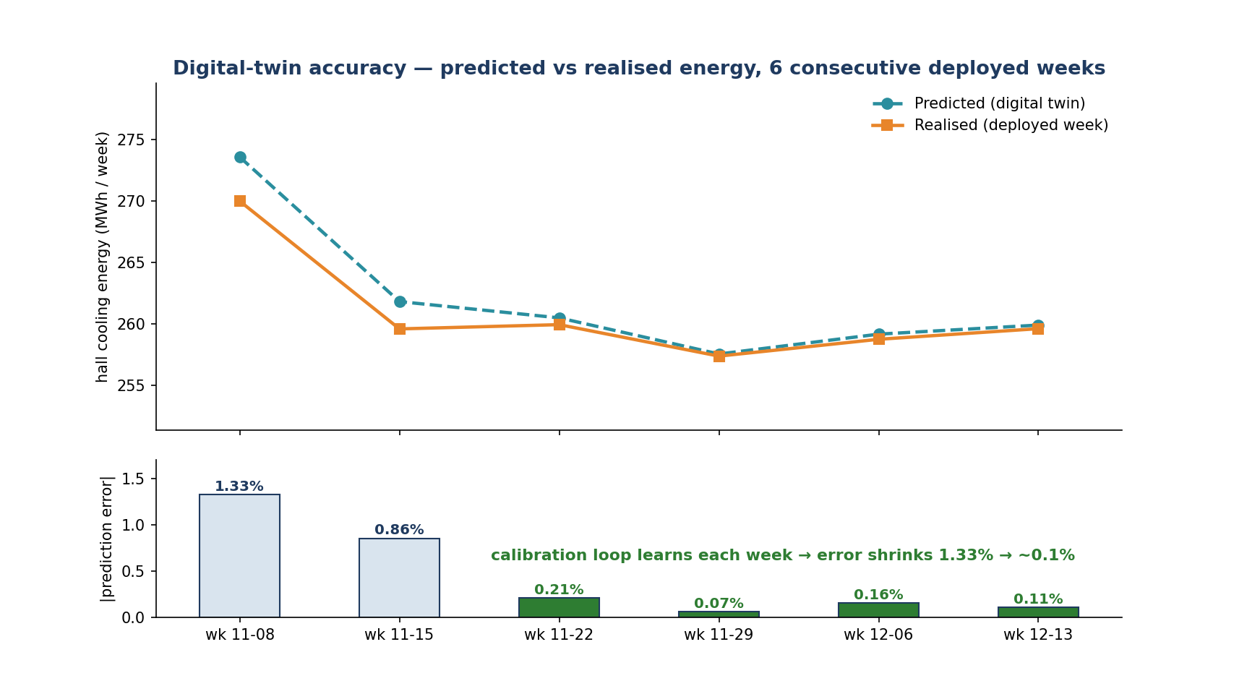
Result 1 — the twin predicts reality
Measured
Predicted vs realised weekly cooling energy; the residual calibration loop drives error 1.33% → ~0.1%.

Slide 5
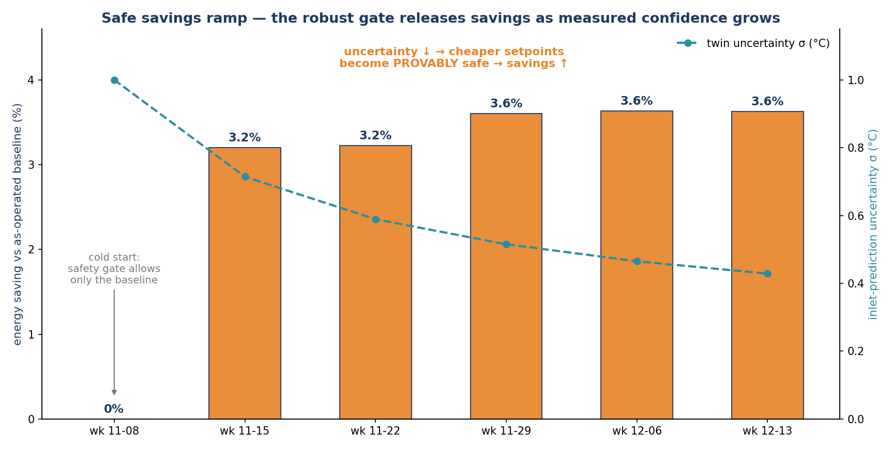
Result 2 — savings released by earned confidence
Measured
The robust gate only passes savings it can PROVE safe; as measured uncertainty σ falls, provably-safe savings rise 0 → 3.6%.

Slide 6
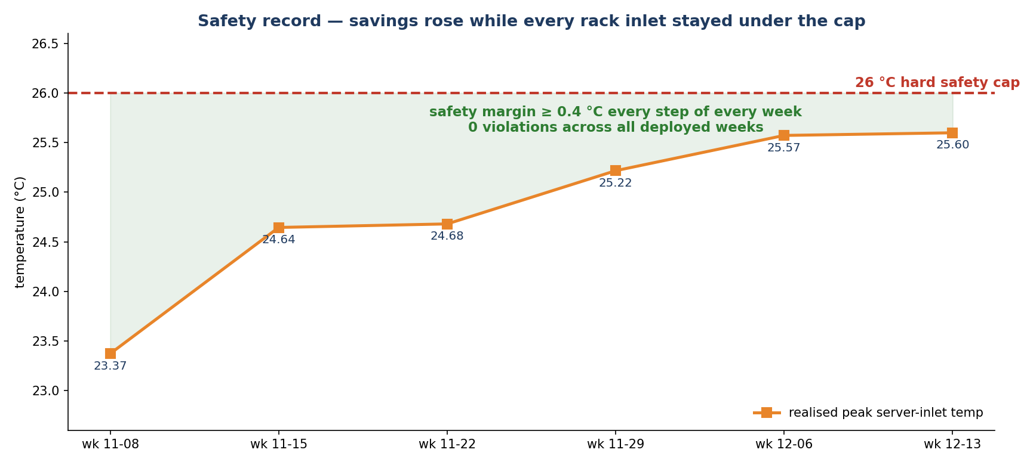
Result 3 — zero violations while saving
Measured
Realised peak inlet per week: rising toward — never past — the cap as the gate spends margin only when confidence allows.

Slide 7
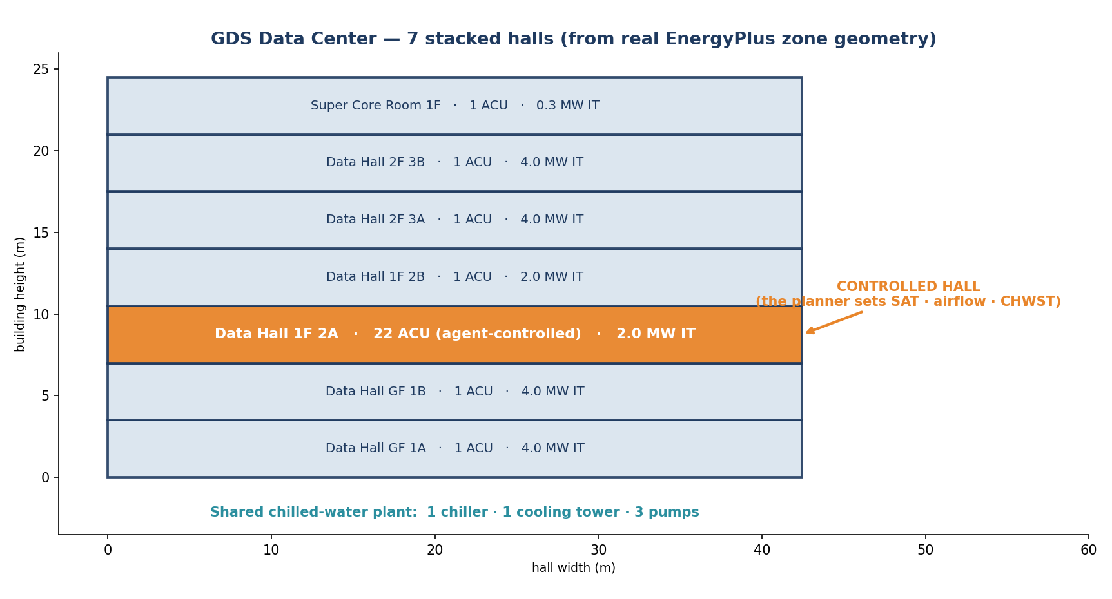
The plant — from the real EnergyPlus model
Physical model
7 stacked halls; controlled hall 1F 2A: 22 agent-controlled CRAHs, 2.0 MW IT; one shared chilled-water plant.

Slide 8
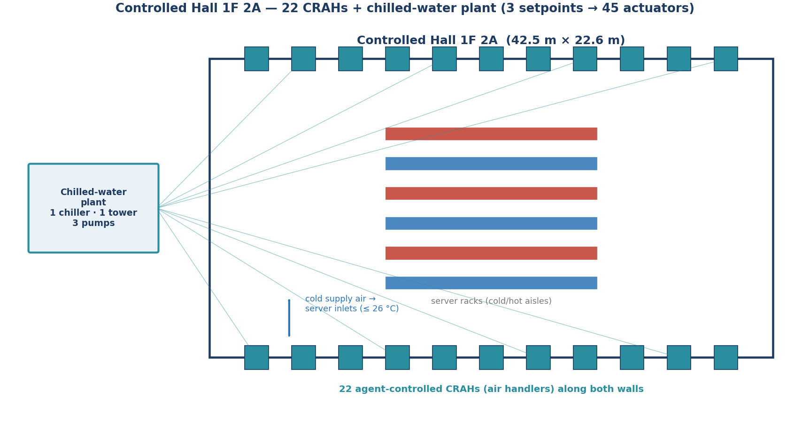
Controlled hall detail — 3 setpoints → 45 actuators
Physical model
CRAH supply-air temperature (20–26 °C) · airflow (4.8–13.8 kg/s) · chilled-water supply temperature (13–19 °C), broadcast to 22+22+1 actuators.

Slide 9
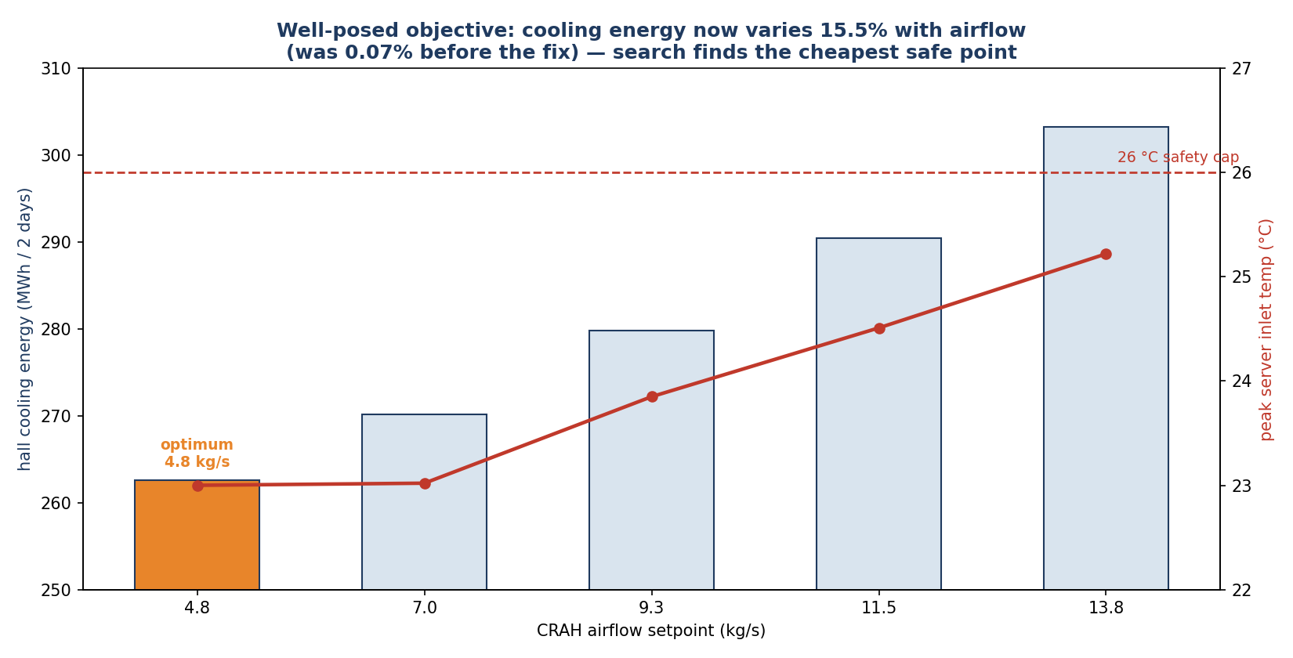
Why the optimization is well-posed (verified by sweep)
Validation
Real-E+ sweeps: airflow moves hall energy 15.5%, CHWST 3.4%, SAT ~0.5% — a true physical gradient with the safety cap binding.

Slide 10
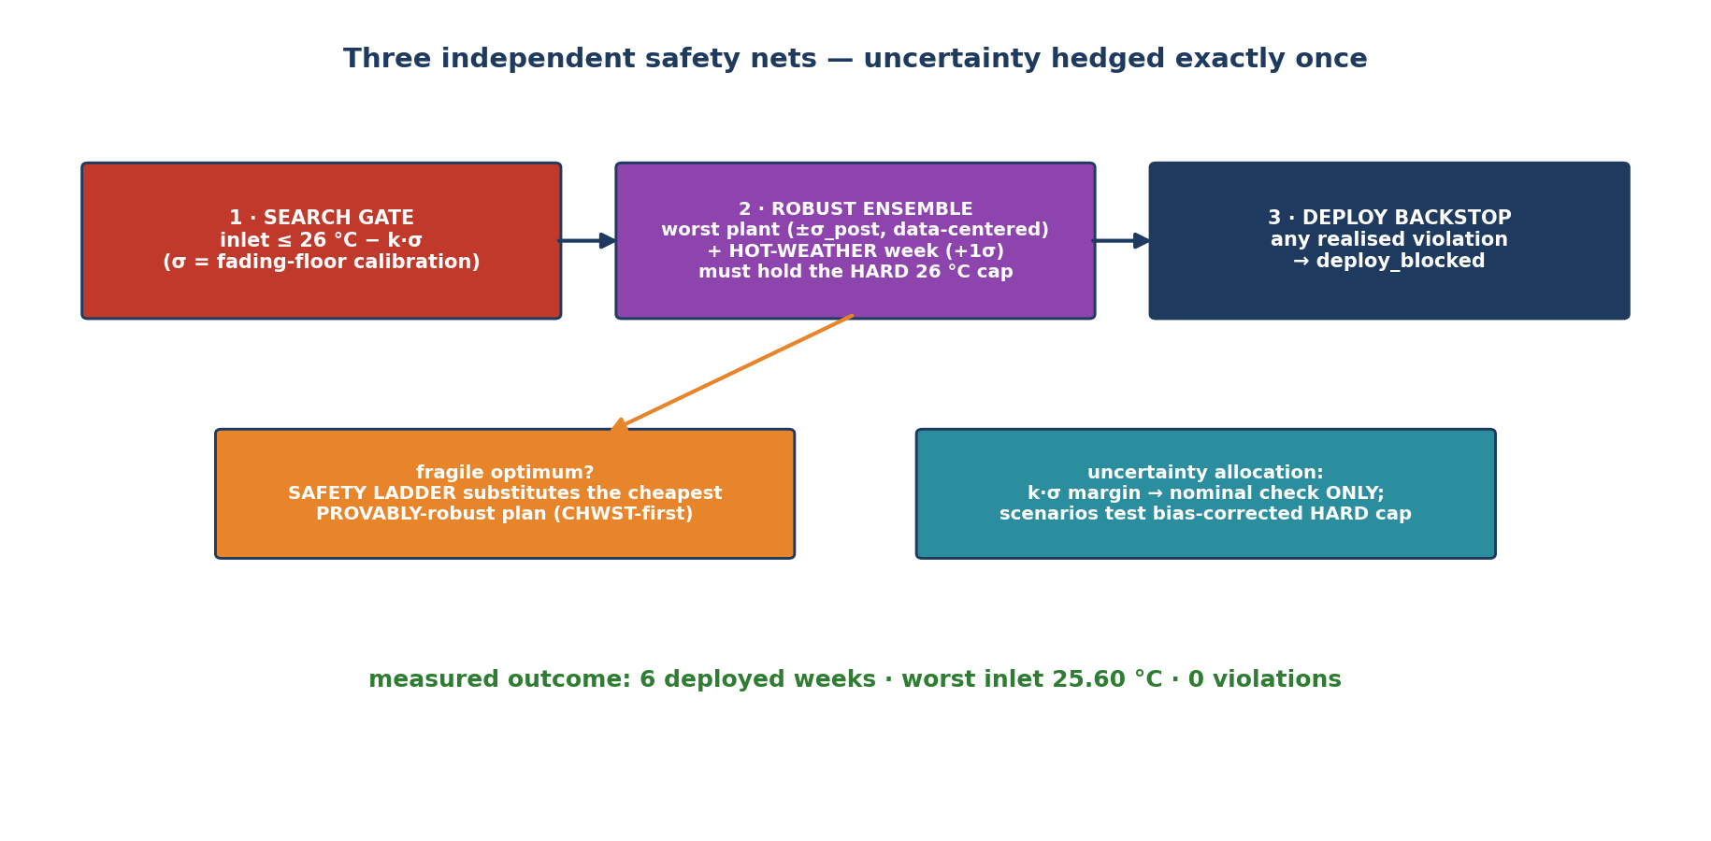
The safety architecture
Safety never trades against energy or price
Hard cap with k·σ margin in search; a data-centered worst-case ensemble (plant ±σ_post + hot-weather week) against the hard cap; a zero-tolerance deploy backstop.

Slide 11
Technical: the planning engine
Inner loop
• Oracle: every candidate = a full-week EnergyPlus 9.5 run (Docker/BCVTB), fanned across a process pool; per-candidate watchdog (300 s) + batch deadline + stall watchdog (1.5× timeout) bound any hang to minutes.
• Search: coarse grid (g³ over the 3-setpoint space) → top-B beam → halving-step refinement; optional day/night time-blocks; degenerate-signal detection.
• Objective: weekly hall-scoped HVAC energy (ACU fans + shared CHW plant) — or, when data/tariff.json exists, the 24-hour tariff/carbon-weighted cost. Soft penalties: inlet excess, RH excursion, zone band.
• Live recirculation fidelity: recirc fraction estimated from rack inlets (mixing identity); flow-shortfall model adds a conservative-only inlet penalty; provable no-op until field-calibrated (fit_recirc.py).
• Forecasting: IT load (persistence/seasonal + calendar alignment, p10/50/90 bands); weather via historical-analog mean+σ with EPW variants — the +1σ hot week joins the robust ensemble.

Slide 12
Technical: the learning loop
Outer loop
• After every deployed week: paired (predicted, realised) KPIs update per-KPI bias + two uncertainties:
– fading-floor σ = max(sample, prior/n) → the nominal k·σ search margin (never under-states early);
– empirical-Bayes σ_post = √((n·s² + σ₀²)/(n+1)) → sizes the robust ensemble (evidence tightens it; ±2% physical floor).
• Physics re-calibration: persistent energy bias over ≥4 weeks fits a bounded fan-efficiency correction (clip ±15%) → data/plant_calibration.json → becomes the ensemble's CENTER (the believed plant state is data-driven).
• Measured: n=7 calibration weeks · inlet bias 0.005 °C · σ_inlet 1.0 (prior) → 0.14 °C (measured).
• Safety-ladder substitution: when the energy optimum is fragile under the ensemble, the cheapest PROVABLY-robust alternative is recommended (chilled-water-first — ~3% energy span vs ~15% for airflow), never an unactionable block.

Slide 13
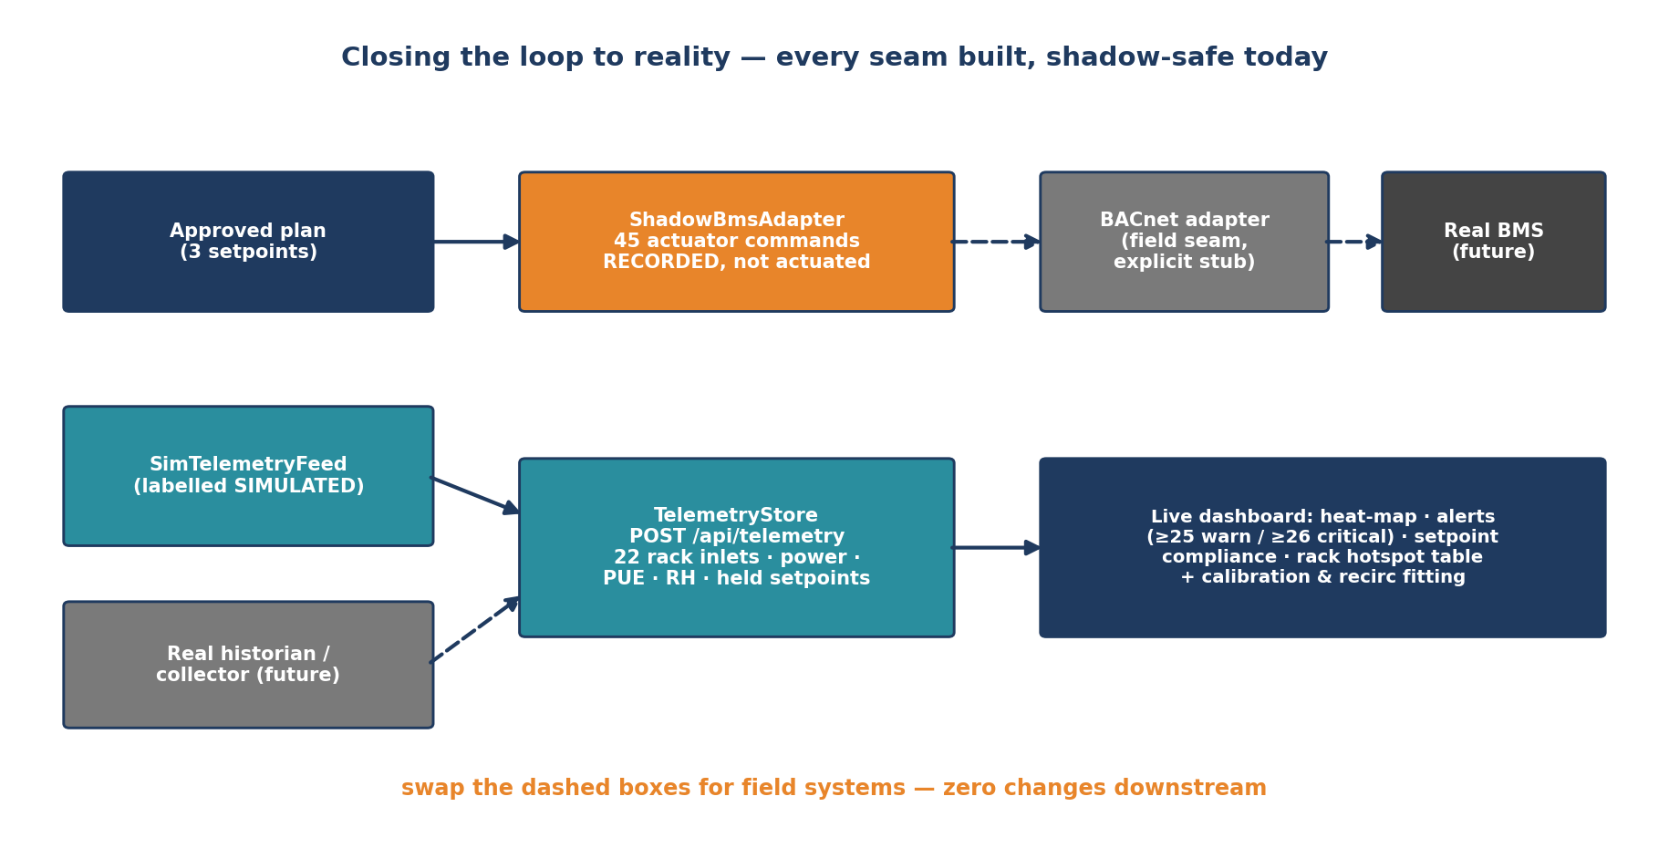
Closing the loop to reality — the seams
Field connection = config + one adapter class, not a rebuild
Shadow deploys record the exact 45-command artifact a field adapter will write; telemetry accepts any historian push; simulated data is always labelled.

Slide 14
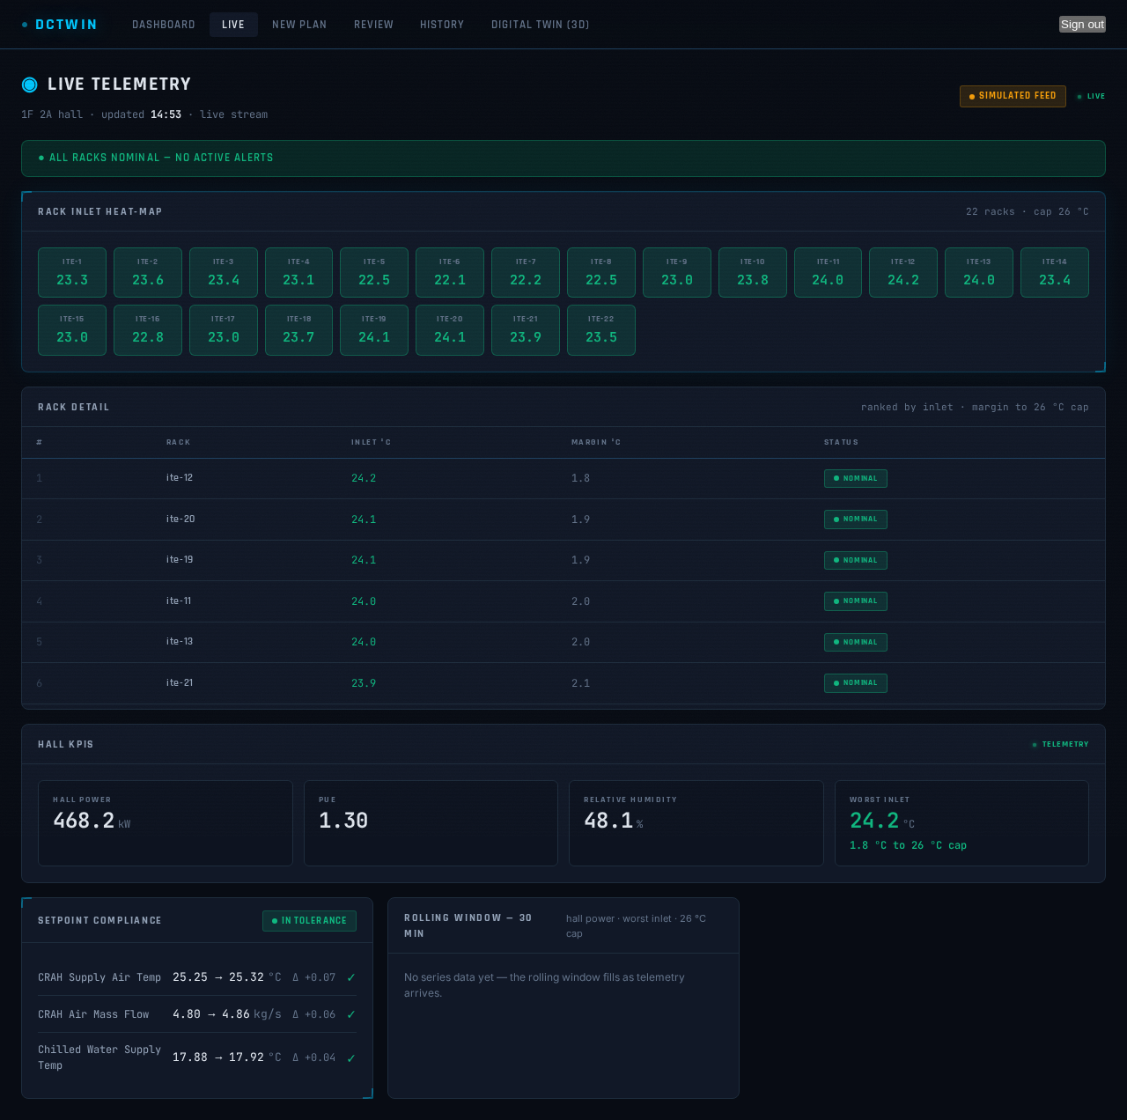
Operator cockpit — live monitoring (real screenshot)
Expert Supervision: real-time monitoring
22-rack heat-map · alert banner (warn ≥25 °C, critical ≥26 °C) · ranked rack hotspot table · commanded-vs-held setpoint compliance · rolling charts · SIMULATED badge.

Slide 15
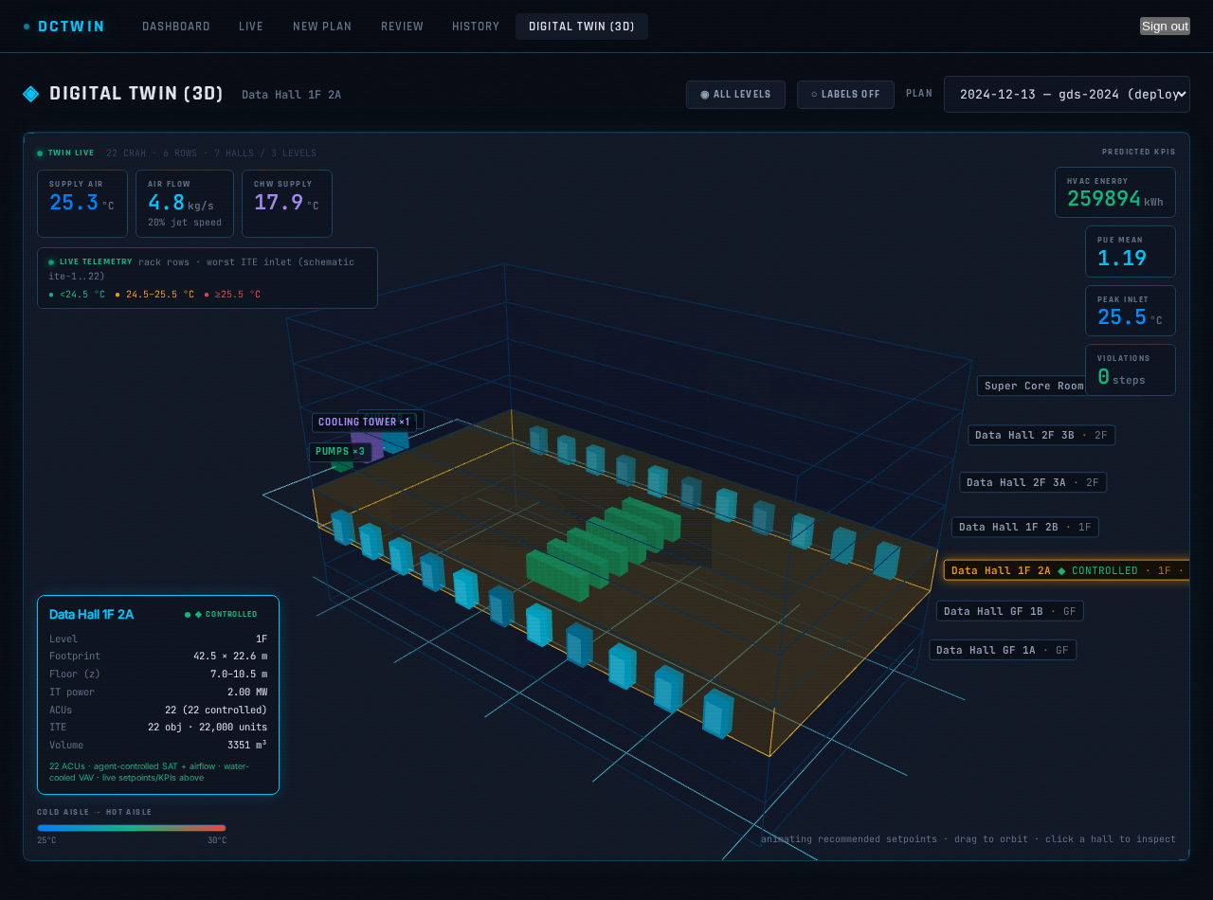
Operator cockpit — 3-D twin with live rack colors (real screenshot)
Hotspot visibility
The controlled hall's rack rows colored from live telemetry (5 s refresh) with legend; HUD shows the active plan's setpoints and KPIs.

Slide 16
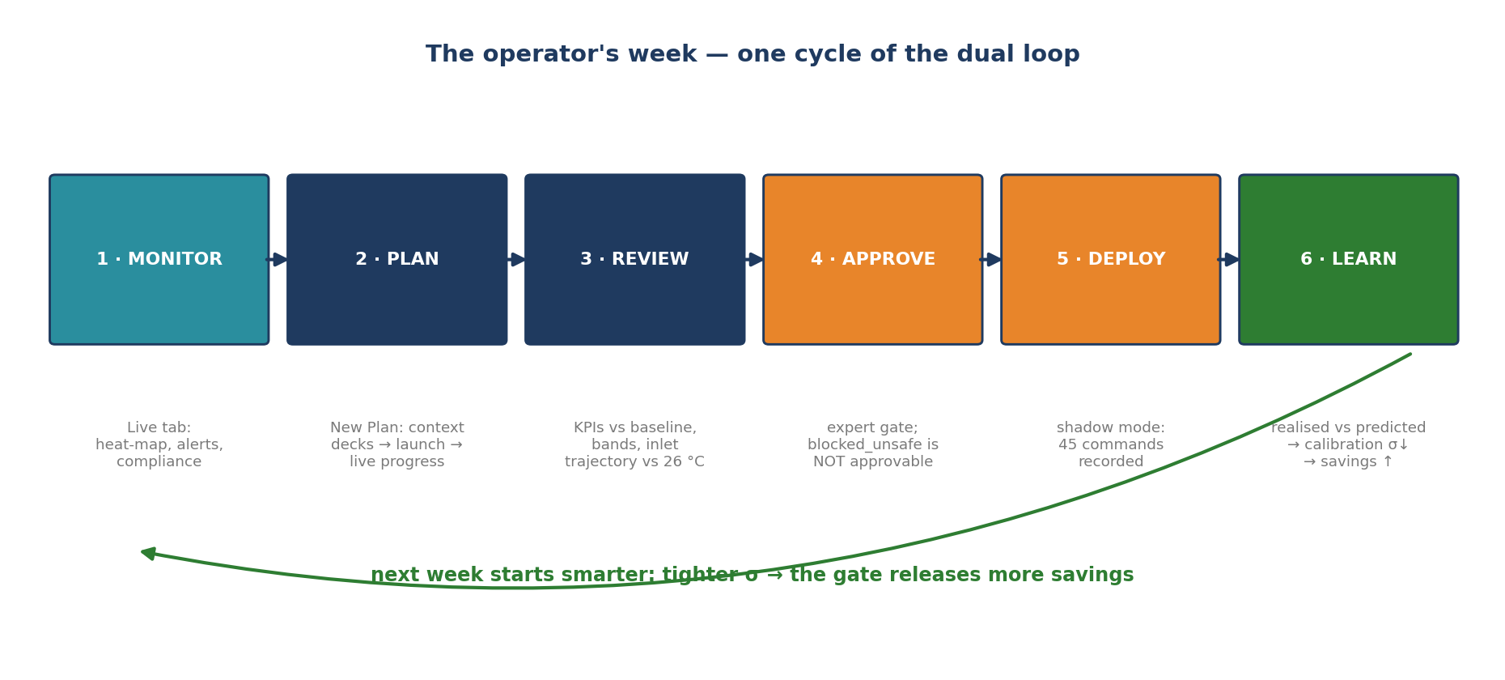
Operational procedure — one week, one cycle
Operator runbook
Monitor → plan (context decks) → review (trajectories vs 26 °C) → expert approve → shadow deploy → learn. Every cycle tightens σ and unlocks more savings.

Slide 17
Operational considerations
What operators should know
• blocked_unsafe is the system WORKING: the gate refused a plan it could not prove safe — it cannot be force-approved by design. Re-plan or accept the substituted robust alternative.
• All simulated data is labelled (SIMULATED FEED badge; deploy artifacts say actuated:false) — no one can mistake rehearsal for reality.
• Restarting the backend kills a running plan (orphans are marked failed, never lost silently); cancel from the UI first. A wedged run recovers in minutes (stall watchdog + driver unstick).
• Old plans (schema <1.7) show '—' for baseline/reduction by design; re-run to compare. Artifacts are schema-versioned 1.0→1.8, additive.
• Alerts: warn at 25 °C (margin <1 °C), critical at 26 °C; compliance flags drift >0.5 per axis vs the deployed command.
• Reproducible operations: scripts/clear-and-run.sh for humans; the committed /run-dctwin driver (start/smoke/plan/screenshot/unstick) for agents and CI.

Slide 18
Implemented vs not — honest scorecard
vs the original plan
• ✅ Every box of the original diagram is implemented: forecaster (load + weather), EnergyPlus model, heuristic planner, unsafe-action filtering, pre-validation, expert supervision incl. REAL-TIME monitoring, system-data feedback.
• 🟡 Authorized commands to the real DC: SHADOW mode (recorded, not actuated). The BACnet adapter is an explicit one-class seam; field access is the only blocker.
• 🟡 'Realised' data is a perturbed-plant simulation stand-in until a real collector connects — the learning loop is structurally proven, not yet field-proven.
• Deliberately out of scope: humidity as a control actuator (monitored + penalized only), intra-week automatic re-planning, CI browser E2E (manual driver covers it).
• Known caveats: recirc margin optimistic until field-calibrated; analog-σ weather understates synoptic extremes (+1σ hot scenario partially compensates); IT load ~flat so weather dominates.

Slide 19
Next steps
The path to the field
• 1 · Field pilot, shadow-first: real collector → POST /api/telemetry; implement BacnetBmsAdapter; recommend-only 4–8 weeks; then actuate hall-by-hall.
• 2 · Calibrate recirculation from the first real rack-inlet data (fit_recirc.py) — de-risks the safety margin directly.
• 3 · Swap the weather provider seam to a real short-horizon forecast API (downstream unchanged).
• 4 · Load the site tariff / grid-carbon profile (data/tariff.json) to optimize the operator's true target.
• 5 · Let robustness grow with data: σ_post tightens and the ensemble re-centers automatically; raise n_scenarios for high-stakes weeks.
• 6 · Operator hardening: alert webhooks, guided mid-week re-plan, per-ACU power telemetry, CI-managed E2E.

Slide 20
Summary
• A physics-based digital twin + web cockpit that plans a data-center's cooling week and proves its recommendations safe before anyone acts on them.
• Measured, not promised: 6 deployed weeks · 0.1% energy prediction error · 0 → 3.6% savings released by earned confidence · zero violations.
• Live monitoring, shadow deploys, telemetry seams, physics re-calibration, weather + tariff awareness — all tested (526 green) and labelled honestly.
• One step remains to the field, and it is config-shaped: connect real telemetry and the BACnet adapter behind seams that already exist.

